Slide 1




National Apprenticeship Week 2024
Office of Apprenticeship
Employment and Training Administration
U.S. Department of Labor

Slide 2
AGENDA OVERVIEW
U.S. Department of Labor Welcoming Remarks:
John Ladd, Administrator, Office of Apprenticeship, Education and Training Administration (ETA)
Cierra Mitchell, Acting Deputy Administrator, Office of Apprenticeship, ETA
Speaker Panel:
Yelena Vaynberg, Government Programs Executive, IBM (Apprenticeship Ambassador)
Lydia Arthurs, Claims Shared Services Specialist, Zurich Insurance (Apprentice Trailblazer)
David Jaeger, Program & Operations Lead, Zurich Apprenticeship Program (Apprenticeship Ambassador)
Karen Heyward-West, Executive Director, Baltimore Alliance for Careers in Healthcare
Brian Cavey, International Vice President, MidAtlantic States Conference - International Association of Heat and Frost Insulators & Allied Workers
Jeffrey Smith (Facilitator), Workforce Liaison/Program Analyst, Office of Apprenticeship, ETA
Your Role in NAW 2024:
Sasha Cooper-Morrison, Acting Division Director, Office of Apprenticeship, ETA

Slide 3

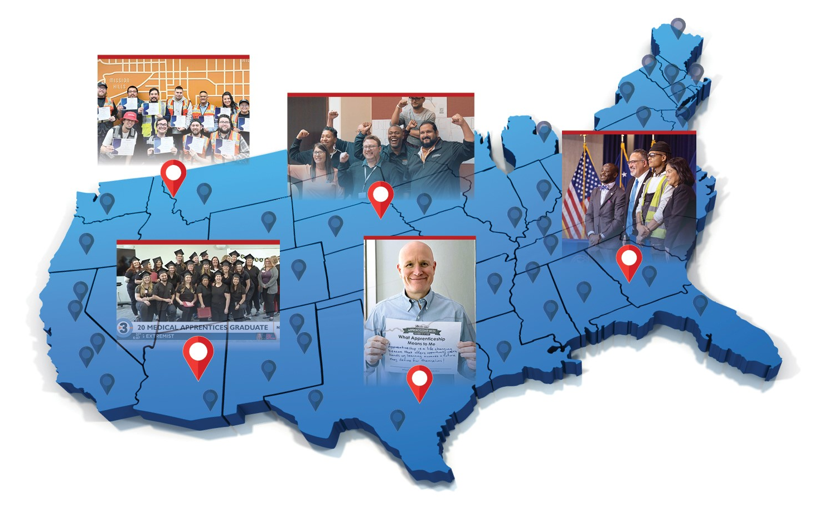
THE 10th ANNUAL
NATIONAL APPRENTICESHIP WEEK (NAW)
NOVEMBER 17-23, 2024
NAW is a nationwide celebration that brings together employers, industry associations, labor organizations, community-based organizations, workforce partners, education providers, and government leaders
to demonstrate their support for Registered Apprenticeship.

Slide 4

National Apprenticeship
Week
10th Anniversary
The theme for NAW 2024 is “National Apprenticeship Week 2024: Celebrating 10 Years of Engagement, Expansion, and Innovation.” This theme reflects the transformative power of Registered Apprenticeship and its ability to bring together key national, regional, state, and local stakeholders across the country to meet critical workforce needs.
4

Slide 5

A DECADE OF GROWTH AND DIVERSIFICATION!
Since its inception in 2014, NAW has helped broaden public awareness of Registered Apprenticeship. The dedicated efforts of these partners working to expand the National Apprenticeship System has led to the following accomplishments over the past 9 years:
Over 2.4 million new Registered Apprentices representing over 90% growth
A total of 23,729 new Registered Apprenticeship programs
Increased percentages of active apprentices from underrepresented populations, including
  225% more women
  97.5% more people representing communities of color
  126.9% more young people ages 16 through 24
  3,825% more individuals with disabilities
  42% more veterans
5

Slide 6

DAILY THEMES
Monday, November 18
Youth and Young People Apprenticeship Day
Tuesday, November 19
Registered Apprenticeship in New and Emerging Industries and Around the Globe
Wednesday, November 20
Expanding Registered Apprenticeship to Underserved Populations
Thursday, November 21
Women in Apprenticeship
Friday, November 22
Federal Apprenticeship and Veterans in Apprenticeship
6

Slide 7

REGISTERED APPRENTICESHIP:
A PROVEN WORKFORCE SOLUTION
Registered Apprenticeship is an industry-driven, high-quality career pathway where employers can develop and prepare their future workforce, and individuals can obtain paid work experience with a mentor, receive progressive wage increases, classroom instruction, and a portable, nationally-recognized credential.
7

Slide 8

REGISTERED APPRENTICESHIP HAS A PROVEN TRACK RECORD OF PRODUCING STRONG RESULTS FOR EMPLOYERS AND WORKERS
IMPRESSIVE INDIVIDUAL – EMPLOYEE –
PUBLIC RETURN ON INVESTMENT
44.3%
Employer return on investment in Registered Apprenticeship
94%
Of those that complete their apprenticeship retain employment after completion.
$28
In benefits for every $1 invested by the government
$80K
$300K+
Completers earn per year on average
Apprentices’ lifetime earning advantage
Data provided by www.apprenticeship.gov

Slide 9










A DIVERSE RANGE OF INDUSTRIES
Agriculture
Healthcare
Cybersecurity
Biotechnology
Transportation
Construction
Energy
Hospitality
Financial Services
Information Technology
Advanced Manufacturing
Critical Supply Chain
Infrastructure
Engineering
Public Service
Telecommunications
9

Slide 10



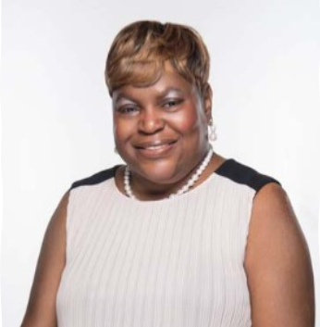
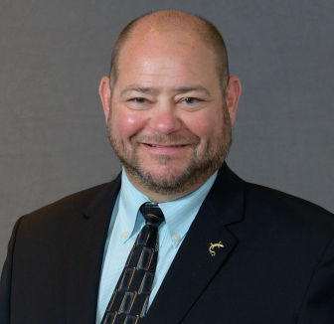
NAW Partners Panel
Yelena Vaynberg​
Government Programs Executive, IBM
Lydia Arthurs
Claims Shared Services Specialist, Zurich Insurance
David Jaeger
Program & Operations Lead, Zurich Apprenticeship Program, Zurich Insurance
Karen Heyward-West
Executive Director, Baltimore Alliance for Careers in Healthcare
Brian Cavey
International Vice President, International Association of Heat and Frost Insulators & Allied Workers

Slide 11

10 YEARS OF NAW ENGAGEMENT
All 50
U.S. states participate
9,960+
events held nationwide
1.4 million
event
attendees
1,825
proclamations
made
11

Slide 12
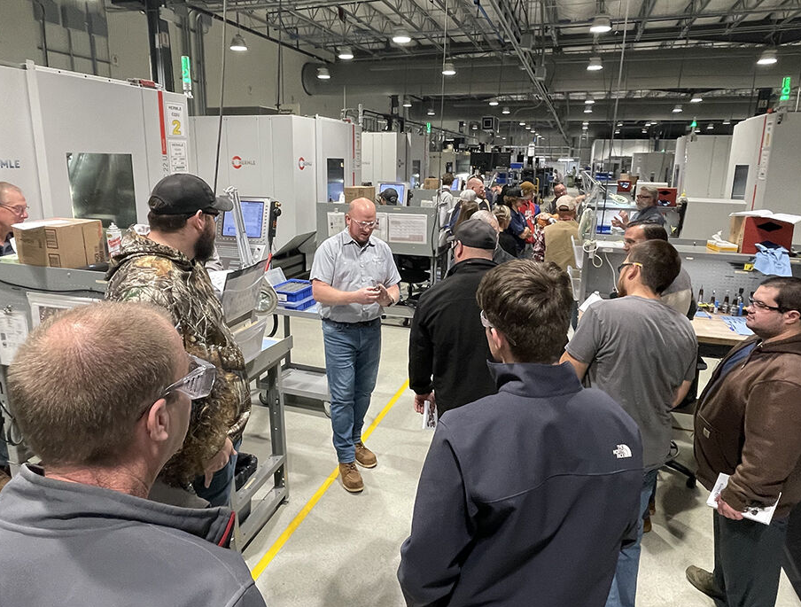
TYPES OF EVENTS
  Business open houses
  Skills competitions
  Community forums
  Apprentice graduations
  High school or college career fairs
  Apprenticeship signing day
  Diversity & Equity discussions
  Industry roundtable events
  Commercials, podcasts, radio interviews
  Twitter storms
  Issuing blog posts, Op-Eds, White Papers
  And more!
Oberg Industries Open House

Slide 13
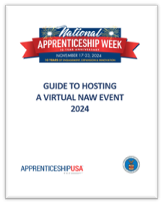
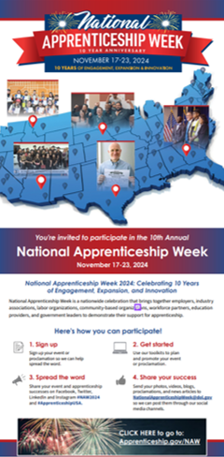
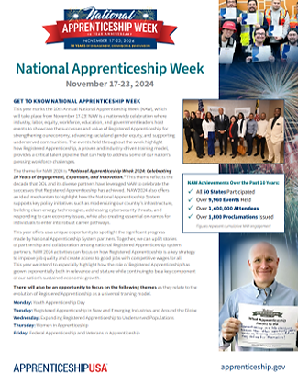
NAW RESOURCES
The NAW Resources page provides materials to help you plan, promote and enhance your NAW events and proclamations. There you will find:
NAW Logo
Factsheet
Planning & Promotional Toolkits
Guide to Hosting a Virtual Event
NAW Promotional Flyers & Mailer
Proclamation Templates
Social Media Tip Sheet
Other Resources
13

Slide 14

HERE’S HOW YOU CAN GET INVOLVED
Spread
The Word
Find An Event
Near You
Host
An Event
Submit Proclamations
Share Your Event Highlights
Share information about NAW and encourage your stakeholders to get involved.
Use our
interactive
NAW map
to find an event near you to participate in.
Help plan and promote NAW events, and
don’t forget to submit details
on the
NAW website.
Connect with local and state government, industry and educators
and encourage them to support National Apprenticeship Week.
Share photos, videos, blogs and more
on social media with hashtags
#NAW2024 and
#ApprenticeshipUSA.
14

Slide 15
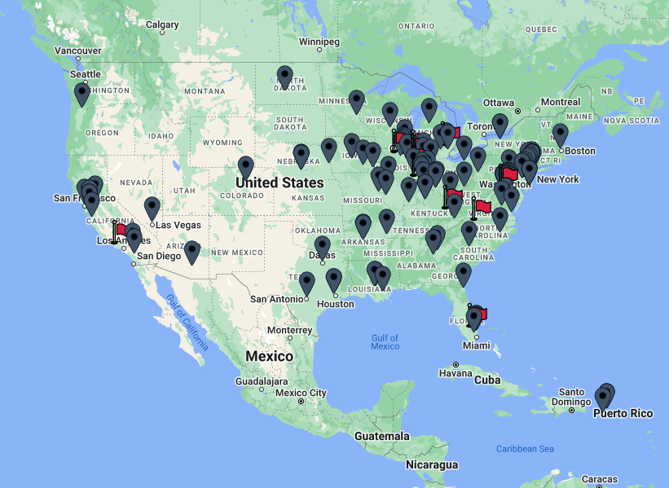
FIND AN EVENT TO ATTEND
NAW Events & Proclamations Map

Slide 16

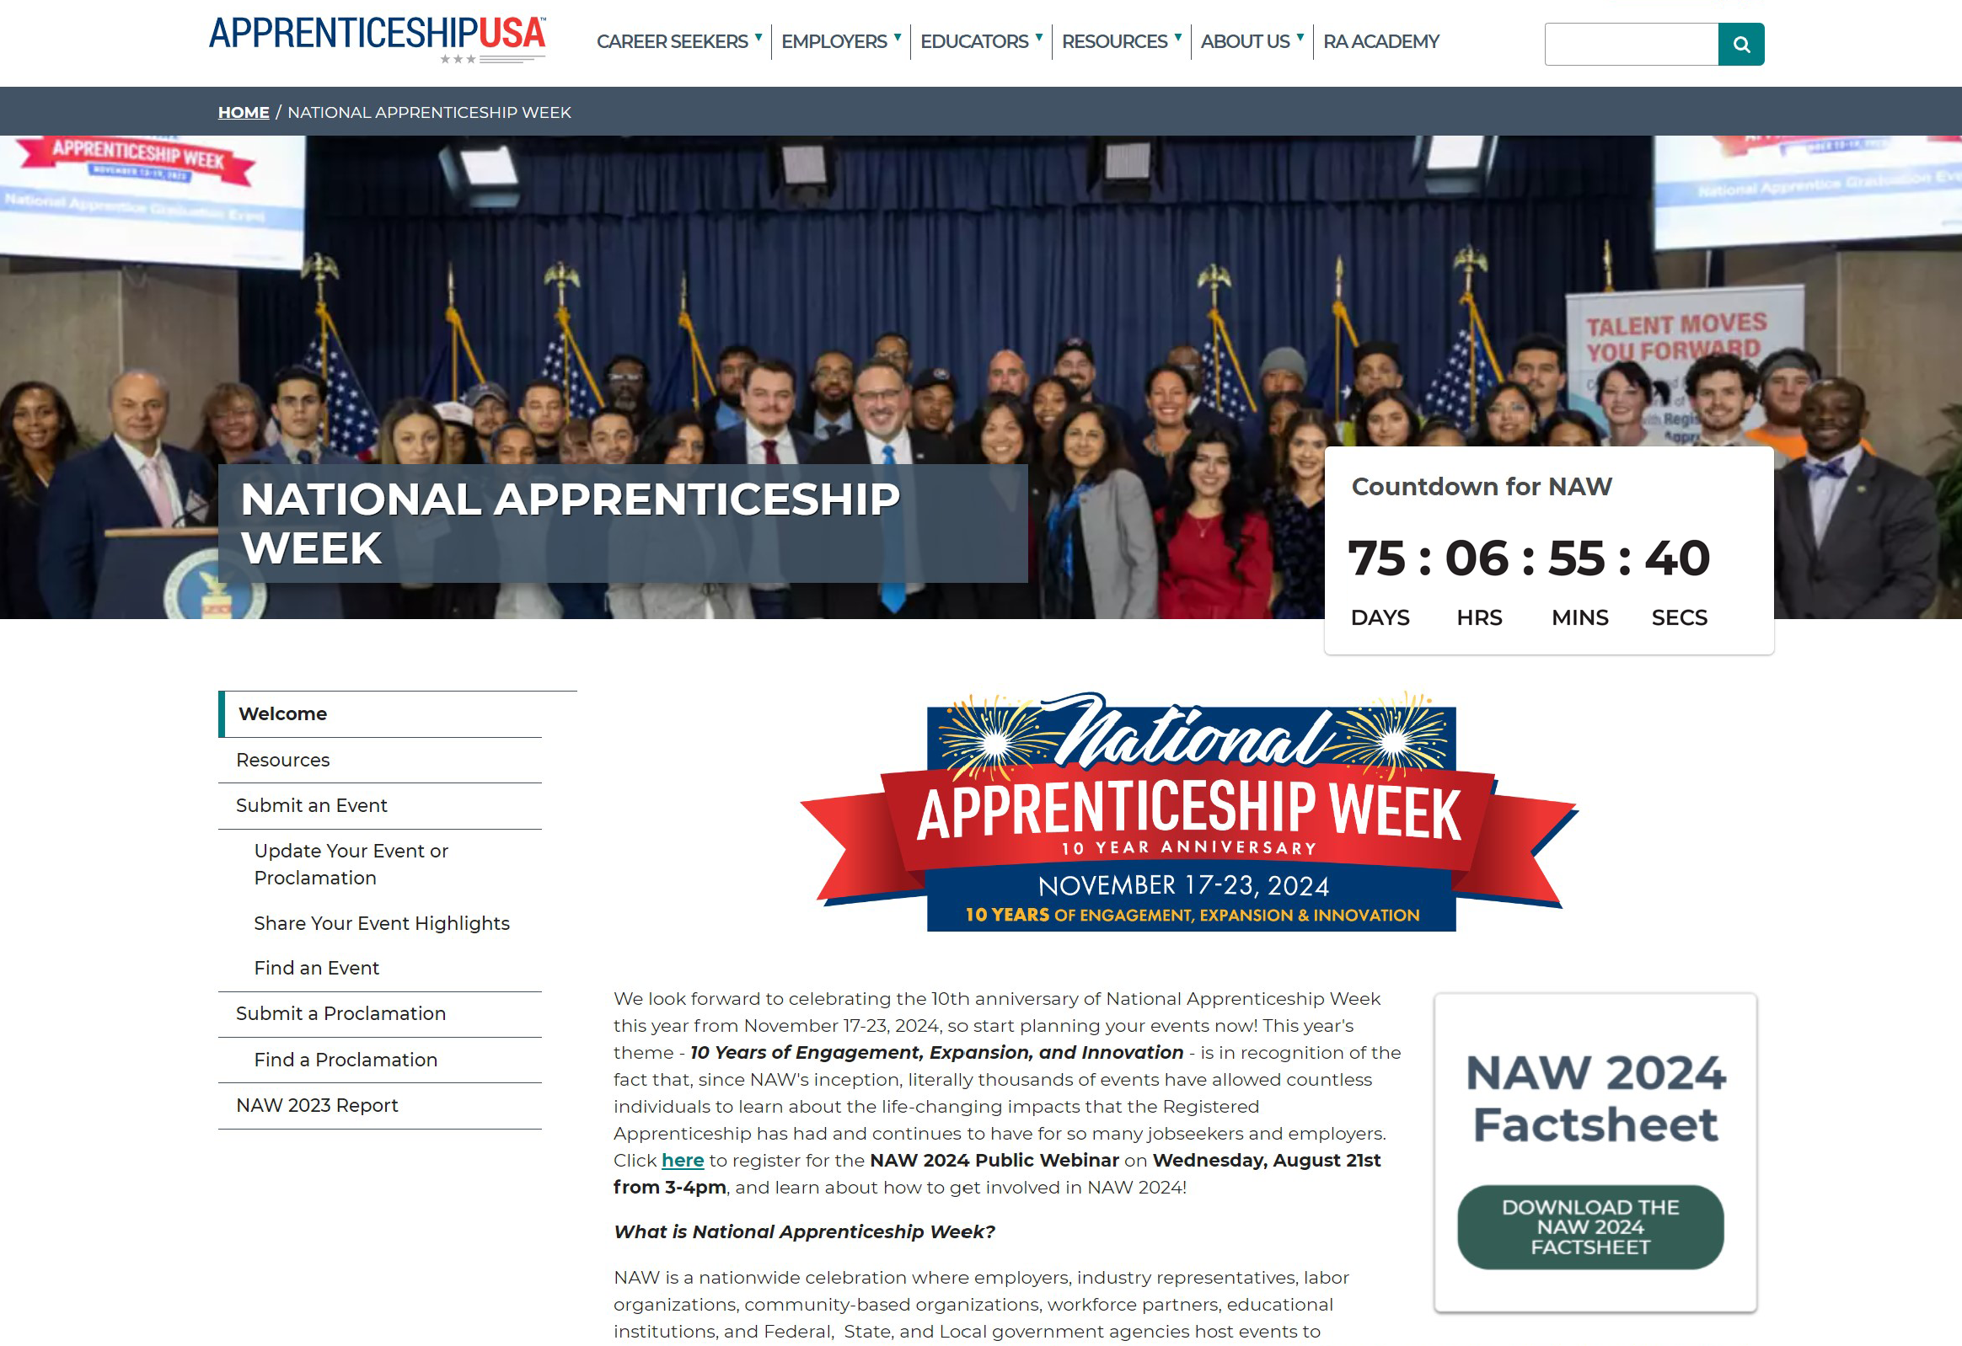
NOT SURE WHERE TO BEGIN? REACH OUT AND WE’LL HELP YOU GET STARTED
VISIT:
www.apprenticeship.gov/national-apprenticeship-week
Or contact us at NationalApprenticeshipWeek@dol.gov

