Slide 1
The Impacts of Opioid Addiction on the Rural Workforce

Slide 2
Today’s Moderators
Ashley Moore
Workforce Analyst
Division of Adult Services and Governance
Office of Workforce Investment
Employment and Training Administration
US Department of Labor
Amy Ambrose
Workforce Analyst
Division of Adult Services and Governance
Office of Workforce Investment
Employment and Training Administration
US Department of Labor
Notes:
Hello, and welcome. I am Ashley Moore, workforce analyst with the Office of Workforce Investment within the Employment and Training Administration at the US Department of Labor. On behalf of the Office of Workforce Investment, my colleague, Amy Ambrose and I welcome you to this webinar on the topic of The Impacts of Opioid Addiction on the Rural Workforce.
This is the last of our seven scheduled webinars featured in our Spring 2023 Opioid Webinar Series. These webinars on serving individuals with opioid addiction and other substance use disorders bring professionals throughout the public workforce system together with partner agencies to discuss innovative strategies and effective solutions. Thank you so much for being here today.
According to the American Farm Bureau Federation, 45% of rural adults say they have been impacted by the opioid epidemic, and 74% of farmers and farmworkers have been directly affected. Rural communities encounter unique challenges when combating substance misuse in the community and the workplace. Rural areas typically have a high poverty rate, are sparsely located, and lack access to healthcare, mental health, and recovery services. To tackle opioid misuse, strong community partnerships, quality programs to connect people in recovery to employers, and supportive services are central to ensuring a productive and strong workforce and community.

Slide 3
Today’s Speakers
Kellie Kubena, USDA Rural Health Liaison, USDA Rural Development
Carol Wetuski, Program Development Specialist, USDA Rural Development
Lauren Wood, MPH, Health Program Manager, Appalachian Regional Commission (ARC)
Lottie Ryans, Director of Workforce & Literacy Initiatives, First Tennessee Development District
Jennifer Jones, Recovery Program Manager -Ballad Health | PEERhelp Program
BJ Gott, Director of Operations, RiteScreen
Notes:
We have a ______ webinar planned for you today. We are pleased to welcome Kellie Kubena and Carol Wetuski from the US Department of Agriculture who will present on USDA programs that support rural communities with substance use, workforce development, and economic development and in particular the Rural Workforce Innovation Network (RWIN) which is a forum for public and private partners to help increase access to workforce opportunities across rural America.
Next, we will have Lauren Wood, from the Appalachian Regional Commission will provide an overview of what ARC does and present on the The Investments Supporting Partnerships In Recovery Ecosystems (INSPIRE) Initiative addresses the substance use disorder (SUD) crisis across Appalachia by creating or expanding a recovery ecosystem that will lead to workforce entry or re-entry.
Last, we will have a Lotti Ryan from the First Tennessee Development District and their partner organizations speak on the impact of substance use in their local rural community and how FTDD, through collaborative efforts with their many partner support individuals in recovery in the workplace. First Tennessee Development District is recipient of the Department of Labor’s Workforce Opportunities for Rural Communities (WORC) grant. As part of WORC, the Appalachian Regional Commission partners with the Department of Labor to develop technical assistance and comprehensive approaches addressing economic distress and workforce development activities throughout the Region.

Slide 4
USDA Rural Development Innovation Center May 31, 2023
Notes:
#2 Script Title Slide:

Slide 5
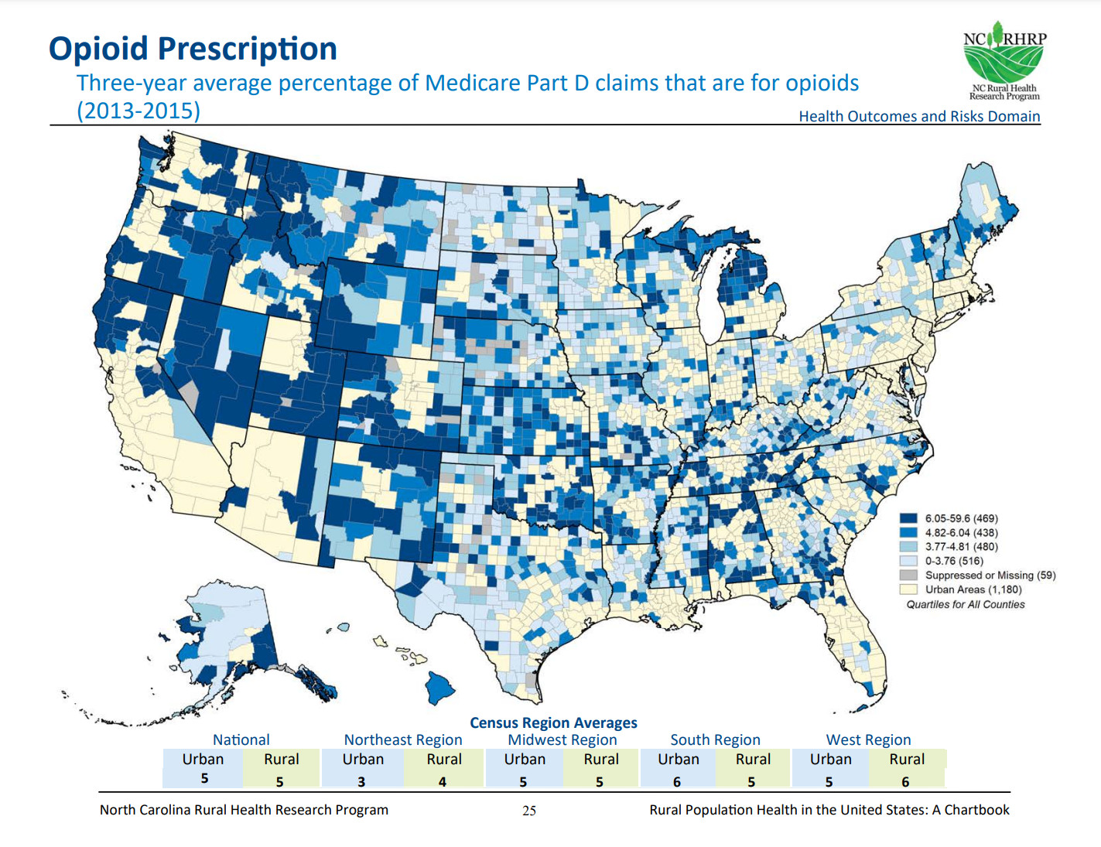
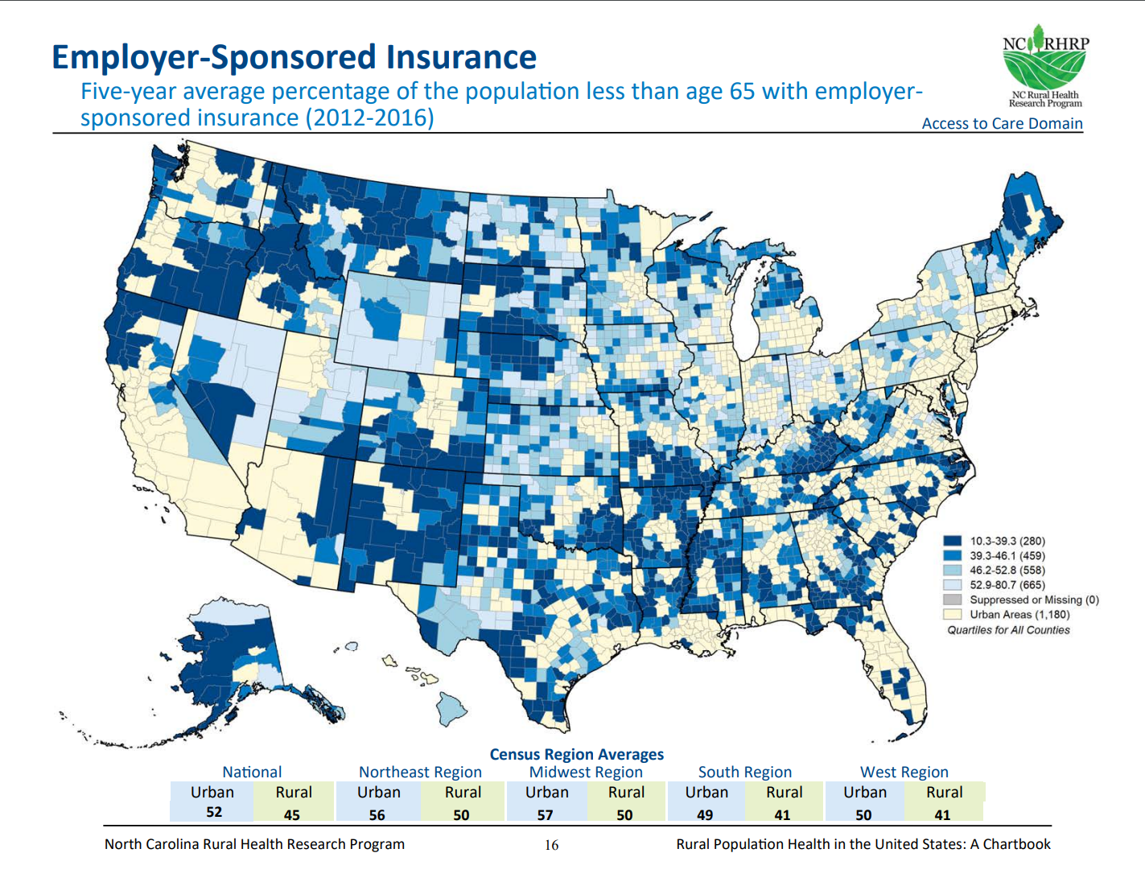
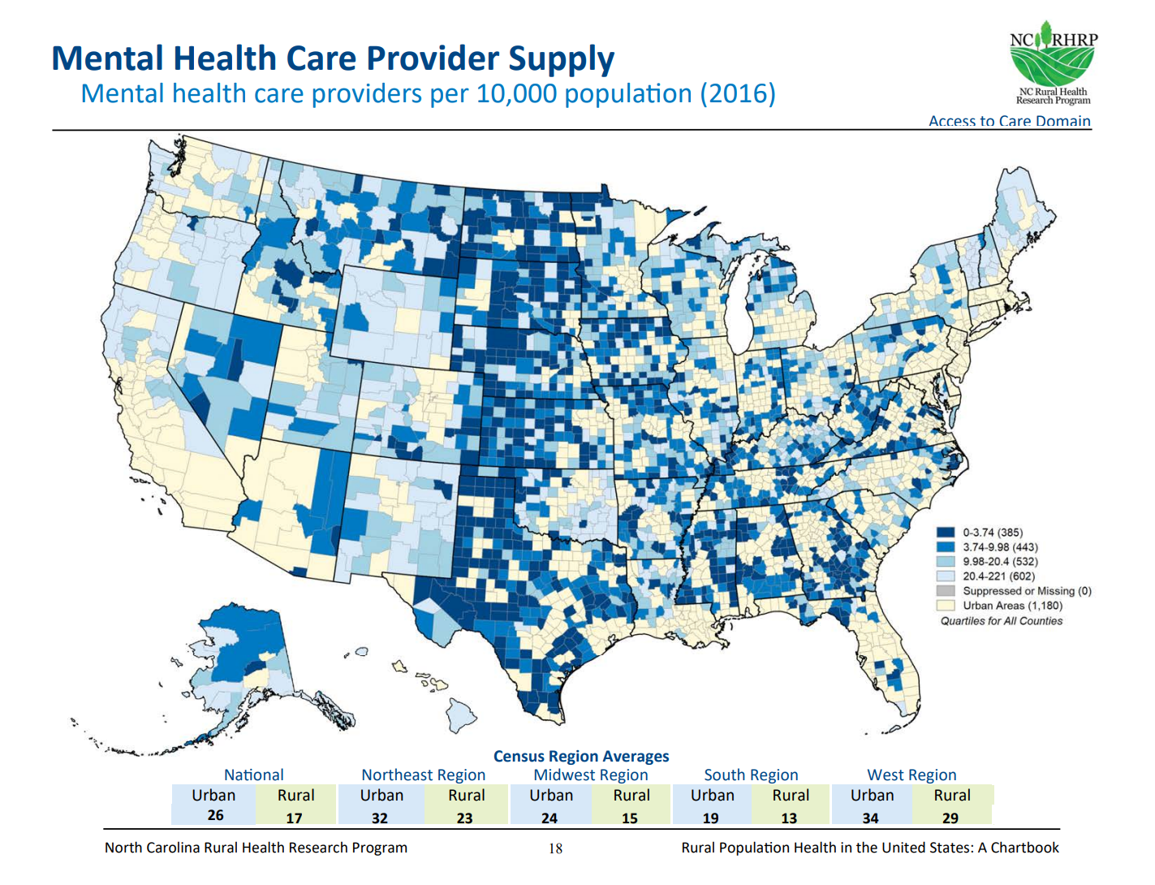
Rural Impacts related to substance use and employment
Typically, in rural areas, we see lower labor force participation and therefore also lower rates of employer-sponsored health insurance
Lower supply of mental health care providers are more common in rural areas
Substance use disorder rates are similar between rural and urban areas
USDA programs support rural communities with substance use, workforce development, and economic development
Figures from Rural Health Research Gateway Rural Population Health Chartbook

Slide 6
USDA – Who we are
Office of the Secretary
Deputy Secretary
Farm Production and Conservation
Food, Nutrition, and Consumer Services
Food Safety
Marketing and Regulatory Programs
Natural Resources and Environment
Research, Education and Economics
Rural Development
Trade and Foreign Agricultural Affairs
Farm Services Agency
Natural Resources Conservation Service
Risk Management Agency
Food and Nutrition Service
Food Safety and Inspection Service
Agricultural Marketing Service
Animal and Plant Health Inspection Service
Forest Service
Agricultural Research Service
Economic Research Service
National Agricultural Statistics Service
National Institute of Food and Agriculture
Rural Business and Cooperative Service
Rural Utilities Service
Rural Housing Service
Foreign Agricultural Service
Notes:
Notes for presentation:
FPAC developed mental health first aid training for their frontline staff, more than 90% of their staff have completed the training
FNS- SNAP and WIC are examples of food support services that can be critical to rural health
Deputy Secretary- personally very interested in supporting rural mental health and reducing Farm Stress, it was a big priority for her when she was in Virginia too.
Economic Research Service- They do research on all kinds of things like the effectiveness of RD programs and the recruitment and retention of rural health providers
National Institute of Food and Agriculture fund the Farm and ranch Stress Assistance Networks which provides mental health support for farmers through grants to regional agencies, and 4-H which provides a lot of supports for youth through grants
Rural Development buys and builds things, everything from hospitals, training, utilities, businesses, and housing

Slide 7
USDA Rural Development
USDA Rural Development
Innovation Center
Rural Business and Cooperative Service
Rural Utilities Service
Rural Housing Service
Business and Industry Guaranteed Loans
Rural Economic Development Loan & Grant
Cooperative Development
Water and Waste Disposal
Distance Learning and Telemedicine
Renewable energy
Single Family and Multifamily housing
Community Facilities
Rural Hospital Technical Assistance
Notes:
Zooming in on Rural Development
RBCS can fund private healthcare providers and supports, healthcare cooperatives, and healthcare services or education like in the Delta Region
RUS can fund utilities like water and waste treatment for non-profits or government entities, broadband infrastructure at a retail or community level and can fund telemedicine, and energy like utility supports for renewable energy and energy efficiency through the Rural Energy Savings Program.
RHS- can fund housing such as for the healthcare workforce or other important parts of the community, community facilities can fund non profit or government run healthcare facilities, and ERHC had broad authority for healthcare and food support, but is only in the American Rescue Plan
Innovation Center- home to three divisions, data, regs, and strategic engagement, the Rural Health Liaison is located here.

Slide 8
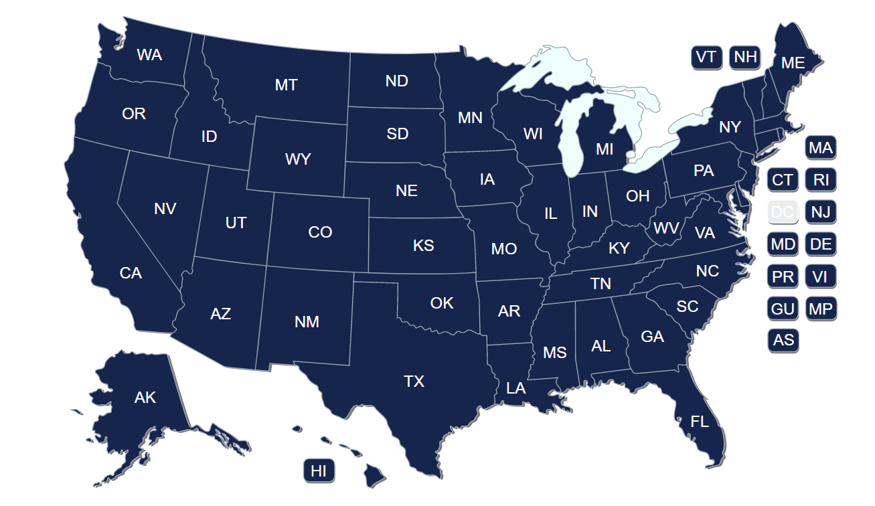
USDA Rural Development
Open Funding Announcements
Notes:
Many of our programs are operated out of our state offices (click on picture to get to the state offices)
Open funding announcements linked here

Slide 9
Advancing Racial Justice, Equity, Opportunity, and Rural Prosperity
Under the Biden Harris Administration and Secretary Vilsack’s leadership, Rural Development is focused on advancing the following key priorities:
Addressing Climate Change and Environmental Justice
Advancing Racial Justice, Place-Based Equity, and Opportunity
Creating More and Better Market Opportunities

Slide 10
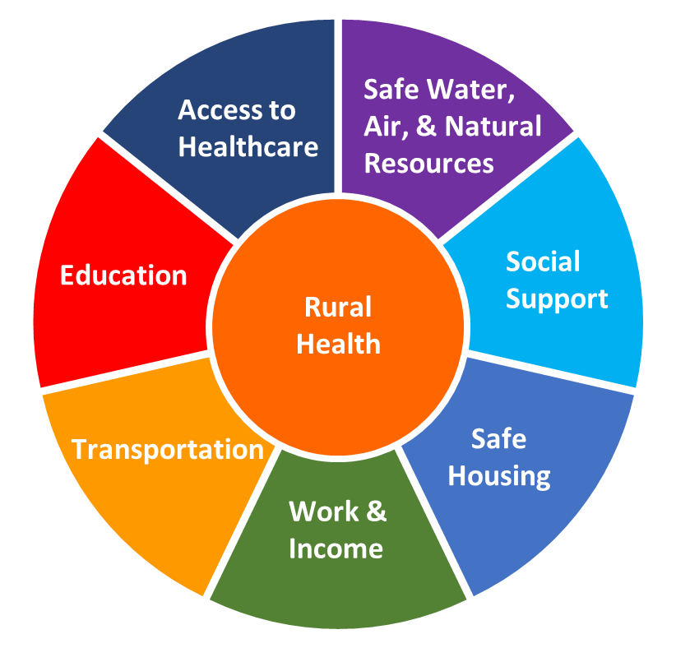
Rural Health Liaison
2018 Farm Bill created USDA Rural Health Liaison to
Coordinate across USDA, with Dept of Health and Human Services (HHS), and other partners to promote rural health
Share information and data related to USDA programs with customers and rural health information with USDA programs and partners
Mental Health Events
NIFA/FSA/RD/HHS 2022 Behavioral Health Conference
Events for 2023 Mental Health Month
Rural Data Gateway
Keep up to date with the Rural Health GovDelivery list
Reach out with questions or ideas to Kellie (kellie.kubena@usda.gov) or to rural health email: rural.health@usda.gov

Slide 11
Rural Partners Network Pilot States
Rural Partners Network
Cohort One States: Georgia, Kentucky New Mexico, Mississippi and Three Tribes in Arizona
Cohort Two States and Territory: Alaska, Nevada, North Carolina, Puerto Rico, Wisconsin, and West Virginia.
Notes:
Vision: A place where kids choose to stay and people choose to spend a lifetime.
America’s rural places successfully leverage economic recovery resources, improve social, economic and health outcomes and build lasting public, private and philanthropic relationships
How: Both a local, place-based support and a broader, whole-of-government approach.
Navigating resources: both specific driver for a town or community and easier access through federal collaboration
Leveraging partnerships: NETWORK, convening local partners, shared local success stories, federal programs building on each other (ie match requirement)
Long-term capacity: building experience locally for bigger and bigger investments; building experience collaborating and literacy of rural investments beyond own agency/department
Big goal: Steps build upon each other: building relationships through resource navigation, growing partnerships between local and regional stakeholders are foundational steps toward improving social and economic opportunity for all people and places. By building capacity, we are investing in rural voices to directly participate in strategic discussions where the vision for community prosperity is formed and community priorities, goals, and objectives are identified.

Slide 12
USDA Rural Development Rural Workforce Innovation Network (RWIN): https://www.rd.usda.gov/rwin

Slide 13
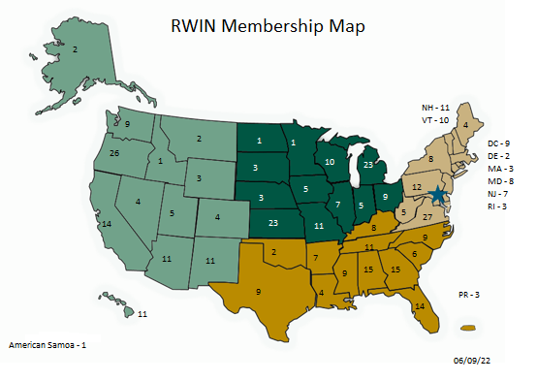
Rural Workforce Innovation Network (RWIN) – The Network

Slide 14
The Network
Region | Education | Nonprofit | Private Business | Public (local, state, federal, or tribal govt) | Totals
Midwest | 13 | 46 | 17 | 25 | 101
Northeast | 9 | 45 | 22 | 33 | 109
South | 16 | 38 | 23 | 35 | 112
West | 9 | 43 | 27 | 25 | 104
Totals | 47 | 172 | 89 | 118 | 426

Slide 15
Appalachian Regional Commission INvestments Supporting Partnerships In Recovery Ecosystems (INSPIRE) Initiative
May 31, 2023

Slide 16
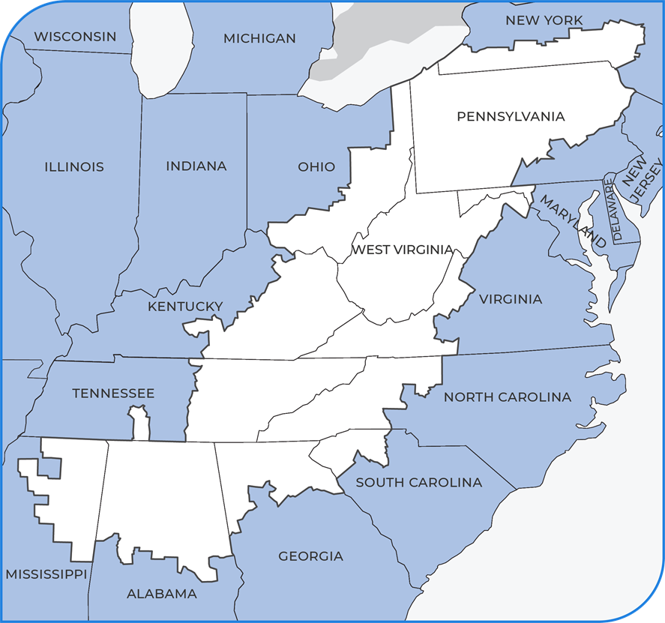
Appalachian Regional Commission
ARC VISION STATEMENT
Appalachia is a region of great opportunity that will achieve socioeconomic parity with the nation
ARC MISSION STATEMENT
To innovate, partner and invest to build community capacity and strengthen economic growth in Appalachia

Slide 17
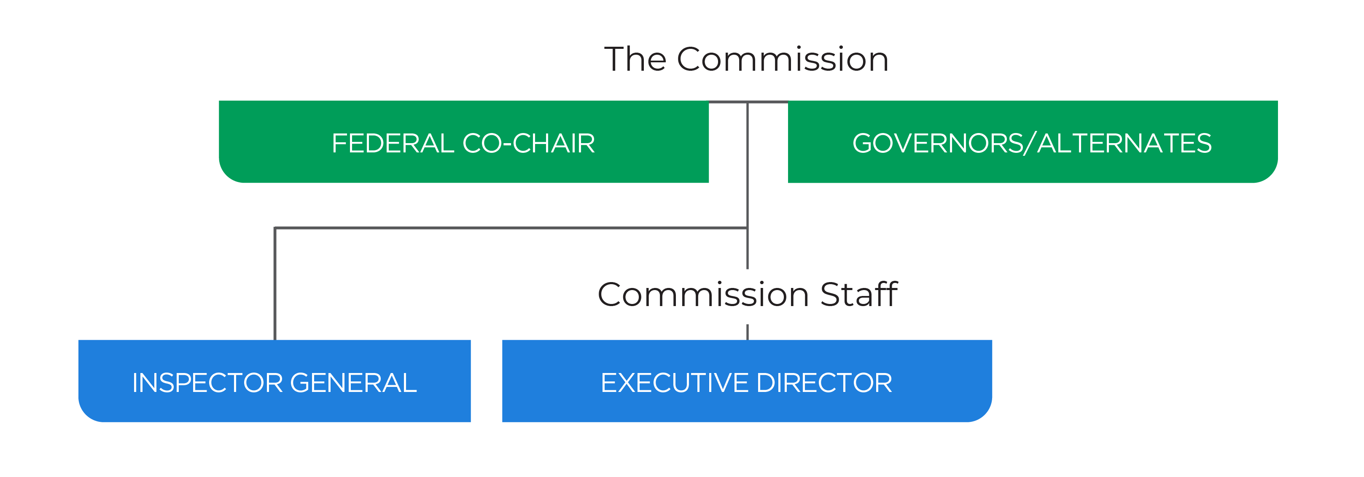
Federal–State Partnership

Slide 18
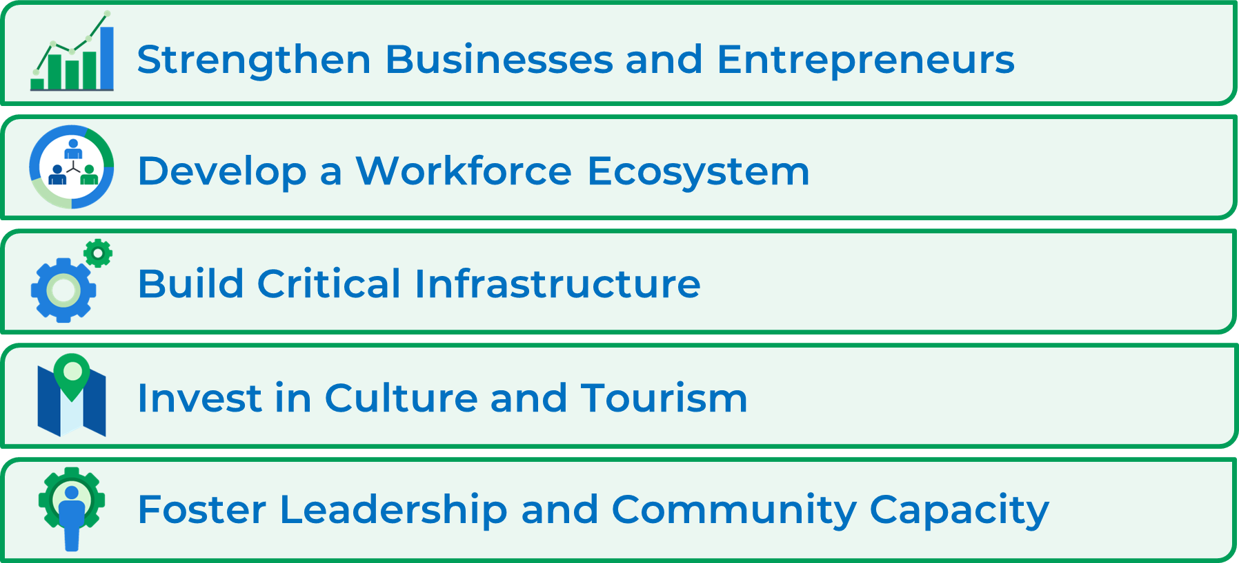
What does ARC do?

Slide 19
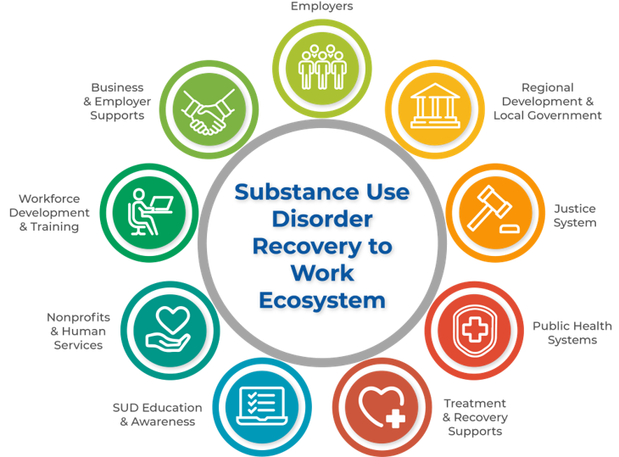

Slide 20
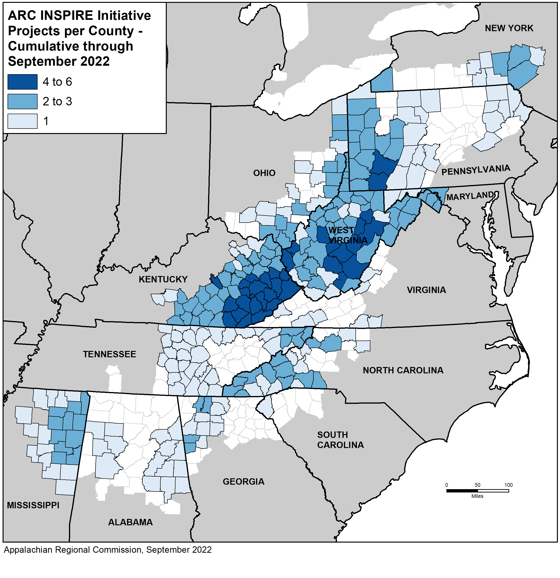
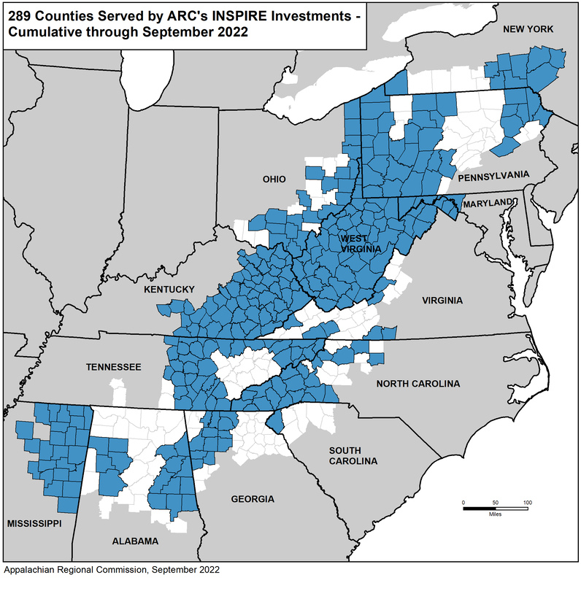
INSPIRE Counties Served

Slide 21
Grantee Themes & Best Practices
Utilizing recovery ready activities to support entry or reentry into the workforce
SUD Recovery to Work Ecosystem
Developing workforce training
Improving linkages to care
Increasing capacity
Understanding needs
Fostering partnerships
Creating sustainability
Creating social enterprises to foster entrepreneurship
Referral systems to ensure seamless transitions throughout the ecosystem
Communicating with non-traditional partners; chambers of commerce; unions; local development districts
Creating training and certification pipelines for peer support specialists
Conducting needs assessments to understand gaps and resources available within the ecosystem; at the community, state, or regional level

Slide 22
Funding Pathways
Funding Mechanism | Application Cycle
Investments Supporting Partnerships in Recovery Ecosystems Initiative (INSPIRE) | Applications are accepted from January – March each year.
Partnerships for Opportunity and Workforce and Economic Revitalization Initiative (POWER) | Applications are accepted from February – April each year.
Appalachian Regional Initiative for Stronger Economies (ARISE) | Applications are accepted on a rolling basis.
Area Development Program (AD) | State’s set their own application timelines each year. Reach out to your respective State Program Manager for more information.

Slide 23
Lauren Wood, Health Program Manager, ARC lwood@arc.gov 202-603-4750
Thank You!

Slide 24
Caring Workplaces Initiative
www.caringworkplaces.org

Slide 25
objectives
objectives
Objective 1: Introduce Caring Workplaces Rural
Opportunities Initiative
Objective 2: Allow you to hear from our partners
Objective 3: Share challenges from a rural region’s perspective

Slide 26
grant overview
The Caring Workplace Rural Opportunities Initiative is fully funded through a Workforce Opportunities for Rural Communities (WORC) grant by the United States Department of Labor in the amount of 1.3 million dollars awarded to the First Tennessee Development District.

Slide 27
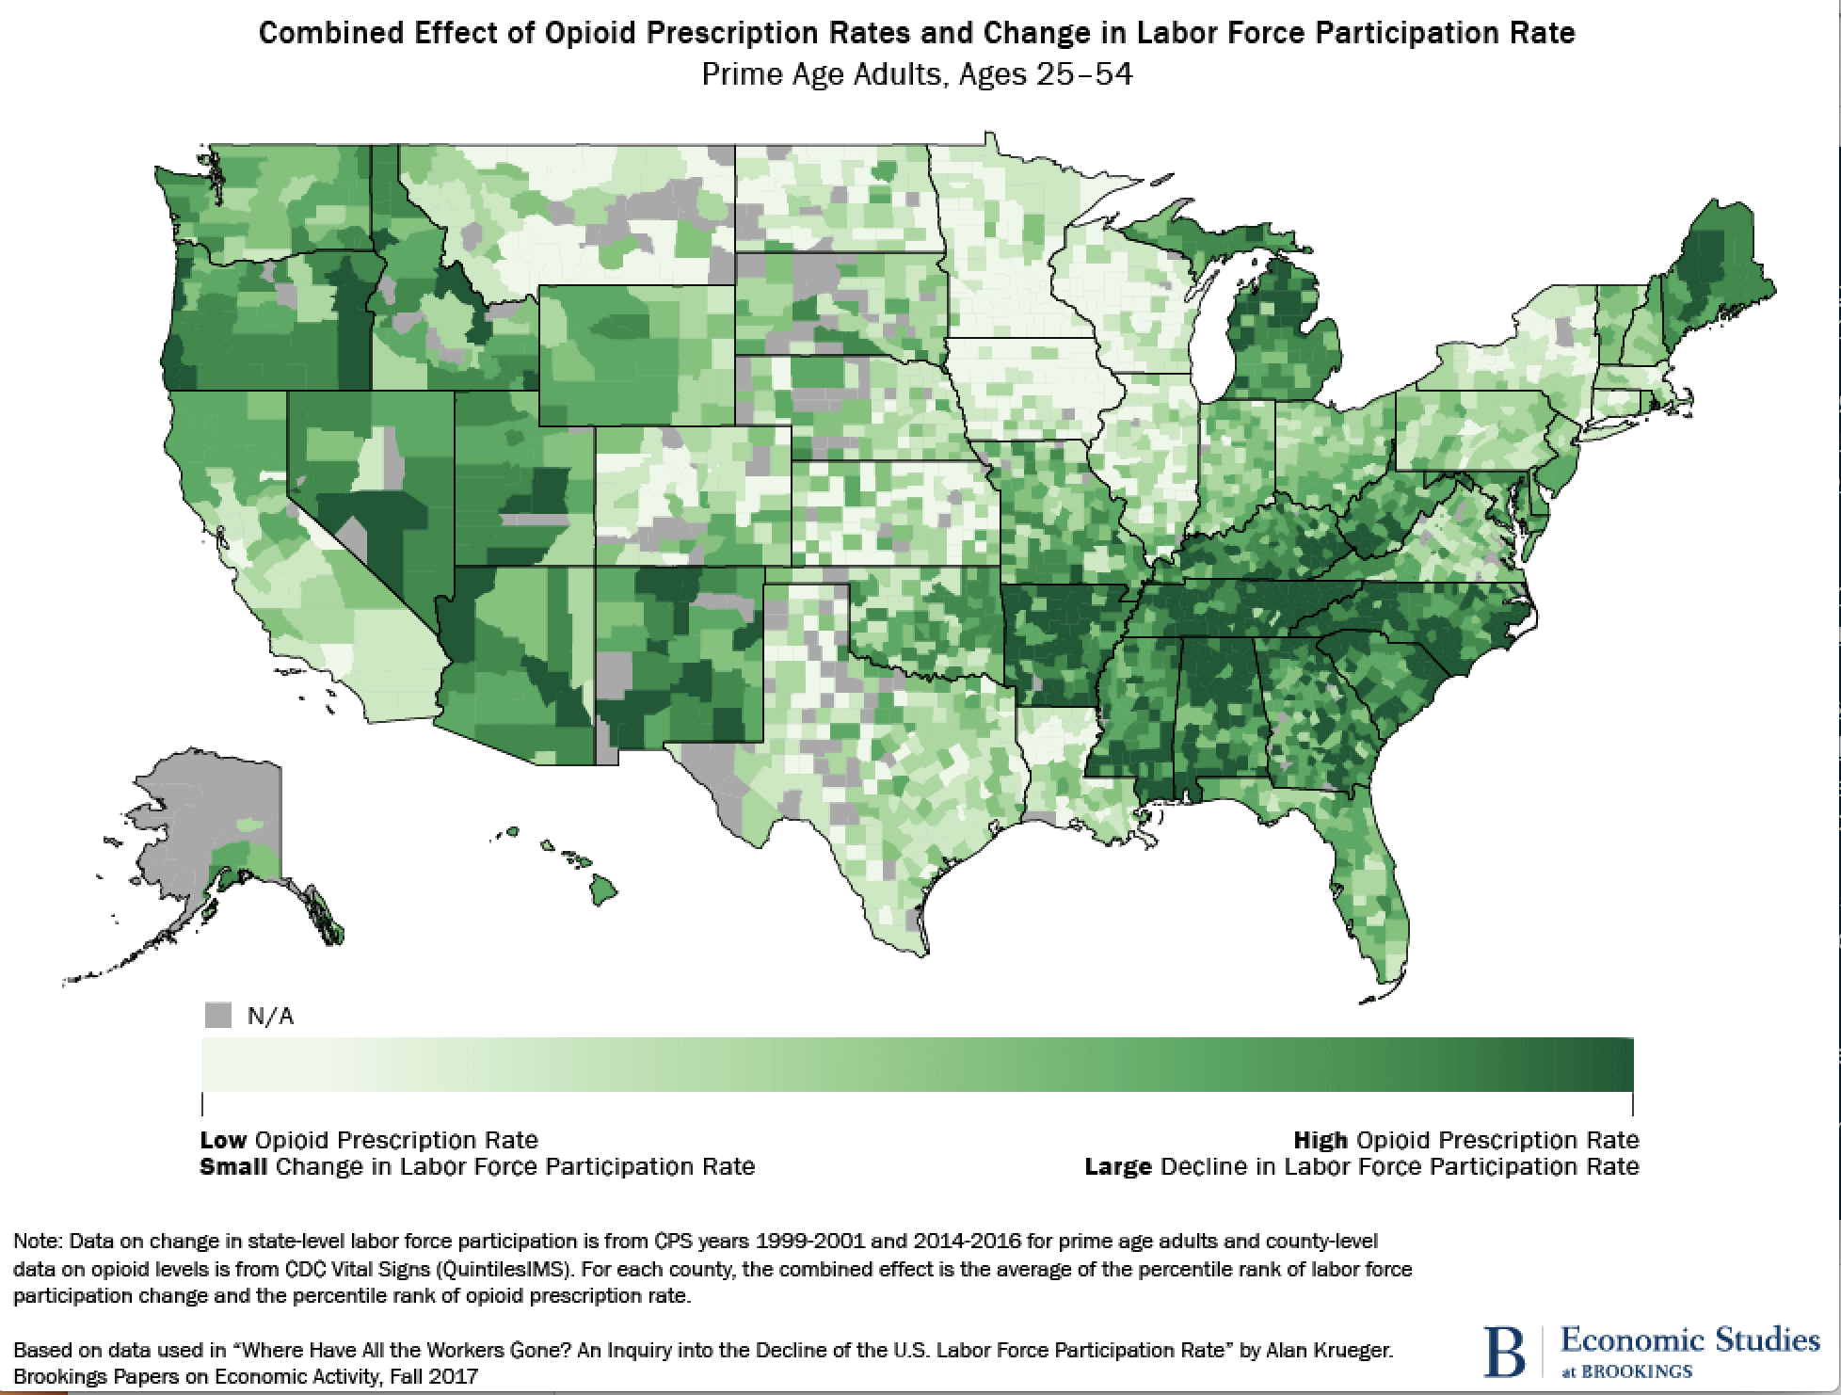
why it is important

Slide 28
why it is important
Approximately 70,000 Tennesseans suffer from some form of dependence on prescription narcotics.
Tennessee ranks 3rd in the nation for opioid consumption with at least 2,089 reported overdose deaths in 2019.
Over 75% of employers have been affected in some way by employee opioid use costing employers billions each year.
Only 17% of employers believe their organization is extremely well prepared to deal with opioid use in the workplace.
Employees who are in recovery have equal or lower health care costs, absenteeism and job turnover.
statistics

Slide 29
why it is important
Substance Use Disorder (SUD) is a Workforce Problem
Bookings Institute: Where have all the workers gone? An inquiry into the decline of the U.S. labor force participation rate (2017)
“The increase in opioid prescriptions from 1999 to 2015 could account for about 43% of the observed decline in men’s labor force participation during that same period, and 25% of the observed decline in the women’s labor force participation.”
According to a 2017 study by the Recovery Research Institute at Massachusetts General Hospital:
People in recovery from substance use disorder face an unemployment rate 3 times higher than the average rate.
additional statistics

Slide 30
the importance of community partners
commun
PEER Navigators
90 day pre release from incarceration
Pipeline of potential employees
Policy review / creation
Training partner
Data analysis
Department of Labor Partner
Jobs4TN
Tracking of Clients & Employers
Client & Employer Job Matching

Slide 31
steps to become a Certified Caring Workplace
PARTICIPANT
Sign a Letter of Agreement & Intent
Sign a Declaration Statement
CERTIFICATION
Drug & Alcohol Policies
Review
Leadership & Employee Training
GOLD CERTIFICATION
Additional Trainings and/or Community Event Participation

Slide 32
benefits of becoming a Caring Workplace
Have access to a new pipeline of individuals, supported and ready to work
Have access to free resources for your current workforce and their family members, including navigator assistance and support
Have access to free trainings and policy review
Have access to employee retention resources
Have access to quarterly “Employer Networking Sessions” with guest speakers on an array of pertinent work topics

Slide 33
benefits of becoming a Caring Workplace
Employer Networking Sessions
Focus group and employer feedback to help inform the creation of
Stigma in the Workplace training
Employment Law
Mental Health in the Workplace
Certified Peer Recovery Specialist

Slide 34
statistics
We currently have 27 partnering and/or referral agencies

Slide 35
Referral Partners
Correctional Counseling Institute Alternative Community Corrections Program Alternative Correctional Services Tennessee Department of Correction Probation T.D.O.C. Day Reporting Center and Career Resource Center Recovery Courts: Hawkins County and Greene County
U.S. Federal Probation: Greeneville, TN
U.S. Veterans Affairs Employment Program American Job Centers TN State Vocational Rehabilitation Services Frontier Health ETSU Addiction Science Center
Recovery Resources
Bridge to Shore
Sullivan County Jail
Johnson County Jail
Hawkins County Jail
Johnson City Recovery Center
East TN State University Addiction Medicine Family Practice
REVIDA Recovery
Recovery Associates
Unite Way of Greene County
United Way of Greater Kingsport
Kingsport Chamber of Commerce

Slide 36
Statistics
We currently have 62
Caring Workplace Employers

Slide 37
current employer participants
We would LOVE to celebrate YOU here!

Slide 38
current employer participants
We would LOVE to celebrate YOU here!

Slide 39
current employer participants
We would LOVE to celebrate YOU here!

Slide 40
Statistics
Number of participants enrolled to date: 742
Number of participants successfully employed to date: 214
Employed participants at the 3 month retention mark: 201 (94%)
Employed participants at the 6 month retention mark: 144 (67%)
Employed participants at the 1 year retention mark: 67 (31%)

Slide 42
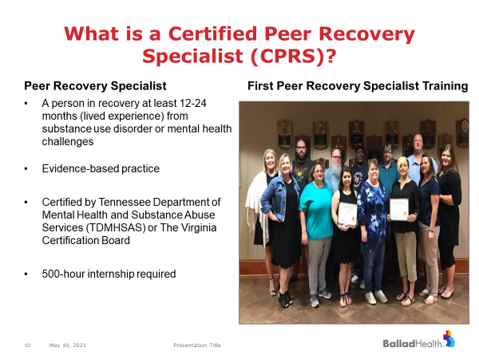

Slide 43
Trainings
Community Navigation
Warmline
Recovery Meetings
PEERhelp Programs:

Slide 44
Self Sufficiency
Community Colleges & Educational Institutions
SUD Treatment Providers
Behavioral Treatment Providers
Gainful Employment
Life Skills:
-Resume Building
-Interviewing
-Professional Attire
Education Training
Career Exploration
$
Medicare
Primary Care Providers
$
Commercial
Navigation to Employment Resource Hub
Community Resource Inventory
Service
Providers
Funding Sources
$
Grants
CRI
CPRS
Navigation to support services and needed programs to foster a workforce ready individual
$
Food
Employers
Housing
$
Job Support
Medicaid
ACC
Accountable Care Community
Transportation
Law Enforcement
Court Systems
Hospitals and Physician Offices
Probation and Parole Officers
Jails and Prisons
SUD Treatment Facilities
Employers
Community Partners
Warmline and
Jail Email
Members of the community in recovery or
post-incarceration

Slide 45
community engagement

Slide 47
benefits
“Many employers fear that people in recovery will threaten a company’s success. In reality, they offer unique strength you can’t find in other job candidates.”
Increased gratitude- once individuals enter recovery, they become committed to regaining the life they lost. Employment is an important part of that process. When you hire someone in recovery you are giving them so much more than a job.
A sense of purpose- employment provides a new, healthy sense of purpose
Daily responsibilities- employment assists with maintaining recovery by keeping individuals busy and engaged
Healthy socialization- opportunities to socialize with people in healthy circles of life
Confidence, loyalty and dedication- for many getting a job and contributing to society and their family helps restore the confidence that was lost. As an employer because you have bettered this individual’s life, they dedicate themselves to bettering the company.
Hiring people in recovery: The case for how it benefits employers | HRD Canada (hcamag.com)

Slide 48
individuals served
Over 2,873 encounters in PEERhelp’s support groups
843 served through jail email (Tier1)
299 served through navigation (Tier 2)
214 individuals connected to fair chance employment
201 (94%) of individuals at 3-month employment
144 (67%) of individuals at 6-month employment
67 (67%) of individuals at 1 year employment
this includes individuals from previous FYT’s that were connected to employment

Slide 49
STIGMA and Manufacturing
HR Philosophy
Flexibility
Accommodation
Why?

Slide 50
rural challenges
Multiple smaller counties but often large land mass
Housing
Transportation
Stigma
Types & size of employers
Need bilingual materials

Slide 51
how we address
Multiple, smaller counties but often large land mass
Create partnerships, organize by work area
Housing
Coalitions and partnerships, groupings of potential employees
Transportation
Working on solutions, planning grant, build multiple models
Work with employers
Stigma
Address head on (Holy Friendship summit), customized training
Types & size of employers
Work with ALL employers, any sector, but recognize impact may be different
Need bilingual materials
New challenge that we hope to seek funding to address, very specific areas of our region

Slide 52
what can we help answer
Q & A

Slide 53
contact us
for more information
please contact
Lottie Ryans: lryans@ftdd.org
Kristina Peters: kpeters@ftdd.org
www.caringworkplaces.org

Slide 54
Any Questions?
Notes:
Thank you Sam and Jonathan. As we move to questions and answers time, I want to point out one more resource and that is the National Safety Council, which has a number of resources available including a Substance use cost calculator and a Mental Health cost calculator. Tara Leystra from the National Safety Council is on our call today. Tara, if you could pop these links into the chat, we can be sure to share them to our audience. We hope to have the NSC join us as guest speakers at a future webinar.

Slide 55
Current DWG Funding Opportunities
The Work Opportunity for Rural Communities (WORC) 5 - Closing Date: June 13, 2023
Critical Sector Job Quality Grants – Closing Date: July 17, 2023
2023 Quality Jobs, Equity, Strategy, and Training (QUEST) Disaster Recovery National Dislocated Worker Grants – Closing Date: August 4, 2023

Slide 56
DOL’s Resources and Technical Assistance
National Dislocated Worker Grants Community of Practice
https://dwg.WorkforceGPS.org
Opioid Crisis Page -
Upcoming webinars
Related resource materials
Research
Case studies
Notes:
This program is coming to you from the Office of Workforce Investment, where our grants focused on opioids and substance use disorder are largely within the category of National Dislocated Worker Grants. Our Opioid-related resources and events are posted in our Community of Practice which can be found at dwg.workforceGPS.org.
Register for the Community of Practice website to stay up to date on future events.

Slide 57
Save the Dates: 2023 Spring Opioid Webinar Series
Recovery Ready Workplace Resource Hub ✔
March 30, 2023
Trauma Informed Care – OVERVIEW ✔
May 2, 2023
Native Americans and the Opioid Epidemic – Finding Solutions in the Workforce ✔
May 8, 2023
Trauma Informed Care - SUD ✔
May 11, 2022
Combating Discrimination Against Individuals in Recovery ✔
May 23, 2023
Trauma Informed Care – YOUTH COMMUNITIES (Hosted by OWI’s Division of Youth Services) ✔
May 30, 2023
The Impacts of Opioid Addiction on the Rural Workforce ✔
May 31, 2023
Notes:
Please make a note of upcoming webinar in our series on opioid-related topics. On August 11, we will host guest speakers from Ohio to walk through their Training Toolkit for Workforce Professionals for Serving Individuals with Substance Use Disorder. To register, you will want to join our workforceGPS National Dislocated Worker Grant Community of Practice. At workforcegps.org
We know there are many agencies working in this space, and we are looking future topics for the fall.
With that, I want to thank you all for coming today, and for all that you do to assist American businesses, workers, and job seekers and in particular, individuals in recovery.

Slide 58
US Department of Labor Contacts
Ashley Moore
Workforce Analyst
Office of Workforce Investment
Employment and Training Administration
Moore.Ashley.n@dol.gov
Amy Ambrose
Workforce Analyst
Office of Workforce Investment
Employment and Training Administration
Ambrose.Amy@dol.gov

Slide 59
Thank You!
Need help? Email: Support@workforceGPS.org

