Slide 1
Read Before You Proceed: Instructions for Use & Legal Compliance
Legal Accessibility Requirements: 508 Compliance
Only use tables when standard content delivery is insufficient, and never merge table cells.
Do not use screenshots or images of text items. All text must be editable and not blur when the screen is zoomed in.
Avoid using “Smart Art” or the “Design Ideas” tool.
Do not repurpose slide title boxes for any other use.
Do not use multiple spaces, empty paragraphs, or strings of tabs to visually adjust your content, as every such repeated character must then be manually stripped from all slides before posting. Instead:
Use soft returns to bump content to the next line in lieu of spaces (Shift + Enter)
Manage paragraph spacing and tabs in the “Paragraph” panel.
Every image or visual element used must either have alternative “alt” text applied or be marked as “decorative”.
Alt text translates visual information into verbal information, which is read aloud in screen readers, while items marked “decorative” are skipped.
This step is required to deliver the full message provided by any graphics.
The person who laid out the content should also provide that alternate information to ensure their message stays intact.
Learn about the new innovative features!
Please watch this webcast before using this template.
https://vimeo.com/370983870/2afa9e8306
(Ctrl + Click to open link)
Duration: 6 minutes

Slide 2
Where Are You?
Please enter your location in the chat window
(lower left of screen)

Slide 3
Who is in the audience?
What organization do you represent?
Youth Program
Local Workforce Development Board
Youth Committee/Council
State Workforce Development Board/Agency
Federal Government
Foundation
Other
Select the answer that best applies. If “Other” please type role into chat.

Slide 4
Technical Assistance to Meet Equity Goals in WIOA Youth Programs
Using an Equity Framework

Slide 5
Today’s Speaker / Today’s Moderator
Sara Hastings
Unit Chief, Division of Youth Services
ETA/DOL

Slide 6
Today’s Speakers
Renee Browne
Workforce Development Specialist / Division of Youth Services
ETA/DOL
Maisha Meminger
Manpower Specialist / Division of Youth Services
ETA/DOL

Slide 7
Today’s Objectives
Shared understanding of equity
Brainstorm what equity looks like in WIOA Youth programming
Lift up technical assistance (TA) resources
Explore what TA is needed

Slide 8
Advancing Equity and Supporting Underserved Communities
Background

Slide 9
Executive Order
On January 20, 2021 President Biden issued Executive Order 13985 on advancing equity and support for underserved communities through the federal government.
“The policy of the Federal Government is to pursue a comprehensive approach to advancing equity to include people of color and others who have been historically underserved, marginalized, and adversely affected by persistent poverty and inequity.”
“Executive departments and agencies must recognize and work to redress inequities in policies and programs that serve as barriers to equal opportunity.”
https://www.whitehouse.gov/briefing-room/presidential-actions/2021/01/20/executive-order-advancing-racial-equity-and-support-for-underserved-communities-through-the-federal-government/

Slide 10
Equity
What does equity mean to you?
Type your input into the Chat feature

Slide 11
Definitions
Equity – the consistent and systematic fair, just, and impartial treatment of all individuals, including individuals who belong to underserved communities that have been denied such treatment, such as Black, Latino, and Indigenous and Native American persons, Asian Americans and Pacific Islanders and other persons of color; members of religious minorities; lesbian, gay, bisexual, transgender, and queer (LGBTQ+) persons; persons with disabilities; persons who live in rural areas; and persons otherwise adversely affected by persistent poverty or inequality.

Slide 12
Definitions
Underserved Communities - refers to populations sharing a particular characteristic, as well as geographic communities, that have been systematically denied a full opportunity to participate in aspects of economic, social, and civic life.

Slide 13
Equity Work In Your Local Area/WIOA Youth Program
Where are you at as it relates to ensuring equity in your WIOA Youth program?
We have been intentional and explicit about equity in our WIOA Youth program for years.
We’ve only recently (in the last year or so) begun to focus on equity in our program.
We have not started our equity work but we have plans to this year.
We have not discussed equity as it relates to WIOA Youth programming.
No one uses the language of equity but I am pretty sure it is incorporated in how we do our work.
Select the answer that best applies.

Slide 14
Equity Work In Your WIOA Youth Programming
What parts of your programming integrate equity strategies?
Outreach/Recruitment
Service Delivery
Youth Leadership Opportunities/Youth Voice
Staff Development/Training
Nothing at this time
Other strategies
Select all that apply

Slide 15
Who Do We Serve?
Demographic Data Analysis

Slide 16
WIOA Youth Eligibility/Target Population
Eligibility criteria are low-income in-school youth and out-of-school youth with barriers to employment: basic skills deficient or English language learner; justice system involved; homeless, runaway, or foster care; pregnant or parenting; and with disability. (WIOA Sec. 129)

Slide 17
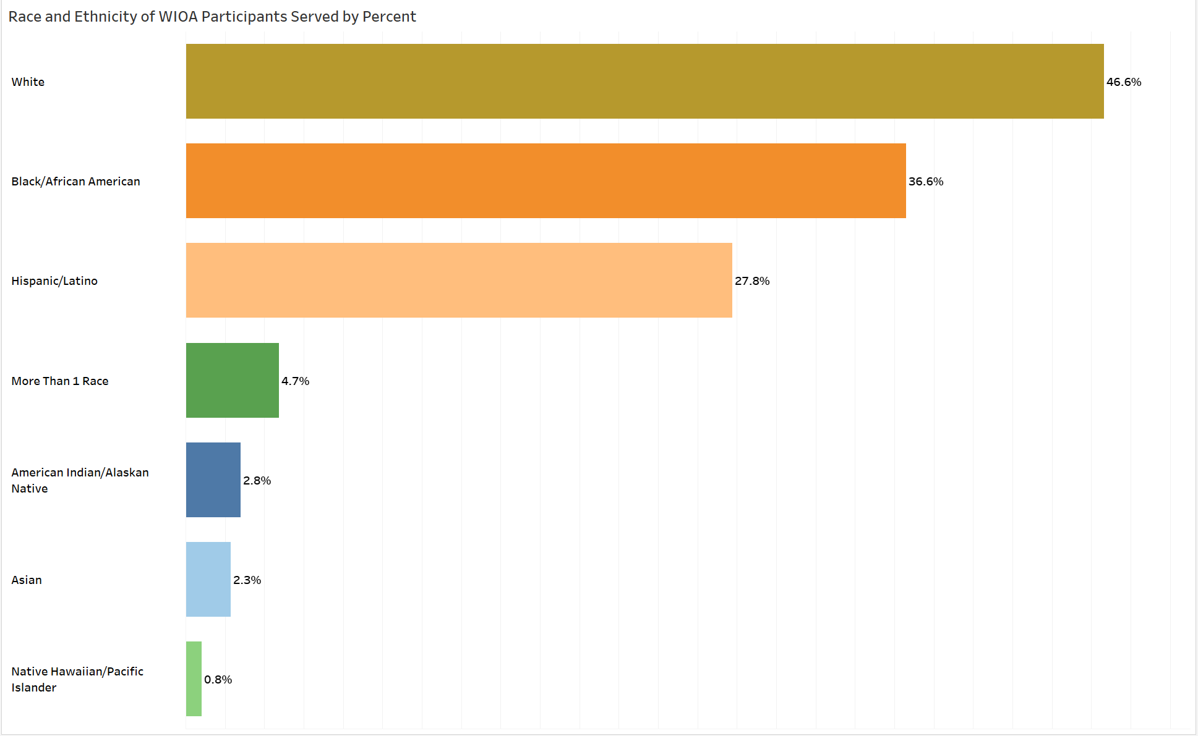
Notes:
Now let’s look at the performance data that reveals racial diversity in youth WIOA programs serves!
Large numbers: 47% of the total number of participants are White; 37%, Black; and 28%, Hispanic/Latino youth.
Other racial groups are smaller: less than 5% American Indian/Alaskan Native; Asian; and Native Hawaiian/Pacific Islander. Almost 5% are of more than 1 race.

Slide 18
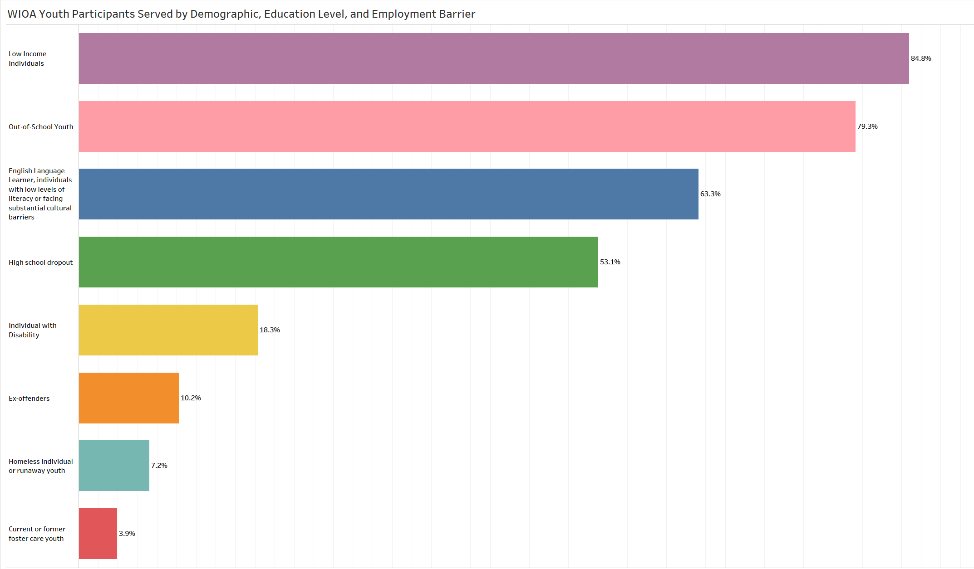

Slide 19
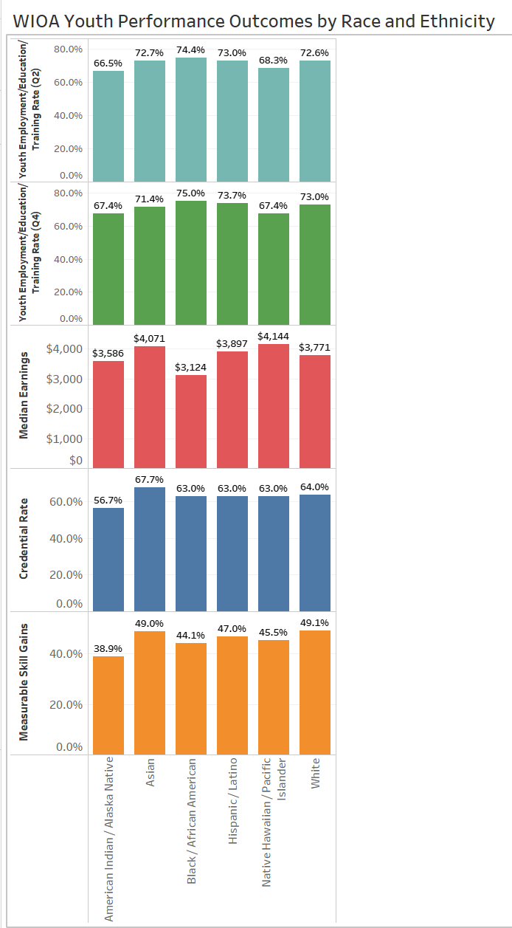

Slide 20
Data as a Tool to Help Advance Equity!
Important Data Questions to Consider to Meet Equity Goals
Are you serving who you are intending to serve?
Are there data points that surprise you?
Are there populations that you thought you were serving but the data shows otherwise?
What does the data show when you look at performance outcomes by specific groups? And what questions does that raise?
Do you have the right/adequate data to answer all your questions?
And other important data questions to consider!

Slide 21
Equity in WIOA Youth Programs
What does this look like in your local area?
What could this look like in your local area?

Slide 22
How to Incorporate Equity in Programming
Recruitment and Retention
Youth Voice/Decision making/Leadership Development
Work Experience and Employment
Target Populations and Partnerships
Type into the chat

Slide 23
TA Resources to Help Meet Equity Goals
Recruitment and Retention
Sample Youth Individual Service Strategy (ISS) from the Employment and Training Administration
Strategies and Considerations: A Brief on Youth Assessments
Civic Engagement for Leadership Development - NEW
Work Experiences for Youth Videos
Work Experiences for Youth: Covid-19 Adaptations
Summer-at-a-Glance: Building Workforce Opportunities for Youth During Challenging Times
Strategies WIOA Youth Programs Can Use When Serving Court-Involved Youth
Tipsheet: Providing Employment Services to Homeless and Runaway Youth
Collaboration Opportunities: WIOA Youth Programs and Apprenticeship
Collaboration Opportunities: Youth Entrepreneurship

Slide 24
What TA is Needed Now to Help Advance Equity in WIOA Youth programming?
We want to hear from you

Slide 25
Technical Assistance Needs
What are some of your current TA needs, using an equity lens?
Outreach and Recruitment (type in details)
Program Design (type in details)
Program Elements (type in which ones)
Mental Health (type in details)
Partnerships (type in details)
Others (type in details)
Type into the chat

Slide 26
Technical Assistance Needs
Are there any other technical assistance needs related to advancing equity?
Type your input into the Chat feature

Slide 27
More Technical Assistance Resources
Youth Connections Community of Practice
An online learning destination for public workforce system staff and partners who serve youth in the Workforce Innovation and Opportunity Act (WIOA) Youth Program
about this resource
https://youth.workforcegps.org/
U.S. Department of Labor Coronavirus Resources
Technical assistance resources to help workers and employers prepare for the COVID-19 virus
https://www.dol.gov/agencies/eta/coronavirus
Summer Jobs for Youth Resources
Resources and lessons learned from past summers that are relevant to any program and can be used to enhance a summer youth employment program.
https://youthsummerjobs.workforcegps.org/

Slide 28
Any Questions?
Add guidance for how to answer questions here.
(If more info is needed as a parenthetical, add here. If not needed, delete this block.)

Slide 29
Contact Us
Employment and Training Administration’s
Division of Youth Services
youth.services@dol.gov
Become a member of Youth Connections Community
youth.workforcegps.org
_
_

Slide 30
Thank You!
Thank you for all the work you do on behalf of our nation’s most vulnerable youth!
Need help? Email: Support@workforceGPS.org
_

