Slide 1
What’s Important When You’re Engaged in Community College Systems Change?

Slide 2
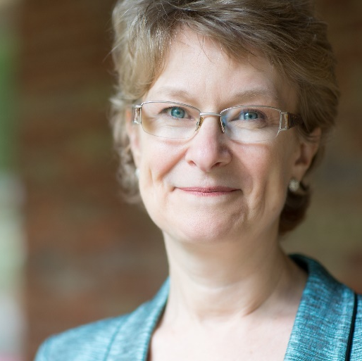
Moderator
Cheryl Martin
Program Manager, Competitive Grants
Division of Strategic Investments, Employment and Training Administration, U.S. Department of Labor

Slide 3
Hannah Betesh
Senior Associate, Social and Economic Policy
Abt Associates
Dawn Jackman Murphy
Workforce Development Specialist, SCC
Department of Labor, Employment and Training Administration

Slide 4
What factors affect implementation of statewide systems change efforts in a community college context?
Context
State community college structure
Evolution of community college missions in the state
State progress on implementation of WIOA

Slide 5
What factors affect implementation of statewide systems change efforts in a community college context?
Infrastructure
Prior relevant grants
Statewide policies and initiatives

Slide 6
What factors affect implementation of statewide systems change efforts in a community college context?
Alignment
Engagement of employers
Coordination with state agencies
Integration with workforce development system

Slide 7
How might these factors play out differently in a pandemic-era context than they did under TAACCCT?
Acceleration of technology-based learning created infrastructure more rapidly
Further shift in community college missions due to declining enrollment
Employer needs more acute due to labor shortages

Slide 8
What does this all mean for Strengthening Community College grantees?
Adapt based on state, institution, and system context
Statewide systems change
Align with current priorities of key stakeholders for a post-pandemic world
Leverage prior infrastructure and lessons

Slide 9
Questions and Discussion

Slide 10
Resources
TAACCCT evaluation findings, including career pathways brief, employer perspectives studies, and more https://www.dol.gov/agencies/oasp/evaluation/currentstudies/14
Context, Infrastructure, and Alignment Matter: Statewide Systems Change in Round 4 of TAACCCT
https://www.dol.gov/sites/dolgov/files/OASP/evaluation/pdf/ETA_SystemChange_Brief_Sep2020.pdf
CLEAR - Clearinghouse for Labor Evaluation and Research
https://clear.dol.gov/topic-area/community-college
SkillsCommons - free and open online library containing free and open learning materials and program support materials for job-driven workforce development. https://www.skillscommons.org/discover?filtertype=type&filter_relational_operator=equals&filter=Final+Program+Report

Slide 11
Contact Information
Round 4 TAACCCT Evaluation Department of Labor Project Officers
Janet Javar, Javar.Janet.O@dol.gov>
Chayun Yi, Yi.Chayun@dol.gov
Round 4 TAACCCT Evaluation Team
Karen Gardiner, Project Director, karen_gardiner@abtassoc.com
Hannah Betesh, Brief Author, hannah_betesh@abtassoc.com
Strengthening Community Colleges
SCC@dol.gov

Slide 12
Thank You!
Need help? Email: Support@workforceGPS.org

