Slide 1
Poll Question - All
What is your role?
Trade Staff
RESEA Staff
Trade & RESEA Staff
Other
Please select one answer.

Slide 2
RESEA Program and TAA Program Connections

Slide 3
Today’s Moderator
Timothy Theberge
Senior Policy Analyst
OTAA, U.S. DOLETA

Slide 4
Today’s Speakers
Lawrence Burns
Workforce Development Specialist
OUI, U.S. DOLETA
Ellen Wright
Workforce Development Specialist
OUI, U.S. DOLETA
Beth Goguen
Director of Central Programs
MassHire Department of Career Services

Slide 5
Today’s Objectives
Learn about the Reemployment Services and Eligibility Assessment (RESEA) Program
Learn ways RESEA can partner with TAA
Learn why and how Massachusetts integrates the RESEA and TAA program
Learn about additional resources for RESEA

Slide 6
What’s Happening in the Trade World?

Slide 7
Trade Overview
Video

Slide 8
Why Trade and RESEA?
Common Demographic Factors
Older
Less formal education
Longer tenure in previous employment
Narrower skill sets
These common factors contribute to higher likelihood of long-term unemployment.

Slide 9
PIRL 401 Element: UC Eligible Status
Record 0 if the participant was neither a UC Claimant nor an Exhaustee.
Record 1 if the participant is a person who (a) filed a claim and has been determined eligible for benefit payments under one or more State or Federal Unemployment Compensation (UC) programs and whose benefit year or compensation, by reason of an extended duration period, has not ended and who has not exhausted his/her benefit rights, and (b) was referred based on participation in the Reemployment Services and Eligibility Assessment (RESEA) program.
Record 2 if the participant is a person who (a) filed a claim and has been determined eligible for benefit payments under one or more State or Federal Unemployment Compensation (UC) programs and whose benefit year or compensation, by reason of an extended duration period, has not ended and who has not exhausted his/her benefit rights, and (b) was referred to service through the state's Worker Profiling and Reemployment Services (WPRS) system.
Record 3 if the participant is a person who meets condition 2 (a) described above, but was not referred to service through the state's WPRS system or the RESEA program.
Record 4 if the participant meets condition 2(a), but has exhausted all UC benefit rights for which he/she has been determined eligible, including extended supplemental benefit rights.
Record 5 if the participant is claimant who is exempt from normal work search requirements according state law, and does not have to perform work search activities.
Leave blank if this data element does not apply to the participant.
0 = Neither Claimant nor Exhaustee
1 = Claimant Referred by RESEA
2 = Claimant Referred by WPRS
3 = Claimant Not Referred by RESEA or WPRS
4 = Exhaustee
5 = Claimant is Exempt

Slide 10
PIRL 401 Data
0 = Neither Claimant nor Exhaustee
1 = Claimant Referred by RESEA
2 = Claimant Referred by WPRS
3 = Claimant Not Referred by
RESEA or WPRS
4 = Exhaustee
5 = Claimant is Exempt
PIRL Data: 7/1/2020-6/30/2021, as of 10/18/2021

Slide 11
Poll Question - All
What is level of integration between RESEA and Trade in your state?
None to my knowledge
Informal (person to person communication)
Formal (includes SOPs, electronic file sharing)
Varies from local to local
Not sure
Please select one answer.

Slide 12
Any Questions?

Slide 13
Overview of RESEA

Slide 14
RESEA Background
Reemployment Eligibility Assessment (REA) Program-
Began in 2005
Based on Nevada model combining referrals to reemployment services with eligibility assessment.
RESEA
2015-Present-
Expanded REA model
Historical focus on claimants profiled as likely to exhaust and UCX
Permanently authorized in 2018 (§306,SSA)

Slide 15
SSA Section 306(b) Purposes --
4 Goals
“To improve employment outcomes of individuals that receive unemployment compensation and to reduce average duration of receipt of such compensation through employment.”
To strengthen program integrity and reduce improper payments of unemployment compensation
To promote alignment with the vision of the Workforce Innovation and Opportunity Act of increased program integration and service delivery.
Establish RESEA as an entry point to other workforce system partners.

Slide 16
Minimum Required RESEA Services
Initial Meeting
Subsequent
UI Eligibility Assessment
Labor Market Info
ES enrollment
Support with individual reemployment plan (IRP)
Information/Referrals to other services
UI Eligibility Assessment
Review of work search activities/IRP
In the majority of states, additional reemployment services are also provided
RESEA uses WIOA “Career Services” to define reemployment services

Slide 17
New Requirements
Required use of evidence-based strategies and evaluations
Increased state discretion in participant selection
Formula allocation of funding and new funding requirements
Submission and approval of annual RESEA state plan

Slide 18
Targeting Participants
States now have significant discretion in how RESEA is targeted to UI claimants.
Limited to regular UI program and does not include federal or special program (i.e. extended benefits or PUA)
Worker Profiling and Reemployment Services (WPRS) is still a separate statutory requirement
Generally states use RESEA to meet WPRS by targeting claimants identified as likely to exhaust

Slide 19
Funding Outlook (In Millions of Dollars)
BBA/SSA provides both authorizations and cap adjustments
FY | 2020 | 2021 | 2022 | 2023 | 2024 | 2025 | 2026 | 2027
Base | $117M | $117M | $117M | $117M | $117M | $117M | $117M | $117M
Cap | $58M | $83M | $133M | $258M | $433M | $533M | $608M | $633M
Total | $175M | $200M | $250M | $375M | $550M | $650M | $725M | $750M

Slide 20
RESEA Performance Measures
Aligned with WIOA: (TEGL 9-20 and UIPL 07-21)
Core Measure: Reemployment Rate in the 2nd Quarter after Program Exit Quarter for RESEA Participants
Targets currently based on WP
Program Performance Measure: Median Earnings in the 2nd Quarter after Program Exit Quarter for RESEA Program participants.
Data Captured via WP-ES Program

Slide 21
Opportunities for Alignment and Integration: RESEA, TAA, WIOA

Slide 22
RESEA, TAA, and the WIOA Vision
Opportunities
RESEA now more flexible and permanent
Similar Populations
Permanent Program
RESEA Integration with WIOA/Workforce System Partners
Co-enrollment/Informed transition of participants
Virtual/Remote Services
Common definitions and performance
Limitations
WIOA/RESEA State Plans
Conflicting timeframes
WIOA & RESEA Evaluations
Different Programs
TAA and RESEA Timing of Services
Early/Late
Supplement not Supplant

Slide 23
Examples of Alignment
Trade informs RESEA of pending certifications
RESEA has procedure for transferring participants to Trade
Both programs are included in strategic planning , e.g., State Plans
Cross-Training
Data and funding agreements as needed

Slide 24
Poll Question – TAA Staff
For TAA Staff:
At the point of TAA participation, do you have a flag that checks in UI status?
No. This is completed by another program (e.g. Wagner Peyser)
Yes. We specifically ask about RESEA referral.
Not sure
Please select one answer.

Slide 25
Any Questions?

Slide 26
Massachusetts Model
Integration, Cross-training and
Maximizing Resources

Slide 27
Massachusetts RESEA Data
Massachusetts has the 3rd highest level of current participants with the client referred by RESEA (PIRL 401 = 1)
Nation – 11.4%
Massachusetts – 36.8%
PIRL Data: 10/1/2020-9/30/2021, as of 10/18/2021

Slide 28
Massachusetts’ Model
Customer Flow for All Customers

Slide 29
Massachusetts’ Model
Key Components of the RESEA Program
Element | RESEA
Enrollment | RESEA enrollment up to 2,000 weekly at the time of first UI payment
Notification Letters | Customers are sent notification letters from DUA at the time of enrollment
Welcome Letters | Customers are sent welcome emails from DDCS on the Tuesday after enrollment welcoming them into MassHire Career Center system
Mandatory Attendance at a Career Center Seminar (CCS) and initial RESEA | Must attend CCS and complete the initial RESEA by week 3 after enrollment May be rescheduled additional week up to week 4 with good cause if requested prior to “must attend by date” (in week 3)
Handling 60-Dayers | Waived from CCS if they attended in the last 60 days Must return to complete initial RESEA and RESEA Review
Reminder Emails and Calls | Reminder emails are sent to those that have not attined 1 week prior to deadlines and calls are made by local MCCs

Slide 30
Massachusetts’ Model
Key Components of the RESEA Program
Element | RESEA
Referral to Appropriate Reemployment Services | Must attend prior to RESEA Review
RESEA Review | Must attend RESEA Review by week 5 after enrollment May be rescheduled additional week up to week 6 with good cause if requested prior to “must attend by date” (in week 5)
CCS Sanction – RESEA Review | One-week sanction if CCS is not attended by week 3 Indefinite Sanction if RESEA Review not attained by week 5

Slide 31
Massachusetts’ Model
RESEA Program Flow

Slide 32
Massachusetts’ Model
TAA Program Flow
Review for A/RTAA,
Job Search Allowances, etc.
Review if Company is TAA and file 1666
Submit to MDCS fro approval

Slide 33
Massachusetts’ Model
Best Practices
Central Programs Director
Cross-Training
Title I, WIOA
TAA
Career Planning
RESEA Integration in the MCC
Partnership with DUA
Integrated Budget

Slide 34
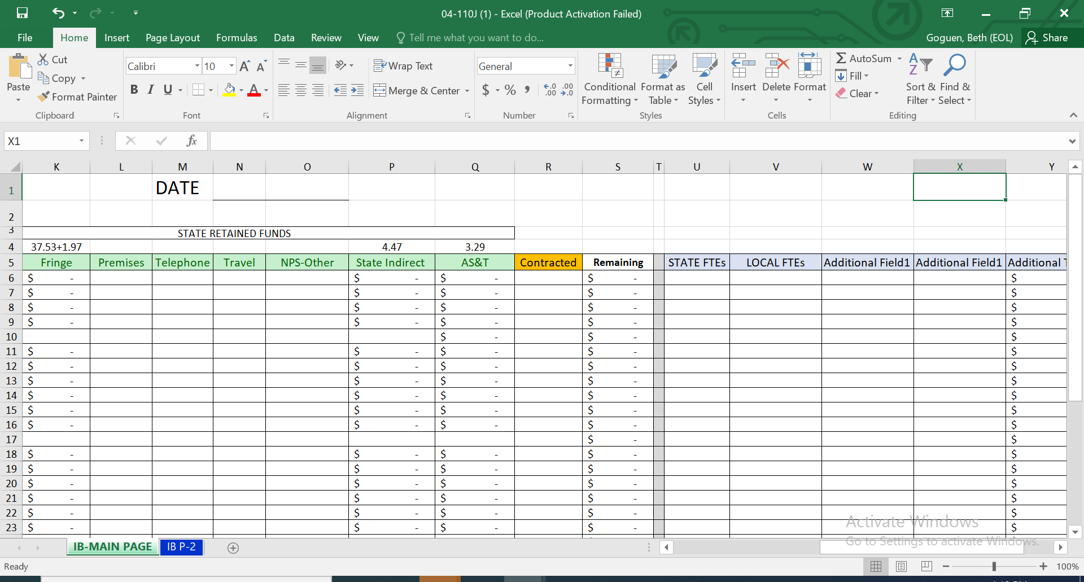
Massachusetts’ Model
Integrated Budget
https://www.mass.gov/service-details/massworkforce-wioa-local-plan-guidance-policy-issuances
04-110J: Integrated Budget – Revised Format 04-110K: Integrated Budget Instructions 04-110L: Integrated Budget Program List

Slide 35
Massachusetts’ Model
Challenges or Opportunities to Integration
Virtual Service Delivery
Staff and customer training
Different programs; different missions
TAA program is too complicated!
Same but different
Lack of program knowledge
Cross-training
Misconception

Slide 36
Poll Question – RESEA Staff
For RESEA Staff:
Are RESEA staff aware of TAA applications or other related activities that might affect participants?
No. There is no intersection.
Yes. There is one or more procedures for such communication.
Yes. RESEA and Trade are operated by the same agency.
Not sure
Please select one answer.

Slide 37
Any Questions?

Slide 38
Resources

Slide 39
Clear.dol.gov

Slide 40
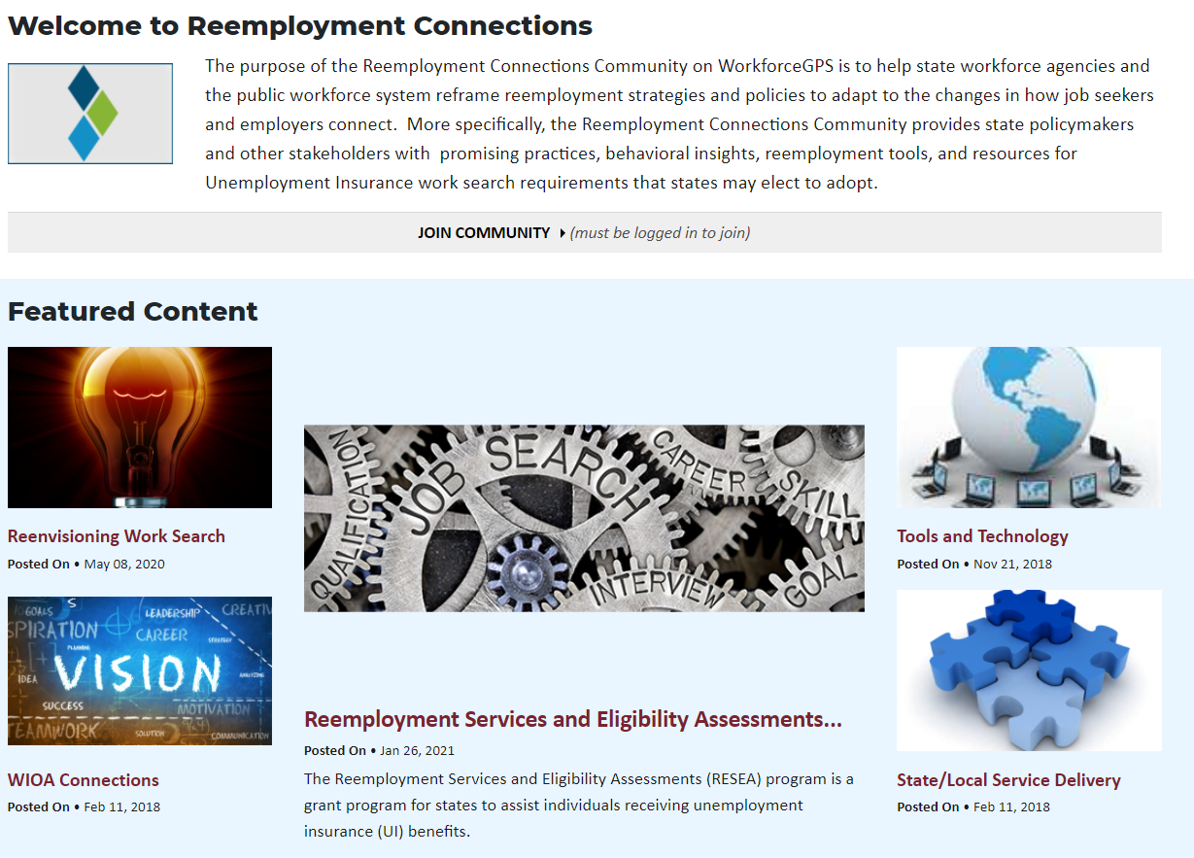
My Reemployment Connections (rc.workforcegps.org)

Slide 41
Resources:
General
My Reemployment Plan
Reenvisioning Work Search
Behavioral Interventions (Reemployment)
RESEA Customer Flow Scenarios
Performance
RESEA Performance Reporting Guide
Evaluation and Research
Clearinghouse for Labor Evaluations and Research (CLEAR)
Reemployment Topic Area
RESEA Page
Plain Language Tool
Tutorial
RESEA/Evaluation Technical Assistance
Report to Congress
TAA
TAA Website
TAA WorkforceGPS Community

Slide 42
Any Questions?

Slide 43
PIRL 401 Data
0 = Neither Claimant nor Exhaustee
1 = Claimant Referred by RESEA
2 = Claimant Referred by WPRS
3 = Claimant Not Referred by
RESEA or WPRS
4 = Exhaustee
5 = Claimant is Exempt
PIRL Data: 7/1/2020-6/30/2021, as of 10/18/2021

Slide 44
Contact Us
Lawrence Burns
Office of Unemployment Insurance, U.S. DOL/ETA
Burns.Lawrence@dol.gov
Ellen Wright
Office of Unemployment Insurance, U.S. DOL, ETA
Wright.Ellen.D@dol.gov
RESEA Inbox
OUI.RESEA@dol.gov
Beth Goguen
Director of Central Programs
MassHire Department of Career Services
Elizabeth.M.Goguen@state.ma.us
617-626-6053

Slide 45
Thank You!
Need help? Email: Support@workforceGPS.org

