Slide 1
Best Practices with Partnerships/Employers Blue Ridge Community and Technical College West Virginia

Slide 2
Start with the End in Mind! How BRCTC determined that a large partnership base was needed.
Goal – 40 enrollees
Estimated 80 applications to get 40 enrollees
Estimated 200 interested appointments to get 40 people to submit applications.
Estimated 1000 contacts ( A contact is someone that can apply or can refer an applicant ) to get an appointment
Partnerships that work directly with qualified applicants provide a higher quality of applicant (those that meet the eligibility requirements).

Slide 3
Time Frame
Divide contacting all of the local partners.
Met twice a week
Divided contacting among the entire team.
Three week time frame to contact partners and schedule follow up meetings.
Four month time frame to meet our goal of 40 applicants .
Outreach Coordinator
Assisted in scheduling lunch meetings when possible with the larger partnerships. BRCTC paid for the lunches in partnership with the programs that would receive enrollments.

Slide 4
Determining Priority Partners
Determine which partnerships need the services of Job Scholars
Priority Partnerships Included:
DOL Workforce OneStop
OneStop Youth Programs
School Boards
Martinsburg Initiative – a local partnership commissioned with the task of helping the community find the appropriate services
Internal Partners – Treat the internal partners at your college like any other partnership. Schedule lunches, meetings, etc to be sure that you aren’t missing internal referrals.
Economic Development Boards and affiliated programs
NAACP

Slide 5
How to make partnerships successful
Focus on:
“What’s in it for them”
How can Job Scholars make the referral process easy
Job Scholars takes initiative for constant contacts

Slide 6
Constant Contacts
Monthly Information Sessions
Same time and location each month
Partners always know how to get referrals to you
Tour the classrooms where applicants will work
Invite Partners to the Information Session if they don’t have a separate luncheon meeting

Slide 7
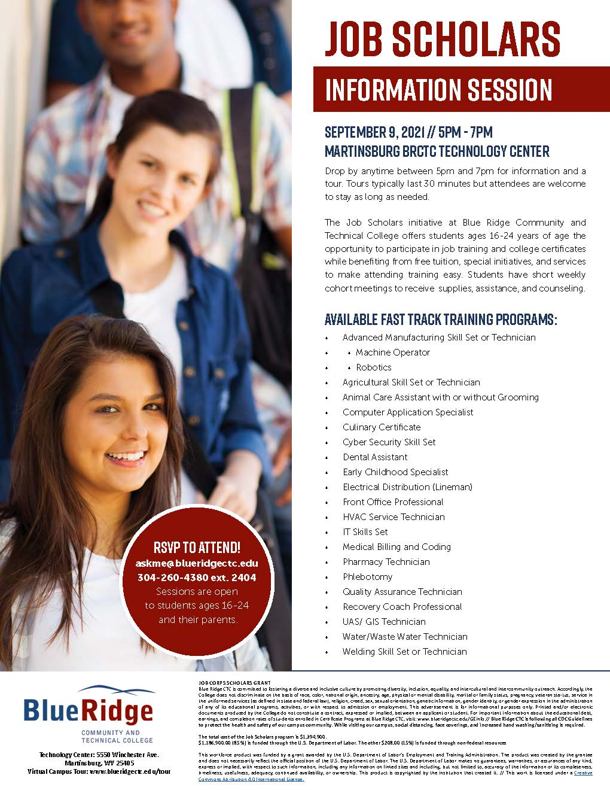

Slide 8
Constant Contact Ideas
Monthly emails and phone calls – check-in
Mail all partnership contacts the Monthly Information session twice each month so they can give to referrals
Newsletter
Meetings as needed only- provide lunch if you can find the funds
Offer to speak at the partners meetings
County Fairs and Community Events
Employer Advisory Meetings
Job Scholars Advisory Committee
College Recruitment Events

Slide 9
Blue Ridge Community and Technical College
Using this method we have approximately 210 community partners
List partners by contact person name
Some organizations have more than one contact person
Approximately 60 organizations

