Slide 1
Familiarity with 2021 TAAACS
How familiar are you already with the 2021 TAAACS?
What is TAAACS?
I know the old TAAACS, but not the revision.
I attended the listening session in the Spring, but haven’t looked at the final version.
I have looked through the new TAAACS, but have questions.
I was filling it out and got stuck.
I’m good with the 2021 TAAACS, but listening to make sure I didn’t miss anything.
Select the most appropriate response.

Slide 2
TAA Administrative Collection of States (TAAACS):
Filling out the 2021 Version

Slide 3

Today’s Speaker
Robert Hoekstra
  Program Analyst (Data Analytics) / Technical Expert
    Office of Trade Adjustment Assistance

Slide 4

Objectives
What is TAAACS?
Why a 2021 Revision?
Basics of Completing the Form
Section Revisions and Walkthrough
Focus on Worker Lists
Comments/Affirmation/Submission

Slide 5
What is TAAACS?
(aka the TAA Administrative Collection of States)

Slide 6

TAA Administrative Collection of States
The TAA Administrative Collection of States (TAAACS):
  Collects discrete, quantitative data on state organization and practice for analysis
  Collected annually to capture changes
  Primarily filled out by TAA Coordinators, but requires information from fiscal, reporting, and other areas

Slide 7

TAA Administrative Collection of States
TAAACS allows DOL to:
  Conduct data analysis around state practices
  Find practices that may be promising
  Identify outlier states
  Provides monitoring staff with critical information about how the state is organized
  Better understand challenges

Slide 8
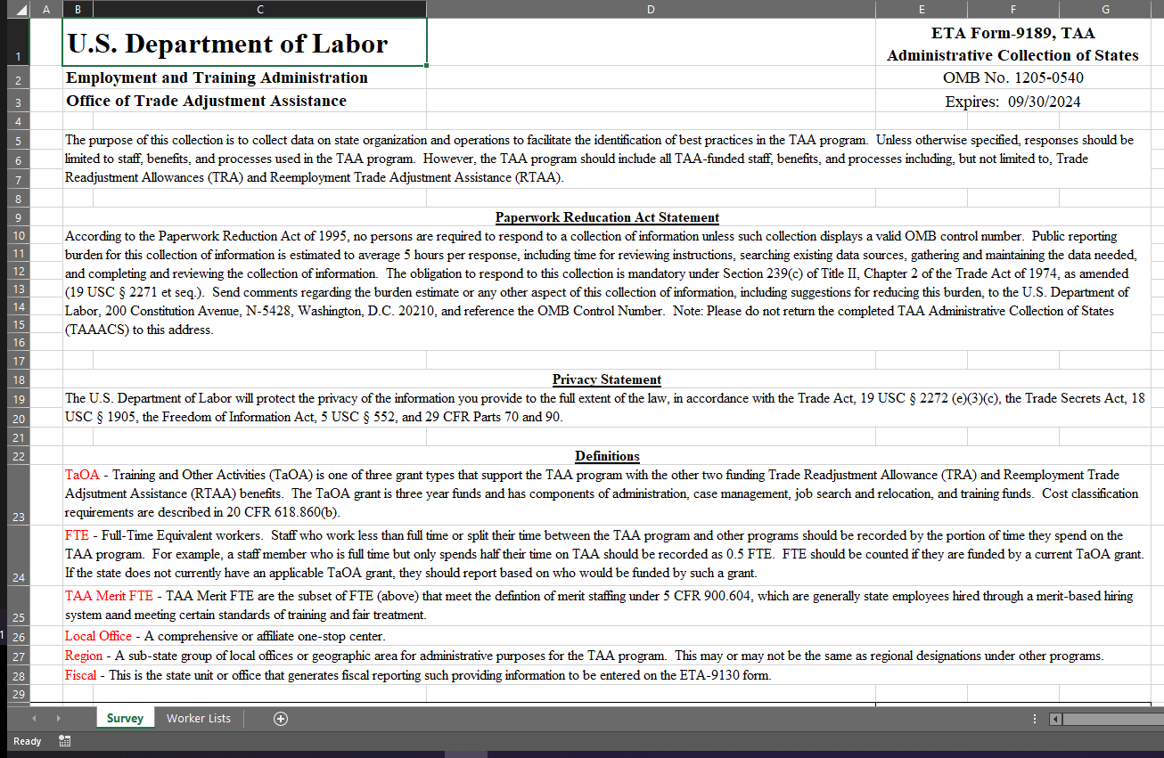
TAA Administrative Collection of States
Two-Tabbed Excel Sheet
Completed between 10/1 and 11/30 annually
Emailed back
Must be completely filled out

Slide 9
TAAACS Sections
Definitions!
State Organization
Outreach
Eligibility and Program Benefits/Services
Integration
IT Systems and Reporting
Training for TAA Staff
Barriers and Technical Assistance
Worker Lists!

Slide 10
Why a 2021 Revision?

Slide 11
PIRL 2021 Revision
Goals:
  Improve Clarity
  Improve Data Usability
  Simplification and Removal of Unhelpful Information
  Created Consolidated Outreach Section
  More Integration Information
  Expanded Barriers and Technical Assistance Information
  Worker Group Numbers

Slide 12
Basics of Completing the Form

Slide 13
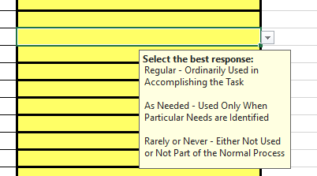
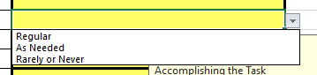
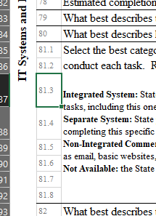
Filling Out the Form Principals
Do not modify the form
Return the form as an Excel to me (hoekstra.robert@dol.gov)
Only enter information in the yellow fields (no side comments, use comment section if clarification is needed)
Check field tips explanations
Select the “best option” in drop downs
Ask questions!
  (Use Column B to reference question numbers)

Slide 14
Section Revisions and Walkthrough
Definitions!

Slide 15
Definitions!
TaOA –
  Training and Other Activities (TaOA) is one of three grant types that support the TAA program with the other two funding Trade Readjustment Allowance (TRA) and Reemployment Trade Adjustment Assistance (RTAA) benefits. The TaOA grant is three year funds and has components of administration, case management, job search and relocation, and training funds. Cost classification requirements are described in 20 CFR 618.860(b).
Most people skip over these, but they provide some essential information for filling out the form!

Slide 16
Definitions!
FTE - Full-Time Equivalent workers
  Staff who work less than full time or split their time between the TAA program and other programs should be recorded by the portion of time they spend on the TAA program. For example, a staff member who is full time but only spends half their time on TAA should be recorded as 0.5 FTE. FTE should be counted if they are funded by a current TaOA grant. If the state does not currently have an applicable TaOA grant, they should report based on who would be funded by such a grant.
Does NOT include TRA and RTAA
Most people skip over these, but they provide some essential information for filling out the form!

Slide 17
Definitions!
TAA Merit FTE - TAA Merit FTE are the subset of FTE that meet the definition of merit staffing under 5 CFR 900.604, which are generally state employees hired through a merit-based hiring system and meeting certain standards of training and fair treatment.
Local Office - A comprehensive or affiliate one-stop center.
Region - A sub-state group of local offices or geographic area for administrative purposes for the TAA program. This may or may not be the same as regional designations under other programs.
Fiscal - This is the state unit or office that generates fiscal reporting such providing information to be entered on the ETA-9130 form.
Most people skip over these, but they provide some essential information for filling out the form!

Slide 18
Any questions on definitions?

Slide 19
Section Revisions and Walkthrough
State Organization

Slide 20
State Organization
Let’s start out by talking about staffing levels.

Slide 21

State Organization
Let’s start out by talking about staffing levels
Each category is exclusive (unique)
Each category needs counts for Merit and Non-Merit (may be zero)
Pay attention to cost allocation (Admin/CM)
Totals should add up
Only the TaOA grant (not TRA or RTAA)
Questions? Ask!

Slide 22
State Organization
Local Offices and Regions
Q6: How many local offices?
  This should include all offices including satellite offices.
Q7: Number of Regions
  Zero if not setup in regions

Slide 23
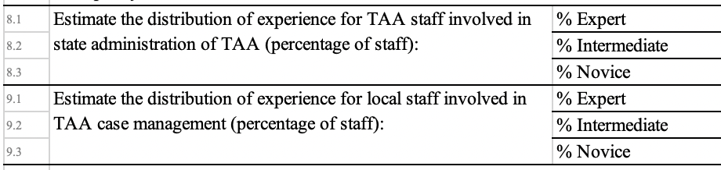
State Organization
Expertise
Each question should add to 100%

Slide 24
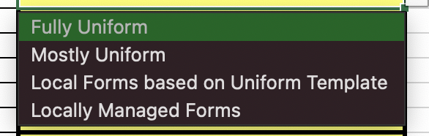
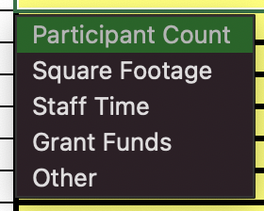
State Organization
Other Questions
Merit or Non-Merit?
Local or Centralized?
Cost Allocation Methodology

Slide 25
Any questions on state organization?

Slide 26
Section Revisions and Walkthrough
Outreach

Slide 27
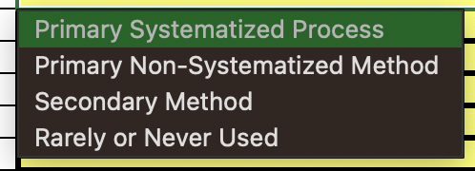
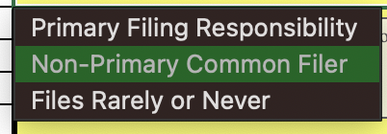
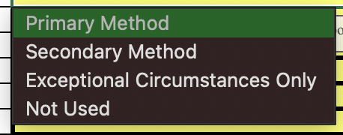
Outreach
Which Unit?
  RR, TAA, TRA/UI, Local, Other
What is a systematized process?
Steps:
Identifying Layoffs
Petition Filing
Getting Contact Information
Contacting Workers

Slide 28
Any questions on outreach?

Slide 29
Section Revisions and Walkthrough
Eligibility and Benefits/Services

Slide 30
Simple Drop-Downs
First half is simple drop downs such as Yes/No, State/Local
Expanded information on which staff make certain determinations
Training Threshold

Slide 31
Assessment Tool
Q34: What tool do you use for participant assessments (occupational, soft skills, needs assessments, literacy/numeracy)?
  Free Text (!!!)
  Provide the actual name

Slide 32
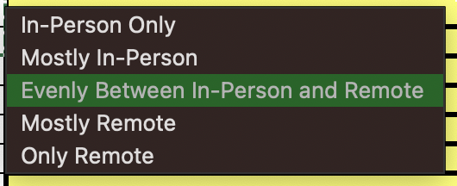
Remote vs. In-Person
“In the Last Year” = Fiscal Year
Select the best Option
Related to new 2021 PIRL elements, but gives an idea in aggregate

Slide 33
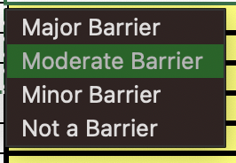
Job Search and Relocation
We really need to understand how to improve the utilization of these benefits
  When Offered
  Significance of Barriers

Slide 34
Any questions on eligibility, benefits, and services?

Slide 35
Section Revisions and Walkthrough
Integration

Slide 36
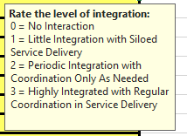
Integration Ratings
Integration Ratings are modified and expanded
Now a rating from 0 to 3:
  Adds a zero if there is no interaction with the program
  Reduces the scale because intermediate values were not used
Number of programs rated were increased such as adding RESEA

Slide 37
Methods of Coordination
Removed some unhelpful categories
Note “Systematized” specifies electronic in this section
Added “Same Agency” Questions for WIOA DW, WIOA Adult, and RESEA

Slide 38
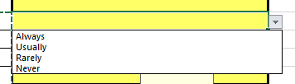
Front-Line Staff and RESEA Procedures
Are these the same people?
RESEA Focus Questions

Slide 39
Co-Enrollment and Common Exit
Do you have a common exit policy with Title I (DW/Adult), Title III (WP), and TAA?
What is your co-enrollment policy with Adult?
What is your co-enrollment policy with DW?*
*Yes, this is required by the regulations. Do you have a policy implemented?

Slide 40
Any questions on integration?

Slide 41
Section Revisions and Walkthrough
IT Systems and Reporting

Slide 42
Reporting Basics
Do you have a data reporting unit and what does it cover?
How many systems? Important to count all systems needed to generate the TAA PIRL including financial or other systems.
Vendor: Free-Text, but common answers include…
  Geographic Solutions, Inc., America’s Job Link Alliance (AJLA), etc.
  Leave blank if not supported by a vendor
Last Upgrade Dates – REQUIRED, but old dates can be estimates
Next upgrade – OPTIONAL, because it might not be planned yet

Slide 43
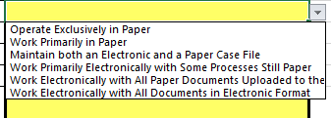
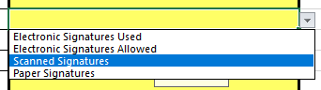
IT System Use
Use of Electronic Files by Case Managers
Collection of Signatures

Slide 44
How integrated are your IT systems?
Definitions!

Slide 45
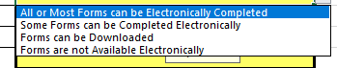
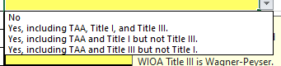
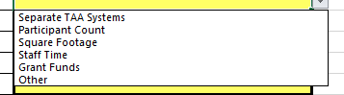
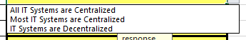
Other
Electronic Forms
Shared Case Management System?
Cost allocation
Centralization

Slide 46
Any questions on IT Systems and Reporting?

Slide 47
Section Revisions and Walkthrough
Training for TAA Staff

Slide 48
Methods and Frequency of Staff Training
Questions are:
  Yes/No
  Frequency

Slide 49
Any questions on training for TAA staff?

Slide 50
Section Revisions and Walkthrough
Barriers and Technical Assistance

Slide 51
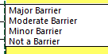
Rate the Barriers (not a Ranking!)

Slide 52
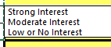
Interest in Working with Other States
Similar/Peer States
Neighbors

Slide 53
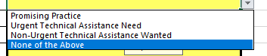
Strengths Assessment!
Who needs TA? What kinds of TA?
Who can we ask about their promising practices?
Would you like this shared?

Slide 54
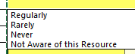
Use of TA Materials
We do a lot of different kinds of TA, but rarely have a good way to know what is reaching people most effectively
Not knowing about a resource is okay

Slide 55
Any questions on barriers and technical assistance?

Slide 56
Focus on Worker Lists

Slide 57
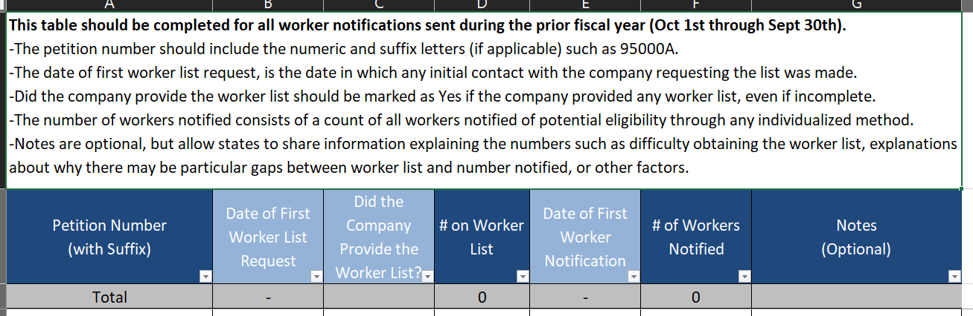
Worker Lists

Slide 58
Worker Lists
For any notifications sent during the period, the row should be included
  A petition may be included in multiple years
  The petition may not have your state as the primary location (remote workers?)
Date of First Worker List Request
  “Initial Contact” may be before certification
Did the Company Provide the Worker List?
  Yes, if any worker list was provided (even if incomplete)
# on Worker List
  Fill out even if the list was not obtained from the firm/company (UI lists?)
Number of Notifications
  Individualized methods
  Only notifications in the period

Slide 59

Worker Lists
If the TAW is not listed, we will assume no notifications were made
Need to provide context? Use the notes!
Total should equal the number of individuals notified in the FY

Slide 60
Comments, Affirmation, and Submission

Slide 61
Comments, Affirmation, and Submission
Need to provide some clarifications?
  Use the comment box (#93). This will ensure that comments are saved and reviewed.
Affirmation Needs to be Filled Out
  Signature can just be:
  /s/ Robert Hoekstra
Email it to me (hoekstra.robert@dol.gov)
  I will review and either accept or send back if there is something wrong

Slide 62
Any Questions?

Slide 63
Contact Us
Robert Hoekstra
  Program Analyst (Data Analytics) / Technical Expert
    Office of Trade Adjustment Assistance
      hoekstra.robert@dol.gov
        202-693-3522

Slide 64
Thank You!
Need help? Email: Support@workforceGPS.org

