Slide 1
Poll Question 1
Today I’d like to learn more about…
What areas should be covered
The administrative requirements (page length, attachments, due date)
Best practices
Other (tell us in the chat)
Select the appropriate response(s) or enter your response in the chat.

Slide 2
Refresher: Title I and III Annual Statewide Performance Report Narrative

Slide 3
Today’s Moderator
Cesar Villanueva
Workforce Analyst
U.S. Department of Labor
Employment and Training Administration

Slide 4
Poll Question 2
Coordinating the report narrative in my state is:
Easy
Somewhat easy
Challenging
Very challenging
Select the appropriate response.

Slide 5
Today’s Speakers
Christina Eckenroth
Workforce Analyst
U.S. Department of Labor
Employment and Training Administration
Jessica Hale
Workforce Analyst
U.S. Department of Labor
Employment and Training Administration

Slide 6
Today’s Speakers
Sean Fox
Workforce Analyst
U.S. Department of Labor
Employment and Training Administration
Dana Westgren
Workforce Analyst
U.S. Department of Labor
Employment and Training Administration

Slide 7
Today’s Objectives
Requirements Refresher
Spotlight:
Evaluations
Waivers
Best Practices
Questions & Discussion

Slide 8
Requirements Refresher

Slide 9
Requirements Refresher
Authority
WIOA Common Performance Reporting OMB Control No. 1205-0526
TEGL 05 – 18 WIOA Annual Statewide Performance Report Narrative

Slide 10
Requirements Refresher
Programs
Title I: Adult, Dislocated Worker, Youth
Title III: Wagner-Peyser Employment Services

Slide 11
Background Benefits
Share Your Story!

Slide 12
Requirements Refresher
Due Date
December 1st

Slide 13
Formatting
25 Pages or Less
508 Compliant
Machine Readable Format
Can Include Appendices

Slide 14
Content
State’s Performance Accountability System
Effectiveness in Serving Employers
Activities Provided by State Funds
Customer Satisfaction Approach
Progress Made Towards Strategic Vision/Goals
Waivers
Data Validation
Evaluations

Slide 15
Did You Know?
You can use visuals!

Slide 16
Where Do They Go?
Reports are read and used throughout ETA.
dol.gov/agencies/eta/ performance/wioa-stories
dol.gov/agencies/eta/performance/results

Slide 17
Spotlight
Evaluations
Waivers

Slide 18
Evaluations
Objectives
Review the WIOA evaluation requirements within the context of the state annual reports;
Provide examples of annual report narratives discussing evaluation; and
Share resources and contact information for additional technical assistance.

Slide 19
Focus of the Evaluation Section
Evaluation
Monitoring, Performance, and Assessment

Slide 20
Progress to Report
Planning and design
Implementation and analysis
Interpreting, reporting, and disseminating results
Evaluation Lifecycle

Slide 21
Evaluations in the Annual Report Narrative
Current or Planned Evaluations
State and Local Coordination
Current or planned evaluation and related research projects, including methodologies used
Efforts to coordinate the development of such projects with WIOA core programs, other state agencies and local boards
Completed Reports
List of completed evaluation and related reports and links to where they were made accessible to the public electronically
Federal Evaluations
State efforts to provide data, survey responses, and timely site visits for Federal evaluations
Continuous Improvement
Any continuous improvement strategies utilizing results from studies and evidence-based practices evaluated
TEGL 05-18

Slide 22
Evaluations in the Annual Report Narrative
Current or Planned Evaluations
Current or planned evaluation and related research projects, including methodologies used
The following is a list of ongoing program evaluation and assessment activities initiated, developed, or partially completed between July 1, 2019 and June 30, 2020:
…
Evaluations of Regional Plan Implementation Grants 2.0 and 3.0. Qualitative research methods being used include the following: interviews and focus groups with local workforce board directors, regional leadership, regional organizers (ROs) and training coordinators (RTCs), technical assistance providers and relevant project stakeholders and staff; site visits to leverage engagement with regional partnership stakeholders; a synthesis and analysis of the qualitative data surfaced to develop recommendations on how to support regions and ensure connection between regional strategic thinking and local service delivery.
….
California

Slide 23
Evaluations in the Annual Report Narrative
State and Local Coordination
Efforts to coordinate the development of such projects with WIOA core programs, other state agencies and local boards
The CWDB and its 3rd party program evaluators work with the California Workforce Association and the 45 Local Workforce Development Boards on the aforementioned evaluations pertaining to AJCCs, regional planning, and the AB 1111 Grant Program. Additionally, multiple state agencies are involved in the CAAL-Skills data-sharing initiative including the agencies, departments, and Local Boards that play a role in the following programs: WIOA Title I Adult; WIOA Title I Dislocated Worker; WIOA Title I Youth; WIOA Title II; WIOA Title III Wagner-Peyser; WIOA Title IV; CalWORKS (California’s TANF program); CalFresh (California’s SNAP E&T program); Trade Adjustment Assistance; Incumbent Worker Training accessed through the California’s Employment Training Panel program; State Certified Apprenticeship; Career Technical Education programs at the California Community Colleges; -rehabilitative programs at the California Department of Corrections and Rehabilitation and the Prison Industry Authority.
California

Slide 24
Evaluations in the Annual Report Narrative
Completed Reports
List of completed evaluation and related reports and links to where they were made accessible to the public electronically
The full report is available on the State Workforce Development Board website jobs.utah.gov/edo/ statecouncil/wioafinalreport.pdf.
Utah

Slide 25
Evaluations in the Annual Report Narrative
Federal Evaluations
State efforts to provide data, survey responses, and timely site visits for Federal evaluations
“The NJDOL Office of Internal Audit (OIA) coordinates the collection of data, survey responses, and site visits for all information requests received from the Federal Government. This includes information needed for federal evaluations, assessments, and compliance reviews. As the main contact for the Federal team, OIA will reach out to the appropriate divisions to obtain the information requested and ensures all requests for information are responded to in a timely fashion.”
New Jersey

Slide 26
Evaluations in the Annual Report Narrative
Continuous Improvement
Any continuous improvement strategies utilizing results from studies and evidence-based practices evaluated
The full report, data, findings and recommendations were reviewed and presented to Workforce Services staff and the State Workforce Development Board in the Fall of 2020. Workforce Services program staff, in collaboration with local area managers, developed an action plan to build on successful program implementation behaviors and recommended program improvements. This action plan will be further developed and implemented in PY20.
Utah

Slide 27
Evaluations
Opportunities
Supports Dissemination
Encourages Evidence Use
Promotes Continuous Improvement

Slide 28
Evaluation Action Planning
Report Progress
Review Evidence
Leverage Data
Collaborate/ Coordinate

Slide 29
Evaluation and Research Hub
evalhub.workforcegps.org/

Slide 30
Evaluation and Research Resources:
USDOL-ETA Division of Research and Evaluation
Manages ETA’s rigorous research and evaluation approach under Section 169 of the Workforce Innovation and Opportunity Act
doleta.gov/research/
CLEAR
CLEAR identifies and summarizes many types of research on labor topics, including descriptive statistical studies and outcome analyses, implementation, and causal impact studies
clear.dol.gov
Workforce System Strategies
Contains over 1,500 profiles of workforce development research and evaluation studies, toolkits, and other resources to support program management and operations, education and training, and employment, retention or advancement activities.
strategies.workforcegps.org/

Slide 31
Evaluation Questions?
Interested in learning more about the Evaluations, contact:
Gloria Salas-Kos, Evaluation TA Coordinator
Salas-Kos.Gloria@dol.gov
Neil Ridley, Evaluation Team Lead
Ridley.Neil.P@dol.gov
Evaluation Contacts:
Jessica Hale, Workforce Analyst
Hale.Jessica.S@dol.gov
Gloria Salas-Kos, Evaluation TA Coordinator
Salas-Kos.Gloria@dol.gov
Neil Ridley, Evaluation Team Lead
Ridley.Neil.P@dol.gov

Slide 32
Waivers

Slide 33
The Basics: Content
Active Waivers
Progress Towards Outcomes
Affect on Performance Outcomes
Quantifiable Outcomes
State Plans Modifications Due Spring 2022 – Waiver Renewals
Outcomes reported in annual report will be used to evaluate renewals!
WAIVERS
WAIVERS

Slide 34
The Basics: Projected Outcomes And Results
Acceptable
Unacceptable
Results are clear and measurable
Results correspond directly to projected outcomes in request
Cite data as appropriate
Cut and paste from initial waiver request
Vague statements: “performance data indicate that the percentage of WIOA Youth that has earned a credential has increased since PY 2017…”

Slide 35
The Basics: Content
Example: 75% Statewide OSY Expenditures Waiver
Projected Outcomes
Youth participants increased; higher % of Youth in drop-out prevention activities and work experience.
Results Reported
Number and percentage of at-risk ISY enrolled in work experience increased from 31.5 percent in PY 2018 to 40 percent in PY 2019.
Twenty-nine-point one (29.1) percent of ISY participated in tutoring, study skills and dropout prevention services compared to 19.4 percent in PY 2018.

Slide 36
Outcomes and Results
Question to Consider
Example
Has your State undertaken a monitoring effort to oversee effective waiver implementation?
Assess expansion of OJT on employer side.
Have contracts with SBEs increased under this waiver?

Slide 37
The Basics: Content
What has this waiver done for your State lately?
Do you need this waiver?

Slide 38
Poll Question 4
What do you use your State’s WIOA Annual Statewide Performance Narrative Report for?
To meet the DOL requirements
To showcase the state’s vision and workforce system activities with internal and external stakeholders.
We use it internally but want to expand. Got any ideas? We want to hear more!
Other (tell us in the chat)
Select the appropriate response.

Slide 39
State Best Practices

Slide 40
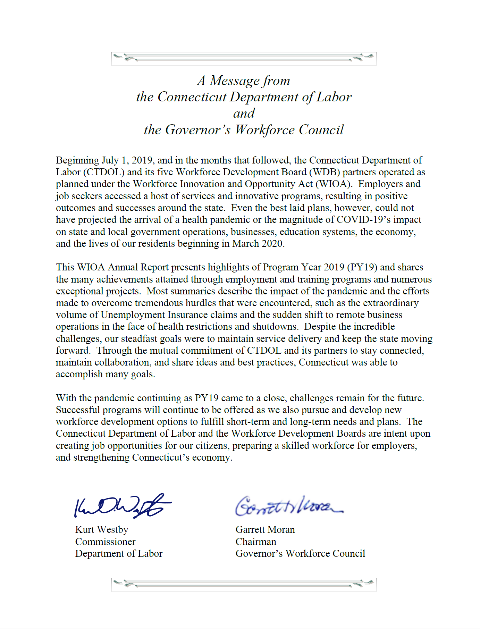
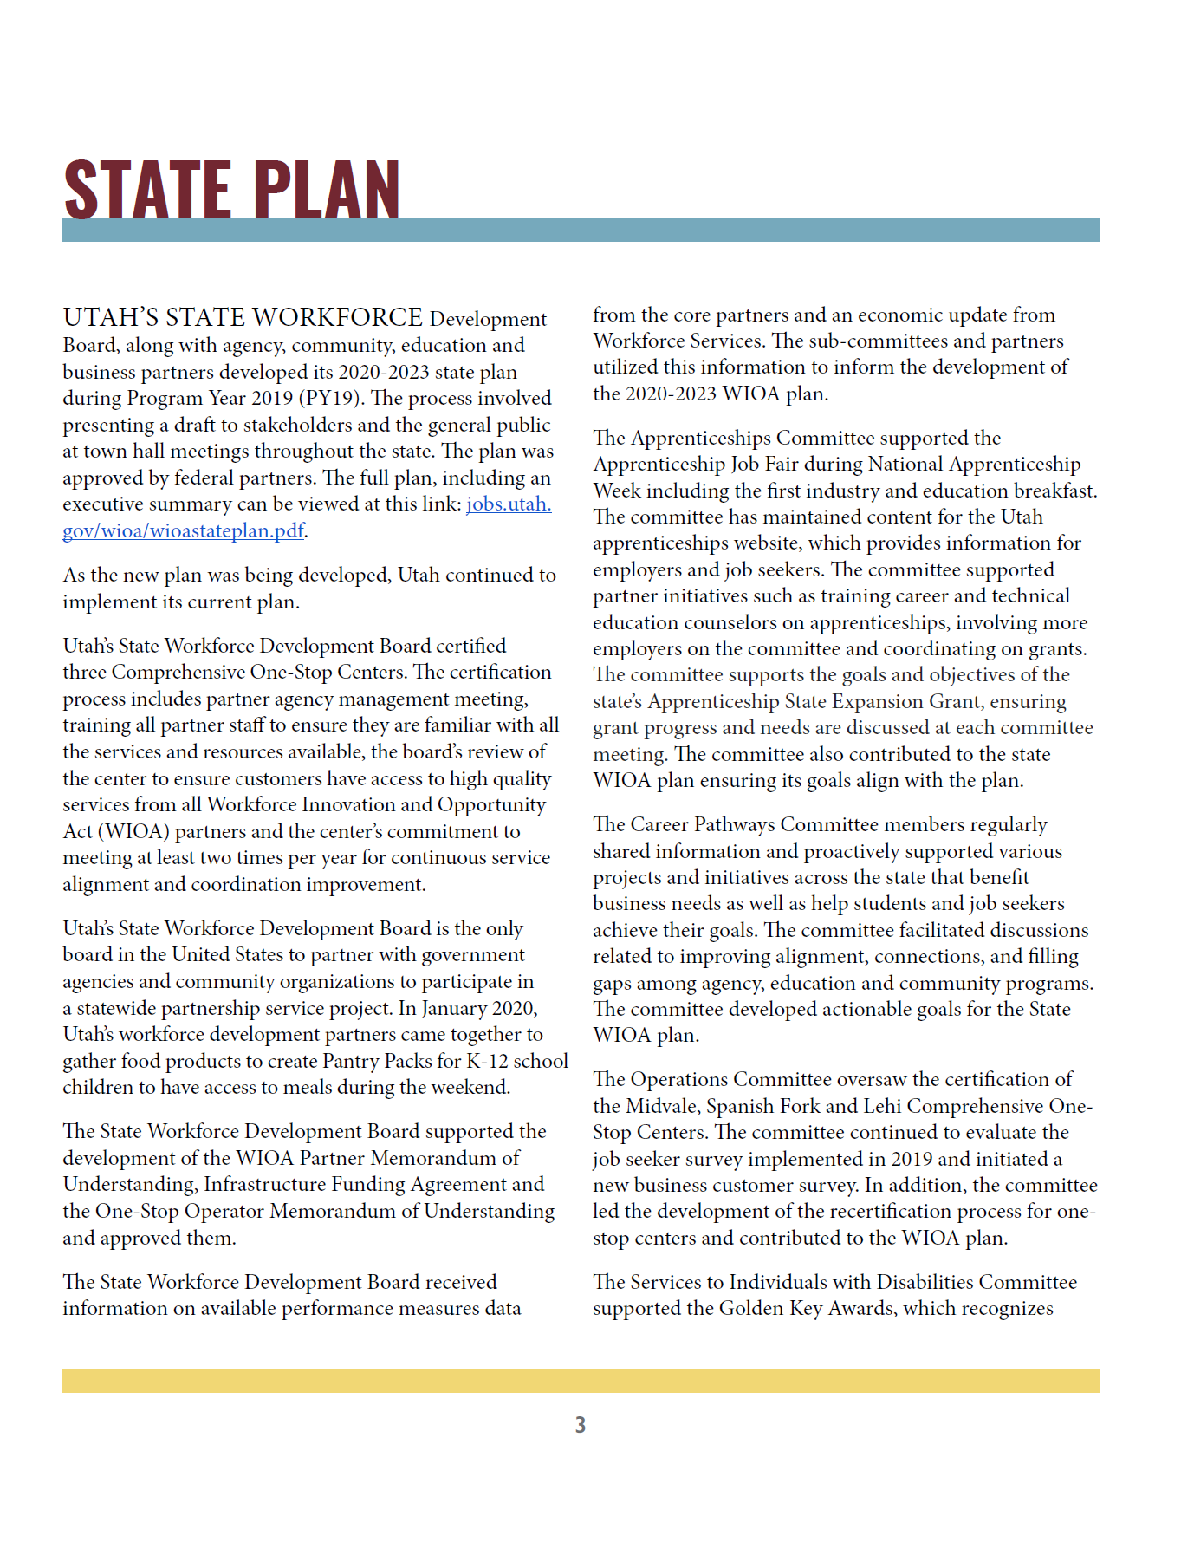
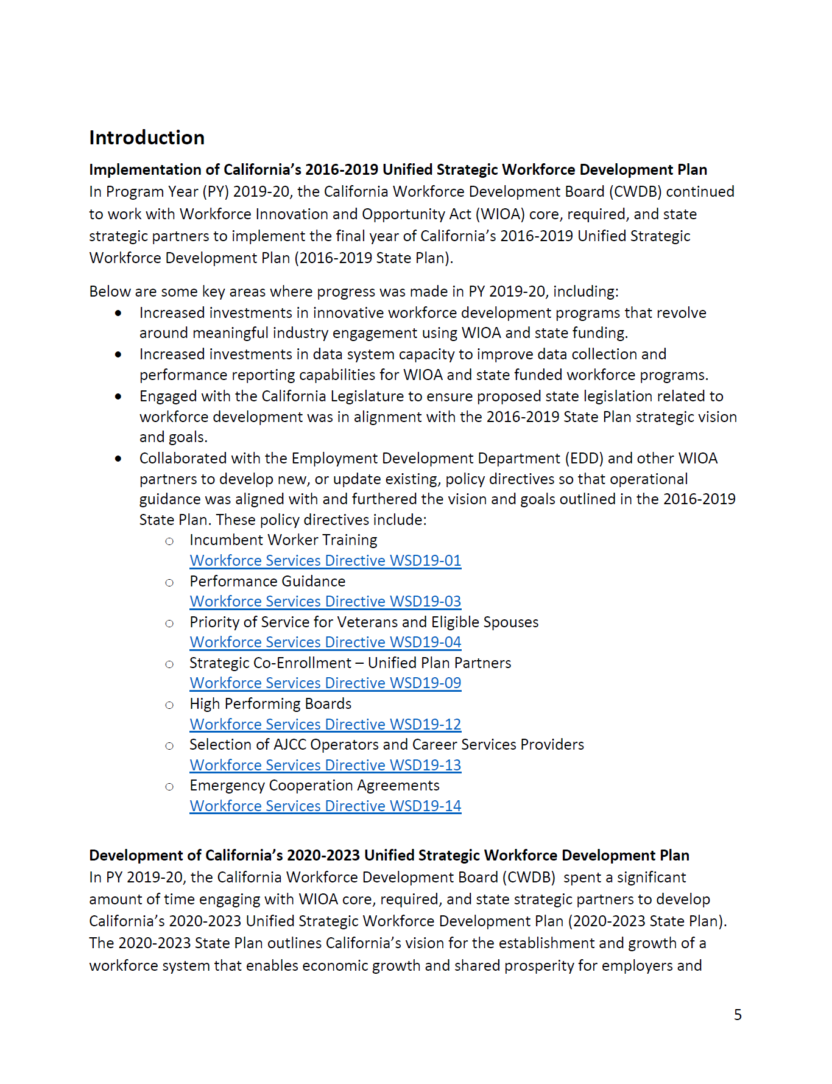
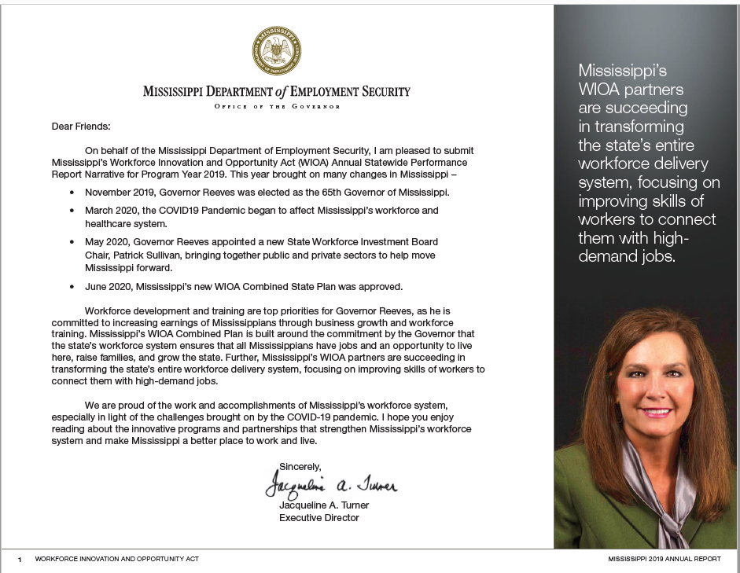
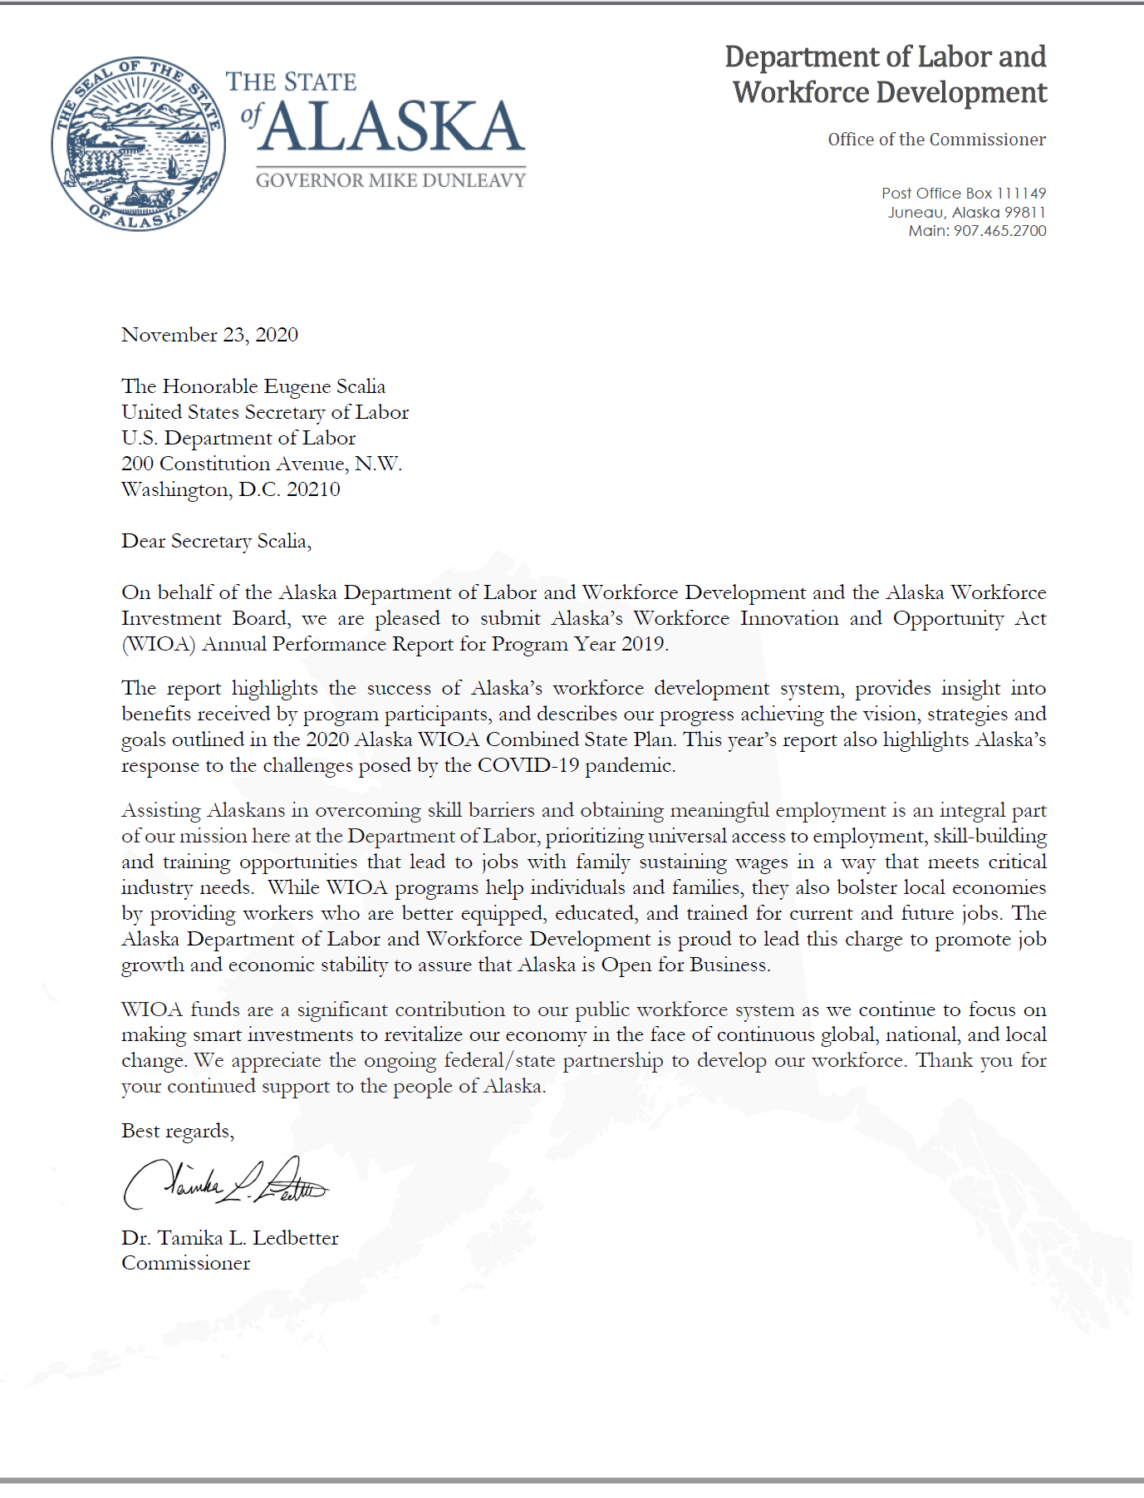
Did You Know?
You can include your State’s vision, a letter from the Governor or a quote about the workforce system’s role in your report.

Slide 41
Recycle, Reuse, Repurpose
System Report
Community Stakeholders
AJC Staff Training
Outreach
Board Members

Slide 42
Did You Know?
Hyperlinks and footnotes are allowed!

Slide 43
Important Reminders
Submit to WIOA.AR@DOL.GOV
Copy your ETA Regional Administrator & FPO
Due on December 1, 2021
508 Compliant
One PDF (preferred)
No separate partner narrative required.
25 page limit | Use graphics, charts, and visuals | Appendices allowed

Slide 44
Any Questions?
Type your question in the chat room.

Slide 45
Contact Us
ETAPerforms@dol.gov

Slide 46
Thank You!
Need help? Email: Support@workforceGPS.org

