Slide 1
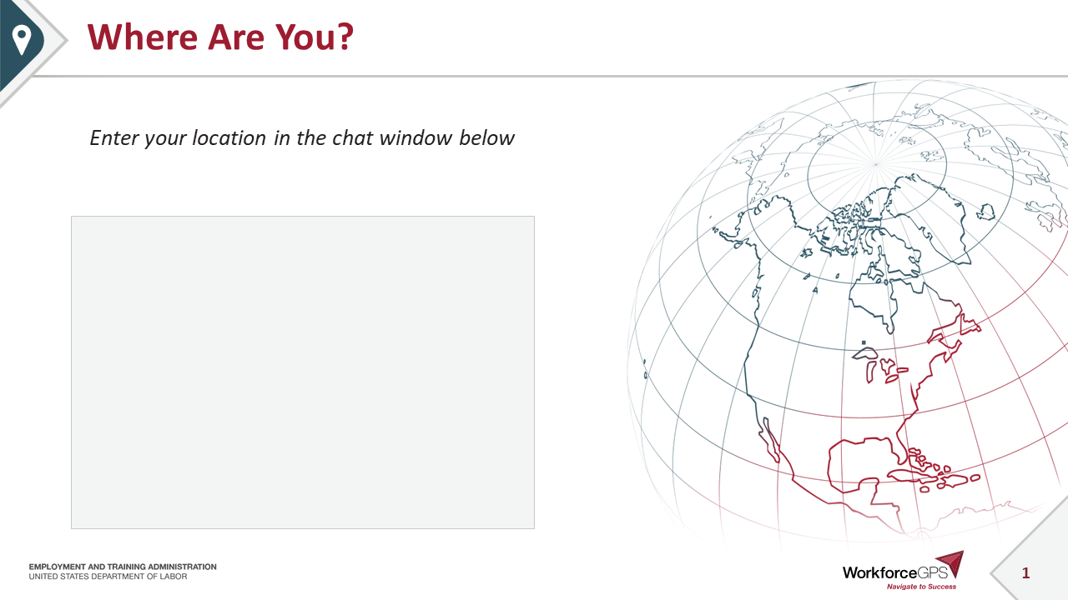
Where Are You?
Enter your location in the chat window below

Slide 2
Poll Question #1
Let’s get to know who is on the call today. Using the poll, select the role that you play in your H-1B Closing the Skills Gap grant.
Authorized Representative
Program Director/Manager
IT Data Manager/Staff
Training Partner
Employer Partner
Service Provider
Other (case manager, job developer, or employment specialist)
Choose the answer that best reflects you (or your organization)

Slide 3
H-1B 2021 Amended PIRL Webinar
Scaling Apprenticeships and Apprenticeships: Closing the Skills Gap Grants

Slide 4

Today’s Moderator
Zodie Makonnen
  Workforce Analyst/Program Lead
  U.S. Department of Labor/Employment and Training Administration

Slide 5


Today’s Speakers
Dani Abdullah
  Performance Lead/DSI Cross-Program
  Safal Partners
Ayreen Cadwallader
  Lead, Rural Healthcare Grant
    Office of Workforce Investment

Slide 6
Today’s Objectives / Agenda
Reporting Guidance for the Quarter Ending September 30, 2021
Describe what has changed from PIRL 2018 to PIRL 2021
Review how these changes affect your report submissions
Review why these changes took place
Review next steps/action items for August – November 2021

Slide 7
Reporting Process for 9/30/2021
Use of 2018 PIRL ended with the
quarter ending June 30, 2021
For the quarter ending September 30, 2021:
Grantees will select 2021 PIRL when submitting their QPR
    Quarter ending September 30, 2021 – report due November 14, 2021

Slide 8
What’s New?
What is the 2021 PIRL?
Change in organization of your Performance Handbook

Slide 9
WIOA Performance Accountability - PIRL
Participant Individual Record Layout (PIRL)
  Reporting calculation specifications, and quarterly report templates have been approved by the Office of Management and Budget (OMB) for collection.
  Contains all of the required individual data elements and code values that should be tracked and reported for WIOA Formula and discretionary grants.
  H-1B grants use a subset (90) of all DOL PIRL data elements in 2021 PIRL
Tab 2
2021 PIRL for H-1B Grants

Slide 10
Summary of H-1B Schema in WIPS Reflected in the 2021 PIRL
Tab 1 (2021 Full DOL PIRL)
Tab 2 (H-1B Only PIRL)
Tab 4 (H-1B Valid Values)
Tab 5 (H-1B Duplicate Rules)
Tab 6 (H-1B Logic Rules)
Tab 7 (H-1B QPR Aggregation Rules)
Tab 8 (H-1B QPR Template)

Slide 11
Data Element Changes in 2021 PIRL
5 Removed (Previous quarter services received)
6 Added (Training Leading to Associate’s Degree and Apprenticeship-specific data elements)
15 Revised
PIRL 105 Grant Program | Creates a code value for each current grant program
PIRL 407 Highest School Grade Completed at Program Entry | Leave blank if highest school grade completed cannot be obtained
PIRL 907 Recipient of Incumbent Worker Training | Adds apprenticeship funded grant code value (does not affect DSI)
PIRL 931 Apprenticeship Program | Expands apprenticeship types: RAP, IRAP, other
PIRL 1328 → | Changes name of data element to “Training Provided Virtual/Online” and includes new code values for training
PIRL 2109-2117 | Removes code value for Registered Apprenticeship
PIRL 2126 → | Changes name of data element to “Entered Training-Related Employment After Training Program Completion”
90 Data Elements
Total

Slide 12
How PIRL Affects Apprenticeship-Specific Grants
Grantees will need to update their current data file to retroactively reflect these changes
  Removing columns
  Adding columns
  Revising code values as appropriate to correspond with accurate grantee information
Data elements affecting how apprenticeship is reported
  PIRL 105, PIRL 931, PIRL 2908, PIRL 2909, PIRL 2911

Slide 13
PIRL 2901 and PIRL 2907
PIRL 2901 Pre-apprenticeship Program Status and PIRL 2907 Apprenticeship Program Status will not be used - Leave blank
Columns must still be included in the data file to accommodate these data elements.
Grantees will continue to use PIRL 106 to report pre-apprenticeship.

Slide 14
PIRL 2908 Date Entered Apprenticeship
Previously could not report apprenticeship start date
New PIRL 2908 allows for entry of apprenticeship start date
  Must also report
RTI start date can be reported in PIRL 1302 Date Entered Training #1 as soon as it occurs.

Slide 15

Performance Reporting Handbook
Updated to reflect changes from 2018 PIRL
Reorganized to better correspond with how data is reported
Data element reorganization
  H-1B Grants: Special ID and Grant Numbers
  Participant-level Demographic Information and Employment Status
  Program Participation and Enrollment Information
  Training Activities and Additional Services
  Program Completion Outcomes
IMPORTANT: The reorganization of the data elements in the handbook DOES NOT change the order of the data elements need to be in your WIPS data file!!

Slide 16
Poll Question #2
How many data element columns will be in the data file you submit for the quarter ending September 30th, 2021?
79
90
89
We have submit a data file?
Choose the answer that best reflects you (or your organization)

Slide 17
Any Questions?
Enter your questions in the chat window (lower left of the screen)

Slide 18
PIRL 2018 to PIRL 2021
What’s Changed?

Slide 19
PIRL 105 Special Project ID – 1 Grant Program
Grantees will now use PIRL 105 to specify their H-1B Grant Program
Grant Program (Reported in PIRL 105) | Code Value
Scaling Apprenticeship | SAG1111
Apprenticeships: Closing the Skills Gap | CSG2222
Rural Healthcare | RHG3333
One Workforce | OWG4444

Slide 20
PIRL 931 Apprenticeship Type
This information was previously reported only in PIRL 105
Now includes code value for Industry-Recognized Apprenticeship Program

Slide 21
PIRL 931 Apprenticeship Type
Apprenticeship Program (Reported in PIRL 931) | Enter Code Value
The participant entered into a Registered Apprenticeship Program (RAP) or if the participant was a registered apprentice at the time of program entry. | 1
The participant entered into an Industry-Recognized Apprenticeship Program (IRAP) or if the participant was participating in an Industry-Recognized Apprenticeship at the time of program entry. | 2
The participant entered into an apprenticeship program that is neither a RAP nor IRAP. | 3
The participant did not enter an apprenticeship during program participation or was not participating in any apprenticeship program at the time of program entry. | 4

Slide 22
PIRL 106 Pre-Apprenticeship
Grantees will continue to use PIRL 106 to report pre-apprenticeship
PIRL 2901 Pre-apprenticeship Program Status will not be used.
  Note that PIRL 2907 Apprenticeship Program status also will not be used.

Slide 23
PIRL 2911 Date Completed Apprenticeship
Previously grantees reported apprenticeship completion in PIRL 1813 Date Completed Program.
Apprenticeship grantees will now use PIRL 2911 Date Completed Apprenticeship to report completion of an apprenticeship.
Grantees must still use PIRL 1813 Date Completed Program separately to indicate when all components of training have been completed
  May include supplemental training to the apprenticeship, training that includes multiple apprenticeships, other
PIRL 2909 Expected Completion Date: Apprenticeship is optional

Slide 24
PIRL 2109 – 2117 Series
Used to further specify training activities for PIRL DEs 1303, 1310, and 1315 Type of Training Service #1, #2, and #3
These are optional for participants who are not incumbent workers but can simplify reporting
For incumbent workers, grantees must enter code value 6 = Incumbent Worker Training.
For participants who are in an Industry-Recognized Apprenticeship Program or an apprenticeship that is neither a RAP nor IRAP who are not incumbent workers, grantees may enter:
  1 = On-the-Job Training
  2 = Classroom Occupational Training
  3 = Contextualized Learning
  4 = Distance Learning
  5 = Customized Learning
  7 = Other Occupational Skills Training
*Code value 8 = Registered Apprenticeship has been removed because it is reported in PIRL 931

Slide 25
Other 2021 PIRL Updates
Incumbent workers count in the QPR as retaining employment after one quarter after completion.
  Previously counted only after retaining for three quarters
  Note that incumbent workers cannot count as both retaining employment and advancing in employment
Note that other PIRL data element revisions not referenced in this section are optional for grantees or have no effect on H-1B reporting

Slide 26
WIPS Tips!
Inactive users will be automatically logged out after 30 minutes of inactivity.
H-1B grants will not generate an H-1B QPR from the WIOA Full PIRL multi-program schema.
If you use a .csv file, it must have 90 columns.
If your organization was awarded multiple H-1B grants, you must submit the performance data in WIPS as separate data files.
Establish a strategy receiving and validating data from partners – only one data file is submitted by each grantee!
Start the submission process early!
More WIPS TIPS available in Appendix B of the H-1B Performance Reporting Toolkit and Workforce Integrated Performance System (WIPS) User Technical Guide

Slide 27
Poll Question #4
What PIRL data element is used to report Apprenticeship Program?
PIRL 2021
PIRL 106
PIRL 931
PIRL 2908
PIRL 105
Choose the answer that best reflects you (or your organization)

Slide 28
Any Questions?
Enter your questions in the chat window (lower left of the screen)

Slide 29
Next Steps: Your Action Items
What should we do …

Slide 30
Performance Reporting Next Steps
August - November 2021
Review updated performance reporting handbook (and other TA materials)
Attend Performance Reporting Office Hours
  Will be scheduled for late October / early November
Revise your data file to accommodate PIRL 2021 (format and code values) and include information from quarter ending September 30, 2021
Submit and certify your grant’s QNR and data file in WIPS
  Start early!
Contact us via the appropriate grant mailboxes for any performance reporting technical assistance. Please make sure to cc your FPO.
ScalingApprenticeship@dol.gov or ClosingtheSkillsGap@dol.gov
_
_

Slide 31
Poll Question #4
How prepared are you to use the 2021 PIRL for this next reporting quarter?
Eeks! 2021 PIRL What?! We’re not ready!
Whew, we’re almost there! We might need some help
Feeling great! We’re ready to use 2021 PIRL
Choose the answer that best reflects you (or your organization)

Slide 32

Performance Reporting Resources
H-1B Performance Reporting Handbook
H-1B 2021 PIRL for Scaling Apprenticeship and Apprenticeships: Closing the Skills Gap Grants
H-1B Reporting Toolkit & WIPS Technical Guide
Sample case management/data file - Updated

Slide 33
Thank You!

