Slide 1
Read Before You Proceed: Instructions for Use & Legal Compliance
Legal Accessibility Requirements: 508 Compliance
Only use tables when standard content delivery is insufficient, and never merge table cells.
Do not use screenshots or images of text items. All text must be editable and not blur when the screen is zoomed in.
Avoid using “Smart Art” or the “Design Ideas” tool.
Do not repurpose slide title boxes for any other use.
Do not use multiple spaces, empty paragraphs, or strings of tabs to visually adjust your content, as every such repeated character must then be manually stripped from all slides before posting. Instead:
Use soft returns to bump content to the next line in lieu of spaces (Shift + Enter)
Manage paragraph spacing and tabs in the “Paragraph” panel.
Every image or visual element used must either have alternative “alt” text applied or be marked as “decorative”.
Alt text translates visual information into verbal information, which is read aloud in screen readers, while items marked “decorative” are skipped.
This step is required to deliver the full message provided by any graphics.
The person who laid out the content should also provide that alternate information to ensure their message stays intact.
Learn about the new innovative features!
Please watch this webcast before using this template.
https://vimeo.com/370983870/2afa9e8306
(Ctrl + Click to open link)
Duration: 6 minutes

Slide 2
Credentials: What they are, where to find them, and what counts for performance

Slide 3
Where Are You?
Please enter your location in the chat window
(lower left of screen)

Slide 4
Today’s Moderator
Christina Eckenroth
Workforce Analyst
Office of Policy Development and Research

Slide 5
Today’s Speakers
Pam Frugoli
Workforce Analyst
Office of Workforce Investment
Kellen Grode
Economist
Office of Policy Development and Research
Gregory Scheib
Workforce Analyst
Office of Workforce Investment

Slide 6
Framing the Conversation on Credentials
What are Credentials?
What Credentials Count in ETA Program Performance Indicators?
The universe of credentials is vast and stretches beyond those credentials that are recognized under the Workforce Innovation and Opportunity Act (WIOA).
Credentials that do not fall under the WIOA criteria for performance may often be valuable and can often result from allowable services under ETA workforce programs.
Not all credentials and certificates count for performance purposes
Those that count are based on WIOA statutory definitions and requirements.

Slide 7
Guidance on Credentials

Slide 8
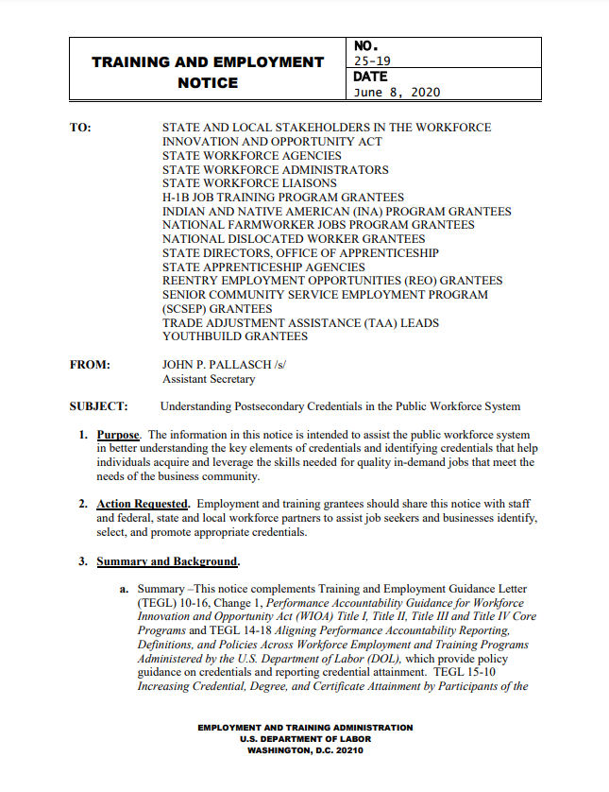
Overview of Guidance on Credentials
TEGL 10-16, Change 1
TEGL 14-18
TEN 25-19

Slide 9
TEGL 10-16, Change 1
Performance Accountability Guidance for Workforce Innovation and Opportunity Act (WIOA): Title I, Title II, Title III, and Title IV Core Programs
Title I Adult, Dislocated Worker, and Youth programs;
Adult Education and Family Literacy Act (AEFLA) program;
Employment Service program authorized under the Wagner-Peyser Act; and
Vocational Rehabilitation (VR) program
Provides guidance on the performance accountability requirements for ETA performance reporting including:
Methodology for calculating the six primary indicators of performance including Credential Attainment

Slide 10
TEGL 14-18
Aligning Performance Accountability Reporting, Definitions, and Policies Across Workforce Employment and Training Programs Administered by the U.S. Department of Labor (DOL)
DOL-specific guidance on performance accountability for DOL programs that are not included in the core programs
Indian and Native American (INA) Program
Job Corps
National Farmworker Jobs Program (NFJP)
YouthBuild
Reentry Employment Opportunities (REO)
National Dislocated Worker Grants (DWG)
H-1B Job Training Programs
Senior Community Service Employment Program (SCSEP)
Trade Adjustment Assistance (TAA)
Jobs for Veterans State Grants (JVSG)

Slide 11
TEN 25-19
Complements TEGL 10-16, Change 1 Workforce System
Understanding Postsecondary Credentials in the Public Workforce System
Provides up-to-date information on various types of credentials
Attributes of high quality credentials
Ways the public workforce system can expand the use of credentials to meet America’s workforce needs.

Slide 12
The Role of the Public Workforce System in Credential Attainment
Plays a vital role in developing a skilled workforce that meets the needs of business
Credentials play an important role in this endeavor.
A strong workforce development strategy should offer training that provides the skills needed for in-demand jobs and leads to credentials that attest to an individual’s skills and competencies.
Such credentials can serve as an important signal to businesses that they are hiring qualified individuals.

Slide 13
How Can Credentials Support a Workforce Talent Pipeline?
For Businesses:
For Job Seekers:
Credentials can assist in:
Identifying qualified workers;
Upskilling their current workforce; and
Helping them better compete in the marketplace.
Obtaining credentials can improve employability, and:
Document the skills and competencies they bring to an employer.
Lead to higher earnings, greater advancement opportunities, and enhanced job security.
Can be earned in as little as six months to two years, and offer viable alternatives to more lengthy and costly undergraduate degrees.

Slide 14
How Can Credentials Support a Workforce Talent Pipeline?
Career Pathways
All workforce development activities occur within the context of a regional labor market and its businesses.
A well-designed career pathway leads to the attainment of stackable and portable credentials that are recognized by businesses and used in hiring decisions.
Pro Tip:
Technical assistance about career pathways programs and how to implement a successful framework is available on WorkforceGPS in the Career Pathways Community of Practice at careerpathways.workforcegps.org

Slide 15
Credentials and Performance
There is no comprehensive national list of approved credentials
However, there are tools and resources for identifying:
Available credentials related to industries and occupations
Indicators of quality and demand
Additional information on various credentials

Slide 16
Any Questions?
Enter your questions into the chat

Slide 17
Credential Types and Characteristics

Slide 18
Recognized Postsecondary Credentials
WIOA defines “recognized postsecondary credential” as:
…a credential consisting of an industry-recognized certificate or certification, a certificate of completion of an apprenticeship, a license recognized by the State involved or Federal Government, or an associate or baccalaureate degree.
Recognized postsecondary credentials are awarded in recognition of an individual’s attainment of measurable technical or industry/occupational skills necessary to gain employment or advance within an industry/occupation

Slide 19
Credential Types
Educational Diplomas, Degrees and Certificates
Associate’s degree
Bachelor’s degree
Educational certificate
Apprenticeship Certificates
Registered Apprenticeship Program Certificates of Completion
Interim credentials
Industry-Recognized Apprenticeship Program (IRAP)
Occupational licenses issued by government entities
Certifications – industry or professional association, product-vendor, etc.
Other recognized certificates of industry/occupational skills completion sufficient to qualify for entry-level or advancement in employment

Slide 20
Characteristics of Credentials
Four characteristics that strengthen the value of credentials to individuals and businesses are:
Industry-recognized
Stackable
Portable
Accredited

Slide 21
Characteristics of Credentials
Industry-Recognized
An industry-recognized credential is either:
Developed and offered by, or endorsed by, a nationally- or regionally-recognized industry association or organization representing a sizeable portion of the industry sector, or
Is sought or accepted by companies within the industry sector for purposes of hiring or recruitment, which may include credentials from vendors of certain products.

Slide 22
Characteristics of Credentials
Stackable
Part of a sequence of credentials that can be accumulated over time to build up an individual’s qualifications.
Help individuals move along a career pathway or career ladder to different and potentially higher-paying jobs.

Slide 23
Characteristics of Credentials
Portable
Recognized and accepted as verifying the qualifications of an individual in other settings—such as other geographic areas across the country, other educational institutions, or other industries or businesses.
Registered Apprenticeship Program (RAP) Certificates of Completion are portable.

Slide 24
Characteristics of Credentials
Accredited
Accreditation by an independent, quality-review body is a valuable attribute and is often required for educational institutions or for specific educational programs in order for students to be eligible for Federal financial aid.
Note: Some valuable credentials offered by industry or professional associations, or by product vendors, may not be accredited.
It is important to look for additional markers of quality or labor market value, such as industry-wide recognition, professional association acceptance, or local demand.

Slide 25
Characteristics of Credentials
Accredited
U.S. Department of Education “Accreditation in the United States: ” https://www2.ed.gov/admins/finaid/accred/index.html
The American National Standards Institute https://www.ansica.org/wwwversion2/outside/PERdirectory.asp?menuID=2
Directory of Accredited Certificate Issuers, Applicants, and Suspended Issuers https://www.ansi.org/Accreditation/credentialing/certificate-issuers/Directory
The Institute for Credentialing Excellence (ICE) /National Commission for Certifying Agencies: https://ice.learningbuilder.com/Public/MemberSearch/ProgramVerification

Slide 26
Identifying Relevant Credentials and their Characteristics

Slide 27
Identifying Relevant Credentials
Employment and training grantees will need to consider state and local economic conditions, state and local employer need, and the skill gaps in the state and local workforce
Establish guidelines for identifying relevant credentials
Employment and training grantees should identify and regularly review valuable credentials that meet the needs of the local economy
While many credentials are valuable in many economic areas, grantees should analyze local labor market information and job postings data and consult with local employers to validate which credentials are valuable

Slide 28
Identifying Relevant Credentials
Basic Considerations When Selecting Credentials:
What type of credential is it?
If the credential is a certification has it been endorsed by a relevant industry association, or been accredited?
What type of organization is offering the credential?
Is it is offered by an educational institution, is the institution accredited?
Is the training provider offering the credential included on the WIOA Eligible Training Provider (ETP) list?
Is the credential valued by industry?
Is the credential endorsed by an industry or professional association?
Do employers prefer job seekers who have earned the credential?

Slide 29
Identifying Relevant Credentials
Basic Considerations When Selecting Credentials:
Is there evidence that the credential leads to positive employment outcomes and earnings?
Performance data that is reported under WIOA for Eligible Training Providers (ETP) may provide relevant information regarding credential attainment and/or other outcomes.
Is the credential portable to other employers or other geographic areas?
While state occupational licenses may not always be portable to other states, they still have high value as they are typically required to obtain employment in the licensed occupation.

Slide 30
Identifying Relevant Credentials
Basic Considerations When Selecting Credentials:
Does the credential result in occupational or technical skills that prepare for entry into or advancement in an occupation?
WIOA funds can be used to provide training for credentials attesting to general skills such as work readiness, hygiene or safety, but
Credentials can only be counted toward recognized postsecondary credential attainment if they prepare a person with the competencies required to perform a specific occupation.
Is the credential cost-effective, readily available, and can it be completed in a reasonably short period of time?

Slide 31
Identifying Relevant Credentials
CareerOneStop Credentials Center
Local Training Finder
Certification Finder
License Finder
and more

Slide 32
Identifying Relevant Credentials
CareerOneStop Local Training Finder
Find postsecondary degree and certificate programs
Search by:
Occupation title
School name
Program name

Slide 33
Identifying Relevant Credentials
CareerOneStop Certification Finder
Information on accreditation
A for ANSI accreditation
N for NCCA accreditation
“I” indicates formal industry association recognition
Local employers may also demand certain credentials
Chile pepper indicates in-demand based on national job postings

Slide 34
Identifying Relevant Credentials
Occupational Licenses
Awarded by a government agency —typically a State licensing board
Required to practice in the occupation in that jurisdiction
License may require other
specified educational credentials
or examinations
Searchable database in
CareerOneStop License Finder

Slide 35
Identifying Relevant Credentials
Credentials Matter
Provides information on career and technical education credentials
Identifies national trends
Shares state-level information about
The credentials students earn
The credentials employers demand
For select states

Slide 36
Identifying Relevant Credentials
Credential Engine and Credential Finder
Identified hundreds of thousands of credentials available in the U.S.
Some of them are listed in the Credential Registry and appear in the Credential Finder tool at: credentialfinder.org.
New credentials emerge regularly.

Slide 37
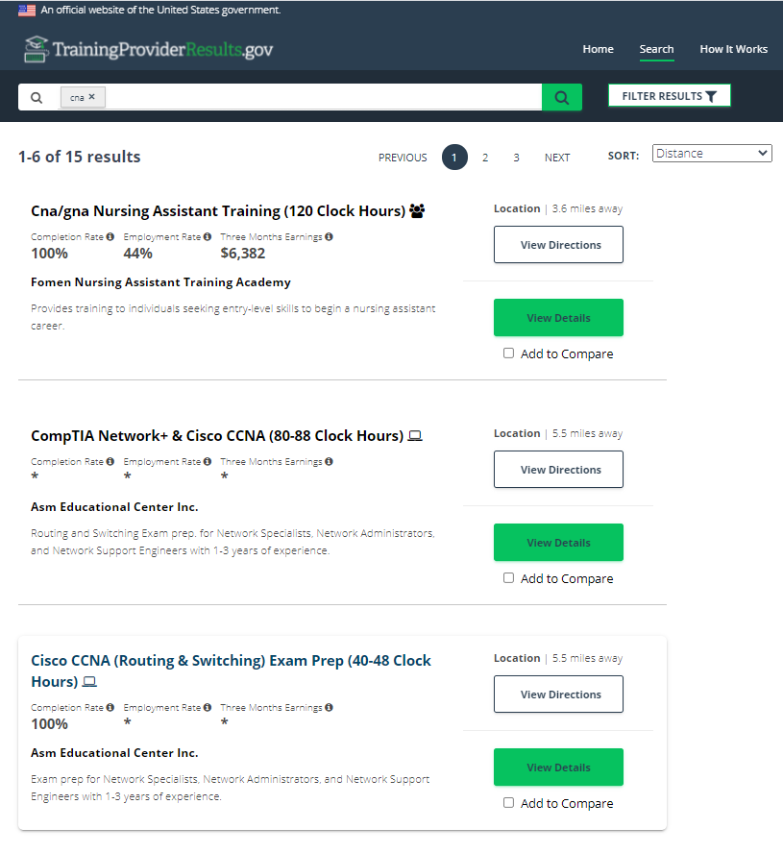
Identifying Relevant Credentials
TrainingProviderResults.gov
Searchable list of training providers eligible under WIOA to provide training
Includes information and outcomes on training programs reported to USDOL
Includes information on credential names, types, and credential attainment rates
Allows job seekers and AJC staff to view and compare different training programs

Slide 38
Any Questions?
Enter your questions into the chat

Slide 39
Credentials and Performance:
Recognized Postsecondary Credentials

Slide 40
Credentials and Performance
Remember at the start of our webinar
WIOA defines “recognized postsecondary credential” as:
…a credential consisting of an industry-recognized certificate or certification, a certificate of completion of an apprenticeship, a license recognized by the State involved or Federal Government, or an associate or baccalaureate degree.
Recognized postsecondary credentials are awarded in recognition of an individual’s attainment of measurable technical or industry/occupational skills necessary to gain employment or advance within an industry/occupation

Slide 41
Credentials and Performance
For Grants Serving Youth: Recognized Secondary Credentials
A secondary school diploma (or alternate diploma) (commonly referred to as high school diploma)
A secondary school equivalency certification signifies that a student has completed the requirements for a high school education

Slide 42
Credentials and Performance
For Grants Serving Youth: Recognized Secondary Credentials
Examples of secondary school diplomas, alternate diplomas, and recognized equivalents recognized by individual states include:
Obtaining certification of attaining passing scores on a State-recognized high school equivalency test
Earning a secondary school diploma or State-recognized equivalent through a credit bearing secondary education program sanctioned by State law, code, or regulation
Obtaining certification of passing a State-recognized competency-based assessment; and
Completion of a specified number of college credits

Slide 43
Credentials and Performance
What Does Not Count as a Credential for Performance Purposes?
Certificates awarded by Local Workforce Development Boards
Work readiness certificates related to general hygiene (handwashing), general safety, cardiopulmonary resuscitation (CPR), work readiness, and food-handling certificates even if such general skills certificates are broadly required to qualify for entry-level employment or advancement in employment.
Why Not?
While these can be useful in obtaining employment, neither type of certificate documents measurable technical or industry/occupational skills necessary to gain employment or advance within an occupation, nor are they recognized industry-wide

Slide 44
Credentials and Performance
What Does Not Count?
Certificates for discrete skills such as general hygiene (handwashing), general safety, cardiopulmonary resuscitation (CPR), work readiness, and food-handling certificates have value.
Typically these certificates may be offered as a grant funded service depending on the needs of the grant and the participant’s needs.
However, they are typically not eligible to be counted towards the credential attainment indicator since they do not prepare individuals with the competencies required to perform a specific occupation.

Slide 45
Credential Attainment Resources

Slide 46
Credential Attainment Resources
Important Note
There is no comprehensive national list of approved credentials.

Slide 47
Linked Resources on WorkforceGPS
Credential Attainment Decision Tree Interactive tool and accompanying guide
Credential Attainment e-Learning Module Explains Credentials and recognized equivalents
Credential Attainment Decision Pathway Based on how an individual is coded in the PIRL, determine whether they are included in the Credential Attainment Denominator
WIOA Performance FAQs
WIOA Quarterly Performance Report ETA-9173
WIOA Annual Performance Report ETA-9169
Related Webinars

Slide 48
WINTAC Credential Checklist
Is the training program offered by one of these types of organizations and institutions that award postsecondary credentials?
Is the credential one of the WIOA types of acceptable credentials?
Have you verified that the credential results in industry-wide, measurable technical or industry/occupation skills?
Are you confident that the training is not excluded from the indicator?

Slide 49
Credential Decision Tree Tool

Slide 50
Credential Attainment Decision Path
How is this measure calculated?
There's a tool for that!

Slide 51
Any Questions?
Enter your questions into the chat

Slide 52
Thank You!
Please send any questions to ETAPerforms@dol.gov
Need help? Email: Support@workforceGPS.org

