Slide 1
Building Evaluation Capacity through Communities of Practice and Peer Learning Cohorts

Slide 2
Facilitators
Gloria Salas-Kos
Senior Program Analyst/Evaluation Technical Assistance Coordinator
Office of Policy Development and Research
Employment and Training Administration/U.S. DOL
Wayne Gordon
Director, Division of Research and Evaluation
Office of Policy Development and Research
Employment and Training Administration/U.S. DOL

Slide 3
Objectives
Introductions
Evaluation and Research Background and Resources
Setting Expectations
Communities of Practice
Capacity-Building Tools
Peer Learning Cohort – State Experiences
2021 Evaluation Peer Learning Cohort Applications
Open Chat for Questions

Slide 4
Moderator
Cynthia Forland
Senior Consultant
Employment and Training Administration/Maher & Maher

Slide 5
Featured State Representatives
Bryan Huebsch
Data Integration and Governance Manager
Wisconsin Department of Workforce Development
Sacha Stadhard
Manager, Special Grants and Youth Policy
MassHire Department of Career Services

Slide 6
Setting Expectations
“Research and evaluation begins where performance reporting and results end.”

Slide 7
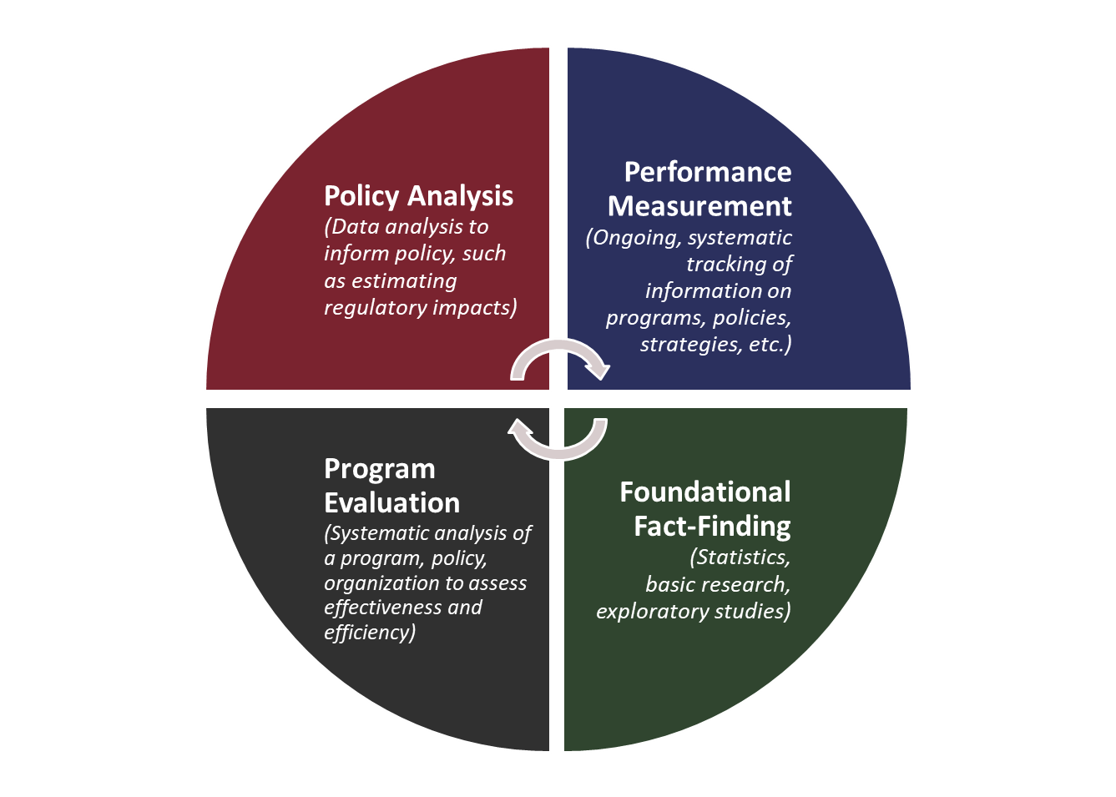
Using Evidence to Inform Policy and Practice

Slide 9
Relevant Research and Evaluation Questions
What does past research suggest are effective service strategies?
How is a program or service component being implemented?
Did the program or activities contribute to the intended outcomes in the short, medium and long term?
What features of the program or intervention made a difference?
How do customers experience or view a service?
Was the service effective?

Slide 10
Workforce Innovation and Opportunity Act (WIOA)*
“The State, local boards, and State agencies shall conduct evaluations…in order to achieve high-level performance within, and high-level outcomes from, the workforce development system.”
“Results of evaluations…are to be used to promote the efficiency and effectiveness of the workforce development system.”
* WIOA Section 116(e) and 20CFR 668.220

Slide 11
Polling Question
What is your agency’s capacity to conduct research and evaluation?
We have capacity for evaluation and are coordinating evaluations of programs and services across all four WIOA titles.
We have capacity for evaluation and are ready initiate evaluations of our programs and services.
We have some capacity for evaluation and plan to start.
We have little or no capacity for evaluation.
Select the answer that best fits your understanding of the evaluation capacity.

Slide 12
Evaluation and Research Resources

Slide 13
Explore research topics for program evaluations.
Workforce System Strategies

Slide 14
Explore Evaluation Capacity Resources

Slide 15
Evaluation and Research Hub
Learn more about the Evaluation Toolkit.

Slide 16
What types of resources would you like to see on the Evaluation and Research Hub?
More how-to tools and guides.
Podcasts or videos with “Voices of Experience.”
Templates and examples of statements of work, evaluation reports, and relevant research questions and/or findings.
Professional development resources.
Other (please type your response into the chat).
Select the two responses that are the most helpful for your work.

Slide 17
2019 and 2020 Evaluation Peer Learning Cohorts: State Teams’ Experiences

Slide 18
Highlights from the EvalPLC State Team Activities
Five states chose to focus on evaluation culture and awareness.
Four of the state teams identified funding strategies.
Three states considered updates to existing data mechanisms or implement new data processes, use, dissemination, and documentation.
Five states began planning for ways to build in-house research and evaluation capacity.
Three states identified goals for integrating strategic evaluation planning into their evaluation action plans.

Slide 19
The Massachusetts Team’s EvalPLC Experience
Began with strong Funding Strategies and Data Collection and Analysis Planning
Describe 1-2 lessons learned from your state’s participation in the 2020 EvalPLC.
Talk about 1-2 steps from your action plan that Massachusetts implemented.
Share how the EvalPLC helped build your state’s capacity for conducting evaluation.

Slide 20
How Wisconsin Built on its EvalPLC Participation
Began with strong Funding Strategies and Data Collection and Analysis Planning
Describe 1-2 lessons learned from the state’s participation in the 2019 EvalPLC.
Explain how the evaluation planning activities have progressed since your participation.
What is one thing a state considering participation in the EvalPLC should know.

Slide 21
Any Questions?
What questions do you have for Sacha-Massachusetts and Bryan-Wisconsin about their states’ EvalPLC participation or evaluation activities?

Slide 22
2021 Evaluation Peer Learning Cohort
Application Process

Slide 23
Evaluation Peer Learning Cohort: Application Questions
What does your state workforce agency (SWA) want to gain from participation in this cohort?
How does your SWA use evaluations and other evidence to improve or support programs, policies or services?
Excluding labor market research, what do you see as the primary benefits of research and evaluation for your workforce development programs and services?
To what extent have you partnered with your WIOA core programs to
conduct evaluations,
coordinate on evaluations with partners, and
collaborate with Federal evaluations?
How are evaluation plans and results incorporated into your WIOA State Plan?

Slide 24
Evaluation Peer Learning Cohort: Structure
Interactive, customized technical assistance forum comprised of cross-agency representatives from up to six states.
State teams who represent core WIOA programs have opportunity to collaborate and develop a capstone project (e.g., evaluation design or statement of work for a specific project, and/or state evaluation action plan).
Participants learn from Federal evaluation and research staff, subject matter experts from the evaluation community, dedicated coaches, and fellow state workforce and program partner representatives.

Slide 25
Evaluation Peer Learning Cohort: Technical Assistance
Identify a range of research and evaluation experience and capacity to create, test, and exchange promising evaluation practices with their peers.
State teams will have access to technical assistance coaches to:
Help evaluate their states’ readiness to conduct rigorous, relevant, independent, and transparent evaluations that inform policy and practices, and
Support designing research and evaluation activities and building evaluation capacity.

Slide 26
Evaluation Peer Learning Cohort: Expectations and Benefits
Expectations
Benefits
Establish a cross-agency state team.
Complete self-assessments of state evaluation readiness and design/implementation.
Prepare for and actively participate in five virtual EvalPLC sessions.
Hold state team meetings in between EvalPLC virtual sessions.
Develop capstone project.
Learn directly from Federal research and evaluation staff, subject matter experts, and fellow cohort states.
Participate in five virtual sessions designed specifically to meet the needs of the six cohort states.
Access to assigned coach throughout the process.
Access to private community of practice website.

Slide 27
Evaluation Peer Learning Cohort: Application Timeline
Compose a state team consisting of at least four state and local representatives from WIOA, titles I and III, and at least two representatives from WIOA, titles II and IV or other partners.
Complete the online application by August 31, 2021.
A panel of ETA staff will review applications and select up to six state teams to participate.
Applicant states will be notified in September.

Slide 28
Evaluation Peer Learning Cohort: Activities
After being selected to participate, state teams will:
Participate in initials calls with assigned coach to set up regular meeting times, discuss the state’s needs, and identify what each team hopes to gain from participation.
Finish the cohort with a capstone project selected by the state team with a goal to build capacity and conduct evaluations.
All meetings will be virtual:
EvalPLC state teams will meet five times as a group from October 2021 through March 2022.
In between meetings, the state teams will meet with their coaches to facilitate ongoing progress in building evaluation capacity and conducting evaluations.

Slide 29
Any Questions?
What questions do you have about the—
Expectations for the 2021 Evaluation Peer Learning Cohort or the application process?
State evaluation capacity or available evaluation resources?

Slide 30
Additional Evaluation Resources

Slide 31
Evaluation Capacity-Building Resource Links
2021 Evaluation Peer Learning Cohort
https://evalhub.workforcegps.org/resources/2019/10/09/02/41/Evaluation_Peer_Learning_Cohort_Application
Evaluation Toolkit for State Workforce Agencies
https://evalhub.workforcegps.org/resources/2018/09/07/19/58/WIOA-Evaluation-Toolkit

Slide 32
Where to find DOL Evaluation Reports and other Studies
USDOL-ETA Division of Research and Evaluation
Contains numerous resources and links, rigorous research and evaluation publications, public data sets, and current projects.
https://www.doleta.gov/research/
Workforce Systems Strategies
Contains over 1400 profiles of workforce development research and evaluation studies, toolkits, and other resources to support program management and operations, education and training, and employment, retention or advancement activities.
https://strategies.workforcegps.org/
Chief Evaluation Office
Current studies: https://www.dol.gov/agencies/oasp/evaluation/currentstudies
Completed reports: https://www.dol.gov/agencies/oasp/evaluation/completedstudies
Evaluation and Research Hub
A community point of access to support policymakers and program managers with their efforts to use evaluations to improve services and choose evaluations and research to inform program policies and evidence-based practices
https://evalhub.workforcegps.org/

Slide 33
Contact Us
Gloria Salas-Kos
Senior Program Analyst/Evaluation Technical Assistance Coordinator
Employment and Training Administration/U.S. DOL
Salas-Kos.Gloria@dol.gov
Wayne Gordon
Director, Research and Evaluation
Employment and Training Administration/U.S. DOL
Gordon.Wayne@dol.gov
EvalHub Technical Assistance
Safal Partners
EvalPLC@SafalPartners.com

Slide 34
Thank You!

