Slide 1

National Monitoring Training for State Workforce Agencies
Digging Deeper:
Effective entrance meetings and interviews
Employment and Training Administration

Slide 2


Today’s Presenters
Annie Leonetti
    USDOL/ETA Regions 4 and 6
    Deputy Regional Administrator
      Leonetti.Ann@dol.gov
Nanette Green
    USDOL/ETA Region 4
    Chief, Division of Unemployment Insurance
      Green.Nanette.E@dol.gov

Slide 3
Objectives of this Session
Understand the role of the Entrance Conference in setting the stage for the monitoring review:
  Who should attend, what the objectives are, what the approach is
  Local area/subrecipient responsibilities
Identify appropriate program staff and participants for interviews
Implement effective interviewing techniques

Slide 4

Entrance Meetings

Slide 5
Knowledge Check
Which of the following items should be discussed at the entrance meeting?
Select all that apply.
  Scope of the review
  Process used to measure progress
  Critical issues identified during pre-monitoring review
  Date of the next on-site review

Slide 6
Knowledge Check
Which of the following items should be discussed at the entrance meeting?
Select all that apply.
  Scope of the review
  Process used to measure progress
  Critical issues identified during pre-monitoring review
  Date of the next on-site review

Slide 7
The Entrance Conference
The on-site review typically begins with the entrance conference.
  Follow protocol
  Be punctual, prepared, and courteous
  Acknowledge complex challenges
  & encourage improvements
The entrance conference is an opportunity to manage the grant recipient’s expectations by explaining the review process.

Slide 8
During the Entrance Conference
The Reviewer should:
Introduce the members of the review team;
Reiterate the purpose of the review;
Share the review agenda;
Confirm logistics;
Ensure understanding of needed access to files and staff;
Initiate discussions on any perceived critical issues that were identified during the pre-monitoring document review; &
Describe the monitoring process and timelines for the report and grant recipient response.

Slide 9
Entrance Conference as Group Discussion
Gather information
Promote conversations
Discover new issues that may not be apparent in traditional one-on-one interviews
Discuss any Technical Assistance needs
Advantageous for the Reviewer to facilitate the discussion in the group and focus on open-ended questions.
  Resource F: Using Effective Interviewing Techniques (page 187)

Slide 10
Setting the Tone: Communication
Establish positive relationships
Make grantee feel at ease
Ensure productive monitoring
Clarify pre-review, review, and post-review questions
Provide opportunity for technical assistance
Support development of evidence-based monitoring report
Prevent surprises

Slide 11

Who Should Attend the Entrance Conference
The entrance conference should include the local area director/program director and anyone else they would like to have participate:
Local Director
CFO/Director of Finances
Program Staff
Subrecipients
  Service Provider(s)
Fiscal Agent
MOU One Stop Partners
Others

Slide 12
Local Area Role in the Entrance Meeting
Coordinate staff to assist the monitor(s)
  Fiscal & Program Staff to be available
Schedule interviews
Schedule site visits
Provide quite space and access to technology
  Participant file review
  Fiscal books

Slide 13
Objectives of the Entrance Conference
A Walk through of the schedule
Ensure understanding of access needed to files and staff
Reviewer with audit compliance with:
    State and Federal law, as applicable—which may include:
      WIOA requirements
      2 CFR Part 200 and 2900
      Federal Unemployment Tax Act, Social Security Act, UIPLs
    State Plan
      Project Implementation Plan
    Policies and Procedures
Critical issues identified during pre-monitoring document review
Best Practices

Slide 14

Approaches Used in the Monitoring Review
Monitoring Guide/Tool
Walk Through and Tour
Interviews
Sampling
Analysis
Technical Assistance

Slide 15
Monitoring Guide/Tool
Monitoring Guide/Tool should be sent in advance
Brief Overview of the Objectives to be covered
  Provides consistent framework
  No surprises
  Helps to assess technical assistance needs

Slide 16

Walk Through and Tour
“Seeing is believing”
Staffing
Services
Space
Access

Slide 17

Interviews
Effective Interviewing Techniques:
Closed-ended questions
Open-ended questions
Probing questions
Reflective questions
Resource F: Using Effective Interviewing Techniques (page 187)

Slide 18
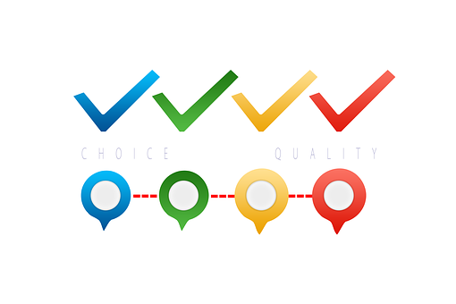
Sampling
Population pool
Timeframe
Dollar threshold
Sampling Method: Random / Non-Random
Sample Size

Slide 19
Analysis
Content analysis: Used to understand the meaning of the information provided; uncovers the what, where, and when.
CROSS-CHECKING ANALYSIS: Further analyzes data and identifies how sets of data relate to each other.
VARIANCE ANALYSIS: Conducted to understand the difference between actual and planned data. By nature, variance analysis uses numbers; thus, documents such as budgets would be ideal when doing a variance analysis.

Slide 20
Technical Assistance
Interpret the laws, rules, and regulations pertaining to the grant under review
Uncover trends or practices that may trigger an immediate opportunity to provide technical assistance
Grant recipient may ask for help or guidance to improve its service design and delivery, grant operations, or administrative or financial management systems

Slide 21

Staff and Participant Interviews

Slide 22
Interviewing Program Staff
Broad to Narrow:
  Start with leadership with the broadest knowledge/big picture person
    Ask them as much as you can in your scope.
    Use this to narrow down and determine where your focus should lie.
  Then go to subject matter experts for more information.
Report back to the big picture person/program leadership each day for check-in.
  Let them know what you found out
  Give them a chance to rebut or research

Slide 23
Interviewing Program Participants
If doing a case file review, get one of the exiters from the case review.
  Choose an exiter because you have the case file and they can discuss their whole journey with you.
Look at the spectrum of participants/claimants
  See a Successful Participant: Choose someone who has gone through training because you get all the program elements and a longer duration of participation in the program.
  See an Unsuccessful Participant: Also choose someone who did not finish training to find out why and learn about the potential pitfalls.
If reviewing multiple programs, select a participant from each of the programs that you are reviewing.

Slide 24
Interview Methodology
Set the tone
  Tell them what you’re going to ask about
  Tell them that you’ll take notes so that is not a surprise
  Let me them know you are learning from them
    “Teach me about your job”
  Explain that this is a discussion not a “gotcha” situation
  Remind the interviewee that “I don’t know” is a permissible answer
Takes notes but do so sparingly and focus on friendly eye contact.
Put your interviewee at ease
  Never let them know that something is wrong. Otherwise, the process becomes adversarial quickly.

Slide 25

Interview Methodology (cont.)
Funnel Technique
  Start with broad questions and go narrower.
  And then ask anything else to make sure you have all question asked.
Use open-ended questions
  Describe...
  Who?
  What?
  Why ?
  When?
  Did you?
  Anything else? Close off the funnel at the end.

Slide 26
Interview Methodology (cont.)
Start with data and ask questions about it.
  Bring charts and graphs showing changes over time and ask questions about trends.
Have the program manager walk you through everything like you have never seen it before.
Be skeptical: Don’t be afraid to ask questions to satisfy your own interest, clarify your understanding, or probe further.

Slide 27

Interview Guides
Interview Guides are for the Interviewer not the Interviewee.
They are checklist only and should be adapted for each interview to allow for a flowing conversation.
Use a guide to brainstorm in advance; use your brain during the interview.

Slide 28

Interviewing Techniques
Question types:
Closed-ended questions
Open-ended questions
Probing questions
Reflective questions

Slide 29
Closed-ended Questions
Closed-ended questions generally result in a “Yes” or “No” answer or with a specific fact or figure.
Often used to elicit baseline information and are helpful for gathering details and understanding the source of an issue or success.
May lead to additional open-ended, probing, or reflective questions.
Too many closed-ended questions can halt a conversation.

Slide 30
Open-ended Questions
Encourage a two-way conversation and often lead to follow-up questions.
Show that the Interviewer wants to learn, has an open-mind, and is knowledgeable.
Provide opportunities for the Interviewee to discuss the topic and provide input.
Often used to clarify responses or build on the baseline information elicited from closed-ended questions.
Allow for the Interviewee to provide input on the “how” and “why” or to describe processes and situations.

Slide 31
Probing Questions
Probing questions enable the Interviewer to dive deeper into a particular subject or response.
They provide the Interviewee more latitude to elaborate or provide further details.
May follow a specific statement or response used by the Interviewee.

Slide 32
Reflective Questions
Require the interviewee to reflect on a situation and describe it.
Allow the interviewee to provide more detail on the cause and effect on a problem.
Allow the interviewee to express an opinion, analysis, or insight.

Slide 33
Broad Take-Aways
The entrance conference sets the stage for the entire monitoring review.
The most successful monitoring reviews use multiple approaches to gain information.
Use interview techniques, such as careful question selection and the funnel technique, to gain the most comprehensive and definitive information possible.

Slide 34

Questions???

Slide 35
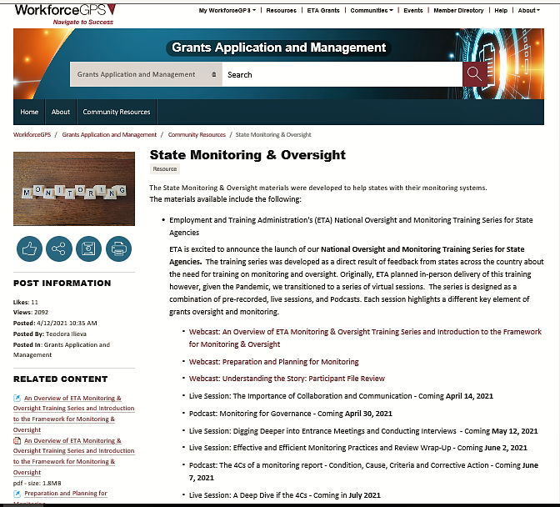

Slide 36
https://grantsapplicationandmanagement.workforcegps.org/resources/2019/05/22/03/19/State_Monitoring_Oversight

Slide 37

Thank You!

