Slide 1
National Health Emergency (NHE) Disaster and SUPPORT Act Grantee Webinar

Slide 2
Today’s Agenda
Opening Remarks and Welcome
Introduction to Today’s Session
Remarks from the Chief Evaluation Officer
NHE Demonstration Grants, Preliminary Findings
Audience questions and feedback/observations on evaluation
Facilitated Discussion with NHE DEMO Grantees
Audience questions and feedback
Discussion with Audience
ETA Evaluation Resources and Opportunities
Wrap up

Slide 3
Today’s Moderator
Ashley Johnson
Workforce Analyst
Partnership and Innovation Unit
Office of Workforce Investment
Employment and Training Administration

Slide 4
Opening Remarks and Welcome
Charlotte Harris
Unit Chief, Partnership and Innovation Unit Office of Workforce Development,
Employment and Training Administration

Slide 5
Welcome and Introductions
Jillian Berk PhD, Project Director, Mathematica Policy Research
Christina Yancey PhD, Department of Labor, Chief Evaluation Officer

Slide 6
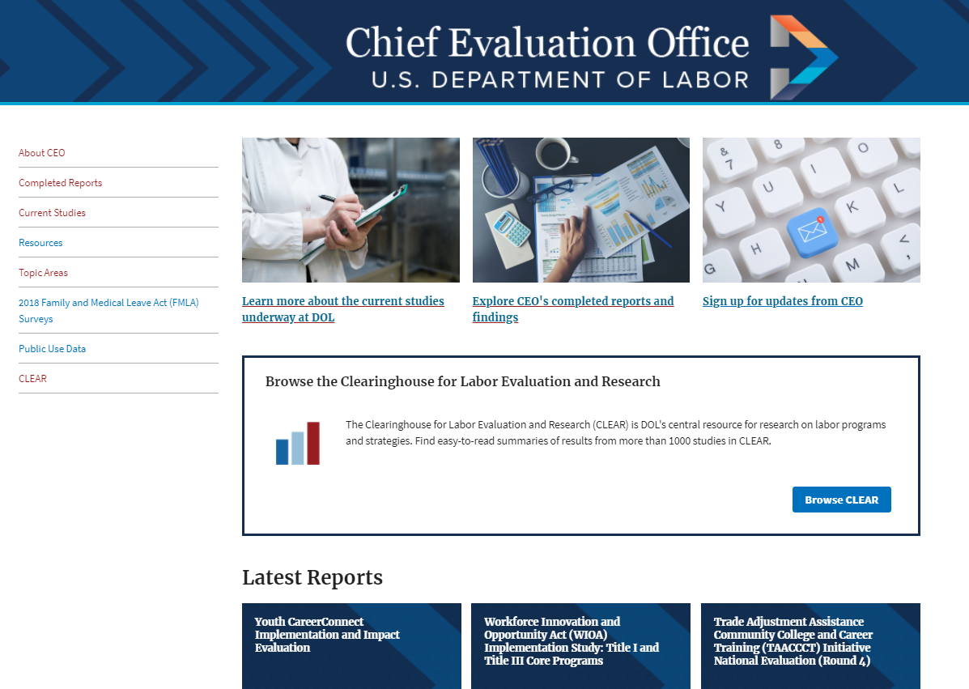
About the Department of Labor’s Chief Evaluation Office
CEO is a Department-level office, supporting all of DOL in developing and disseminating independent, credible information and data about DOL programs, policies, operations, and activities, using scientific methods.
Learn more about CEO on our website:
https://www.dol.gov/agencies/oasp/evaluation
Sign up for CEO’s newsletter, Building the Evidence Base, to stay up to date on our latest research.

Slide 7
DOL Clearinghouse on Labor Evaluation and Research (CLEAR)
The Department’s central resource for labor-related research
identifies and summarizes rigorous studies, including descriptive statistical analyses, implementation studies, and causal impact evaluation studies
More than 1000 studies summarized across 20 labor-related topics
Search for ‘substance use disorder’ on www.clear.dol.gov

Slide 8
Providing Employment Services to People Affected by Opioid Use Disorder
Early insights from virtual site visits to National Health Emergency demonstration grantees
Jillian Berk, Mathematica
April 20, 2021

Slide 9
NHE demonstration grants – awarded in 2018
Alaska
Maryland
New Hampshire
Pennsylvania
Rhode Island
Washington

Slide 10
Goals of the evaluation
Document all facets of the NHE demonstration grants
Identify challenges and promising practices
Generate information for grantees, sub-grantees, and practitioners about approaches to delivering workforce services to people affected by opioid addiction

Slide 11
Early insights from site visits
Conducted virtual site visits from November 2020 – January 2021
Respondents included state grant director, state administrator, state partners, subgrant directors, frontline staff, local partners, and employers
Conducted two participant focus groups in each state:
Participants receiving general employment and training services
Participants in training for health care occupations (including peer specialists)

Slide 12
What comes next for the evaluation?
Additional analysis of site visit data
Analysis of Workforce Integrated Performance System (WIPS) data on participant characteristics and service receipt
Final evaluation report, issue briefs, and strategy spotlights should be available in the fall

Slide 13
Bringing workforce system staff to behavioral health providers
Adapting the workforce system to support people in recovery
+
AJC

Slide 14
Adapting the workforce system to support people in recovery

Slide 15
Reaching new customers
Grantees aimed to “get people in the door” at AJCs and other employment agencies by:
Developing relationships with new referral sources (e.g., Recovery Community Organizations, corrections agencies, homeless shelters, and behavioral health providers)
Hiring staff members in recovery to facilitate outreach to community recovery organizations (e.g., recovery houses, treatment facilities), and in some cases, accompany participants to AJCs

Slide 16
Promising practice spotlight: Using navigators
Can leverage connections to recovery organizations in the community to recruit potential participants
Help participants gather needed documentation for eligibility/enrollment
Accompany participants to AJC appointments and provide “warm handoffs” to workforce system staff

Slide 17
Adapting the service environment
Grantees worked to make the AJC environment more welcoming and better able to serve this population by:
Training staff on use of non-stigmatizing language
Reducing caseloads for case managers serving people with opioid use disorder
Providing funding for pre-eligibility services to help participants obtain necessary documentation
Using positive language to highlight the strengths that people in recovery can bring to employers

Slide 18
Promising practice spotlight: Training AJC staff
Draw on trainers with lived experience to help change staff's preconceived notions about people in recovery
Highlight behavioral health and social resources in the community and provide Narcan training
Use breakout discussion groups to help staff practice communication strategies and discuss challenges
Include all staff who interact with clients, and integrate training into ongoing professional development

Slide 19
Bringing workforce system staff to behavioral health providers

Slide 20
Embedding services in a community resource center
One grantee implemented employment services at county resource center that also provides housing, mental health, and substance use treatment services
Using a co-location strategy reduces need for outreach, as many referrals come from within resource center and many clients at the center are eligible for grant services
Rotating employment navigators can meet with new participants as needed

Slide 21
Embedding staff at substance use treatment clinic
Helps develop strong relationships and trust between workforce system and substance use disorder treatment staff
Workforce staff provide information during group sessions at the methadone clinic and leave flyers around the building to advertise their services
Employment and training services are provided by workforce staff at the clinic location, which is less intimidating for these participants than going to an AJC
Clients are placed directly in employment rather than training services

Slide 22
Bringing workforce system staff to behavioral health providers
Adapting the workforce system to support people in recovery
+
AJC

Slide 23
Paths to employment for people in recovery

Slide 24
Providing supportive infrastructure to promote employment readiness
Grantees addressed participant readiness for employment by:
Promoting use of readiness assessments to understand participants’ stage of treatment and basic needs (e.g., housing, transportation)
Tailoring work readiness trainings and soft skills trainings to people in recovery
Funding supportive services to meet immediate needs, such as housing
One grantee partnered with a residential treatment program to help connect participants living in the residential treatment facility to employment

Slide 25
Promising practice spotlight: Adapting work readiness training
Adapt existing programs to be a “bridge” to prepare people in recovery for further work readiness training
Address specific issues that people in recovery often face such as resume gaps and the pros and cons of sharing about their recovery during job interviews
Provide trainings at recovery centers and corrections facilities to make trainings more accessible and solicit staff input on curriculum content to improve buy-in

Slide 26
Employment paths
Transitional jobs (subsidized work experience):
Help participants start earning money and obtaining references and work experience
Connect participants to community-based organizations, which are generally very receptive to hiring people in recovery
Peer recovery specialist careers
Names of these professions vary by state; all require lived experience
Five states supported training, on-the-job training, or apprenticeships for peer recovery specialists through the grant

Slide 27
Promising practice spotlight: Peer recovery specialist training
Promote this as a career option to people in recovery seeking to draw on their lived experience to help others with opioid use disorder
Highlight the high employability in this profession since insurance reimburses peer services in many states
Develop on-the-job trainings or apprenticeships to help participants accrue hands-on field hours needed for certification in these fields

Slide 28
Questions and feedback?

Slide 29
Discussion with NHE Demonstration Grantees
Sandra Burgess
Employment Security Analyst III Project Coordinator: NHE Demo Grant to Combat Opioid Crisis
Alaska Department of Labor and Workforce Development, Division of Employment and Training Services
Lauren Robbins
Project Supervisor
Opioid Use Reduction & Recovery (OURR)
Reentry Rapid Response Project

Slide 30
Any Questions?

Slide 31
Discussion Among NHE Disaster Grantees and Support Act Grantees
What surprised you the most in the preliminary findings by the Evaluation Team and the experiences of the NHE Demonstration Grants?
What rings true for your grant projects about adapting the workforce system or bringing the workforce system to behavior health providers?
What was most useful for you from today’s presentation?
What technical assistance would further support your grants going forward?

Slide 32
ETA Evaluation Resources and Opportunities
Sande Schifferes
Division of Research and Evaluation
Office of Policy Development and Research
Employment and Training Administration

Slide 33
Evaluation Resources -- ETA
Workforce Systems Strategies
Contains over 1200 profiles of workforce development research and evaluation studies, toolkits, and other resources to support program management and operations, education and training, and employment, retention or advancement activities.
https://strategies.workforcegps.org/
ETA’s Research and Publications Database
Numerous resources and links on ETA funded research/cross-posted research with CEO. Contains rigorous research and evaluation publications, public data sets, and current projects.
https://www.doleta.gov/research/
Evaluation and Research Hub
A community point of access to support policymakers and program managers with their efforts to use evaluations to improve services and choose evaluations and research to inform program policies and evidence-based practices
https://evalhub.workforcegps.org/
Evaluation Peer Learning Cohort (Training for States; new round of applications in late summer)

Slide 34
State Evaluation Requirements -- Under WIOA Title I (Sec. 682.220 of the Regs)
State workforce agencies are required to conduct evaluations under WIOA (also to coordinate on evaluations with other core programs, and to cooperate in Federal evaluations)
Multiple types of evaluations are allowed – process, outcome, impact
Phase II NHE grants present an opportunity for States to meet WIOA evaluation requirements (SUPPORT Act grants being separately evaluated by CEO)
The MPR study of Phase I grants provides a model for conducting a process study – could build on the design and the question lists.
Also, for learning about how to conduct an evaluation – ETA has extensive technical assistance materials (at EvalHub in WFGPS); also formal peer learning cohorts (applications will be out this summer for next round), and can provide direct assistance.

Slide 35
Contact Us
Ashley Johnson
Workforce Analyst, Innovation and Partnership Unit
U.S. Department of Labor - ETA
Johnson.Ashley.N@dol.gov

Slide 36
Any Questions?

Slide 37
Thank You!

