Slide 1
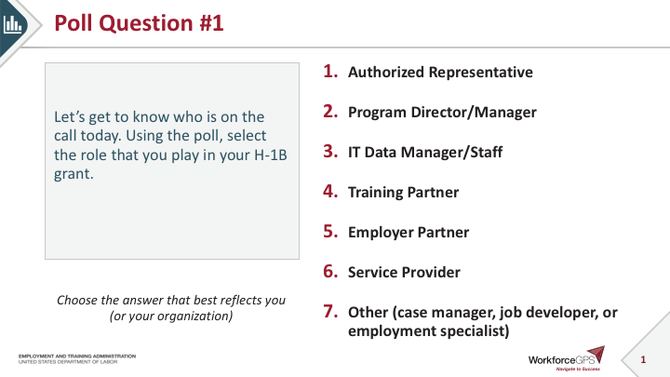
Poll Question #1
Let’s get to know who is on the call today. Using the poll, select the role that you play in your H-1B grant.
Authorized Representative
Program Director/Manager
IT Data Manager/Staff
Training Partner
Employer Partner
Service Provider
Other (case manager, job developer, or employment specialist)
Choose the answer that best reflects you (or your organization)

Slide 2
Poll Question #2
Let’s get to know who is on the call today. Using the poll, select all of the other grants on which you have worked in the past or on which you currently work.
SWFI/TechHire/America’s Promise Grant
Scaling Apprenticeship / Closing the Skills Gap Grant
Ready to Work Grant
TAACCCT
Other DOL Grant (not mentioned)
None
Choose the best answer(s) that reflect your work with the Department

Slide 3
H-1B Performance Reporting Orientation 1.0
H-1B Rural Healthcare
and
H-1B One Workforce
Grants

Slide 4

Today’s Moderator
Ayreen Cadwallader
  Workforce Analyst / Grant Program Lead
  U.S. Department of Labor/Employment and Training Administration

Slide 5


Today’s Speakers
Kristen Milstead
  Workforce Analyst
  U.S. Department of Labor/Employment and Training Administration
Gregory Scheib
  Workforce Analyst
  U.S. Department of Labor/Employment and Training Administration

Slide 6
Today’s Agenda and Objectives
Key H-1B performance policy guidance
  The H-1B Quarterly Progress Report
  Performance policy guidance for the quarters ending 3/31/2021 and 6/30/2021
Introduction to Workforce Integrated Performance System (WIPS)
  Overview of the Quarterly Narrative Report (QNR)
  Accessing WIPS and how to report the QNR in WIPS
Participant data collection and tracking requirements
  Performance policy guidance for the quarter ending 9/30/2021
  H-1B real-time and Workforce Innovation and Opportunity Act (WIOA) performance measures
  Overview of the participant-level data you will track and collect for the Quarterly Performance Report (QPR)

Slide 7
Key H-1B Performance Policy Guidance
The H-1B Quarterly Progress Report
Interim Reporting Guidance through Quarters Ending 3/31/2021 and 6/30/2021

Slide 8
H-1B Reporting Requirements
Quarterly Progress Reports
H-1B grantees are required to submit two reports in order to track performance in DOL ETA’s Workforce Integrated Performance System, or WIPS:
Quarterly Performance Report (QPR)
  Quantitative performance outcomes
Quarterly Narrative Report (QNR)
  Qualitative summary of grant activities through the reporting quarter
Both reports are due 45 days after the end of each quarter.

Slide 9
Quarterly Progress Report
Each grantee must submit a Quarterly Progress Report
Quarter End Date | Progress Report Due Date | Report Activities Occurring Between
March 31 | May 15 | January 1 – March 31
June 30 | August 14 | April 1 – June 30
September 30 | November 14 | July 1 – September 30
December 31 | February 14 | October 1 – December 31
Your first QNR is due no later than May 15, 2021
Covers activities from February 1 through March 31st.

Slide 10
Reporting Process for the First Three Quarters of Your Grant
For the quarters ending March 31, 2021 and June 30, 2021:
Grantees will submit a Quarterly Narrative Report (QNR)
QNRs will be submitted to ETA using WIPS each quarter:
    Quarter ending March 31, 2021 - report due May 15, 2021
    Quarter ending June 30, 2021 - report due August 14, 2021
Grantees will not upload a participant data file and submit a Quarterly Performance Report (QPR)
For the quarter ending September 30, 2021:
Grantees will submit both a QPR and a QNR
    Quarter ending September 30, 2021 - report due November 14, 2021

Slide 11
Knowledge Check!
For the Performance Reporting Quarter Ending March 31, our H-1B grant program will submit a…
Data File upload in WIPS
Quarterly Narrative Report to my FPO with a cc to my Grant Mailbox
Quarterly Narrative Report (QNR) in WIPS
Request for Technical Assistance (We’re Not Sure!)
Notes:
.

Slide 12

Introduction to Workforce Integrated Performance System (WIPS)
Overview of the Quarterly Narrative Report and how to report in WIPS

Slide 13
Joint Quarterly Narrative Performance Report (ETA-9179)
H-1B grantees are required to submit a quarterly narrative report using the approved Joint Quarterly Narrative Performance Report (ETA-9179)
The QNR is a qualitative summary of grant activities that occurred during the reporting quarter
Grantees will submit and certify directly in WIPS

Slide 14
Quarterly Narrative Report sections
Contact Information
Summary of Grant Progress
Progress of Grant Timeline
Development and Implementation of Effective Practices and Program Model Strategies
Status Update on Match and/or Leveraged Resources
Status Update on Strategic Partnership Activities
Status Update on Employer Engagement Strategies
Key Issues and Technical Assistance Needs
Significant Activities, Accomplishments, and Success Stories
Evidence and Evaluation
Additional Information *

Slide 15
WIPS Access
After this webinar, WIPS user accounts will be created for each grant this week.
The Authorized Representative for your H-1B grant will receive a mandatory Level 1 “Certification” Account
If your Authorized Representative requested a Level 2 “Upload” Account this past month, those will be created this week.
If you have not requested a Level 2 account, but need one, the Authorized Representative should send an email request with the following information for the designated Level 2 “Upload” Account:
  Contact Full Name
  Contact E-mail Address
  Whether the individual is a new user or currently has a WIPS account for another program

Slide 16
WIPS User Account Types
H-1B Level 1 (Certification Account): Can perform all WIPS functions, including certifying both the QNR and the QPR reports.
  Level 1 accounts are issued automatically and are mandatory.
  Issued only to the Authorized Representative of the grant.
H-1B Level 2 (Upload Account): Can perform WIPS functions that support report completion, including entering information into the reporting system, file upload, reviewing errors, and viewing reports.
  This user cannot certify either the QNR or the QPR report.
  Level 2 accounts are optional.

Slide 17
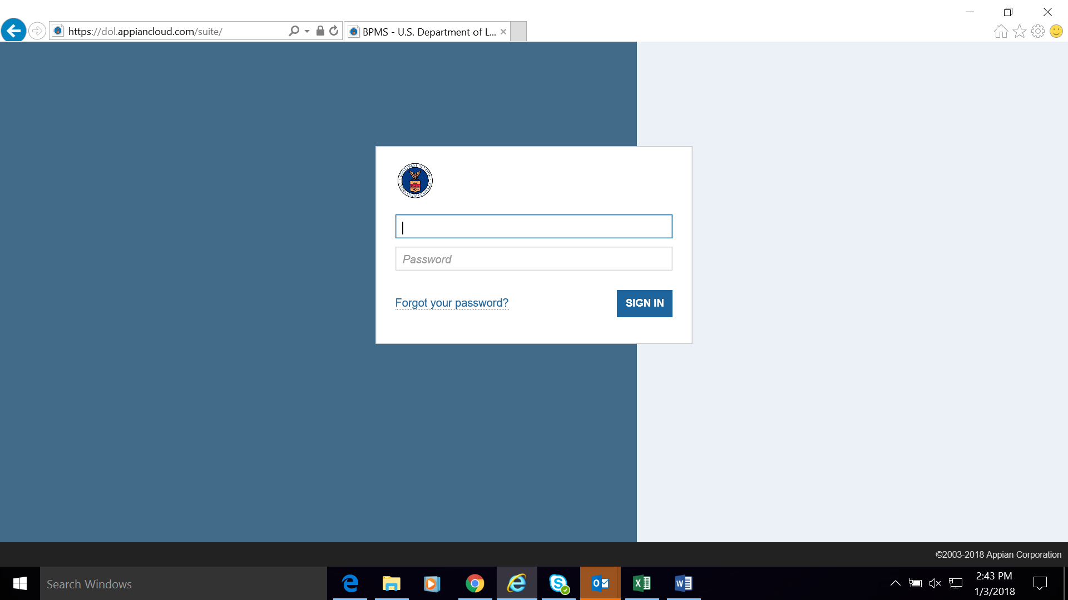
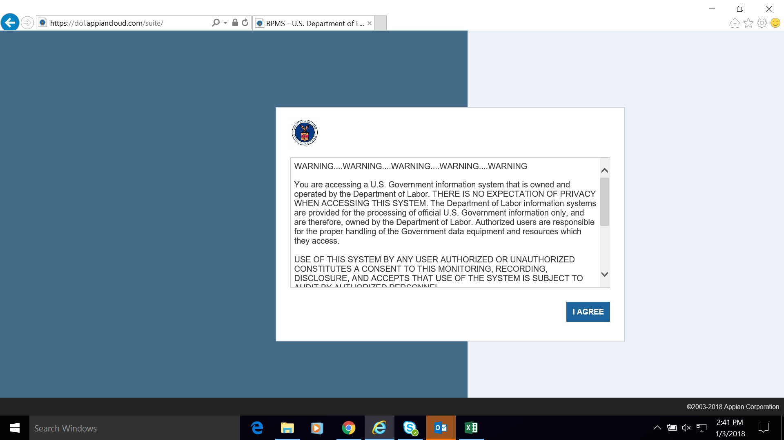
WIPS Access
Username and Passwords
The ONLY way to access WIPS is with a WIPS-generated username and password.
Both username and password are sent via email from the following email address: admin@dol.appiancloud.com.
_

Slide 18
Reset Password in WIPS
Select the Reset Your Password link on the WIPS login screen. Then enter your email address in the Username field and select Request Password Reset.
You will receive an email with a temporary password that you will have to change the next time you log in. Your new password must be at least eight (8) characters and have at least one (1) of each of the following:
Uppercase letter
Special character
Lowercase letter
Number
AFTER CHANGING YOUR PASSWORD, YOU MUST LOG OUT AND LOG IN AGAIN.

Slide 19
Change Authorized Representative
Any Authorized Representative change needs to go through the grant modification process, assisted by your FPO.
  The modification, signed by the Grant Officer, is the formal approval of the Authorized Representative change.
  Please note that after submitting the request to your FPO, it could take 1-2 weeks for the modification to be signed by the Grant Officer and transmitted to you.

Slide 20
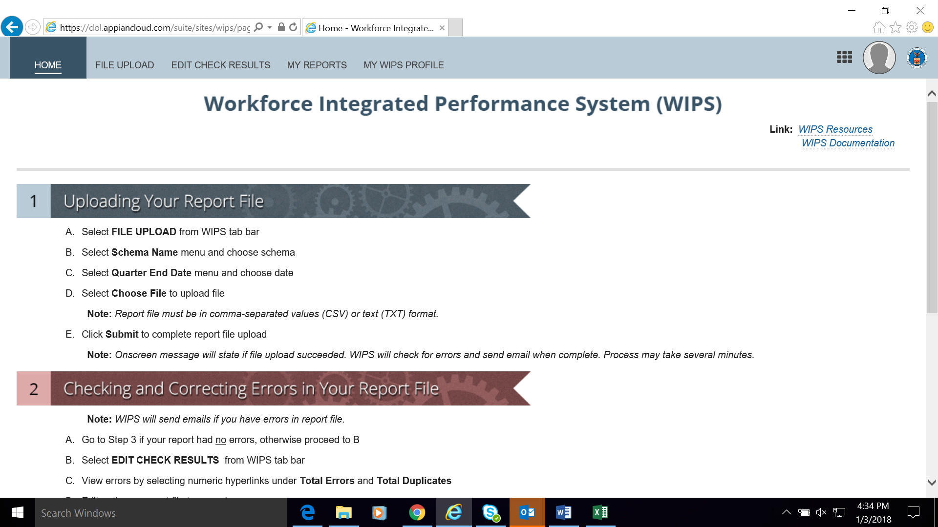
H-1B WIPS Homepage (First Tab)
Once the username and password is entered, the WIPS homepage will display.
Instructions for “Uploading your QPR File” and “Checking and Correcting Errors in Your QPR” will be listed below on the homepage.

Slide 21
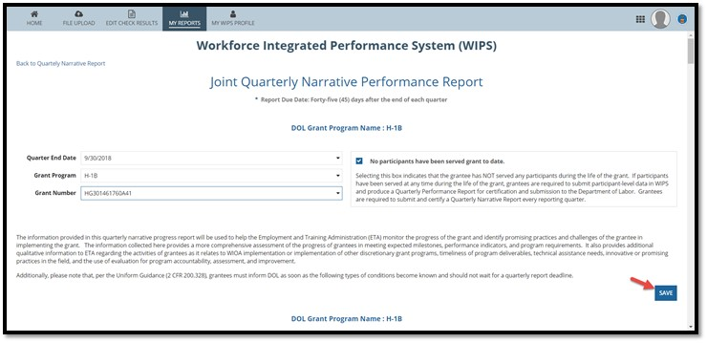
Submit: Joint Quarterly Narrative Performance Report

Slide 22
Submit: Joint Quarterly Narrative Performance Report

Slide 23
Submit: Joint Quarterly Narrative Performance Report

Slide 24
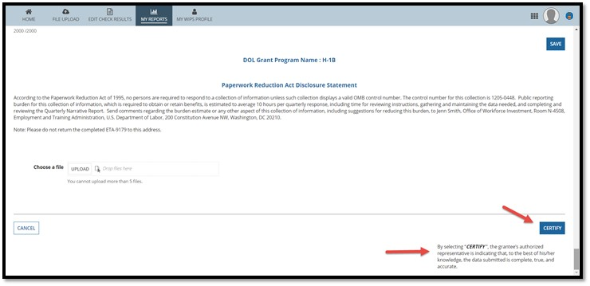
Certify: Joint Quarterly Narrative Performance Report

Slide 25
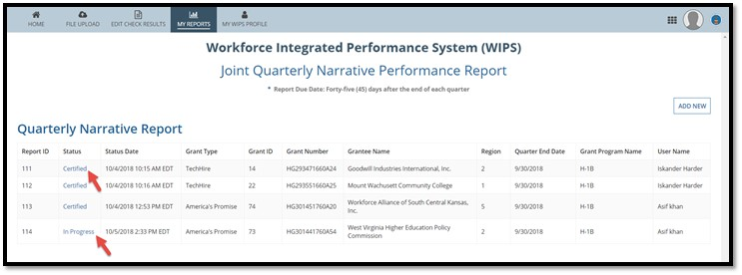
Verify Certification: Joint Quarterly Narrative Performance Report

Slide 26
Any Questions?
Enter your questions in the chat window (lower left of screen)

Slide 27
Participant Data Collection and Tracking Requirements
Performance policy guidance for the quarter ending 9/30/2021
H-1B QPR real-time and WIOA performance measures
Key information about data preparation and storage
Overview of the participant-level data you will track and collect for the Quarterly Performance Report (QPR)

Slide 28
Preparing for the Reporting Quarter Ending September 30, 2021
Grantees will submit a participant-level data file
  Demographic information, services and training received, credential outcomes, and employment
  Includes full participant SSNs
  Please ensure you follow PII protocol
  Data file should include cumulative data for all participants served since the start of the grant through September 30, 2021
  Participant outcomes achieved prior to September 30, 2021 should be reported in the QNR, Section XI.C. “Additional Information”

Slide 29
Performance Measures
WIOA primary indicators of performance
  DOL tracks these outcomes for grantees to better align with ETA programs using WIOA outcomes
  You provided target outcomes for two WIOA indicators:
    Employment Rate – 2nd Quarter After Exit and
    Employment Rate – 4th Quarter After Exit.
H-1B real-time measures
  Grantees provided target outcomes for these “real-time” measures in SOW
  DOL uses reported data on these measures to track grantee progress on meeting these projections and provide technical assistance
WIOA Primary Indicators of Performance and H-1B Real-Time Performance Outcome Measures and

Slide 30
WIOA Primary Indicators of Performance
1. Employment Rate – 2nd Quarter After Exit | Percentage of participants who are in unsubsidized employment during the second quarter after exit from the program.
2. Employment Rate – 4th Quarter After Exit | Percentage of participants who are in unsubsidized employment during the fourth quarter after exit from the program.
3. Median Earnings – 2nd Quarter After Exit | Median earnings of participants who are in unsubsidized employment during the second quarter after exit from the program.
4. Credential Attainment Rate | Percentage of participants enrolled in an education or training program who attain a recognized postsecondary credential during participation in or within one year after exit from the program.
5. Measurable Skills Gains | Percentage of program participants who, during a program year, are in an education or training program that leads to a recognized postsecondary credential or employment and who are achieving measurable skill gains.
6. Effectiveness in Serving Employers (Retention of your participants with the same employer in the 2nd and 4th quarter after exit) | Retention with the same employer in the 2nd and 4th quarter after exit.

Slide 31
H-1B Real-Time Performance Measures
H-1B Real-Time Performance Measures
 | Total participants served
 | Total participants enrolled in education/training activities
 | Total participants who complete education/training activities
 | Total participants who complete education/training activities and receive a degree, or other type of credential
 | Total number of unemployed and underemployed participants who complete education/training activities and obtain employment
 | Total number of incumbent worker participants who complete training activities and advance into a new position

Slide 32
H-1B Real-Time Performance Measures + Definitions
*Total Participants Served
After determining eligibility, a participant is defined as an individual that receives grant-funded services.
*Total Participants Enrolled in Training
*Total Participants Complete Training
*Total Participants Complete Training and Receive a degree, or credential
Participant progress from program enrollment to program completion and earned credentials.

Slide 33
H-1B Real-Time Performance Measures + Definitions
*Obtained Employment
Unemployed and Underemployed
After Program Completion
Employment Placement
*Advanced to a New Position
Incumbent Workers
After Program Completion
Advancement is defined as utilizing advanced skills resulting from grant-funded training

Slide 34

Becoming a Grant Participant
An individual becomes a grant participant when he or she is determined eligible to participate and receives a grant-funded service.
Grant funded services might include (but not limited to):
  Case management services
  Assessments
  Drug-testing
Follow the money!
Staff time may be charged to the grant for outreach activities, however, outreach activities are not considered services and the individuals affected should not be considered participants.

Slide 35
Knowledge Check!
What are real-time measures?
Outcome measures for which we provided target outcome numbers in our Statement of Work
Outcome measures that ETA will use to track my grant’s quarterly performance and identify TA opportunities
Exit-based outcomes
Options 1 & 2 Above

Slide 36
Any Questions?
Enter your questions in the chat window (lower left of screen)

Slide 37
Tracking and Reporting Data for the QPR Outcomes
In the data file, grantees should be prepared to report:
  Demographic information, including employment status at entry
  Dates and types of services and trainings received
  Dates and types of credentials received
  Completion outcomes
  Employment outcomes
  Includes full participant SSNs
    Please ensure you follow PII protocol
Grantees will receive a list of all data elements that must be collected and tracked within the next few weeks.
Further guidance will be provided on how report participant data in WIPS for the QPR in Webinar 2.0 later this summer.

Slide 38
Setting Up a Data Management System
You will use your own internal management information system (MIS) or database system to track participant data
This can be as simple as an Excel file, or as complicated as you’d like it to be.
At the end of each quarterly reporting period, you will export their data files and upload them into WIPS. You will also submit your H-1B Quarterly Narrative Report (QNR) in WIPS.
  Remember! WIPS is exclusively a performance reporting system, not a case management system
Whatever system you use, it must be able to export your data into the approved Comma Separated Values (.csv) file format for upload into WIPS.

Slide 39
WIOA Performance Indicators and Social Security Numbers
You will not need to provide outcomes for the WIOA Primary Indicators Of Performance as they will be collected on your behalf using the Common Reporting Information System (CRIS), and through data you provide in the QPRs.
DOL will calculate the exit-based WIOA Primary Indicators Of Performance for employment on behalf of grantees using SSNs.
  H-1B grantees may not have access to wage records in order to track and report exit-based employment rates and median earnings
  Reporting timelines for these exit-based indicators sometimes fall after the conclusion of the grant’s period of participation

Slide 40
Data Collection Requirements for Social Security Numbers and other Personally Identifiable Information (PII)
Data collected and reported to DOL/ETA includes participant Social Security Numbers (SSNs)
Data must be protected through utilization of PII protocol
The following resources all provide information on handling and protecting PII
  H-1B Training and Employment Guidance Letter (TEGL) 39-11 Guidance on the Handling and Protection of Personally Identifiable Information (PII)
  TEGL 14-18 Aligning Performance Accountability Reporting, Definitions, and Policies Across Workforce Employment and Training Programs Administered by the U.S. Department of Labor (DOL)

Slide 41
Any Questions?
Enter your questions in the chat window (lower left of screen)

Slide 42
Next Steps:
Your Action Items
What should we do …

Slide 43
Performance Reporting Timeline
3/31/2021 and 6/30/21 Reporting Quarters: Submit QNR only in WIPS
Performance Policy Guidance
Performance TA
Prepare Participant Data File
09/30/2021 Reporting Quarter:
Submit Both Data File and QNR in WIPS
Performance Reporting Webinar 2.0 (July 2021)
  Data elements definitions and code values
  Understanding logic rules
  Into the weeds: answering your performance policy questions
Performance Reporting Webinar 3.0 (August 2021)
  Preparing a data file
  Submitting a data file and passing WIPS technical edit checks
  Reading your aggregated data on the QPR

Slide 44
Current Performance Resources
Joint Quarterly Narrative Performance Report Template (ETA -9179)
Joint Quarterly Narrative Performance Report Instructions
COMING SOON! (Spring)
  List of H-1B PIRL Data Elements
  Performance Reporting Toolkit and WIPS Technical User Guide

Slide 45
Performance Resources and TA
ALSO COMING SOON! (Summer)
Workforce GPS Community of Practice
ALSO COMING SOON! (Summer)
Performance Reporting Webinar 2.0
2021 DOL PIRL Schema for H-1B Grants
One Workforce & Rural Healthcare Performance Reporting Handbook
  July: Date TBD
Performance Reporting Webinar 3.0
  August: Date TBD
Performance Reporting Community of Practice (CoP) for Rural Healthcare and One Workforce Grants
  Coming soon on WorkforceGPS!
Grant Program resources may currently be found on the following two Workforce GPS sites:
  Rural Healthcare: https://h1bskillstraining.workforcegps.org/resources/2021/03/19/14/41/H-1B-Rural-Healthcare-Grant-Program
  One Workforce: https://h1bskillstraining.workforcegps.org/resources/2021/03/26/19/29/H-1B-One-Workforce-Grant-Program
_
_

Slide 46
Quarter Ending March 31, 2021 – Reminders and Next Steps
Important Reminders!
  Quarterly Narrative Report due May 15, 2021
    Prepare and submit your QNR into WIPS
    Submit email request to provide Level 2 grantee staff access to WIPS
Next Steps for Grantees:
  Review performance reporting technical assistance materials
  For performance reporting technical assistance please send your questions to the appropriate mailbox:
    OneWorkforce@dol.gov
    RuralHealthcare@dol.gov
  Please make sure to cc your FPO
_
_

Slide 47
Any Questions?
Enter your questions in the chat window (lower left of screen)

Slide 48
Poll Question #6
How are you feeling about your ability to submit performance data?
We’re on it! We are ready to jumpstart our performance reporting!
Performance What?!…We still have a few more questions!
A little overwhelmed, but excited!
Choose the best answer that reflects you (or your organization)

Slide 49
Thank You!

