Slide 1
Read Before You Proceed: Instructions for Use & Legal Compliance
Legal Accessibility Requirements: 508 Compliance
Only use tables when standard content delivery is insufficient, and never merge table cells.
Do not use screenshots or images of text items. All text must be editable and not blur when the screen is zoomed in.
Avoid using “Smart Art” or the “Design Ideas” tool.
Do not repurpose slide title boxes for any other use.
Do not use multiple spaces, empty paragraphs, or strings of tabs to visually adjust your content, as every such repeated character must then be manually stripped from all slides before posting. Instead:
Use soft returns to bump content to the next line in lieu of spaces (Shift + Enter)
Manage paragraph spacing and tabs in the “Paragraph” panel.
Every image or visual element used must either have alternative “alt” text applied or be marked as “decorative”.
Alt text translates visual information into verbal information, which is read aloud in screen readers, while items marked “decorative” are skipped.
This step is required to deliver the full message provided by any graphics.
The person who laid out the content should also provide that alternate information to ensure their message stays intact.
Learn about the new innovative features!
Please watch this webcast before using this template.
https://vimeo.com/370983870/2afa9e8306
(Ctrl + Click to open link)
Duration: 6 minutes

Slide 2
Where Are You?
Please enter your location in the chat window
(lower left of screen)

Slide 3
Lessons Learned From COVID-19 Using a Sector Strategy as the Compass for Finding Successful YouthBuild Career Pathways

Slide 4
Today’s Moderator
Jenn Smith
YouthBuild Director
U.S. Department of Labor, Employment and Training Administration

Slide 5
Today’s Speakers
Phoebe Reeves
Associate Director of Technical Assistance
YouthBuild USA
Mary McRae
Senior Manager, DOL Coaching
YouthBuild USA
Jennifer Lawrence
Executive Director
Social Enterprise & Training (SEAT) Center
Schenectady, NY

Slide 6
Today’s Objectives
Define “sector strategy” and show its value-added approach to creating pre-apprenticeship to apprenticeship career pathways for YouthBuild programs
Share SEAT Center’s specific sector strategy experience and its successes and challenges
Summarize several key COVID-19 challenges and how they are changing the nature of industries in the United States
Introduce an adaptable sector strategy mapping tool for immediate use

Slide 7
Poll - Construction Plus (C+) Offerings
How many C+ tracks are you offering?
One track
Two tracks
Three or more tracks
Not currently offering a C+ track

Slide 8
Poll - Construction Plus (C+) Offerings
If you are offering one or more C+ tracks, what industry or industries are you targeting?
Healthcare
Culinary
Hospitality
Manufacturing
Logistics
Information Technology
Customer Service/Retail
Other

Slide 9
Introduction to a Sector Strategy

Slide 10
Defining Sector Strategy
A sector strategy is a partnership of multiple employers within a critical industry that brings together education, economic development, workforce systems, and community organizations to identify and collaboratively meet the workforce needs of that industry within a regional labor market.
ETA Sector Strategies Technical Assistance Initiative: Sector Strategy Implementation Framework, 2016

Slide 11
Why Use a Sector Strategy Approach?
A sector strategy integrates education and professional training approaches and directly connects these approaches to industry, economic, and career pathways.

Slide 12
ETA Sector Strategy Implementation Framework
Successful sector strategies have the following traits:
Serve the dual purpose of aligning education, training, and support services to the needs of employers in an industry sector while ensuring that those services are accessible to a range of workers
Require a strong intermediary organization
Are employer-driven
Promote systemic change
Include the workforce system

Slide 13
Five Key Capabilities and Capacities of Successful Sector-Focused Organizations

Slide 14
1. Data-Informed Decision Making
Is your organization using rigorous data to make decisions about target industries and training investments?
Understanding of the region’s most important industry sector(s)
Use of traditional and real-time Labor Market Information (LMI) and workforce planning information
Provision of data that is understandable and shared across partners

Slide 15
2. Industry Engagement
How broad and deep is the involvement of targeted industry sector employers in designing and delivering programs and services?
Regional influence to bring key industry leaders to the table
Industry as a strategic partner
Capability to take on the sector partnership intermediary role

Slide 16
3. Sector-Based Service Delivery
How well are you and your partners facilitating the delivery of workforce solutions that are responsive to the needs of workers and the targeted industry sector(s)?
Capability to fill the industry’s near-term workforce needs
Capability to meet the industry’s longer-term pipeline needs
Experience with and capability to develop effective, employer-validated career pathways
Partnership with the right regional organizations
Willingness and ability to respond to non-workforce needs

Slide 17
4. Sustainability and Continuous Improvement
How well is your organization able to measure sector strategy outcomes? Are you positioned to financially sustain sector work for the long run?
Ability to “build the buzz” about the value of sector partnerships
Sector partnership indicators of successful outcomes identified
Sustainable funding source(s)

Slide 18
5. Organizational Capacity and Alignment
Does your organization have the personnel, policies, vision, and resources in place to continually support sector strategy outcomes?
Organizational commitment
Organizational culture
Organizational structure
Staff expertise

Slide 19
Poll - Sector Strategy Readiness
Which of the following sector strategy actions are you already taking in your program/organization?
Data-informed decision making
Industry engagement
Sector-based service delivery
Sustainability and continuous improvement
Organizational capacity and alignment

Slide 20
How Sector Strategy Connects to Career Pathways
Sets real-world industry context
Identifies specific career placement steps for participants
Focuses on employer partner needs

Slide 21
New York State Energy Market Sector
Weatherization Technician
Certified Rater
-HERS -RESNET -BPI
Air Sealing Technician,
Crew Chief, Supervisor
Building Performance Contractor
BPI Energy Auditor
Technician Installer
Building Services
USGBC LEED AP
Building Operations
Occupations
Weatherization
Building Diagnostics
Duct Testing and Sealing
EE/RE/Retrofits
HVAC Installation
Lighting and Controls
Solar Installer
New Construction
Energy Star 3.0
HPwES
Career
Pathways
Basic Energy Concepts
Intro
to
Green
Intro
to
Renewable
Energy
Whole Building Science
Energy
Fundamentals
Workforce
Entry
Basic Math
Reading/
Literacy
Graphs/ Measurement
Presentation Skills
Schenectady YouthBuild

Slide 22
Dynamic Market
The need for residential energy efficiency services in targeted communities
Supply workforce pipeline of underrepresented youth
An expanded energy efficiency market sector
The availability of funding for energy retrofits and training

Slide 23
Sample Construction Plus Healthcare Career Track
4. Emergency Medical Technician (EMT)
3. Certified Nursing Assistant (CNA)
1. Foundation Courses – Healthcare Training Curriculum
2. Personal Care Assistant (PCA)

Slide 24
Annotated Box 1: Foundation Courses - Healthcare Training Curriculum
Participants enter track at enrollment
Foundation courses offered during core YouthBuild programming
Introduction to healthcare field; lifting and transfer techniques; therapeutic dining/prevention of choking and aspiration; aging with an intellectual disability; and virtual dementia tour
Enhanced science curriculum also provided to increase participants’ knowledge
Certifications (stackable but do not count as DOL performance measure certification): OSHA Blood Borne Pathogens, First Aid, CPR, Universal Health Precautions

Slide 25
Annotated Box 2: Personal Care Assistant (PCA)
40 hours of classroom and clinical time
Offered during core YouthBuild programming
Credential and training placement - Personal care assistant with community organization partner (i.e., mental health residential, nursing home, etc.)
Can result in job placement with this partner or other health-related organization

Slide 26
Annotated Box 3: Certified Nursing Assistant (CNA)
90 hours of classroom and 30 hours of clinical time (may occur as part of core YouthBuild programming or after exit)
Participants may need to attain a GED or HSD – this requirement varies state to state
Postsecondary education (PSE) placement – credential as certified nursing assistant with a community college partner
Job placement/retention with local human services and/or healthcare provider

Slide 27
Annotated Box 4: Emergency Medical Technician (EMT)
Those participants with PCA, CAN, and GED/HSD apply and have exited YouthBuild program
PSE Placement/Retention - 152 hours classroom/lab and 144 hours internship with local ambulance partner
Classroom/lab offered through community college partner
Credential as Emergency Medical Technician with college credit
Job Placement/Retention with local ambulance partner

Slide 28
Poll - Career Pathway
First placement in an entry-level position in an industry
Second placement in a next tier position in an industry
Career assessment
Job shadow
Work experience
Stackable and/or portable credentials and/or certificates
Soft skills
Transportation/tools/uniforms, other supportive services
What are the top three ingredients of a career pathway?

Slide 29
Impact of COVID-19 on an Industry and its Workforce Now and in the Future

Slide 30
With the COVID-19 pandemic causing unprecedented disruptions, many companies have been compelled to respond with new ways of working and doing business…
The Fourth Industrial Revolution has also gathered pace, with the pandemic highlighting the role of technologies, such as the Internet of Things, big data, artificial intelligence and robotics, in enabling new ways of business and life in the new normal. From the rise in virtual learning and telecommuting to online banking and telemedicine, these are just some of the pervasive changes that on one hand, empower people and drive innovation, but on the other, erode established notions of work, service and customer experience . . .
We expect industries to emerge from the crisis in one of these four states: strong, transformed, reshaped or uncertain.
Liew, Nam Soon, COVID-19: Changing Industry Fortunes and How Businesses Can Thrive, EY, 2020.

Slide 31
If the U.S. is going to have a recovery that not only brings the economy back to where it was but also ensures a more equitable future, it is crucial to understand what jobs and skills are likely to drive the recovery.
Burning Glass Technologies, After the Storm: The Jobs and Skills that will Drive the Post-Pandemic Recovery, 2021

Slide 32
The “After the Storm” Report Identifies Five Distinct Economies That Will Shape the Recovery
The Readiness Economy
The Logistics Economy
The Green Economy
The Remote Economy
The Automated Economy

Slide 33
1. The Readiness Economy
The pandemic highlighted weaknesses in a wide range of industries that provide social resilience (defined as: “[t]he timely capacity of individuals and groups–family, community, country, and enterprise–to be more generative during times of stability and to adapt, reorganize, and grow in response to disruption.” )
Industries include healthcare, cybersecurity, and insurance.
Project managers and other organizers of work will be in demand.
Threshold GlobalWorks, An Introduction to the Social Resiliency Model, 2019.

Slide 34
2. The Logistics Economy
The pandemic exposed the failure of supply chains to keep up with high demand.
There will be a new demand for advanced logistics skills, advanced manufacturing, and "the ‘Internet of Things’ (IoT) will become more critical to creating chains that are both efficient and resilient.”
Internet of Things is defined as: “the concept of basically connecting any device with an on and off switch to the Internet (and/or to each other) . . . The IoT is a giant network of connected ‘things’ (which also includes people). The relationship will be between people-people, people-things, and things-things.”
Jacob Morgan, A Simple Explanation of 'The Internet of Things,' Forbes, 2013

Slide 35
3. The Green Economy
Nation’s energy system is now moving to renewables.
New administration goals around climate and incentives for businesses will likely speed up the shift.

Slide 36
4. The Remote Economy
The pandemic forced the workforce to move to remote.
For many, it will become permanent.
Growing dependence on data, software, and networks will drive change.
Eventually artificial and virtual reality will play a larger role.

Slide 37
5. The Automated Economy
The pandemic has accelerated the adoption of automation and artificial intelligence.
Employers will prioritize automation over hiring back low-skill workers.
Jobs developing and driving automation will thrive.

Slide 38
The Report Identified Five Distinct Fields That Will Shape the Recovery
ECONOMY | RELATED FIELD
1. The Readiness Economy | Healthcare, IT, Culinary, Hospitality
2. The Logistics Economy | Logistics, Manufacturing, IT, Retail
3. The Green Economy | Construction, Manufacturing, Forestry, Renewable Energy/Materials
4. The Remote Economy | Retail, IT, Manufacturing, Culinary, Customer Service
5. The Automated Economy | IT, Manufacturing, Retail

Slide 39
We find that areas with economies that rely on the movement of people—like Las Vegas with tourism—faced substantially higher unemployment at the end of 2020 than cities with core industries based on the movement of information. Further, we find the hardest-hit areas have larger Hispanic or Latino communities, reflecting the demographic composition of workers in heavily impacted industries and susceptible areas.
Klein, Aaron and Smith, Ember, Explaining the economic impact of COVID-19: Core industries and the Hispanic workforce, Brookings, 2021

Slide 40
Where do these economies leave our young people?

Slide 41
The Intersectionality of Sector Strategy, Career Pathways, and YouthBuild

Slide 42
Course and Career Map – Sector Foundation
Degree/ Certificate | Whole House Air Leakage Control Installer, BPI Certification | Heating/Air Conditioning/ Refrigeration Technical Services, AOS | Photovoltaic Installation Certificate | Construction Technology, AAS | Architectural Technology, AAS | Wind Technician Certificate | Plant Utilities Technology, AAS
Applicable Careers | Crew Chief, Project Manager | HVAC Service Technician | Solar Panel Installer and Technician | Construction Manager | Architectural Related – Architect, Assistant to Architect | Wind Turbine Installer and Technician | Power Plant Operator, Project Manager
AAS – Associate in Applied Science
AOS – Associate in Occupational Studies
BPI – Building Performance Institute
42

Slide 43
Course and Career Map – Career Pathway Foundation
AAS – Associate in Applied Science
AOS – Associate in Occupational Studies
BPI – Building Performance Institute
Entry Requirements | High School Diploma/ GED; understanding of at least eighth grade math | 70% or better in one course of Math I, Algebra, or an equivalent academic math class | 70% or better in one course of any math | 70% or better in Math I and Math II or Equivalent | 70% or better in Math I and Math II or Equivalent | Must be a Hudson Valley Community College Electrical Construction and Maintenance graduate or graduate of an academically equivalent program, or by assessment and approval of the department chairperson. | 70% or better in one course of Math I, Algebra, or an equivalent academic math class
Other Recommended Training | Conflict Resolution; internship in project management and/or as a crew chief | Internship with an HVAC company | Internship with a solar panel installation and/ or technician company | Internship with a commercial or residential construction company | If pursuing a career as an architect, you should continue your education at a four-year architecture college | Internship with a wind turbine installation and/or technician company | Internship with power plant transmission, infrastructure, and/ or operations company

Slide 44
1. Five Key Capabilities and Capacities

Slide 45
2. YouthBuild Construction Plus Framework

Slide 46
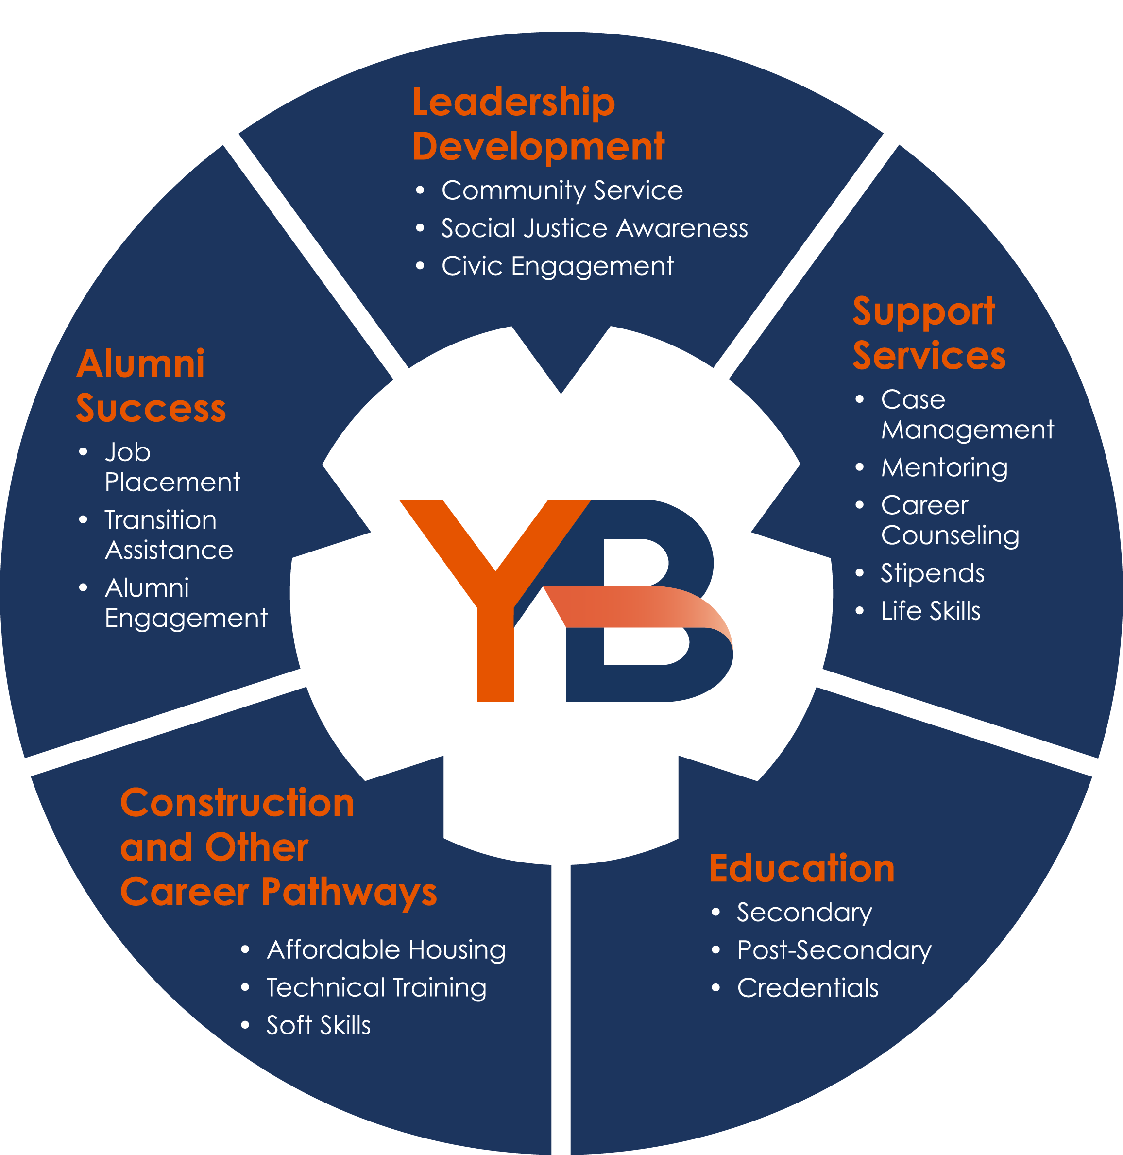
3. YouthBuild Model

Slide 47
Career Pathway Pre-Apprenticeship
Sector
Strategy
YouthBuild Model

Slide 48
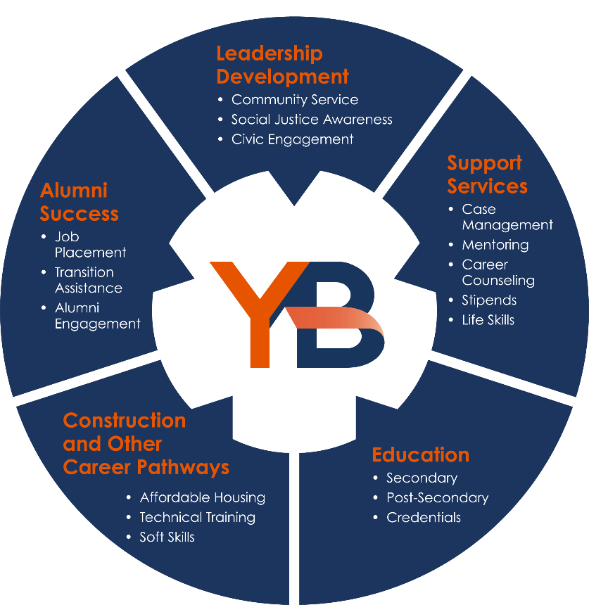
Partnership of Sector Strategy and Career Pathway
Sector Strategies
Career Pathways
Industry Demand for Skills
Workforce Supply of Skills
Identifies Industry Requirements
Provides Educational Options
INDUSTRY REQUIREMENTS
Rigorous Collection & Analysis of Labor Market Data
Sets Skill Requirements of Jobs Within Industry
Identifies Natural Progression of Jobs Within Industry
Verifies Competency Models
Provides Work-based Learning Options
Establishes Industry Credential Requirement
Sets Global Skill Standards
KEY FEATURES
Registered Apprenticeships
Contextualized Learning
Integrated Education and Training
Career Ladders/Lattices/Roadmaps to Careers
Competency Models
Multiple Entry/Exit Points
Stackable Educational/Training Options
Supportive Services
Degree/Certificate Attainment
https://wdr.doleta.gov/directives/attach/TEN/TEN_17-15_Attachment_Acc.pdf

Slide 49
Successes and Challenges of the Operational Intersectionality of Sector Strategy and Career Pathways
Sector Work
The Ideal: Industry leads voice their critical human resource needs and form customized regional education and workforce development solutions for workers and businesses.
The Ideal: The workforce development system should respond with a focus on long-range career development; the advancement of individuals through industry-defined career pathways; and the integration of work-based learning experiences as an essential part of training, including the expansion of registered apprenticeship programs, the “gold standard” of work-based learning.
The Reality: Successful sector initiatives require systemic changes in business and employer behavior; and in the organization and delivery of workforce, education, and training systems.
U.S. Department of Labor, Employment and Training Administration, Sector Strategies and Career Pathways: A Mutually-Beneficial-Alliance, Mary Clagett et al, Maher & Maher

Slide 50
Successes and Challenges of the Operational Intersectionality of Sector Strategy and Career Pathways
Career Pathways Work
The Ideal: The most successful career pathways systems provide multiple entry and exit points; sequenced, modularized, and contextualized coursework that aligns with stackable credentials and jobs; and the careful articulation of each education level ending in the attainment of industry-recognized credentials. Career pathways also offer flexible scheduling, opportunities for acceleration, work-based learning, and extensive supports and counseling services. This includes navigation services that help participants identify and access the most efficient routes to credential attainment and careers (often through career and course mapping).
U.S. Department of Labor, Employment and Training Administration, Sector Strategies and Career Pathways: A Mutually-Beneficial-Alliance, Mary Clagett et al, Maher & Maher

Slide 51
Successes and Challenges of the Operational Intersectionality of Sector Strategy and Career Pathways
Career Pathways Work
The Reality: Career pathways systems require systemic changes on the part of education and workforce development systems, who must agree to make significant changes in the delivery, organization, and culture of education and training—regardless of which specific sector is the focus.

Slide 52
Recent DOL Sector Initiatives
The Strengthening Community Colleges Training Grants Program (referred to as Strengthening Community Colleges or SCC) aims to build the capacity of community colleges to collaborate with employers and the public workforce development system to meet local and regional labor market demand for a skilled workforce. The grants also build the capacity of community colleges to address challenges associated with the COVID-19 health crisis, such as expanding online and technology-enabled learning and migrating services to a virtual environment.
H-1B One Workforce Grants - The U.S. Department of Labor (DOL) awarded $145 million in the H-1B One Workforce Grant Program to invest in training for key sectors in the U.S. economy including information technology, advanced manufacturing, and transportation sectors to upskill its present workforce and train a new generation of workers to build a pipeline for the future workforce.

Slide 53
Any Questions?
Place your questions in the chat box.

Slide 54
Resources:
Sector Strategies Resources
https://youthbuild.workforcegps.org/resources/2021/02/07/17/17/Sector-Strategies-Resources
Sector Strategy Implementation Toolkit
https://businessengagement.workforcegps.org/-/media/Communities/rapidresponse/Files/Sector-Strategies/etas_sector_strategies_framework_201503015_final.ashx?sc_lang=en
Career Pathways Toolkit
https://www.careeronestop.org/CompetencyModel/
Competency Model Clearinghouse
https://careerpathways.workforcegps.org/resources/2016/10/20/10/11/Enhanced_Career_Pathways_Toolkit
Sector Strategies Overview
https://businessengagement.workforcegps.org/resources/2016/05/11/09/49/Sector-Strategies-An-Overview
Sector Partnership Policy Toolkit
https://www.nationalskillscoalition.org/wp-content/uploads/2021/01/Sector-Partnership-Policy-Toolkit-Summary.pdf
Deeper Dive Into Demand-Side Data: Identifying Target Sectors
https://businessengagement.workforcegps.org/resources/2016/03/16/10/34/Sectors_Data_IDTargetSectors

Slide 55
Contact Us
Jenn Smith
YouthBuild Director
U.S. Department of Labor, Employment and Training Administration
smith.jenn@dol.gov
202.693.3597
Phoebe Reeves
Associate Director of Technical Services
YouthBuild USA
phoebereeves@youthbuild.org
207.744.9951

Slide 56
Contact US
Mary McRae
Senior Manager of Technical Assistance
YouthBuild USA
mmcrae@youthbuild.org
413.426.0961
Jennifer Lawrence
Executive Director
SEAT Center
jlawrence@seatcenter.org
518.342.4100 ext. 2803

Slide 57
Save the Date:
NCCER Certification Training
April 20-28 2021
Work Experience Webinar
April 27, 2021
Virtual and Hybrid Learning Webinar
May 11, 2021
NCCER Your Role in the Green Environment
May 18-19, 2021

Slide 58
Thank You!
Need help? Email: Support@workforceGPS.org

