Slide 1
Where Are You?
Please enter your location in the chat window
  (lower left of screen)

Slide 2
Polling Question: Who’s on the call?
What role do you play in your Strengthening Community Colleges Grant?
Authorized Representative
Program Director/Manager
Training provider
Employer partner
Other type of partner supporting the grant
Case Manager / Career Navigator
Performance / Data Analyst
Federal Project Officer
Choose the best answer that reflects your role in your SCC grant project!

Slide 3
Strengthening Community Colleges Training Grants Program
Grantee Orientation

Slide 4

Welcome and Introductions
Let’s get to know one another!
Enter your name, location, organization name, project name, and contact information into the chat.
What is the name of your project?
What is your name?
What is your email?
Where are you
located?
What is your grant project name?

Slide 5

Moderator
Cheryl Martin
Program Manager, Competitive Grants
DOL ETA Office of Workforce Investment, Division of Strategic Investments

Slide 6
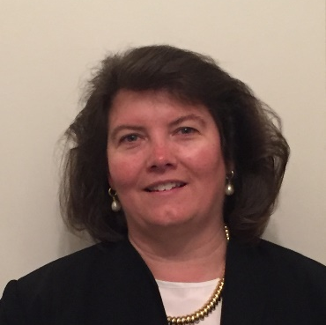
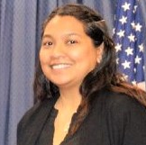
Speakers
Robin Fernkas
Deputy Administrator and Division Chief
DOL ETA Office of Workforce Investment, Division of Strategic Investments
Melissa Abdullah
Grant Officer
DOL ETA Office of Grants Management

Slide 7

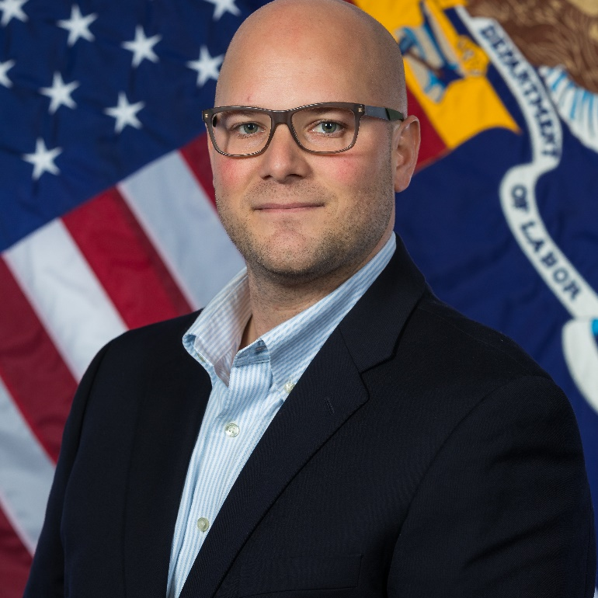

Speakers
Eugenie Agia
SCC Program Lead
Division of Strategic Investments
Steven Canger
Grants Management Specialist
Office of Grants Management
Ayreen Cadwallader
Workforce Analyst
Division of Strategic Investments

Slide 8
Today’s Agenda
Grant Program Overview
The Federal Team
Grants Management: Award Package Overview
Grant Modifications
Performance Reporting Guidance & Technical Assistance
Communication Methods

Slide 9
What are your biggest concerns right now?
Let’s CHAT!

Slide 10
Strengthening Community Colleges (SCC) Training Grants
Grant Program Overview

Slide 11
Polling Question: Preparing to Launch your Grant
Which resources have you reviewed in advance prior to today’s webinar?
Grant Award Package
Grantee Handbook
Rise Module: Competitive Grant Program Basics Reference Guide (Reference Guide)
All of the above
(Choose all that apply)

Slide 12
SCC Grant Objectives
Increase the capacity and responsiveness of community colleges to address the skill development needs of employers and dislocated and unemployed workers, incumbent workers, and new entrants to the workforce.
Offer this spectrum of workers and other individuals accelerated career pathways that enable that enable them to gain skills and transition from unemployment to (re)employment quickly.
Address the new challenges associated with the COVID-19 health crisis that necessitate social distancing practices and expanding online and technology-enabled learning and migrating services to a virtual environment.

Slide 13
Grant Award Information
$40 million awarded
Awarded to 11 grantees
  7 consortia, 4 single institutions
Awards range from approximately $1.6 million (for single institutions) to around $5 million (for consortia)
The period of performance is 48 months (no extensions).
  February 1, 2021 – January 31, 2025
Leveraged funds are encouraged.

Slide 14
Targeted Industry Sectors
Advanced Manufacturing only – 2 grants
Healthcare only – 2 grants
Information Technology (IT) only – 1 grant
Healthcare, Advanced Manufacturing, and IT – 2 grants
Advanced Manufacturing and Cybersecurity – 1 grant
Technology, Health Care, and Education – 1 grant
Public Sector – 1 grant
Construction and Shipbuilding/Repair – 1 grant

Slide 15
Overview of SCC Grantees
Applicant Legal Name | Location | Grant Type | Funding Amount | Federal Project Officer
American River College (Los Rios Community College District) | CA | Consortium | $5,000,000 | Joshua Hodges
Forsyth Technical Community College | NC | Consortium | $5,000,000 | David Bridges
Grand Rapids Community College | MI | Consortium | $5,000,000 | Alice Mitchell
Mt Hood Community College | OR | Consortium | $5,000,000 | Joshua Hodges
Norwalk Community College (Board of Trustees of Community-Technical College) | CT | Consortium | $3,400,000 | Keith Hubert
Research Foundation CUNY obo Queensborough Community College | NY | Consortium | $4,999,003 | Keith Hubert
Savannah Technical College (Technical College System of Georgia) | GA | Consortium | $4,850,244 | William Mitchell
Broward College | FL | Single | $1,689,143 | Adrian Barrett
Los Angeles City College | CA | Single | $1,686,201 | Joshua Hodges
Northwest State Community College | OH | Single | $1,689,151 | Alice Mitchell
Thomas Nelson Community College | VA | Single | $1,686,258 | Keith Hubert

Slide 16
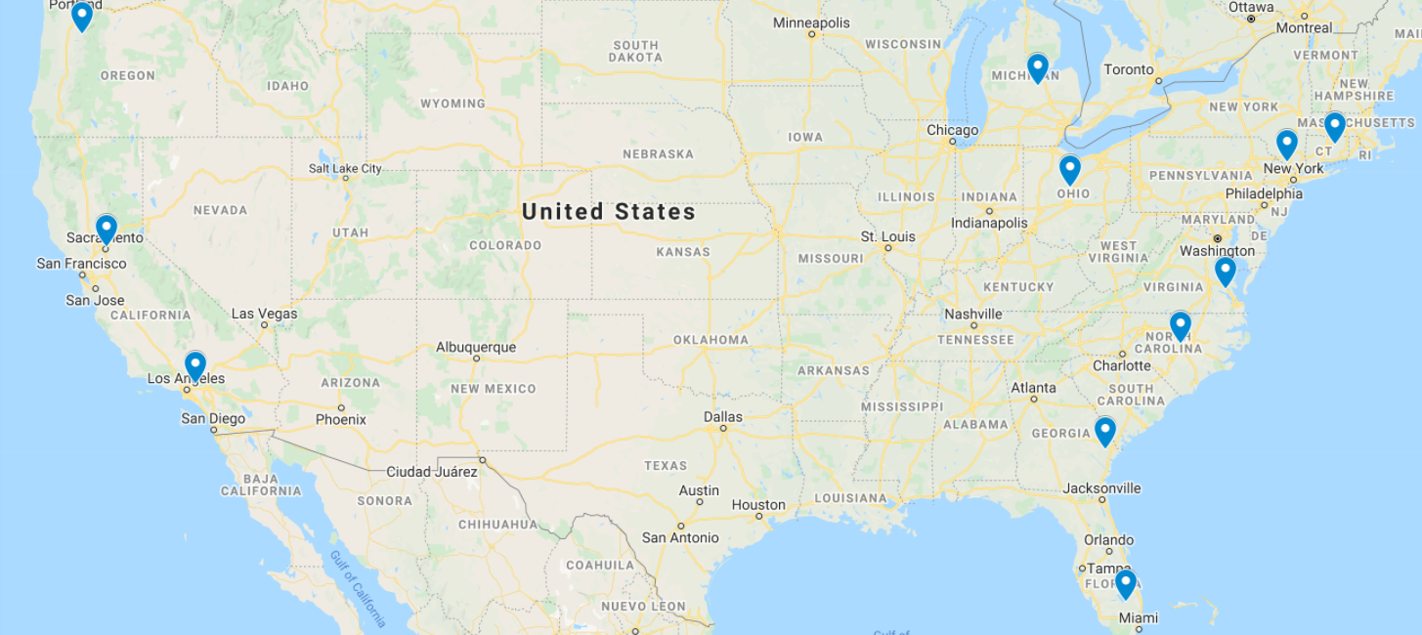
SCC Grants across the United States
Mt. Hood Community College (OR)
Grand Rapids Community College (MI)
Norwalk Community College (CT)
West River Area Health Education Center
Northwest State Community College (OH)
Workforce Development Board of Herkimer, Madison and Oneida Counties
RFCUNY (NY)
Michigan Department of Labor and Economic Opportunity
American River College (CA)
Colorado Center for Nursing Excellence
Tecumseh Area Partnership, Inc., dba Region 4 Workforce Board
Ohio Area 7 Consortium of Chief Elected Officials
Western Colorado Area Health Education Center
Thomas Nelson Community College (VA)
California Rural Indian Health Board
Governor's Office of Workforce Innovation
Eastern Kentucky Concentrated Employment Program, Inc.
Forsyth Technical Community College (NC)
Los Angeles City College (CA)
Pee Dee Regional Council of Governments
Savannah Technical College (GA)
Workforce Solutions Rural Capital Area
CommunityHealth IT
Broward College (FL)

Slide 17
Lead Applicants and Geographic/Project Scope
Eligible lead applicant is a community college.
Lead applicant applied as a single institution lead or as a consortium lead representing a consortium of institutions of higher education (IHEs).
Single institutions undertake capacity building at one institution – 4 grants
Consortia undertake systems change within one state or across one or more community colleges districts with a state – 7 grants
  Statewide – 5 grants
  District-wide – 2 grants

Slide 18
SCC Partnership: Required Partners
Consortia and Single Institutions:
  Workforce Development System: one or more partners from the publicly funded workforce development system
  Employer: industry/trade association or a consortium of at least three employers.
Consortia only:
  IHE Consortium: May include community colleges and public and private, non-profit, four-year IHEs.
    Statewide: all or a majority of community colleges in a state
    District-based: all colleges within the district(s), but no less than three colleges across one or more geographically contiguous districts.
  IHE Coordinating Entity: at least one state- or district-level entity responsible for regulating, governing, advising, and/or coordinating the IHEs in the consortium.

Slide 19
SCC Partnership: Optional Partners
State Apprenticeship Agencies
Federally funded programs, such as Adult Education and Perkins
American Job Center operators
Economic development agencies
Labor-management organizations
Community-based organizations that provide social support and/or wrap-around services
Foundations and philanthropic organizations

Slide 20
Performance Outcomes
Single Institutions
  Capacity-Building Outcomes. One grant-specific (customized) outcome target in three outcomes areas, for a total of three customized outcomes targets.
  Participant Training and Employment Tracking. Grantees will track and report participant outputs/outcomes for a selected cohort of students throughout their grants, using DOL’s Workforce Innovation Performance System (WIPS).
Consortia
  Systems Change Outcomes. Two grant-specific (customized) outcome targets in all outcomes areas, for a total of eight customized outcomes targets.
  The customized performance outcomes targets (either three or eight), and the related outputs, milestones, and deliverables in the work plan, form the basis of DOL’s assessment of grantee performance.

Slide 21
Comparing FOA Requirements: Single and Consortium Applicants
FOA Category | Single Institution Applicants | Consortium Applicants
Geographic/ Project Scope | Capacity building at one institution | Capacity building and systems change within one state, or across one/more community college districts within a state
Award Range | $1 million to $2 million | $1 million to $5 million
Eligible Lead Applicant | Single institution lead community college | Lead community college representing a consortium of Institutions of Higher Education (IHEs)
Required Partners | Workforce development system partner(s) Employer partners Plus any optional partners | IHE consortium members IHE coordinating entity(ies) Workforce development system partner(s) Employer partners Plus any optional partners
Performance Outcomes | One capacity-building performance outcomes target in three outcomes areas (three targets in total) Tracking of eight participant outputs/outcomes for a selected cohort of students | Two capacity-building and systems change performance outcomes targets in four outcomes areas (eight outcomes total)

Slide 22
Program Design
Core Elements:
  Single institutions incorporate #1-4
  Consortia incorporate #1-5
Results-Based Design
  Gap Analysis
  Logic Model
  Project Work Plan
Third-Party Evaluation
Sustainability Plan
Core Element 1: Evidence-based Design
Core Element 2: Sector Strategies and Employer Engagement
Core Element 3: Enhanced Career Pathway Programs and Accelerated Learning Strategies
Core Element 4: Strategic Alignment with Workforce Development System
Core Element 5: Innovative Systems Change
  Option A: Accelerated Learning Pathways
  Option B: Statewide Data Integration/ Use

Slide 23
Individuals Eligible to Participate in SCC
Includes a spectrum of adult workers–dislocated workers, incumbent workers, and new entrants to the workforce—as well as older youth who are new entrants to the workforce.
“New entrants to the workforce” may include:
  Long-term unemployed individuals and formerly incarcerated individuals
  Youth enrolled in junior or senior year of secondary school, who could be employed before or within six months after grant end; and youth who have dropped out of school and are seeking their first full-time job
Within these categories, you may serve a wide range of individuals, including:
  Individuals receiving UI or public assistance
  High school students/dropouts
  Enrollees in adult basic/other education programs
  Individuals with disabilities
  Veterans
  Indian and Native Americans
  Individuals with Limited English Proficiency

Slide 24
Allowable Activities
Wide range of capacity-building activities. Most common include:
  hiring or training instructors/staff to develop and deliver curricula, online/distance learning, and work-based learning experiences;
  purchasing or upgrading classroom supplies/equipment and/or educational technologies
  implementing changes in time/scheduling of courses and data integration tools
Capital expenditures and equipment (next slide)
Participant-related costs are allowable, but we encourage grantees to leverage college or federal/state resources (e.g., WIOA, Perkins) to cover them. Such costs include:
  Conducting outreach and recruitment of eligible participants, implementing initial skills assessment, providing direct education and training, providing job search and placement assistance, providing case management and supportive services

Slide 25
Capital Expenditures/Equipment
Certain capital expenditures, such as equipment or capital improvements related to upgrading the training infrastructure, are allowable with prior written approval from the Grant Officer.
We encourage you to submit your written requests for prior approval to acquire grant-funded special purpose equipment and/or to renovate space (capital expenditures) within the first 90 days. Requests must be submitted no later than 12 months after the award date of the grant.
Grant Officer-approved special purpose equipment and/or renovated space must be acquired, completed, and available for use in support of the project’s statement of work no later than 24 months after the grant award date; DOL strongly encourages grantees to begin using such investments sooner.

Slide 26
Making Credentials and Competencies Publicly Accessible
To meet this requirement, grantees must:
  describe grant-funded credentials and competencies using common structured, linked data formats, e.g., through use of credential transparency description language (CTDL) specifications; and
  post this information in a publicly accessible location online.
Grantees may need to seek assistance from a specialist in credential/data transparency in their SCC Partnership or an outside expert.
DOL will provide further information and additional technical assistance regarding this requirement.
For further information, you may view these slides, as well as the following resources:
  Comprehensive Learner Record Specification
  Credential Engine’s Services and Publishing
  Open Badge 2.0 Specification
  W3C Verifiable Credentials Data Model

Slide 27
Third-Party Evaluation Requirements
Implementation Evaluation (preferably a developmental evaluation)
No more than 5 percent of budget, i.e., ~ $40k for singles, ~ $250,000 for consortia
No later than Month 2: Submit detailed procurement work plan
No later than Month 6: Procure third-party evaluator (if possible under institution’s procurement requirements)
No later than Month 9: Submit draft detailed evaluation design from evaluator
No later than Month 12: Submit final detailed evaluation design
Month 27: Interim report due
Month 48: Final report due
Program Office will coordinate technical assistance for third-party evaluations

Slide 28
Polling Question: Preparing to Launch your Grant
When do you anticipate hiring your project manager?
Our project manager is already in place!
By March 31, 2021
By April 30, 2021
By May 31 or later

Slide 29
Your Federal Team
Collaboration and Coordination

Slide 30
Your Federal Team at the Department of Labor (DOL)
ETA Regional Offices
Office of Grants Management (OGM)
Division of Strategic Investments (DSI, Lead Program Office)
Chief Evaluation Office (CEO)
Federal Project Officer
Grant Officer (OGM / Regional Office)
Program Office
Grantee

Slide 31
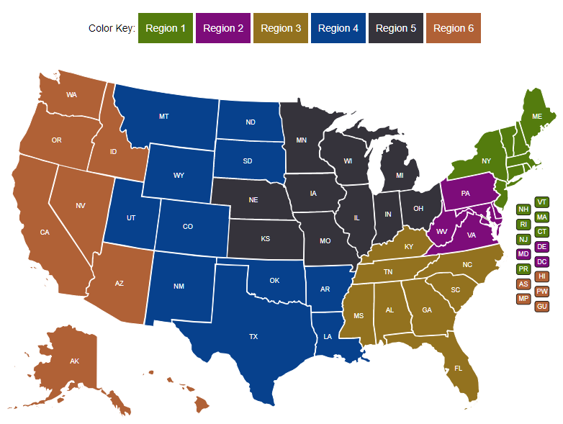
Your FPO is identified in your grant package.
Federal Project Officer (FPO)
Your FPO is critical to the success of your grant program.
Role of Your FPO
Assist you on grant-related matters
Provide compliance assistance
Conduct oversight and review of grant performance
Deliver or arrange for technical assistance
Serve as your primary point of contact

Slide 32

Grant Officer (OGM)
Your assigned Grant Officer is listed on the Notice of Award page of the Grant Package. Only the Grant Officer can approve changes to the Grant Agreement.
Maintains official grant documents
Regional Grant Officer can approve grant modifications and equipment purchases
National Grant Officer approves complicated grant modifications: limited changes to SOW, changes in signatory and NICRA
OGM staff provide guidance and training on policy issues and fiscal/administrative requirements of the grant.

Slide 33
Program Office Staff
Support FPOs
Provide policy clarification and guidance
Provide technical assistance (TA) (together with an external provider)
Create peer learning opportunities
Collect performance data
Review specific grant modifications
The Program Office for your grant may periodically request information about your grant outcomes for quarterly reports to Congress.

Slide 34
Any Questions?

Slide 35
Grants Management Overview
Melissa Abdullah, Grant Officer
35

Slide 36

Grant Transmittal Package
Grant Award Letter
Grant Agreement
Grantee Handbook

Slide 37
Grant Award Letter
Acknowledgements of Award
Payment Management System
  Information and forms on www.doleta.gov/grants under Manage your Awarded Grant
ETA’s on-line Grantee Financial Reporting System
  ETA 9130
  Information to access system on www.doleta.gov/grants under Manage your Awarded Grant
Passwords/PINs are sent separately after supplying the necessary information.
Once you receive this please DO NOT LOSE IT!

Slide 38
Grant Award Package
Grant Agreement:
Notice of Award (NOA)/Signature Page
Condition of Award Page/ Program Compliance Notification
Terms and Conditions
Application for Federal Assistance
Budget
Statement of Work (SOW)
Indirect Cost Rate Agreement (if applicable)

Slide 39

Grant Agreement Notice of Award (NOA)
Project Title – Strengthening Community Colleges Training Grants
Grant Awardees' Identifying Information
Federal Award Identification Number (FAIN)
  Grant Number # MI-350XX-20-60-A-XX
Period of Performance
Award Amount
Uniform Administrative Requirements
Cost Principles
Signatures

Slide 40
Notice of Award Regulations
    2 CFR Part 200
      Uniform Administrative Requirements
      Cost Principles, and
      Audit Requirements for Federal Awards
    2 CFR Part 2900
      DOL Exceptions
    Terms and Conditions of Award

Slide 41
Conditions of Award
Areas that require clarification and/or modification are outlined in the award package and specified as conditions of award.
    Budget revisions/clarifications
    Indirect Cost Rate Agreement
Responses were due to your Federal Project Officer (FPO) within 30 days of the receipt of the grant award package.

Slide 42
Conditions of Award
  Conditionally Approved Funding (if applicable): Grantee is conditionally approved with an initial increment of $80,000 drawdown restriction in PMS. This constitutes a Partial Notice to Proceed. Release of additional funds up to the amount approved for the project, will be based on the grantee’s ability to address this Condition (see Conditions of Award page). Grantee is not authorized to incur costs above $80,000 until Condition 1 is resolved.
    Financial Assessment Form (All grantees)
    Financial and Administrative Policies and Procedures (Grantees new to ETA)
  Lifting the Drawdown Restriction: Submission of the requested information specified in Condition 1 does not in itself constitute approval by ETA. Should the provided documentation be found satisfactory, a Full Notice to Proceed will be incorporated into the grant agreement as an official modification, and the drawdown restriction will be lifted.
  New Grantee to ETA: Grantee that has never received ETA grants or has not received ETA grants within five (5) years from the closing date of the FOA. Grantees that meet this criterion will receive Conditionally Approved Funding.
42

Slide 43
Program Compliance Notification
  Federal Staff are still reviewing your projects
  Key areas of Compliance are highlighted
  Grantees are responsible for
      Learning how to manage their award in compliance with all Federal Regulations & this grant agreement
        Reading the grant agreement
        Learning about Federal Regulations, and the nuances of your program
        critically looking at their project and being proactive in clarifying items of potential concern with your FPO

Slide 44
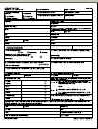
Specific Terms and Conditions of Award
Order of Precedence
Funding Opportunity Announcement (FOA)
  & Amendment One (incorporated by reference)

Slide 45
Terms – Equipment Purchases
  Equipment purchases with a per-unit acquisition cost of $5,000 or more, and a useful life of more than one year need prior approval from Grant Officer
    Capital improvements and other alterations and renovations also allowable with prior approval
  Submit a detailed equipment purchase list with descriptions of each item to your FPO for review
  Your FPO will review the request and submit for approval. A modification to your grant will be processed approving the equipment purchase and/or renovation

Slide 46
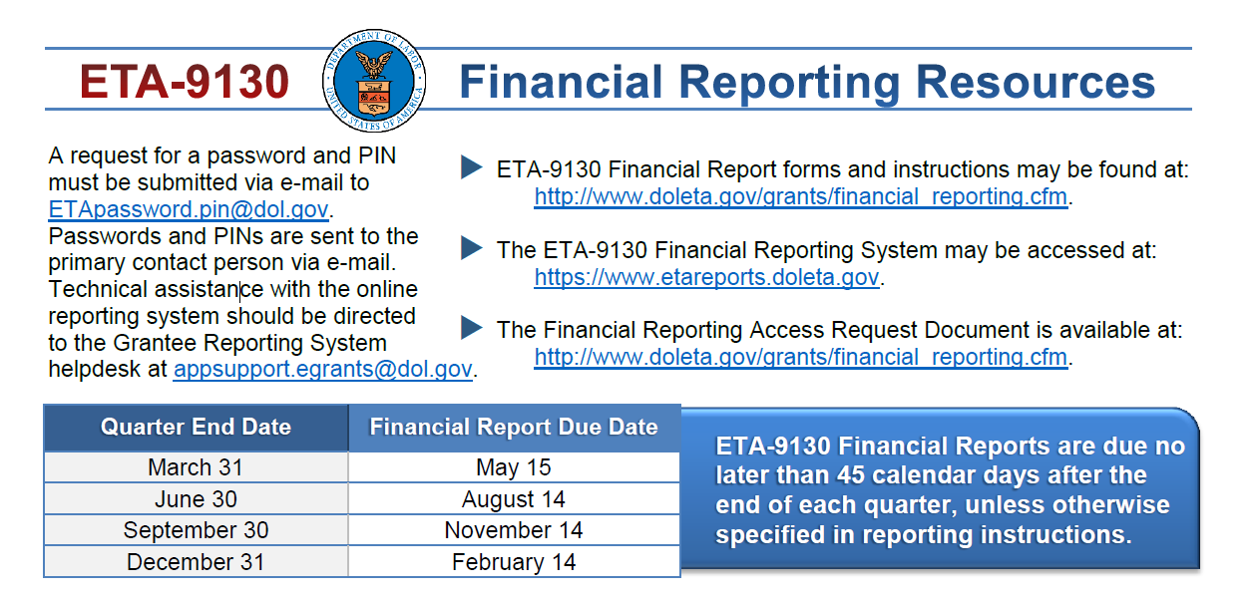
Quarterly Financial Report
Each grantee must submit a Quarterly Financial Report (ETA 9130), due no later than 45 days after the end of a quarter
Use the Grantee Reporting System to submit QFR
46

Slide 47
Grant Agreement
SF-424 – Attachment A
Budget Information
  SF-424A – Attachment B
  Budget Narrative – Attachment C
Statement of Work - Attachment D
  Project Narrative
  Abstract
  Project Work Plan
  Performance Outcomes Table
  Documentation of Partnership Commitments

Slide 48
Indirect Cost Rate Agreement
Attachment E - only applicable to those claiming indirect costs
If grantee is claiming indirect costs but did not provide agreement, placed on 90-day temporary rate
Applicants missing indirect cost rate agreements or submitting expired ones limited to lesser of either total claimed indirect costs or 10% of total Personnel budget

Slide 49
Any Questions?

Slide 50
Grant Modifications
Requests, Review Process
Steven Canger, OGM
50

Slide 51
Grant Modifications
What is a modification?
Why do a modification?
What are modification indicators?
FPO Modification Analysis
  Reasonable
  Performance
  Best interest of the government
51

Slide 52
What is a Grant Modification?
Mechanism to Change the Terms of the Grant Agreement
52

Slide 53
Why do a Modification?
Change of Scope
  {Very rare & only minor changes will be considered}
Program Design
    Service Area
    Change in Partners (outlined in compliance notification)
    Key Personnel Changes
53

Slide 54
FPO Modification Analysis
Grant Quality
  Services
  Staffing
Grant Efficiency
  Timely
  Cost Effective
Grant Performance
  Enrollments
  Expenditures
Benefit to the Government’s Goals for the Grant Program
54

Slide 55
Required Documentation for Modification Requests
Must be submitted on Organization’s Letterhead
Must be signed by the Authorized Representative
Provide the purpose
Why it’s necessary
How the change will benefit the program
Appropriate documentation to support Modification
55

Slide 56
Modification Process
Write a formal letter of request addressed to your Grant Officer.
Include modification type, grant number, and justification for request.
Submit the final letter, signed by your signatory to FPO, who then forwards to the Grant Officer.
Formal review and execution of approved modification.
Discuss potential mod with your FPO.
56

Slide 57
POP QUIZ!
You would like to add a new industry or occupation to your grant.
Which answer provides the best response that describes the process for submitting a Grant Modification?
A
Launch the program in the new industry and begin enrolling participants.
C
Reach out to your FPO to discuss the need for your request.
Write a formal letter of request to the Grant Officer which provides a justification. Have the Authorized Representative sign and submit the request.
Reach out to your partner organizations to determine if the new industry or occupation is in-demand.
B
D
57

Slide 58
Any Questions?

Slide 59
Performance Reporting Guidance

Slide 60
The Value of Reporting
Department of Labor
SCC Grants
Report the success of high profile programs to Congress, Administration, OMB, GAO, etc.
Inform the design of future grant investments
Demonstrate the impact of these grant investments
Capture effective program design models and service delivery strategies.
Demonstrate grant outcomes to investors and partners
Illustrate Return on Investment (ROI) to employer partners
Build additional strategic partnerships and leveraging resources
Sustainability of the project and partnership
Continuously improve program design to meet the needs of participants

Slide 61
Strengthening Community College Performance Reporting Requirements
Grantees are required to submit performance progress reports quarterly to ETA. The performance requirements depends on the type of SCC grantee:
  Final Report
    QPR and QNR submitted at the end of the grant
Single Institution | Consortium
Quarterly Performance Report (QPR) | N/A
Quarterly Narrative Report (QNR) | Quarterly Narrative Report (QNR)
Suggested Customized Outcomes Report | Suggested Customized Outcomes Report

Slide 62
Quarterly Progress Reports
Submitted to ETA using the Workforce Integrated Reporting System (WIPS)
Quarterly Progress Reports
  Quarterly Performance Report (QPR)
    Single Institution Grantees should prepare to track and collect participant-level data for the QPR.
  Quarterly Narrative Report (QNR)
    Single Institution and Consortium Grantees
    Includes the suggested Customized Outcomes Report
WIPS
QNR
QPR
Suggested Customized Outcomes Report
Participant Data File Upload

Slide 63
Performance Measures For Single Institution Grantees
Single institutions must track and report participant level data for a select cohort of students throughout the grant period of performance using DOL’s Workforce Innovation Performance System.
SCC1: Participant Cohort Students Who Begin Education/Training | SCC5: Students Who Enter Unsubsidized Employment
SCC2: Students Who Complete the Cohort Program of Study | SCC6: Students Who Enter Training-Related Employment
SCC3: Students Who Complete the Cohort Program of Study and Receive a Credential | SCC7: Incumbent Workers That Retain Current Position
SCC4: Credentials Received by Students Enrolled in the Cohort Program of Study | SCC8: Incumbent Workers That Advance into New Position
These outcomes are reported using participant level data that is uploaded in WIPS and aggregated into the QPR.

Slide 64
Customized Outcomes For Single Institution Grantees
Single institutions must report against their proposed project outcomes as it aligns with Core Elements 1-4
Core Element 1: Evidence-based Design
Core Element 2: Sector Strategies and Employer Engagement | Outcome Area 2a: Increase in the level and depth of employer engagement and investment in educational and training programs.
Core Element 3: Enhanced Career Pathway Programs and Accelerated Learning Strategies | Outcome Area 3a: Design or implementation of new, accelerated instructional techniques or technologies, including the use of advanced online and technology-enabled learning.
Core Element 4: Strategic Alignment with Workforce Development System | Outcome Area 4a: Increase in program and policy alignment across systems and/or decrease in duplicative services or service gaps

Slide 65
Customized Outcomes For Consortium Grantees
Consortium leads must report against the proposed project outcomes as it aligns with Core Elements 1-5
Core Element 1: Evidence-based Design
Core Element 2: Sector Strategies and Employer Engagement | Outcome Area 2a: Increase in the level and depth of employer engagement and investment in educational and training programs Outcome Area 2b: Percent of employers that change policies to better support work-based learning opportunities and/or employment, retention, and advancement of career pathways participants
Core Element 3: Enhanced Career Pathway Programs and Accelerated Learning Strategies | Outcome Area 3a: Design or implementation of new, accelerated instructional techniques or technologies, including the use of advanced online and technology-enabled learning Outcome Area 3b: Measure of restructuring or alignment of educational and training programs based on local or regional labor market data
Core Element 4: Strategic Alignment with Workforce Development System | Outcome Area 4a: Increase in program and policy alignment across systems and/or decrease in duplicative services or service gaps Outcome Area 4b: Development of new and/or expanded partnerships among key system actors that results in streamlined or expanded services for participants

Slide 66
Customized Outcomes For Consortium Grantees
Consortium leads must report against the proposed project outcomes as it aligns with Core Elements 1-5
Core Element 5: Innovative Systems Change Option A: Accelerated Learning Pathways | Outcome Area 5a: Measure of removing significant systemic barriers career pathways participants Outcome Area 5b: Increase in linkages developed throughout a career pathway to encompass bridge programs, career and technical training programs, and work-based training
Core Element 5: Innovative Systems Change Or Option B: Statewide Data Integration/ Use | Outcome Area 5c: Increased access to available data on stakeholders’ activities, outputs, and outcomes Outcome Area 5d: Evidence of effective data sharing and data management

Slide 67
Interim Reporting Process for the Quarter Ending 03.31.21
Grantees will submit a Quarterly Narrative Report (QNR) to ETA
  Interim reporting guidance
  Report program activities from February 1 - March 31 using the OMB-Approved QNR Template
  Submit the QNR by EMAIL to FPOs and the SCC grant mailbox SCC@dol.gov no later than the performance reporting due date of May 14, 2021
  This interim guidance is only for the quarter ending
  March 31, 2021

Slide 68
Additional Reporting Guidance for Future Quarters
Reporting Quarter: 6/30/21
Interim Reporting Guidance and access to WIPS
Guidance on the customized outcomes for each core element using a suggested template.
The QNR and suggested Customized Outcomes report will be submitted in WIPS.
Reporting Quarter: 9/30/21
Reporting Policy Guidance for all future reporting quarters
QPR, QNR, Suggested Customized Outcomes template will be submitted in WIPS.
Single Institution Grantees must still collect participant-level data as it aligns with the required reporting elements for all participants served as of the start of the grant.
The first QPR will be submitted for the quarter ending September 30, 2021.

Slide 69
Quarterly Progress Report: Key Performance Deadlines
Quarter ending March 31
QNR
Quarter ending June 30
Due May 14
Submit via Email
Due August 15
QNR + Suggested Template
Quarter ending September 30
QPR (Single Institution Grantees only)
Due November 15
Submit in WIPS
Submit in WIPS
QNR + Suggested Template
  Quarterly Progress Reports will be submitted in WIPS for all future quarters starting with the quarter ending 9.30.21

Slide 70
Quarterly Progress Report: Key Performance Deadlines
Reminder: Quarterly Progress Reports
  Due no later than 45 days after the end of a quarter
  More information and training will be provided
Quarter End Date | Progress Report Due Date | Report Activities Occurring Between
March 31 | May 14 | January 1 – March 31
June 30 | August 15 | April 1 – June 30
September 30 | November 15 | July 1 – September 30
December 31 | February 14 | October 1 – December 31
Your 1st progress report is due no later than May 14, 2021
Covers activities from February 1 through March 31st

Slide 71
Any Questions?

Slide 72
Communication
Communication Plan, Point of Contact and Community of Practice

Slide 73

Your Primary Point of Contact (POC)
Role of POC
Receives communication from ETA
Is responsible for sharing information with project team and consortium members
Any time the main point of contact for your grant changes, please remember to contact the Federal Project Officer (FPO) and Program Office by email.

Slide 74
Communication Plan
YOU
ETA
Always contact your FPO first if you have questions.
If you… | Contact:
Are the grant lead (POC) | FPO
Are a member of a grant project | The lead for your grant
Have questions or difficulty accessing the performance reporting system | https://www.doleta.gov/performance/wips/WIPS_Technical_Assistance_Request.cfm
Have questions or difficulty accessing the financial reporting system | EBSS.help@dol.gov, with a copy to your FPO
Have questions about evaluations | SCC@dol.gov with a copy to your FPO

Slide 75
Communication Guidelines
YOU
ETA
When you communicate with your FPO, etc.:
Copy the SCC mailbox at SCC@dol.gov, if appropriate
Include your grant number and lead grantee organization name
Describe your question or issue in detail
Please be patient!

Slide 76
ETA Communications to You
ETA
YOU
Program Office staff may send periodic guidance and other communications through the SCC Mailbox.
Your FPO or Program Office staff may contact you for specific requests and information.
ETA posts information on the WorkforceGPS.org Community of Practice site.
  https://collegeconnection.workforcegps.org/
ETA shares new information on its website.
  https://www.dol.gov/agencies/eta/skills-training-grants/scc
Please make sure your email system does not confuse our communication as spam.

Slide 77
Technical Assistance Needs

Slide 78
Technical Assistance Needs
The compliance review process provides us an opportunity to identify potential technical assistance needs.
The Program Office will be developing a technical assistance plan for the grant over the next quarter.
At present, we expect to have the following TA resources:
  A TA-to-PA hire
  Limited TA contract
  Limited coaching based on need (not assigned for entire period)
We will provide more information on the TA plan and rollout as it is developed.
Please help us identify any TA topics that you feel would be valuable to the grantees

Slide 79
What technical assistance topics would you like to see in the next year?
Let’s CHAT!

Slide 80

Next Steps
Respond to Conditions of Award in your Grant Award Package (send to FPO, cc) (if you have any)
Review the DOL Fiscal Training Tutorials from the SMART 3.0 Webinar Training Series
Review the Grantee Handbook and RISE Modules
Review the DOL Performance Reporting Requirements
Refer to the Funding Opportunity Announcement as needed
Update your grant’s Point of Contact(s) as needed
Get to know your FPO and ask questions!

Slide 81
Any Questions?

Slide 82
Thank You!
Need help? Email: Support@workforceGPS.org

