Slide 1
Please Let Us Know Who Has Joined Today’s Webinar
Please enter your name, organization and state in the chat window
  (lower left of screen)
Please also complete this short polling question to let us know which of these categories best describes your organization:
Title I or III PACIA
Title II PACIA
Title IV PACIA
Other

Slide 2
State Wage Interchange System (SWIS)
PACIA Data Transmission Training

Slide 3



Today’s Moderators
Toquir Ahmed
  Workforce Analyst
  Office of Policy Development and Research, Employment and Training Administration, U.S. Department of Labor
Bruce Rankin
  Technical Assistance Lead
  SWIS Administration Team, CDS²

Slide 4


Today’s Speakers
Lynda Weber
  Statewide Manager Data Quality
  Division of Workforce Development and Adult Learning
  Maryland Department of Labor
Cynthia Binkley
  UI-ICON Project Manager
  Conduent, Inc.

Slide 5
Federal Representatives
Participating and available for questions:
  Titles I & III: Greg Wilson, Supervisory Workforce Analyst, Office of Policy Development and Research, Employment and Training Administration, U.S. Department of Labor
  Title II: Jay LeMaster, Education Program Supervisor, Office of Career, Technical and Adult Education, U.S. Department of Education
  Title IV: Andrea Hall, Vocational Rehabilitation Program Specialist
  Office of Special Education and Rehabilitative Services, Rehabilitation Services Administration, U.S. Department of Education

Slide 6
Today’s Training Objectives
Provide a Step-by-Step Review of the PACIA Data Transmission Process from the Initial Request to Reporting
  Insights and best practice recommendations from a PACIA operator
  Revisit Clearinghouse operations – what happens when they receive a request
Conduct a Q & A session to address common topics and anything new raised by the participants

Slide 7
The First Step: Create the Request File
What does the request file include?
  SSNs, just SSNs of all exiters
Where are these participant records captured?
  Participant records from the case management system
What is the format required by the SWIS Clearinghouse
  Text file

Slide 8
Confirm and Review the Contents of the Request File
Before transmitting the file, review the contents
Consider a data quality check or “scrub”
  Remove duplicates and non-conforming SSNs
  Confirm total number of requested records is consistent with past requests
  Other considerations
    Keep email chain, check records number submitted and date to be returned

Slide 9
Transmit to the Clearinghouse
PACIA Transmission
  Log on to the Clearinghouse portal
  Create a new request, and name the request
  Request “need by” date
    at minimum 7 working days, for Maryland we make a request by the 4th following a quarter end for a return file by the 15th
  Select All Quarters to search for wages
  Select All Participating States to search for wages from
  Upload file, ensure the correct file is being uploaded
  Click Submit
  Review confirmation email from the Clearinghouse

Slide 10
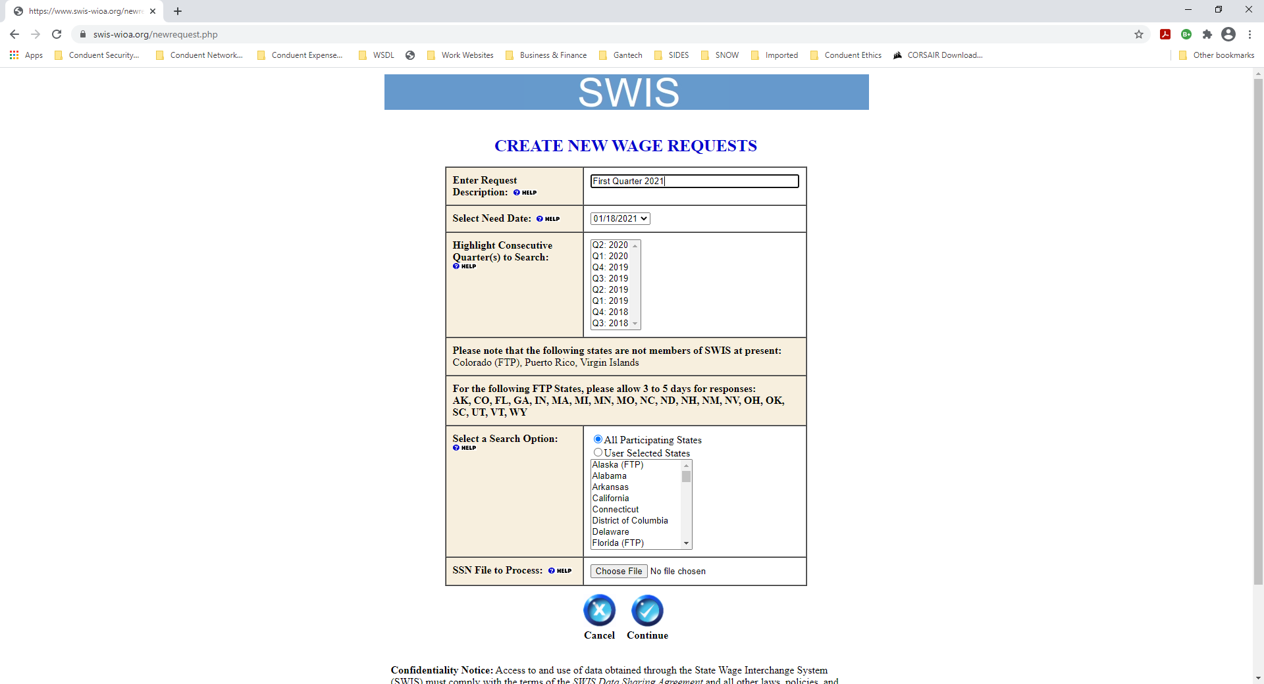
PACIA Creates a SWIS Wage Record Request
Enter a Description of the request
Select a Need Date: default is 2 weeks (14 days). However, you can override the need by date but allow three to five business days allowing time for a state to respond.
Consecutive Quarters: Use the mouse to highlight fiscal quarters from the selection box; you must select consecutive quarters. with the left mouse button while pressing the SHIFT key. You can select multiple quarters from the box by dragging the mouse with the left button depressed, or by clicking on quarters Highlighted quarters denote that you wish to receive wage records for those periods.
Select a search option: Allow SWIS to search the DDBI to identify all states that have wage data associated with the SSN’s submitted in the Request by selecting All Participating States, or you may select states individually.
Upload the SSN File to Process that contains the SSNs for which you are seeking wage information. The SSN file should come from your local or network drive.
The SSN file should be an ASCII text file. The text file should contain nine-digit numeric data on each line, nothing else should be listed in the file or it will be rejected. Only SSN’s should be in the ASCII text file, nothing else.
  Please ensure that the SSNs you submit are valid. According to the Social Security Administration Website, SSNs may not have zeros in positions 4 through 9. The first three positions may not be all zeros or greater than 772. Also, SSNs of all 1’s, 2’s, 3’s (and so on) are invalid. By validating the SSNs prior to submission, you decrease the transmission and processing time associated with invalid SSNs.
  The file can be uploaded as is or can be compressed using a zip utility.
Click the Continue button.

Slide 11
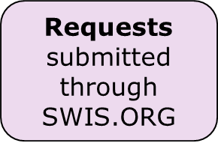
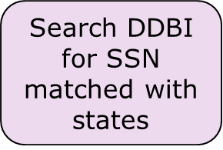

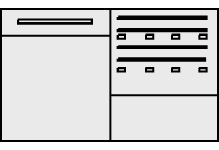

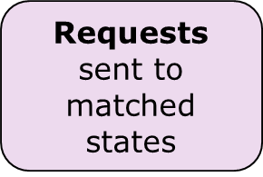

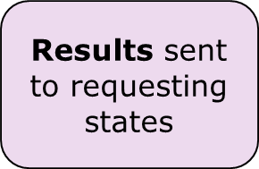

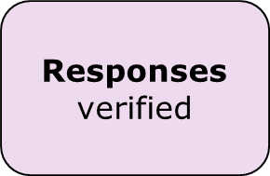
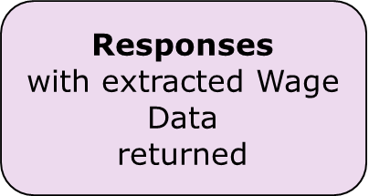

SWIS Clearinghouse Operations

Slide 12
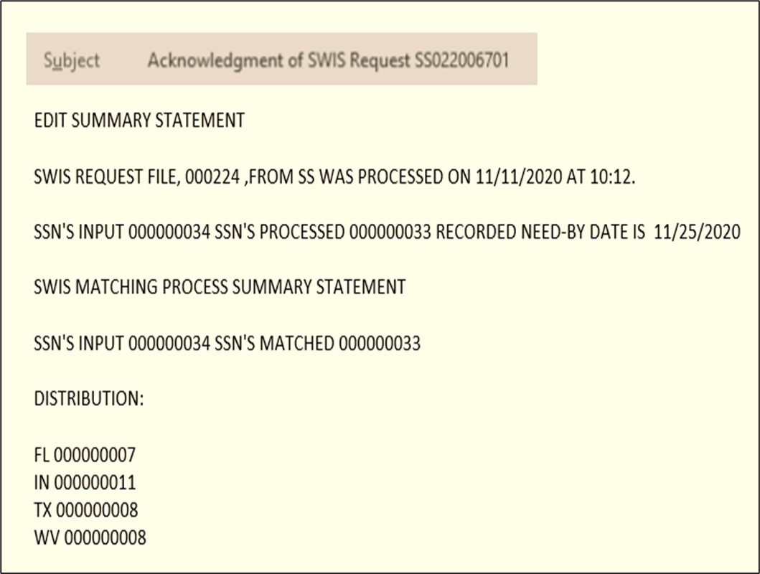
PACIA E-Mail Confirmation
PACIA submits SWIS request
PACIA receives an e-mail from Clearinghouse. See example to the right
This email tells the PACIA several things;
  Date the request was processed 11/11 at 10:12.
  Number of SSN’s processed 33
  Need By Date 11/25 (meaning this is the date the request will be returned to the PACIA.
  The Summary Statement shows 34 SSN’s were submitted; however, when matched against the DDBI database only 33 SSN’s were found for the following states, FL, IN, TX, and WV.
  Of the 33 SSN’s Clearinghouse sent FL 7 SSN’s, IN 11 SSN’s, TX 8 SSN’s, and WV 8 SSN’s.

Slide 13
Wage Records Contents – What’s in the Response File
Wage Data is confidential UC information under 20 CFR Part 603.
Wage Data from SWIS
Wage Data are individually-identifiable information reported quarterly by employers.
Wage Data include, but are not limited to:
Social Security Numbers (SSNs)
Wages
Employer Name
Employer Address
Federal Employer Identification Numbers (FEINs)
North American Industry Classification System (NAICS) codes
Quarter and Year for Reported Wages
State Postal Code
13
Reference Section V, SWIS Agreement

Slide 14
Download the Response File
Receive email notice that the data file is ready
Log on to the Clearinghouse to retrieve the data file
  Download to a secure, limited access folder on the agency network
  Only the SWIS Operator and one other state employee have access to this file
Other considerations:
  Review the email summary which details a by state result
  If any state comes back as 0 returns, inform SWIS and create a new request for those states

Slide 15
Process Wage Data from SWIS
Confirm data file is complete and conduct quality check
  Flag duplicate entries and unusually high reported wages
  Review individuals with reported wages in multiple states
Add SWIS wages to database/case management tool used to support federal performance reporting
  Note best practice of limiting access to these wage data
  If a contractor has access, make sure that access and use is consistent with the DSA
  Retain a log of where wage data from SWIS are stored
Other considerations:
    Details of SWIS file deletion should be maintained

Slide 16
Complete Federal Performance Reporting/PIRL/SIR/RSA 911
Use SWIS Data in PIRL or RSA 911 Reporting
  PIRL/SIR development steps
  Upload to WIPS/Error Checking
Other Considerations:
  States can prepare aggregate data reports from Wage Data received through the SWIS Clearinghouse, for use in preparing program performance reports and individual records (the PIRL data) for DOL
  States (Title II) can use aggregate data to complete federal reporting for Perkins and Adult Education

Slide 17
Archive Wage Records/Implement Retention/Deletion Process
Archive Wage Data from SWIS
  SWIS DSA specifies no longer than five years (shorter is better)*
  Applies to all copies of the Return File and individual records saved in data management systems
  Best practice to have a documented process for data retention and deletion that is specific to SWIS
Other considerations:
  Prepare clear instructions of rules surrounding SWIS for your contractors. Sometimes contractors have different insight if rules are not clear.
  Confirm case management systems mask individual wage records obtained through SWIS – local service providers are not permitted to see or access these records.
* Note: If a state has identified a requirement to keep Wage Data longer than 5 years, the first step is that the state provide information (to DOL or ED) about that legal requirement and describe how the retention of SWIS Wage Data is impacted. The details of specifically why the Wage Data is needed and in what format it will be maintained will likely be helpful to understanding the issue.

Slide 18
Questions/Review
Q & A with the Presenters
New Topics?

Slide 19
SWIS Resources
General information on SWIS can be found on the DOL/ETA Web site:
  https://www.dol.gov/agencies/eta/performance/swis
General information on performance reporting can be accessed through the WorkforceGPS Community:
  https://performancereporting.workforcegps.org/home/
SWIS Town Hall 9-29-2020: https://www.workforcegps.org/events/2020/08/27/14/19/State-Wage-Interchange-System-SWIS-Town-Hall
SWIS Orientation Training 7-15-2020 Session
  https://www.workforcegps.org/events/2020/06/22/16/07/~/link.aspx?_id=363119CD9F22493CB2EC61371FEA91E2&_z=z
SWIS Informational Webcast 4-23-19: https://www.workforcegps.org/resources/2019/05/14/15/12/State-Wage-Interchange-System-SWIS-Informational-Webcast
SWIS Operational Handbook (available only with a Clearinghouse Access Account

Slide 20
Save the Date
SWIS Advisory Group Q1 Call
  Quarterly webinar to discuss topics of common interest and share program updates
    March 4, 2021
TBD 2021 – SWIS Topics of Interest Webinar/Town Hall/Training

Slide 21
Contact Us
Remember – You can reach us several ways:
For administrative and policy questions
  State workforce agencies: SWIS@dol.gov
  State adult education agencies: NRS@ed.gov
  State VR agencies: RSAData@ed.gov
  SWIS Administration Contractor: SWIS@cds2.com
For operational questions
  SWIS Clearinghouse Contractor:
  SWIS-WIOA.Support@conduent.com

Slide 22
Thank You!
Need help? Email: Support@workforceGPS.org

