Slide 1
Poll:
What type of organization do you represent?
State Government Agency
Local Government Agency
Training Provider
Federal Government Agency
Other

Slide 2
Eligible Training Provider (ETP) Webinar Series
Part 2: Performance Reporting and trainingproviderresults.gov

Slide 3
Today’s Moderator
Christina Eckenroth
Workforce Analyst
Employment and Training Administration
US Department of Labor

Slide 4
AGENDA
ETP Performance Reporting
Introducing trainingproviderresults.gov
Hot Topics
Questions and Answers

Slide 5
Today’s Speakers
Cesar Acevedo
Workforce Analyst
Employment and Training Administration
US Department of Labor
Kellen Grode
Workforce Analyst
Employment and Training Administration
US Department of Labor

Slide 6
ETP Performance Reporting

Slide 7
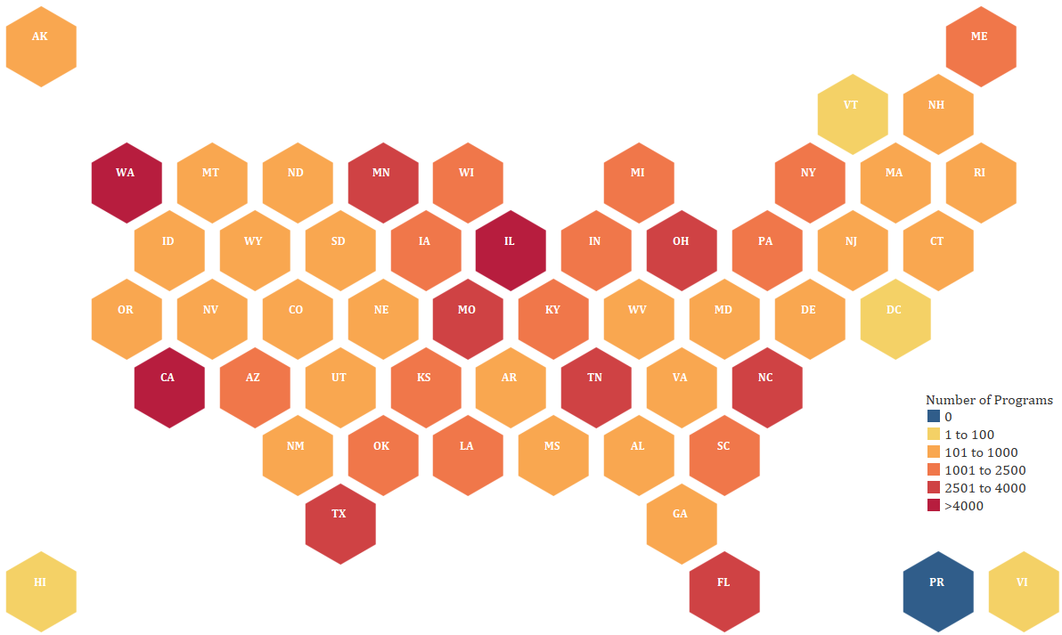
PY 2019 Snapshot of ETP Performance
Number of Programs Reported by State
Total Number of Providers Nationwide: 7,389
Total Number of Programs Nationwide: 74,501

Slide 8
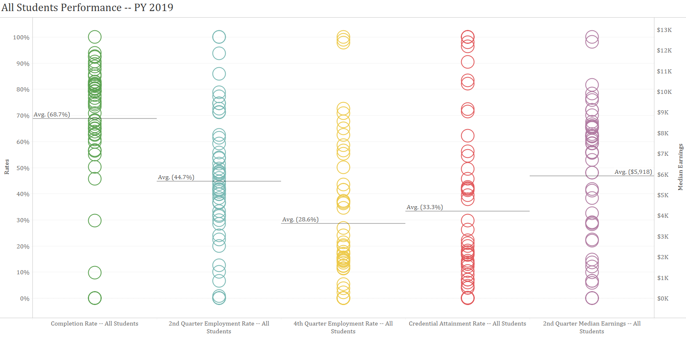
PY 2019 Snapshot of ETP Performance

Slide 9
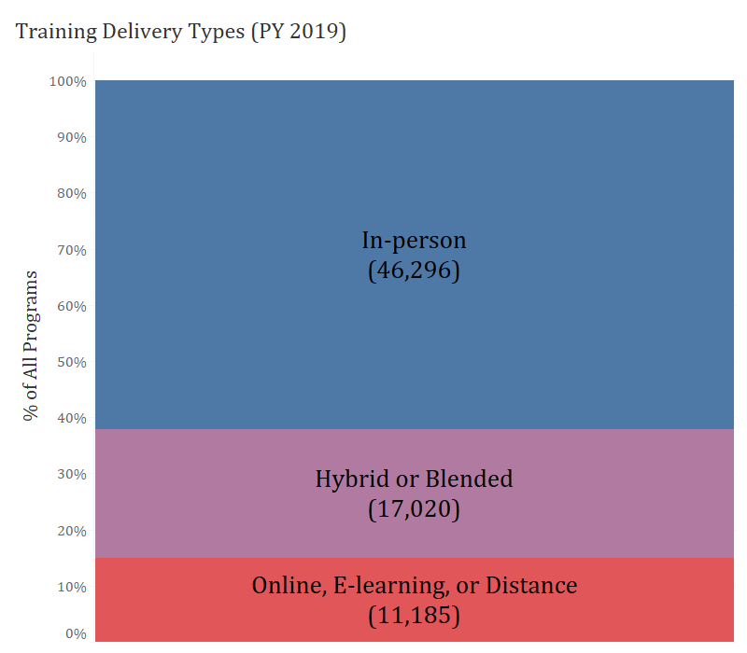
PY 2019 Snapshot of ETP Performance
Increase in hybrid or online programs in the last year

Slide 10
Refresher
Reporting requirements outlined in detail in Training and Employment Guidance Letter (TEGL) 03-18
ETA hosted two webinars in 2018 that did deep dives on the reporting requirements, which can be found on the ETP Resource Page: https://performancereporting.workforcegps.org/resources/2018/09/11/14/58/Eligible-Training-Provider-ETP-Resource-Page

Slide 11
Refresher on Requirements
1
Types of information included in the reports:
Basic program info: description, cost, url, address, credentials, provider information.
“All Students” outcome information
WIOA participants outcome information
WIOA participants demographic information
Reports must include record for each program on the list
Reports will continue to build towards containing years of data (reporting year + 3 previous years)
4

Slide 12
Common reporting challenges
Duplicate records
Reporting that does not always equate to a training program
e.g. reporting on a single class or course, such as “intro to MS Word” or “OSHA 10” or “Accounting 101”
Incorrect Cost Per WIOA Participant

Slide 13
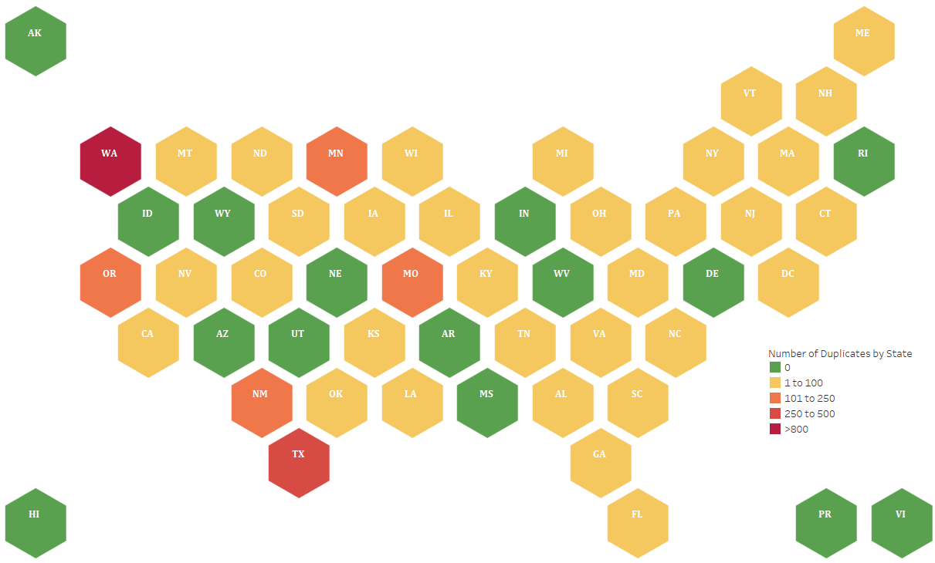
Duplicate Records
Number of Duplicate Entries
Complete record duplicates and duplicates by reporting state and DEs 101, 102, 103, 105, and 106 were removed before populating the website.

Slide 14
Reporting of Individual Classes or Courses

Slide 15
Reporting of Individual Classes or Courses

Slide 16
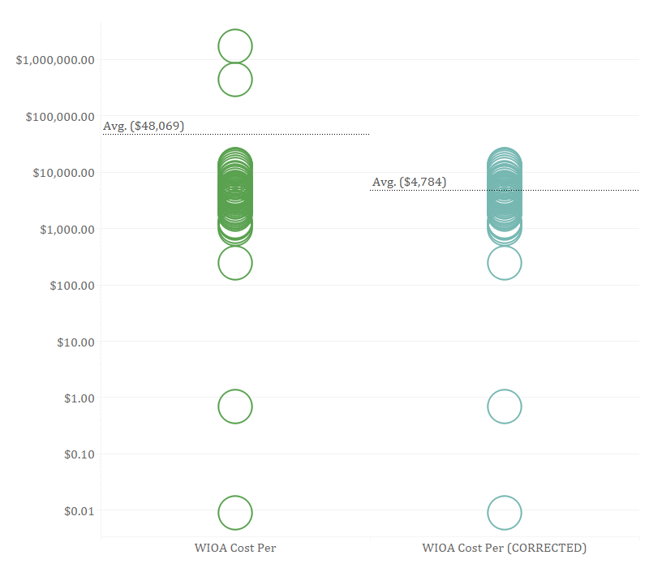
Cost per WIOA Participant Results (PY 2019)
Cost per WIOA Participant Results
The current instructions for DE 138 in the collection (ETA-9171) are ambiguous and some states reported this information incorrectly.
The revised ICR will clarify these instructions.

Slide 17
ETP Re-submission Window (one-time only!)
For PY 2019 ETP reports only, ETA will allow states to re-submit their reports if they have discovered and corrected issues with their original reports.
Re-submission is optional, and must take place during the 60-day resubmission window.
Re-submission window opens on 1/4/2021
Re-submission window closes on 3/5/2021
ETA will use resubmitted data to refresh trainingproviderresults.gov

Slide 18
Proposed Changes to Information Collection Request (ICR)
Breaking out the Address element into multiple elements to fit standard practices
Adding denominator elements that correspond to the outcome cohorts
Element name/definition clarifications
Other minor changes based on public feedback

Slide 19
Introducing trainingproviderresults.gov
Improving Informed Consumer Choice

Slide 20
What is trainingproviderresults.gov?
A resource to help job seekers find the right job training and help further the workforce system’s mission of providing high-quality job training and enhanced employment opportunities to the American workforce.
Help individuals make informed career training choices based on the program’s completion and employment results
Help individuals make the best use of their Individual Training Account (ITA) funds
Assist American Job Center staff compare the quality of programs offered by approved training providers

Slide 21
Website demonstration

Slide 22
Hot Topics
Waivers and Online Training

Slide 23
Waivers
ETP “All Students” Reporting Waiver Ending June 30, 2021.
This means that PY20 will be the last year this waiver for reporting exists.
Remember that even if you have the waiver, all programs must still be included in your reports, and the “all students” numbers should be greater than or equal to the corresponding WIOA numbers.
Reminder: Annual Narrative Reports should include discussions of waiver outcomes, which can include a discussion of the plan or process for being able to meet the requirement without the waiver.

Slide 24
A Note About Out-of-state and Online Training Providers
Virtual Training Programs are permitted on the ETP list.
Physical location in the state is not required by WIOA.
Provider not Platform

Slide 25
Questions?
Please enter your questions in the chat.
Today’s presenters as well as other DOL National and Regional Office staff are standing by to answer and discuss.

Slide 26
Resources:
TEGL 03-18
Eligible Training Provider (ETP) Reporting Guidance under the Workforce Innovation and Opportunity Act (WIOA)
https://wdr.doleta.gov/directives/corr_doc.cfm?DOCN=3527
ETP Resource Page
ETP Eligibility and ETP Performance Resources
https://performancereporting.workforcegps.org/resources/2018/09/11/14/58/Eligible-Training-Provider-ETP-Resource-Page
Training Provider Results
Searchable website to compare ETP Programs.
Trainingproviderresults.gov
TEGL 08-19 Introductory Webcast Series and Additional Resources
Webcasts and Resources Relating to ETP Eligibility
https://performancereporting.workforcegps.org/resources/2020/04/10/19/18/TEGL-08-19-ETP-Eligibility-Introductory-Webcast-Series-and-Additional-Resources
Eligible Training Provider (ETP) Webinar Series Part 1: Eligibility and TEGL 08-19
Staff from the U.S. DOL National office, U.S. DOL Regional offices, and state grantees will discuss a variety of topics relating to ETP Eligibility.
https://www.workforcegps.org/events/2020/10/23/12/02/Eligible-Training-Provider-amp-35-40-ETP-41-Webinar-Series-Part-1-Eligibility-and-TEGL-08-19

Slide 27
Upcoming Event Later Today!
Learning and Leading: Service Delivery to Job Seekers in a Virtual Environment
Wednesday, December 16, 2020 2:00 PM ~ 3:30 PM ET
https://www.workforcegps.org/events/2020/12/08/12/20/Learning-and-Leading-Service-Delivery-to-Job-Seekers-in-a-Virtual-Environment
With the decreased ability to deliver in-person services during the COVID-19 pandemic, workforce and training organizations have met this challenge through delivering online services. This webinar will highlight promising practices and feature organizations that have successfully used virtual platforms to deliver workforce development services to jobseekers.

Slide 28
Thank You!
Need help? Email: Support@workforceGPS.org

