Slide 1
Implementing Priority of Service Provisions for Most in Need Individuals in the WIOA Adult Program
TEGL 07-20

Slide 2

Today’s Speaker / Today’s Moderator
Kimberly Vitelli
  Administrator of Office of Workforce Investment
    U.S. Department of Labor, Employment and Training Administration

Slide 3
Today’s Agenda
Introductions of Presenters
Opening Remarks
WIOA Adult Program Priority of Service Vision and Requirements
Monitoring WIOA Adult Priority of Service Requirements Using Performance Data
Improving Service Delivery and Leveraging Additional Resources to Support WIOA Adult Priority Populations
Questions and Answers

Slide 4

Today’s Speakers
John Pallasch
  Assistant Secretary for Employment and Training
    U.S. Department of Labor

Slide 5



Today’s Speakers
Cesar Acevedo
  Workforce Analyst
    U.S. Department of Labor, Employment and Training Administration
Patrick Dennis
  Workforce Analyst
    U.S. Department of Labor, Employment and Training Administration
Kellen Grode
  Workforce Analyst
    U.S. Department of Labor, Employment and Training Administration

Slide 6
Tell us about yourself
What type of organization do you represent?
State Workforce Agency or Board
Local Workforce Agency or Board
One Stop Operator or Workforce Development Provider
Other (type in your response in the chat box)
Select an answer
if “Other” type in your response in the chat box.

Slide 7
Opening Remarks
  John Pallasch
  Assistant Secretary for Employment and Training
  U.S. Department of Labor

Slide 8
WIOA Adult Program Priority of Service Vision and Requirements
Training and Employment Guidance Letter 07-20

Slide 9

Priority Population or Individuals with Barriers to Employment?
The first purpose listed in WIOA is
  “To increase, for individuals in the United States, particularly those individuals with barriers to employment, access to and opportunities for the employment, education, training, and support services they need to succeed in the labor market.”
WIOA sec. 3(24) defines the 14 groups that are considered to be individuals with barriers to employment.
Though related, WIOA establishes three groups that must receive priority of service in the WIOA Adult program.

Slide 10
What is the WIOA Adult Program Priority of Service Requirement?
WIOA sec. 134(c)(3)(E) requires that American Job Center (AJC) staff, when using WIOA Adult program funds to provide individualized career services and training services, must give priority of service to:
  recipients of public assistance,
  low-income individuals, and
  individuals who are basic skills deficient (including English language learners).
AJC staff must prioritize services to these populations at all times, regardless of the amount of funds available to provide services in the local area.
WIOA requires states to develop criteria, policies, and procedures for applying this priority, including monitoring local areas’ compliance with this priority provision (see 20 CFR 680.600 and TEGL 19-16).

Slide 11

How does this relate to Veteran’s Priority of Service requirements?
These priorities are in addition to the requirements that veterans and their eligible spouses receive priority of service for all DOL-funded job training programs.
Priority must be provided in the following order:
  First, veterans and eligible spouses who are also recipients of public assistance, other low-income individuals, or individuals who are basic skills deficient receive first priority for services with WIOA Adult formula funds for individualized career services and training services.
  Second, individuals who are not veterans or eligible spouses (aka non-covered persons) but who are included in the WIOA Adult priority groups.
  Third, veterans and eligible spouses who are not included in one of WIOA’s Adult priority groups.
  Fourth, priority populations established by the Governor and/or Local WDB.
  Last, to non-covered persons outside the groups given priority under WIOA.

Slide 12
What does it mean to provide “priority”?
There are multiple ways that priority may be provided and demonstrated, but the simplest measure is the percentage of participants receiving individualized career or training services who are from one of the priority populations.
ETA envisions effective implementation of priority of service means 75% of WIOA Adult participants receiving individualized career or training services will be from one or more of the three priority groups.
ETA expects that this rate will be no lower than 50.1% in any state.
Example:
  2000 participants receiving individualized career and training services
  1275 participants receiving individualized career and training services are from priority populations
  Result: 63.75% (meets expectation, misses goal)

Slide 13

What happens if a state is below 50.1 percent?
When a state is determined to be below the 50.1% benchmark, ETA may initiate a review of the state’s policies and practices for priority of service.
ETA will provide technical assistance as needed to support improvement.
Reviews will consider other metrics and evidence of priority of service provision.
States that continue to fall below this benchmark may be subject to existing mechanisms used to address compliance failures (monitoring findings, corrective actions, etc), as appropriate.

Slide 14
Monitoring WIOA Adult Priority of Service Requirements Using Performance Data
Leveraging the Quarterly Report Analysis (QRA) Process

Slide 15
How will ETA monitor this requirement?
ETA has incorporated this metric into our Quarterly Results Analysis (QRA) process.
The QRA will serve as ETA's primary tool for identifying states that may not be in compliance of priority of service requirements.
  As such a failure in QRA priority of service metrics will result in additional inquiry from regional performance specialists, regardless of a state's status as a volunteer pilot state.
The QRA process uses individual records from states’ quarterly performance report (QPR) submissions to calculate this (and other) metrics, which are then shared with states and performance specialists in the ETA regional offices.
ETA performance specialists and federal project officers (FPOs) will also use this information to help inform their monitoring and technical assistance efforts.

Slide 16

Improving Low Outcomes
Low outcomes on this metric can be a result of policy, implementation, or performance reporting.
A key part of the QRA process is identifying if there are problems with the way the data are reported.
  To be successful on this metric, it is important to report accurate information on participant services and demographics. For example, failing to report someone as low-income could result in a lower outcome for this metric even if they rightfully received priority.
While ETA may consider other information and evidence for those that are below the 50.1% benchmark, it may be the case that states need to update their policies and procedures in order to ensure compliance with the WIOA Adult priority of service requirements.

Slide 17
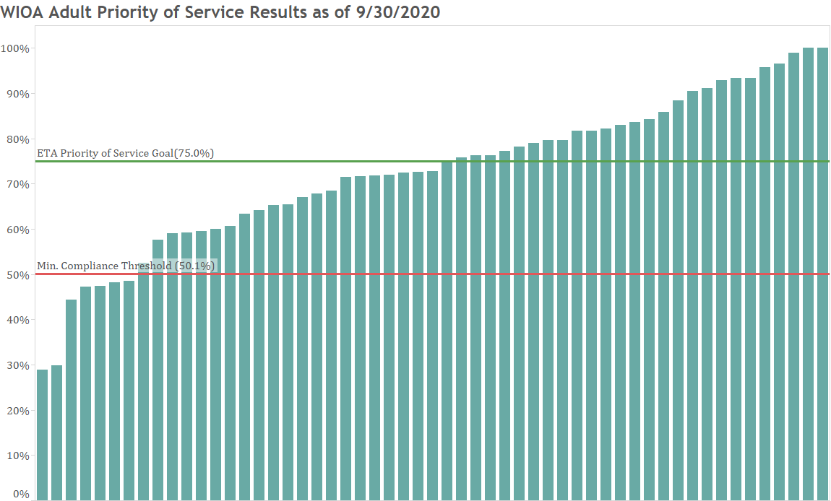
Recent QRA Results
The majority of states are meeting the minimum compliance threshold of 50.1%.
Nearly half of all states/territories are meeting ETA’s Priority of Service Goal of 75.0%

Slide 18
Improving Service Delivery and Leveraging Additional Resources to Support WIOA Adult Priority Populations

Slide 19
A One Workforce Approach to Serving Adult Priority Populations
Planning, aligning, and integrating services across federal, state, and local partner programs is key to ensuring that those most in need receive the services they need to achieve success.
Examples of AJC partners working together towards this objective:
  Cross-train staff from different programs to understand partner programs and to share their expertise about the needs of specific populations.
    WP Act Staffing Flexibility Final Rule lowers barriers to accomplishing this.
  Develop and implement policies that support integrated case management, and use technology to align service delivery across programs wherever possible.
  Partner across programs, including community-based and philanthropic organizations, to effectively maximize necessary services, including supportive services, to those most in need while minimizing duplicative processes and resource use.
  Develop outreach strategies, including referral processes and data sharing agreements, with partner programs to ensure that those most in need are identified and served.
  Encourage, develop, and implement the use of career pathways for those most in need.

Slide 20
Working with Partner Programs to Serve Adult Priority Populations
Context - Local workforce areas that are successful in serving low-income adults often are familiar with the varied publicly-funded and community-based programs that support these jobseekers, as sources of recruitment and as supports for customers.
Strategies - Interventions with evidence of success for low-income individuals are showcased at HHS’s Pathways to Work Evidence Clearinghouse and DOL’s Clearinghouse for Evaluation and Research
  Industry-recognized credentials
  Work-based learning
  Role of case management and high-quality coaching
  Supports to participate in training

Slide 21

Serving Individuals at Risk of, or Experiencing, Homelessness
Providing quality services to individuals at risk of or experiencing homelessness is an important opportunity to strengthen services to the priority populations of the WIOA Adult program.
Attachment I of TEGL 07-20 provides examples of federal funded programs that provide services to individuals at risk of or experiencing homelessness and can provide access to resources and services that may be made available for individuals that are eligible for services under the WIOA Adult program.

Slide 22
Serving Individuals at Risk of, or Experiencing, Homelessness
Programs discussed in Attachment I:
  Homeless Veterans Reintegration Program (HVRP),
  Community Development Block Grant Program (CDBG),
  Continuum of Care Program (CoC),
  The EnVision Center Demonstration,
  Emergency Solutions Grants (ESG),
  Family Self-Sufficiency Program (FSS),
  Family Unification Program (FUP),
  Grants for the Benefit of Homeless Individuals (GBHI),
  Treatment for Individuals Experiencing Homelessness (TIEH),
  Homeless Providers Grant and Per Diem Program (GPD),
  Supportive Services for Veterans Families (SSVF), and
  Transitional Housing Assistance Grants for Victims of Sexual Assault, Domestic Violence, Dating Violence, and Stalking (Transitional Housing Program)

Slide 23
Enter your questions in the chat, and we will try to get to as many as possible.

Slide 24
Resources
TEGL 07-20
  Guidance: Effective Implementation of Priority of Service Provisions for Most in Need Individuals in the Workforce Innovation and Opportunity Act (WIOA) Adult Program.
  https://wdr.doleta.gov/directives/corr_doc.cfm?docn=8675
Attachment I of TEGL 07-20
  Contains a variety of descriptions and links for programs serving individuals at risk of or experiencing homelessness.
  https://wdr.doleta.gov/directives/attach/TEGL/TEGL_7-20_Attachment_acc.pdf
WIOA Partner Websites
  Workforce GPS page with links to WIOA Partner Programs.
  https://ion.workforcegps.org/resources/2015/09/03/16/48/Directory_of_Partner_WIOA_Websites
DOL Data Integrity Page
  DOL page containing additional information on DOL data validation and the Quarterly Results Analysis (QRA).
  https://www.dol.gov/agencies/eta/performance/reporting/data-integrity
SNAP E&T Policy and Guidance
  Resource page to learn more about the SNAP Employment and Training Program.
  https://www.fns.usda.gov/snap/et-policy-and-guidance
Continuum of Care (CoC) Resource Page
  Resource page to learn more about the Continuum of Care program.
  https://www.hudexchange.info/programs/coc/

Slide 25
Upcoming Events on Wednesday!
Eligible Training Provider (ETP) Series Part 2: Performance and New Website
  Wednesday, December 16, 2020 12:30 PM ~ 1:30 PM ET
  https://www.workforcegps.org/events/2020/11/19/14/49/Eligible-Training-Provider-ETP-Series-Part-2-Performance-and-New-Website
  The second year of Workforce Innovation and Opportunity Act (WIOA) Eligible Training Provider (ETP) performance reports were due on October 1, 2020. Join the Employment and Training Administration (ETA) to learn about ETP Performance Reporting Requirements, Program Year 2019 Results, and the Department of Labor’s new website for ETP results and information: trainingproviderresults.gov.
Learning and Leading: Service Delivery to Job Seekers in a Virtual Environment
  Wednesday, December 16, 2020 2:00 PM ~ 3:30 PM ET
  https://www.workforcegps.org/events/2020/12/08/12/20/Learning-and-Leading-Service-Delivery-to-Job-Seekers-in-a-Virtual-Environment
  With the decreased ability to deliver in-person services during the COVID-19 pandemic, workforce and training organizations have met this challenge through delivering online services. This webinar will highlight promising practices and feature organizations that have successfully used virtual platforms to deliver workforce development services to jobseekers.

Slide 26
Contact Us
Questions for us?
      DOL.WIOA@DOL.GOV

Slide 27
Thank You!
Thanks for all your hard work adapting to these challenging times and effectively serving business and jobseekers!
Need help? Email: Support@workforceGPS.org

