Slide 1
Polling Question
Please let us know who is here today:
State workforce agency leadership and staff
State Workforce Board members
State Workforce Board staff
Chief Elected Officials
Local Workforce Board Members
Local Workforce Board Staff
Thanks!

Slide 2
Polling Question
Please let us know what state you are representing:
Connecticut Delaware
District of Columbia Maine
Maryland Massachusetts
New Hampshire New Jersey
New York Pennsylvania
Puerto Rico Rhode Island
Virgin Islands Virginia
Vermont West Virginia

Slide 3
Northeast Region Governance Training
High-impact Strategic Boards
November 19, 2020

Slide 4
Northeast Region Governance Training
October 22, 2020 – The foundations of Governance in the Workforce Innovation and Opportunity Act. Audience - state workforce leaders, state and local workforce board members and staff
November 19, 2020 - High-impact, strategic boards. Audience - State workforce leaders, local workforce board members and staff.
December 10, 2020- Governance Opportunities Audience - state workforce leaders, state workforce board members and staff

Slide 5
One Workforce Vision
USDOL manages an investment of $20 billion dollars in over 2,200 grants.
$17 Billion dollars are invested in programs operated by
$3 Billion is awarded in the form of discretionary grants.
Other public investments in the workforce system.
US Department of Education,
US Department of Agriculture
US Department of Health and Human Services

Slide 6
One Workforce Vision
ETA envisions that all of these investments are part of One Workforce System—an aligned, flexible, and simplified state and local-driven system of workforce services and programs that brings together disparate workforce and education programs with a shared goal of achieving self-sufficiency for American workers and jobseekers.

Slide 7
AGENDA
Four Roles for High Impact Strategic Boards
The Strategist
The Convener
The Manager
The Optimizer

Slide 8
The Four Strategic Roles
ETA has developed a vision for the impact of State and Local WDBs in transforming and improving the workforce system and building a sustaining system for board excellence.
It outlines four strategic roles that all high-performing boards will play. Working together, board members will ensure that the board has the capacity to perform the functions associated with each of these roles.
As you develop and expand your board’s membership, you can use this guidance to recruit members who have specific expertise or interest in one or more of these roles.

Slide 9
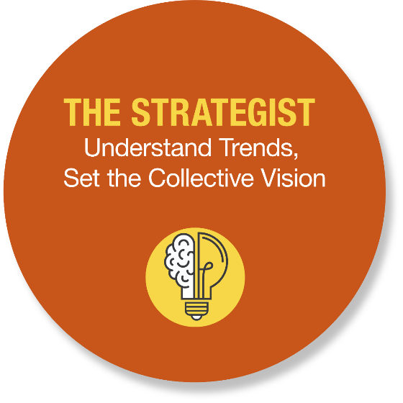
Northeast Region Governance Training
The STRATEGIST

Slide 10
BOARDS AS STRATEGISTS
Understand the demand in the local area (information attained through strong industry sector partnerships);
Respond to demand by developing career pathway systems;
Be aware of trends impacting the business community; and
Develop a vision that meets both current and future needs, as one that anticipates any reasonable challenges that may arise.

Slide 11
STRATEGIC ACTIONS
Setting comprehensive, “big picture” agendas, driven by community success;
Positioning the board to become the regional backbone of the local workforce system; and
Convening regional organizations, partners, and other community resources to implement the collective community vision.

Slide 12
Polling Question
Does your Board have a vision statement?
Yes
No
Are you using the WIOA State Plan to inform your local plan?
Yes
No

Slide 13
Polling Question
How much time does your board devote to Strategic Planning?
No time at All
10% of Board Time
20% -50% of Board Time
More than 50% of Board Time

Slide 14
Challenge
If you do not have a vision statement, create one.
Increase the time the board spends on Strategic Planning by 10%.

Slide 15
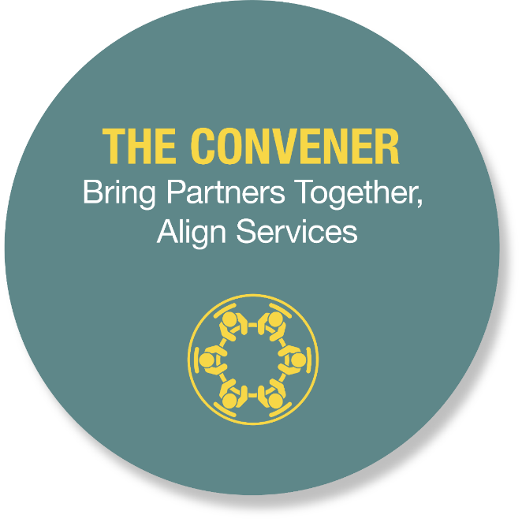
Northeast Region Governance Training
The CONVENER

Slide 16
BOARDS AS CONVENERS
Build and nurture strong local partnerships with community organizations, including business, education, one-stop partners, and economic development associations;
Recognize that they are not the only entity responsible for building a world-class workforce system;
Understand that their strength lies in the ability to set an appropriate vision, convene the right partners, and broker a comprehensive set of solutions for business and job seeker customers; and
Develop and maintain strong workforce development board meetings.

Slide 17
CONVENING ACTIONS
Expanding the use of standing committees and establishing ad hoc committees to address issues and final solutions;
Convening groups to resolve workplace related issues that do not require the participation of board leadership; and
Work with businesses directly to gain information about industry needs and challenges.

Slide 18
Polling Question
How engaged are the Board members in informing and developing the meeting agenda?
Not at all
10% of the board is engaged
20% -50% of the board is engaged
More than 50% of the board is engaged

Slide 19
Peer Feedback
Who are the non-Board members that are part of your Standing Committee? Are they CBOs, Chambers of Commerce representatives, etc?

Slide 20
Peer Feedback
Share one idea on how you would change your board meetings.

Slide 21
Challenge
Have board members create the Agenda items.
Ask at least three different board members per meeting to contribute.
Review your standing committees and determine if the non-board members represent your two customers – job seekers and businesses.

Slide 22
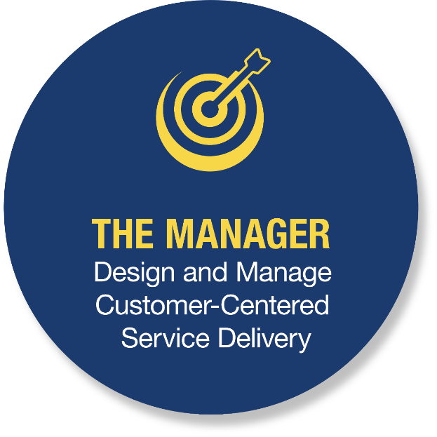
Northeast Region Governance Training
The Manager

Slide 23
BOARDS AS MANAGERS
Design and manage customer-centered service delivery;
Leverage private sector board representation to strengthen the workforce system; and
Conduct oversight of the entire workforce system, ensuring it is functioning efficiently and that funding is being managed responsibly.

Slide 24
MANAGEMENT ACTIONS
Designing and operating a customer-centered system, by establishing both the strategic vision, as well as operational goals, for the local system;
Ensuring that staff listen to customer feedback and incorporate what they learn in delivering services; and
Ensuring responsible stewardship of federal and non-federal funds.

Slide 25
Polling Question
25
Are you utilizing technology effectively and innovatively to manage and deliver services efficiently?
Yes
No
Have you leveraged funds and assets of other state agencies and partners.
Yes
No

Slide 26
Peer Feedback
26
Share one customer-centered design strategy you have implemented.

Slide 27
Challenge
Invite your customers ( job-seekers and business) to your board meetings for feedback sessions.
Conduct asset mapping to determine resources available in the local areas and how to best deploy them in each AJC.

Slide 28
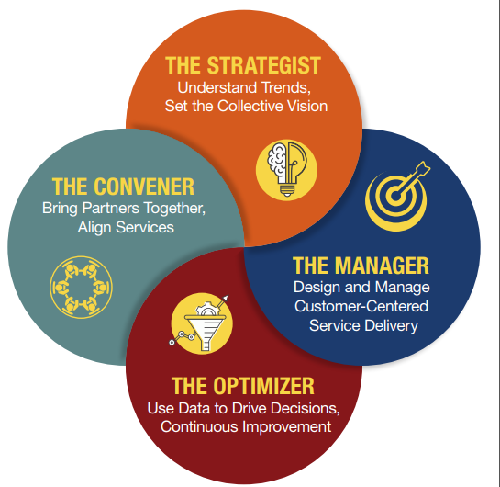
Northeast Region Governance Training
The optimizer

Slide 29
BOARDS AS OPTMIZERS
Use data to drive decisions and continuous improvement;
Monitor performance and adjust the system in anticipation of trends and how to respond to them; and
Leverage public investments with commitments from industry, labor, public and community partners to implement new ideas and strategies.

Slide 30
OPTIMIZING SYSTEMS

Slide 31
OPTIMIZING ACTIONS
Continuously analyze data gathered;
Use analysis to examine macroeconomic trends-patterns that impact the workforce system; and
Plan and make strategic decisions to address issues in rural areas (e.g., impact of transportation on the decisions related to economic expansion and training needs within the community or specific sectors).

Slide 32
Polling Question
Do you use data other than the WIOA performance indicators to drive your decisions?
Yes
No

Slide 33
Peer Feedback
33
If you answered yes to the previous polling question and you use data other than the WIOA performance indicators, please share what metrics you use.

Slide 34
Challenge
Create a metrics(s) to measure your success (other than the WIOA performance indicators).
Bonus challenge - The additional metric(s) aligns with your existing or newly created Vision statement.

Slide 35
Meeting the Challenges
The Action Planner

Slide 36
ETA Action Planner
Accountability Goals
Strategic partnerships
System accountability
Managing the work of the board
Conducting impactful and effective board meetings
Engaging the board members
Taking strategic actions
Developing and sustaining Sector Strategies
Creating and implementing Career Pathways
Coordinating and aligning all of the above

Slide 37
Questions?
Minnie Holleran- Holleran.Minnie@dol.GOV
Jennifer Friedman – friedman.Jennifer@dol.gov

