Slide 1
Workforce Opportunities for Rural Communities (WORC) New Grantee Orientation
October 21, 2019
An introductory webinar for WORC round two grantees.

Slide 2
Welcome and Introductions
Let’s get to know each other!

Slide 3
Your Moderator
Jeff Ryan
  Workforce Analyst, Division of Adult Services and Governance
  Office of Workforce Investment/ETA

Slide 4

Today’s Agenda
Welcome & Introductions
Federal Team Overview
Grant Program Overview
Grant Management / Package Overview
Grant Modifications
Performance Reporting Requirements
Technical Assistance
Communication / Next Steps

Slide 5
Today’s Presenters
Lynn Fraga
  Grant Officer
  Office of Grants Management/ ETA
Kellen Grode
  Workforce Analyst, Division of Adult Services & Governance
  Office of Workforce Investment/ETA
Emela Halilovic
  Director, Business & Workforce Investment
  Appalachian Regional Commission
Aury Kangelos
  Program Manager
  Delta Regional Authority

Slide 6
Grantees: ARC Region
Appalachian Sustainable Development
Big Sandy Community & Technical College
Blue Ridge Community & Technical College
County of Tazewell, VA
First Tennessee Development District
Maysville Community & Technical College
Northeast Georgia Regional Commission
Save the Children Federation
Total Action Against Poverty in the Roanoke Valley
University of North Georgia
University of Pittsburgh
Wallace State Community College
Williamson Health and Wellness Center
Workforce Wayne/Wayne Pike Workforce Alliance

Slide 7
Grantees: DRA Region
Delta Area Economic Opportunity Corporation
Delta Health Alliance
Lurleen B. Wallace Community College
Management, Training and Consulting Corporation
Marquette Tech District Foundation
McNeese State University
Missouri State University
NextOp, Inc
Ozarka College
Southern Arkansas University Tech
University of Louisiana-Monroe
University of Memphis
West Kentucky Community & Technical College

Slide 8
Grantee Polling Question
What are your 3 biggest concerns as you begin your grant?
Developing regional partnerships
Performance reporting
Partnering with the workforce system (e.g. American Job Centers)
Outreach, recruitment, and assessment
Grant modifications and prior approval
Other (please specify in the chat window!)

Slide 9
Your Federal Team
Roles and Responsibilities

Slide 10
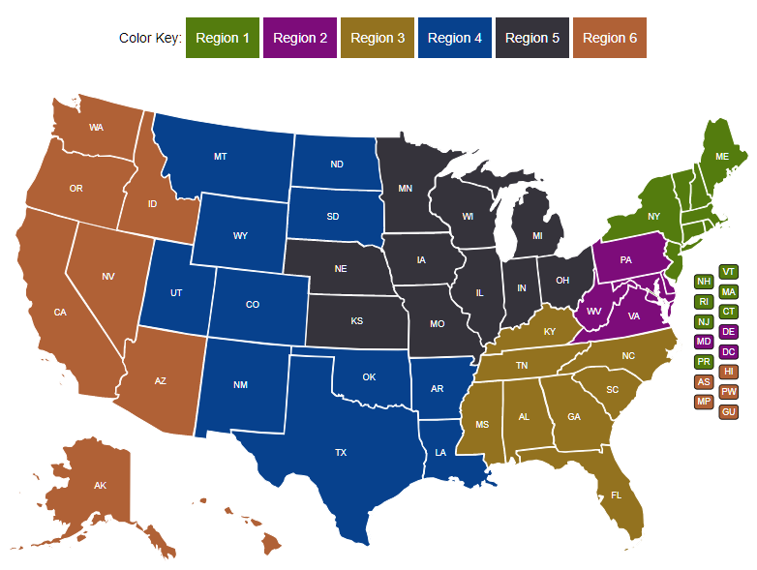
Your Federal Project Officer (FPO) is identified in your grant package.
Federal Project Officer (FPO)
Your FPO is critical to the success of your grant.
Role of Your FPO
Assist you on grant-related matters
Provide compliance assistance
Conduct oversight and review of grant performance
Deliver or arrange for technical assistance
Serve as your primary point of contact

Slide 11
Program Office Staff
Support FPOs
Provide policy clarification and guidance
Support technical assistance (TA) efforts provided by ARC and DRA
Help create peer learning opportunities
Analyze performance data
Review some grant modifications
The Program Office may periodically request information about your grant outcomes for quarterly reports to Congress.

Slide 12

Grant Officer
Your assigned Grant Officer is listed on the Notice of Award page of the Grant Package.
Only the Grant Officer can approve changes to the Grant Agreement
Reviews and approves grant modification requests in consultation with assigned Federal Project Officer and Program Office staff
Maintains official grant file
OGM staff provide guidance and technical assistance on grant policy issues, along with the fiscal/administrative requirements of the grant.

Slide 13
Roles of ARC and DRA
Provide grantee technical assistance including:
  Grantee meetings and peer-exchange workshops
  Issue-focused TA
  Request-based TA
  which we will cover later)
We’ll cover technical assistance for grantees in more detail later in this webinar

Slide 14
Grant Program Overview
Funding, Grantee Information, Outcomes

Slide 15

Purpose of Grant
The goal of the WORC Initiative is to create economic prosperity and that leads to gainful employment opportunities for eligible residents in impacted Appalachian and Lower Mississippi Delta regions, enabling them to remain and thrive in these communities, by:
implementing innovative approaches to address the economic and workforce-related impacts within each of the regions
providing enhanced training and support activities in coordination with the workforce system where applicable
supporting workforce development activities that prepare eligible participants for good jobs in high-demand occupations aligned with a state, regional, or community economic development strategy
helping to address the impacts of the opioid crisis and other substance use disorder

Slide 16

Funding Overview
DOL awarded $29.2 million for the
WORC Initiative.
27 total grantees
  14 representing Appalachian Region, 13 representing Delta Region
  Awards range from approximately $275,000 to $1.5 million
Period of performance is 36 months
  Grant start date: 10/1/2020
  Grant end date: 9/30/2023

Slide 17
Grants Management Overview
Award Letter, Agreement, Terms and Conditions, Attachments

Slide 18

Grant Package
Welcome Letter
Instructions for Payment and Reporting Systems
  Payment Management System
  ETA’s Grantee Financial Reporting System
  System Passwords / PINs Information
Grantee Handbook
Grant Agreement

Slide 19
Grant Package
Grant Agreement
  Notice of Award (NOA) / Signature Page
  Special Conditions of Award
  Federal Award Terms
  Application Components:
    Application for Federal Assistance (SF-424)
    Budget (SF-424A) / Budget Narrative
    Statement of Work (SOW)
    Indirect Cost Rate Agreement, if applicable

Slide 20

Special Conditions of Award
Conditionally approved modifications carry with them specific requests made by the Grant Officer to clarify or revise components of the modification.
A response is generally due 30 days after the conditional award of the modification. Requested information must be submitted to your Federal Project Officer for concurrence.
Please check with your grant’s Authorized Representative or Point of Contact (referenced on the SF-424 in the initial application submission) to see if your organization has Special Conditions of Award following the post-award compliance review. Emails went out on or around November 1, 2020.

Slide 21
Grant Modifications
Requests, Review Process

Slide 22
Modification Process
Write a formal letter of request addressed to your Grant Officer.
Include modification type, grant name and number, and justification for request.
Submit the final letter, signed by your signatory to FPO.
FPO forwards request to Grant Officer.
Step by Step:

Slide 23

Modification
Analysis
Your FPO reviews the modifications
Limited SOW modifications require review by Program Office
National Grant Officer gives final approval
Grantee receives copy signed by Grant Officer
Regional Grant Officer can approve some budget modifications and equipment purchases
Otherwise, regional management sends to National Grant Officer for review

Slide 24
Fiscal Reporting
WORC Grants

Slide 25
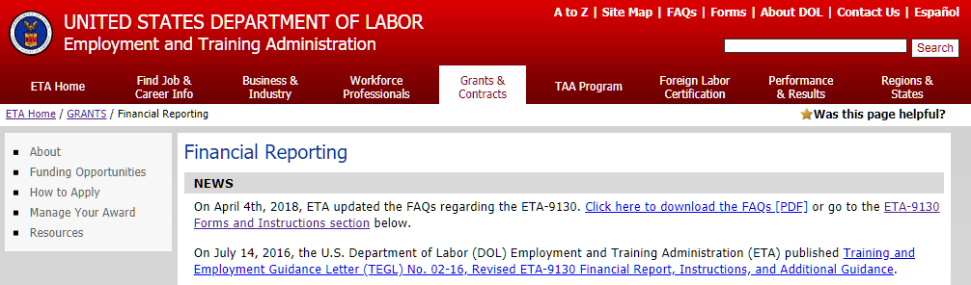
Quarterly Financial Report (QFR)
Each grantee must submit a Quarterly Financial Report (ETA 9130), due no later than 45 days after the end of a quarter.
Use the Grantee Reporting System to submit QFR.
Grant award package included instructions on accessing system.
Your first financial report is due on February 14, 2021.
For resources:
https://www.doleta.gov/grants/financial_reporting.cfm

Slide 26
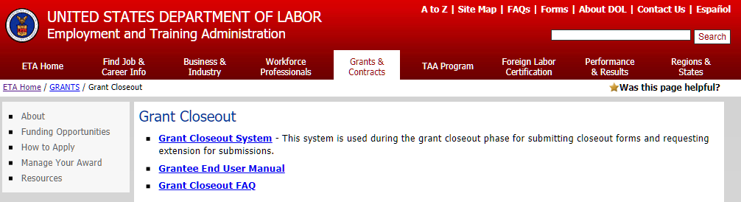
Final ETA-9130 Report
Final Quarterly Financial Reports is due within 45 days of the end of the quarter in which all funds were expended, OR within 45 days of the end of the quarter.
Closeout ETA-9130 Report is due within 90 days of grant expiration.
For additional information, visit: Grant Closeout.

Slide 27
Performance Reporting

Slide 28
Narrative Report Format
Quarterly Narrative Report (QNR)
ETA “Quarterly Narrative Report Template” is report form ETA 9179. To view the required template, go to: https://performancereporting.workforcegps.org/resources/2018/08/13/20/59/Quarterly-Narrative-Report-ETA-9179

Slide 29


Quarterly Narrative Report
Identify Key Milestones and achievements each quarter
Share successes
Identify technical assistance needs and challenges
Quarterly Narrative Report (QNR)

Slide 30
Narrative Report Format
The template provides grantees a set of questions including progress of the grant timeline, strategic partnership activates, grant activities and accomplishments
The QNR must address the performance goals described in the approved grant proposal
  Outcomes and outputs

Slide 31
Narrative Report Submission
Grantees must submit the QNR via email with the subject line “WORC Quarterly Narrative Report”
To three recipients:
  The assigned ETA Federal Project Officer (FPO)
    Contact information for this individual is contained in the grant agreement documents;
  Delta Regional Authority (DRA) at: workforce@dra.gov; and
  Appalachian Regional Commission (ARC) at: WORC@arc.gov.

Slide 32
Key Dates to Remember
Quarter End Date | Reports Due Date | Report for Activities Occurring Between:
March 31 | May 15 | January 1 – March 31
June 30 | August 14 | April 1 – June 30
September 30 | November 14 | July 1 – September 30
December 31 | February 14 | October 1 – December 31

Slide 33
Co-enrollment with Wagner-Peyser Act Employment Service Program
WORC grantees that serve individuals are required to coordinate with State Workforce Agencies that administer the Wagner-Peyser Act Employment Service and ensure the registration of participants in the Employment Service.
This allows the Department to collect employment outcomes data in alignment with other workforce initiatives (e.g. WIOA) and minimizes duplicative reporting burden.

Slide 34
Co-enrollment with Wagner-Peyser Act Employment Service Program
The participants that will register with Employment Service are those who receive:
  Staff-assisted career services, specifically comprehensive skill assessments, development of an individual employment plan, individual career counseling or career planning, internships or work experiences, or out-of-area job search assistance; or
  Training services, specifically occupational skills training, entrepreneurial training, or training programs operated by the private sector.

Slide 35
WORC Participant
State Workforce Agencies register WORC participants in the state’s Employment Service
Utilize code value “WORC001” in one of the Special Project ID fields:
  (Participant Individual Record Layout (PIRL) data element(s) 105, 106, or 107). Please see the PIRL layout (ETA-9172) for more details (https://doleta.gov/performance/reporting/).

Slide 36
Co-enrollment with Wagner-Peyser Act Employment Service Program
WORC grantees are responsible for initiating these conversations with their respective State Workforce Agency.
ETA can assist in facilitating connections between WORC grantees and State Workforce Agencies upon request to the Regional office or Federal Project Officers (FPO) assigned to the grant.
Please download the hand-out of state contacts

Slide 37
Grantee Technical Assistance
Overview of Technical Assistance Support

Slide 38
Technical Assistance Meetings: ARC
ARC will convene grantees for virtual meetings to support effective project implementation and promote the achievement of project outcomes.
  “Kickoff” calls in late November and early December of this year
    introductions, review your WORC-funded project, and discuss any objectives or preferences you might have for a virtual gathering.
  Conduct a virtual meeting or series of meetings in late January, 2021
    Topics likely to include, but are not limited to: a review of their contractual requirements, activities designed to help them plan for marketing and recruitment, data collection and reporting, role-based discussions, and risk mitigation.
    Opportunity for grantees to hear from ARC, DOL subject matter experts, and other speakers

Slide 39
Technical Assistance Meetings: ARC cont.
  3. On-demand, one-on-one, and group-based TA
    TA via email, phone, and virtual meetings, by request and through a planned schedule of topic based calls and other check-in meetings.
    connect R1 and R2 grantees where logical and valuable to the grantees, through activities such as topic-based group discussions.
    conduct one to two voluntary, individual discussions with grantees to check in on progress, discuss any pitfalls with program delivery, operations, data tracking, and other topics, and to identify needed resources and assistance.

Slide 40
Technical Assistance: DRA
DRA’s TA will consist of three phases: one-on-one calls and two peer exchange workshops.
The one-on-one calls will allow an opportunity for new grantees to be introduced to DRA staff; allow grantees to ask specific questions regarding their project specifically, implementation support, compliance, and additional funding opportunities; and discuss the project timeline and benchmarks.
The first peer-to-peer workshop will focus on the following topics:
  Building a community of practice;
  Developing regional workforce partnerships across sectors;
  Recruitment strategies for training program enrollment;
  Job placement; and
  Program implementation and financial sustainability.

Slide 41
Technical Assistance: DRA, cont.
The second peer exchange workshop focuses on:
  Project Implementation & progress,
  Data Collection & Reporting,
  Implementation Challenges and Successes, and
  Cross-Sector Relationship Development.

Slide 42
Technical Assistance Contacts
ARC
  Nicole Dunn
  nd@chamberlindunn.com (preferred contact method)
  317.874.6321
DRA
  Aury Kangelos
  Program Manager
  akangelos@dra.gov
  (901) 484-5082

Slide 43
Comparison: Role of FPO vs TA Providers
Federal Project Officer’s Role
Clarification of the FOA, including definitions
Statement of work alterations
Fiscal questions, including allowable expenditures and budget
Quarterly performance outcomes against target outcomes
Connections to the grant officer
Assistance addressing policy questions, as they arise
TA Provider Role
One-on-one coaching and support
Peer-to-peer learning opportunities
Approaches to data collection
Organizational structure: staffing, systems, and processes
Project planning and management
Participant outreach and recruitment strategies
Participant services, including case management, supportive services, and job placement
Employer engagement and participant placement

Slide 44
Communication
Communication Plan, Point of Contact

Slide 45
For Assistance with WORC Grants
GRANTEE
ETA
If you… | Contact:
Are the grant lead (POC) | Federal Project Officer (FPO)
Are a member of a grant project | The lead for your grant
Have questions or difficulty accessing the performance reporting system | Email your FPO
Have questions or difficulty accessing the financial reporting system | EBSS.help@dol.gov, copy to FPO
Always contact the Employment and Training Administration (ETA) assigned FPO first if you have questions.

Slide 46

Communication Guidelines
GRANTEE
ETA
When you communicate with your FPO, etc.:
Include your grant number and lead grantee organization name
Describe your question or issue in detail
Please be patient!

Slide 47
Next Steps

Slide 48

Next Steps
Respond to Conditions of Award in your Grant Award Package, as appropriate
Review the DOL Fiscal Training Tutorials
Review the DOL Performance Reporting Requirements
Review the Grantee Handbook
  https://www.doleta.gov/grants/docs/ETA_Grantee_Handbook.pdf

Slide 50
Thank You!
_
Need help? Email: Support@workforceGPS.org
_

