Slide 1

National Dislocated Worker Grant – COVID Disaster Relief
Implementing NDWG COVID-19 Disaster Relief at the Grantee Level

Slide 2
Today’s Host
Charlotte Harris
  Unit Chief /Division of Adult Services and Governance
    U.S. Department of Labor, Employment and Training Administration
Stephen Duval
  Chief / Division of Workforce Investment
    U.S. Department of Labor, Employment and Training Administration
    Northeast and Caribbean Region

Slide 3
Today’s Agenda
Review the Status of DWG- COVID Awards
  Overview of Awards
  Priority Areas
    Timely and Efficient Participant Outreach and Recruitment
    Participant Eligibility
Three Additional States with Early Success in Priority Areas
    California
    Rhode Island
    Washington
Q and A

Slide 4
Overview of DWGs
Coronavirus Aid, Relief, and Economic Security Act (CARES) Act provided additional $345 million in DWG funding
Nationally, the Department has awarded ETA over $392 million in COVID-19 DWG funding to 63 states, territories, and tribal entities
All of the awards are listed on ETA’s website: https://www.dol.gov/agencies/eta/dislocated-workers/grants/covid-19
Employment and Training Administration

Slide 5
Significant Investment in Response to Pandemic
The Workforce System is a vital component to recovery
To date, ETA has awarded 63 NDWG-COVID requests from states and communities to help strengthen economies through:
  Disaster Relief Employment
  Employment Recovery
  Humanitarian Aid
These funds will help individuals, families and communities recover through the provision of temporary employment and/or career, training and supportive services

Slide 6
Priority Areas
Pandemic Response Accountability Committee
  Offices of Inspector General (OIG) will focus on key areas related to the implementation of the CARES Act Provisions
  DOL OIG will conduct audits to review the effectiveness, efficiency, and integrity of all DOL programs funded by the CARES Act
The Department anticipates the OIG to focus initially on two areas:
  Efficient and Timely Project Start-up
  Eligibility Documentation

Slide 7
Today’s Agenda
The focus will be a continuation on efficient and timely startup activities including:
  Participant and work site outreach
  Participant enrollment and eligibility documentation
  Selection of sub recipients and contractors

Slide 8
Today’s Speakers
Northern Rural Training and Employment Consortium
Alliance for Workforce Development, Inc.
Rhode Island Department of Employment and Training
Skills for Rhode Island’s Future
Pacific Mountain Workforce Development Council
Terrianne Brown
  Assistant Director
    NoRTEC
Kristine Farrell
  Program Director
  AFWD
Sarah Blusiewicz
  Assistant Director, Workforce Development Services
    Rhode Island Department of Employment and Training
Nina Pande
  Executive Director
    Skills for Rhode Island’s Future
Julie Baxter
  Workforce Initiatives Manager
    Washington State Employment Security Department
Corinne Watts
  Director of Workforce Services
    PacMtn

Slide 9


NDWG – COVID Disaster Relief
NDWG – COVID Disaster Relief
Presented by:
NoRTEC Workforce Development Board
Alliance for Workforce Development, Inc.

Slide 10
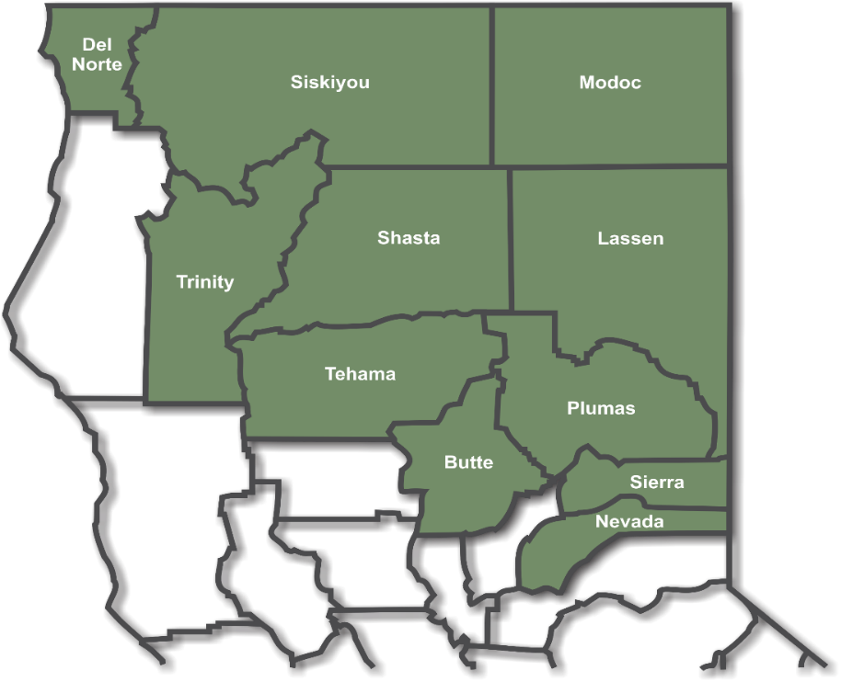
NoRTEC – Who we are
Formed in 1983 under JTPA
Administered more than two dozen TJ Projects
Workforce Development Board (11 counties)
31,000+ sq miles (20% California land mass)
2% of California population
All services contracted to CBOs
3 WIOA Service Providers
13 AJCCs
CBOs responsible for worksite
development and participant services
Worksite Agreements between
CBOs and local entities

Slide 11
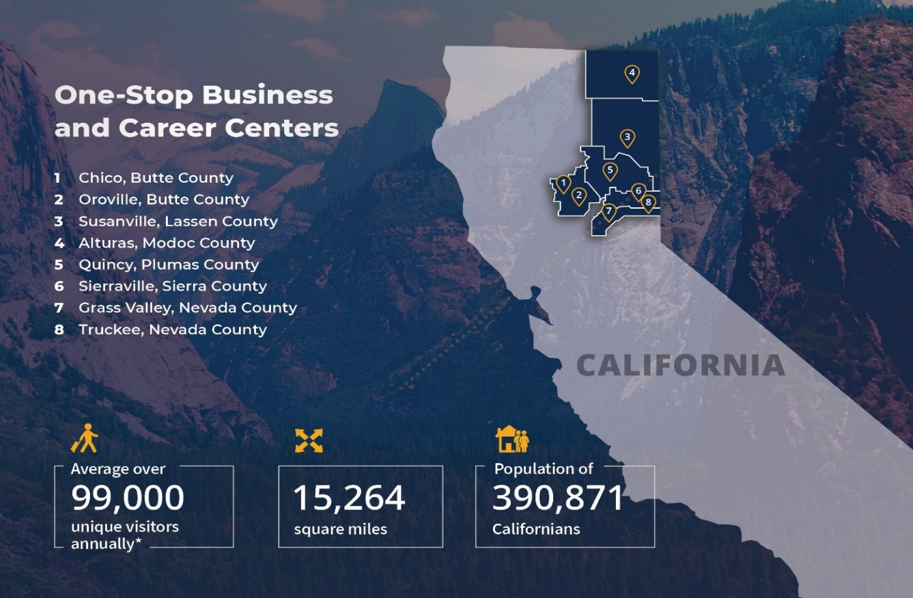
AFWD – Who we are
Operating programs since 1986
Service area over 15,000 square miles
  Larger than 9 states

Slide 12


Slide 13

COVID Disaster NDWG
Key Factors to Success?
Experience
Partners

Slide 14

COVID Disaster NDWG
Components of our NDWG Grant?
Disaster Relief Employment (DRE/TJC)
Humanitarian Aid
Contact Tracing

Slide 15

COVID Disaster NDWG
Challenges?
Approval / Implementation timeline
Finding participants
Onboarding participants
Finding Worksites

Slide 16

COVID Disaster NDWG
Primary Partners? Assisted in Success?
Local Counties (6 county region)
EDD / State agency

Slide 17

COVID Disaster NDWG
How are the Participants doing?
Early Success?
Revolving door / High turnover
Encouraged to apply

Slide 18

COVID Disaster NDWG
Training Services? Community Response?
Co-enroll in Regular WIOA programs
Grateful and Thankful

Slide 19

COVID Disaster NDWG
Next level plans? Assistance needed?
Thinking Outside the Box

Slide 20
Contact Information
NoRTEC
Terrianne Brown, Assistant Director
tbrown@ncen.org, (530)892-9600, x203
Stephanie Bruce, Program Services Analyst
sbruce@ncen.org, (530)892-9600, x207
AFWD
Kristine Farrell, Program Director
kfarrell@ncen.org, (530) 616–1525

Slide 21

Rhode Island
COVID-19
Disaster Recovery NDWG

Slide 22
Process Flow
Phase 2: Employer Selection
Phase 4: Employer On-Boarding
  Employers apply online
  DLT conducts an eligibility review on employer requests
  DLT connects w/ Skills to discuss ability to fill roles
  Skills/DLT make final decision on the request
  Skills enters into MOU with employer
    MOU includes all required elements under the grant
  Skills refers eligible candidates to jobs
  DLT conducts eligibility on candidates; enrollment occurs once candidate accepts position
Phase 1: Employer Application
Phase 3: Employer Review

Slide 23







Recruitment Strategy
Engagement
Sourcing
Screening
SkillsRI
Employer
Advertising & Digital Outreach
Resume review of inbound candidates
and outbound sourcing
Print Ads
Online Banner Ads
Email Campaigns
Social Media
Behavioral and Geo Targeted ads
Governor
C-Level
Job Boards
Phone screens
Top career sites (CareerBuilder, Indeed, etc.)
Industry Specific/Niche job sites
Educational partners (college career services)
Internal Sourcing
Interviews
Skills RI
VP of HR
Skills database
Career site databases
Government unemployment database
Presented to Employer
Community Outreach
Workforce & Community Partners
Offers to candidates
Real Jobs RI
HR Rep
Events
Hires
Internal job fairs
External/Public hiring events
Multi-tiered engagement model based on private sector consulting best practices
“White glove” service to businesses
Wide-reaching sourcing strategy to identify broad base of talent
Extension of business’ HR departments
High volume phone outreach
High-touch screening model; all candidates interviewed in person
Metrics-driven organization that delivers results

Slide 24
Successes & Challenges
Early Wins
Immediate implementation – participant enrollment began within days of award
Weekly meetings to ensure coordination between Skills for RI and DLT ensured seamless collaboration
Pre-dated CARES Act, supporting COVID-19 response work in contact tracing and inspection prior to CARES Act implementation
Challenges Faced
PUA/UI payments made recruitment for temporary work more difficult
  Wages were not high enough to compete with payments
  People were concerned about the effect taking temporary employment on their UI
Coordinating response work once CARES Act programs began
  Difficult to coordinate which temporary workers are on which funding stream at the state level.
  CARES Act oversight and governance involves multiple agencies making it difficult to coordinate this grant with larger CARES Act initiatives.

Slide 25
Thank You
For more information, please contact:
Sarah Blusiewicz
RI Dept. of Labor & Training
sarah.Blusiewicz@dlt.ri.gov
Nina Pande
Skills for Rhode Island’s Future
npande@skillsforri.com

Slide 26
PacMtn Food Security Project
Corinne Watts,
Director Workforce Services
Corinne@PacMtn.org

Slide 27
Local Context & Response
COVID-19 upended both the employment and the food system landscape
Farms, also, are struggling. With restaurants, schools and farmers markets closed or at limited capacity, farmers are reacting quickly to locate new buyers and find innovative ways to get their products delivered.
Provide food-system related training programs and connect dislocated workers to the food system through WBL opportunities & train individuals for careers in kitchens

Slide 28
Partner Development
SW WA Food Hub: WSU, Thurston County Economic Development Council
Northwest Agricultural Business Center for food box distribution from local farmers
GRuB, Squaxin Island Tribe, and local food banks

Slide 29
Outreach & Registration:
Use Technology
Facebook
Jotform
Google Voice
QR Codes

Slide 30
Enrollment
WEX opportunities designed to assist with:
  Disbursement of emergency food assistance
  Food distribution centers
  Food banks
  Transportation
  Production and processing of food boxes
  Farm labor
  Administration assistance
Disaster Employment Positions with Partners: NW Ag Business Center, Thurston EDC, Squaxin Tribe

Slide 31
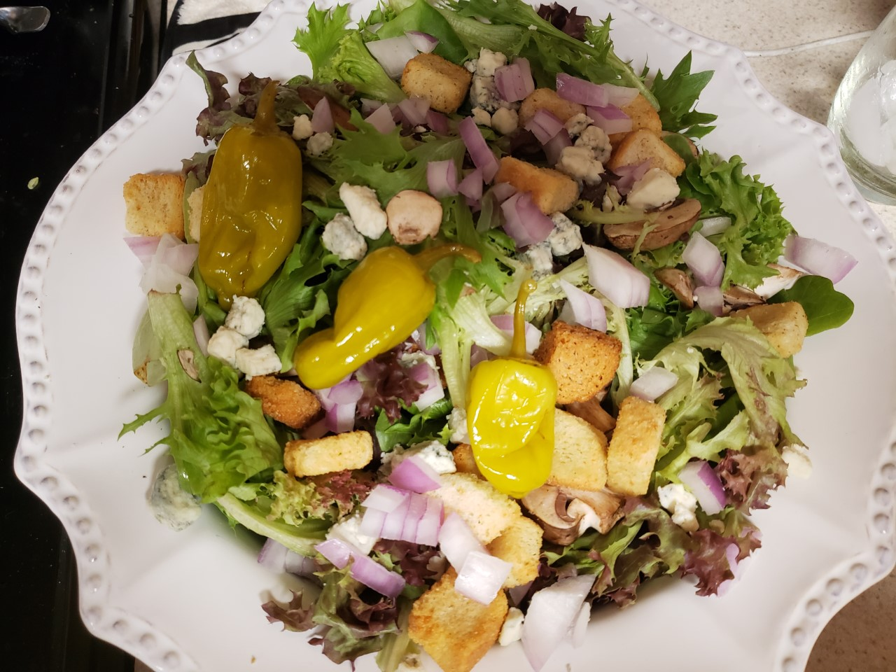
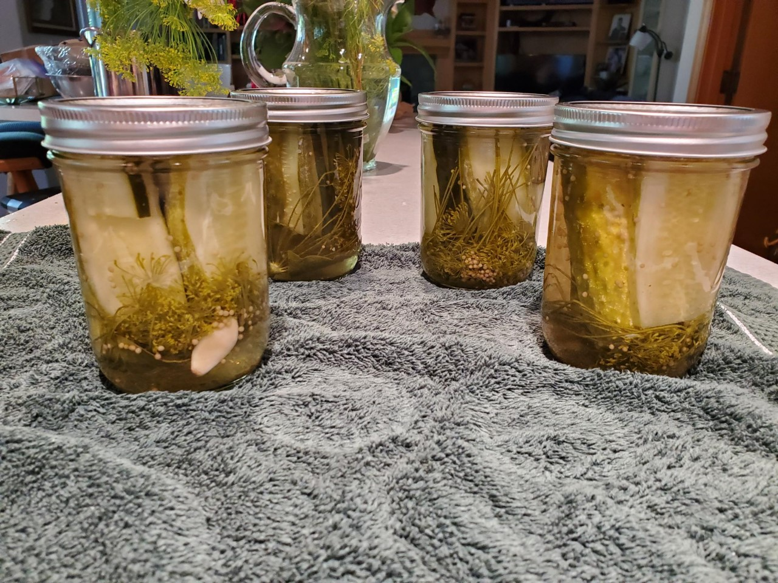
Training
WSU SNAPeD and MadCap Marketing
https://www.youtube.com/watch?v=6Bt3JkAJlT8

Slide 32
Cooking With The Seasons
Using local chefs to teach
  Knife skills
  Food safety
  Intermediate culinary methods & techniques
  Preservation of fruits & vegetables
  How to properly store fruits & vegetables

Slide 33
Unsubsidized Employment
Success Stories
WEX to UE positions have started prior to training completion
Receptionist position with Migrant Farm Laborers Association
Operations Manager at local Organic Farm

Slide 34
PacMtn Best Practices
Co-Enrollment (Youth, Community Jobs/TANF)
New outreach techniques brought new WorkSource Customers
Strong community partnerships

Slide 35
Article in Thurston Talk
Partnerships Feed Those In Need Thanks To the Southwest Washington Food Hub

Slide 36
THANK YOU!
Julie Baxter, Workforce Initiatives Manager, Washington State Employment Security Department
  jbaxter@esd.wa.gov
  360.890.5941
Corinne Watts, Director of Workforce Services, Pacific Mountain Workforce Development Council
  Corinne@pacmtn.org
  360.570.4249

Slide 37
Any Questions?

Slide 38
Thank You!
Need help? Email: Support@workforceGPS.org

