Slide 1
Evaluation Planning for Remote Workforce Services and Online Learning

Slide 2


Moderators
Cynthia Forland
  Evaluation Peer Learning Cohort Lead
    Employment and Training Administration/Safal Partners Team
Wayne Gordon
  Director, Division of Research and Evaluation
  Office of Policy Development and Research
    Employment and Training Administration/U.S. DOL

Slide 3
Overview
Introductions
Setting the Context for Evaluation Planning
Learning from Practitioners, Researchers and Evaluators
Supporting Your Evaluations

Slide 4
Delivering Remote Workforce Services and Online Learning
WIOA emphasizes the importance of facilitating access to services, including facilitating access using technology.
This year, the ability to provide remote/virtual services and online learning became even more important, with states, local areas, and training providers temporarily unable to rely on delivering services and training through brick-and-mortar facilities.
States and local areas have quickly adapted to providing services remotely, through the use of virtual delivery tools, apps, and websites.

Slide 5
Polling Question # 1
Has your state or local workforce board or agency initiated plans to evaluate remote services or online learning?
We are still struggling with delivering services remotely.
We have little to no capacity to evaluate our services.
We have some capacity to evaluate services but are unsure about how to start.
We have begun to evaluate our remote services.
Not only have we evaluated our remote services, we have published our evaluation results!

Slide 6


Presenters
Deniece Thomas
  Deputy Commissioner
    Tennessee Department of Labor and Workforce Development
Alisa Belzer
  Professor, Program Coordinator, Ed.M. in Adult and Continuing Education
Rutgers University

Slide 7


Presenters
Kathy Krepcio
Executive Director & Senior Researcher, John J. Heldrich Center for Workforce Development
Rutgers University
Burt Barnow
Amsterdam Professor of Public Service, Trachtenberg School of Public Policy and Public Administration George Washington University

Slide 8
Learning from Practitioners, Researchers, and Evaluators

Slide 9
Presenter
Deniece Thomas
  Deputy Commissioner
    Tennessee Department of Labor and Workforce Development

Slide 10
Background
Tennesseans were engaging our agency digitally
A few topics accounted for most of traffic
Missed opportunities to serve over 400,000 people annually
Needed to better understand and track customer inquiries/needs
This began our journey to…..
Enhance customer engagement
Modernize service delivery
Shift to a “learning” strategy

Slide 11

Customer Management Tools
Launched Zendesk in 2014 and expanded capability over the next several years
  Help center
  Updated the articles in our knowledge base
  Reviewed tickets to identify the most frequently asked questions and published updates

Slide 12
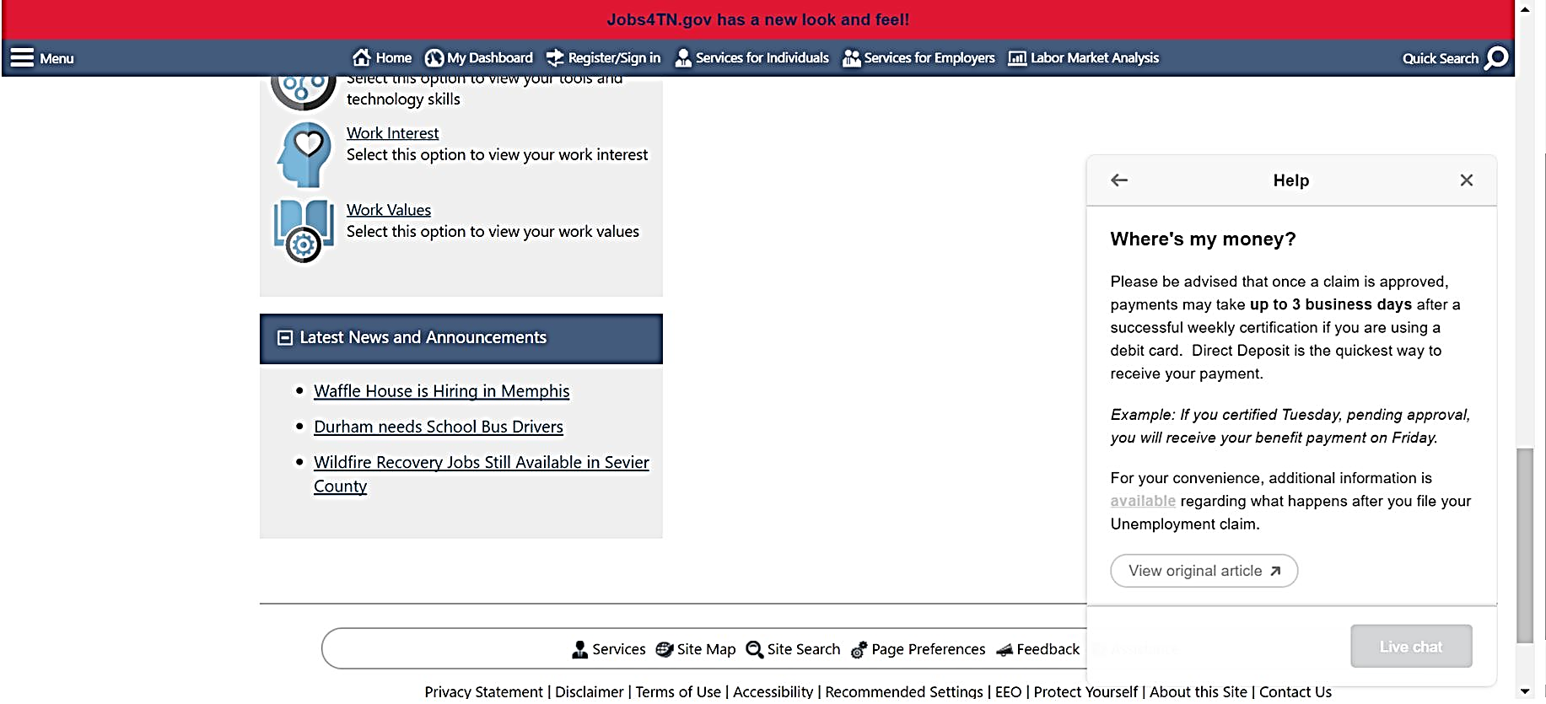
Self Service Capability
Article
Notes:
Chat

Slide 13
Expanded Service Delivery
Doubled mobile American Job Center presence
Launched Virtual American Job Center (VAJC) concept in 2017 to expand reach
Goals
Proactive and intuitive
Self-service model
Partner engagement
Provide information on programs and services across multiple departments

Slide 14
VAJC Overview
Widening access to full array of services
Virtual agent / live agent available to help understand eligibility
Interactive wizard to browse recommended programs
Complete forms online, upload supporting docs and e-sign
Schedule and conduct virtual counseling sessions
Ticket generation to fuel enrollments into ALL programs
Feedback loop

Slide 15

How Do We Know If We Are Meeting the Needs of Customers?
They Tell Us!

Slide 16
Presenter
Alisa Belzer
  Professor, Program Coordinator, Ed.M. in Adult and Continuing Education
Rutgers University

Slide 17


Project Participants
Conducted by the Evidence-based Adult Education System (E-BAES), an initiative of Open Door Collective, a program of Literacy Minnesota
The E-BAES volunteer taskforce includes 30+ researchers, practitioners, government officials, professional developers, and education leaders in adult education
_
_
_
A program of

Slide 18


E-BAES Interviews
49 interviews (14 interviewers) in late April through May
Interviewees from 18 states
Practitioners (40)
State staff (9)
Goals: Describe shifts programs made and illustrate challenges and successes

Slide 19

Report Overview
Nine sections
  How programs implemented distance education
  Technology access and capacity
  Learner enrollment and classroom engagement
  Learner support
  How the job has changed
  Professional development
  Program changes
  Silver linings
  Future
Most sections conclude with
  Key Takeaways
  Innovations/Recommendations for Practice

Slide 20
Relevant Considerations for Evaluating Remote Services
Programs are responding in a dynamic way; responses are quickly evolving
  Changing access to tools
  Knowledge and skills development
  Shifting policy directives
  Changing conditions of learners
  Uncertainty regarding progression of the virus (to open or not to open)
Learners (and teachers) have significant digital literacy gaps (broadband access and skills)
  Programs improvised a variety of ways to meet needs from mailed paper packets to phone supports to in person, socially distanced assistance
  Practitioners needed significant professional development in order to be able to offer remote services and were on a steep learning curve

Slide 21
Relevant Considerations for Evaluating Remote Services
Policy guidance was needed/shined a light on policy gaps
  On how to track attendance hours
  On how to do remote assessment/evaluation (has implications for intake and accountability benchmarks)
  New standards and expectations may be needed
State level leadership made a significant difference to how local programs responded

Slide 22
Relevant Considerations for Evaluating Remote Services
Prior remote learning efforts supported effective emergency response
New kinds of supports are needed (for learners and staff)
  To deal with COVID-19-related stress
  To support digital learning
  The need for additional support has required staffing shifts
  Staff workload as increased dramatically (doing more support, more professional development, shifting and redesigning lesson plans)

Slide 23
Presenter
Kathy Krepcio
Executive Director & Senior Researcher, John J. Heldrich Center for Workforce Development
Rutgers University

Slide 24

Why the Heldrich Center went “Suddenly Virtual” and what we have learned from our early pandemic research:
In March 2020 public workforce staff were suddenly forced into virtual operations
Suddenly Virtual is a series of briefs, toolkits, blog posts, supported by an online community of practice about offering virtual services
Heldrich Center staff members Michele Martin, Liana Volpe, and Amanda Bombino have led this initiative
John J. Heldrich Center for Workforce Development

Slide 25
Why we are moving to being “Strategically Virtual”:
We are building off the lessons learned from the Suddenly Virtual series
We are exploring how the public workforce system could engage community resources and partners to holistically address job seeker needs
Strategically Virtual will develop a framework for job seeker services and produce issue briefs, Medium blog posts, practical guides, and more.
John J. Heldrich Center for Workforce Development

Slide 26
Lessons from the field: Considerations on how to evaluate virtual workforce services
Traditional qualitative methods are difficult or challenging to conduct
Evaluators and program operators must take into account the lack of broadband and digital/video skills, computer and/or broadband equipment, and computer literacy
Important to have strong program model documentation and program data available to evaluators
Quantitative (data) analysis is critical, and these must be set up and embedded up front to reflect virtual services during program start up
Evaluation research questions and methods need to reflect a new virtual environment (“just in time feedback”)
John J. Heldrich Center for Workforce Development

Slide 27

Presenter
Burt Barnow
Amsterdam Professor of Public Service, Trachtenberg School of Public Policy and Public Administration
George Washington University

Slide 28

Evaluation Planning Topics Covered
Developing a logic model to gain perspective
Types of evaluations you can conduct
Selecting the outcome for your evaluation
Approaches to the impact evaluation
Concluding thoughts about evaluating remote services and online learning

Slide 29
Generic Program Logic Model
Inputs
Processes
Outputs
Outcomes
People
Money
Clients
Case-load
Activities
Initiatives
Procedures
Services
Products
Impacts
Effects
Results
Intervening (Contextual) Variables

Slide 30
What Questions Do Evaluations Answer?
Evaluations are investigations into programs and policies to answer one or more of the following questions:
  What happened? (process studies)
  What difference did it make? (impact evaluations)
  Was it worth it? (cost-benefit analysis)
In 7 minutes I cannot cover all three types of studies, but you probably need all three to assess your remote programs
Remainder of presentation focuses on impact studies

Slide 31
Identify and Select Outcomes to Analyze
Two broad choices
  Knowledge, skills, and abilities (KSAs) addressed by the services
  Ultimate labor market outcomes
Both are important but both have pros and cons
  There may not be good assessment tools for KSAs
  Gaining skills no assurance people will do better in labor market
  Labor market outcomes affected by many other factors
Consider both types of outcomes
Research has shown that both types of impacts can fade over time—be wary of extrapolating findings

Slide 32
Approaches to Impact Evaluations
Two broad approaches
  Randomized controlled trials (RCTs)
  Quasi-experimental methods
When feasible RCTs often considered the “gold standard” because quasi-experimental methods make strong assumptions that are untestable, but there are issues with RCTs
  Ethical issues
  RCTs expensive and may cost a lot more
  Not all questions can be answered by RCTs
Because strong assumptions required for QEDs, consider using multiple methods and varying key assumptions

Slide 33
Conclusions for Planning Evaluations
Don’t assume the remote learning approaches are worse—evaluate them
Begin planning now—you may be able to include an RCT as you transition, and you will need to determine what data you will need
Give careful consideration to what your outcomes of interest are, how you will measure them, who you will compare, where you will obtain the data for the evaluation, and what questions you can and cannot answer
Know your strengths and limitations: You may want to hire an outside evaluator to help you with the evaluation

Slide 34
Any Questions?
Any questions for today’s presenters?

Slide 35
Supporting Your Evaluations

Slide 36
Polling Question #2
When technical assistance on evaluation is available, which methods are of most interest to you?
Implementation Studies
Outcome Studies
Impact Studies
Cost Studies
All of the above!
None of the above – I’m an expert evaluator!
*Please note other preferred TA delivery modes in the chat box.

Slide 37
Polling Question #3
When technical assistance on evaluation is available, which modes do you prefer?
Referrals to existing toolkits and literature on evaluation
Interactive, small group webinars with peers
Online learning modules
Individual coaching or mentoring support
All of the above, please!
N/A – I’m an expert evaluator!
*Please note other preferred TA delivery modes in the chat box.

Slide 38
Resource Links
Evaluation and Research Hub
    evalhub.workforcegps.org
Evaluation Toolkit
    evalhub.workforcegps.org/resources/2018/09/07/19/58/WIOA-Evaluation-Toolkit
    Technology-Based Learning (TBL) in the Workforce System
    www.abtassociates.com/projects/technology-based-learning-tbl-in-the-workforce-system
    COVID-19 Rapid Response Report from the Field
    www.proliteracy.org/Portals/0/pdf/Research/COVID-19/COVID-19-Report.pdf?ver=2020-07-31-090141-130
    Suddenly Virtual: Helping Workers, Businesses, Practitioners, and Policymakers During the COVID-19 Pandemic
    medium.com/suddenly-virtual
_
_
_

Slide 39
Contact Us
Deniece Thomas
    Deputy Commissioner
    Tennessee Department of Labor and Workforce Development
      deniece.thomas@tn.gov
Alisa Belzer
  Professor, Program Coordinator, Ed.M. in Adult and Continuing Education
  Rutgers University
      alisa.belzer@gse.rutgers.edu
Kathy Krepcio
  Executive Director & Senior Researcher, John J. Heldrich Center for Workforce Development
  Rutgers University
      krepcio@rutgers.edu
Burt Barnow
  Amsterdam Professor of Public Service, Trachtenberg School of Public Policy and Public Administration
  George Washington University
      barnow@gwu.edu
_
_

Slide 40
Contact Us
Gloria Salas-Kos
    Senior Program Analyst/Evaluation Technical Assistance Coordinator
    Employment and Training Administration/U.S. DOL
      salas-kos.gloria@dol.gov
Wayne Gordon
  Director, Research and Evaluation
  Employment and Training Administration/U.S. DOL
      gordon.wayne@dol.gov
EvalHub Technical Assistance
  Safal Partners
      EvalPLC@SafalPartners.com
_

Slide 41
Thank You!

