Slide 1
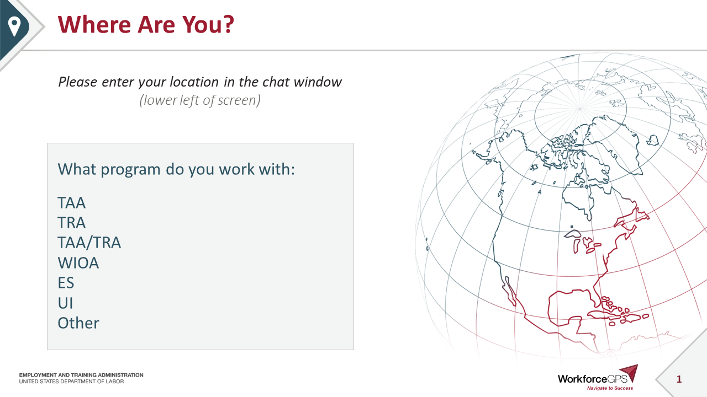
Where Are You?
Please enter your location in the chat window
  (lower left of screen)
What program do you work with:
TAA
TRA
TAA/TRA
WIOA
ES
UI
Other

Slide 2
Subpart I
Allocation of Funds
TAA Final Rule
20 CFR 618

Slide 3

Today’s Speaker
Frankie Russell
  Lead Program Analyst
    OTAA / ETA
Notes:
**Tim: Please note that the speaker notes are in Today’s PPT in the file share, if you’d like to download and follow along. Also, during the presentation please enter your questions into the chat. Lastly, please consider having the copy of the Final Rule open so you can follow along.
Let me now turn it over to Frankie Russell to introduce herself.
Frankie: Introduction and greetings.

Slide 4
Today’s Objectives
Major Updates
Initial Allocation
Second Distribution
Reserve Requests
Recapture
Notes:
Frankie – read slide

Slide 5
Major Updates
Notes:
Frankie - Subpart I revises the regulations currently found at 20 CFR 618.900 through 618.940. The Department first published these regulations on April 2, 2010 (75 FR 16988); they became effective May 3, 2010.
Additional note: This final rule does not provide regulatory text for TRA or RTAA funding since those allocations are made through the Department’s administration of the UI Program. The one exception, as provided by sec. 235A(1)(C) of the Act, and addressed in subpart H, involves the use of TAA Program funds for the administration of RTAA.

Slide 6
Subpart I – Major Updates
Introduces the term “Training and Other Activities” or TaOA
Codifies the statutory availability of funds
Updates the language and clarifies rules on:
  Initial allocation
  Second distribution
  Reserve requests
Establishes regulations on the recapture and reallocation of unexpended funds
Notes:
Frankie: The updates in this final rule reflect subsequent statutory revisions and policy updates. Subpart I addresses the Act’s provisions at secs. 236(a)(2) and 245 and introduces the term, Training and Other Activities – or TaOA; it codifies a statutory update of the annual funding limit; annual allocations of funds to states; and an update to the reserve fund request process. This subpart also addresses the recapture and reallocation provisions established by sec. 245(c) of the Act.

Slide 7
Annual Cap on Funds /
Training and Other Activities
20 CFR 618.900
Notes:
Frankie - Section 618.900 includes some revisions to the existing rule.

Slide 8
Annual Cap on Funds / Training and Other Activities – 20 CFR 618.900
a) The total amount of funds made available for the costs of training and other activities (TaOA) for each of fiscal years 2015 through 2021 is $450,000,000
b) Funds are available for a total of three years
Notes:
Frankie - Section 618.900, paragraph (a) summarizes what services may be paid under the funding, and introduces the term, “Training and Other Activities,” and its acronym, TaOA, both of which refer to the benefits and services described in secs. 235 through 238 of the Act. TaOA benefits and services are: employment and case management services, training, job search and relocation allowances, and related State administration.
This paragraph is also updated to reflect the 2015 Program’s annual funding limit of $450 million for Fiscal Years 2015 through 2021.
Paragraph (b) is new and explains the statutory period of availability of funds set out at sec. 245(b) of the Act. Funds allocated to States under the TAA Program for TaOA can be spent in the fiscal year awarded and the next 2 fiscal years, for a maximum altogether of 3 fiscal years.

Slide 9
Initial Allocation
20 CFR 618.910
Notes:
Frankie - Section 618.910 updates the language to reflect statutory changes and minor grammatical corrections and other clarifications. These changes primarily relate to indicating that the annual funding cap in sec. 236(a)(2)(A) of the Act applies to TaOA, not only to the training services described in sec. 236.

Slide 10
Initial Allocation – 20 CFR 618.910
a) 65% of available funds awarded via the initial allocation
  No state will receive less than 75% of the previous year’s initial allocation
f) Initial Allocation factors
  Number of workers covered by certifications
  Number of workers participating in training during 4 most recent calendar quarter
  Weighted ratio of workers in training during the previous fiscal year
  Average cost of training
Notes:
Frankie – Paragraph (a) through (f)(1) contain nonsubstantive changes to enhance the readability of the section.
The Initial Allocation section includes:
Paragraph (a) Initial allocation.
Paragraph (b) Timing of the distribution of the initial allocation.
Paragraph (c) Hold harmless provision.
Paragraph (d) Minimum initial allocation.
Paragraph (e) Process of determining initial allocation.
Paragraph (f) Initial allocation factors.
Paragraph (f)(2) gives each of the four factors listed in paragraphs (f)(1)(i) through (iv) equal weight. Paragraph (f)(3) retains the rest of the existing rule at 20 CFR 618.910(f)(3) but removes the word “weighted” in referring to the factors.

Slide 11
Reserve Fund
20 CFR 618.920
Notes:
Frankie - Section 618.920 describes the reserve fund request process established by sec. 236(a)(2)(D) of the Act.

Slide 12
Reserve Fund – 20 CFR 618.920(a) and (b)
a) 35 percent of the TaOA funds that remain after the initial allocation will be held by DOL as a reserve.
  Reserve funds will be used, as needed, for additional distributions to States during the remainder of the fiscal year, including distributions to those States that did not receive an initial allocation.
b) States must show 50% in available funds expended; OR Needs additional funds due to an unexpected increase in the number of trade-affected workers
Notes:
Frankie - Section 618.920, paragraph (a) updates the reserve funds process. The existing rule at 20 CFR 618.920(b) is divided into § 618.920(b) and (c) for organizational purposes.
- THEN READ SLIDE

Slide 13
Reserve Fund – 20 CFR 618.920 (c)
State’s reserve fund request must provide a documented estimate of funding needs through the end of the fiscal year.
That estimate must be based on an analysis that includes at least the following:
  The average cost of training in the State;
  the expected number of participants in training through the end of the fiscal year; and
  the remaining TaOA funds the State has available.
Requested via form ETA-9117
Notes:
Frankie – Paragraph(c) describes what the state’s reserve fund request must also include. READ SLIDE

Slide 14
Second Distribution
20 CFR 618.930
Notes:
Frankie - Section 618.930 updates the existing rule regarding the second distribution of TaOA funds, by changing the reference from training funds to TaOA funds, and makes other minor language clarifications and organizational changes.

Slide 15
Second Distribution – 20 CFR 618.930
90% of remaining funds will be distributed by July 15
  Amount will be initial allocation less all reserve requests received before June 1
Any funds remaining will be held for additional reserve requests
Notes:
Frankie – Section 618.930 provides that the Department will distribute at least 90 percent of the total TaOA funds (including reserve funds) for a fiscal year to the States no later than July 15 of that fiscal year. The Department will first fund all acceptable requests for reserve funds filed before June 1. After these requests are satisfied, any funds remaining will be distributed to those States that received an initial allocation in an amount greater than their hold harmless amount, using the methodology described in § 618.910.

Slide 16
Insufficient Funds and
Recapture
20 CFR 618.940
20 CFR 618.950
Notes:
Frankie - § 618.940 and 618.950 on Insufficient Funds and Recapture

Slide 17
Insufficient Funds – 20 CFR 618.940
If the remaining funds are determined to be insufficient to meet demand, the Department will decide on the allocation of the remaining funds and notify the states of its decision through administrative guidance
Notes:
Frankie - If, during a fiscal year, the Department estimates that the amount of funds necessary to provide TaOA will exceed the annual $450 million cap, the Department will decide how the available funds that have not been distributed at the time of the estimate will be allocated among the States for the remainder of the fiscal year, and will communicate this decision to States through administrative guidance.

Slide 18
Recapture and Reallocation – 20 CFR 618.950
The Department may recapture unobligated funds and reallocate those funds to meet demand in other states
  Only used if there is a catastrophic event
  Not an annual process
  Will recapture funds from the states with the highest percentage of unobligated funds
  Will notify states of recapture at least 15 business days in advance
Notes:
Frankie - Section 618.950 is new and provides the description of recapture and reallocation procedures that the Department may use to implement the recapture and reallocation provisions of sec. 245(c) of the Act. Although the Department is including this provision in the final rule, this is an extreme action that will only be taken in the event of a catastrophic event. This will not be an annual process.
Consistent with sec. 245(c) of the Act, paragraph (a)(1) provides that funds remaining unobligated at the end of the second or third fiscal year after the funds were provided to the State may be recaptured. Paragraph (a)(2) provides that those recaptured funds may be reallocated in accordance with the procedures established in this section of the final rule.
Paragraph (b) sets out the circumstances under which the Department may recapture and reallocate funds. The Department may recapture and reallocate unobligated funds when it is determined there are, or are projected to be, insufficient funds in a State or States to carry out TaOA for a fiscal year, or when the recapture and reallocation of funds would likely promote the more efficient and effective use of funds among the States. The Department concludes these procedures provide the necessary flexibility to promote sound financial practices, and use the limited available funds most effectively, by directing unobligated funds that are not likely to be spent to those States that are more in need of such funds in order to continue to provide program services.
Paragraphs (c) and (d) provide the methodology that will be used during the recapture and reallocation process. If the Department determines that there are, or are projected to be, insufficient funds in a State or States to carry out TaOA for a fiscal year, paragraph (c) allows the Department to recapture unobligated funds from the State or States with the highest percentage of unobligated or unexpended funds from the second or third fiscal year after the year in which the funds were awarded, and reallocate them to the States with, or projected to have, insufficient funds.
Paragraph (d) allows the Department to recapture funds from the State or States with the highest percentage of unobligated or unexpended funds from the second or third fiscal year after the year in which the funds were awarded, and reallocate them to the States with the lowest percentage of unobligated or unexpended funds or to all States from which funds are not being recaptured.
Paragraph (e) provides that if the Department determines to recapture and reallocate funds under this section, an administrative notice must be sent to the States describing the methodology used and the amounts to be recaptured from and reallocated to each affected State not less than 15 business days in advance of the recapture of funds.
Lastly, paragraph (f) makes clear that the reallocation of funds under this section does not extend the period of availability for those funds.

Slide 19
Question
What happens if a state has a large petition certified after funds are recaptured?
Can states get the recaptured money back?
Notes:
Frankie – read slide
Answer: The Department clarifies that for unforeseen situations, a State may always request TAA Program reserve funds using the Reserve Funds Process set forth at Section 618.920, TAA Program Reserve Funds. Unlike WIOA, the TAA Program is a mandatory entitlement with “capped” funds for training; however, 35 percent of fiscal year training funds are held in reserve for exactly this reason (i.e., States experience unexpected/unforeseen events that require additional funds). Further, the Department will only recapture funds after having consulted with the State.

Slide 20
Wrapping Up
Questions on Subpart I?
Notes:
Frankie – will turn this over to Tim:
Tim – Questions on Subpart I? Please enter your questions into the chat window.

Slide 21
Resources:
TAA Community
  Workforce GPS TAA Program Community
    taa.workforcegps.org
20 CFR 618 (Advance Copy)
  TAA Program Regulations
    www.dol.gov/sites/dolgov/files/ETA/tradeact/pdfs/TAA_Final_Rule_1205_AB78.pdf
TAA Program Website
  Official website of the TAA Program
    www.dol.gov/agencies/eta/tradeact
Trade Act of 1974, as amended
  Official US Code version of the Trade Act
    uscode.house.gov/browse/prelim@title19/chapter12/subchapter2/part2&edition=prelim
Notes:
Tim: Please see additional resources that include the links to the TAA Community on WorkforceGPS and the official TAA Program website.
Also links to the TAA final rule, located on the Federal Register website, and the link to the official law (2015 Program).
Please note that we will be announcing additional training in the next few weeks, so please join taa.workforcegps.org for an upcoming schedule of events. We will also be asking the regions to send information to state Trade coordinators to disseminate, once the training has been scheduled.

Slide 22
Any Questions?
Regulation Questions
  General Inbox
      regulations.taa@dol.gov
Notes:
Tim: If you have questions about the final rule – please send the question to your appropriate Regional Trade Coordinator or to regulations.taa@dol.gov. We have a team standing by to respond to questions.

Slide 23
Thank You!

