Slide 1
State Apprenticeship Expansion “Building State Capacity to Expand Apprenticeship through Innovation”
ETA-TEGL-15-19
SAE 2020
GRANTEE ORIENTATION

Slide 2
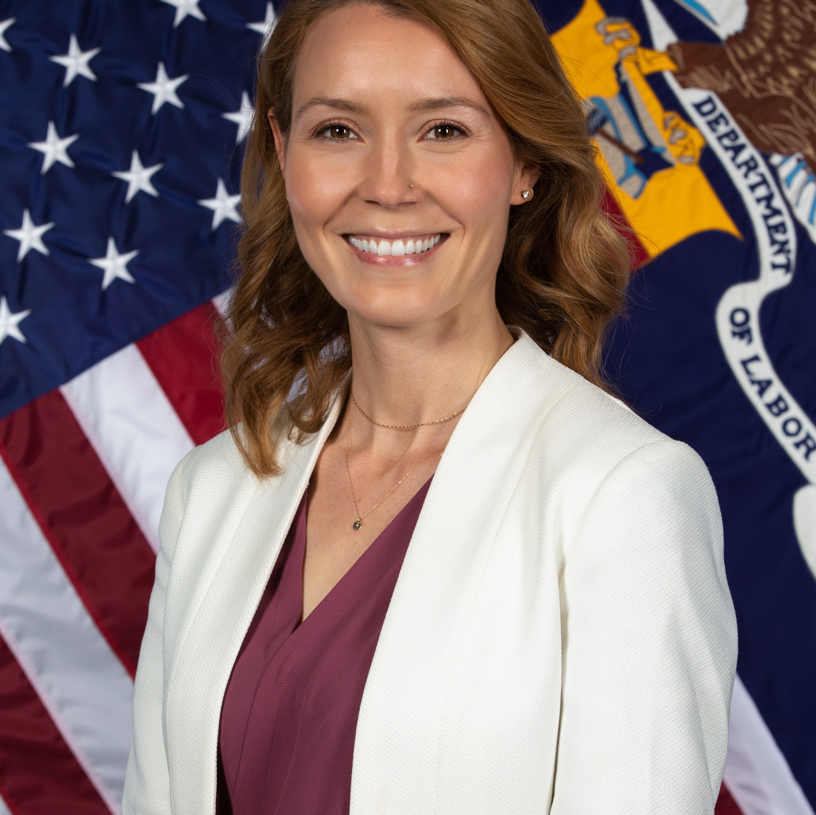
Today’s Moderator
Megan Baird
  Division Director / Division of Workforce, Operations, & Investments
    US Department of Labor, Office of Apprenticeship
Notes:
Megan:
Good morning all, welcome to the SAE 2020 Grantee Orientation. Many of you are familiar from the past ASE and SAE and others may be new grantees. We welcome you to this discussion about the grant and the resources we have available. Next, here is the agenda with a quick highlight of what will be covered today…

Slide 3
AGENDA
Purpose of Grant Program
Agency Offices and Roles
Definitions and Allowable Grant Activities
Reporting Requirements
SAE, ASE, and SAE 2020 Similarities and Differences
Technical Assistance
Grant Agreement and Award Package
Evaluation
Resources
Questions
Agency Contacts
Notes:
Megan: As noted on this slide, we will discuss roles and responsibilities at the national and regional offices, the support system that we have in place as you implement the grant. We will also point out some key differences between the different rounds of state expansion grants that have been awarded. We will also cover the grant agreement and discuss things like grant modifications and wrap up by pointing to some of our available resources. Next slide please.

Slide 4



Today’s Speakers
Michelle Mills
  Project Manager, Division of Workforce, Operations, & Investments, Office of Apprenticeship
Marcia Hampton
  Grants Investment Supervisor / Division of Workforce, Operations, & Investments, Office of Apprenticeship
Brinda Ruggles
  Grant Officer, Division of Federal Assistance, Office of Grants Management (OGM)
Notes:
Megan: Today’s speakers include Brinda Ruggles – your grant officer, Michelle Mills – the project manager for this grant, and Marcy Hampton – the grants and partnership manager in my division of workforce, operations, and investments. Now… we want to get some interaction here, so please go ahead and type in the chat they state that you are representing today. Next slide please.

Slide 5
Where Are You?
Please enter your location in the chat window
  (lower left of screen)
Notes:
We awarded 42 states and territories the SAE 2020 grant, again, welcome to this session. Now I will turn it over to Marcy Hampton. Marcy, take it away….

Slide 6
Grant Purpose
Overview of Tiered Funding Approach
Notes:
Marcy: Thanks Megan. As Megan mentioned, I manage the grants and partnerships team that Michelle Mills, your project manager, works in. Today I will discuss the main purpose of this grant. Next slide please…

Slide 7
Grant Purpose
Build State Capacity & Promote Innovate to Expand RAPs
The goal of these funds is to expand the national Registered Apprenticeship system by funding baseline activities that improve States’ ability to serve, improve, and strategically scale the Registered Apprenticeship Program (RAP) model described in 29 C.F.R. parts 29, Subpart A, and 29 C.F.R.30; and to fund innovations aimed at using RAPs as a tool for developing the economy and building infrastructure.
Notes:
Marcy:
In June 2017, the President issued an Executive Order (E.O.) 13801, Expanding Apprenticeship in America, with a focus on preparing workers to fill both existing and newly created jobs, and to prepare workers for the jobs of the future.
Apprenticeship is an industry-driven, high-quality career pathway where employers can develop and prepare their future workforce, and apprentices can obtain paid work experience, classroom instruction, and a portable, nationally-recognized credential. The E.O. directs the federal government to “promote apprenticeships and effective workforce development programs.”
This funding seeks to implement this recommendation to increase system alignment using Registered Apprenticeship to connect the education and workforce systems. Additionally, this funding builds on recent funding made available to states to expand apprenticeship opportunities. In 2016, the Department awarded $50.5 million in state apprenticeship expansion grants to expand Registered Apprenticeship Programs (RAP) to more workers and more companies and advance RAPs as an industry-driven, high-quality career pathway within states’ education and workforce development systems.

Slide 8
Tiered Funding Activities
Tier I: Baseline Goals and Activities (Required): Every State applying that meets the application requirements will receive a base amount of funding ($450,000 for States and $300,000 for U.S. territories) to engage in activities to strengthen the structures supporting RAPs in their State.
  National Apprenticeship System Building. States must spend base funding on developing structures that ensure that all RAPs in the State have the features of high-quality apprenticeship described in 29 C.F.R. parts 29 (Subpart A) and 30.
  System Alignment for Apprenticeship Expansion. States must spend base funding to build state-wide capacity to increase the number and quality of Registered Apprenticeships through stronger alignment with the education and workforce systems. Activities must demonstrate coordination with secondary education CTE programs, local workforce development programs, and post-secondary educational institutions.
  Improving Data Sharing and Data Integrity. States must commit to improving data sharing and data integrity regarding registration activities.
Notes:
Marcy:
All eligible States and Territories that applied for funding were awarded Tier I funding ($450,000 for States, and $300,000 for Territories). In addition to Tier I funding, 42 States and Territories were awarded additional funds under Tier II, ranging from $3 million to $9 million, based on the quality of Tier II applications received, as well as strong evidence of past performance in expanding Registered Apprenticeship Programs (RAP), geographic, industry, and Tier II goal distribution.
Both Tiers had minimum goals and activities. Tier I had baseline goals and activities that were required for all states that applied for funding. States that also applied for Tier II had to address Tier I goals and activities. These goals and activities included the following mentioned on the above slide. Next slide please.

Slide 9
Tiered Funding Activities Continued
Tier II: Innovation Goals and Activities (Optional): ETA will award States as much as $9 million if their application demonstrates improvements and innovations to RAPs in their State that spread the RAP model, develop infrastructure, and impact other significant policy issues. Applications must also credibly demonstrate that stated goals can be accomplished during the life of the grant.
Up to $3,000,000 on (2 goals +10% RAP increase); $3,000,001 to $6 million (4 goals +20% RAP increase); $6,000,001 to $9 million (6 goals + 25% RAP increase + 5 year strategic plan for growth)
Categories:
    Category A: General Business Outreach, Technology and/or Technical Assistance (TA) Goals
    Category B: Apprenticeship Diversification/New Industry Goals
    Category C: General Apprenticeship Quality Improvement Goals
    Category D: Diversity and Inclusion and/or Special Population Goals
    Category E: System Alignment or Partnership Goals
    Category F: Innovative State-Proposed Goals
Notes:
Marcy:
Tier II states had to address innovation goals and activities. The number of goals varied depending on the funding threshold: up to 3 million (2 goals and 10% RAP growth), up to 6 million (4 goals and 20% RAP growth), and up to 9 million (6 goals and 25%RAP growth). Each application in this tier had to credibly demonstrate that stated goals could be achieved throughout the life of the grant. 11 states received funding under Tier II, you know who you are….. And the categories addressed above that you are focusing on. Now I will turn it over to you project manager, Michelle Mills.. Michelle take it away. Next slide please.

Slide 10
Role and Responsibilities
Roles and Responsibilities between OGM, OA and Regional Offices
Notes:
Michelle:
Thanks Marcy, and to all of you for joining this webinar today. We are excited about the work that you will accomplish through this discretionary grant. Per our records, about 64 percent of you are not new, meaning you received either the first SAE or the ASE grant, and about 34 percent of you are new. We want to go over the roles and responsibilities as it relates to DOL and how we want to communicate with you throughout the life of the grant. Next slide please.

Slide 11
Employment and Training Administration (ETA)
National Office
  Program Office – Office of Apprenticeship (OA)
  Grant Office – Office of Grants Management (OGM)
Regional Office
  Federal Project Officer (FPO)
  Office of Apprenticeship (OA) Subject Matter Experts (SME)
Notes:
Michelle:
The OA has a bifurcated system with the national office consisting of about 30 people, and then we have regional and state staff amount to a little over 100 staff. The national office is the overarching responsible office for this grant, but we work with the regional staff, especially our federal project officers and OA subject matter experts to provide oversight of the grant and ensure compliance with the grant conditions as outlined in your agreements. Next slide please.

Slide 12
National Office – OGM
The office of Grants Management provides:
  Policy Guidance
  Provides fiscal and administrative requirements
The Grant Officer performs official grant duties including:
  Reviews and executes grant modifications
  Ensures adherence to Federal Statues and Regulations, grant terms and conditions, fiscal and administrative requirements
  Maintains the official grant file (actions and documentations such as modifications, no-cost extensions)
  Is the official with final approval for grant activities when there is a question
Notes:
Michelle:
We just mentioned grant agreements, and later today you will be introduced to your Grant Officer, Brinda Ruggles. The OGM provides policy guidance and address fiscal and admin requirements, review modification and so on. We work hand in hand with OGM, question about your grant should be directed to the mailbox apprenticeship.grants@dol.gov and we will work with the FPO and determine which issues should be escalated to our OGM. Next slide please.

Slide 13
National Office – OA
The Program Office has several functions, including:
  Provides support to Federal Project Officers (FPOs)
  Provides clarification and guidance on ETA policy
  Provides Technical Assistance (with support from the external TA provider)
  Creates Learning Opportunities
  Collects and Analyzes performance data
  Provides Apprenticeship policy guidance in coordination with Regional OA Staff
  Develops and delivers performance guidance
  Reviews some grant modifications prior to OGM approval
  Periodically requests additional information about your grant
  Looks at nationwide program trends
Notes:
Michelle
As mentioned, we have the national office and a main part of my role as your project manager is to provide support to FPOs, clarification of policy guidance, ensure TA, etc. And many of you have been introduced to our TA provider, Maher, that will continue to provide services for this discretionary grant – SAE 2020. Next slide please.

Slide 14
Regional Office – Federal Project Officer (FPO)
The FPO’s primary job function includes:
Is your primary point of contact, and first resource for questions to help you manage your entire grant
Coordinates initial special conditions/compliance review response modifications
Ensures adherence to Federal Statutes and Regulations, grant terms and conditions, fiscal and administrative requirements
Reviews and accepts/rejects quarterly financial reports
Provides oversight/monitoring
Provides grant program development and performance guidance in coordination with the National Office
Serves as a resource, provides support, guidance and promising practices on an individual grant basis
Coordinates and/or is apprised of grant-team interactions w/ grantee (SMEs, TA Coaches, OGM, Program Office)
Notes:
MICHELLE:
While I just discussed the program office responsibilities, one key mention was that of the role of the FPO and providing support to your FPO. In that vein, please see about the primary functions of your FPO. Please familiarize yourselves, if not already done so, to ensure you know that you can seek their guidance as it related to compliance with federal regulations and statutes, as well as the terms outlined in the grant agreement. Next slide please.

Slide 15
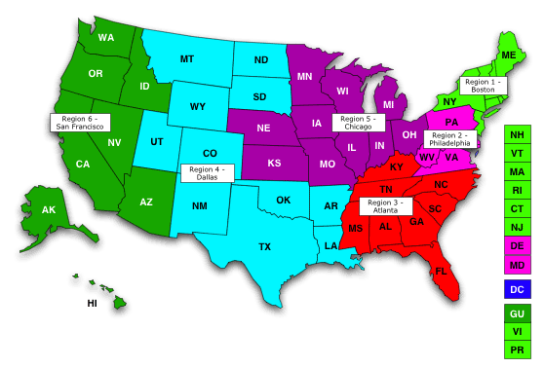
Regional Offices
as
gu
mp
pw
15
Notes:
Michelle:
Again, this provides a quick snap shot of the regional breakdown for the office . Note, we have RDs in each state as follows:
Region I: Boston
Bernard Treml, Regional Director
25 New Sudbury St
Room E-350
Boston, MA 02203
Phone: 617-788-0176
Email: treml.bernard.e@dol.gov
States: Connecticut, Maine, Massachusetts, New Hampshire, New Jersey, New York, Puerto Rico, Rhode Island, Vermont, Virgin Islands
Region II: Philadelphia
James Foti, Regional Director
170 S Independence Mall West
Suite 825 East
Philadelphia, PA 19106-3315
Phone: 215-861-4830
Fax: 215-861-4833
Email: Foti.James@dol.gov
States: Delaware, District of Columbia, Maryland, Pennsylvania, Virginia, West Virginia
Region III: Atlanta
Garfield G. Garner Jr., Regional Director
61 Forsyth St SW
Room 6T100
Atlanta, GA 30303
Phone: 404-302-5478
Fax: 404-302-5479
Email: Garner.Garfield@dol.gov
States: Alabama, Florida, Georgia, Kentucky, Mississippi, North Carolina, South Carolina, Tennessee
Region IV: Dallas
Dudley Light, Regional Director
525 S Griffin St
Room 317-L
Dallas, TX 75202
Phone: 972-850-4682
Fax: 972-850-4688
Email: Light.Dudley@dol.gov
States: Arkansas, Colorado, Louisiana, Montana, New Mexico, North Dakota, Oklahoma, South Dakota, Texas, Utah, Wyoming
Region V: Chicago
Dean Guido, Regional Director
230 S Dearborn St
Room 656
Chicago, IL 60604
Phone: 312-596-5500
Fax: 312-596-5501
Email: Guido.Dean@dol.gov
States: Illinois, Indiana, Iowa, Kansas, Michigan, Minnesota, Missouri, Nebraska, Ohio, Wisconsin
Region VI: San Francisco
Patricia Garcia, Regional Director
90 7th St
Suite 17-100
San Francisco, CA 94103
Phone: 415-625-2232
Fax: 415-625-2235
Email: Garcia.Patricia@dol.gov
States: Alaska, Arizona, California, Guam, Hawaii, Idaho, Nevada, Northern Mariana Islands, Oregon, Washington

Slide 16
Regional Office – Apprenticeship Subject Matter Expert (SME)
The SME’s grant function is to:
Assist with developing Registered Apprenticeship Programs (RAPs)
  and their associated program standards
Advise on matters directly related to apprentices, apprenticeship pipelines and the apprenticeship system
  In coordination with the National Office
They also assist
  with specific apprenticeship-related program questions
  in highlighting success stories and identifying promising practices
  the FPO with grant analysis, where applicable
  Including grantee success or risk factors
  the TA Coach, where requested
16
Notes:
MICHELLE:
As mentioned earlier, we have OA SMEs, and these are their functionalities, including understand the intricacies of 29 CFR 29 and 29 CFR 30 to help you understand the ins and outs of a registered apprenticeship program. Next slide please.

Slide 17
Allowable Grant Activities
Definition on Pre-Apprenticeship, Restrictions to RAP only, and Funding Restrictions
Notes:
MICHELLE:
Now we want to hone in on allowable activities, as mentioned also in the TEGL and the Program Compliance Letter you all received. Next slide please.

Slide 18
Apprenticeship PROGRAM COMPONENTS
Registered apprenticeship program FOCUS
APPRENTICESHIP CORE ELEMENTS | REGISTERED APPRENTICESHIP PROGRAM (RAP) | INDUSTRY-RECOGNIZED APPRENTICESHIP PROGRAM (IRAP)
Paid Job Apprentices are paid allowing them to earn and learn. | Apprentices are paid a progressively increasing schedule of wages consistent with the skill acquired. | Apprentices are paid. Pay increases are not required, but IRAPs must make clear what wages will be paid and under what circumstances the pay may increase.
Work-Based Learning Create a Work-Based Learning model that is either time-based, competency-based or a hybrid approach. | Requires a minimum of 2,000 hours (or one year) for time-based and hybrid programs. RAPs can also be competency-based. | No minimum time requirement and may be shorter than one year. Structured work experiences must be competency-based.
Classroom Learning / Related Instruction Choose a training provider that can be either internal or external (e.g., community college, online training provider, or in-house). | A minimum of 144 hours of Related Training and Instruction (RTI) is recommended for each year of the RAP. | Industry sets the standard and defines the parameters for the Related Instruction (RI) component of the program.
Mentorship Form an internal mentorship program to provide one-to-one support to apprentices. | A one-to-one ratio is highly recommended; however, RAP sponsors can request an expanded ratio based on their occupational needs. | No set ratio of mentors to apprentices; however, programs must provide apprentices structured mentorship opportunities throughout the duration of the apprenticeship that involve ongoing, focused supervision and training by experienced instructors and employees.
Credentials Select a credential to be issued upon completion of the program. | Certificate of Completion from DOL or the DOL recognized State Apprenticeship Agency conveys occupational proficiency and is considered a credential that counts positively towards the Workforce Innovation and Opportunity Act (WIOA) Credential Attainment Rate. | IRAPs result in at least one industry-recognized credential issued during participation in or upon program completion. The credential would also count positively towards the WIOA Credential Attainment Rate.
Notes:
MICHELLE: RAP only, no IRAP or other apprenticeships not registered.
Program Authority. Funds awarded come from the Department’s annual appropriated funds to develop and expand RAPs. This appropriation allows the Department to grant funds to “[e]xpand opportunities relating to apprenticeship programs registered under the National Apprenticeship Act[.]” This means recipients must spend these funds on activities that will create or assist in the creation of RAPs. Funding is authorized under the Department of Defense and Labor, Health and Human Services, and Education Appropriations Act, 2019 and Continuing Appropriations Act, 2019 (Public Law 115-245, Division B, Title I) and was awarded under CFDA Number 17.285. In other words, this funding does not support IRAPs or other programs that are not registered apprenticeships.
Apprenticeships registered by DOL or a recognized SAA are a proven model of job preparation that combine paid on-the-job learning (OJL) with related instruction to progressively increase workers’ skill levels and wages. RAPs are also a business-driven model that provides an effective way for employers to recruit, train, and retain highly skilled workers. RAPs allow employers to develop and apply industry standards to training programs, thereby increasing productivity and the quality of the workforce. RAPs offer job seekers immediate employment opportunities that pay sustainable wages and offer advancement along a career path. Graduates of RAPs receive nationally recognized, portable credentials, and their training may be applied toward further post-secondary education. The regulations for RAPs at 29 C.F.R. parts 29, subpart A, and 30 are authorized through the National Apprenticeship Act of 1937 (29 U.S.C. 50). The Office of Apprenticeship (OA), in conjunction with SAAs, are responsible for: RAPs that meet federal and State standards, issuing certificates of completion to apprentices, encouraging the development of new programs through outreach and technical assistance, protecting the safety and welfare of apprentices, and assuring that all programs provide high-quality training. All RAPs consist of the following five core components: direct business involvement, OJL, related instruction, rewards for skill gains, and a national occupational credential.

Slide 19
Pre-Apprenticeship Leading to RAP
Five Core Elements of A Quality Pre-Apprenticeship
  Designed in Collaboration with RAP Sponsors.
  Facilitated Entry and/or Articulation.
  Meaningful Hands-on Training that does not displace paid employees.
  Sustainability through Partnerships.
  Access to Appropriate Supportive Services.
Notes:
MICHELLE:
Equally so this funding may support pre-apprenticeship leading to RAPs, but note that for your specified targets pre-apprenticeships are not counted towards enrollment goals but can be served as participants under the grant.
Note well, that TEN 13-12 describes pre-apprenticeship but you must adhere to the definition as outlined in the TEGL.

Slide 20
Funding Restrictions
All proposed project costs must be necessary and reasonable and in accordance with federal guidelines.
Determinations of allowable costs will be made in accordance with the Cost Principles found at 2 CFR Part 200 (Uniform Guidance) and 2 CFR Part 2900 (Uniform Guidance – DOL Specific).
See Appendix IV

Slide 21
SAE, ASE, and SAE 2020 Similarities and Differences
All State Grants with Same Overarching Purpose With Some Differences in Strategies and Implementation
Notes:
MICHELLE
Thanks Marcy, now I want to talk a little about the difference between the various state grants. Next slide please.

Slide 22
State Grants Overview
SAE
1. Purpose:
  Increase number of new apprenticeship registrations
  Increase number of businesses engaged
  Expand existing apprenticeship programs
  Create new apprenticeship programs
  Identify unregistered apprenticeships
2. Target outcomes:
  Minimum target number of registered apprentices
3. Staffing: N/A
4. Reporting: QPRs emailed
5. $100 Million - 37 Grantees
ASE
1. Purpose:
  Increase RAP enrollments to expand the number of apprentices in RAPs nationwide
  Broaden RAP diversification
  RAP Workforce Integration
2. Target outcomes:
  Minimum goals for participants served based on funding allotment
3. Dedicated grant staff (FTE) required
4. Reporting in WIPS to meet data requirements
5. $73 Million – 52 Grantees
SAE 2020
1. Purpose:
  Expand the national Registered Apprenticeship system by funding baseline activities to improve States’ ability to serve, improve and strategically scale RAPs.
2. Primary Goals:
  (Tier 1) Strengthened RAP structures
    Increases in targeted industries and /or occupations
  (Tier 2) Improvements and innovations to RAP structures
    10-25% RAP increase from State baseline
    Improvements that impact other significant policy issues related to RAPs
    Innovations in targeting industries and/or occupations
3. Staffing
  Staffing plan and organizational structure required
4. Reporting in WIPS to meet data requirement
5. $81 Million – 42 Grantees
Notes:
MICHELLE – Thank you Marcy for highlighting a very important segment. As Marcy mentioned, the ASE grantees will also be using the system. Now I want to highlight some of the differences between the grants. [Highlight some of the differences between the grants.]

Slide 23
Reporting Requirements
QFRs, QPRs, and DOL-Only PIRL
Notes:
Now back over to Marcy:
Thanks Michelle. This is one of my favorite topics to speak on –performance and reporting. This year, for the first time, we will be reporting in the WIPs system. This is not a case management but a database that allows us to verify and validate participants served under this grant. Next slide please.

Slide 24
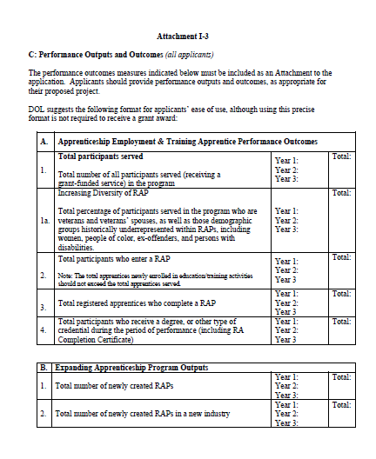
Performance Outputs and Outcomes
Notes:
MARCY:
Here is a snapshot of the performance outputs and outcomes. We noted in the TEGL that targets were not required for Tier I but definitely for Tier II awardees. As seen here we want to capture information not just about those served, but about targeted populations such as minorities, veterans, persons with disabilities and so on.
Next slide please.

Slide 25
Reporting Requirements
QFRs and QPRs
DOL-Only PIRL
1) Quarterly Financial Reports. A Quarterly Financial Status Report (ETA 9130) is required until such time as all funds have been expended or the grant period has expired. Quarterly reports are due 45 days after the end of each calendar year quarter.
2) Quarterly Performance Reports. Grant recipients must submit a quarterly progress report within 45 days after the end of each calendar year quarter. This report includes a quarterly narrative report that details all grant activities that occurred during the quarter.
Performance reporting for these grants will align with the DOL-Only Performance Accountability Information and Reporting System (OMB Control No. 1205-0521) information collection request (ICR).
As part of quarterly performance reporting, DOL requires grant recipients to conduct data validation to ensure the validity of data submitted to DOL. Grant recipients are encouraged to fully implement the data validation framework published in forthcoming DOL data validation guidance.
Notes:
MARCY:
This year for the first time, we will be using the WIPs – Workforce Integrated Performance System, to capture participant level data from these grants. As noted above, the first quarterly report is due 45 dates at the end of each calendar quarter. No worries, for the new grantees present, our TA provider, Maher will send out reminders for you. We will also have upcoming webinars to walk through requirements for data submission in the PIRL. We will have a beta testing group that will provide data for the PIRL, so we will try and address all the technical difficulties you may encounter. Of note, this is not a case management system, you will need to have your own to help validate and confirm apprentice participants. Thank you, next slide please.

Slide 26
Technical Assistance
TA Contractor – Maher and Maher
Notes:
MICHELLE – Will continue with Maher. For newer grantees, there is a specific ASE CoP and a general Apprenticeship CoP that will be used for the SAE 2020 grantees.

Slide 27
Technical Assistance – Maher & Maher and WorkforceGPS
Maher & Maher will continue to provide technical assistance (TA) to state grants under SAE 2020.
Maher & Maher TA will include:
  Subject matter expertise and customized support
  One-on-one coaching by a dedicated TA coach who will provide grantees with personalized support to address challenges
  Individual or small-group conversations with experts in the field designed to inform strategy and address challenges
  Intensive TA provided on-site or virtually by coaches and subject matter experts
Community of Practice (COP): Provides an on-line collection of apprenticeship information, tools, resources, and best practices.
Apprenticeship Connections Monthly Newsletter: Provides shared resources, best practices, grants management tools, and announces upcoming events.
Notes:
Your grant work will be supported by a technical assistance contract with Maher and Maher.
As part of this TA, you will receive
Subject matter expertise and customized support
One-on-one coaching by a dedicated TA coach who will provide you with personalized support to address challenges
Opportunities to advance your knowledge and build skills through webinars, trainings, cohort learning and more
Intensive TA provided on-site or virtually by coaches and subject matter experts
A community of practice on workforce GPS provides a wide range of apprenticeship information, toolkits, resources and best practices
You'll also receive a monthly newsletter called Apprenticeship Connections that provides critical grant management information, TA resources, announcements of upcoming events, and more.
Over the next few weeks, you will here from the TA Project Director, Gina Wells with information about accessing coaching and other TA.

Slide 28
Grant Award Package
& Modifications
Notes:
Michelle to Brinda.

Slide 29
The Grant Award Package
Grant Award Letter
Grant Agreement:
  Special Conditions of Award Page
  Signature Page / Notice of Award (NOA)
  Terms and Conditions
  Application for Federal Assistance
  Budget
  Statement of Work (SOW)
  Indirect Cost Rate Agreement (if applicable)
29
Notes:
Brinda
Good afternoon everyone. I am Brinda Ruggles from the Office of Grants Management. Congratulations again on receiving your awards.
You already received from our office your grant award package, which consisted of the grant award letter, which is the document labeled Payment Management System Letter; the Grantee Handbook; and the actual grant agreement. This agreement includes the Notice of Award, which contains the signature page; the Condition of Award page; the grant terms and conditions; the Application for Federal Assistance (also known as the SF-424); the budget, which includes the SF-424A and Budget Narrative; the Statement of Work, and (if applicable) the Indirect Cost Rate Agreement.

Slide 30

Grant Award Letter
Acknowledgement of Award
Payment Management System
  Information and forms on www.doleta.gov/grants under Manage your Awarded Grant
ETA’s on-line Grantee Financial Reporting System
  ETA 9130
  Information to access system on www.doleta.gov/grants under Manage your Awarded Grant
Passwords/PINs are sent separately after supplying the necessary information
Once you receive this please DO NOT LOSE IT!
30
Notes:
Brinda
The Grant Award Letter, which is the Payment Management Letter, or PMS, contains important information about 1) how to access your funds via the PMS, which is operated by the Department of Health and Human Services, and 2) how to access DOL’s Grantee Reporting System for financial reporting. These systems require two separate passwords and PINs. Information and forms for these systems can be found at www.doleta.gov/grants under “Manage your Awarded Grant”.
You’ll find information on this site about the grantee fiscal reporting system and the Federal Financial Report form, also known as the ETA-9130.
Your passwords and PINs are sent separately after you supply the necessary information.
Once you receive it, please do not lose it!

Slide 31
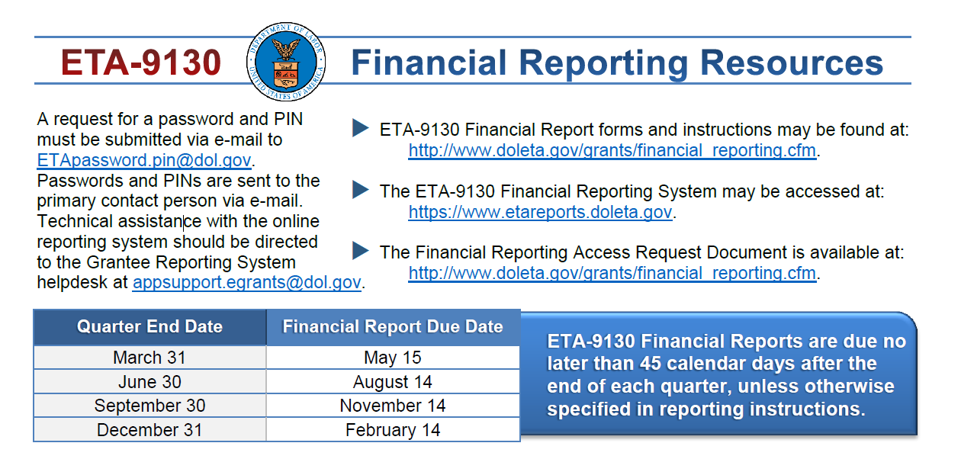
Quarterly Financial Report
Notes:
Brinda
Briefly, we will go over the Quarterly Financial Report.
All ETA grant recipients use the ETA 9130 Quarterly Financial Form to report expenditures charged against the grant.
As with the QPR, the quarterly report is due within 45 days from the end of the quarter.

Slide 32
Grantee Handbook
A general resource designed to orient grantees to the grant process in ETA.
It contains pertinent information grantees need to know regarding the goals and expectations for managing ETA grants.
Notes:
Brinda
You also received the Grantee Handbook; a general resource designed to orient grantees to the grant process in ETA.
We recognize that administering grants can be an overwhelming responsibility; therefore, our goal in assembling this Grantee Handbook was to make sure that you have the resources and information at hand to help you succeed.
The Grantee Handbook is presented in seven sections. Each section contains pertinent information that you and your staff need to know regarding the goals and expectations for managing an ETA competitively awarded grant, such as how to manage your period of performance, modifying your grants, the audit phase and close out phase.

Slide 33
Grant Agreement Notice of Award
Project Title
– Apprenticeship State Expansion
Grant Awardees' Identifying Information
Federal Award Identification Number (FAIN)
    Grant Number # AP-33XXX-19-60-A-XX
Period of Performance
– July 1, 2020 to June 30, 2023
Award Amount
Uniform Administrative Requirements
Cost Principles
Signatures
33
Notes:
Brinda
The first page of the grant agreement is the Notice of Award, or NOA. This page has the project title – which is Building State Capacity to Expand Apprenticeship through Innovation - and it contains the grant recipient’s identifying information, which is the name of your organization, address, EIN and DUNS number.
It also contains the Federal Award Identification Number, or FAIN, otherwise known as the Grant Number, the period of performance, award amount, Uniform Administrative Requirements and cost principles, and signatures are also included in this document. All Apprenticeship State Expansion agreement numbers should start with “AP” and then a five-digit number, a “19-60-A”, and then either a one or two-digit number. Please reference this number when you contact the National Program Office or your Federal Project Officer (FPO) when you have questions about your grant.

Slide 34

Notice of Award Regulations
    2 CFR Part 200 (Uniform Guidance)
      Uniform Administrative Requirements
      Cost Principles, and
      Audit Requirements for Federal Awards
    2 CFR Part 2900
      DOL Exceptions to the Uniform Guidance
    Terms and Conditions of Award
34
Notes:
Brinda
As grantees, you are required to fully comply with all applicable Statutes, regulations and cost principles in performing your responsibilities under this grant agreement.
Cost principles that are a set of government-wide rules that apply to all ETA grantees, and are outlined in 2 CFR 200 (the Uniform Guidance) and 2 CFR 2900 (DOL Exceptions) which define the conditions under which educational institutions, non-profit organizations, and government agencies may charge costs within federally-funded grants. These regulations provide guidance to help you determine whether specific planned expenditures are allowable, unallowable, or allowable with conditions.
The Uniform Administrative Requirements stated in 2 CFR 200 and codified by ETA regulations at 2 CFR 2900 outline the standards for obtaining consistency and uniformity across Federal agencies.
There are also other requirements included in the Terms and Conditions of the award.

Slide 35
Budget Review and Statement of Work
Review of Budget Documents
Program Compliance Notification Letter
35
Notes:
Brinda
After the NOA page of the award agreement is the condition of award page.
ETA has reviewed your budgets, and accompanying materials to ensure that you are in compliance with the requirements outlined in the TEGL… to identify potential unallowable cost and compliance issues. The conditions of award are based on the analysis of the budget information submitted for the competition. The review was focused on major potential cost and compliance items. You will have 30 days to work with your FPO to respond to these items.
As for the Program Office Compliance Reviews, no reviews was conducted this year. In lieu of receiving individual findings regarding programmatic non-compliance, included in the NOA is a “Program Compliance Notification Letter” that outlines key programmatic compliance requirements such as: key required activities grantees must ensure are incorporated into their grant; key activities that are not allowable (which could lead to unallowable costs if not addressed); links to existing grantee guidance (such as FAQs, the TEGL, and administrative/financial trainings); and grantee guidance on performance expectations and reporting mechanisms.
Please note that the signature of the Authorized Representative on the SF-424, and indicated in the Program Compliance Notification Letter, confirms your organization’s acceptance and acknowledgment of programmatic compliance requirements. Please review that letter, if you have not done so, as it provides critical information that you need to know to successfully manage your grant. And again, any questions, concerns that you may have, please contact your FPO.

Slide 36

Grant Agreement Conditions of Award & Terms
Order of Precedence
TEGL-17-18 and Amendments
(incorporated by reference)
36
Notes:
Brinda
Following the Conditions of Award are the terms and conditions of your grant, starting with the Order of Precedence, if there is any conflict in what Federal laws require. This is followed by any other applicable Federal statutes and their implementing regulations, and finally by the terms and conditions of award.
Next is the reference to the TEGL followed by other pertinent grant information.

Slide 37

Grant Agreement Terms
FPO Contact Information
Indirect Cost Rates
Audit Requirements
Pre-Award Costs
Reporting Requirements
Procurement
Intellectual Property Rights
37
Notes:
Brinda
The other terms and conditions of your grant agreement include, to list a few:
contact information for your FPO, who is your primary point of contact throughout the duration of your grant;
the status of any indirect cost rates;
audit requirements;
grantee responsibility for pre-award costs – meaning that all costs incurred prior to the start date specified in the award are incurred at the grantee’s expense;
reporting requirements;
procurement requirements -the Uniform Guidance Procurement Standards at 2 CFR 200.317-326 require all award recipients and subrecipients to conduct procurement transactions in a manner that promote practical, open and free competition. If the award recipient specifies the entity that will provide the goods or services in their statement of work, then the ETA’s description of award does not provide the justification for such sole-source procurement;
intellectual property rights requirements.

Slide 38
Terms to Note
  12.e: Equipment
    Equipment purchases are not an allowable cost for these grants
  12.f: Federal Funding Accountability and Transparency Act (FFATA)
    A prime grantee (these grants) must report any sub-awards (sub-grants and/or contracts) which are $25,000 or more through the FFATA Subaward Reporting System (FSRS)
  12.i: Personally Identifiable Information
    Award recipients must meet the requirements in Training and Employment Guidance letter (TEGL) 39-11, Guidance on the Handling and Protection of Personally Identifiable Information (PII)), found at http://wdr.doleta.gov/directives/corr_doc.cfm?DOCN=7872
38
Notes:
Brinda
One very important term of your grant deals with equipment purchases, which are not allowable under this award.
Another is the requirement to submit FFATA reports for sub-awards (which includes both sub-grants and contracts) which exceed $25,000 – your accounting departments should be aware of this requirement, but it is something program managers should also be aware of.
Grantees are required to follow TEGL number 39-11 when handling personally identifiable information (PII), which you should keep in mind as you develop your reporting systems. Award recipients must recognize and safeguard PII except where disclosure is allowed by prior written approval of the Grant Officer or by court order.

Slide 39
Terms to Note
  14.l: Restriction on Lobbying /Advocacy
    “… no federal funds may be used by a grant recipient, other than for normal and recognized executive-legislative relationships, to engage in lobbying or advocacy activities related to the enactment of federal, state, or local legislation, regulation, appropriations, order, or other administrative action, except in presentation to Congress or a State or local legislature itself …”
  14.o: Salary and Bonus Limitations
    Places a limit on the amount of Federal funds which can be paid individuals either as direct costs or as indirect costs, at a rate in excess of Executive Level II.
  14.g: VETERANS’ PRIORITY PROVISIONS
    The Jobs for Veterans Act (Public Law 107-288) requires recipients to provide priority service to veterans and spouses of certain veterans
39
Notes:
Brinda
14.l address the prohibition of utilizing Federal funds to support lobbying-types of activities.
14.o address limitations on the Federal funding which can be utilized to pay any single individual.
14.g Veterans’ Priority Provision - requires recipients to provide priority service to veterans and spouses of certain veterans for the receipt of employment, training, and placement services in any job training program directly funded, in whole or in part, by the DOL.

Slide 40

Grant Agreement Attachments
Attachment A: SF-424
Attachment B: SF-424A
Attachment C: Budget Narrative
Attachment D: Statement of Work
Attachment E: Indirect Cost Rate
Agreement (if applicable)
40
Notes:
Brinda
There are five attachments to the grant agreement. These are the SF-424, SF-424A, budget narrative, Statement of Work, and the indirect cost rate agreement (if applicable).

Slide 41
Budget and Statement of Work
Budget Information
  SF-424A
  Budget Narrative
Grantee’s original proposal
  Project Narrative
  Timeline/Workplan
  Performance Outcome Measures Table
  Governor’s Letter
  Project Attestation Confirmation
41
Notes:
Brinda
Attachment A, B and C of the grant agreement contain the SF-424, SF-424A and Budget Narrative, respectively. All three of these documents were taken from your proposal.
Attachment D is your Statement of Work, commonly known as the SOW. This also comes from your application and includes the project narrative and all required attachments, such as the timeline/work plan; performance outcomes table; Governor’s letter; and project attestation confirmation.

Slide 42
Indirect Cost Rate Agreement
Only applicable to those claiming indirect costs
If grantee is claiming indirect costs but did not provide agreement, placed on 90-day temporary rate
Applicants missing indirect cost rate or CAP agreements (or submitting expired ones) are limited to lesser of either total claimed indirect costs or 10% of total Personnel budget
42
Notes:
Brinda
For those applicants claiming indirect costs, Attachment E includes the Negotiated Indirect Cost Rate Agreement.
If you claimed indirect costs and did not provide a Negotiated Indirect Cost Rate Agreement from your federal cognizant agency, you were put on a 90-day temporary billing rate. If that is the case, that means that 10% of the Personnel line or total Indirect line (whichever is less) only is released to support indirect costs in the absence of your NICRA or CAP approved by the cognizant agency.
The remaining funds for Indirect Costs are restricted and cannot be used for any purpose until you provide ETA a signed copy of the NICRA or CAP. When ETA receives the NICRA or CAP, ETA will issue a grant modification to the award to remove the 10% restriction. Basically, the Grant Officer will approve the grant modification and lift the restriction.
please send your approved indirect cost rate agreement to your FPO. Please note that until a negotiated agreement is received, spending on indirect costs will be limited to the lesser of either total indirect costs or Personnel budget.
If the Agreement is not submitted within 90 days of the effective date of the award, no funds will be approved for reimbursement of indirect costs.

Slide 43
Grant Modifications
What is a modification?
Why do a modification?
What are modification indicators?
FPO Modification Analysis
  Reasonable
  Performance
  Best interest of the government
43
Notes:
Brinda
OK…. Let’s discuss next about grant modifications.
Processing of grant modifications is vital in the grant process. During the next few slides, I will outline the modification process. The What, Why, How, and When…

Slide 44
What is a Grant Modification?
Mechanism to
CHANGE
the Terms of the Grant Agreement
44
Notes:
Brinda
That leads us to this question:
What is a Modification?
It’s a tool used to make a change to your grant agreement for clarity between the grantee, the regional office, and the national office.

Slide 45
Why Do A Modification?
Change of Scope
  {Very rare & only minor changes will be considered}
  Program Design
    Service Area
    Change in Partners
    Key Personnel Changes
  Performance Outcomes
    Outcome Measures
45
Notes:
Brinda
Why should you do a mod?
One reason would be a change of scope. Note that a change in scope is rare and not always approved. Your scope of work is based solely on the requirements outlined in the TEGL and this is how you competitively won this grant. For instance, if your proposal was to create apprenticeship programs in cybersecurity and you would like to change the industry to cosmetology, this would not be allowable. However, there are other types of changes to the scope that could be considered.
1. A change in service area: expanding or shrinking the area to be served
2. A change in partners. Your partnership structure is crucial to the success of your grant, so if something happens to one of these partners, let us know immediately.
3. Changes in the project’s management: if things have changed with these key personnel, let us know immediately.
4. A change in the number of participants: Decreasing participant numbers must be thoroughly reviewed by your FPO, the Program Office, and the Grant Officer. It is a change that we do not easily approve of.

Slide 46
Why Do A Modification?
Budget Re-alignment
  Transfer of funds among direct cost categories if cumulative amount of such transfer exceeds or expected to exceed 10% of the total budget
Change in Period of Performance
Change Indirect Cost Rate
Change Authorized Representative
46
Notes:
Brinda
There are a few other reasons to request a Modification:
1. Prior approval is required from the Grant Officer when transferring funds between 424A categories or programs, functions, and activities if the cumulative amount of such transfers exceeds or is expected to exceed 10 percent of the total budget. Please note that if a budget realignment modification is submitted, we ask that you specifically outline the affected costs. For example, if adding funds to the Travel line item, specify the purpose of the needed travel, number of staff traveling, exact costs (or close estimates) to be incurred, per diems, etc.
2. If you might have room to extend your grant, a modification is required to extend your period of performance.
3. If the Indirect Cost Rate negotiated with your federal cognizant agency has changed.
4. If there has been a change in the Authorized Signatory or the Contact Person for the grant.
Again, these are examples and when in doubt, always consult your FPO.

Slide 47

FPO Modification Analysis
Grant Quality
  Services
  Staffing
Grant Efficiency
  Timely
  Cost Effective
Grant Performance
  Enrollments
  Expenditures
47
Notes:
Brinda
When the FPO receives a request for a mod, they will review the request. He or she will ask:
How will services and staffing be impacted?
Is the change effective and beneficial?
What about the enrollments the expenditures, are they on target, if not why not?
Does the change conflict with the requirements of the TEGL?
Is it an allowable change?
Prior to submitting the modification to the grant officer for approval the FPO must first concur with the changes.

Slide 48
Required Documentation for Modification Requests
Must be submitted with letter on Organization’s Letterhead
Must be signed by the Authorized Representative
Provide the purpose
Why it’s necessary
How the change will benefit the program
Appropriate documentation to support Modification
48
Notes:
Brinda
Requests must be submitted on the organization letterhead and signed by the authorized representative at least 30 days prior to the effective date you are seeking.
Include the modification purpose, why the modification is needed, and how the change will benefit the program, along with supporting/required documentation as needed.
Two requirements for supporting documentation:
-If the modification is to change the Authorized Representative, the letter should not come from the new or incoming AR. Instead the letter should come from either the departing AR or someone in a supervisory or oversight role over the AR.
-If a budget realignment modification is being submitted, you are required to provide a revised SF424, SF424A and a budget narrative. The budget narrative should have clear delineated description of costs associated with each line item on the SF424A in a narrative format which aligns with the subtotals and total provided in the narrative and aligns with the totals indicated on the SF424A. It should also justify amounts and changes requested. The amounts listed in the budget narrative should match the amounts listed for each line item on the SF424A. When in doubt, always consult your FPO for guidance.

Slide 49
How to Submit a Modification?
ALL requests for modifications should be submitted to your FPO
  See the grantee hand book for details
The FPO will review and
  recommend approval to the Grant Officer; or
  request revisions; or
  recommend another course of action
49
Notes:
Brinda
I encourage you not to wait until the last minute to submit a modification.
You should always be monitoring the performance of your grant and make adjustments as needed.
Again, you can discuss any anticipated changes with your FPO. He/she is your first line of contact and is available to provide any necessary technical assistance.

Slide 50

Modification Analysis
Your FPO reviews the modifications
Limited SOW modifications require review by Program Office
National Grant Officer gives final approval
Grantee receives copy signed by Grant Officer
Regional Grant Officer can approve some budget modifications and equipment purchases
Otherwise, regional management sends to National Grant Officer for review
Notes:
Brinda
Diagram…
Your FPO will be the first to review your modification request. They will provide feedback on your request letter and then submit it to the Regional Grant Officer for approval, if it’s a simple budget modification or equipment purchase. If it’s a more complicated modification, your FPO will send your request to the National Grant Officer for final review and approval after the regional management team provides their okay. Limited SOW changes also require review by the Program Office. Your FPO will send these requests to the Program Office for review. The Grant Officer will review the request and may ask for additional information or revisions. If there are no additional questions the Grant Officer reviews and signs the modification. Both you and your FPO will receive a copy of the signed modification via email.
There is more detailed information about submitting a modification in your Grantee Handbook, so please use that as a guide when submitting modifications.

Slide 51
Modification Process
Write a formal letter of request addressed to your Grant Officer.
Include modification type, Closing the Skills Gap grant number, and justification for request.
Submit the final letter, signed by your signatory to FPO, with a copy to the Program Office.
FPO forwards request to Grant Officer.
Notes:
Brinda
To recap, to submit a modification, you should start by discussing the potential mod with your FPO. This will save you a lot of time! After that, you will draft a letter of request addressed to your Grant Officer. The letter should be written on your organization’s letterhead and include the modification type, the CSG grant number and justification for the requested modification. Your FPO will review the letter and provide feedback, if needed. A final letter, signed by your signatory should be submitted to your FPO who will then forward it to the Grant Officer.

Slide 52
ETA Evaluation
As a condition of grant award, grantees are required to participate in an evaluation, if undertaken by DOL.
The evaluation may include an implementation assessment across grantees, an impact and/or outcomes analysis of all or selected sites within or across grantees, and a benefit/cost analysis or assessment of return on investment.
Notes:
MARCY:
Thanks Brinda. Before we wrap up this session, we wanted to remind our grantees that DOL may conduct an evaluation of your grant to assess the impact and outcomes of the investments. This is typically done through ODPR- the Office of Policy Development and Research. Now I will turn it back over to your project manager, Michelle Mills.

Slide 53
Additional Resources:
WorkforceGPS – Apprenticeship
  Key resource and best practices for grantees
    https://apprenticeship.workforcegps.org/homeName of Reference Item
Uniform Guidance Overview
  Grants Management Requirements
    https://doleta.gov/grants/UniformGuidance.cfm
OGM SMART Training
  Additional information about this resource
    https://grantsapplicationandmanagement.workforcegps.org/resources/2019/12/15/21/50/SMART_3-0_Webinar_Training_Series
Grantee Handbook
  Resource on how to effectively manage ETA grants
    https://doleta.gov/grants/docs/ETA_Grantee_Handbook.pdf
Performance reporting
  WIPS Performance Reporting Resources
    https://www.doleta.gov/performance/Name of Reference Item
Grants Management Training
  Workforce GPS Grants Management Training Resources
    https://grantsapplicationandmanagement.workforcegps.org/resources/2016/12/14/10/45/Grant-Management-TrainingName of Reference Item
  Grants.gov Grants Management Training
    https://www.grants.gov/web/grants/learn-grants/grant-reporting.html
Notes:
MICHELLE : Thanks to all our amazing presenters and of course, thanks to you our grantees. Here you will find some highlighted resources for grant management and performance reporting.

Slide 54
Any Questions?
Notes:
If you have any questions, feel free to type in the chat or email us at apprenticeship.grants@dol.gov. Now I will turn it back over to Megan, our Division Director.
Next slide please.

Slide 55
Contact Us
Marcia Hampton
  Grants Investment Supervisor
    USDOL, ETA, DWOI
      Hampton.Marcia@dol.gov
        202.693.2626
Brinda Ruggles
  Grant Officer
    USDOL, ETA, OGM
      Ruggles.Brinda@dol.gov
        202.693.3437
Michelle Mills
  Project Manager
    USDOL, ETA, DWOI
      Mills.michelle.v@dol.gov
        202.693.3998
Notes:
MEGAN:
Thanks to all the presenters and grantees. Just to reiterate, if you have questions about the SAE 2020 grant, please direct them to your project manager, Michelle Mills, and send emails to the apprenticeship.grants@dol.gov mailbox. Next slide please.

Slide 56
Thank You!
Grant related questions? Email: Apprenticeship.grants@dol.gov
Need help? Email: Support@workforceGPS.org

