Slide 1
Grant Closeout Process
Division of Policy Review and Resolution
ETA Office of Grants Management

Slide 2
The Closeout Process Objectives
What is Grant Closeout
Policy and Grant Requirements
Recipient Responsibilities
Closeout Timeline
Elements of a Closeout Package
Closeout Review Process (Financial and Compliance)
Common Delays
Authority after Closeout
Questions

Slide 3
What is Grant Closeout?
Closeout takes place following the expiration or
termination of the grant period for a grant or cooperative
Agreement.
Closeout is the completion of the grant life cycle.
The purpose of closeout is to ensure:
Final reports are received and evaluated;
Allowable costs are identified; and
Amounts due to the Federal Agency or to the recipient
are determined and payments are made.

Slide 4
What is Grant Closeout? Policy and Grant Requirements
Official end of the government’s relationship with the grant recipient
2 CFR 200.343: Closeout
2 CFR 200.344: Post- closeout adjustment
2 CFR 200.345: Collection of Amounts Due
2 CFR 2900, Subpart D
Grants Oversight and New Efficiency Act (GONE Act) (Public Law 114-117) requires agencies to report federal grant awards which have not yet been closeout for the period of performance has elapsed for more than two years.

Slide 5
What is Grant Closeout? Grant Closeout Partners
Department of Labor
Direct Recipient
Primary Partners
HHS
Sub-recipient

Slide 6
What is Grant Closeout? Closeout Roadmap
Sub-recipient Closeout
Direct Recipient closeout
DOL Role

Slide 7
Closeout Timeline Closeout Begins
Within 7 days before the period of performance end date, an initial notification will be sent to the direct recipients to start the grant closeout process.
Grant recipient must submit final 9130 for last quarter (Check box 6 as “Final”) - Within 45 days after period of performance (PoP) end date
Grant recipient must submit all remaining closeout documentation - No later than 90 calendar days after the end date of PoP
2 CFR 200.343

Slide 8
Recipient Responsibilities Key Steps to a Successful Closeout
Work with your sub-recipient
Communicate and coordinate due dates
Review reports submitted by sub-recipient
Do they agree with the grant records?
Take care of advances or over-payments
Does everything agree to the dollar?

Slide 9
Recipient Responsibilities
Key Steps to a Successful Closeout…
Reconcile Financial Expenditures
Costs must be reasonable, allowable, accurate per the Uniform Guidance, 2 CFR 200
Liquidate all costs incurred
Submit the final and closeout 9130 financial reports
Reconcile the closeout 9130 to PMS report

Slide 10
Recipient Responsibilities
Key Steps to a Successful Closeout….
Submit performance/progress report or other reports required by the terms and conditions specified on the Notice of Award.
Account for any real and/or personal property acquired with federal funds
Return any funds due as a result of refunds, corrections, or audits
Retain records for three (3) years

Slide 11
Closeout Timeline Deadlines
October 30, 2020 – Grant expires, closeout begins.
February 15, 2021 – Final 9130 financial report due.
Because the grant ends in October, the final quarterly report is December 31, 2020 and the due date to submit the financial report is 45 days after the quarter ends
February 28, 2021 – Closeout 9130 and remaining closeout documents due.

Slide 12
Elements of the Grant Closeout Package
Documents to be submitted:
Closeout 9130 financial report
(In order to access the closeout 9130, the final quarterly report must be marked “FINAL” and you will see a “Closeout” hyperlink in Box 6).
Grantee’s Detailed Statement of Costs
NICRA/CAP/SWCAP and calculation (if applicable)
Grantee’s Release
Grantee’s Assignment of Refunds, Rebates, and Credits
Grantee’s Property Inventory Certification
Inventory List (if applicable)
Grantee’s Closeout Tax Certification

Slide 13
Closeout Review Financial Reconciliation - Final Quarterly 9130

Slide 14
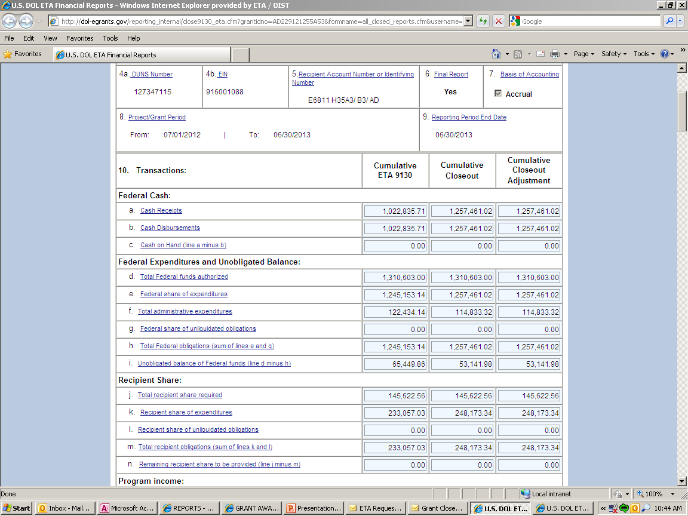
Closeout Review… Financial Reconciliation -Closeout 9130

Slide 15
Closeout Review… Financial Reconciliation -Final Quarterly 9130/ Closeout 9130

Slide 16
Closeout Review… Financial Reconciliation Liquidation of Obligation & Accrued Expenditures (2 CFR 2900.15)
No new obligations. In closeout, grantee may only liquidate obligations incurred during PoP.
The only liquidation that can occur during closeout is the liquidation of accrued expenditures (NOT obligations) for goods and/or services received during the grant period.
Grant recipient may not direct charge staff time to work on closeout of grant after PoP end date

Slide 17
Closeout Review…. Financial Reconciliation - Final
Recipient
HHS
DOL
Net Draws
- Final cost
$0.00
Award Amount
Net Draws
Available
Award Amount
Final Cost
Unexpended Balance
HHS Net Draws = Final Cost
Unexpended Balance = HHS Available = Closeout Deobligation

Slide 18
Closeout Review… Compliance - Indirect Costs
Indirect cost reporting line items have been added.
Indirect cost expenses are only to be reported by the non-federal entity receiving direct awards from DOL.
Indirect cost expenses are reported only on the FINAL ETA-9130 report.
Negotiated Indirect Cost Rate Agreements (NICRAs) or Cost Allocation Plans (CAPs) must be provided at closeout if indirect costs claimed.

Slide 19
Closeout Review… Compliance - Indirect Costs con’t

Slide 20
Closeout Review…. Compliance - Budget and Costs

Slide 21
Closeout Review… Compliance - Budget Realignments in Closeout
Grant recipient provides written detailed budget narrative and justification to the closeout specialist.
The closeout specialist consults the FPO on the retroactive budget realignment and request for recommendation and concurrence, if appropriate.
FPO sends the recommendation to the closeout specialist and it is documented in file.

Slide 22
Closeout Review…complete Grant Closed
A final notification will be emailed to the recipient when award is officially closed:
All programmatic requirement met
Required reports and certifications received
Federal outlays = Federal draws
Unexpended grant funds deobligated

Slide 23
Common issues Which Delay Closeout
Non-responsive grantees
Not submitting all required documents accurately and timely
Expenditure amount higher than drawdown amount.
*They need to match*
Refunds
Equipment disposition
9130 issues
Indirect cost issues
Question and disallowed costs/ID’s and FD’s
Budget realignments

Slide 24
Common Issues…. Refunds
2 CFR 200.343 (d)
Grant closeout does not affect recipients obligation to return funds due to DOL as a result of refund.
Prompt refund of any balances of unobligated funds.
Refunds may require revising final expenditure report.
Refunds can be electronically through PMS or Pay.gov.

Slide 25
DOL Authority after Closeout
Disallowances
Debt
Access to Records
Property Management
Audit

Slide 26
Key Takeaways
Look out for the Closeout Notification email.
All closeout documents must be submitted within 90-day.
Late payment draw request and liquidation of accrued expenditures.
Submission of the final quarterly 9130 and the Closeout 9130.
Budget Realignment during closeout…better done while the grant is active.
Grant funded property/equipment and continued use.
Indirect charges will only be allowed based on approved rate agreement or cost allocation plan.

Slide 27
I close… You close… We close!
Questions?
Comments?

Slide 28
Thank you!

