Slide 1
Effective Community College-Workforce Development Board Partnerships
High Impact Partners on behalf of the Employment and Training Administration
U.S. DOL

Slide 2
Let’s get to know who is on the call today. Using the poll, select the role that you play in your America’s Promise grant.
For America’s Promise I am the:
Authorized Representative
Program Director/Manager
IT/Data Manager or staff
Training Partner
Employer Partner
Service Provider

Slide 3
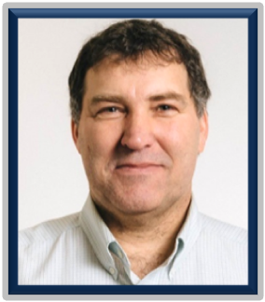
Today’s Moderator
Gregory Scheib
Workforce Analyst
U.S. Department of Labor,
Division of Strategic Investments,
Employment & Training Administration

Slide 4
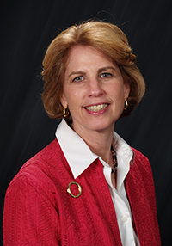
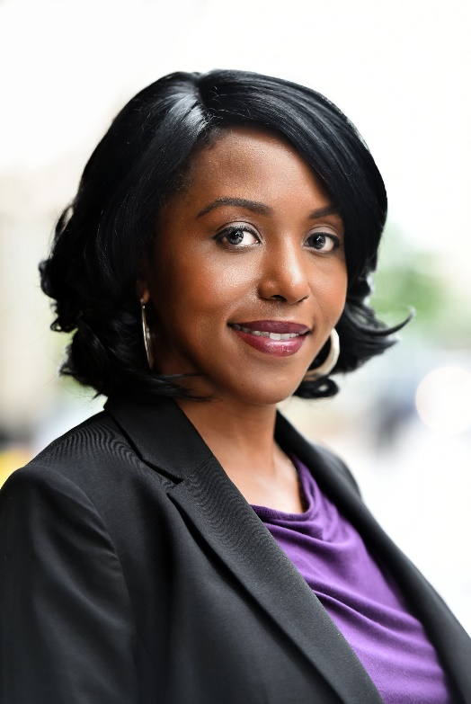
Today’s Facilitator
Jan Bray
TA Coach
National Association of Workforce Boards
Kelly Middleton Banks
TA Coach
National Association of Workforce Boards

Slide 5
Today’s Objectives
Think differently about community college-workforce development board partnerships by learning something new or thinking about something from a new perspective.
Be inspired to strengthen the current partnerships and continue to cultivate the partnerships not yet fully developed.
Understand how to leverage the partnership to meet the efforts under the America’s Promise grant and move forward in meeting short- and long-term goals.

Slide 6
Poll: Partnerships between WDBs and Community Colleges
Please select the choice that applies to your relationship with your local community colleges or Workforce Development Board (WDB)
I am a community college and I have a partnership with my WDB.
I am a community college and I do not have a partnership with my Community College.
I am a WDB and I have a partnership with my Community College.
I am a WDB and I do not have a partnership with my Community College.

Slide 7
Grantee Presenters
Julie Parks
AP Project Leader
Grand Rapids Community College
Grand Rapids, MI
Angie Barksdale
Chief Operating Officer
West Michigan Works!
Grand Rapids, MI

Slide 8
Grantee Presenters
Mellisa Leaming
Director of Operations
Region 4 Workforce Board
Lafayette, IN
Cindy Randolph
Executive Director of Career Experiences and Student Talent Connections
Ivy Tech Community College
Indianapolis, IN

Slide 9
WDB and Community College Partnerships

Slide 10
Establishing the Partnership
How did the community college and workforce board build consensus around establishing a partnership?
What steps did you take to build the partnership and how long did it take you to reach the relationship you have today?
How would you describe the roles you each play in the partnership and how did this come about?

Slide 11
Programming and Engagement
What type of programs do you provide in which both partners are engaged (i.e. apprenticeships, prior learning assessments, etc.)?
What challenges did you face as you built the partnership?
Have organizational shifts impacted the partnership?

Slide 12
Partnerships: Sustainability
How have you sustained the partnership?
How are these partnership included in your sustainability planning?
Can you share an example of the role your partnership has played during challenging or changing economic times?
What tips can you provide to other grantees interested in developing or sustaining the partnership?

Slide 13
Powerhouse Partnerships Community Colleges and Workforce Boards Working Together
Link to Resource on WorkforceGPS

Slide 14
Key Takeaways – Powerhouse Partnerships Community Colleges and Workforce Boards Working Together
Strategy and Planning
Funding
Align the work of the partnership with the goals and priorities of other large-scale statewide or regional initiatives.
Jointly and strategically engage employer partners.
Build leader-to-leader and staff-to-staff relationships.
Have a written agreement.
Look for opportunities to share costs.
Develop grant proposals together.
Source: Powerhouse Partnerships: Community Colleges and Workforce Boards Working Together
https://collegeconnection.workforcegps.org/resources/2018/04/09/17/11/Powerhouse_Partnerships_Community_Colleges_and_Workforce_Boards_Working_Together

Slide 15
Key Takeaways – Powerhouse Partnerships Community Colleges and Workforce Boards Working Together
Systems and Processes
Communication
Develop staff knowledge of each other’s systems.
Co-enroll students when possible.
Continue to build and maintain systems of communication.
Recognize that a strong level of trust between the organizations is critical.
Source: Powerhouse Partnerships: Community Colleges and Workforce Boards Working Together
https://collegeconnection.workforcegps.org/resources/2018/04/09/17/11/Powerhouse_Partnerships_Community_Colleges_and_Workforce_Boards_Working_Together

Slide 16
Any Questions?

Slide 17
Final Remarks

Slide 18
Save-the-Date
Grantee Check-In Call
June 9, 2020

Slide 19
Contact Information
America’s Promise
U.S. Department of Labor
AmericasPromise@dol.gov
202.693.3949

Slide 20
Thank you

