Slide 1
Where Are You?
Please enter your location in the chat window
(lower left of screen)

Slide 2
Senior Community Service Employment Program (SCSEP) Funding Opportunity Announcement National Grants for Program Year 2020 FOA-ETA-20-09
Prospective Applicant Information Webinar
Notes:
Intro - Steve

Slide 3
Today’s Moderator
Steve Rietzke
Division Chief, Division of National Programs, Tools, and Technical Assistance U.S. Department of Labor, Employment and Training Administration

Slide 4
Today’s Presenters
LaMia Chapman
Unit Chief, Older Workers Unit U.S. Department of Labor, Employment and Training Administration
Marakinesh Kassaye
Workforce Analyst, Older Workers Unit U.S. Department of Labor, Employment and Training Administration

Slide 5
Polling Question 1
Is your organization:
Current SCSEP Grantee
Previous SCSEP Grantee
New potential applicant
I am a current SCSEP grantee
I was a previous SCSEP grantee
I am a new potential applicant
Choose one response.

Slide 6
Today’s Objectives
SCSEP Overview
Award Information
Eligibility Information
Application and Submission Information
Award Administration Information
Agency Contacts

Slide 8
PROGRAM PURPOSE
SCSEP is authorized under Title V of the Older Americans Act (OAA) and is a Federally-sponsored employment and training program targeted specifically to low-income individuals 55 years and older who have poor employment prospects and barriers to employment.
The purpose of this program is to move SCSEP participants into unsubsidized employment in both the public and private sectors, promote part- time work experiences in community service assignments for unemployed low-income individuals who are 55 years of age or older, and foster self-sufficiency among such individuals.
The Department strives for as many participants as possible to achieve unsubsidized employment, recognizing that SCSEP participants have a broad range of skill sets, interests, and barriers to employment.
This FOA specifically encourages applicants to propose strategies for providing practical, short-term training opportunities for in-demand occupations that utilize on-the-job experience (OJE) or skill-specific training as a way for participants to transition from a CSA to unsubsidized employment.

Slide 9
AWARD INFORMATION

Slide 10
AWARD INFORMATION
AWARD TYPE AND AMOUNT
Funding Opportunity Number – FOA-ETA-20-09
FOA is being issued for eligible PY 2020 applicants to compete for SCSEP funding
Funding will be provided in the form of a grant and is renewable annually for a total of 4 years based on annual Departmental application requirements and subject to the availability of funds
Expect the availability of approximately $312 million to fund approximately 10-22 grants, including statutory set-asides for at least one award to an Indian/Native American organization and at least one award to an Asian and Pacific Islander organization
Applicants for these statutory set-asides will hereafter be referred to as “set-aside applicants” and applicants for other national grant funding will be referred to as “general applicants”

Slide 11
AWARD INFORMATION
AWARD TYPE AND AMOUNT
General Applicants
Maximum Request
Applicants may apply for up to $50 million and must apply to provide services in more than one state
Minimum Request
Applicant must apply for at least 10 percent of a state’s authorized positions or $1,600,170 (which equates to a minimum of 165 positions) or whichever is larger
If a state has fewer than 165 positions the applicant must apply for the entire state (such as Idaho, Nevada, New Hampshire, New Mexico, and Wyoming)
Applicants are encouraged to apply for at least 20-25 percent of a state’s allocation for maximum operational efficiency but grantees will not be penalized for failing to do so

Slide 12
AWARD INFORMATION
AWARD TYPE AND AMOUNT
Additional Bidding Requirements
In conjunction with the minimum and maximum requests for funding, general applicants must adhere to the additional bidding requirements outlined on pages 4 and 5 (FOA sec. II.A.1.c), which specify that general applicants:
Must apply for all authorized positions in a county
May request positions in multiple counties in a state, but the counties requested must be contiguous
May apply for more than one group of contiguous counties in a state, but each such group must meet the minimum State funding requirements
Must list requests for locations and number of positions by county and state through online application at www.SCSEPapply.org
National grant funds are not allocated for States of Alaska, Delaware, Hawaii and for the territories of American Samoa, Guam, Northern Marianas Island, and the U.S. Virgin Islands

Slide 13
AWARD INFORMATION
AWARD TYPE AND AMOUNT
Set-Aside Applicants
Maximum Request
Applicants may apply for up to $5,498,766 or 567 authorized positions
Minimum Request
There is no minimum funding request by state or county, and set-aside applicants may indicate the number of positions they propose to serve in each county without regard to contiguity
Although set-aside applicants are exempt from the number of positions and contiguity requirements, you should consider program management and the effectiveness when selecting states and counties to bid on

Slide 14
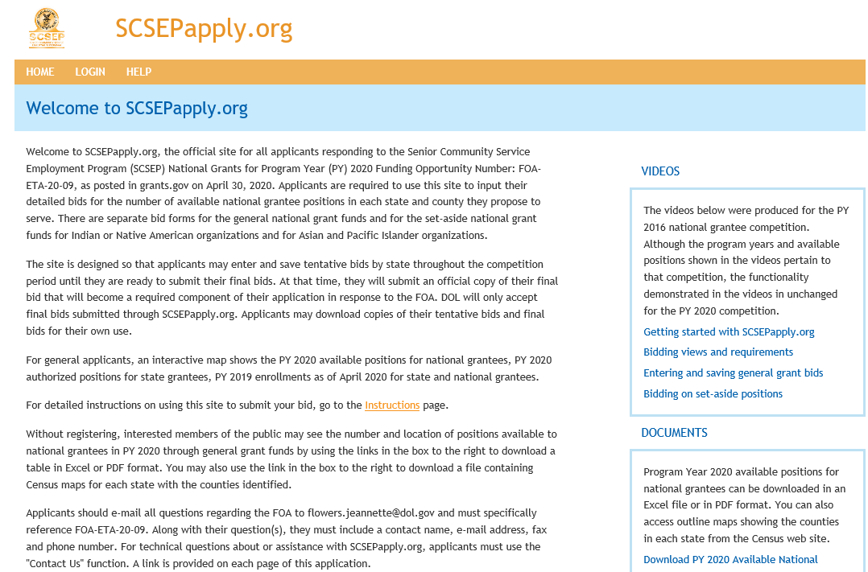
SCSEPapply.org

Slide 15
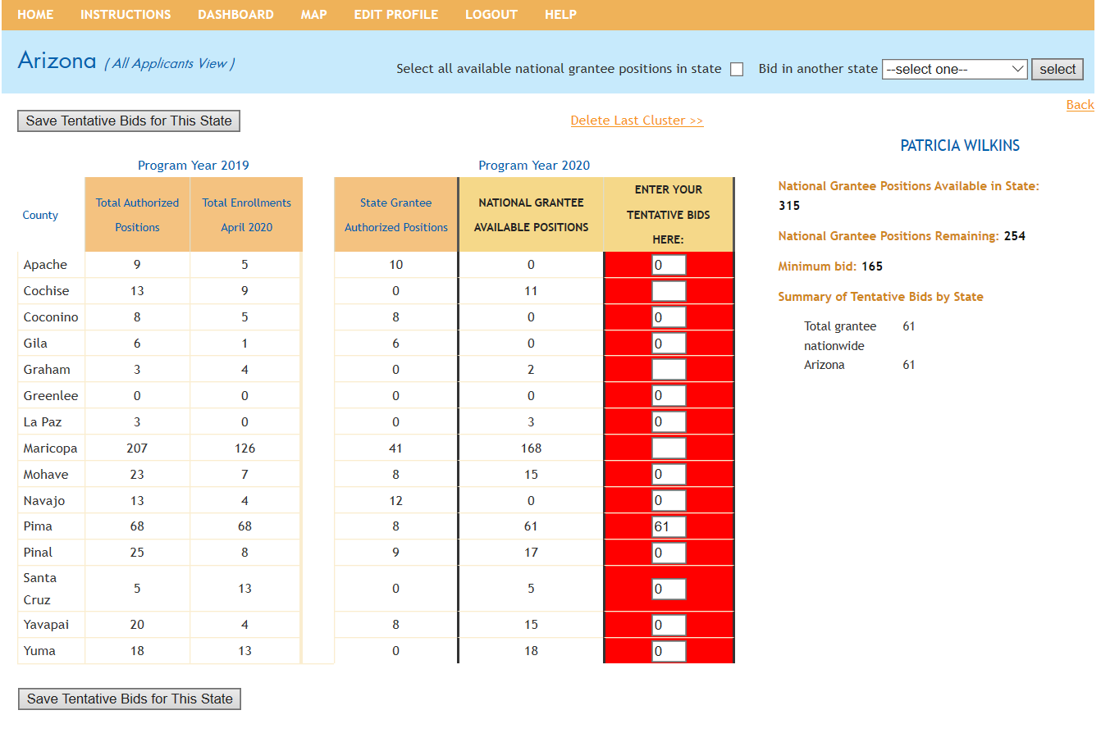
SCSEPapply Bidding Process: All Applicants

Slide 16
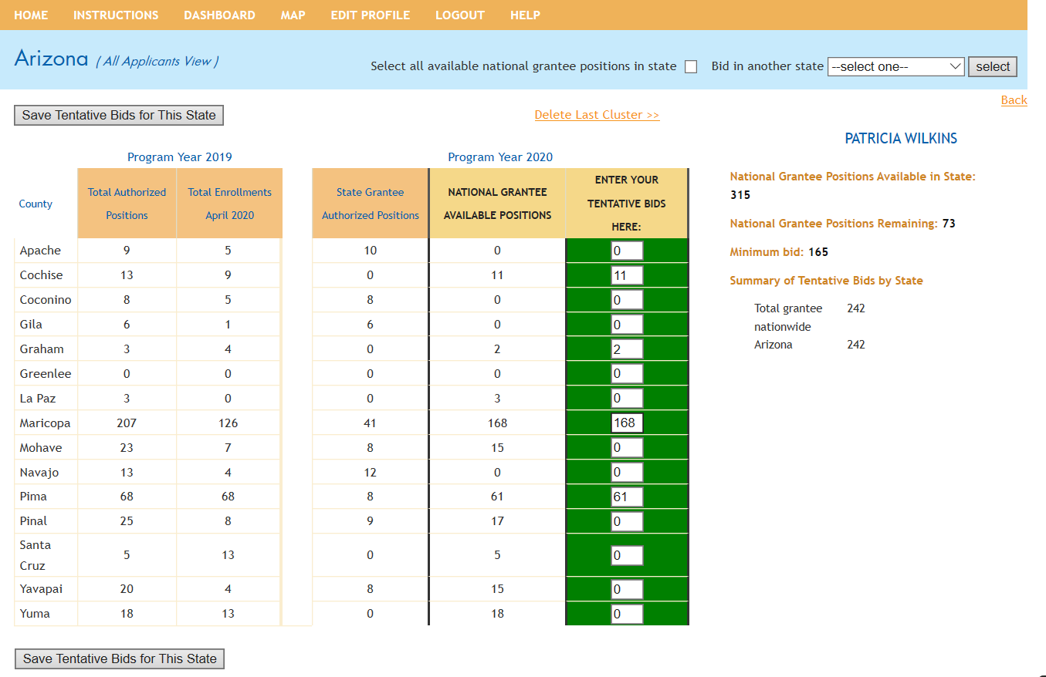
SCSEPapply BIDDING PROCESS: All Applicants

Slide 17
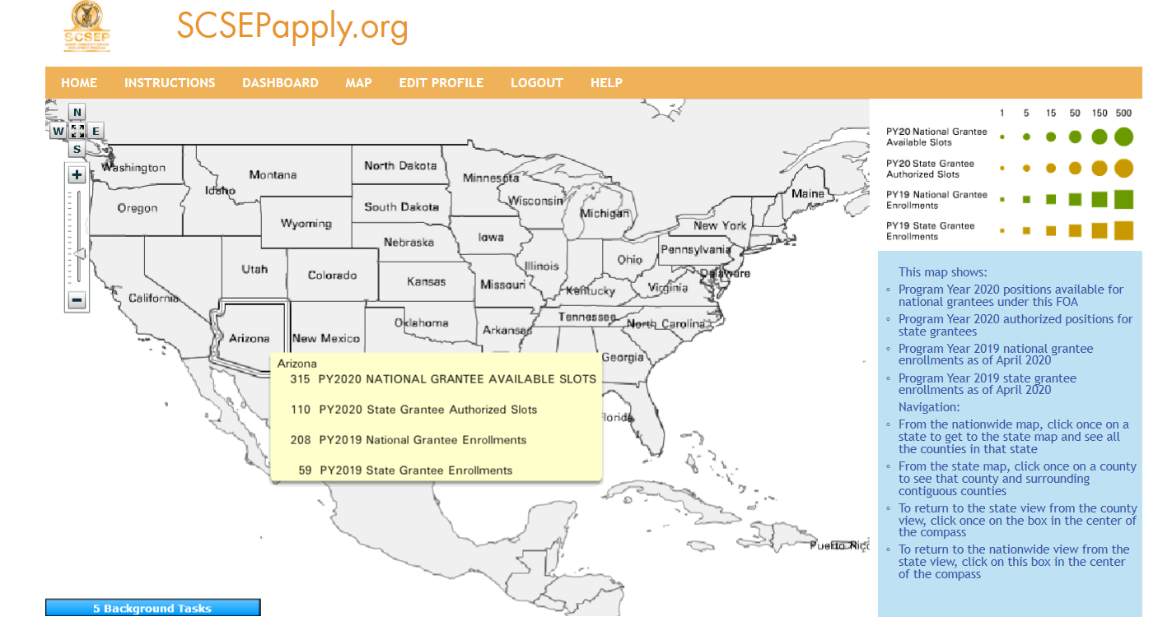
SCSEPapply MAPPING FEATURE

Slide 18
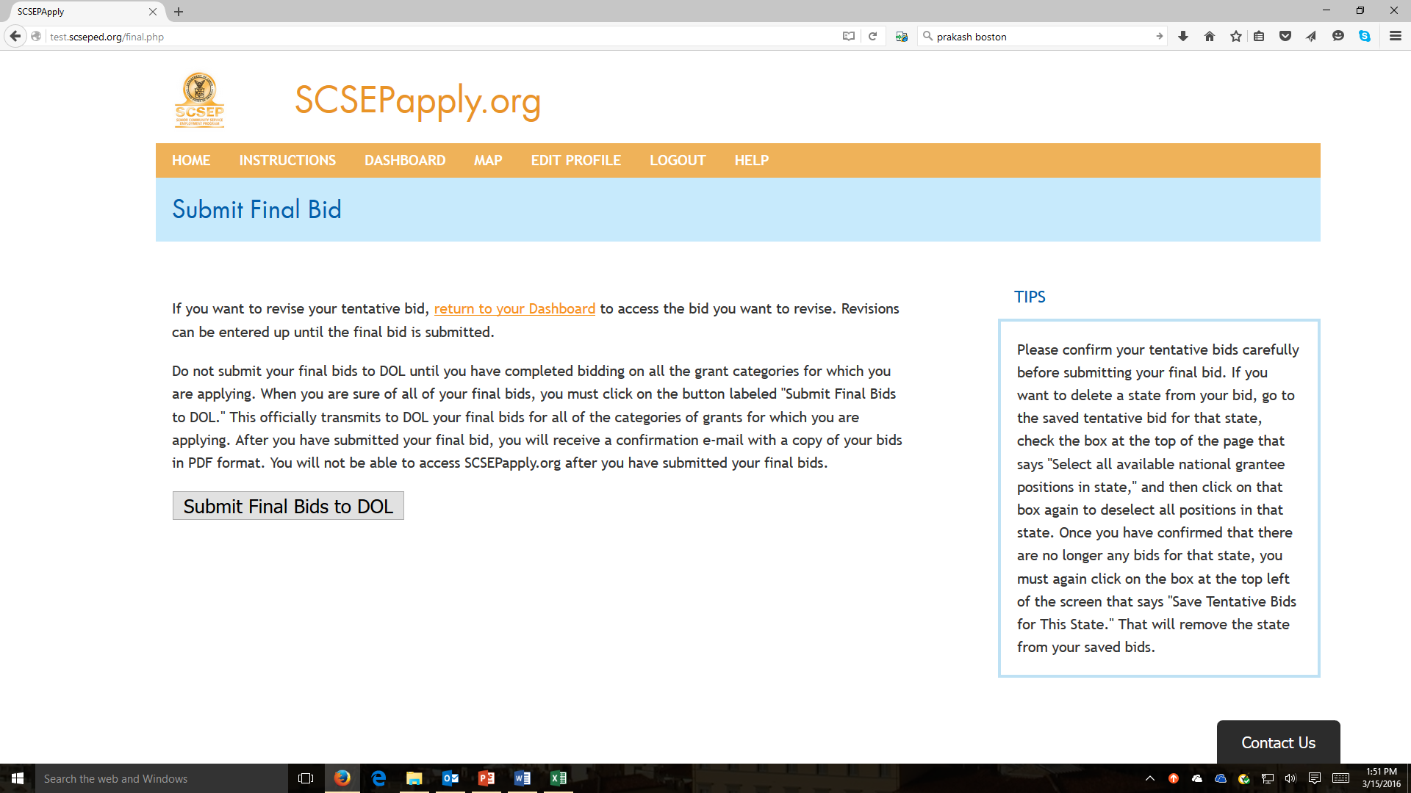
SCSEPapply FINAL BID SUBMISSION
Final Bids for counties must be submitted through SCSEPapply.org
no later than 4:00pm eastern time on the closing date of June 15, 2020

Slide 19
PERIOD OF PERFORMANCE
Grant is renewable annually for a total of 4 years subject to the availability of funds
Anticipated award date of July 1, 2020
Period of Performance includes all necessary implementation and start-up activities
Anticipated transition period of 4-months from approximately July 1, 2020 – October 31, 2020
Successful applicants would begin direct services on November 1, 2020
SCSEP Participants will be transitioned from previous grantees to the new awardees
Dates of the transition period are subject to change based on the actual date of award

Slide 20
ELIGIBILITY INFORMATION

Slide 21
ELIGIBILITY INFORMATION
Following organizations are eligible to apply
Nonprofit Organizations
Federal Public Agencies
Tribal Organizations
Eligible applicant agency or organization must demonstrate its ability to administer a multi-state program (specified in Section IV.B.4.a (5))
The Department reserves the right to award a grant to only one applicant per State, and to award an applicant funds to serve only one State.
Other Eligibility Requirements
All applicants must also meet the eligibility and responsibility requirements detailed in 20 CFR 641

Slide 22
ELIGIBILITY INFORMATION
There are three categories for which an applicant may apply to receive a grant under this FOA:
General National Grant Funds
Indian/Native American Set-Aside Grant Funds
Asian and Pacific Islander Set-Aside Grant Funds
Applicants applying for more than one category must submit separate applications for each, up to three separate applications
Note in particular the bold instructions in the “Applicant Categories” section (FOA p. 8) that direct applicants to start the descriptive title of application project in block 15 of the SF-424 form with the appropriate wording to identify the applicant category (i.e. “General,” “Indian/Native American” or “Asian and Pacific Islander”)

Slide 23
ELIGIBILITY INFORMATION
ELIGIBLE PARTICIPANTS
The intent of the FOA is to fund projects that provide services to eligible participants who have poor employment prospects, who can benefit from unsubsidized employment, and are not job ready. SCSEP eligible individuals must:
Be 55 or older;
Have family income of no more than 125% of the federal poverty guidelines; and
Be unemployed.
Grantee and sub-recipients must give priority to individuals who have one or more priority of service characteristics as provided in 2 CFR 641.520 (see FOA page 11)
When selecting eligible individuals for participation, 38 U.S.C. 4215 requires grantees to provide priority of service to veterans and spouses of certain veterans

Slide 24
APPLICATION AND SUBMISSION INFORMATION

Slide 25
APPLICATION AND SUBMISSION INFORMATION
**You must ensure that the funding amount requested is consistent across all parts and sub-parts of the application
Obtain an Application Package at www.Grants.gov and https://www.doleta.gov/grants
Content and Form of Application – Applications must consist of four separate and distinct parts
SF-424, “Application for Federal Assistance” https://www.grants.gov/web/grants/forms/sf-424-family.html#sortby=1
DUNS Number https://fedgov.dnb.com/webform/displayHomePage.do
Requirement for Registration with SAM https://www.sam.gov
Requirement to Bid on Authorized Positions – All applicants must enter their requested authorized positions (bids) into SCSEPapply www.SCSEPapply.org; hardcopy requests for authorized positions will not be accepted
Project Budget, composed of the SF-424 and Budget Narrative
SF 424A Budget Information Form https://www.grants.gov/web/grants/forms/sf-424-family.html#sortby=1
Project Narrative and Project Narrative Data (new for this FOA)
Attachments to the Project Narrative

Slide 26
PROJECT NARRATIVE AND PAST PERFORMANCE SCORING FACTORS
Criterion | Points (maximum)
a) Statement of Need (See Section IV.B.3.a). Statement of Need) | 2 Total
b) Project Design (See Section IV.B.3.b). Project Design) | 26 Total
(1) Evidence-Informed Strategies for Working with Employers and Employer Associations | 10
(2) Recruiting and Managing Host Agencies | 8
(3) Evidence-Informed Strategies for Providing Quality Service to Participants | 8
c) Organizational, Administrative, and Fiscal Capacity (See Section IV.B.3.c). Organizational, Administrative, and Fiscal Capacity) | 22 Total
(1) Capacity to Manage Core Organizational Functions and Program Operations | 4
(2) Capacity to Manage Data | 8
(3) Financial Stability and Ability to Adjust to Changes in Funding | 6
(4) Reporting and Audits | 4
d) Partnerships (See Section IV.B.3.d). Partnerships) | 14 Total
e) Budget and Budget Justification (See Section IV.B.2. Project Budget) | 4 Total
f) Past Performance – Programmatic Capability (See Section IV.B.3.f). Past Performance – Programmatic Capability) | 32 Total
TOTAL | 100

Slide 27
APPLICATION AND SUBMISSION INFORMATION
PR0JECT NARRATIVE DATA (New for this FOA)
Applicants are required to incorporate and explain quantitative data as part of the written narrative responses for a number of rating factors
Unlike in the “Past Performance” section, applicants will not be rated specifically on their performance on these measures or on the variation from the aggregate program or nationwide performance
The score on the relevant rating factors will consider the extent to which the applicant supports the narrative responses utilizing the data that are listed is explained in the specification for “Supporting Data” in each relevant rating factor and detailed in Attachment A
Current grantees and new applicants will take a different approach to submitting the project narrative data
Note that new applicants must also provide a Certification of Accuracy for this data, as explained further in the Requested Attachments section of the FOA. (Current Grantees must submit a certification if they submit any additional data for the Project Narrative)

Slide 28
APPLICATION AND SUBMISSION INFORMATION
Past Performance
Past performance as described in section 514(c) of the OAA, requires the grants be awarded on the basis of prior performance in the following areas:
Unsubsidized employment
Prior Performance on SCSEP Core Measures (in Aggregate) and Additional Measures
Community service employment
Greatest number served and most-in-need (see definition below in sub-section (1))
Current SCSEP grantees do not write a narrative or submit any data about past performance as they will be evaluated based on SPARQ data.
New applicants must describe prior performance in a comparable program and provide detailed data on performance in the areas listed above.
New Applicants must include signed copies of the Certification of Accuracy in separate attachments labeled “Certification of Accuracy” for data submitted for both Past Performance and the Project Narrative. Failure to attach this document will impact scoring of those sections of the application.

Slide 29
APPLICATION AND SUBMISSION INFORMATION
REQUIRED ATTACHMENTS
Submission of Application to the Governor – Certified Mail Receipt
Copy of Statutory Provisions (Federal applicant only)
Non-Federal Share Exemption (if applicable)
Federal Agency Applicant
REQUESTED ATTACHMENTS
The following attachments are requested, but their omission will not cause the application to be disqualified
Abstract
Project Narrative Data
Past Performance Data
Certification of Accuracy for Past Performance and Project Narrative Data
Letters of Commitment or MOUs
Financial Statements
Indirect Cost Rate Agreement
Organizational Chart and Staffing Plans
Financial System Assessment Information

Slide 30
SUBMISSION DATE, TIME, AND PROCESS
Applications must be received by June 15, 2020, no later than 4:00 P.M. Eastern Time
Applications must be submitted electronically on https://www.grants.gov
Applicants are encouraged to submit their application before the closing date to minimize the risk of late receipt
Application received after 4:00 p.m. Eastern Time on the closing date will not be reviewed
Application sent by e-mail, telegram, or fax will not be accepted
Applications submission must include a final bid through SCSEPapply.org for the counties proposed to be served

Slide 31
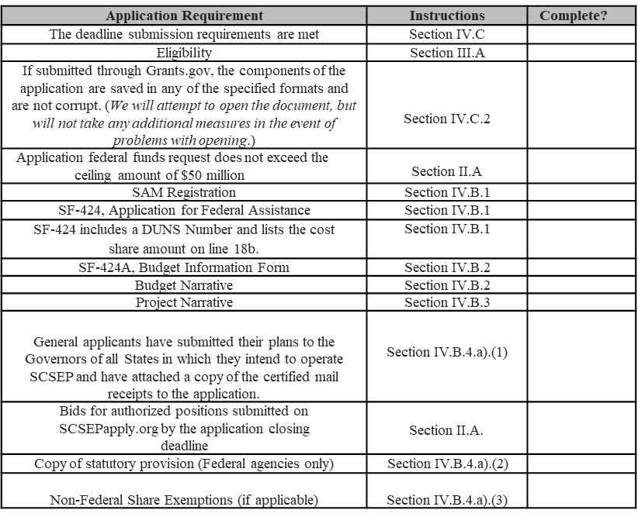
APPLICATION AND SUBMISSION INFORMATION
Application Screening Criteria
Applicants should use the checklist provided in the FOA as a guide when preparing the application
Applications that do not meet all the screening criteria will not move forward through the merit review process

Slide 32
AWARD ADMINISTRATION INFORMATION

Slide 33
AWARD ADMINISTRATION INFORMATION
AWARD NOTICES
All award notifications will be posted on the ETA Homepage at https://www.dol.gov/agencies/eta/
Applicants selected for award will be contacted directly before the grant’s execution
Non-selected applicants will be notified by mail or email and may request a written debriefing on the significant weaknesses of their application
Selection of an organization as a recipient does not constitute approval of the grant application as submitted
Before the actual grant is awarded, the Department may enter into negotiations about such items as program components, staffing and funding levels, and administrative systems in place to support grant implementation
The Department reserves the right not to fund any application related to this FOA and all Grantees will be subject to all applicable federal laws and regulations, including the OMB Uniform Guidance, and the terms and conditions of the award

Slide 34
AWARD ADMINISTRATION INFORMATION
SPECIAL PROGRAM REQUIREMENTS
ETA Evaluation - As a condition of grant award, grantees are required to participate in an evaluation, if undertaken by DOL
Performance Goals – Note that applicants will be held to negotiated goals and targets, and failure to meet those goals and targets may result in technical assistance or other intervention by ETA, and may also have a significant impact on decisions about future grants with ETA

Slide 35
AWARD ADMINISTRATION INFORMATION
Use of Grant Funds for Participant Wages (20 CFR 641.570)
Grantee must spend a minimum of 75% of their SCSEP grant funds on participant wages and fringe benefits
Grantee may use up to 10% of SCSEP grant funds to provide additional training and supportive services (ATSS) (subject to Departmental approval)
Participant wages are based on higher of the Federal, State, or local minimum wage; or the most nearly comparable wage for similar employment, for time spent in approved program activities only
Administrative Cost Limitation (20 CFR 641.570)
Grantee may not use more than 13.5% of SCSEP funds
Administrative cost may be increased to 15% based on requirements in (subject to Departmental approval)
Cost Sharing or Match (20 CFR 641.809)
Funds may be in the form of cash or in-kind contributions or a combination of the two
Match is at least 10% of the total cost of activities carried out under a SCSEP grant ( non-Federal share of costs)
Maintenance of Effort Requirements (20 CFR 641.844)
A community of service assignment for a SCSEP participant is permissible only when specific maintenance of effort requirements are met. Each funded project must not:
Reduce the number of employment opportunities or vacancies that would otherwise be available to individuals not participating in the program
Displace currently employed workers (including partial displacement, such as reduction in the hours of non-overtime work, wages, or employment benefits)
Impair existing contracts or results in the substitution of Federal funds for other funds in connection with work that would otherwise be performed
Employ or continue to employ any eligible individual to perform the same work or substantially the same work as that performed by any other individual who is on layoff (OAA § 502(b)(1)(G); 42 USC § 3056(b)(1)(G)

Slide 36
AGENCY CONTACT

Slide 37
FOR FURTHER INFORMATION ABOUT THIS FOA
PLEASE CONTACT:
Jeanette Flowers
Grant Management Specialist
Office of Grants Management
PH: (202) 693-3322
Applicants should e-mail all questions about the FOA to:
Flowers.Jeannette@dol.gov
Email must reference FOA-ETA-20-09 along with the question(s)
Include a contact name, fax and phone number
Technical questions about SCSEPapply should be entered into the “Contact Us” which is available on each page of the web site

Slide 38
Thank you!
We appreciate your interest in the Senior Community Service Employment Program
Please note that this webinar covered only highlights of the FOA
Read the FOA carefully so you are fully informed and prepared to respond We wish you the best in the application process!

