Slide 1
Polling Question: Who’s on the call?
What role do you play in your Apprenticeships: Closing the Skills Gap (CSG) Grant Project?
Authorized Representative
Grant Director/Manager
Training Provider
Employer Partner
Supportive Services Provider
Case Manager / Career Navigator
Performance / Data Analyst
Choose the best answer that reflect your role in your CSG grant project!

Slide 2
Apprenticeships: Closing the Skills Gaps
Grant Program Overview

Slide 3

Welcome and Introductions
Let’s get to know one another!
Enter your name, location, institution name, grant project name, and contact information into the chat.
What is the name of your institution?
What is your email or phone #?
What is your name?
Where are you
located?
What is your grant project name?

Slide 4

Moderator
Danielle Kittrell, Workforce Analyst
Department of Labor, Employment and Training Administration
Office of Workforce Investment, Division of Strategic Investments

Slide 5


Speakers
Robin Fernkas, Acting Deputy Administrator and Division Chief
DOL ETA Office of Workforce Investment, Division of Strategic Investments
Brinda Ruggles, Grant Officer
DOL ETA Office of Grants Management

Slide 6



Speakers
Ayreen Cadwallader
Workforce Analyst
Office of Workforce Investment, Division of Strategic Investments
Denise Roach
Grants Management Specialist
Office of Grants Management
Gregory Scheib
Workforce Analyst
Office of Workforce Investment, Division of Strategic Investments

Slide 7
Today’s Agenda
Grant Program Overview
Getting to Know You
Polling Questions &
Pop Quiz
The Federal Team
Grants Management: Award Package Overview
Brief Chat:
ETA Grants and COVID-19
Grant Modifications
Performance Reporting Guidance
Communication Methods

Slide 8
ETA Grants and COVID-19
Commitment to support grantees during this unprecedented time
Prioritize the health and well-being of yourselves, your families and colleagues, and individuals that you serve.
ETA’s Frequently Asked Questions on COVID-19’s impact to grant programs:
https://www.workforcegps.org/resources/2020/03/18/23/35/Coronavirus-COVID-19-Resources
Remote continuity of operations, and virtual training and delivery of services.
Visit the Centers for Disease Control and Prevention (CDC) for information on Covid-19 and community resources. OSHA has also published information on keeping workplaces safe at https://www.dol.gov/coronavirus.

Slide 9
Share any strategies you are doing now to minimize the impacts of COVID-19, or any concerns or questions you may have in the chat window.
Let’s CHAT!

Slide 10
Apprenticeships: Closing the Skills Gap
Grant Program Overview
Speaker: Ayreen Cadwallader

Slide 11
Polling Question: Preparing to Launch your Grant
Which resources have you reviewed in advance prior to today’s webinar?
Grant Award Package
Grantee Handbook
Rise Module: Competitive Grant Program Basics Reference Guide (Reference Guide)
(Choose all that apply)

Slide 12

Funding Overview
Department of Labor awarded $99,281,216 million to 28 public-private apprenticeship partnerships.
17 Institutions of Higher Education (IHE)
  Five grantees are State Systems of Higher Education; two grantees are IHE representing a consortium of IHEs; and ten are IHEs
11 Nonprofit Trade, Industry, or Employer Associations; Labor Unions or Labor Management Organizations
  Of these, eight grantees are Trade, Industry or Employer Associations; and three grantees are Labor Union or Management Organizations)

Slide 13
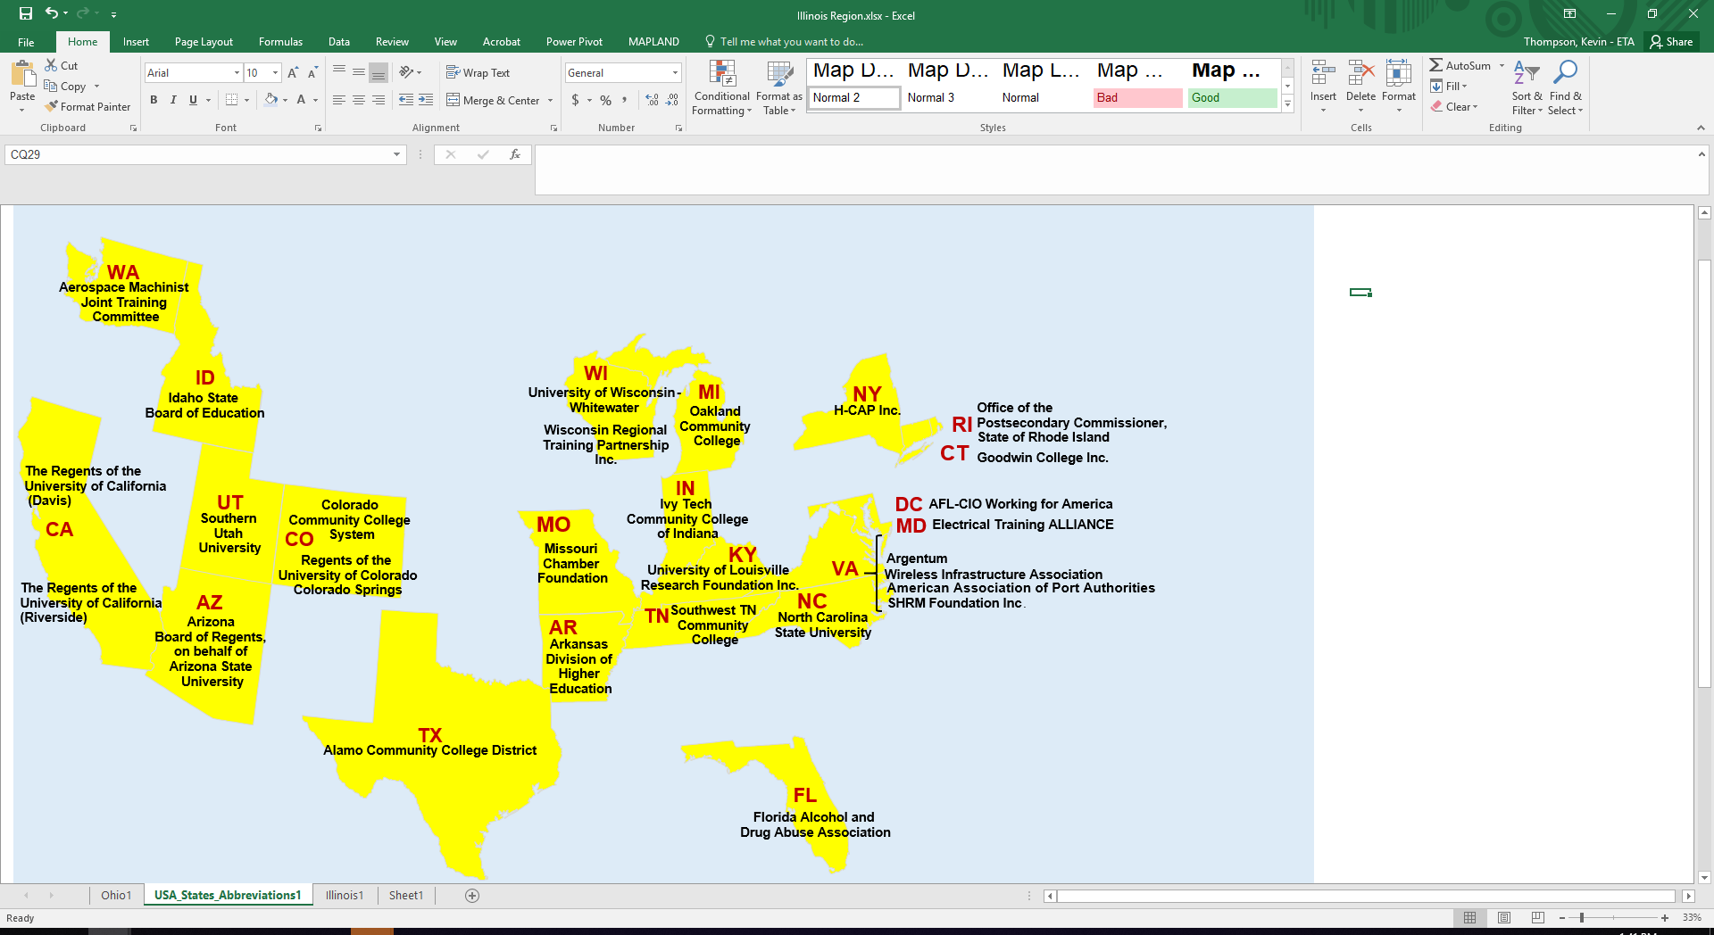
Apprenticeship: Closing the Skills Gap
The Department of Labor has awarding of grants to 28 public-private apprenticeship partnerships totaling nearly $100 million through the Apprenticeship: Closing the Skills Gap grant program. These grants will support large-scale expansions of apprenticeship in industries including advanced manufacturing, healthcare and information technology.
Service Areas are National, Statewide, Regional and Local in scope, including Opportunity Zones Across the Country

Slide 14
Apprenticeship: Closing the Skills Gap Investments
The Apprenticeships: Closing the Skills Gap Funding Opportunity Announcement’s (FOA) had a 45% match requirement.
As a result, grantees secured approximately $45 million in match funds from their apprenticeship partnership.
While leveraged funds were not required, some grantees secured an additional $82 million in leveraged funds.

Slide 15
Grant Period of Performance and Eligible Participants
Approximately 92,000 participants will be served by this grant program.
Unemployed, underemployed, workers currently employed and incumbent workers
Veterans, military spouses, transitioning service members, and underrepresented populations in apprenticeships and H-1B Industries, such as women, people of color, and ex-offenders.
Grant Start Date: March 1, 2020
Grant Period of Performance
Grant End Date: February 29, 2024

Slide 16
Apprenticeships: Closing the Skills Gap Grants
Almost 80% of grantees have proposed apprenticeship training in cybersecurity and/or artificial intelligence occupations.
18 grantees proposed Cybersecurity;
Two grantees proposed Artificial Intelligence;
Three grantees combined Cyber and AI

Slide 17
Share with us what you are specifically excited about your Closing the Skills Gap Grant Program!
For example, let us know about your apprenticeship training model, your target participants, or your H-1B target industry.
Let’s CHAT!

Slide 18
Apprenticeships: Closing the Skills Gap Grants
Program Requirements
Speaker: Robin Fernkas

Slide 19
Apprenticeships: Closing the Skills Gap Grant Program
Goals and Objectives
CSG Grants Apprenticeship Models
Accelerate the expansion of apprenticeships to industry sectors and occupations that have not traditionally deployed apprenticeships for building a skilled workforce, such as cybersecurity, artificial intelligence, and health care
Promote the large-scale expansion of apprenticeships across the nation to a range of employers, including small and medium-sized employers; and
Increase apprenticeship opportunities for all Americans.
CSG Grantees have proposed a mix of apprenticeship programs to
  Expand existing Registered Apprenticeship programs (RAPs)
  Create new RAPs
  Develop unregistered apprenticeship programs

Slide 20
High-Quality Apprenticeship Programs
Definition of Apprentice
1. Paid Work Component
All apprentices served by the Closing the Skills Gap grant must be in an apprenticeship program.
Grant participants are hired by an employer and are paid wages while completing the requirements of their apprenticeship.
All apprenticeship programs must meet the characteristics of high-quality apprenticeship programs.
Apprenticeship programs must pay apprentices at least the applicable Federal, state, or local minimum wage or a Federally approved stipend under Federal wage requirements if otherwise applicable, and must describe wage progression requirements. Additionally, programs must address how they will provide apprentices the opportunity to gain upward mobility in the industry.

Slide 21
High-Quality Apprenticeship Programs
2. Work-based Learning and Mentorship
3. Educational and Instructional Component
An important aspect of apprenticeship programs is offering apprentices the opportunity to apply what they are learning to their work through well-designed and highly structured work experiences. While they are learning on the job, programs must provide mentors to support apprentices and provide guidance on an industry or company culture, and industry or workplace policies and procedures.
Apprenticeship programs must provide or arrange for classroom or related instruction that is high-quality and adequate to help apprentices achieve their proficiency goals and earn certifications or equivalent credentials. As an important indication of quality programs must lead to an industry-recognized, portable credential, and may also be designed to ensure that apprentices receive college credit for classroom or related instruction.

Slide 22
High-Quality Apprenticeship Programs
4. Industry-Recognized Credentials Earned
5. Safety, Supervision, and Equal Employment Opportunity
Apprentices must earn industry-recognized credential(s) as part of their apprenticeship programs. The credential(s) earned in the program must be portable, and applicants must identify all of the portability benefits in the application.
Apprenticeship programs must have policies and procedures in place to ensure a safe working environment that adheres to all applicable Federal, state, and local safety, employment, and equal opportunity laws and regulations.

Slide 23
Public Private Partnerships
Required:
Minimum of 3 to 5 Employer Partners, depending on geographic scope of proposed service area
Institutions of Higher Education (if lead applicant is not an IHE)
Optional:
Organizations to support outreach and training activities;
Community organizations that provide social support and/or wrap-around services; and
The workforce investment system established under the Workforce Innovation and Opportunity Act (WIOA)

Slide 24
Grant Program Activities
Grant funds must be used primarily to support the training of apprentices in new or expanded programs.
Grantees may establish new apprenticeship programs,
Create the training infrastructure/network necessary to deploy these programs,
Expand existing Registered Apprenticeship Programs, and
Promote all grant-funded apprenticeship programs within a local/regional, statewide or national scope.
Provide up to 10 percent of grant funds may be used for supportive services, such as those necessary to enable an individual to participate in education and training activities funded through this grant program.

Slide 25
Industry-Recognized Apprenticeship Programs (IRAP)
DOL recently published a Final Rule to establish a system for advancing the development of high-quality, industry-recognized apprenticeship programs (IRAPs).
  Industry-Recognized Apprenticeship Programs General Overview Webinar
IRAPs are high-quality apprenticeship programs that provide individuals with opportunities to obtain workplace-relevant knowledge and progressively advancing skills.
The final rule establishes a process for the Department of Labor’s Office of Apprenticeship to recognize qualified third party entities, known as Standards Recognition Entities (SREs), which will, in turn, evaluate and recognize IRAPs consistent with the Department’s standards.
Guidance to CSG grantees that proposed IRAPs

Slide 26
Any Questions?
Add guidance for how to answer questions here.
  (If more info is needed as a parenthetical, add here. If not needed, delete this block.)

Slide 27
Your Federal Team
Collaboration and Coordination
Speaker: Danielle Kittrell and
Ayreen Cadwallader

Slide 28
Polling Question: CSG Grant Implementation
In what stage of implementation is your Closing the Skills Gap grant project?
Preparation: Key staff are still being hired; identification of key policies and procedures.
Early Implementation: Staff are hired; initial participants recruited for service delivery.
Full Implementation: Project is fully implemented; staff are providing skillful service delivery.
Other (please specify in the textbox!)

Slide 29
Your Federal Team at the Department of Labor (DOL)
ETA Regional Offices
Office of Grants Management (OGM)
Division of Strategic Investments (DSI, Lead Program Office)
Office of Apprenticeship (OA)
Chief Evaluation Office (CEO)
Federal Project Officer
Grant Officer (OGM / Regional Office)
Program Office
Grantee

Slide 30
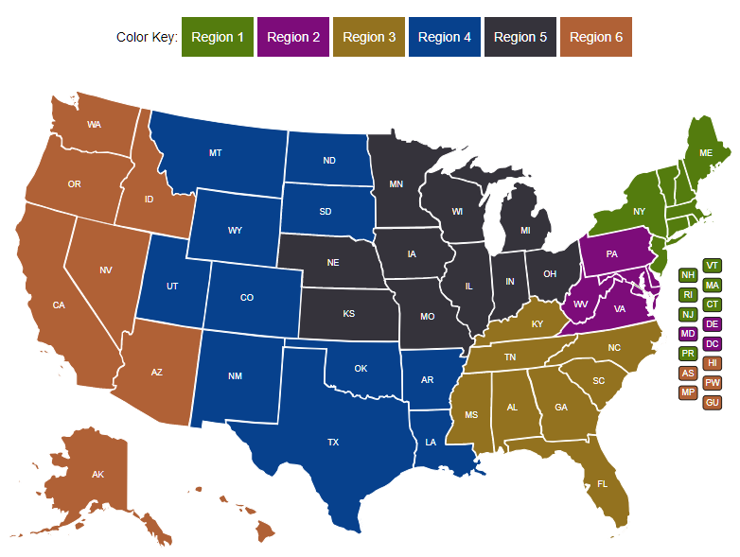
Your Federal Project Officer (FPO) is identified in your grant package.
Federal Project Officer (FPO)
Your FPO is critical to the success of your grant program.
Role of Your FPO
Assist you on grant-related matters
Provide compliance assistance
Conduct oversight and review of grant performance
Deliver or arrange for technical assistance
Serve as your primary point of contact

Slide 31

Grant Officer (OGM)
Your assigned Grant Officer is listed on the Notice of Award page of the Grant Package. Only the Grant Officer can approve changes to the Grant Agreement.
Maintains official grant documents
Regional Grant Officer can approve grant modifications and equipment purchases
National Grant Officer approves complicated grant modifications: limited changes to SOW, changes in signatory and NICRA
OGM staff provide guidance and training on policy issues and fiscal/administrative requirements of the grant.

Slide 32
Program Office Staff
Support FPOs
Provide policy clarification and guidance
Provide technical assistance (TA) (together with an external provider)
Create peer learning opportunities
Collect performance data
Review some grant modifications
The Program Office for your grant may periodically request information about your grant outcomes for quarterly reports to Congress.

Slide 33

Chief Evaluation Office (CEO) Staff
Implement DOL’s evaluation policy
Conduct program evaluations
Determine success strategies that improve performance outcomes

Slide 34
Chief Evaluation Office (CEO) Staff
  Evaluating Strategies for Apprenticeships: Closing the Skills Gap Grants
  CEO oversees the national implementation evaluation
Committed to building evidence and highlighting innovation among the systems changes, partnerships, and strategies
An impact evaluation, including a random-control trial (RCT), is under exploration. All grantees will be assessed for feasibility.
Next Steps:
We will be reaching out to grantees in the near future to tell you more about the evaluation and to learn more about your programs.

Slide 35
Any Questions?
Add guidance for how to answer questions here.
  (If more info is needed as a parenthetical, add here. If not needed, delete this block.)

Slide 36
Grant Award Package and Grant Modifications
Award Letter, Agreement, Terms and Conditions, Attachments
Speaker: Brinda Ruggles

Slide 37


Grant Award Package
Grant Award Letter, Grantee Handbook & Grant Agreement
Grant Agreement:
Notice of Award (NOA)/Signature Page
Condition of Award Page
Terms and Conditions
Application for Federal Assistance
Budget
Statement of Work (SOW)
Indirect Cost Rate Agreement (if applicable)

Slide 38
Grant Award Letter
Acknowledgements of Award
Payment Management System
  Information and forms on www.doleta.gov/grants under Manage your Awarded Grant
ETA’s on-line Grantee Financial Reporting System
  ETA 9130
  Information to access system on www.doleta.gov/grants under Manage your Awarded Grant
Passwords/PINs are sent separately after supplying the necessary information.
Once you receive this please DO NOT LOSE IT!

Slide 39
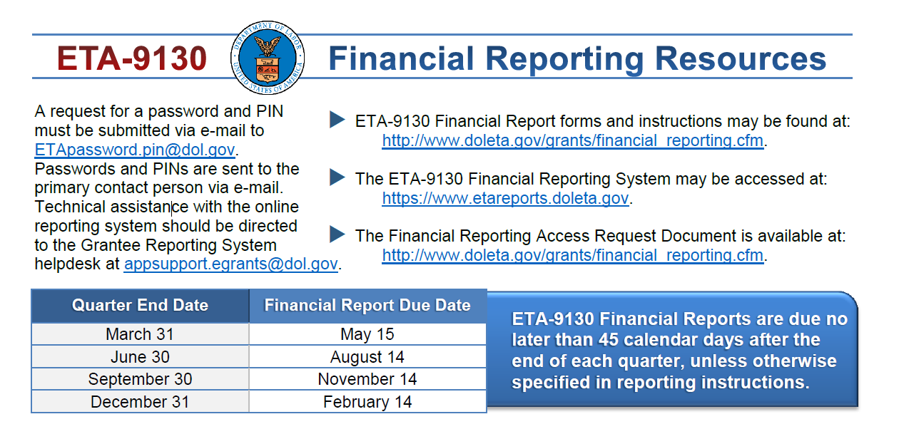
Quarterly Financial Report

Slide 40
Grantee Handbook
A general resource designed to orient grantees to the grant process in ETA.
It contains pertinent information grantees need to know regarding the goals and expectations for managing ETA grants.

Slide 41
Grant Agreement Notice of Award
Project Title – Apprenticeships: Closing the Skills Gap
Grant Awardees' Identifying Information
Federal Award Identification Number (FAIN)
  Grant Number # HG-34XXX-19-60-A-XX
Period of Performance
Award Amount
Uniform Administrative Requirements
Cost Principles
Signatures

Slide 42
Notice of Award Regulations
    2 CFR Part 200
      Uniform Administrative Requirements
      Cost Principles, and
      Audit Requirements for Federal Awards
    2 CFR Part 2900
      DOL Exceptions
    Terms and Conditions of Award

Slide 43
Statement of Work and Budget Review
  CSG Apprenticeship Grantees
  Conditions detailing potential issues in your SOW and Budgets are included in your grant award package
Review of SOW, budgets, other attachments
  30 days to respond
  Assistance from FPO, DSI, and OGM
Review of Program Outcomes
  Mathematical accuracy and benchmarks for years 1-4
  30 days to respond
  Assistance from FPO and DSI

Slide 44
Conditions of Award
  Conditionally Approved Funding (if applicable): Grantee is conditionally approved with an initial increment of $80,000 drawdown restriction in PMS. This constitutes a Partial Notice to Proceed. Release of additional funds up to the amount approved for the project, will be based on the grantee’s ability to address Condition 1 (see Conditions of Award page). Grantee is not authorized to incur costs above $80,000 until Condition 1 is resolved.
    Financial Assessment Form (All grantees)
    Financial and Administrative Policies and Procedures (Grantees new to ETA)
  Lifting the Drawdown Restriction: Submission of the requested information specified in Condition 1 does not in itself constitute approval by ETA. Should the provided documentation be found satisfactory, a Full Notice to Proceed will be incorporated into the grant agreement as an official modification, and the drawdown restriction will be lifted.
  New Grantee to ETA: Grantee that has never received ETA grants or has not received ETA grants within five (5) years from the closing date of the FOA. Grantees that meet this criterion will receive Conditionally Approved Funding.

Slide 45
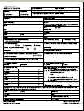
Conditions of Award: Statement of Work-Related Conditions
Five Hallmarks of Quality Apprenticeship Programs
Types of Apprenticeship Training Models
Participant Eligibility
Participant Co-Enrollment
Use of Funds for Supportive Services
Participate in the Closing the Skills Gap National Evaluation
Use of Grant Funds to support Wages for Apprentices for Businesses with 50 or fewer employees
Project Work Plan
Performance Items

Slide 46
Conditions of Award
Statement of Work–related conditions of award:
Responses must be submitted to both the Federal Project Officer and the ETA Apprenticeships CSG National Program Office at closingskillsgap@dol.gov within 30 days of the receipt of the grant award package.

Slide 47
Conditions of Award
Match
  In accordance with the Funding Opportunity Announcement, all grantees are required to provide and expend cash (funds committed specifically to support this grant project, not prior investments), in-kind or third party resources equivalent to exactly 45 percent of the grant award amount as “matching” funds. All matching funds or contributions must be expended on allowable grant activities and in accordance with the cost principles outlined in the Uniform Guidance at 2 CFR 200. Match can be in the form of cash, in-kind contributions and third-party contributions and must meet the requirement found at 2 CFR 200.306, 2 CFR 200.403, 2 CFR 200.434, and 2 CFR 2900.8. 2 CFR 2900.8 requires that match is recognized at the time in which the funds are expended. In other words, proposed matching funds (revenue or contribution) are recognized when expended on grant activities and valued at the amount expended (not received).

Slide 48
Specific Terms & Conditions of Award
Terms and Conditions
Order of Precedence
Funding Opportunity Announcement (FOA) and Amendment One (incorporated by reference)

Slide 49
Grant Agreement Attachments
Attachment A: SF-424
Attachment B: SF-424A
Attachment C: Budget Narrative
Attachment D: Statement of Work
Attachment E: Indirect Cost Rate Agreement (if applicable)

Slide 50
Terms – Equipment Purchases
  Equipment purchases with a per-unit acquisition cost of $5,000 or more, and a useful life of more than one year need prior approval from Grant Officer.
  Submit a detailed equipment purchase list with descriptions of each item to your Federal Project Officer (FPO) for review.
  Your FPO will review the items and submit the list for approval. A modification to your grant will be processed approving the equipment purchase.

Slide 51
Budget and Statement of Work
Budget Information
  SF-424A
  Budget Narrative
Grantee’s original proposal
  Project Narrative
  Abstract
  Project Work Plan (if separate attachment)
  Performance Outcomes Table
  Documentation of Commitment from Private Sector Partners and Optional Partners that make up the Apprenticeship Partnership

Slide 52
Indirect Cost Rate Agreement
Only applicable to those claiming indirect costs
If grantee is claiming indirect costs but did not provide agreement, placed on 90-day temporary rate
Applicants missing indirect cost rate agreements or submitting expired agreements are limited to lesser of either total claimed indirect costs or 10% of total Personnel budget

Slide 53
Any Questions?
Add guidance for how to answer questions here.
  (If more info is needed as a parenthetical, add here. If not needed, delete this block.)

Slide 54
Grant Modifications
Requests, Review Process
Speaker: Denise Roach

Slide 55
Grant Modifications
What is a modification?
Why do a modification?
What are modification indicators?
FPO Modification Analysis
  Reasonable
  Performance
  Best interest of the government

Slide 56
What is Grant Modification?
Mechanism to Change the Terms of the Grant Agreement

Slide 57
Why Do A Modification?
Change of Scope
  {Very rare & only minor changes will be considered}
  Program Design
    Service Area
    Change in Partners
    Key Personnel Changes
  Performance Outcomes
    Outcome Measures

Slide 58
FPO Modification Analysis
Grant Quality
  Services
  Staffing
Grant Efficiency
  Timely
  Cost Effective
Grant Performance
  Enrollments
  Expenditures

Slide 59
Required Documentation for Modification Requests
Must be submitted on Organization’s Letterhead
Must be signed by the Signatory Authority
Provide the purpose
Why it’s necessary
How the change will benefit the program
Appropriate documentation to support Modification

Slide 60
Modification Process
Write a formal letter of request addressed to your Grant Officer.
Include modification type, Closing the Skills Gap grant number, and justification for request.
Submit the final letter, signed by your signatory to FPO, with a copy to the Program Office.
FPO forwards request to Grant Officer.

Slide 61

Modification Analysis
Your FPO reviews the modifications
Limited SOW modifications require review by Program Office
National Grant Officer gives final approval
Grantee receives copy signed by Grant Officer
Regional Grant Officer can approve some budget modifications and equipment purchases
Otherwise, regional management sends to National Grant Officer for review

Slide 62
POP QUIZ!
You would like to add a new industry or occupation to your grant.
Which answer provides the best response that describes the process for submitting a Grant Modification?
A
Launch your apprenticeship program in the new industry and begin enrolling apprentices.
C
Send an email request to your FPO.
Write a formal letter of request to the Grant Officer, provide justification, and signed by your Authorized Representative
Reach out to your employer partners to determine if the new industry or occupation is in-demand.
B
D

Slide 63
Any Questions?
Add guidance for how to answer questions here.
  (If more info is needed as a parenthetical, add here. If not needed, delete this block.)

Slide 64
Performance Reporting Guidance
Speaker: Gregory Scheib

Slide 65
The Value of Reporting
Department of Labor
Closing the Skills Gap Grantees
Report the success of high profile programs to Congress, Administration, OMB, GAO, etc.
Inform the design of future grant investments
Demonstrate the impact of these grant investments
Capture effective program design models and service delivery strategies.
Demonstrate grant outcomes to investors and partners
Illustrate Return on Investment (ROI) to employer partners
Build additional strategic partnerships and leveraging resources
Sustainability of the project and partnership
Continuously improve program design to meet the needs of participants

Slide 66
Reporting Requirements
Apprenticeships Closing the Skills Gap grantees are required to submit performance progress reports quarterly to ETA, including a final report.
These reports are:
  Quarterly Progress Report
    Includes performance report (Quarterly Performance Report)
    Includes narrative report (Quarterly Narrative Report)
  Final Report

Slide 67
Quarterly Progress Report
Each grantee must submit a Quarterly Progress Report
  Due no later than 45 days after the end of a quarter
  More information and training will be provided
Your 1st progress report is due no later than May 15, 2020
Covers activities from March 1 through March 31st.
Quarter End Date | Progress Report Due Date | Report Activities Occurring Between
March 31 | May 15 | January 1 – March 31
June 30 | August 14 | April 1 – June 30
September 30 | November 14 | July 1 – September 30
December 31 | February 14 | October 1 – December 31

Slide 68
Quarterly Progress Reports
Submitted through the Workforce Integrated Performance System (WIPS).
Progress reports in WIPS:
  Data file = Quarterly Performance Report (QPR)
  Quarterly Narrative Report (QNR)
Data File
WIPS
QNR
QPR
Grantees should prepare to track and collect
participant-level data for the QPR.

Slide 69
Interim Reporting Process for the Quarter Ending 03.31.20
Grantees will submit a Quarterly Narrative Report (QNR) to ETA for this quarter
  Grantees will receive an interim reporting guidance email that includes the QNR Template.
  QNRs will be submitted to the grant mailbox no later than the reporting due date of May 15, 2020.
  Send your QNRs to your FPOs, with a cc to ClosingSkillsGap@dol.gov.
Grantees will NOT upload a participant data file in WIPS or submit a Quarterly Performance Report (QPR) to ETA for this reporting quarter
  However, grantees must still collect participant-level data as it aligns with the required reporting elements for all participants served as of the start of the grant.
  Grantees will submit their first QPR for the quarter ending June 30, 2020, including cumulative data on all participants served to date.
  This interim guidance is only for the quarter ending March 31, 2020. Additional information will be provided soon.

Slide 70
Any Questions?
Add guidance for how to answer questions here.
  (If more info is needed as a parenthetical, add here. If not needed, delete this block.)

Slide 71
Communication
Communication Plan, Point of Contact and Community of Practice

Slide 72

Your Primary Point of Contact (POC)
Role of POC
Receives communication from ETA
Is responsible for sharing information with project team and consortium members
Any time the main point of contact for your grant changes, please remember to contact the Federal Project Officer (FPO) and Program Office by email.

Slide 73
Communication Plan
YOU
ETA
Always contact your FPO first if you have questions.
If you… | Contact:
Are the grant lead (POC) | FPO
Are a member of a grant project | The lead for your grant
Have questions or difficulty accessing the performance reporting system | WIOA.Feedback@dol.gov with a copy to your FPO and closingskillsgap@dol.gov
Have questions or difficulty accessing the financial reporting system | EBSS.help@dol.gov, with a copy to your FPO and [Email address]
Have questions about evaluations | closingskillsgap@dol.gov with a copy to your FPO

Slide 74
Communication Guidelines
YOU
ETA
When you communicate with your FPO, etc.:
Copy the Apprenticeships: CSG Mailbox at closingskillsgap@dol.gov if appropriate
Include your grant number and lead grantee organization name
Describe your question or issue in detail
Please be patient!

Slide 75
ETA Communications to You
ETA
YOU
Program Office staff may send periodic guidance and other communications through the Apprenticeships: Closing the Skills Gap Mailbox.
Your FPO or Program Office staff may contact you for specific requests and information.
ETA posts information on the WorkforceGPS.org Community of Practice site [site forthcoming]
ETA shares new information on its website
  www.doleta.gov
Please make sure your email system does not confuse our communication as spam.

Slide 76

Next Steps
Respond to Conditions of Award in your Grant Award Package (send to FPO, cc Closingskillsgap@dol.gov)
Review the DOL Fiscal Training Tutorials from the SMART 3.0 Webinar Training Series
Review the Grantee Handbook and RISE Modules
Review the DOL Performance Reporting Requirements
Refer to the Funding Opportunity Announcement as needed
Update your Grant’s Point of Contact (s)

Slide 77
Resources:
ETA Grantee Handbook
    https://www.doleta.gov/grants/docs/ETA_Grantee_Handbook.pdf
Competitive Grant Program Basics Reference Guide
    https://rise.articulate.com/share/4eRGrXGtIjJRwOJ5_QgQiS_wR5rdo1wy
Smart 3.0 Webinar Series (Financial Management)
    https://grantsapplicationandmanagement.workforcegps.org/resources/2019/12/15/21/50/SMART_3-0_Webinar_Training_Series
H-1B Scaling Apprenticeship Grants
  Community of Practice for H-1B Apprenticeship Grants
    https://h1bsa.workforcegps.org/
Apprenticeship.gov
  Your One-Stop Source for All Things Apprenticeship.
    https://www.apprenticeship.gov/
Industry-Recognized Apprenticeship Program
  Learn about the new IRAPs
    https://www.apprenticeship.gov/industry-recognized-apprenticeship-program
Industry-Recognized Apprenticeship Program Webinar
  General overview of the key elements of the Final Rule and information for those interested in IRAPs. https://www.workforcegps.org/events/2020/03/06/18/22/Industry-Recognized-Apprenticeship-Programs-General-Overview-Webinar

Slide 78
Any Questions?
Add guidance for how to answer questions here.
  (If more info is needed as a parenthetical, add here. If not needed, delete this block.)

Slide 79
Thank You!
Need help? Email: Support@workforceGPS.org

