Slide 1
Read Before You Proceed: Instructions for Use & Legal Compliance
Legal Accessibility Requirements: 508 Compliance
Only use tables when standard content delivery is insufficient, and never merge table cells.
Do not use screenshots or images of text items. All text must be editable and not blur when the screen is zoomed in.
Avoid using “Smart Art” or the “Design Ideas” tool.
Do not repurpose slide title boxes for any other use.
Do not use multiple spaces, empty paragraphs, or strings of tabs to visually adjust your content, as every such repeated character must then be manually stripped from all slides before posting. Instead:
Use soft returns to bump content to the next line in lieu of spaces (Shift + Enter)
Manage paragraph spacing and tabs in the “Paragraph” panel.
Every image or visual element used must either have alternative “alt” text applied or be marked as “decorative”.
Alt text translates visual information into verbal information, which is read aloud in screen readers, while items marked “decorative” are skipped.
This step is required to deliver the full message provided by any graphics.
The person who laid out the content should also provide that alternate information to ensure their message stays intact.
Learn about the new innovative features!
Please watch this webcast before using this template.
https://vimeo.com/370983870/2afa9e8306
(Ctrl + Click to open link)
Duration: 6 minutes

Slide 2
TAA Performance Series: Measurable Skill Gains

Slide 3
Today’s Speaker
Robert Hoekstra
Program Analyst, Performance Management Data Reporting
Technical Expert
Office of Trade Adjustment Assistance

Slide 4
Who is on the call?
What is your role?
Fiscal Staff
TAA Program Reporting Staff
TAA Staff
TRA Staff
DOL ETA Staff
Other
Please click on the most appropriate answer in the poll.

Slide 5
Today’s Objectives
What is the definition of measurable skill gains?
How is it calculated?
What are some basic trends on this measure?
What are the current reporting issues?
What groups have higher or lower outcomes?

Slide 6
TAA Performance Basics

Slide 7
TAA Performance Basics
Performance Indicators
Trade Adjustment Assistance Reauthorization Act of 2015 (TAARA 2015) Section 239(j)(2)(A)(i) specifies Primary Indicators of Performance
Employment Rate Q2 (ERQ2)
Employment Rate Q4 (ERQ4)
Median Earnings
Credential Attainment
Measurable Skill Gains (MSG)
No Employer Measure in TAA

Slide 8
TAA Performance Basics
Other Required Reporting
TAARA 2015 Section 249B(b) specifies an extensive list of other reporting requirements including:
Petition data – down to Congressional District
Financial data
Rapid response
Benefits received – workers, durations, Trade Readjustment Allowance (TRA) weeks
Training – types, waivers, costs, durations
Performance data by age, education, and credential attainment
Median Earnings as a percentage of Prior Earnings (wage replacement)

Slide 9
TAA Performance Basics
Reporting, Not Targets
Reported through the Workforce Integrated Performance System (WIPS) in the Participant Individual Record Layout (PIRL)
TAA sets national performance targets
Government Performance and Results Act (GPRA)
Does not negotiate or set state performance targets
No statistical modeling for states
No sanctioning mechanism
Ongoing oversight is conducted and technical assistance is provided if performance significantly differs from expectations

Slide 10
Any Questions?
Questions on general TAA performance reporting?

Slide 11
Calculating MSG

Slide 12
Measurable Skill Gains Definition
MSG: TAARA 2015 Section 239(j)(2)(A)(i)(V)
“the percentage and number of workers who received benefits under the trade adjustment assistance program who, during a year while receiving such benefits, are in an education or training program that leads to a recognized postsecondary credential or employment and who are achieving measurable gains in skills toward such a credential or employment.”
Mirrors WIOA Definition

Slide 13
MSG Calculation
Who is included? (denominator)
TAA Current Participant
TAA Benefit or Service (PIRL 925): less than or equal to the end of the query period (replaces PIRL 900)
Exit Date (PIRL 901): Blank or Greater than or equal to the start of the query period
Training
Date Enrolled During Program Participation in an Education or Training Program Leading to a Recognized Postsecondary Credential or Employment (PIRL 1811): not blank and less than or equal to the end of the query period
Date Completed, During Program Participation, an Education or Training Program Leading to a Recognized Postsecondary Credential or Employment (PIRL 1813): blank or greater than or equal to the start of the query period
Other Reasons for Exit (PIRL 923): blank, zero (no other reason), or 7 (Criminal offender – doesn’t apply to TAA)

Slide 14
MSG Calculation
What is a positive outcome? (numerator)
Gain Type | PIRL Element
Educational Functioning Level (EFL) | 1806
Secondary Credential | 1801 (when 1800 = 1) 1803 (when 1802 = 1) 1805 (when 1804 = 1)
Postsecondary Transcript/Report Card | 1807
Secondary Transcript/Report Card | 1808
Training Milestone | 1809
Skills Progression | 1810

Slide 15
Dates for Performance Measures
MSG Aligns with Current Participants

Slide 16
Any Questions?
Questions on MSG?

Slide 17
MSG Reporting Issues

Slide 18
Some States Not Reporting MSG at All
Nine states (red) are not reporting any MSG.
Based on PIRL data for the most recent four quarters ending 9/30/2019 as of 3/10/2020.

Slide 19
MSG by Type
Many states favor only one or two MSG types.
Based on PIRL data for the most recent four quarters ending 9/30/2019 as of 3/10/2020.

Slide 20
MSG Documentation Delays
One quarter delays in documentation not uncommon.
Based on PIRL data for the most recent four quarters ending 9/30/2019 as of 3/10/2020.

Slide 21
No MSG when Credential Attained
43% of those who received a post-secondary credential in the period didn’t have an MSG recorded.
Secondary credential is 100% because it is part of the calculation, but documentation of secondary report cards is low.
Based on PIRL data for the most recent four quarters ending 9/30/2019 as of 3/10/2020.

Slide 22
Any Questions?
Questions on the measurement issues?

Slide 23
MSG Results

Slide 24
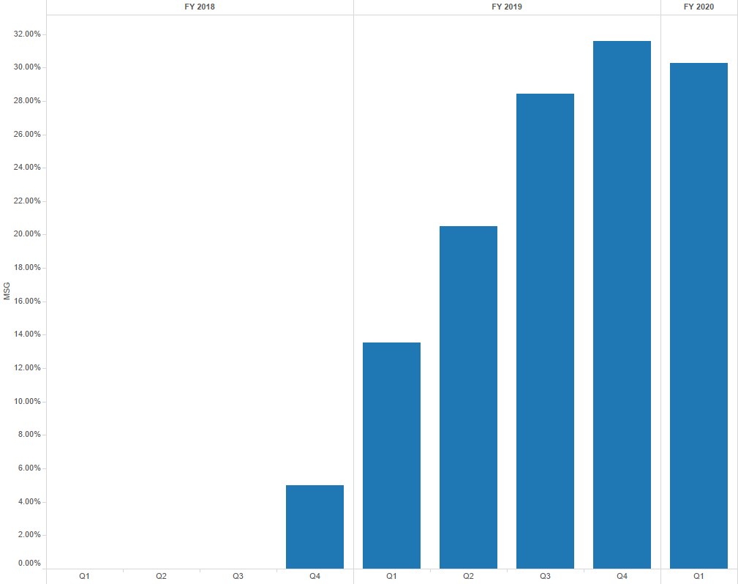
Overall MSG Trend
New under PIRL
Consistent increases until most recent quarter

Slide 25
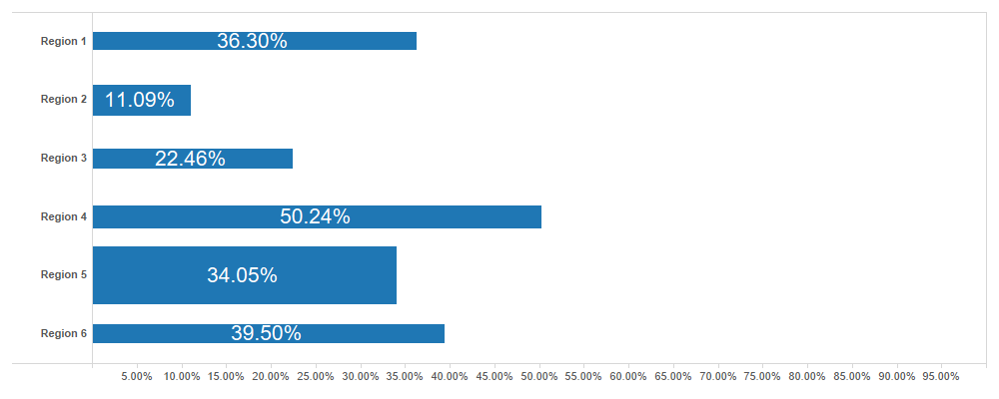
MSG by Region*
*PIRL data 10/1/2018 through 9/30/2019 (as of 3/10/2020)

Slide 26
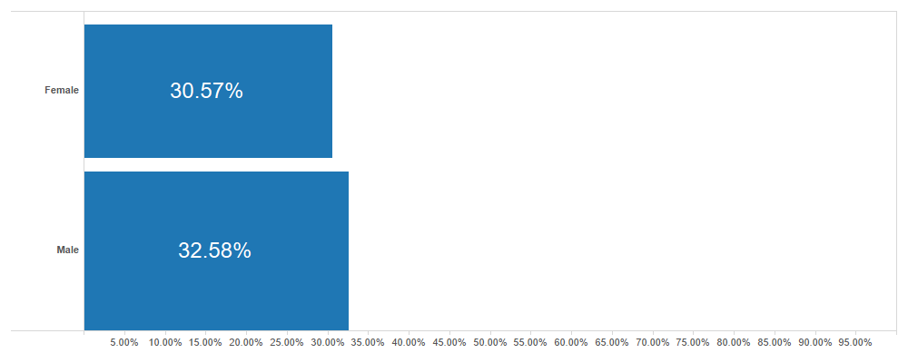
MSG by Gender*
*PIRL data 10/1/2018 through 9/30/2019 (as of 3/10/2020)

Slide 27
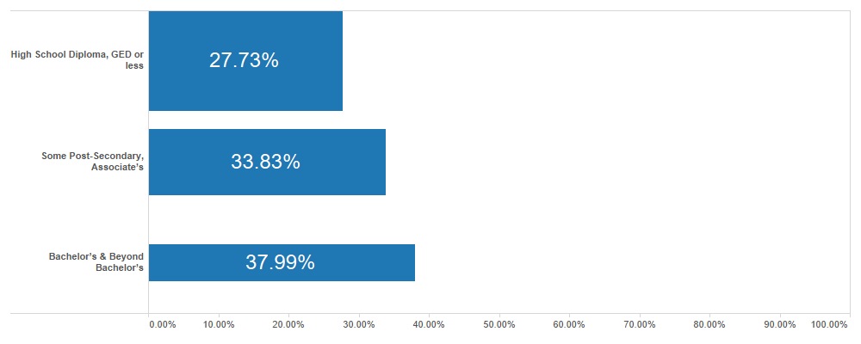
MSG by Education at Participation*
*PIRL data 10/1/2018 through 9/30/2019 (as of 3/10/2020)

Slide 28
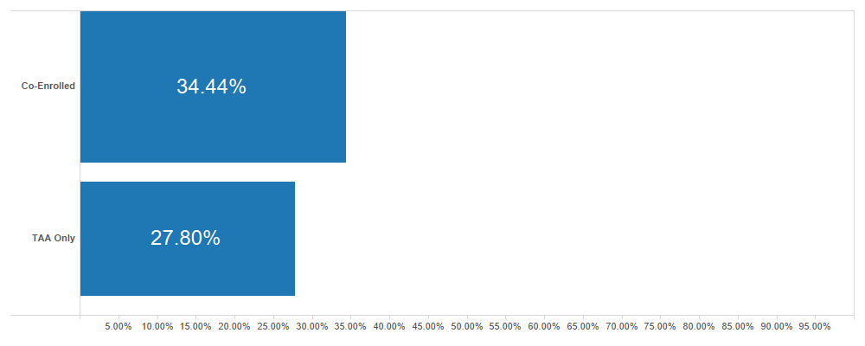
MSG by Co-Enrollment with DW and WIOA Adult*
*PIRL data 10/1/2018 through 9/30/2019 (as of 3/10/2020)

Slide 29
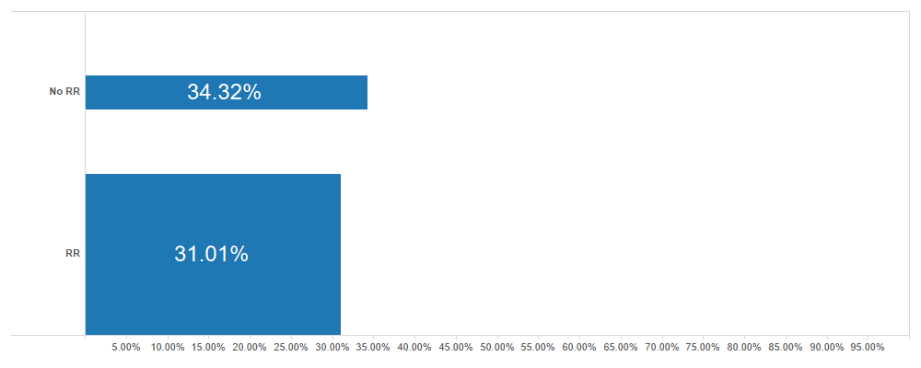
MSG by Rapid Response (RR)*
*PIRL data 10/1/2018 through 9/30/2019 (as of 3/10/2020)

Slide 30
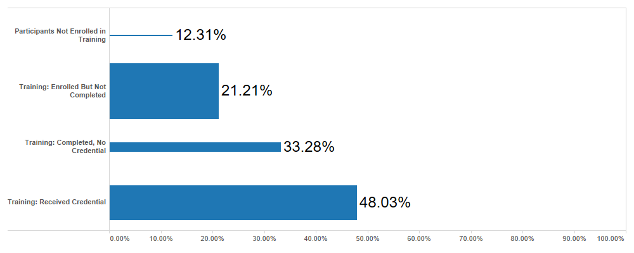
MSG by Service Category*
*PIRL data 10/1/2018 through 9/30/2019 (as of 3/10/2020)

Slide 31
Any Questions?
Questions on TAA MSG results?

Slide 32
Resources:
Trade Website
Public information and resources about TAA
https://www.doleta.gov/tradeact/
TAA Participant Reporting Page
TAA Reporting Resources
https://www.doleta.gov/tradeact/taa-data/participant-reporting/
Quarterly Analysis of TAA Data
A quarterly analysis is conducted of TAA data
https://www.doleta.gov/tradeact/taa-data/participants-data/
TAA Performance Reporting
Describes performance reporting measures
https://www.doleta.gov/tradeact/taa-data/participant-reporting/performance.cfm
TEGL No. 10-16, Change 1
TEGL outlining performance calculations
https://wdr.doleta.gov/directives/corr_doc.cfm?DOCN=3255
TEGL No. 14-18
Alignment of Performance Reporting, particularly note Attachment 10 on TAA
https://wdr.doleta.gov/directives/corr_doc.cfm?docn=7611

Slide 33
Resources:
TAA Community
TAA Community page including upcoming events, discussion forum and other resources
https://taa.workforcegps.org
PIRL Reporting Online Resource
https://performancereporting.workforcegps.org/resources/2019/10/01/13/32/PIRL-Reporting-Online-Resource
Training and Employment Guidance Letter (TEGL) No. 14-18 Resource Page
Including a TAA-specific webcast on Attachment 10
https://performancereporting.workforcegps.org/resources/2019/04/01/15/23/TEGL-14-18-Performance-Alignment-Webcast-Series-and-Resource-Page
WIOA Performance Indicators Series
https://performancereporting.workforcegps.org/announcements/2018/07/09/13/50/WIOA-Performance-Indicators-Summer-E-Learning-Series

Slide 34
Contact Us
Robert Hoekstra
Program Analyst, Performance Management Data Reporting Technical Expert
Office of Trade Adjustment Assistance
hoekstra.robert@dol.gov
202-693-3522

Slide 35
Thank you!
Need help? Email: support@workforceGPS.org

