Slide 1
Where Are You?
Please enter your location in the chat window
(lower left of screen)

Slide 2
What Makes a Quality Work Experience?

Slide 3
Today’s Moderator
Jenn Smith
YouthBuild Director
Department of Labor, Employment and Training Administration

Slide 4
Today’s Speakers
Phoebe Reeves
Associate Director for Technical Assistance
YouthBuild USA
Mary McRae
Senior Program Manager, DOL Coaching
YouthBuild USA

Slide 5
Today’s Speakers
Jerry Farley
Program Director
YouthBuild Dayton
Oscar Grant
DOL YouthBuild Technical Assistance Coach
Wilson Ramos
Program Director
Los Chicanos por La Causa YouthBuild

Slide 6
Today’s Objectives
To support grantees in being able to successfully build, implement, and assess a quality work experience (WEX) by providing an introduction to the range and basics of a quality WEX
To provide a sampling of work experience types within a given career pathway through two grantees’ peer sharing examples
To engage in an interactive peer discussion around putting together and implementing a quality WEX

Slide 7
Some Frequently Asked Questions about Work Experience
Is there a standard for how many hours should be offered in the hands-on training component itself?
How can programs ensure that the WEX provides sufficient training time and exposure?
Any suggestions to help rural programs connect with WEX partners, where they may have limited local employers to draw on?
What are the best ways for programs to determine who their local employers are and how to reach out to them?
How does the WEX relate to the construction work site requirement?

Slide 8
Program Work Experience
Do you feel confident in your program’s current WEX implementation and practice?
Yes
No
Kind of
(Choose the best answer for your organization)

Slide 9
What is a work experience?
Under WIOA, a work experience is “a planned, structured learning experience that takes place in a workplace for a limited period of time. Work experiences may be paid or unpaid, as appropriate. A work experience may take place in the private for-profit sector, non-profit sector, or public sector. Work experiences must include academic and occupational education.”

Slide 10
What is a work experience?
Work experiences may include the following categories:
Summer employment opportunities and other employment opportunities available throughout the year
Pre-apprenticeship programs
Internships and job shadowing
On-the-job training opportunities

Slide 11
Work Experience Requirements from the Funding Opportunity Announcement
Hands-On Meaningful Learning Activities Connected to Education and Training
Applicants must describe how they will ensure participants receive hands-on work experience in all industries in which they provide training. For construction, this requires the identification and approval of qualifying construction work sites.
Hands-On Work Experience:
The applicant must describe how they will provide hands-on work experience to all participants. For construction training, applicants must provide access to low-income home building or renovation projects where participants can practice their skills directly, as well as shadowing journeyman trades people in specialized areas of construction.
The applicant must describe the plan to engage diverse employers that commit to providing meaningful hands-on work experience to participants in Construction Plus industries. Work experiences should be relevant to the training provided, as well as participant interests and goals. Applicants should integrate the work experience component into the timeline of training and certification, and should attach letters of commitment from employer partners that describe and ensure hands-on training and that may connect to career pathways into apprenticeship and/or employment.
Grantees must provide diverse work experience opportunities to meet the needs and interests of youth participants. For youth not interested in construction and youth participating in Construction Plus industries, the program must describe efforts to connect participants to additional work experiences, such as job shadowing, on-the-job training, or internships. These work experiences may be part of the Construction Plus industries in which they are providing training, as well as opportunities in additional industries through applicant partnerships, such as local employer connections, the American Job Centers, or other opportunities for referral.

Slide 12
What Are the Ingredients of a Quality Work Experience?
Components
Real world workplace setting
Clear scope of work being done by participant (this should not be a passive observation/job shadow)
Supervision by an employer partner
Takes place before the end of active programming
Links as directly as possible to the career pathway
Substantial time period for learning, exposure to work, and demonstration of skills to employer
A specific set of professional competencies to meet/make significant progress towards
Consideration of how the work experience can lead into a placement, either with the employer who supervises the work experience or another employer

Slide 13
Professional Field Standards for Young Adult Talent Development –What Staff Should Know and Be Doing
1. Dual-Customer Mindset
2. Demand-Driven Training
3. Cultivation of Young Adult Talent
4. Influence on Business Practices

Slide 14
Roles of YouthBuild Staff in Developing and Implementing a Quality WEX
Job Developer
Case Manager
Teacher/Academic Instructor
Construction or Construction Plus Instructor/Trainer
Program Director
* These roles, which may be primary or secondary, should relate back to the field standards

Slide 15
Quality WEX
What is your biggest question about a quality WEX?
Who should provide the supervision of the WEX?
Does a WEX differ from the construction requirement for hands-on learning opportunities?
What makes a quality WEX?
Where should a quality WEX take place?
Why do a WEX?
Are we required to have WEX?
(Choose the best answer for your organization)

Slide 16
Peer Presenter
Jerry Farley
Program Director
YouthBuild Dayton

Slide 17
Work Experience Insights
Ensure there is an MOU in place
Place participants according to career interests
Do all necessary leg work prior to seeking placement
Place all participants within the same basic time frame
Do Bureau of Criminal Investigation background check and review State law regarding prohibiting offenses
Promote and expect “Teachable Moments”
Ensure rotations within the experience
Conduct routine meetings with participants and work site coordinator
Celebrate placements at WEX sites as being the ideal outcomes for everyone

Slide 18
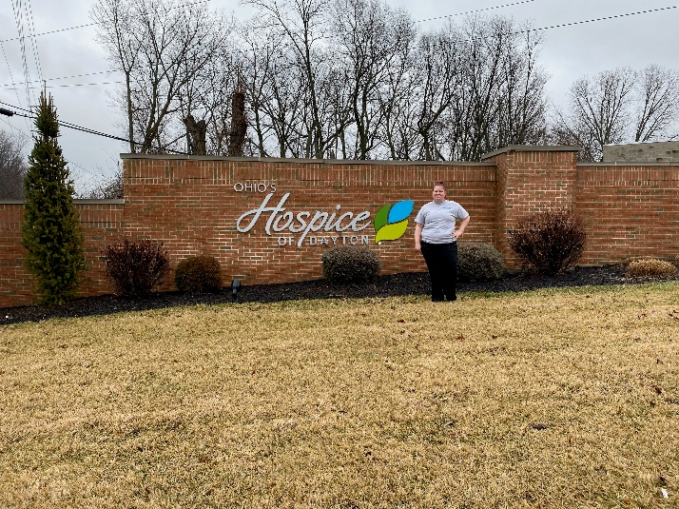
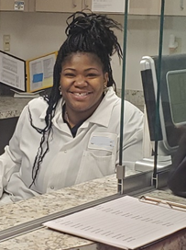
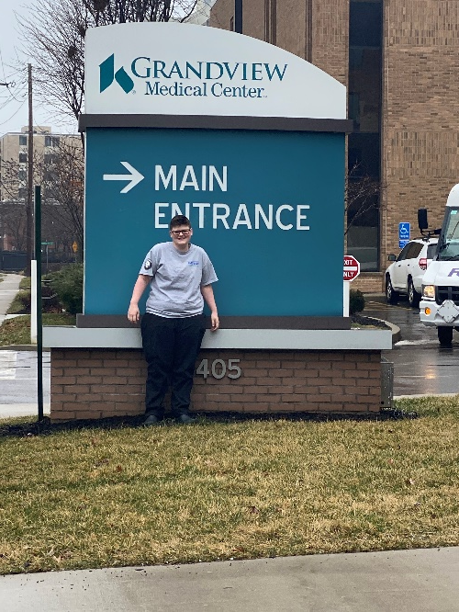
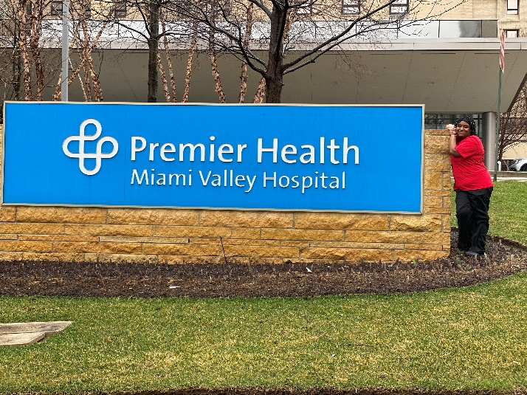
Healthcare Partners

Slide 19
Workforce Advisory Committee
Stephen R. Covey: Start With the End in Mind: Why do you want a partnership with this company?
Practice the Art of Enlighted Self-Interest: Consider why they should want to partner with you?

Slide 20
Workforce Advisory Committee: Key Partnership Ideas
Effectiveness
Quantify the impact of the partnership (hours worked, credentials earned, graduation rate, placement info)
Utilization
Do not let time elapse with no interaction
Communication
Meet quarterly, get input on your curriculum
Appreciation
Ongoing and intentional (in-person, cards, emails, during interviews, and tours)

Slide 21
Peer Presenter
Wilson Ramos
Program Director
Los Chicanos por La Causa YouthBuild

Slide 22
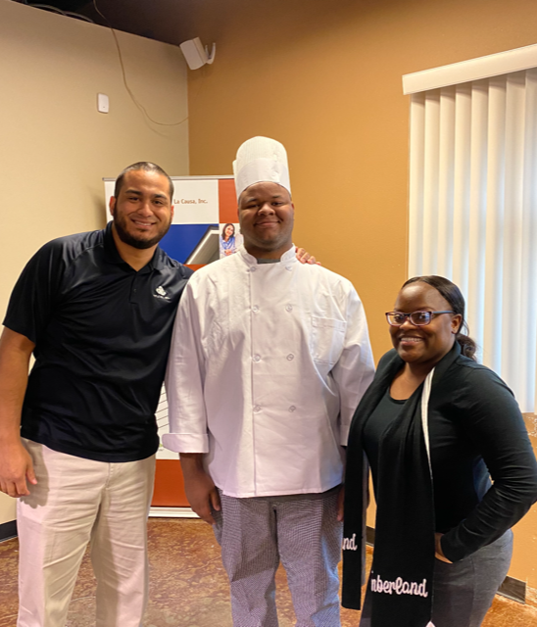
Work Experience and Beyond!

Slide 23
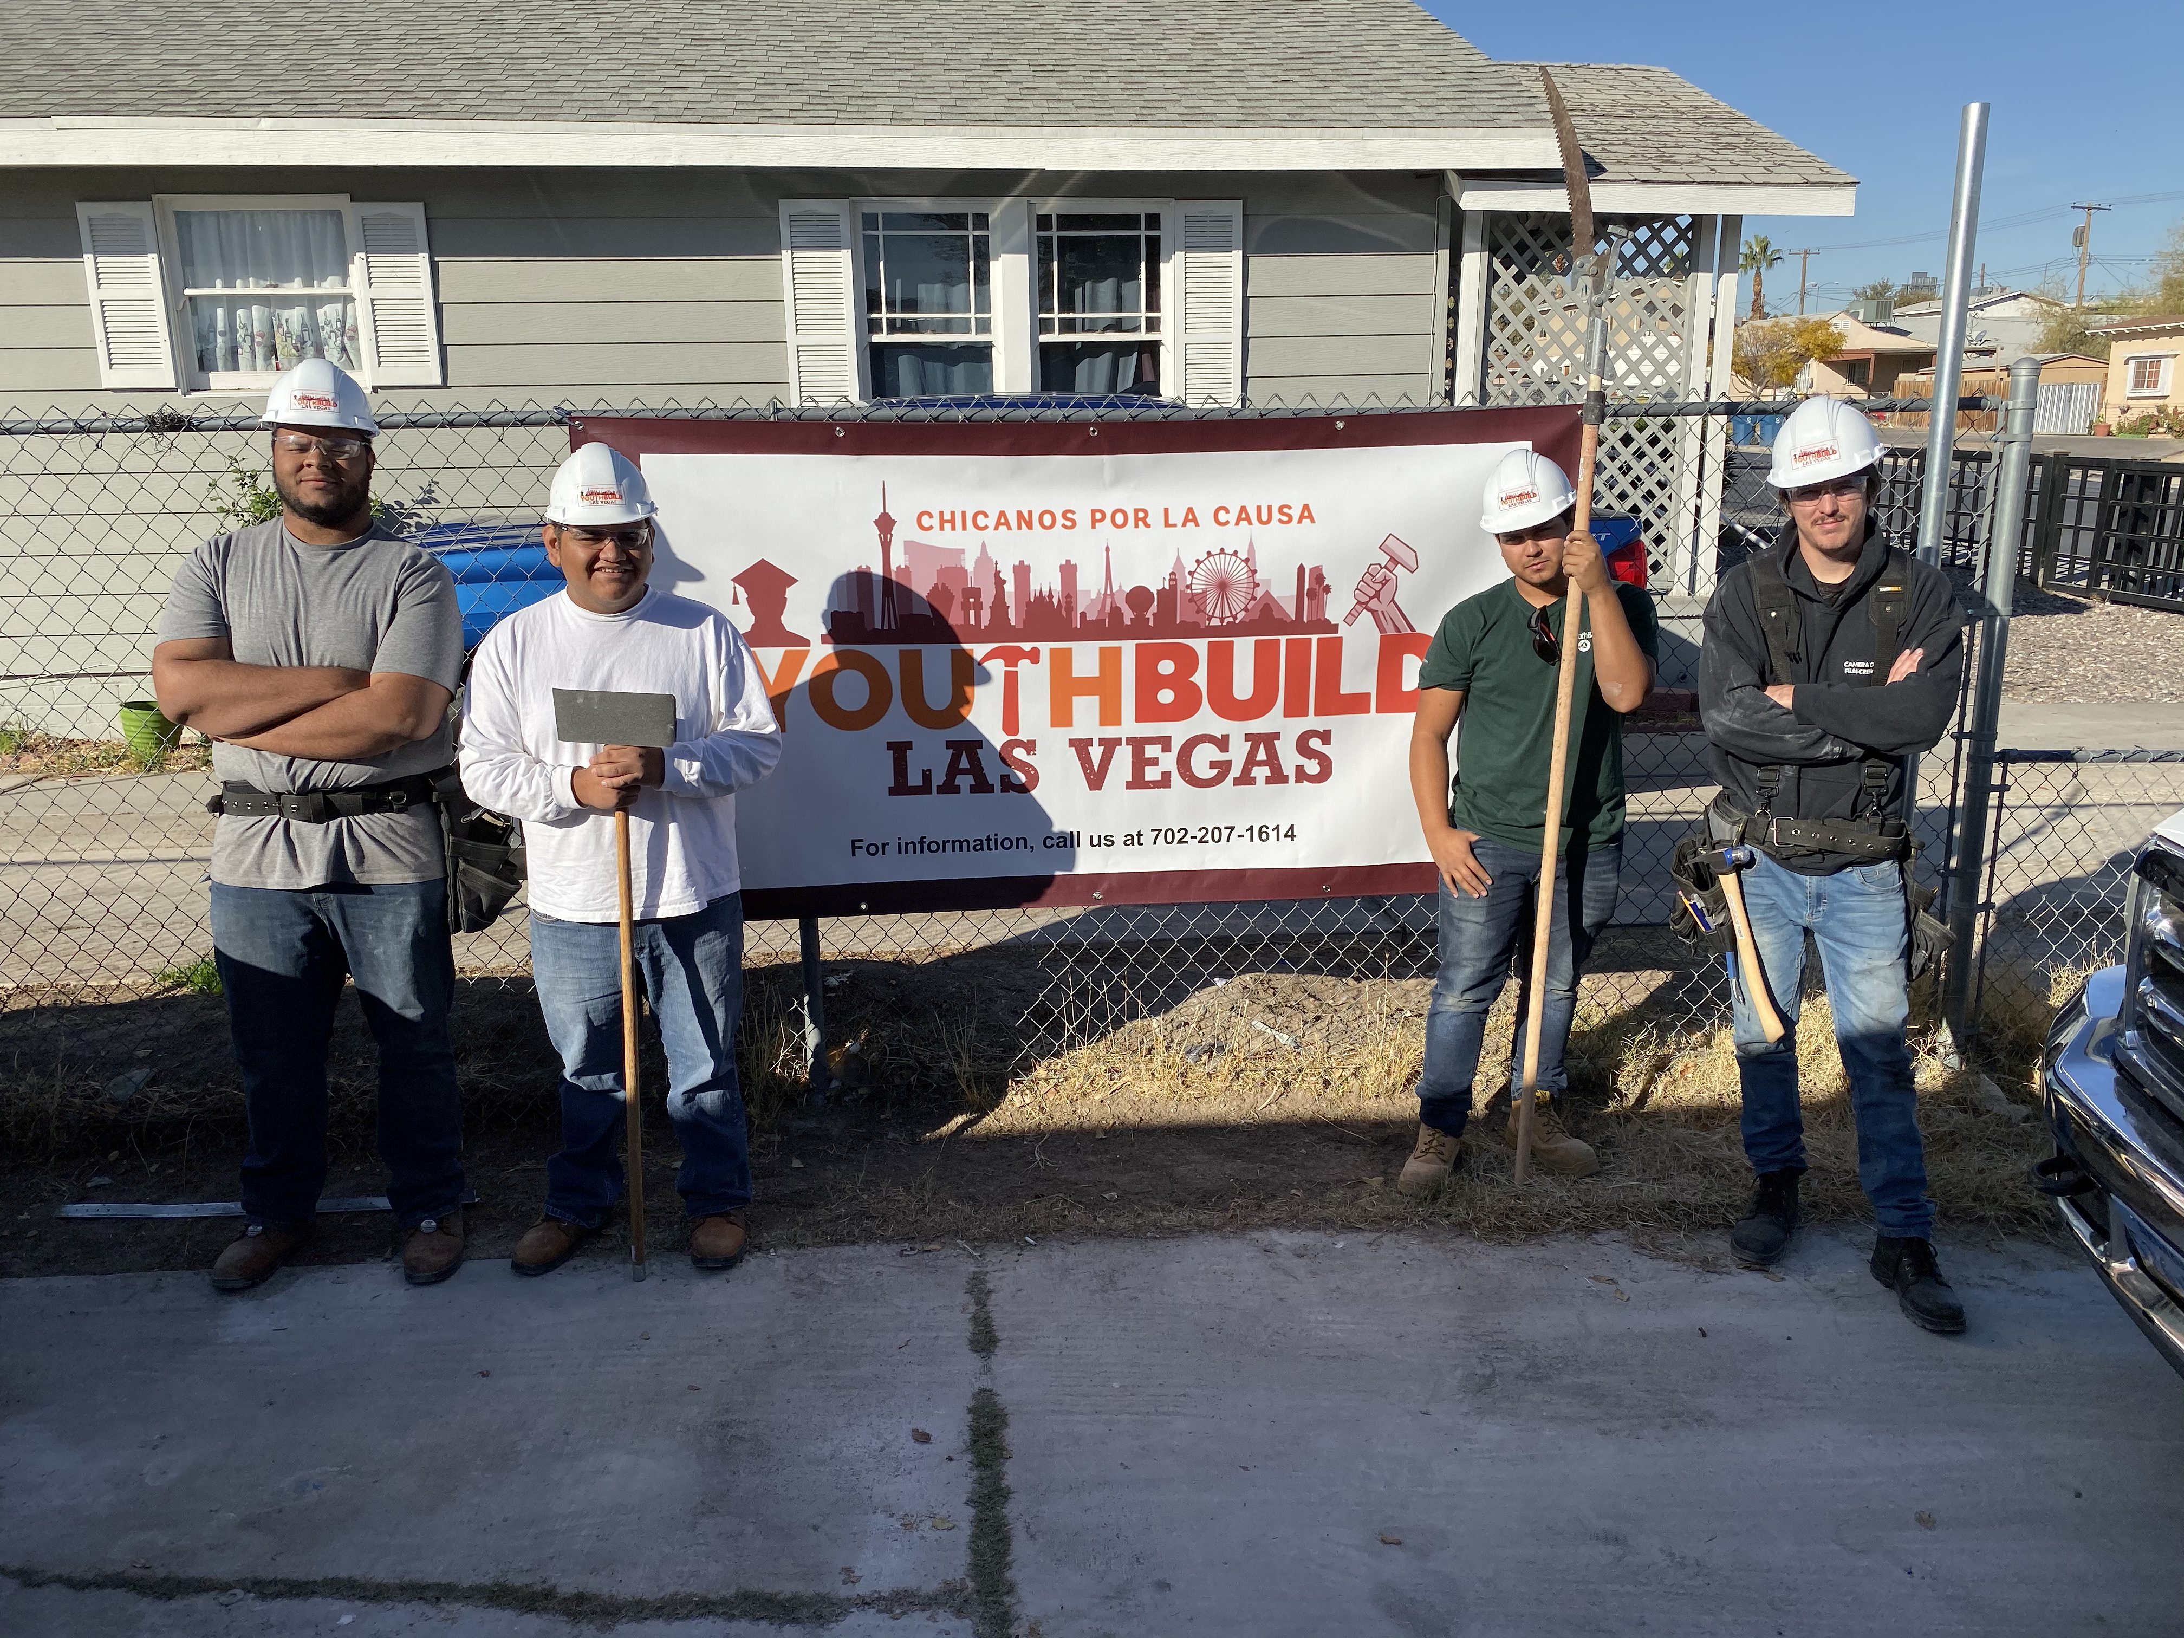
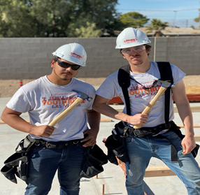
Importance of a healthy partnership
Understanding what services can be applicable to your participant
ASK! “A closed mouth does not get fed”
Ensure all asks are in the MOU or Contractual Agreement
Don’t rely on the partnership to align your WEX

Slide 24
Key Takeaways from Peer Presenters
Ensure you have an MOU re: the work experiences with your partners
Build the work experiences to lead to placements with partners when possible
Know your partners!

Slide 25
Questions for Peer Presenters

Slide 26
Breakout Rooms | Discussion
Scenario 1
Smart House to Castles YouthBuild
Phone dial-in information
Room #1
Scenario 2
To Your Good Health YouthBuild
Phone dial-in information
Room #2
Scenario 3
A Secure Future YouthBuild
Phone dial-in information
Room #3

Slide 27
Key Takeaways from Scenarios Breakouts

Slide 28
Scenario 1
Smart House to Castles YouthBuild program has a parent organization that is construction-focused. This organization works primarily with the local housing authority, typically on multiple sites with multiple individual contractors under a tight timeframe and the tasks vary constantly according to the speed of the different contractors. The participants work on designated job sites under the supervision of their YouthBuild Construction Trainer. Several other partners who are major construction companies are doing mass hires for commercial and residential projects. Some youth have been placed with them, but have tended to quit after several days on the job.
How should Smart House to Castles YouthBuild develop a quality construction work experience? What are key potential challenges that may become roadblocks and how would you address them?

Slide 29
Scenario 2
To Your Good Health YouthBuild is a Construction Plus YouthBuild program whose parent organization is a CDC. They have two tracks in their program: construction and healthcare. All youth have to go through basic construction safety, work a set number of hours on the housing site, and attain their HBI PACT credential. After completing the construction track, youth who are interested in healthcare (sterile scrub tech or phlebotomy) move into this track. The partners for the healthcare track are a community college and a local hospital. The hospital has offered limited work experience, working as a greeter and assistant to patients and families coming in, but nothing else.
How should To Your Good Health YB develop a quality work experience? What are key potential challenges that may become roadblocks and how would you address them?

Slide 30
Scenario 3
A Secure Future YouthBuild is a standalone nonprofit and a C+ grantee which offers construction and IT career tracks. Participants need to complete basic safety and 1-3 months’ worth of construction site work in-program. This YouthBuild program has 6 different IT-related partners, including a remote call center, a small computer repair business, a museum, a city office, an online store, and a cable company. Each partner can handle either teaching/training or a WEX, but not both, for no more than 1 participant at a time.
How should A Secure Future YouthBuild develop a quality work experience? What are key potential challenges that may become roadblocks and how would you address them?

Slide 31
Resources:
WIOA: Investments in Youth Work Experiences
https://forumfyi.org/knowledge-center/wioa-case-study/
Construction Plus Framework for a Quality Pre-Apprenticeship Experience
https://youthbuild.workforcegps.org/resources/2018/06/04/16/48/Construction_Plus_Framework_for_a_Quality_Pre-Apprenticeship_Experience
TEGL 06-15: Qualifying Work Sites and Construction Projects for YouthBuild Grantees and Their Role in Training
https://wdr.doleta.gov/directives/corr_doc.cfm?docn=6610
WIOA Youth Program and Work Activities
https://youth.workforcegps.org/resources/2018/10/30/15/56/Work-Experience-Activities
JFF Young Adult Talent Development Field Standards
https://jfforg-prod-prime.s3.amazonaws.com/media/documents/BRIEF-YATD-Field-Standards-091119.pdf
Registered Apprenticeship and On-the-Job Training: Providing Work-Based Learning Opportunities
https://ion.workforcegps.org/resources/2015/09/16/17/49/Registered_Apprenticeship_OJTs_Work-Based_Learning
Paid and Unpaid Work Experience Resources
https://youth.workforcegps.org/resources/2017/01/19/14/27/Paid-and-Unpaid-Work-Experience

Slide 32
Save the Date:
2019 National New Grantee Orientation
Washington, DC
April 7-9, 2020
YouthBuild Webinar Series: Career Pathway: Construction
May 5, 2020

Slide 33
Additional Questions?
Put questions in chat box or use *6 to unmute your phone.

Slide 34
Contact Us
Jenn Smith
National YouthBuild Director
U.S. Department of Labor
smith.jenn@dol.gov
202.693.3597
Phoebe Reeves
Associate Director, Technical Assistance
YouthBuild USA
phoebereeves@youthbuild.org
207.441.9951
Mary McRae
Senior Manager, DOL YouthBuild Coaching
YouthBuild USA
mmcrae@youthbuild.org
413.426.0961

Slide 35
Contact Us
Oscar Grant
DOL YouthBuild Technical Assistance Coach
opgconsulting@gmail.com
702-204-2450
Wilson Ramos
Program Manager
CPLC YouthBuild
wilson.ramos@cplc.org
702-232-5429
Jerry Farley
Program Director
YouthBuild Dayton
jfarleyedd@gmail.com
937-269-4043

Slide 36
Thank You!
Please stay for a moment to complete a short survey.
Need help? Email: Support@workforceGPS.org

