Slide 1


Read Before You Proceed:
Instructions for Use & Legal Compliance
Legal Accessibility Requirements: 508 Compliance
Only use tables when standard content delivery is insufficient, and never merge table cells.
Do not use screenshots or images of text items. All text must be editable and not blur when the screen is zoomed in.
Avoid using “Smart Art” or the “Design Ideas” tool.
Do not repurpose slide title boxes for any other use.
Do not use multiple spaces, empty paragraphs, or strings of tabs to visually adjust your content, as every such repeated character must then be manually stripped from all slides before posting. Instead:
  Use soft returns to bump content to the next line in lieu of spaces (Shift + Enter)
  Manage paragraph spacing and tabs in the “Paragraph” panel.
Every image or visual element used must either have alternative “alt” text applied or be marked as “decorative”.
  Alt text translates visual information into verbal information, which is read aloud in screen readers, while items marked “decorative” are skipped.
  This step is required to deliver the full message provided by any graphics.
  The person who laid out the content should also provide
  that alternate information to ensure their
  message stays intact.
Learn about the new innovative features!
Please watch this webcast
before using this template.
https://vimeo.com/370983870/2afa9e8306
(Ctrl + Click to open link)
Duration: 6 minutes

Slide 2
TAA Administrative Collection of States
(TAAACS)
Overview and Questions

Slide 3

Today’s Speaker / Today’s Moderator
Robert Hoekstra
  Program Analyst, PMDR Technical Expert
    Office of Trade Adjustment Assistance

Slide 4
Who is on the call?
What is your role?
Fiscal Staff
TAA Program Reporting Staff
TAA Staff
TRA Staff
DOL ETA Staff
Other
Please click on the most appropriate answer in the poll.

Slide 5
Today’s Objectives
What is TAAACS?
Discuss the Reporting Procedures
Understand the Purpose of TAAACS
Section by Section Walk Through
Answer Questions

Slide 6
TAAACS Basics

Slide 7

TAAACS Overview
Purpose of TAA Administrative Collection of States (TAAACS)
Provide Baseline Information on State Organization
Collect State Practice
  Context for technical assistance
  Common practices
  Outlier states
Prioritize Technical Assistance
Investigate Practices Related to Positive Program Metrics

Slide 8
TAAACS Basics
Timeline
8-Week Collection Window
  Ensures flexibility around other reporting obligations
  Allows for time to gather information needed
Initial Collection Runs from January 2020 through February 2020
Collection Will Normally Run October through November
  Allows for integration with annual reporting
Extensions May Be Requested

Slide 9
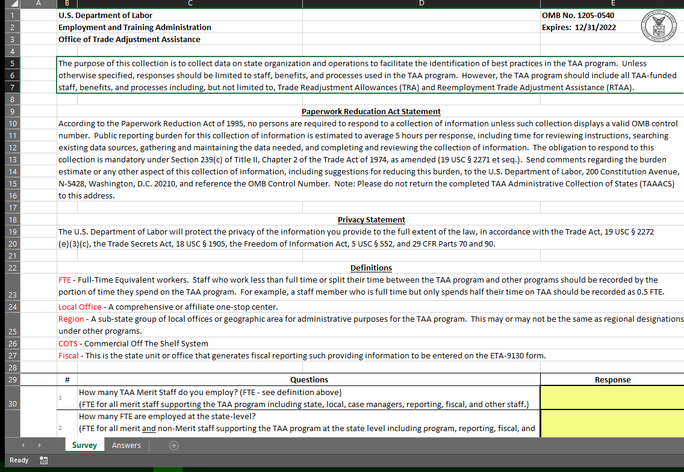
TAAACS Basics
Format
Fillable Excel Sheet
Should be Returned as an Excel Document.
Return by Email to Me (hoekstra.robert@dol.gov)
Reviewed for Completeness

Slide 10
TAAACS Overview

Slide 11

TAAACS Basics
What is TAAACS?
New Collection as of 12/30/2019 (OMB No. 1205-0540)
165 Questions About State Organization and Practice around the TAA program (Estimated 5 hours to complete)
  Discrete data and categories
  Provides help text
Information Submitted Annually
  Snapshot of where the state is at the time of collection
Mandatory under Section 239(c) of Title II, Chapter 2 of the Trade Act of 1974, as amended (19 USC § 2271 et seq.)

Slide 12
TAAACS Basics
Scope
Unless otherwise specified, responses should be limited to staff, benefits, and processes used in the TAA program.
However, the TAA program should include all TAA-funded staff, benefits, and processes including, but not limited to, Trade Readjustment Allowances (TRA) and Reemployment Trade Adjustment Assistance (RTAA).

Slide 13
TAAACS Basics
Definitions
FTE – Full-Time Equivalent workers. Staff who work less than full time or split their time between the TAA program and other programs should be recorded by the portion of time they spend on the TAA program
Local Office – A comprehensive or affiliate one-stop center
Region – A sub-state group of local offices or geographic area for administrative purposes for the TAA program. This may or may not be the same as regional designations under other programs
COTS - Commercial Off The Shelf System
Fiscal – This is the state unit or office that generates fiscal reporting such providing information to be entered on the ETA-9130 form

Slide 14

TAAACS Overview
Topics
The Collection is Broken Down into Eight Topic Areas
  State Organization
  Eligibility Determinations and Participant Training Procedures
  Integration
  IT Systems and Reporting
  Training for TAA Staff
  Outreach
  Job Search and Relocation
  Barriers

Slide 15
TAAACS Overview
Types of Questions
Some Questions Ask for Data (Actual Counts) or Estimates
Many Questions Ask for a Scale
  Some are materially tied to something you might have data on (like most common outreach methods)
  Where there is no data, we are looking for your best estimate
Some Questions Ask for an Opinion
  Most significant barriers?
  Level of integration?
  Must recognize that we are actually capturing subjective information

Slide 16
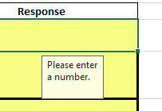
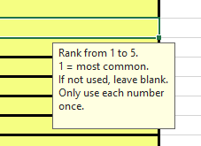
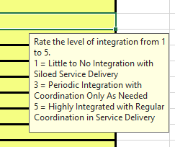
TAAACS Overview
Types of Answers
Enter a Number (Actual vs. Estimates)
Yes/No
Rank – Use Numbers Only Once
Percentages adding to 100%
Categories (Dept, Groups, etc.) – Select Best Choice
Scales
Free Text (Few: Vendor, Comments)

Slide 17
TAAACS Overview
Important Notes
Fields Have Help Text and Data Validation
All Questions Must be Answered (unless specified otherwise)
  Sub-questions are indented
  Including affirmation information
Comments and Caveats must be in Comments Section (Q88)
Don’t Understand Something? Ask!

Slide 18
Any Questions?
Any questions on the setup of TAAACS?
  (before we get specific on the questions in it)

Slide 19
Section 1: State Organization

Slide 20
Section 1: State Overview
Objectives
How is your staffing model arranged?
Which staff do what work?
Do you have different staffing levels than other states of similar size, similar participant levels, etc.?
How experienced is the staff in your state?
Does your state use central control or local control?

Slide 21
Section 1: State Overview
Staffing (Q1-Q8)

Slide 22
Any Questions?
1 | How many TAA Merit Staff do you employ? (FTE - see definition above) (FTE for all merit staff supporting the TAA program including state, local, case managers, reporting, fiscal, and other staff.)
2 | How many FTE are employed at the state-level? (FTE for all merit and non-Merit staff supporting the TAA program at the state level including program, reporting, fiscal, and other staff.)
3 | How many state-level FTE do you employ for the purpose of providing support to local offices on TAA-related issues? (Estimates allowed. Includes merit and non-merit staff, staff grouped into "regions" to support local offices, as well as staff in other units supporting TAA such as Rapid Response. Excludes local staff such as TAA case managers. Excludes state staff who do not directly support local offices such as reporting staff and finance staff.)
4 | How many FTEs are employed by local offices (includes case managers)? (Estimates allowed. Includes merit and non-merit staff and case managers directly supporting TAA participants).
Questions on Staffing
  (Let’s get specific. Who do you not know whether to count or not?)

Slide 23

Section 1: State Overview
Roles
Expertise (Q10 and Q11)
  % Expert / intermediate / novice – must add to 100%
Who does major TAA activities? (Q9, Q12, Q13)
  Filing TAA petitions
  Client intake
  Has the most contact with TAA participants
Other (Q14)
  Centralized/decentralized

Slide 24
Section 2: Eligibility Determinations and Participant Training

Slide 25
Section 2: Eligibility Determinations and Participant Training
Objectives
How do you verify eligibility?
  Who takes the lead in determining various kind of eligibility?
  Do we see differences in take-up depending on how eligibility process are arranged?
  Do we see differences in the utilization of benefits depending on how eligibility determinations are made?
What does your training approval process look like?
  Do differences in training approval processes change what kinds of training gets approved?

Slide 26

Section 2: Eligibility Determinations and Participant Training
Eligibility Determinations
How? Questions should represent your normal process.
  UI wage records, FEIN
Who? Which group generally does it.
  Unit
  State/local/mix
What?
  Program eligibility
  Training eligibility
  TRA and A/RTA eligibility

Slide 27

Section 2: Eligibility Determinations and Participant Training
Training Approvals
Who?
Training Amounts
Remedial Training Only?
Credential Requirement?

Slide 28
Any Questions?
Questions on Sections 1 or 2?

Slide 29
Section 3: Integration

Slide 30
Section 3: Integration
Objectives
How do states integrate?
What types of integration are most common?
What types of integration are most important?
What are the more effective mechanisms for integration?
How are participant services integrated?

Slide 31

Section 3: Integration
Ratings
Collects Subjective Ratings on How Integrated TAA is With Other Programs/Units
Uses Scale 1-Low to 5-High
  1 = Little to no integration with siloed service delivery
  3 = Periodic integration with coordination only as needed
  5 = Highly integrated with regular coordination in service delivery

Slide 32
Section 3: Integration
Ratings
Rapid Response
TRA
Fiscal
WIOA Title 1
Business Services
Adult Basic Education (with Remedial Training)
Adult Education
Apprenticeship
JVSG
Vocational Rehab

Slide 33
Section 3: Integration
Methods of Integration
Detailed methods only needed for Rapid Response, TRA, and Fiscal
Methods
  Joint Department / Unit / Administrator or Manager
  Shared Meetings or Trainings
  Attending Others Meetings
  Systemized
  Email
  Other Formal
  Informal

Slide 34
Section 3: Integration
Common Exit and Co-Enrollment
What is your state common exit policy?
What is your co-enrollment policy with WIOA Adult?
What is your co-enrollment policy with WIOA Dislocated Worker?

Slide 35
Any Questions?
Questions on Section 3?

Slide 36
Section 4: IT Systems and Reporting

Slide 37
Section 4: IT Systems and Reporting
Objectives
How do you staff TAA reporting?
How integrated are your IT systems?
How frequently are there updates to your systems?
  Is there a good balance between adapting to service delivery needs and consistency need for training and expertise?
How much do you leverage IT for your case managers and for participants?
  How much are case managers switching between paper and electronic files?
  The availability of which participant forms online for participants are most tied to service delivery metrics?

Slide 38

Section 4: IT Systems and Reporting
Reporting
Dedicated units or staff for reporting
Are reporting units for DOL-reporting or leveraged for other stakeholders?
Complexity and Integration
Upgrades
  If it has not had a significant upgrade, provide the date the system was created
  If you do not know a specific date, provide an estimate

Slide 39

Section 4: IT Systems and Reporting
IT Systems
Staff / Case Manager usage of IT systems
  Does their work center around the system?
  Or is it a place to document PIRL items?
Online Portals for Participants?
  What can they do?
  What forms can they fill out?
  Is IT leveraged for communications between case managers and participants?

Slide 40
Any Questions?
Questions on Section 4?

Slide 41
Section 5: Training for TAA Staff

Slide 42

Section 5: Training for TAA Staff
Objectives and Other Notes
Only eight quick questions
Objectives
  How do you train your state and local staff?
  What formats of technical assistance best aligns with state training?
  What are the most frequently used mechanisms for training?
  How do the mechanisms utilized change depending on the size and expertise of staff?
Most are yes/no as to whether it is a normal way you train staff
Some provide options for frequency for the best choice to be selected

Slide 43
Any Questions?
Questions on Section 5?

Slide 44
Section 6: Outreach

Slide 45

Section 6: Outreach
Objectives
How do you know to file a petition?
How do you contact workers?
  What methods work best for contacting workers?
  How do you get contact information?
How successful is that contact?
How do these practices relate to state take-up rates and petition filings?

Slide 46
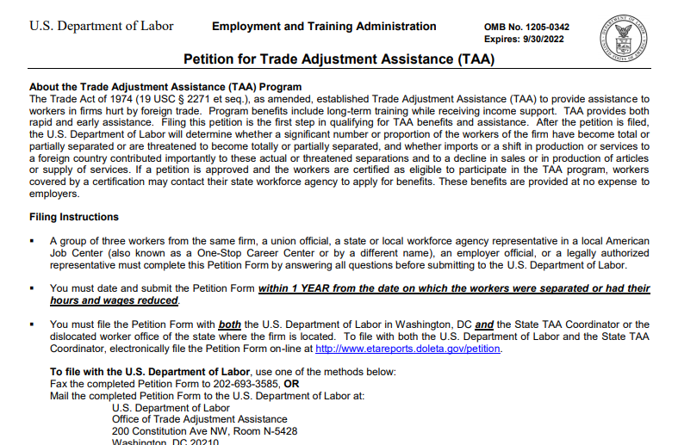
Section 6: Outreach
Petition Filings
Process for evaluating WARNs?
Process for evaluating non-WARN layoffs?
Portion of potentially TAA eligible groups that have petitions filed?
  Best estimate
  This will be subjective

Slide 47

Section 6: Outreach
Reaching Eligible Persons
Estimates
  Groups Notified
  % Acknowledged Notification
  % Applied for TAA
Rankings of most frequently used
  Methods of Contacting
  Sources for Contact Information

Slide 48
Any Questions?
Questions on Section 6?

Slide 49
Section 7: Job Search and Relocation

Slide 50

Section 7: Job Search and Relocation
Objectives And Notes
Determine when states offer job search and relocation
Determine if certain timing is associated with more people utilizing the benefits
Simple yes/no responses
  During initial discussion of potential TAA benefits
  At case manager discretion
  At training completion
  At a required specific follow-up time
  When informed about job search/placement progress

Slide 51
Any Questions?
Questions on Section 7?

Slide 52
Section 8: Barriers

Slide 53

Section 8: Barriers
Objectives
Determine what challenges states are encountering in administering the TAA program
Determine which challenges are the most significant
Help the Department to prioritize technical assistance, training, etc.

Slide 54

Section 8: Barriers
Notes
Potentially the most important section
Ranking is subjective, but should be informed by program experience
Rank from 1 to 15 with 1 as most significant
If one is not applicable, ranking will be from 1-14
Other barriers? Great additions to the Comments section.

Slide 55
Any Questions?
Questions on Section 8?

Slide 56
Closing Notes

Slide 57


Closing Notes
Affirmation MUST be filled out
Many questions could prompt wanting to put caveats or context
  Great! But please put them in the comments Section 88
  We still need an answer, so provide the best answer option you can
Questions/Comments can also be emailed
  Not sure what a question is asking?
  Think there is a better way to ask something?
  With there was another option for a response?
  Thoughts on the process?
  Comments on burden?

Slide 58
Resources:
TAAACS Initial Results Review
  End of March, will discuss initial insights from TAAACS
    https://www.workforcegps.org/events/2020/01/02/18/33/TAA-Administrative-Collection-of-States-Review-of-Initial-Results
TAA Participant Reporting Page
  Tons of information on participant reporting including TAADI resources
    https://www.doleta.gov/tradeact/taa-data/participant-reporting/
Upcoming Webinars on our TAA Community Page
  WorkforceGPS TAA community page lists upcoming webinars and events
    https://taa.workforcegps.org/events

Slide 59
Contact Us
Robert Hoekstra
  Program Analyst, Technical Expert PMDR
    Office of Trade Adjustment Assistance
      hoekstra.robert@dol.gov
        202-693-3522

Slide 60
Any Questions?
Final Questions

Slide 61
Thank You!
Need help? Email: support@workforceGPS.org

