Slide 1
Who are you?
TAA Staff
TRA Staff
Both TAA and TRA Staff
Rapid Response
Both TAA and Rapid Response
Other Workforce (local or state, specify in comments)
Federal Staff

Slide 2
Business Engagement for Successful Outcomes

Slide 3
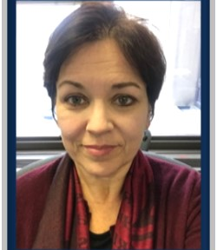
Amanda Poirier
Regional TAA Coordinator
ETA/US Department of Labor
Susan Worden
Supervisory Program Analyst
OTAA/ETA/US Department of Labor

Slide 4
Today’s Objectives
Shared common goal: re-employment
Increase impact through Employer Engagement
Explore options to leverage case management funds
Learn strategies to improve partnerships with stakeholders

Slide 5
NAVIGATOR MODEL
Two Webinars
Guiding and Coaching Trade-Affected Workers
Business Engagement for Successful Outcomes

Slide 6
What are some values of business engagement?
Transactional
Situational
Reactive
Proactive
Across the business cycle

Slide 7
“Begin with the end in mind.” Dr. Stephen Covey

Slide 8
Can case management funds be used for business outreach?
Yes
No

Slide 9
Panel Questions
What was the first step you took to engaging employers?
What are the barriers to engaging employers?
What is the key to developing strong business partnerships?
How as a training provider do you work with employers to determine training needs? What’s the secret?
How have you been successful in articulating and developing apprenticeships? What’s the secret?

Slide 10
Laura Lausmann
TAA Liaison
WorkSource Oregon/TAA
David White
Trade Act Navigator
WorkSource Oregon/TAA

Slide 11
Oregon TAA Program Business Engagement
Oregon TAA is one of several “aligned partners” in our Local American Job Centers who take an employer focused approach to support local businesses and companies.

Slide 12
Trade is a Vital Link in Connecting Employers to Beneficial Services…
Local Sector Strategies
*Navigator
*AJCs
Local WIB
*Community Colleges
Employer Visits
*Navigator
OJT Opportunities
*Navigators
*Title 1B Partners
Job Readiness & Placement
*Navigators
Job Development for TAA
*Navigators
Community College Career Pathway Quarterly Meetings
*Liaison
Attends Community College Career Pathway Alliance meetings – providing input on labor market and certificate alignment.
TAA Participant
Real time Local Labor Market Information shared with participants and Training Case Managers.
...Creating a Path for Trade Impacted Workers to reach their Re-employment Goal!
Re-employment

Slide 13
Employer Engagement: Navigator duties as it relates to working with businesses.”
TAA Navigator’s
Conduct employer outreach and company site visits. *
Review employer need for applicants.
Assist with job listing
Share Labor Market information
Create and participate in employer Career Fairs
Educate employers on TAA program and processes.
Conduct Job Development by matching participants for listing.
Offer OJT opportunities.
Leverage technology: iMatchSkills, Skype for Business, LinkedIn.
Educate employers by sharing Partner services promoting Lay Off Aversion.
Work Opportunity Tax Credit (WOTC)
Trade for Firms
WorkShare
Rapid Response
*All Employer Visits include providing the employer information on: American Job Centers, Rapid Response, Trade for Firms and Workforce initiatives

Slide 14
Example of : OJT/JOB DEVELOPMENT
Advanced Manufacturer in need of qualified candidate.
Company: Metro Based Advanced Manufacturer.
Product: Various Customized Electronic Controllers for Heavy Equipment and Industry.
Need: New Hire who can help company president conduct high cost estimates.
Problem: Finding the “right” applicant. Current applicant pool would need lot’s of expensive training, something the transitioning company could not yet afford.
12

Slide 15
Apprenticeship & Pre-Apprenticeship
Apprenticeship Coordinator Quarterly Meetings
Held onsite – various Union shops
Oregon Employment Department Apprenticeship Program Liaison = Partner
Workforce Grants/AIM Grant
Oregon Apprenticeship Website
http://oregonapprenticeship.org/
TAA Liaison – State Level Collaboration
Community College Apprenticeship Coordinators
Pre-Apprenticeship Programs
TAN & Liaison – Local Level
Outreach to Programs
2018-2019 – Oregon approved six training plans for Apprenticeship Training.
3 have completed and 3 are currently training
4 Electricians, 2 Plumbers, & 1 Diesel Mechanic

Slide 16
Susan D. Huard, Ph. D.
President
Manchester Community College
Lynn Szymanski
Corporate Training Manager
Great Bay Community College

Slide 17
Business Engagement
Community College System of New Hampshire

Slide 18
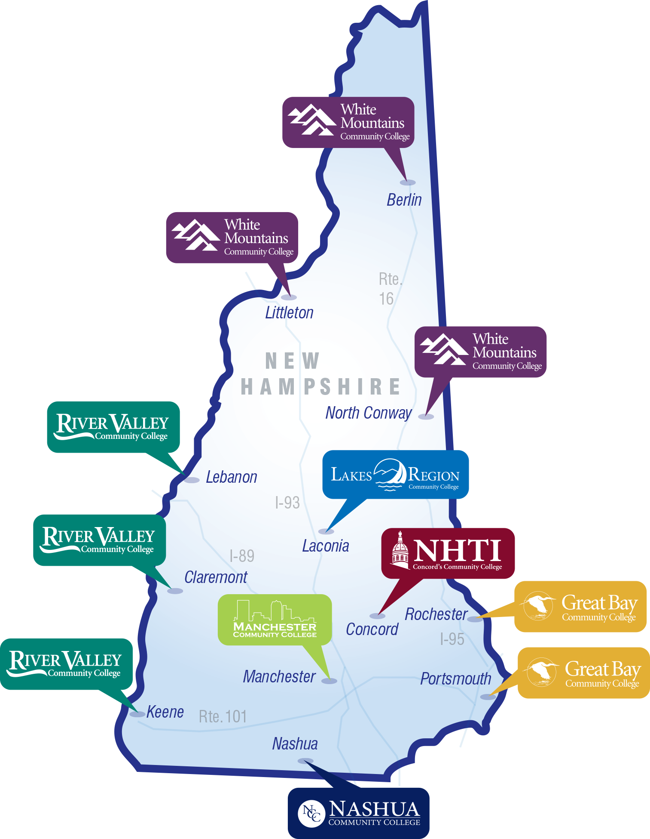
NH Climate
NH is a state of small and medium businesses. Virtually all training created involves multiple businesses in the process since very few companies are large enough to have stand-alone training programs.

Slide 19
Connect the dots: Plugging business into the training process
Engaging Business in the learning process
Inviting employers into the classroom
Engaging partners as curriculum reviewers
Recruiting businesses for advisory boards
Creating celebratory events that bring employers together
Recruiting business people as adjunct faculty

Slide 20
Making training opportunities match business needs
Strategies for conducting business outreach
Use of regional and state business associations
Reaching out to the recent graduates and their companies
Surveying employers that have hosted the College’s student interns
Inviting businesses to recruit at the College
Regularly reviewing job postings to identify new businesses

Slide 21
Making training opportunities match business needs
Working with training providers
Using same work expectation in class as the industry
Structuring vehicles for industry feedback and commentary
Sharing success stories; examples from White Mountains Community College
Engaging faculty in innovative ways; NHTI example of Mindful Communication courses embedded in information Technology certificates (https://vimeo.com/255050650)
Fostering potentially challenging partnerships such as a company and a union working with a college to develop a curriculum; ex. Eversource Energy and the local electricians’ union working with Manchester Community College to create lineworker curriculum

Slide 22
Connections
Partnerships
Formal connections through state economic development offices and professional associations
Blending college advisory committee composition
Industry Advisory Boards: NH Sector Partnership Initiative

Slide 23
Connect the dots: Plugging business into the training process
Apprenticeships and pre-apprenticeships
NH examples in the areas of healthcare (medical assistants, pharmacy technicians, licensed nursing assistants)
Advanced Manufacturing partnerships, including Tecomet, Inc. machine operators
New apprenticeships announced regularly, e.g., medical billing at AdventEdge in Salem, NH TBA Nov. 15, 2019

Slide 24
Tiffany Keune
Associate Dean of Workforce Education
Community College of Vermont

Slide 25
Business Engagement
Community College of Vermont

Slide 26
Community College of Vermont Overview
Vermont has only 1 community college with 12 locations statewide
Average class size: 13
Number of courses per semester: 975
Online and Hybrid courses per semester: 200+
Number of students in fall 2018: 5,844
Average age: 27
First generation students: 58%

Slide 27
Business Engagement Strategy: Hiring Targeted Staff
Associate Dean of Workforce
Business and Community Outreach Manager
Project Manager of Workforce
Program Assistant of Workforce

Slide 28
Business and Community Outreach Manager
Full-time position focused on the development of business and organizational relationships including:
Developing and implementing a comprehensive and innovative community and business outreach plan which responds to both regional and industry specific needs.
Promoting the value of Industry Recognized Credentials to Vermont Employers, while exploring which IRCs are most important to local businesses and career paths.
Developing new strategic partnerships through ongoing research and evaluation, and strengthening those relationships in conjunction with the local CCV Center.
Collaborating with both internal and external partners to create and deliver products for expanding CCV’s workforce presence.

Slide 29
Business Engagement Strategy: Blending Credit and Non-Credit Offerings
CCV is committed to meeting the needs of business through both customized workshops and contracted courses.
Credit opens up the door to both funding, and persistence along a certificate or degree pathway.
Tuition-remission benefits tend to align best with credit-bearing offerings relevant to the position.

Slide 30
Credit and Non-Credit Example: Customer Service Training
Non-Credit Workshops
Credit Courses
Credentials
Customized to the business
4-15 hour trainings
Approved through committee
Imbedded in programs
Recognized by industry
Portable across state lines

Slide 31
Business Engagement Strategy: Apprenticeship and Pre-Apprenticeship
Develops highly-skilled, highly-productive employees
Reduces turnover rates
Increases productivity
Lowers the cost of recruitment
Increases safety in the workplace
Training is customized to the industry/employer
Enhances employee retention
Creates a stable and predictable pipeline of qualified workers

Slide 32
Apprenticeship as a Workforce Strategy
Apprenticeship is different from other training approaches in these important ways:
Wages
A paycheck from day one
Learning
Connects education and work simultaneously
Credentials
Results in an industry recognized credential
Wage increases as apprentices become more proficient
Combines OJT and job-related instruction

Slide 33
Apprenticeship Components
Business Involvement
Structured OJT
Related Instruction
Rewards for Skills Gains
Nationally Recognized Credential

Slide 34
Pre-Apprenticeship Example: Nursing
Pre-Apprenticeship
Basic Skill Courses
Nursing Prereqs
Apprenticeship
Nursing Courses
On-the-job Training

Slide 35
Apprenticeship Strategy: Higher Education as the Sponsor
CCV has become the sponsor for apprenticeships statewide in several areas, including:
Medical Assisting
Production Technician
Pharmacy Technician
With many small businesses statewide, having a higher education sponsor allows businesses to remove some of the “heavy lift”
CCV registers the apprenticeship, submits paperwork, and verifies both related instruction and work competencies

Slide 36
Danielle Calaway
Project Manager, Outreach & Recruitment
Strengthening Working Families Initiative

Slide 37
Employer Engagement at Vermont Technical College
Learn how Vermont Tech collaborates with employers and economic development groups to meet state workforce needs.

Slide 38
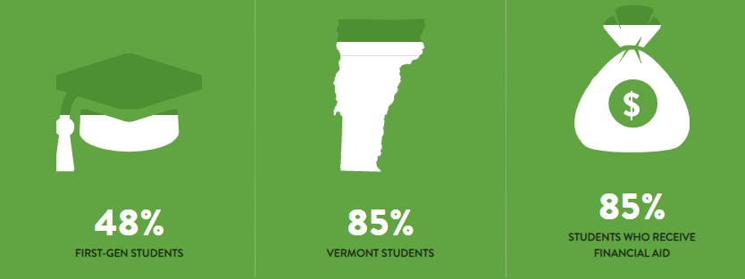
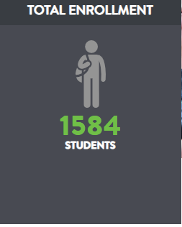
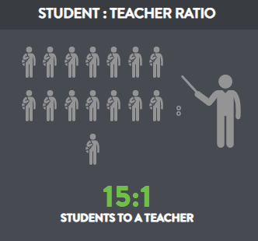
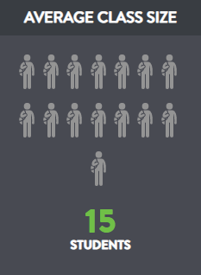
Vermont Tech Employment Success
2018 graduating class achieved 98% placement rate
100% of programs hands-on
Sixth highest salary after graduation for Vermont colleges
Vermont college with the highest earning graduates

Slide 39
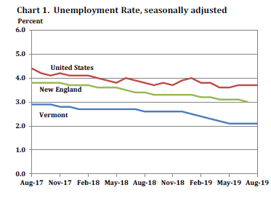
Vermont’s Workforce Challenges
Low unemployment rate:
2.1%
Lowest in nation
Stagnant population:
Aging
Out-of-state migration
Rural landscape:
Insufficient public transportation
Skills gap:
Employees lack skills needed by employers
Source: vermontbiz.com

Slide 40
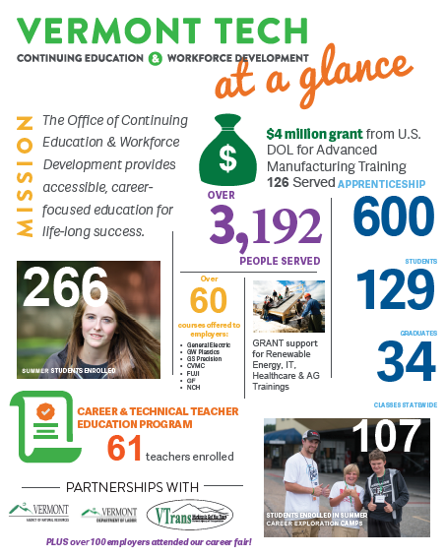

Slide 41
Strengthening Working Families Initiative
Goals:
Provide training and industry recognized credentials to eligible parents.
Break down barriers to training and/or employment via wraparound services.
Help participants obtain employment, including livable wages and benefits.
Develop pipeline of underserved students.

Slide 42
Training in Advanced Manufacturing
Industry-influenced trainings
Apprenticeships, welding, CNC, SolidWorks, etc.
Various on/off-ramps
Stackable credentials
Work-friendly class schedules
Serve incumbents and students new to manufacturing

Slide 43
SWFI Employer Partnerships
Vermont Tech
Employer Partners
Lean on existing partnerships:
Long-standing relationships with Vermont businesses
Communicate regularly:
Share updates re: training
Tailor offerings to meet business needs
Take time to interact with students:
Class visits
Tours
Career fairs
Value upskilling for incumbents:
Accommodate training schedules
Incentivize professional development

Slide 44
Community Partners
Vermont Department of Labor
Creative Workforce Solutions
Reach Up (TANF)
Vocational Rehab
Parent Child Centers
Regional Economic Development Centers
Vermont Adult Learning

Slide 45
Which panel questions would you like answered?
What was the first step you took to engaging employers?
What are the barriers to engaging employers?
What is the key to developing strong business partnerships?
How as a training provider do you work with employers to determine training needs? What’s the secret?
How have you been successful in articulating and developing apprenticeships? What’s the secret?

Slide 47
Seven Tips for Preparing Approvable TAA Program Reserve Funding Requests
December 11, 2019, 2:30-3:30PM Eastern

Slide 48
RevUp Montana Workforce Navigator Training
Module 8 - Business Outreach
Role of a Workforce Navigator in engaging with business
Building relationships with business
Understanding Labor Market needs
Matching participants to open jobs
Engaging business in the training process
Using business input to inform training providers
Informing businesses of public programs for growth

Slide 49
Workforce Navigator Training Modules
Web-based Training
https://revupnavigator.wordpress.com/
Downloadable Modules (for desktop)
https://www.skillscommons.org/handle/taaccct/238
Field Guide of TAACCCT Innovations
http://support.skillscommons.org/showcases/field-guide/student-support/

Slide 50
TAA Community on WorkforceGPS
Continue the Discussions!
https://taa.workforcegps.org/
OJT FAQ
On-The-Job Training (OJT) and the Trade Adjustment Assistance (TAA) Program: Frequently Asked Questions (FAQ) and Myths & Barriers/How to Overcome Them
https://www.doleta.gov/tradeact/benefits/docs/TAA_OJT_FAQ.pdf
Apprenticeship contacts
https://www.doleta.gov/oa/contactlist.cfm
Virginia Best Practice Model: Workforce & Adult Education Working Together
Webinar
https://www.workforcegps.org/events/2017/12/19/18/45/Virginia-Best-Practice-Model-Workforce-Adult-Education-Working-Together
On-The-Job Training (OJT) Best Practices and the Trade Adjustment Assistance (TAA) Program
Webinar
https://www.workforcegps.org/events/2019/02/20/15/45/On-The-Job-Training-OJT-Best-Practices-and-the-Trade-Adjustment-Assistance-TAA-Program

Slide 51
Susan Worden
Supervisory Program Analyst
USDOL/ETA/OTAA
Worden.susan@dol.gov
202.693.3517
Amanda Poirier
Regional TAA Coordinator
USDOL/ETA/NE & Caribbean Region
Poirier.amanda@dol.gov
617.788.0124
Laura Lausmann
TAA Liaison
WorkSource Oregon
Laura.E.Lausmann@oregon.gov
503.947.1236
David White
Portland Metro Trade Act Navigator
WorkSource Oregon
David.A.White@oregon.gov
503.341.5441

Slide 52
Susan Huard
President
Manchester Community College
shuard@ccsnh.edu
603.206.8148
Lynn Szymanski
Corporate Training Manager
Great Bay Community College
lszymanski@ccsnh.edu
603.427.7737
Tiffany Keune
Associate Dean of Workforce Education
Community College of Vermont
Tiffany.Keune@ccv.edu
802.786.0011
Danielle Calloway
Project Manager, Outreach & Recruitment
Vermont Tech
Danielle.calaway@vtc.edu
802.879.2380

