Slide 1
Cost Allocation and Indirect Costs
SMART 3.0 Training
November 14, 2019

Slide 2
Today’s Speakers
Debbie Strama
Fiscal Policy Unit Supervisor
U.S. Department of Labor, OGM DPRR
Chicago, IL
Strama.Deborah@dol.gov
Charlie Watts
Accountant, DFMAS
U.S. Department of Labor – Region 4
Dallas, TX
Watts.Charles@dol.gov

Slide 3
SMART 3.0 Training Strategies
S
SMART 3.0 Training Series:
The training modules are focused on: Strategies for sound grant management that includes: Monitoring, Accountability, Risk mitigation and Transparency
These four themes are weaved throughout the OMB Uniform Administrative Requirements, Cost Principles, and Audit Requirements for Federal Awards also known as the Uniform Guidance (2 CFR Part 200 and 2 CFR Part 2900).
Strategies
M
Monitoring
A
Accountability
R
Risk Mitigation
T
Transparency

Slide 4
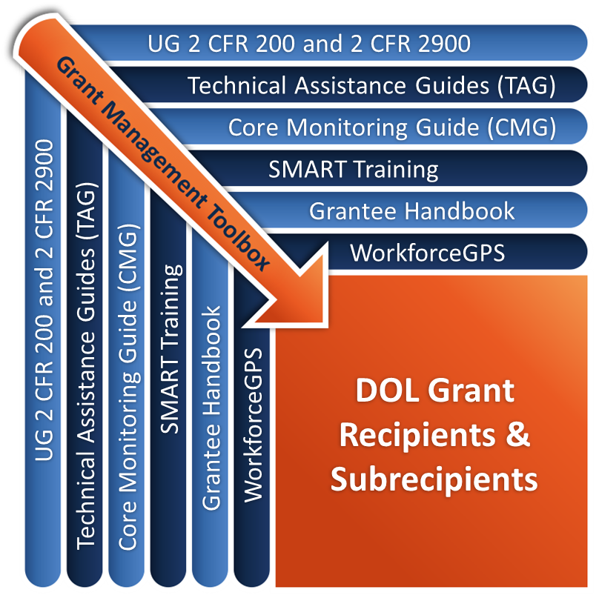
Grant Management Toolbox

Slide 5
Module Overview
Uniform Guidance requirements and definitions
Cost Allocation
Indirect Costs
Cost Allocation Plans
De Minimis Rate

Slide 6
Uniform Guidance Requirements & Definitions

Slide 7
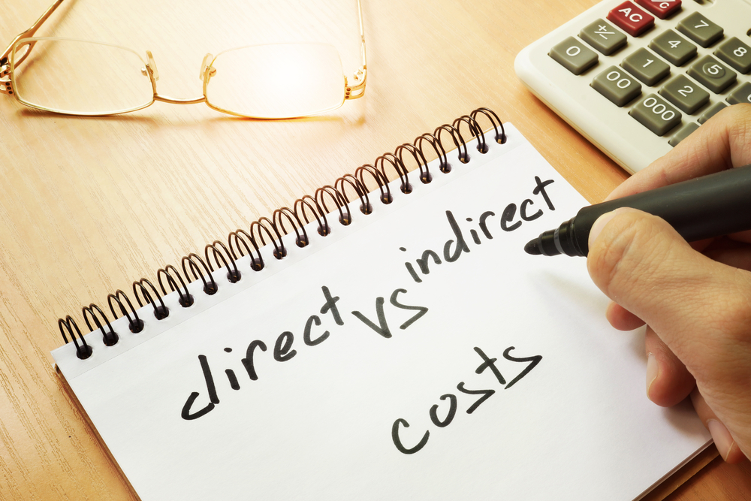
Types of Costs
Direct Costs
Program
Administrative
Indirect Costs
Program
Administrative

Slide 8
What are Direct Costs?
Those costs that can be easily identified with a particular cost objective (2 CFR 200.413). Examples are costs that are specific to a single program:
Salaries for a case manager who only works with your grant or participants
Square footage of space occupied by program staff
Supplies used by the case manager and program staff

Slide 9
What are indirect costs?
Costs incurred for common or joint purposes, benefiting more than one cost objective, and are not readily identifiable to a specific cost objective.
Administrative Salaries
Executive Director Salary*
Administrative space and operational expenses
Staff working on multiple programs and unable to direct charge

Slide 10
Calculation - Indirect Cost Rate
Indirect Costs
--------------------- = RATE
Direct Costs

Slide 11
Simple Example - Rent and Utilities for 3 Grants

Slide 12
Simple Example – Office or One Stop Center Reception Costs for 3 Grants

Slide 13
Knowledge Check – Questions
Which of the following are direct costs?
A. Supplies used by a case manager (who only works with your grant participants)
B. Salaries of Administrative staff
C. Space occupied by the accounting staff
D. Square footage of space occupied by a case manager (who only works with your grant participants)
E. A and D

Slide 14
Knowledge Check – Answers
Which of the following are indirect costs and which are direct costs?
A. Supplies used by a case manager (who only works with your grant participants) Direct Cost
B. Salaries of Administrative staff Indirect Cost
C. Space occupied by accounting staff Indirect Cost
D. Square footage of space occupied by a case manager (who only works with your grant participants) Direct Cost
E. A&D (ANSWER E)

Slide 15
Cost Allocation

Slide 16
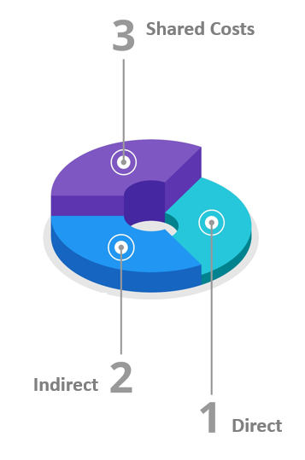
Cost Allocation – Definition
2 CFR 200.4
Cost Allocation means the process of assigning a cost, or a group of costs, to one or more cost objective(s), in reasonable proportion to the benefit provided or other equitable relationship. The process may entail assigning a cost(s) directly to a final cost objective or through one or more intermediate cost objectives.

Slide 17
Allocable Costs
2 CFR 200.405
Allocable Costs A cost is allocable to a particular Federal award or other cost objective if the goods or services involved are chargeable or assignable to that Federal award or cost objective in accordance with relative benefits received.
Criteria for meeting this standard:
Is incurred specifically for the Federal award
Benefits both the Federal award and other work of the non-Federal entity, and
Can be distributed in proportions that may be approximated using reasonable methods
Necessary to the overall operation of non-Federal entity, and assignable, in part, to the Federal award in accordance with UG cost principles

Slide 18
Cost Objectives – Citations
2 CFR 200.28 Cost Objective
A program, function, activity, award, organizational subdivision, contract, or work unit for which cost data are desired
2 CFR 200.60 Intermediate Cost Objective
A cost objective used to accumulate indirect or service-center costs that are subsequently allocated to one or more indirect cost pools or final cost objectives
Example: WIOA One-stop’s facilities costs (rent, utilities, repairs and maintenance costs, etc.)
Cost Pools or “Cost Staging Areas”

Slide 19
Cost Objectives
2 CFR 200.44 Final Cost Objective
Both direct and indirect costs are allocated to it
One of the final accumulation points: an award, internal project, other direct activity
Cost assigned to funding source
Example: shared youth costs
And Cost Category of benefiting program/project
“Final resting place”
Example: WIOA Youth and Youthbuild

Slide 20
Cost Pooling
Direct charge costs to a final cost objective when possible
When that is not possible or practical, use an intermediate cost objective (cost pool)
For any type of cost or grouping of similar costs not readily identified with a single final cost objective (Example: case management function; salaries, space cost, supplies, etc.)
Ultimately allocated to final cost objectives in proportion to the relative benefits received (Example: WIOA Adult, DW, Youth programs)
Limited to shared direct and indirect costs
Only actual, not budgeted, costs may be pooled when being charged to awards
All costs in the pool must be allowable costs for all the cost objectives to which the pooled costs will subsequently be allocated

Slide 21
Measuring Benefit
Costs are allocable to a particular cost objective to the extent of relative benefits provided to that cost objective
If no benefit received, then it is not allocable to that objective
Method used for measuring benefit is an integral part of the process for allocating costs
The method used is the allocation base
Costs pooled or assigned to intermediate cost objectives must be allocated to final cost objectives using an acceptable allocation base

Slide 22
Treatment of Costs
Direct Charge Whenever Possible
Consistent Treatment
In Accounting System
Over Time
Measuring Benefit
Benefit Determines Allocation

Slide 23
Cost Allocation Methods
Cost Allocation Plan (CAP)
Direct Costs
Indirect Costs for Government entities
Negotiated Indirect Cost Rate (ICR)
Indirect Costs
De Minimis Rate
Indirect Costs

Slide 24
Shifting of Costs
Any cost allocable to a particular Federal award under the principles provided for in this part may not be charged to other Federal awards to overcome fund deficiencies, to avoid restrictions imposed by Federal statutes, regulations, or terms and conditions of the Federal awards[2 CFR 200.403(d)], or for other reasons.
This prohibition would not preclude the grant recipient from shifting costs that are allowable under two or more Federal awards in accordance with existing Federal statutes, regulations, or the terms and conditions of the Federal awards. [2 CFR 200.405(c)]

Slide 25
Indirect (F&A) Costs Defined
2 CFR 200.56
Indirect (Facilities & Administrative) costs
Costs incurred for a common or joint purpose benefitting more than one cost objective, and not readily assignable to the cost objectives specifically benefitted, without effort disproportionate to the results achieved.
To facilitate equitable distribution of indirect expenses to the cost objectives served, it may be necessary to establish a number of pools of indirect (F&A) costs.
Indirect (F&A) cost pools must be distributed to benefitted cost objectives on bases that will produce an equitable result in consideration of relative benefits derived.

Slide 26
Indirect (F&A) Costs
2 CFR 200.414
Facilities
Defined as depreciation on buildings, equipment and capital improvement, interest on debt associated with certain buildings, equipment and capital improvements, and operations and maintenance expenses.
Administration
Defined as general administration and general expenses such as the director’s office, accounting, personnel and all other types of expenditures not listed specifically under one of the subcategories of Facilities.

Slide 27
Indirect Costs at end of POP and Grant Closeout
Indirect costs are reportable in section 13 of the FINAL ETA-9130
Unrecovered indirect costs… may be included as part of cost sharing or matching only with the prior approval of the DOL Grant Officer (Federal awarding agency) . 2 CFR 200.306(c)
If you use a provisional indirect cost rate during the grant period of performance but receive a different final rate at grant closeout, you should make adjustments to expenses and submit an amended closeout package.

Slide 28
Administrative Costs as defined in WIOA 20 CFR 683.215
Per WIOA: Costs associated with carrying out administrative and general management functions:
Accounting, budgeting, financial and cash management functions;
Procurement and purchasing functions;
Property management functions;
Personnel management functions;
Payroll functions;
Coordinating the resolution of findings arising from audits, reviews, investigations and incident reports;
Audit functions;
General legal services functions;
Developing systems and procedures, including information systems, required for these administrative functions; and
Fiscal agent responsibilities;

Slide 29
Administrative Costs - 2 Desk-aids
https://grantsapplicationandmanagement.workforcegps.org/resources/2018/08/01/15/57/WIOA-Specific-Resources

Slide 30
Knowledge Check 2 – Questions
True or False?
In order for a cost to be allocable it needs to be able to be distributed in proportions that may be approximated using reasonable methods.
It is best to charge costs to an intermediate cost pool whenever possible.
Monitoring, audits, investigations, and incident reports are all examples of program costs.

Slide 31
Knowledge Check 2 – Answers
In order for a cost to be allocable it needs to be able to be distributed in proportions that may be approximated using reasonable methods. True
It is best to charge costs to an intermediate cost pool whenever possible. False
Monitoring, audits, investigations, and incident reports are all examples of program costs. False

Slide 32
Cost Allocation Plans

Slide 33
Cost Allocation Plan (CAP) – Definition
What is a cost allocation plan?
A document that identifies, accumulates, and distributes allowable direct costs (or indirect costs for governmental organizations) and identifies the allocation methods used for distribution

Slide 34
Cost Allocation Plans
Minimum requirements
In writing
Supported by formal accounting records
Signed by authorized agency official
Include a process for reconciliation and adjustment
Periodically validated and updated
Costs should then be allocated in accordance with the methodology contained in the CAP

Slide 35
CAP Elements
Background and mission statement, including organizational chart
Description of the types of services provided
Copies of financial statements and current budgets
Shared expenses included in the cost of services to be allocated
Allocation bases used for distributing expenses to benefitting cost objectives
Certification by authorized official

Slide 36
Standards for Acceptable Bases
Related to the types of costs being allocated
Fair measure of cost generation or benefit
Results in equitable allocation of costs
Minimal distortion
Actual effort or cost
General acceptability
Cost-effective use of available and representative data
Timely management control
Adjusted for variations in funding and services provided

Slide 37
Unacceptable Allocation Bases
Funds available
Plans, budgets or estimates not adjusted for actual costs
Non-contemporaneous data such as results from prior periods
Job descriptions
Number of staff hours budgeted to an activity not adjusted to actual hours
Planned expenditure levels
Planned participant levels

Slide 38
Using Inputs as the Base
Inputs
Resources used; examples and documentation
Number of employees - staffing plan
Number of transactions - transactions count
Direct labor hours - timesheets/Personal Activity Reports
Space usage - floor plan showing space used by program/function
Traditional method of allocation
Allocated at time of cost incurred
Adjustments to plan
How the input is being used
How the usage varies

Slide 39
Using Outputs as the Base
Outputs
Work units or products completed
Numbers served
Results obtained
Allocated at the end of the process or period of time
Percent share of expenditures
Documentation
Numerical counts
Expenditure reports

Slide 40
Examples – Accounting
Accounting | Number of transactions, direct labor hours, allowable survey methods
Auditing | Expenditures audited, Direct audit hours
Budgeting | Direct labor hours
Consumable Supplies | Total direct costs, Direct labor hours
Case Manager | Number of current enrollees, Number of participants counseled, Direct labor hours
Data Processing | System usage, Direct labor hours
Disbursing Service | Number of checks issued, Direct labor hours

Slide 41
Examples – Intake
Intake | Number of eligible participants, current period enrollments
Equipment | Number of employees, Direct labor hours, Direct expenditures
Office Space | Square feet of space occupied, Direct labor hours
Payroll Services | Number of employees
Personnel Services | Number of employees
Postage | Direct usage, Acceptable survey methods
Reception and intake services | Direct expenditures, Current enrollees

Slide 42
Knowledge Check 3 – Question
Which of the following are acceptable allocation bases?
A. Funds available
B. Actual effort or cost
C. Planned participant levels
D. Job descriptions

Slide 43
Knowledge Check 3 – Answer
Which of the following are acceptable allocation bases?
A. Funds available
B. Actual effort or cost
C. Planned participant levels
D. Job descriptions

Slide 44
Indirect Cost Rates

Slide 45
Indirect Cost Rates
Why I would need a rate:
Ensure equitable cost-sharing among all funding streams, Federal and non-Federal
Means of charging administrative costs
No rate needed if no indirect costs in budget
A rate is required if recipient has a direct Federal cost reimbursable grant, has more than one funding stream or award, and will request reimbursement for indirect costs

Slide 46
Types of Bases Used to Determine ICR
Direct salaries
Direct salaries and fringe benefits
Total direct costs
Modified Total Direct Costs (MTDC)

Slide 47
Applying an Indirect Rate – Example
Program 1
Approved NICRA | 33%
Base Rate (Direct Salaries + Fringe Benefits Cost Pool) | x $500,000
Calculated Indirect that could be recovered from Program 1 | $165,000

Slide 48
Approved Rate Applies to All Grants
All Federal agencies accept the rate as Federally approved for their grants as well
Includes situations when the organization is a subrecipient of another grant
Actual allowable charges may be limited
Grant budget
Cost limitations
Federal regulations
Available funds

Slide 49
Cognizant Federal Agency (Direct Recipient)
2 CFR 200.19 Cognizant agency for indirect costs
The Federal agency responsible for reviewing, negotiating, and approving cost allocation plans or indirect cost proposals on behalf of all Federal agencies
ICR proposal submitted to the cognizant Federal agency.
Largest dollar volume of direct Federal funding (normally) determines the cognizant agency. Concept flows down to state, local, or other levels of funding.
HHS is cognizant for all States’ Statewide Indirect Cost Allocation Plans (SWICAP) and for most educational institutions; for info: http://rates.psc.gov/
If DOL recipient, visit Division of Cost Determination (DCD) link for info: http://www.dol.gov/oasam/boc/dcd/

Slide 50
De Minimis Rate

Slide 51
De Minimis Rate
2 CFR 200.414(f) An eligible entity
Has indirect costs; never received a negotiated indirect cost rate
May charge 10% of modified total direct costs (MTDC) for an indefinite period
Non-eligible entity
Had a previously negotiated indirect cost rate or approved cost allocation plan
Governmental units with more than $35 million in direct Federal funding

Slide 52
Modified Total Direct Costs
Modified Total Direct Costs (MTDC)
Actual salaries, wages, fringe benefits, materials and supplies, services, travel; subawards up to the first $25,000 of each subaward
MTDC Exclusions
Equipment, capital expenditures, patient care, rental costs, tuition and participant support costs
Portion of each subaward in excess of $25,000
Other items may be excluded by Federal cognizant agency

Slide 53
De Minimis Rate Applied

Slide 54
Common Mistakes
Unacceptable bases used to distribute costs
Bases used do not best allocate cost based on benefits received
Not having a cost allocation plan (CAP) or indirect cost rate (ICR)
Not allocating costs in accordance with the CAP or ICR
Non-grant activities not receiving their fair share of costs

Slide 55
Module Review
Cost Allocation
Indirect Costs
Cost Allocation Plans
De Minimis Rate

Slide 56
Questions?

Slide 57
Core Monitoring Guide – Objective 3.g Cost Allocation/Indirect Costs
Indicator 3.g.1: Cost Allocation Principles
Does the grant recipient have written policies and procedures for distributing program costs, staff time, and general administrative costs among funding streams, programs, etc.?
Indicator 3.g.2: Cost Allocation Plan
Does the grant recipient have an approved CAP? Is it the authorized party to that CAP?
Indicator 3.g.3: NICRA
Does the grant recipient have an approved rate specific to its organization?
Indicator 3.g.4: De Minimis
Did the grant recipient correctly calculate the MTDC? Did the grant recipient correctly apply ten percent to the MTC base?

Slide 58
SMART Checklist
Cost Allocation Plans and Indirect Costs
Update policies to require written evidence of costs being allocated to the grant are allowable, being treated consistently over time and within the accounting system, are necessary, reasonable, and allocated to the grant based on benefit received. [2 CFR 200.403]
Create or update policies on the allocation of indirect costs and shared direct costs where necessary and applicable.
Develop or update policies to ensure that a indirect cost proposal or CAP used for distributing indirect costs contains the elements required in the Uniform Guidance.

Slide 59
SMART Checklist (cont.)
Install a process to evaluate and update the distribution bases and cost allocation methodologies to ensure that shared costs are allocated to programs or activities on an equitable or proportionate share.
Update or create a policy to obtain the approval by the Federal cognizant agency or the PTE for the allocation of indirect costs or accept a subrecipients Federally approved indirect cost rate, or negotiated and approve a rate for subrecipients without a Federally approved rate.
Develop or update formalized policies to request and submit a de minimis ICR, if applicable, or determine a subrecipient’s eligibility for the de minimis, if applicable.

Slide 60
ETA and Uniform Guidance Resources
Core Monitoring Guide
Objective 3.g Cost Allocation Plans and Indirect Costs
Grant & Financial Management Technical Assistance Guide
Chapter 10: Cost Allocation Plans
Funding for the One-Stop System Technical Assistance Guide
Chapter 5 Cost Allocation
Uniform Administrative Requirements, Cost Principles, and Audit Requirements for Federal Awards 2 CFR Part 200
2 CFR 200.4
2 CFR 200.19
2 CFR 200.28
2 CFR 200.44
2 CFR 200.56
2 CFR 200.60
2 CFR 200.306
2 CFR 200.403
2 CFR 200.405
2 CFR 200.413

Slide 61
Web Resources
What is the best way to find your local American Job Center (AJC)?
See DOL’s Service Locator
Want More Information?
DOLETA.gov/Grants
Funding Opportunities
How to Apply
Manage Your Awarded Grant
Resources and Information
ETA Grantee Handbook
Annual Grant Terms Template
Core Monitoring Guide
Technical Assistance Guides
Uniform Guidance Quick Reference Sheet
Want More Training?
Workforce GPS’s Grants Application and Management Community of Practice
Financial Reporting
Subrecipient Management and Oversight
Indirect Cost Rates
Policies and Procedures
Procurement and Performance-Based Contracts
Capital Assets and More
WorkforceGPS

Slide 62
Remember the Grant Management Toolbox!

Slide 63
Thank you.
This presentation was developed using Federal funds for training purposes and cannot be used by third parties to earn money or fees.

