Slide 1
Grant Closeout and Grants Management
Division of Policy Review and Resolution
ETA Office of Grants Management
November 14, 2019

Slide 2
Gregory Scheib
Program Lead, America’s Promise Grants
U.S. DOL, ETA, Division of Strategic Investment

Slide 3
Meron Assefa
Grant Officer
U.S. DOL, Employment and Training Administration
Avery Malone
Grant Officer
U.S. DOL, Employment and Training Administration

Slide 4
Objectives
Discover how to prepare for closeout
Learn about the elements of the grant closeout package
Learn about common issues which can delay closeout

Slide 5
What is Grant Closeout?
The completion of the grant life cycle
Official end of the government’s relationship with the grantee
2 CFR 200.343: Closeout
2 CFR 200.344: Post- closeout adjustment
2 CFR 200.345: Collection of Amounts Due
2 CFR 2900, Subpart D

Slide 6
Who We Are
Office of Grants Management
Division of Policy, Review and Resolution (Latonya Torrence)
Policy Unit
Audit Unit
Grant Officer and 5 Resolution Specialists
Closeout Unit
Grant Officer and 7 Resolution Specialists
We close approximately 1,000 – 1,200 grants a year

Slide 7
Preparing for Closeout
We track anticipated workload one year out
Not less than quarterly, we run a report that identifies grants whose period of performance end date is approaching
This report is then compared against information identified in the E-Grants Closeout System
Not Less than 7 days prior to POP end date – Closeout specialist sends out initial closeout notification letter to grantee

Slide 8
Closeout Begins
Within 45 days after period of performance (PoP) end date - Grantee must submit final 9130 for last quarter. Checks box 6 as “Final.”
Approx. 70-75 days after PoP end date – Specialist sends follow up reminder to grantee to submit all documents.
Grantee must submit all remaining closeout documentation - No later than 90 calendar days after the end date of PoP
2 CFR 200.343
Grantee may not direct charge staff time to work on closeout of grant after PoP end date.

Slide 9
Closeout Continues
91+ days after POP end – Compliance and reconciliation
All grants should be closed within 1 year of expiration (DLMS-2 Chapter 800)
Under Uniform Guidance (UG), awards must be closed within one year of receipt and acceptance of all required final reports
Grants Oversight and New Efficiency Act (GONE Act) (Public Law 114-117) requires agencies to report federal grant awards which have not yet been closeout for the period of performance has elapsed for more than two years.

Slide 10
Closeout Deadline Example
September 30, 2020 – Grant expires, closeout begins.
November 14, 2020 – Final quarterly 9130 due.
December 30, 2020 – Closeout 9130 and remaining closeout documents due. Last day to draw down funds without permission from closeout unit.

Slide 11
Notification Letter
Dear Grantee,
This email is to notify you that your grant number HG222441460A0 with the Employment and Training Administration (ETA) will expire/expired on 09/30/20.
Pursuant to grant closeout regulations outlined in 2 CFR §200.343, all reporting requirements must be completed and submitted no later than 90 calendar days after this period of performance end date.
A closeout package is now available to you in the Grant Closeout System (GCS). To access it, enter the Grantee Reporting System and proceed to the GCS using the ‘View Close out Grants’ link. You will receive a Grant Closeout System End-User Manual in a separate email shortly. Please use this manual and the instructions found in the GCS for help in completing your closeout package.
In addition to this package, after you have completed your final expenditure report(s) Form 9130, you must complete and certify the Closeout 9130 financial report(s).
Please contact your Resolution Specialist _________ at _________ @dol.gov or (202)693_XXXX with questions.
Sincerely

Slide 12
End User Manual
Dear Grantee,
Please find the Grant Closeout System (GCS) End User’s Manual in the attachment and use it to assist you in doing your closeout reporting in the GCS system. the URL for GCS system is:
https://www.doleta.gov/grants/grant_closeout.cfm
Inquiries should be directed to the Resolution Specialist.

Slide 13
Elements of the Grant Closeout Package
Documents to be submitted:
Final Quarter 9130 and Closeout 9130
Grantee’s Release
Government Property Inventory Certification
Inventory List
Grantee’s Detail Statement of Costs
NICRA & breakdown
Grantee’s Assignment of Refunds, Rebates and Credits
Grantee’s Close-out Tax Certification

Slide 14
Final Quarterly 9130

Slide 15
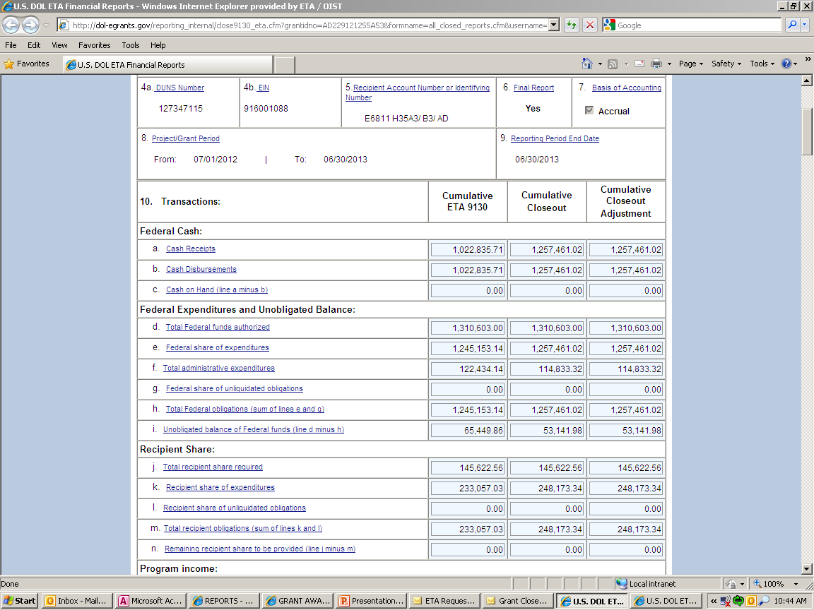
Closeout 9130 Financial Report

Slide 16
Final Quarterly 9130/Closeout 9130

Slide 17
Liquidation of Obligation & Accrued Expenditures 2 CFR 2900.15
In closeout, grantee may only liquidate obligations incurred during PoP – not incur new obligations
The only liquidation that can occur during closeout is the liquidation of accrued expenditures (NOT obligations) for goods and/or services received during the grant period.
Grantee may not direct charge staff time to work on closeout of grant after PoP end date

Slide 18
Indirect Costs
Indirect cost reporting line items have been added.
Indirect cost expenses are only to be reported by the non-federal entity receiving direct awards from DOL.
Indirect cost expenses are reported only on the FINAL ETA-9130 report.

Slide 19
Compliance – Indirect Costs

Slide 20
Compliance
If there is a 10% limitation on administrative costs, 10% of grant award amount.

Slide 21
Compliance–Budget and Costs

Slide 22
Budget Realignments in Closeout
Grantee provides written justification to FPO
FPO determines if appropriate
FPO sends justification to closeout specialist and is documented in file

Slide 23
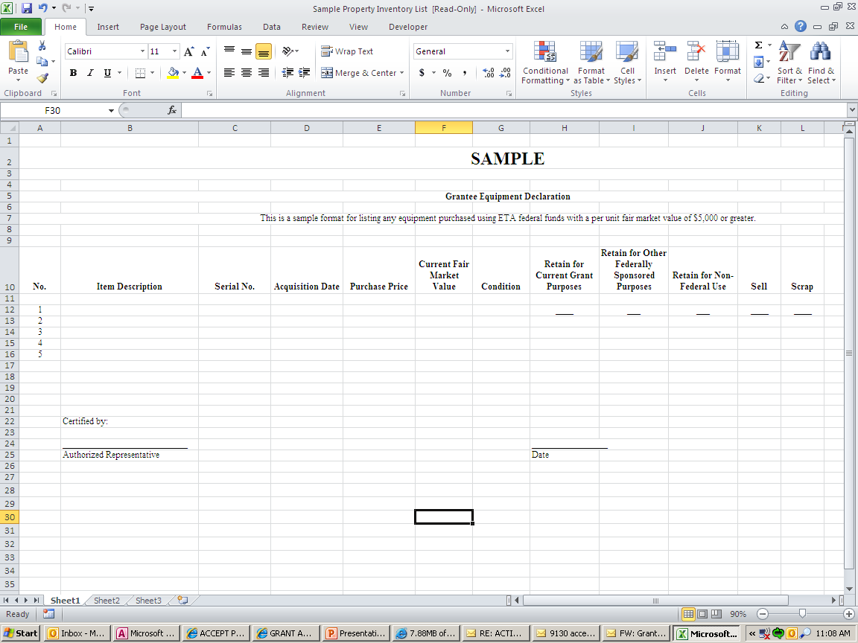
Property Certification Form

Slide 24
Submission Confirmation Letter
From: etareporting.auto-email@dol.gov [mailto:etareporting.auto-email@dol.gov]
Sent: Thursday, February 04, 2016 9:27 AM
To: Mathew, Joe - ETA
Subject: Submission confirmation of Closeout Report
Please do not respond to this message!!!
Closeout Report
Grant Number: HG-22244-14-60-A-0
Has been successfully submitted on 9/30/16 09:26A.M.
And is now certified

Slide 25
Preliminary Settlement Letter
Dear Grantee,
This letter is to notify you that the Department of Labor has closed grant number HG222441460A0 and no further costs may be charged to this agreement. The total amount of allowed Federal cost at the time of close is $21963109.4. At this time, no action is required by your organization. As specified at 29 CFR 95.72, this closeout does not affect: 1) ETA's right to disallow costs and recover funds on the basis of a later audit or other review; or 2) Your obligation to return any funds due to the Federal Government as a result of later refunds, corrections, or other transactions; or 3) Your responsibilities for retention and access requirements, real property and equipment management, and audit requirements, as specified at 29 CFR 95.53, 95.32, and 95.26 respectively. Inquires regarding this closeout may be directed to the Resolution Specialist.
Sincerely,
.

Slide 26
Common Misunderstandings
Expenditure amount higher than drawdown amount.
*They need to match*
Completing the equipment form correctly.
All required forms and documents to be submitted.

Slide 27
Common issues Which Delay Closeout
Non-responsive grantees
Refunds
Equipment disposition
9130 issues
Administrative cost issues
Indirect cost issues
Question and disallowed costs/ID’s and FD’s
Budget realignments

Slide 28
Refunds
2 CFR 200.343 (d)
Grant closeout does not affect recipients obligation to return funds due to DOL as a result of refund.
Prompt refund of any balances of unobligated funds.
Refunds may require revising final expenditure report.
Refunds can be electronically through PMS or Pay.gov.

Slide 29
Frequently Asked Questions
Does marking “Yes” on Box 6 on the ETA 9130 trigger the closeout process?
Grant ends September 30, 2018, when does the grantee need to submit the final 9130 and the Closeout 9130?
November 14, 2018/December 30, 2018
When is the last time I can draw down funds?
December 30, 2018

Slide 30
Questions?
Questions?
Questions?

Slide 31
Period of Performance Extension: The FPO Perspective
Adrian Barrett
Federal Project Officer; H-1B Lead for Region III
U.S. DOL, Employment and Training Administration

Slide 32
Questions?
Questions?
Questions?

Slide 33
Thank You!

