Slide 1
Registering Apprenticeship Programs in OA States
November 1, 2019
Registered Apprenticeship 101 Bootcamp

Slide 2
Your Speakers:
Zach Boren
  Division Chief
    Office of Apprenticeship
    ETA/USDOL
Mark Judge
  Policy Team Leader
    Office of Apprenticeship
    ETA/USDOL

Slide 3
Registered Apprenticeship 101 Bootcamp
Session 1: An Overview of Apprenticeship Structure and Resources (Q&A)
  October 30, 2019 3:00 PM ET
Session 2: Registered Apprenticeship and the Public Workforce System
  October 31, 2019 4:00 PM ET
Session 3: Registering Apprenticeship Programs in OA States
  November 1, 2019 3:00 PM ET
Session 4: Introduction to Business Engagement
  November 5, 2019 4:00 PM ET
Session 5: Office Hours
  November 7, 2019 4:00 PM ET

Slide 4
Today’s Objectives
Discuss the registration process for OA states
Share criteria for apprenticeable occupations
Provide a high-level view of differences in registering apprenticeship programs in SAA states
Offer perspective of sponsors wishing to register in both OA and SAA states

Slide 5
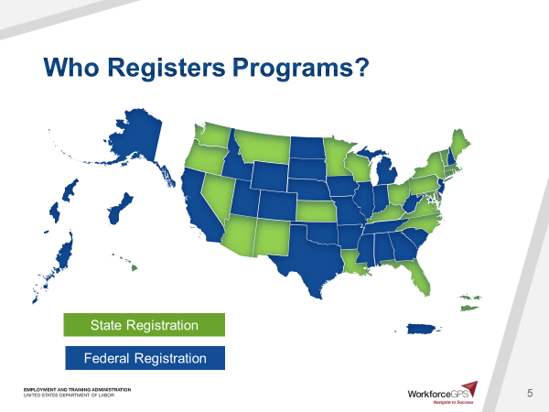
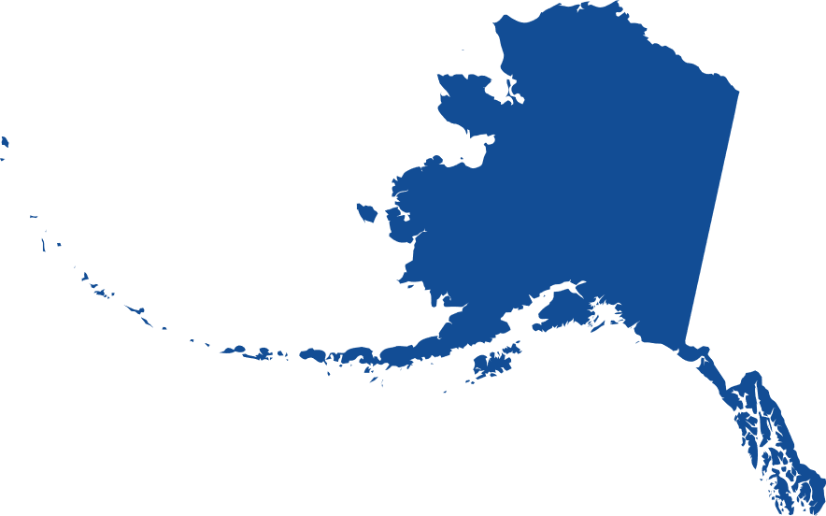
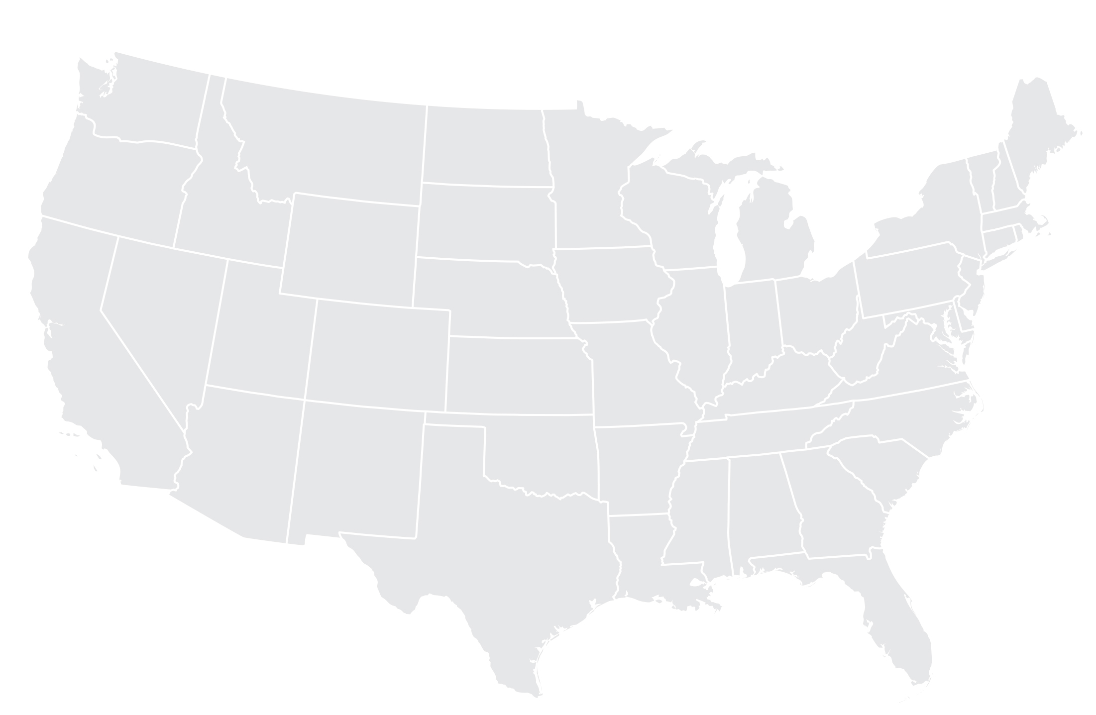







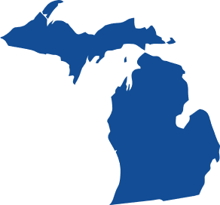



































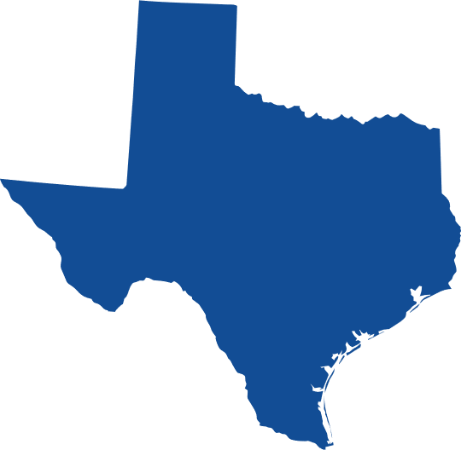



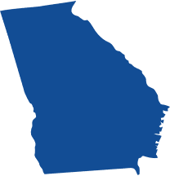





Who Registers Programs?
State Registration
Federal Registration

Slide 6
Registration Process

Slide 7
Review: OA vs SAA
National Office of Apprenticeship (OA)
State Apprenticeship Agency (SAA)
29 states & territories currently have RAPs registered with OA
Policies and regulations for RAPs are developed by OA’s Division of Registered Apprenticeship and Policy
OA offers technical assistance and guidance for both OA and SAA states
26 states & territories currently have RAPs registered with SAAs
SAA’s are responsible for providing their own staff
Requirements for apprenticeship sponsors registration processes vary by each state

Slide 8
State Apprenticeship Agencies
Both OA and SAA states provide incentives
  Incentives might include tuition funding or tax breaks
  RAP tax incentives
SAA states are required by regulation to provide reciprocity with programs registered with OA
SAA states are required to adhere to the regulations developed for all Registered Apprenticeship Programs, including Equal Employment Opportunity (EEO) regulations

Slide 9
Apprenticeship State Directors and Apprenticeship & Training Representatives (ATRs)
Will work with industry experts to get new occupations or revised occupations industry-approved
Will help develop new apprenticeship programs
Can assist with developing standards or finding existing standards to build from
Provide oversight and review programs for compliance with state and national regulations

Slide 10
Apprenticeable Occupations
Nearly 1200 apprenticeable occupations in the US today
Criteria for apprenticeable occupations:
  Involve skills that are customarily learned in a practical way through a structured, systematic program of on-the-job supervised learning;
  Be clearly identified and commonly recognized throughout an industry;
  Involve the progressive attainment of manual, mechanical or technical skills and knowledge which, in accordance with the industry standard for the occupation, would require the completion of at least 2,000 hours of on-the-job learning to attain; and
  Require related instruction to supplement the on-the-job learning.
2019 List of Apprenticeable Occupations
O*Net

Slide 11
Introducing New Occupations
How does occupation become recognized as apprenticeable?
  If a desired occupation is not currently listed as apprenticeable, there is a process for getting the occupation recognized
  Requires industry feedback
    Take approximately 90 days depending on industry review
  Current occupation standards may be able to be adapted to include new occupations

Slide 12
Steps to Register Apprenticeship Program with OA
Explore
  Explore apprenticeship as a strategy to meet the talent needs of the business
Partner
  Partner with key players in your region to develop an apprenticeship program
Build
  Build the core components of your apprenticeship program
Register
  Register your program to join the apprenticeship network
Launch
  Launch your new Registered Apprenticeship program

Slide 13
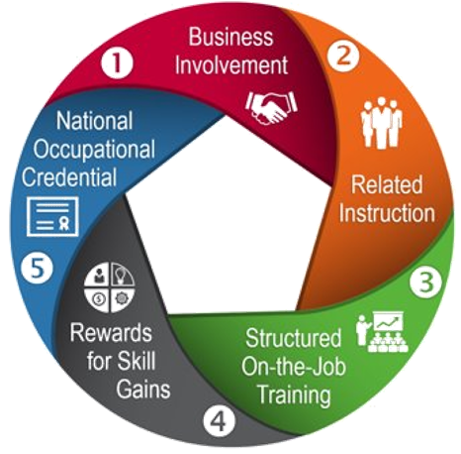
Developing a Program
Sponsors can work with OA staff in their state to write their standards
Standards include several components, including:
  Work Process Schedules that outline the job functions and competencies of the occupation
  Related Instruction Outlines that provide details on how related instruction will be provided
  Information on how apprentices will be supervised by experienced workers
  Specifics on wage progression

Slide 14
Options for Registering Programs
Local/State Program
Most apprenticeship programs will likely be local/state.
National Program Standards
National organization with local affiliations
Is the program in a State Apprenticeship Agency State or OA state?
Meet with apprenticeship staff for guidance.
Need flexibility to meet local needs of the program
NGS are building the basic standards
Certified by OA National office
Registered in every state
Registered by OA National office
300+ employee firms
20 or more apprentices
One standard that employers/company can agree to train
Locations in 5 or more states
Guidance on National Program Standards
National Guidelines for Apprenticeship Standards
Multistate – 3+

Slide 15
Any Questions?

Slide 16
Developing Standards for a New Registered Apprenticeship Program

Slide 17

Standards Development
The Registered Apprenticeship Standards document
  The key document in any registered apprenticeship program
  Describes how the program will run and who is responsible for key aspects of program management
  Signer is the program sponsor or “standards holder” for the program

Slide 18
Standards Development (2)
Boilerplate standards include the following components:
  Boilerplate Apprenticeship Standards
  Appendix A –Work Process Schedule, Related Instruction Outline, Apprentice Wage Schedule, Ratio of Apprentices to Journeyworkers, Type of Occupation, Term of Apprenticeship, Selection Procedures, and Probationary Period
  Appendix B – ETA Form 671 – Apprenticeship Agreement and Application for Certification of Completion of Apprenticeship
  Appendix C – Affirmative Action Plan (not required for two years after initial registration)
  Appendix D – Employer Acceptance Agreement (For programs with multiple-employers only)

Slide 19
Standards Development (3)
Fillable PDF allows sponsors to easily enter information on their program and sign electronically
Editable Word version to allow for increased customization for sponsors that require increase flexibility
Keeps current requirements for registration under 29 CFR parts 29 and 30

Slide 20

Screen share
Main boilerplate document – fillable PDF

Slide 21
What Happens After A Business Submits Standards
Most programs will not prepare standards on their own
  ATRs and State Directors are trained to assist in assembling standards, facilitating the process, and providing technical assistance
Once standards are submitted, they:
  Undergo a review by your State Director
  Can take up to 90 days

Slide 22
Any Questions? (2)

Slide 23
Resources:
2019 List of Apprenticeable Occupations
  Over 900 apprenticeable occupations in the US today
    www.doleta.gov/OA/bul19/Bulletin_2019-37_List_of_Apprenticeable_Occupations.doc
A Quick-Start Toolkit
  Building Registered Apprenticeship Programs
    www.doleta.gov/oa/employers/apprenticeship_toolkit.pdf
O*Net
  Offers detailed descriptions of the world of work for use by job seekers, workforce development and HR professionals
    www.onetonline.org
National Association of State and Territorial Apprenticeship Directors
  NASTAD website
    www.nastad.us/overview.htm
The Federal Resources Playbook for Registered Apprenticeship
  USDOL/ETA Resource
    www.doleta.gov/oa/federalresources/playbook.pdf

Slide 24
Save the Date:
Session 4: Introduction to Business Engagement
    November 5, 2019
Session 5: Office Hours
    November 7, 2019

Slide 25
Contact Information:
For grant related questions, contact your assigned FPO
To contact the Apprenticeship Entity within your state: www.doleta.gov/oa/contactlist.cfm

Slide 26
Thank You!

