Slide 2
What Evaluation Details Do I Need to Plan for and How Long Will the Evaluation Take?
June 20, 2019
RESEA Evaluation Technical Assistance

Slide 3
Megan Lizik
Senior Evaluation Specialist and Project Officer for RESEA Evaluation
U.S. DOL, Chief Evaluation Office

Slide 4
Cycles of learning and doing…
Plan Evaluation of Program
Refine Program or Evaluation
Conduct Evaluation
Reflect on & Communicate Evaluation Findings

Slide 5
In Our Last Webinar, We…
Described implementation and process studies and what you can learn from them;
Discussed the concept of “impact” and how to measure it using control or comparison groups; and
Provided an introduction to different impact evaluation designs.
To find the webinar recording of
“What Evaluation Designs Are Right for My State?”
please visit: https://www.workforcegps.org/events/2019/05/07/13/07/What-Evaluation-Designs-Are-Right-For-My-State.

Slide 6
Key phases and steps in planning your evaluation
Common evaluation activities at different stages
Length of time each step during each phase may take
Potential challenges in each of the evaluation phases and strategies to tackle those challenges
Today’s presentation covers basic evaluation planning and timeline concepts

Slide 7
Phomdaen Souvanna
Senior Analyst
Abt Associates
Tresa Kappil
Senior Analyst
Abt Associates

Slide 8
Which part of an evaluation takes the most time to complete?
Planning the evaluation
Collecting the data
Analyzing the data
Everything!

Slide 9
Evaluations Take Time
Evaluations are often multi-year efforts
Implementation & outcomes studies may take 1.5 years
Impact studies may take 3+ years
Illustrative Example of Impact Study Timeline
Year 1
Year 2
Year 3
Year 4
Evaluation planning, design, and launch
Assign claimants to an intervention group or control group until target sample size is reached
Track claimant outcomes
(2 quarter follow-up period after claim approval)
Collect outcomes data as it becomes available
Data analysis
Complete final report

Slide 10
Thoughtful Planning Ensures You:
Select appropriate research questions and evaluation design
Account for all evaluation activities up-front
Build out appropriate time and cost estimates
Select the right evaluator
Assess and access required data

Slide 11
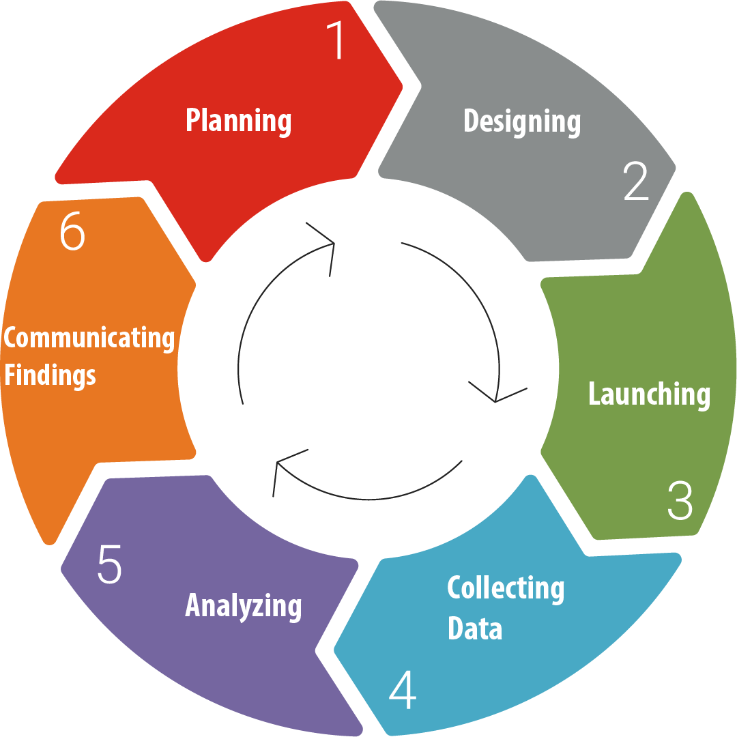
Phases of an Evaluation

Slide 12
About which phase do you have the most questions?
Planning
Designing
Launching
Collecting Data
Analyzing
Communicating Findings

Slide 13
Phase 1: Planning the Evaluation

Slide 14
Activities & Division of Responsibilities:
Activities | RESEA Program | Evaluator
Determine evaluation scope, research questions, & main outcomes of interest | ü
Identify evaluation design type | ü
Develop a timeline that considers the study follow-up period | ü
Select an evaluator | ü
Complete an evaluability assessment | ü | ü
How long will it all take?
~ 6 -12 months

Slide 15
Challenge 1.1: Selecting an Appropriate Evaluator
Producing a high quality evaluation requires your evaluator to have the right expertise
Evaluator should be independent from RESEA
You may need expertise from an evaluator outside your agency
Our next webinar, Procuring and Selecting an Evaluator, will discuss evaluator selection in greater detail.

Slide 16
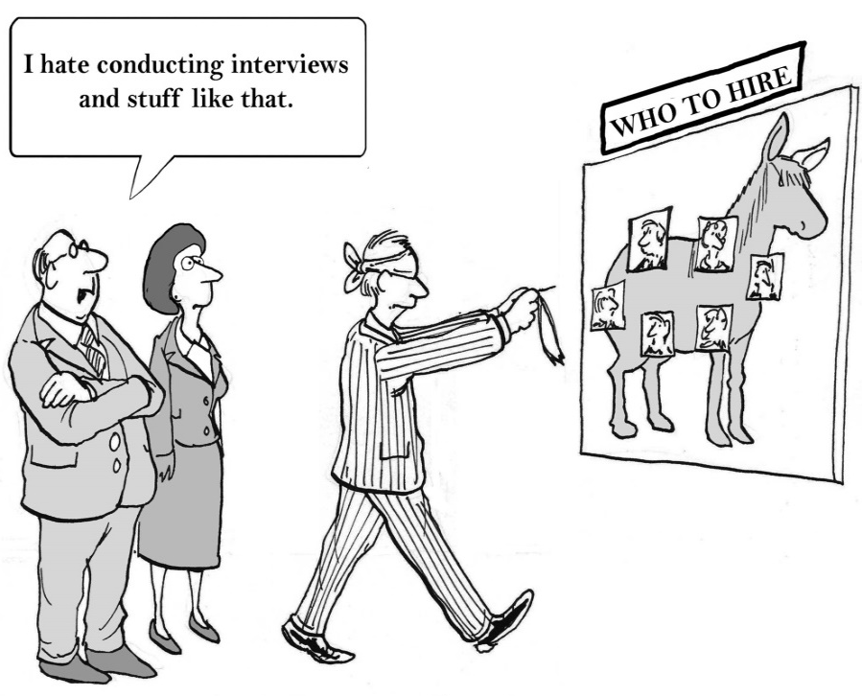
Tackling Challenge 1.1: In Selecting Your Evaluator, Consider…
Evaluator qualifications:
Experience
Expertise
Independence
Process for obtaining external evaluator (if needed):
Procure services?
Rely on existing evaluation partnership?

Slide 17
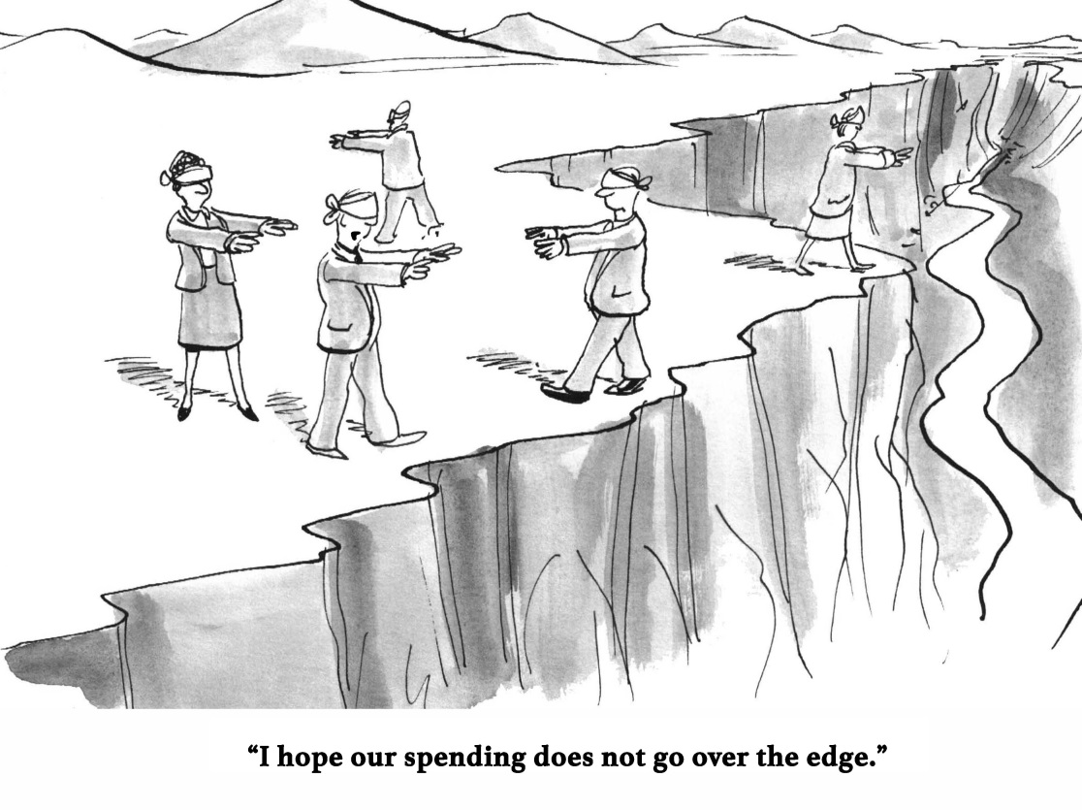
Challenge 1.2: Having Sufficient Resources to Carry out Full Evaluation
Funding:
Can your budget cover all the tasks over multiple years?
Staff:
Does the budget include a staffing mix?
What RESEA staff will need to be involved in the evaluation?
Other resources

Slide 18
Tackling Challenge 1.2: Create a Budget that Considers Level of Effort for…
Planning and implementation
Managing and achieving sample sizes
Completing and analyzing data collection
Synthesizing and writing findings and reports
Budget for program staff:
RESEA State Program Administrators
IT staff
AJC leadership
Frontline staff
Budget for evaluation team staff:
Project Director
Principal Investigator
Mid and junior level staff

Slide 19
Phase 2: Designing the Evaluation

Slide 20
Activities & Division of Responsibilities:
Activities | RESEA Program | Evaluator
Refining outcomes measures, data sources, and required sample sizes | ü | ü
Determining evaluation procedures |  | ü
Establishing the evaluation timeline | ü | ü
Producing an evaluation design report |  | ü
How long will it take?
~ 2-6 months

Slide 21
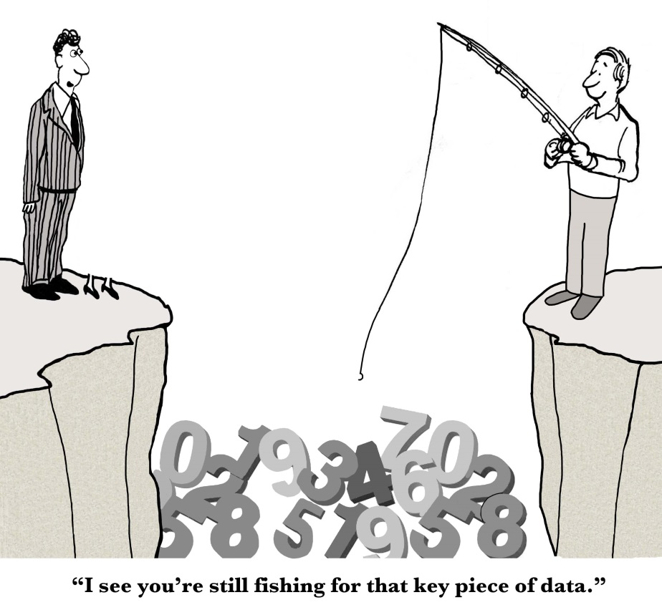
Challenge 2.1: Selecting Appropriate Outcomes
Outcomes that are appropriate and measurable will allow you to:
Determine the best data source
Collect valid or reliable data for outcome measure

Slide 22
Tackling Challenge 2.1: Distinguish between Output and Outcomes
Outputs
Indicator of program activities occurring
Example: 70% of claimants receive job search assistance
Outcomes
Indicator of claimant progress or intervention effectiveness
Example: Reduce number of weeks on UI

Slide 23
Tackling Challenge 2.1: Define Outcomes & Identify Type of and Sources for Data
Outcomes of Interest | Example Definitions | Data Needed | Data Sources
UI duration | Weeks of UI duration | UI dates UI benefits | UI data
Employment outcomes | Employment in 2nd quarter after start of claim | Employed at follow-up period | UI data
Earnings outcomes | Earning in 2nd quarter after start of claim | Earnings at follow-up period | UI data

Slide 24
Challenge 2.2: Estimating Time Needed for Each Evaluation Activity
Accurate time estimates will help you:
Determine feasibility of evaluation
Align evaluation and intervention activities
Misallocating time may lead to:
Having insufficient time to meet target sample size
Inability to gather sufficient outcomes data in time to complete your analysis

Slide 25
Tackling Challenge 2.2: Build a Timeline
Timelines should consider all activities, including:
Institutional Review Board (IRB) approval
Enrolling claimants into study
Baseline & ongoing data collection
Study follow-up period
Data analysis
Dissemination activities

Slide 26
Tackling Challenge 2.2: Have Evaluator Create an Evaluation Design Report (EDR)
EDRs serve as roadmaps to the evaluation activities and its links to program operations.
EDRs include information on:
Purpose, scope, and research questions;
Evaluation design type, methods, and procedures;
Data collection and analysis plans;
Reporting and dissemination; and
Evaluation timeline.

Slide 27
Challenge 2.3: Securing Data
Evaluations require collecting, storing, and sharing individual-level data about claimants in the study
Protecting the privacy of individuals who participate in evaluations is supported by Federal requirements.

Slide 28
Tackling Challenge 2.3: Obtain Institutional Review Board (IRB) Oversight
IRBs are independent committees that review and monitor steps researchers take to protect human subjects of research
Your evaluator should obtain IRB approval before starting to work with claimants or their data
How long will it take?
~1-3 months, based on evaluation design

Slide 29
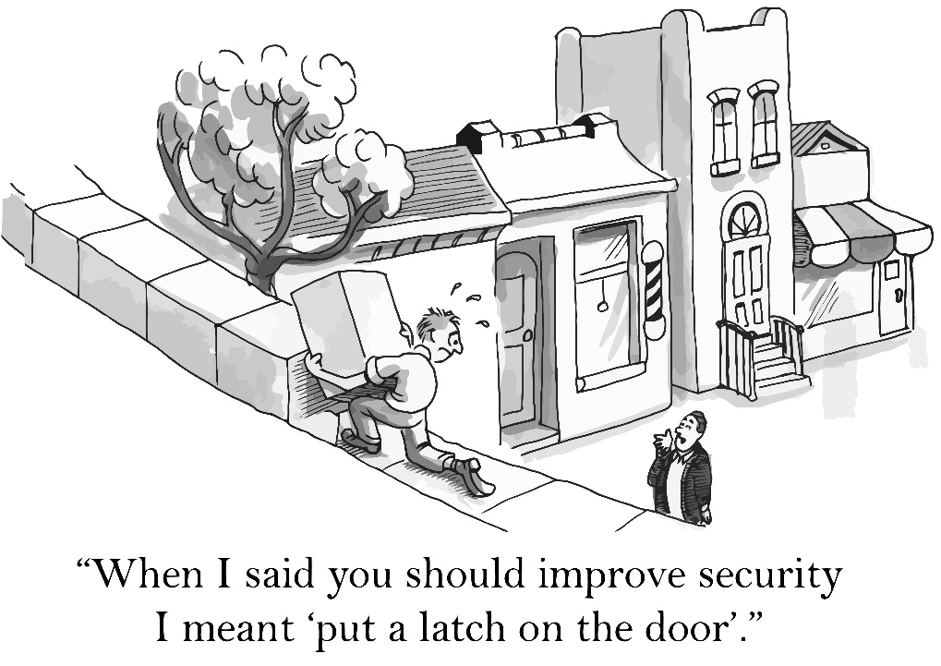
Tackling Challenge 2.3: Take Practical Steps to Ensure Data Security
Don’t leave paper records with claimant information on desks.
Lock computer screens.
Don’t send emails containing personally identifiable information (e.g., SSN, date of birth, etc.) or other sensitive data!

Slide 30
Phase 3: Launching the Evaluation

Slide 31
What should be in place before sharing RESEA data with external evaluators?
Data sharing agreements
Secure methods for transferring data
Established procedures for creating a data extracts
All of the above

Slide 32
Activities & Division of Responsibilities:
Activities | RESEA Program | Evaluator
Aligning data forms across partners | ü | ü
Formalizing DUA & data transfer process | ü | ü
Modifying existing data systems (if needed) | ü
Establish random assignment process |  | ü
Making changes to program operations (if needed) | ü | ü
Training staff |  | ü
Refining research questions of interest | ü | ü
Developing data collection protocols |  | ü
How long will it take?
~2-4 months, based on evaluation design

Slide 33
Challenge 3.1: Making Staff Aware of Evaluation Procedures
Frontline staff often play a critical role in helping implement the evaluation
But they are often less involved in planning the evaluation
Closing this gap is critical for a successful evaluation!

Slide 34
Tackling Challenge 3.1: Train staff on Evaluation Procedures
Evaluators should provide training for all RESEA program staff on evaluation study procedures.
Training should cover:
Evaluation procedures
Changes in program implementation (if applicable)
Data collection and security
Protecting human research subjects

Slide 35
Phase 4: Collecting RESEA Data

Slide 36
Activities & Division of Responsibilities:
Activities | RESEA Program | Evaluator
Enrolling claimants into the study | ü | ü
Continued evaluation data collection |  | ü
Monitoring evaluation activities | ü | ü
How long will it take?
~1-3 years, depending on evaluation design & time needed to achieve sample size

Slide 37
Challenge 4.1: Ensure the RESEA Evaluation Runs as Planned
If evaluation procedures are not followed:
Incorrect implementation of evaluation procedures
Poor data quality

Slide 38
Tackling Challenge 4.1: Establish Evaluation Monitoring Procedures
Establish routine communications to discuss progress
Ensure participants receive only assigned RESEA services
Assess RESEA data quality and completeness

Slide 39
Phase 5: Analyzing RESEA Evaluation Data

Slide 40
Activities & Division of Responsibilities:
Activities | RESEA Program | Evaluator
Preparing data for analysis Data cleaning Robustness checks Initial descriptive analysis |  | ü
Conducting analyses according to plan |  | ü
How long will it take?
~ 4-6 months, depending on type of analysis

Slide 41
Phase 6: Communicating RESEA Evaluation Findings

Slide 42
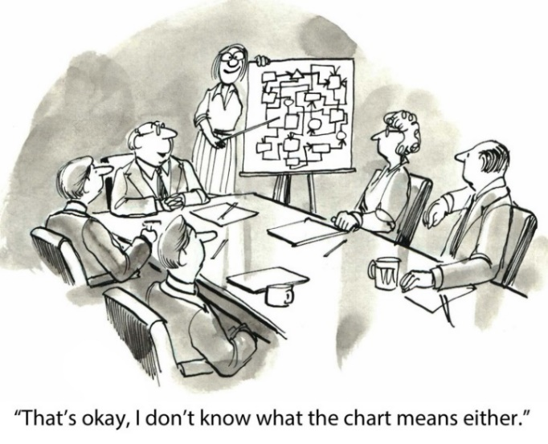
Activities & Division of Responsibilities:
Activities | RESEA Program | Evaluator
Draft & revise reports |  | ü
Review draft of reports | ü
How long will it take?
~ 3-4 months for each report

Slide 43
Challenge 6.1: Timeline
It is important to leave adequate time for:
Evaluators to revise dissemination products
State RESEA to review drafts of products

Slide 44
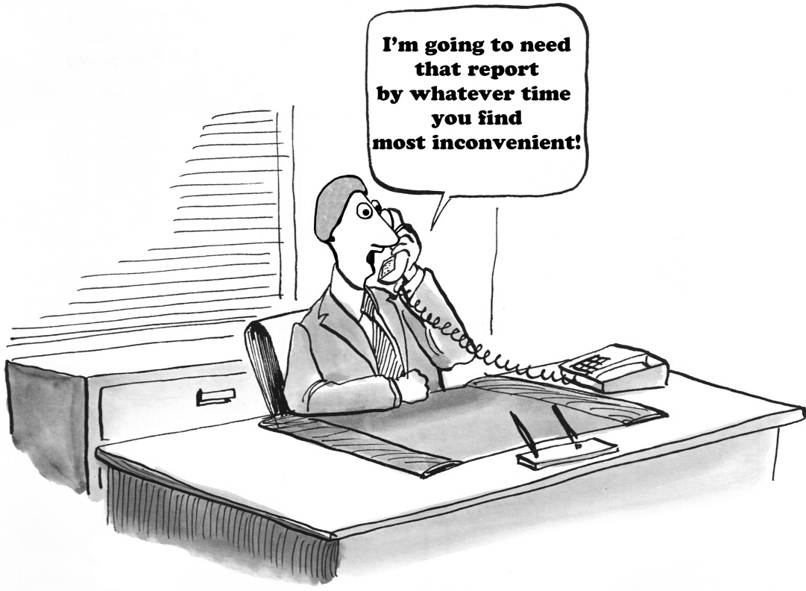
Tackling Challenge 6.1: Include Dissemination Activities in Timeline & Budget
Dissemination activities take time and resources
Clearly communicate reporting expectations
Discuss dissemination activities early on in your evaluation contract

Slide 45
What innovative methods have you used to disseminate information?
Please type your answers in the chat box!

Slide 46
Evaluation Design Assessment Tool
This tool will help you assess the evaluability of your proposed intervention and highlight key operational considerations to assess when determining evaluation feasibility.
https://evalhub.workforcegps.org/resources/2018/09/07/19/53/Evaluation-Design-Assessment-Tool
Evaluation Readiness Assessment Tool
This tool will help you assess your state’s readiness to conduct your proposed evaluation.
https://evalhub.workforcegps.org/resources/2018/09/07/19/45/Evaluation-Readiness-Assessment-Tool
Review past webinars and stay tuned for future webinars!
The RESEA EvalTA Team can help!
Provide support on design, timeline, and budget issues;
Review draft documents; and
Answer technical questions about your preliminary plans!
You can contact the EvalTA team at: RESEA@abtassoc.com

Slide 47
Procuring and Selecting an Independent Evaluator
July 16, 2019 at 1pm Eastern
Using CLEAR – A Demonstration
August 19, 2019 at 2pm Eastern

Slide 49
Larry Burns
Reemployment Coordinator
U.S. DOL – Office of Unemployment Insurance
burns.lawrence@dol.gov
Megan Lizik
Senior Evaluation Specialist and Project Officer
U.S. DOL – Chief Evaluation Office
Lizik.Megan@dol.gov
Phomdaen Souvanna
Senior Analyst
Abt Associates
Phomdaen_Souvanna@abtassoc.com
Tresa Kappil
Senior Analyst
Abt Associates
Tresa_Kappil@abtassoc.com
RESEA E-TA Inbox
RESEA@abtassoc.com

