Slide 1
What type of organization are you with?
Current apprenticeship sponsor
Organization interested in becoming an apprenticeship sponsor
Office of Apprenticeship staff
State Apprenticeship Agency staff
Workforce system staff
Other

Slide 2
Apprenticeship EEO Regulations: Disability Self-Identification and Affirmative Action Programs
January 15, 2019
Presented By:
U.S. Department of Labor
Office of Apprenticeship

Slide 3
Natalie Linton
Program Analyst
Office of Apprenticeship
Employment and Training Administration
U.S. Department of Labor

Slide 4
Keir Bickerstaffe
Counsel
Division of Civil Rights and Labor Management
Office of the Solicitor
U.S. Department of Labor
Zach Boren
Division Chief
Office of Apprenticeship
Employment and Training
Administration
U.S. Department of Labor

Slide 5
Review frequently asked questions about the Equal Employment Opportunity (EEO) regulations that go into effect on January 18, 2019
Answer additional questions that sponsors may have (time permitting)
Ensure sponsors are aware of resources available to help them implement apprenticeship EEO regulations
www.doleta.gov/oa/eeo

Slide 6
Focus on Provisions Going into Effect January 18, 2019
Disability Self-Identification
7% Disability Goal
Affirmative Action Programs
Demographic Analyses for Race, Sex, and Ethnicity
Targeted Outreach, Recruitment, and Retention Efforts to Reach Goals
Annual Reviews of Personnel Practices

Slide 7
Disability Self-Identification Invitations, Question 1
When do I have to start inviting apprentices and applicants to self-identify whether they are individuals with disabilities?

Slide 8
Disability Self-Identification Invitations, Question 2
Where can I find the Voluntary Disability Disclosure Form?
Main page – Disability Self-Disclosure:
https://www.doleta.gov/oa/eeo/tools/disabililty-self-identification.cfm
Voluntary Disability Disclosure Form:
www.doleta.gov/oa/eeo/tools/docs/Disability_Disclosure_form-671_20180823_Final.pdf

Slide 9
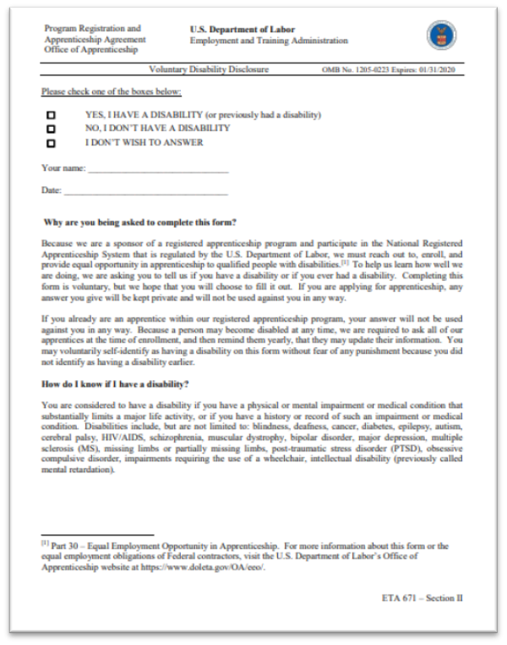
Disability Self-Identification Invitations, Question 3
Do I have to use the
U.S. Department of
Labor’s Voluntary
Disability
Disclosure Form?

Slide 10
Disability Self-Identification Invitations, Question 4
What if an apprentice refuses to complete the Voluntary Disability Disclosure Form?

Slide 11
Disability Self-Identification Invitations, Question 5
Where and when do I report the disability disclosure results to the Office of Apprenticeship?

Slide 12
7% Disability Goal, Question 1
I’ve heard about a goal that 7% of apprenticeship workforces consist of individuals with disabilities. Is this a goal I have to meet?

Slide 13
7% Disability Goal, Question 2
The trade for which my program trains apprentices involves a lot of physical work. How can individuals with disabilities do this work?
Job Accommodation Network:
https://askjan.org
www.doleta.gov/oa/eeo/protected_characteristics/disability.cfm

Slide 14
Other Disability Questions?
Any additional questions on Disability
Self-Identification or the
7% Goal for Individuals with Disabilities?

Slide 15
Affirmative Action Programs (General), Question 1
We’ve always had an Affirmative Action Program (AAP). What is different about this requirement now?

Slide 16
Affirmative Action Programs (General), Question 2
Do I have to prepare the entire AAP by January 18, 2019 (or two years after my program’s registration date, whichever is later)? If not, what do I have to prepare by then?

Slide 17
Affirmative Action Programs – Demographic Analyses for Race, Sex, and Ethnicity, Question 1
You said I don’t have to complete the demographic analyses until the Office of Apprenticeship (OA) reviews my program’s compliance with the apprenticeship EEO regulations. When can I expect OA to do such a review, and will I get advance notice of it?

Slide 18
Affirmative Action Programs – Demographic Analyses for Race, Sex, and Ethnicity, Question 2
What are the steps I need to follow to perform the demographic analyses for race, sex, and ethnicity?
https://www.workforcegps.org/events/2018/07/20/12/48/Equal-Employment-Opportunity-Regulations-for-Apprenticeships-Demographic-Utilization-Analyses

Slide 19
Affirmative Action Programs – Demographic Analyses for Race, Sex, and Ethnicity, Question 3
What if an apprentice didn’t identify his or her race or ethnicity on Form 671?
How do I categorize that individual’s race or ethnicity?

Slide 20
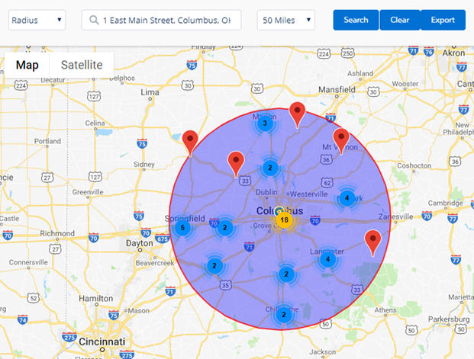
Affirmative Action Program – Demographic Analyses for Race, Sex, and Ethnicity, Question 4
OA has said it will have an online tool to make it easier to do these demographic analyses. How will that tool work and when will it be available?

Slide 21
Affirmative Action Programs – Demographic Analyses for Race, Sex, and Ethnicity, Question 5
If my program is underutilized for a major occupational group, do I necessarily have to set a goal for that group?

Slide 22
Affirmative Action Programs – General and Demographic Analyses for Race, Sex, and Ethnicity
Any additional questions on these topics?

Slide 23
Targeted Outreach, Recruitment, and Retention Efforts to Reach Goals, Question 1
What happens if I don’t meet the goal for any particular group?

Slide 24
Targeted Outreach, Recruitment, and Retention Efforts to Reach Goals, Question 2
What do good faith efforts include?
How will the Office of Apprenticeship evaluate whether our efforts are good enough?

Slide 25
Annual Reviews of Personnel Practices
What is involved in these annual reviews of personnel practices?
What do I have to do?

Slide 26
Targeted Outreach, Recruitment, and Retention Efforts and Annual Reviews of Personnel Practices
Any additional questions on these topics?

Slide 27
Online Resources
Apprenticeship EEO Home Page: www.doleta.gov/oa/eeo
Disability Self-Identification Page: www.doleta.gov/oa/eeo/tools/disabililty-self-identification.cfm
Outreach and Recruitment Resources: www.doleta.gov/oa/eeo/outreach_recruitment
Information on Disability: www.doleta.gov/oa/eeo/protected_characteristics/disability.cfm
Job Accommodation Network: https://askjan.org
EEO Frequently Asked Questions: FAQ tab at top of home page www.doleta.gov/oa/eeo
Apprenticeship.gov

Slide 28
Additional Questions?
Email:
apprenticeship@dol.gov

