Slide 1
Have you ever filed an ITC-related petition?
Yes
No

Slide 3
ITC-Related Petitions
December 18, 2018

Slide 4
Susan Worden
Program Analyst
USDOL/ETA/OTAA
worden.susan@dol.gov

Slide 5
What was your greatest difficulty in filing an ITC-related petition?
Word Cloud
Please answer with one word only.
Examples:
Eligibility
Contacts
Deadline
Procedure
None

Slide 7
Introduce the US International Trade Commission (ITC)
Discuss the ITC notification process
Offer tips for filing ITC-related petitions
Discuss the unique worker eligibility requirements and certification timeline of the ITC process

Slide 8
Megan Wilkins
Program Analyst
DOL/ETA/OTAA
wilkins.megan.1@dol.gov

Slide 9
United States International Trade Commission
What is it?
What are the determination types?
How does it relate to TAA?

Slide 10
U.S. International Trade Commission
Independent Federal agency
Investigates effects of dumping & subsidized imports on domestic industries
Investigates infringement of intellectual property rights
Analyzes trade data & policies

Slide 11
Determination Types
Trade Basis
Injury Status
Antidumping (731-TA)
Dumping occurs when imports are sold at a lower price than in the home market or below the cost of production.
Countervailing Duty (701-TA)
Relevant when a foreign government provides financial assistance to benefit the production or export of a good.
Materially Injured
Not Materially Injured
Status is assigned at the Industry level, not by Company.

Slide 12
Determination Types
Trade Basis
Injury Status
Safeguard (201-TA)
Investigation determines whether such increasing quantities of certain articles are being imported to the U.S. that the domestic industry cannot compete.
Seriously Injured
Not Seriously Injured
Status is assigned at the Industry level, not by Company.

Slide 13
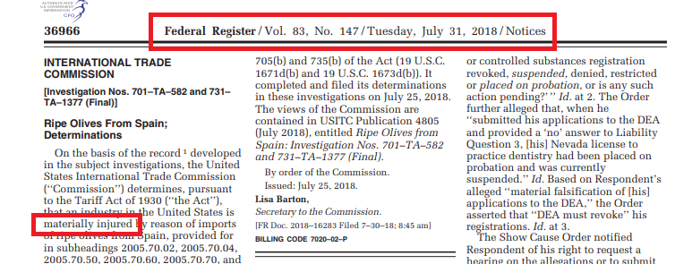
Federal Register Posting

Slide 14
Relation to TAA
Statute
Section 222(e) of the Trade Act of 1974 (19 U.S.C. § 2272(e)), as amended
Paths to TAA Certification
12+ paths or reasons to certify
ITC finding of material injury or serious injury is one path
Expedited Review
Focused investigation
Do not have to explore all paths

Slide 15
Bunmi Sanusi
Program Analyst
DOL/ETA/OTAA
sanusi.oluwabunmi@dol.gov

Slide 16
Notification Process

Slide 17
Newly Published Decisions
How we find them
ITC website
Verify Injury Status
Federal Register posting
Who OTAA notifies
All States
Company officials
Governor’s Offices (affected states only)
Unions

Slide 18
Notification Email
ITC-related petition filing deadline
Range of separation dates of eligible workers
Instructions for section 3 of petition form
List of states where production facilities located
Attachments
Notification Letter
Company Contacts (if available)

Slide 19
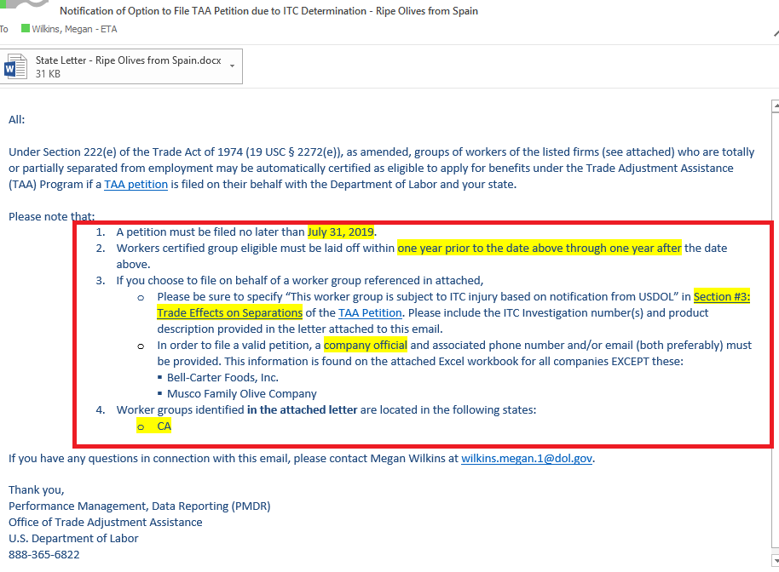

Slide 20
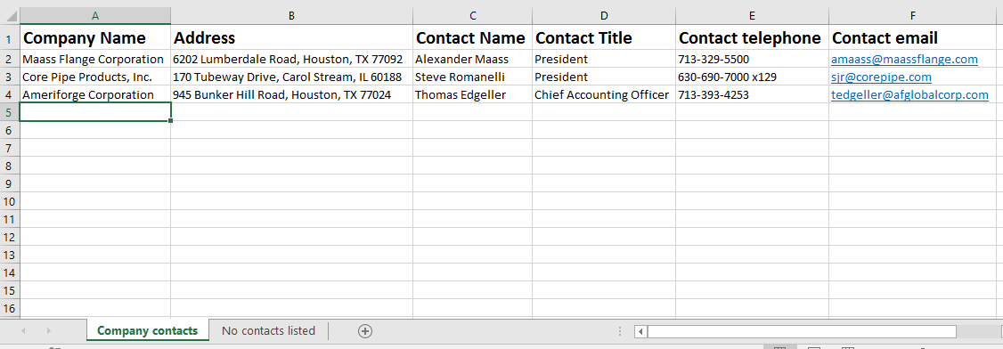
Company Contacts

Slide 21
Notification Letter
ITC Investigation Number(s)
Investigation Title
Federal Register Publication Date
Volume & Page Numbers of Federal Register Notice
ITC-related Petition Filing Deadline
List of Affected Companies with City & State Locations

Slide 22
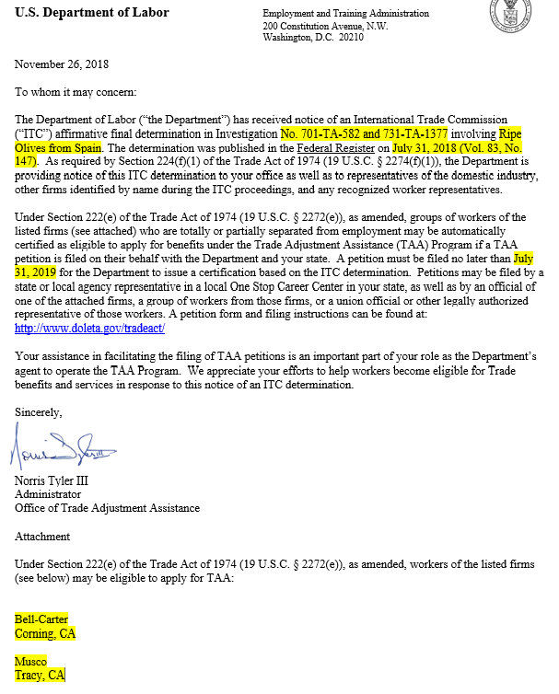

Slide 23
Next Step: ITC-Related Petition Filing
Same petition form as regular petitions (OMB No. 1205-0342)
Use data from the notification email & letter
Contact company officials and/or research to find company contacts

Slide 24
Hope Kinglock
Supervisory Program Analyst
DOL/ETA/OTAA
kinglock.hope@dol.gov

Slide 25
Tips for Filing an ITC-Related Petition

Slide 26
Worker Group Description
Section 1, part i
May cite ITC decision title
Ex: “Softwood Lumber”
Helps when company has multiple product lines or worker groups
Use any additional information gained from company contacts, news, etc.

Slide 27
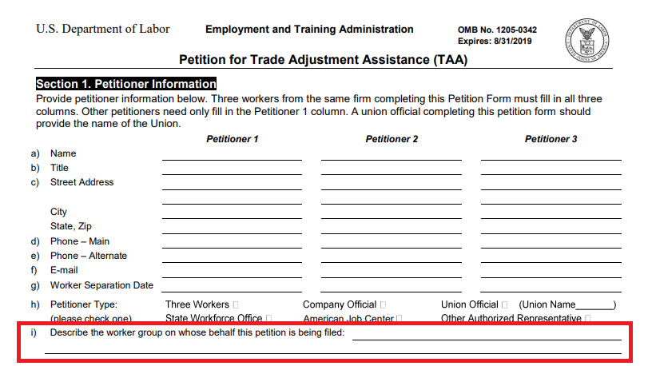

Slide 28
Trade Effects
Section 3, Questions 1 & 2
Cite the ITC Investigation number and title
Good practice to attach notification letter

Slide 29
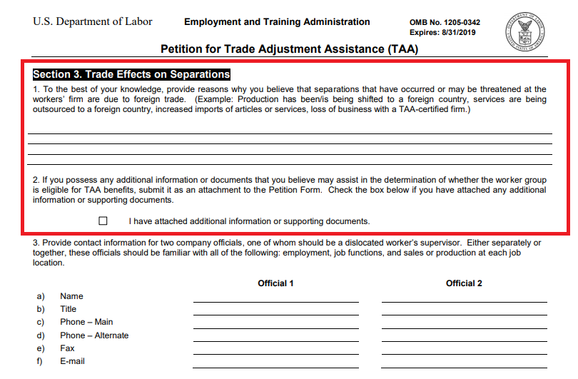

Slide 30
Company Contacts
Section 3, Question 3
If provided in notification:
Often an Executive or Legal Counsel
May contact before filing to get a 2nd contact person, educate firm about TAA
If not provided:
Research!

Slide 31
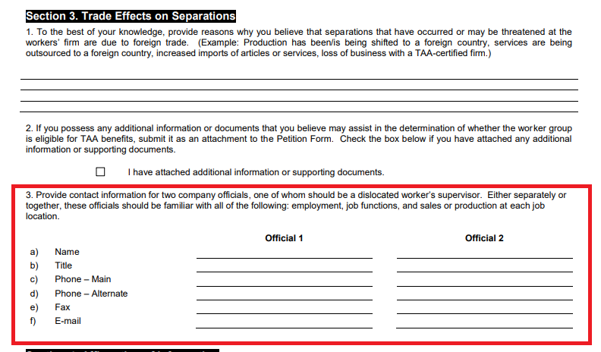

Slide 32
ITC-Related Petition Certification Process

Slide 33
Investigation: BDR
Fewer company details required on BDR
Good news for employers!
Essential data:
Official company name(s)
Alternate company name(s)
Worker Groups
Presence of leased workers?
Products (aka Articles)
NAICS
Number of Affected Workers

Slide 34
Investigation: Timing
Expedited process
Investigator will:
Verify ITC connection
Contact petitioner
Request company info via BDR
Write report
Submit for certification

Slide 35
Certification Period
1 year prior to Federal Register Notice through 1 year after Federal Register Notice
If affirmative final determination, or affirmative determination, FR Notice is published 12/20/18, certification period is 12/20/17—12/20/19.
NOT 2 years from certification date.

Slide 36
Timeline for ITC-Related Petitions
Impact Date/ Begin Eligibility
Federal Register Notice
Filing Deadline/ End of Eligibility
1 year
1 year
Petition Filing
Separations Period

Slide 37
Regular Petition Timeline
Impact/ Begin Eligibility
Petition
Certification
End Eligibility
1 year
Investigation
2 years
Impact 1 year prior to Petition
End Eligibility 2 years after Certification
3+ Years of Eligibility

Slide 38
Sticky Situations
No Company Contacts
Filing Deadlines
Multiple Worker Groups or FRNs
No Worker Separations

Slide 39
No Company Contacts

Slide 40
When no company contacts are provided, how do you find them?

Slide 41
No Company Contacts
Available to All
State-Dependent
Internet Search Engines
Company Websites
LinkedIn
Chamber of Commerce
State Manufacturer’s Registry
Tax records / UI Filings
State Labor Council
Other State Agencies (Business, Economic Development, etc.)
State Workforce Database

Slide 42
Filing Deadlines

Slide 43
Filing Deadlines
If the deadline to file an ITC-related petition has passed,
OR
Members of an affected worker group continue to have separations after an ITC certification expires…
File a regular petition.
Subject to a full investigation.

Slide 44
Multiple Worker Groups

Slide 45
Multiple Worker Groups
Multiple trade-affected worker groups, only some are covered by an ITC decision.
Option 1: File an ITC-related petition for one group of workers & file a regular petition for the other group of workers.
Option 2: File a regular petition for all worker groups.
Requires full investigation.

Slide 46
Multiple FRNs

Slide 47
Multiple Federal Register Notices (FRNs)
Cause:
Material injury to an industry declared on both bases of antidumping & countervailing duty, but decisions published on different dates
Serious Injury + AD and/or CVD determination
Effects:
Extends worker separation eligibility period
1 year prior to 1st FRN through 1 year after last FRN
Extends petition filing period
From 1st FRN through 1 year after last FRN

Slide 48
Steel Flanges: 2 Federal Register Notices
June 4, 2018
Countervailing Duties - China
July 30, 2018
Antidumping - China

Slide 49
Policy Proposal
Issue 2 certifications with overlapping eligibility periods
Eligibility Period
6/4/17
CVD - China
6/4/19
7/30/17
AD - China
7/30/19

Slide 50
No Worker Separations

Slide 51
No Worker Separations
If no workers were separated during the eligibility period, there is no need to file an ITC-related petition!

Slide 52
ITC Petition vs. Regular Petition
ITC cases have established the adverse effects of trade
Expedited investigation
Shorter window for worker eligibility and petition filing
Only separated workers eligible – no AAIWs

Slide 53
Action Steps for ITC-Related Petitions
OTAA
Research published ITC determinations
Send notifications for all affirmative decisions
States
Review notifications sent by OTAA
Research (if not supplied) and contact company officials
Submit complete petition form by deadline

Slide 54
Reporting “Efforts to Improve Outcomes” in PIRL for the TAA Program
Learn how to write high-quality narratives for “Efforts to Improve Outcomes” in PIRL, what information to include, and what not to include.
January 24, 2019

Slide 55
TAA Petitioners’ Webpage
Details on the petition process and FAQs
https://doleta.gov/tradeact/petitioners/
TAA Information for Company Officials
Details on the investigation process and forms including the BDR
https://doleta.gov/tradeact/officials/
ITC Webpages
Details on the ITC’s mission & investigations
https://www.usitc.gov/press_room/about_usitc.htm
https://www.usitc.gov/trade_remedy/731_ad_701_cvd/investigations.htm
How to File a TAA Petition Online
Webinar with instructions for petition filing
https://www.workforcegps.org/events/2016/04/20/12/59/How_to_File_a_TAA_Petition_Online
TAA: New Hampshire and Massachusetts Best Practices
Webinar exploring best practices for TAA group eligibility and use of case management funds
https://www.workforcegps.org/events/2017/09/27/10/47/Trade-Adjustment-Assistance-New-Hampshire-Massachusetts-Best-Practices

Slide 57
Bunmi Sanusi
Program Analyst
DOL/ETA/OTAA
sanusi.oluwabunmi@dol.gov
Hope Kinglock
Supervisory Program Analyst
DOL/ETA/OTAA
kinglock.hope@dol.gov
Susan Worden
Program Analyst
USDOL/ETA/OTAA
worden.susan@dol.gov

