Slide 1
Eligible Training Provider Reporting
September 17, 2018
Requirements and Tools for Reporting – Part I

Slide 2
Andrew Ridgeway
Supervisory Workforce Analyst
U.S. Department of Labor, Employment and Training Administration

Slide 3
Christina Eckenroth
Executive Assistant
U.S. Department of Labor, Employment and Training Administration
Kellen Grode
Workforce Analyst
U.S. Department of Labor, Employment and Training Administration
Matt Gee
Senior Research Scientist
University of Chicago, Center for Data Science and Public Policy

Slide 4
Understand Performance Requirements for Eligible Training Providers (ETPs), including:
Performance factor for determining Initial Eligibility
Performance factor for determining Continued Eligibility
ETP Performance Reporting
Learn about tools for reporting on ETPs

Slide 6
Poll Question How prepared are you for PY 2018 ETP performance reporting?
Choose the best answer
Very
Somewhat
Not At All

Slide 7
Poll Question If “Somewhat” or “Not At All” what is the biggest challenge?
Choose the best answer(s)
Provider concerns
MIS capacity
Internal procedures or policy barriers
Other

Slide 8
ETP Performance Requirements
Including both eligibility determinations and performance reporting

Slide 9
Initial Eligibility – Getting on the List
1
One of the requirements for initial ETP eligibility is that Governors must require ETP programs and providers to
“provide information addressing a factor related to the indicators of performance, as described in WIOA secs. 116(b)(2)(A)(i)(I-IV)”
WIOA secs. 116(b)(2)(A)(i)(I-IV) includes:
Employment rate 2nd after exit,
Employment rate 4th quarter after exit,
Median earnings in the 2nd quarter after exit, and
Credential Attainment.

Slide 10
Continued Eligibility – Staying on the List
2
In establishing continued eligibility criteria, Governors must take into account:
“The performance of ETPs on…the performance accountability measures described in WIOA secs. 116(b)(2)(A)(i)(I-IV) and other matters required by WIOA sec 122(b)(2)” (a.k.a. outcomes for WIOA participants)
“Outcomes of the program for students in general with respect to employment and earnings as defined in WIOA sec 116(b)(2).” (a.k.a. outcomes for all students)

Slide 11
ETP Performance Reporting
What is in the ETP Performance Report?

Slide 12
Report by Program of Study
3
States are required to submit ETP performance reports for all programs of study (which is different than all providers) on the state list of eligible providers.
EXCEPTION: Registered Apprenticeship providers are not required to report performance information.

Slide 13
REPORT ON ALL STUDENTS (WIOA AND NON-WIOA)
4
ETP performance reports include information on everyone served by the program of study
All students served (even those that are not WIOA participants) must be included
There are different requirements and breakouts for students that are WIOA participants.

Slide 14
Required information is defined in the ETA-9171
5
Outcomes information on “all students”
Includes information on employment, earnings, and credentials
Outcomes information on WIOA participants
Includes information on employment, earnings, and credentials
Demographic and employment barrier information on WIOA participants.

Slide 15
ETP Performance Reporting
Who reports what and how?

Slide 16
How are reports submitted?
6
Who? States must submit annual ETP report to U.S. DOL ETA
Where? Reports are submitted via the Workforce Integrated Performance System (WIPS)
How? Files must be submitted in .csv or .txt format
When? First required submission will be for the PY 2018 report (due October 1, 2019)

Slide 17
Who is responsible for collecting which data elements?
7
States
Providers
States must ensure the necessary data is collected, whether by the state or by the training provider
States should attempt to minimize data collection burden on training providers
Some data can be collected by providers and submitted to the state, including during the eligibility determination process.

Slide 18
Blanks: What to Know
8
Some elements of the ETA-9171 may be left blank, but should be collected and reported when appropriate
100 – Reciprocal agreements with other states
107 – URL of Training Program
111 – Out-of-pocket cost for Non-WIOA participant: Tuition and Required Fees
112 – Out-of-pocket cost for Non-WIOA participant: Books and Supplies
118 – O*Net SOC Code Associate with Program Occupation #2
119 – O*Net SOC Code Associate with Program Occupation #3

Slide 19
Knowledge Check
9
True/False – ETP performance reporting is required for PY 2018.
True/False – States can leverage data collection to assist providers.
True/False – ETPs can report by institution rather than by approved program of study.
True/False – ETP Performance Report is only for WIOA participants.

Slide 20
Tools for Reporting on ETP Performance

Slide 21
TEGL 3-18, Attachment II
10

Slide 22
ETP info on WorkforceGPS
11
ETP landing page:
https://performancereporting.workforcegps.org/resources/2018/09/11/14/58/Eligible-Training-Provider-ETP-Resource-Page
ETP topic on Performance discussion page:
https://performancereporting.workforcegps.org/discussions
TEGL 3-18: ETP Performance Reporting
https://wdr.doleta.gov/directives/corr_doc.cfm?docn=3527

Slide 23
ETP Reporting Waivers
12
ETA has granted waiver requests from multiple states on portions of the ETP reporting requirements, specifically the request submitted by some states to waive the requirement to report information on “all individuals”
States that have received a waiver of the requirement to report on “all individuals” for ETPs, must still report a number in ETA-9171 elements 120 and 121 to comply with logical edit checks
Therefore, these states should enter the number of WIOA participants and exiters in 120 and 121, respectively

Slide 24
Training Provider Outcomes Toolkit (TPOT)
13
Matt Gee, University of Chicago
http://dataatwork.org/tools/

Slide 25
A collection of resources from many organizations working to help states by sharing knowledge and building open tools

Slide 26
TPOT Development: What we’ve learned states need
Case studies of state systems for WIOA reporting
Data sharing agreement templates and guidance
Data sheets and field definitions for providers
Data collection and validation tools
Data storage and record linking tools
Data analysis, scorecard creation, and data privacy preservation tools
Data publishing and sharing tools

Slide 27
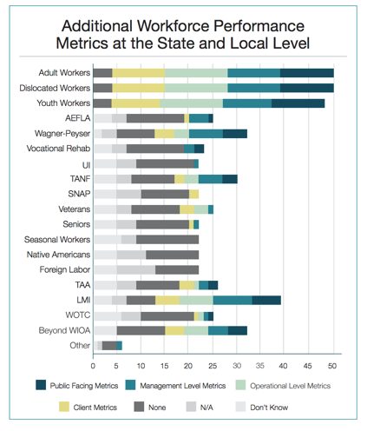
NASWA/NAWB Joint Report
Multi-state survey and assessment
State profiles of challenges, progress and success
Tips and recommendations
https://bit.ly/2xcRTaC

Slide 28
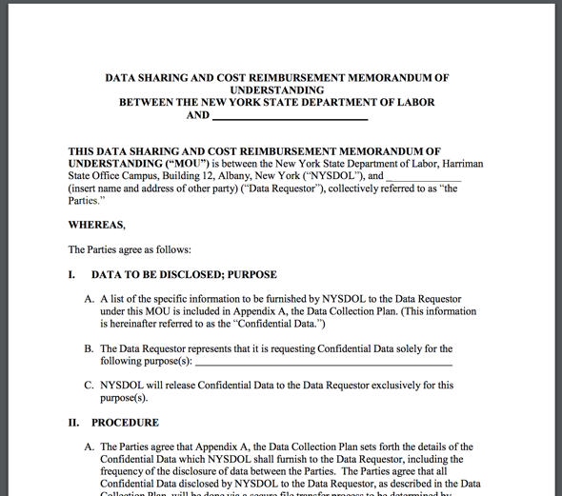
Inter-agency Data Sharing Agreements and MOUs
Many States need these in place to link UI records and measure WIOA outcomes
Templates help state higher education agencies and labor and employment agencies mutually support WIOA reporting without duplicative effort
Some states include MOUs with their Secretary of State to support linking records from providers that don’t collect social security numbers
http://statedatasharing.org/data-sharing/#toolkit

Slide 29
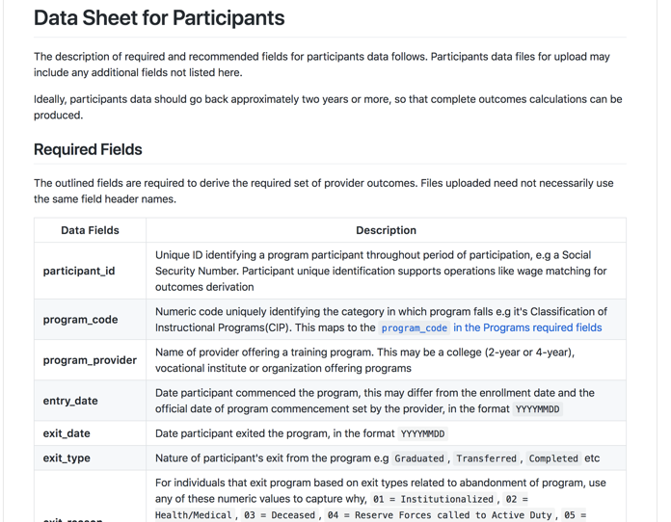
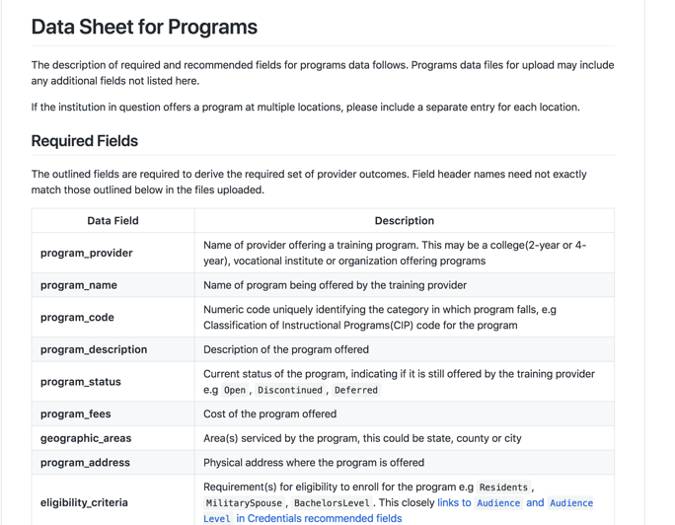
Data sheets and field definitions for providers
Provide clarity to training providers on what data they need to collect and report based on final rule
Provide clarity to technology contractors and vendors about field definitions
TPOT Template Data Sheets support use of data standards that reduce costs and redundancy
https://github.com/workforce-data-initiative/tpot-data-definitions

Slide 30
Data collection and validation best practices and tools
Aim for simple and secure data sharing by providers to state
Validate data in real time to reduce burden to both providers and state staff
TPOT uploader and data validator can work with your existing systems for data collection
https://github.com/great-expectations/great_expectations

Slide 31
Data storage and record linking best practices and tools
Aim to keep it simple with simple & lightweight ETP Performance Report transactional database
Work toward option for providers not collecting SSNs
TPOT data warehouse, record linking, and MCI tools are can work with your existing systems of record
https://github.com/workforce-data-initiative/tpot-warehouse
https://github.com/dedupeio/dedupe

Slide 32
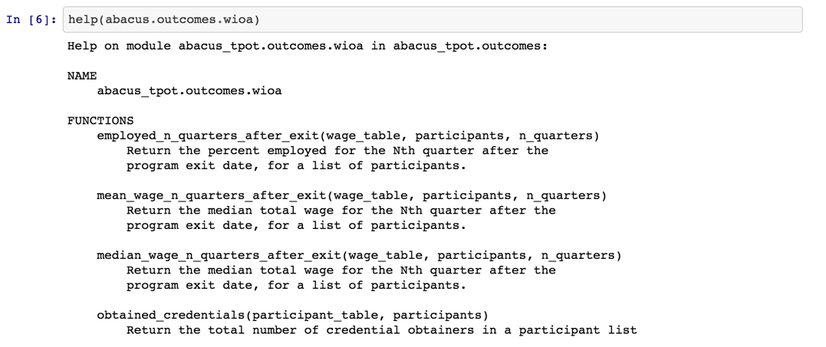
Data analysis, scorecard creation, and privacy preservation best practices and tools
Develop simple cell count cutoff rules (e.g. 7 or greater) to preserve individual privacy
TPOT Abacus tool creates all scorecard fields without requiring UI data to be co-mingled with participant records and ensures privacy based on your state’s privacy rules
https://github.com/workforce-data-initiative/tpot-abacus

Slide 33
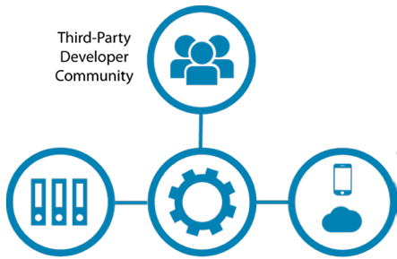
Data publishing and sharing best practices and tools
State Data Infrastructure
Open API
State-run ETPL Websites
Consider making ETPL performance report data available on the web as open, linked data via an Application Programming Interface (API)
Use national data standards for open, linked data on the web make it possible for State ETPL data to support more applications for more people
A large community of application developers are enthusiastic about using open ETPL data to help people better find and connect to providers in their area
TPOT Open API tool makes it simple for you to make state ETPL data openly available on the web in standard scorecard format & publish state-collected data to national registries that can help people find training programs, like the Credential Registry

Slide 34
Feel free to ask questions and get help from TPOT community
Community Discussion Board for TPOT Tools
slack.dataatwork.org

Slide 35
TEGL 3-18: ETP Reporting TEGL
This TEGL addresses ETP Performance Reporting requirements.
https://wdr.doleta.gov/directives/corr_doc.cfm?docn=3527
TEGL 41-14, Change 1
This TEGL addresses ETP eligibility requirements.
https://wdr.doleta.gov/directives/corr_doc.cfm?DOCN=5816
TPOT page
University of Chicago’s Training Provider Outcomes Toolkit
dataatwork.org/tools
WIOA final rule
https://doleta.gov/wioa/Docs/wioa-regs-joint-final-rule.pdf
DOL only final rule
https://www.doleta.gov/wioa/Docs/wioa-regs-labor-final-rule.pdf
WorkforceGPS ETP resource page
This page collects TA materials on ETP all in one place.
https://performancereporting.workforcegps.org/resources/2018/09/11/14/58/Eligible-Training-Provider-ETP-Resource-Page

Slide 37
All questions related to Eligible Training Provider Reporting should be emailed to:
ETAPerforms@dol.gov
All questions related to reporting via WIPS should be emailed to:
WIOA.Feedback@dol.gov

