Slide 1
Ticket to Work Program: An Aligned Mission with WIOA
September 11, 2018
September 12, 2018
1:00 – 2:30 PM EST

Slide 2
David Jones
Workforce Analyst
Employment and Training Administration (ETA)
U.S. Department of Labor

Slide 3
Employment Networks (ENs) to Administer Ticket to Work – An Opportunity
All ENs
Workforce System ENs
Total Number of ENs: 560
Total Income: $63,279,840
Tickets Assigned: 66,020
Workforce ENs: 111
Total Income: $7,790,519
Tickets Assigned: 8,753
Source: Internet Ticket Operations Provider Support System (iTOPSS) for FY 2017 (October 1, 2016 through September 30, 2018)

Slide 4
Understand the mission of the Ticket to Work (TTW) Program
Understand the role of Employment Networks (ENs) and how Ticket to Work is administered against different EN models
Understand the benefits to the American Job Center Network in becoming ENs to administer the Ticket to Work program

Slide 5
Ana Morales
EN Development / Ticket Program Manager for U.S. Social Security Administration
Maximus
Kevin Nickerson
Ticket to Work Program Coordinator Consultant and ADEN Co-Director
National Disability Institute

Slide 6
Lauren Parker
Senior Director, Ticket to Work Program
The SkillSource Group, Inc.
Brandi Brooks
Program Coordinator, Ticket to Work Program
South Carolina Department of Employment and Workforce

Slide 7
Nancy Stensgard
Disability Resource Coordinator
Rural Minnesota Concentrated Employment Program (RMCEP)/ Workforce Center

Slide 8
DOL and SSA Interagency Leadership Welcome Message

Slide 9
Patrick Mannix
Senior Advisor
U.S. Department of Labor, Office of Disability Employment Policy
Robert Pfaff
Deputy Associate Commissioner
U.S. Social Security Administration, Office of Research, Demonstration, and Employment Support

Slide 10
Part I: A Macro Overview of the Ticket to Work Program and Employment Networks (ENs)
Ana Morales and Kevin Nickerson

Slide 11
Part I.A. Ticket to Work – A Brief Overview

Slide 12
What is the Ticket to Work Program?
Ticket to Work provides eligible Social Security beneficiaries with disabilities (Ticketholders) the choices, opportunities and supports needed to obtain and retain employment.
Ticket to Work helps transition Ticketholders to become self-sufficient and may help reduce a Ticketholders reliance on public benefits – Social Security Disability Insurance (SSDI) and Supplemental Security Income (SSI).

Slide 13
Who are the Key Stakeholders?
Ticketholders
Beneficiaries of SSDI and/or SSI ages 18 through 64
Social Security Administration (Social Security)
Office of Research, Demonstration and Employment Support (ORDES) oversees the program
Employment Networks (ENs)
Entities approved by Social Security to provide or coordinate the delivery of employment related services to Ticketholders
State Vocational Rehabilitation (VR) agencies
Automatically participate in the Ticket program to serve Ticketholders and may choose VR Cost Reimbursement (CR) or operate EN
The Ticket Program Manager (TPM)
Manages the day to day administration of the Ticket program for Social Security

Slide 14
How Would you Describe the Typical Ticket to Work Customer?
Generally well educated, having post-secondary education
Higher number of SSDI beneficiaries use Ticket services and have a good work history
Motivated to get back on track with personal financial goals / financial stability
More interested in pursuing full-time work after proper advisement about SSA work incentives

Slide 15
An Essential Customer Base for the American Job Center (AJC)
A 2010 Mathematica research report documented that Social Security disability beneficiaries accessed and benefited from AJC services:
“…average earnings of working SSA beneficiary One-Stop users were much greater than the average earnings of working SSA beneficiaries nationally.”
“One-Stop users also left the SSA disability rolls at relatively high rates during the 12 months after exit from services.”

Slide 16
What are the Benefits for the American Job Center Network to Administer Ticket to Work?
Mission alignment with American Job Center under WIOA
Potential for financial sustainability through income generated
Organizational structure efficiencies to apply, ramp up and operate
Flexibility by American Job Centers to choose an Employment Network model that works best for them – No rigid cookie cutter approach
A possible opportunity to strengthen VR Collaboration through Partnership Plus

Slide 17
Part I.B. Employment Network (EN) Overview
Front-Line Administrators of the
Ticket to Work Program

Slide 18
What is an Employment Network?
An entity approved by the U.S. Social Security Administration to either provide or coordinate the delivery of services to Ticketholders
May be a single entity (public or private), a partnership/alliance, or a consortium of organizations collaborating to provide required services such as:
Career planning
Job placement assistance
Ongoing employment support
A Ticketholder may assign their Ticket to an EN of their choice to obtain employment related services or supports

Slide 19
What are Some Examples of a Public Workforce EN?
American Job Center
State Workforce Agency
State Workforce Development Board
Local Workforce Development Board
Vocational Rehabilitation (VR) Agency
American Indian Vocational Rehabilitation Agency
Total Number of ENs | Workforce ENs
560 | 111
Source: Internet Ticket Operations Provider Support System (iTOPSS) for FY 2017 (October 1, 2016 through September 30, 2018)

Slide 20
What are the Different Employment Network (EN) Model Options?
Single Entity EN (Traditional EN)
Stand-alone EN, responsible for all Ticket program administrative and service provision requirements
Administrative EN (AEN)
Single EN of Record responsible for Ticket program administrative requirements, reporting and interaction with Social Security and TPM
Contracts with AEN provider affiliates to provide required services to beneficiaries
https://yourtickettowork.ssa.gov/employment-networks/administrative-en-directory.html
Administrative EN (AEN) Provider Affiliate
Contracted to provide services to Ticketholders under an AEN structure
Partnership Plus EN
Services are primarily or exclusively to provide ongoing supports after VR case closure for Ticketholders served under VR Cost Reimbursement

Slide 21
What New Developments from SSA about Becoming or Currently Being an EN?
Application - EN Request for Application (RFA)
American Job Centers as workforce entities are prequalified as an Employment Network (EN)
Applications can be accessed at this link: https://www.ssa.gov/work/enrfa.html
Security Clearance - All ENs must have security clearance in place for staff that will be working directly with Ticketholders
Business Plans - Business plans are not required for Workforce entities since Social Security has already deemed one-stops as already having the requisite qualifications to perform EN functions
Outcome Reports - Workforce ENs do not need to complete the Annual Performance Outcome Report (APOR)
Contact - Questions related to the RFA or business model to choose should be directed to enoperations@yourtickettowork.ssa.gov

Slide 22
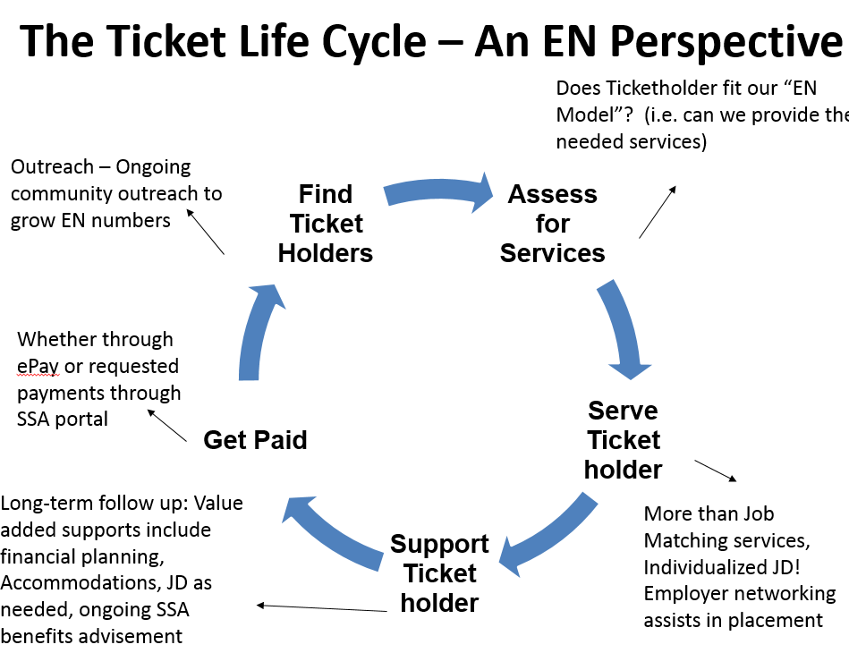
What is the Ticket Lifecycle from EN Perspective?

Slide 23
Part I.C. Employment Network (EN) Payments
An Additional Funding Stream to
Support Sustainability of Operations

Slide 24
What are the Financial Benefits of Being an Employment Network (EN)?
In times of increasing tightened budgets for states, an EN can generate an additional funding stream from Ticket to Work for the American Job Center (Ticket revenue) and VR (Cost Reimbursement)
Ticket revenue can be a great solution for supporting ongoing disability focused services in the workforce system

Slide 25
What were the FY 2017 Employment Network (EN) Statistics?
All ENs
Workforce System ENs
Total Number of ENs: 560
Total Income: $63,279,840
Tickets Assigned: 66,020
Unique SSNs Generating Payments (working): 19,789
Dollars/Unique SSNs Generating Payments: $3,197.73
Workforce ENs: 111
Total Income: $7,790,519
Tickets Assigned: 8,753
Unique SSNs Generating Payments (working): 2,256
Dollars/Unique SSNs Generating Payments: $3,453.24
Source: Data for Fiscal Year (FY) 2017 (10/1/16 – 9/30/17)

Slide 26
How do Payments to an Employment Network (EN) Operate?
ENs receive payments from the Social Security Administration
EN payments are performance based and associated with work and earnings a Ticketholder achieves
These values may change yearly (2017 listed here)

Slide 27
Could an Additional EN Funding Stream Replace Other Funding Resources?
Training and Employment Notice No. 20-07 clarifies that Ticket funding is an additional revenue source for One-Stop delivery systems and is not considered program income and will not replace existing funding sources (i.e. funding is in addition to current funding sources; to be used how you see fit)
Braiding Medicaid funded services and Ticket to Work funds is not “double dipping”

Slide 28
Is My Agency a Good Fit to Become an Employment Network (EN)?
Find out if your agency is a good fit for the Ticket program by contacting EN Operations for personalized assistance:
enoperations@yourtickettowork.ssa.gov
Should your agency be a good match for the Ticket program, check out the Workforce EN Planning Guide on DEI Resource Page.
https://dei.workforcegps.org/

Slide 29
PART I.D. Highlighting Two Effective Partnership Models
1. Partnership Plus EN
2. Administrative EN Provider Affiliate

Slide 30
What is Partnership Plus?
A process by which VR can utilize ENs to provide effective follow-up supports to beneficiaries whose cases are closed from VR per successfully working. Follow-up supports focus on employment maintenance and will vary based on the needs of the beneficiary.
“The two programs provide a continuum of services — VR agencies provide more intensive, up-front services to help beneficiaries enter or return to work, while employment networks under the Ticket to Work program can provide longer-term supports to help beneficiaries stay at work.” (Source: GAO report on Employment for People with Disabilities (June 2012)).

Slide 31
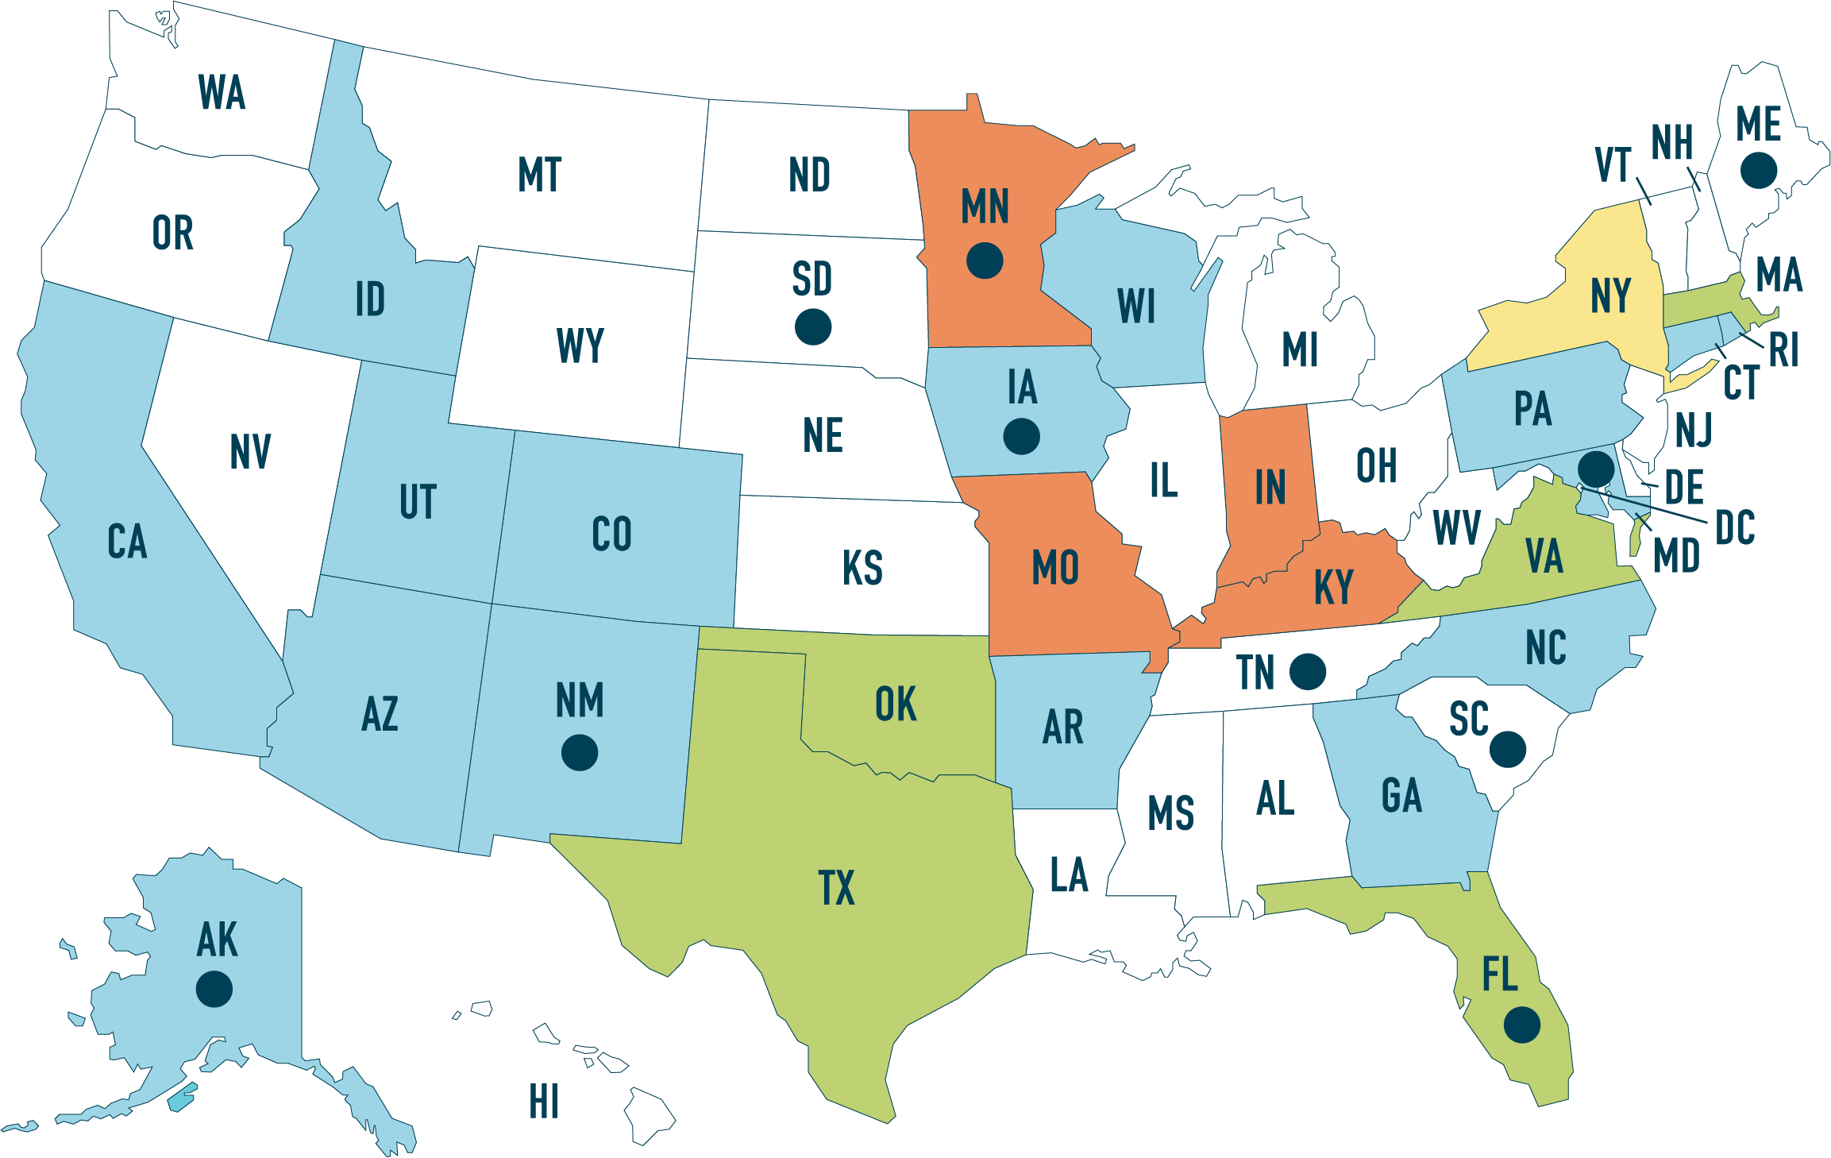
Where are there Partnership Plus Agreements?
Map Key
Memorandum of Understanding (MOU) | AK, FL, IA, MD, ME, MN, NM, SC, SD, TN
Written referral agreement | AK, AR, AZ, CA, CO, CT, GA, IA, ID, MD, NC, NM, PA, RI, UT, WI
Written referral agreement with benchmark payment | FL, MA, OK, TX, VA
Pre-negotiated “handshake” collaboration | IN, KY, MN, MO
Statewide Administrative EN agreement | NY
No known agreements | AL, DC, DE, HI, IL, KS, KY, LA, MI, MS, MT, ND, NE, NH, NJ, NV, OH, OR, VT, WA, WV, WY
Note: The bullets in the map denotes states with an Memorandum of Understanding (MOU)

Slide 32
How Can the Partnership Plus Model Collaborate with American Job Centers (AJCs) as an Employment Network?
Under this model, Social Security can compensate both a state VR agency and an EN that serve the same beneficiary under the same ticket if:
State VR agency has served the beneficiary under the Cost Reimbursement (CR) program
VR and EN services are provided sequentially, not concurrently
Tapping into “Partnership Plus” strategy, the AJC can offer the beneficiary the opportunity to use their Ticket to Work with VR or with the workforce EN or with both sequentially.

Slide 33
Is there a Solution to the Administrative Tracking?
YES! Now we have Administrative EN Provider Affiliate options
No need to apply to become EN, Affiliates work under ADEN contract with SSA
Provides a platform to track all PII, including statistical analysis of current progress
Offers support with all Administrative duties including: Audits, Requests from SSA, billing
Includes ongoing Technical Assistance to Members as well as targeted training
Advances EN affiliates through goal setting
See more here: www.AmericanDreamEN.org

Slide 34
PART I.E. Highlighting Success
1. Customer Success Story

Slide 35
Faces of Success – Success Story
Walter
Custodial Services / Cornell University
Goals included working at Cornell and becoming a home owner
Recently promoted as a National SSA success story, read more here: https://choosework.ssa.gov/library/walter-success-story

Slide 36
How Would (or do currently) Your Entity Use the SSA EN Income?:
Hire More Personnel
Support Disability Services
Support New Programming
Invest in Staff Training/Certifications
Further support the needs of existing Ticketholders who are working
Other

Slide 37
Part II: Single Entity EN Overview
Lauren Parker
Senior Director, Ticket to Work Program
The SkillSource Group, Inc.
Vienna, Virginia

Slide 38
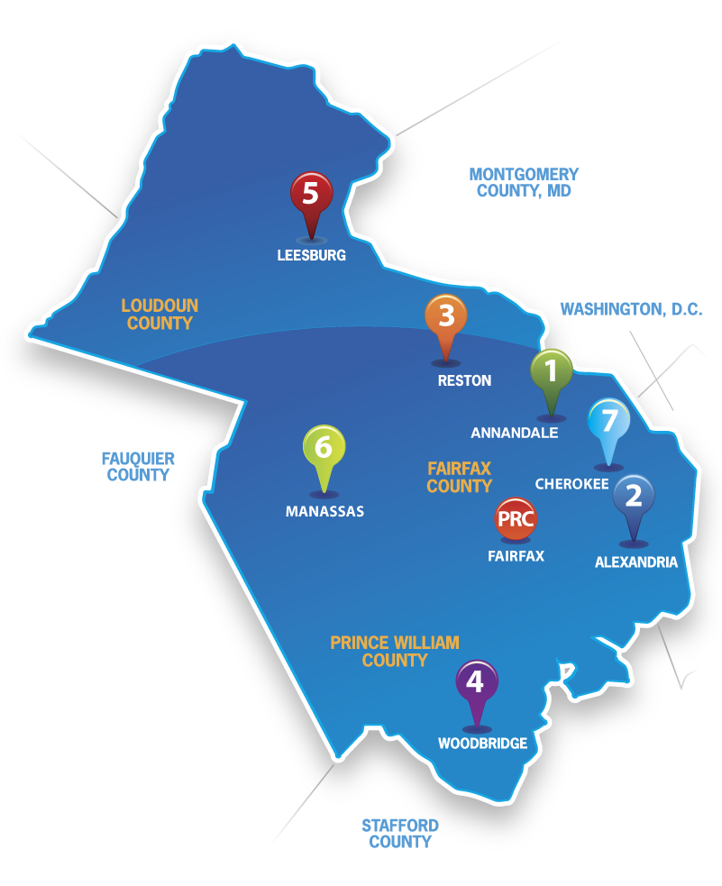
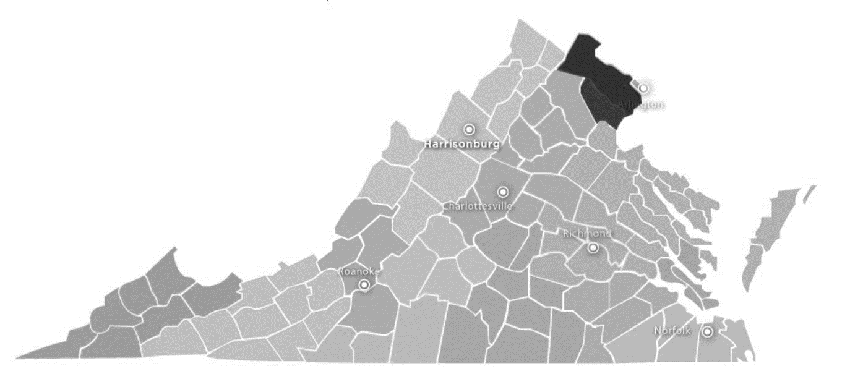
An Overview - The SkillSource Group, Inc.
Program Inception: 2010
Service Area: VA, MD, DC
American Job Centers: 7
Program Totals
Inquiries: 1,639
Assignments: 295
Placements: 141
EN Payments: $1,027,191

Slide 39
Why Did We Initiate the Ticket to Work Program?
The Role of Leadership
Financial Support – Additional Funding Stream
Continuation of the Disability Program Navigator Initiative

Slide 40
What Challenges Did We Overcome and How?
SSI and SSDI Work Incentives Knowledge and Counseling
Rapid Growth
WIOA Dual Enrollment Barrier

Slide 41
What Success Has Been Achieved?
Introducing job seekers with disabilities to the public workforce system
Creating capacity for ongoing disability awareness and system improvement
Collaboration with Vocational Rehabilitation and Partnership Plus

Slide 42
Part III: Administrative EN Overview
Brandi Brooks
Program Coordinator, Ticket to Work
South Carolina Department of
Employment and Workforce

Slide 43
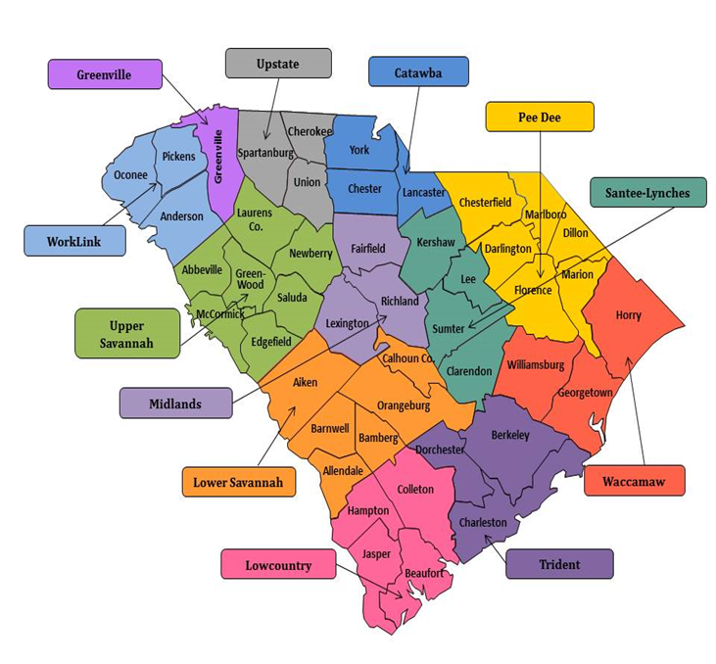
An Overview – South Carolina Department of Employment and Workforce
Program Inception: 2010
Service Area: State of SC
46 Counties
12 Regions
American Job Centers: 45
Program Totals
Assignments: 370
Placements: 156
EN Payments: $843,955

Slide 44
Why Did We Initiate the Ticket to Work Program?
The Agency’s Mission
To promote and support an effective, customer-driven workforce system that facilitates financial stability and economic prosperity for employers, individuals, and communities.
Expand the Number of Programs/Resources Available to Job Seekers in Centers
Increase Clientele
Financial Support

Slide 45
What Challenges Did We Overcome and How?
Basic Knowledge of the Program
EN Coordinators
Program
Purpose
Paperwork
Process
Ensuring the Beneficiary chooses the right EN

Slide 46
What Success Has Been Achieved?
One of the top ENs in the State
Administration of Ticket to Work through SCWorks Centers
Recently Collaborated with Vocational Rehabilitation and Partnership Plus

Slide 47
What are Your Leading Two Concerns Integrating Employment Network (EN) Operations into the American Job Center Network:
Difficulty with the Application Process
Security Clearance Process is Challenging
EN Administration is Time Consuming
Staff Capacity to Operationalize
Concerned We Will Not Find Beneficiaries Willing to Commit to Self-Sufficiency
Other

Slide 48
Part IV: EN Provider Affiliate of ADEN
Nancy Stensgard
Disability Resource Coordinator (DRC)
Rural Minnesota Concentrated Employment Program (RMCEP) / Workforce Center

Slide 49
Part IV.A. Background

Slide 50
RMCEP Background as an American Job Center (AJC)
Awarded Disability Employment Initiative (DEI) Round 3 (2012-2015) and currently in Round 7 (2016-2020)
Serve 19 counties through eight locations including a Mobile Workforce Services Team
Co-located with VR, State Services for the Blind (SSB), DEED, Unemployment Ins., and Veterans Employment Services at most locations

Slide 51
RMCEP Exudes a “No Wrong Door” Philosophy
Customers use RMCEP services through many means
Co-enrollments are made in programs where appropriate to braid funding from other sources for services
Referrals flow between collaborative partners from VR, counties, schools, post secondary institutions, and local agencies

Slide 52
Part IV.B. Responding to Change – A Decision Point

Slide 53
Responding to Change – A Decision Point
For MN DEI Round 3 (2012-2015), MN Department of Employment and Economic Development (DEED) served as the State EN for AJCs operating Ticket to Work in Minnesota
With MN DEI Round 7, DEED would no longer continue their role as a State EN
Decision Point - This required DEI MN grantees to change to either: a) Single-Entity Workforce EN or b) EN Provider Affiliate (under another administrative EN)

Slide 54
RMCEP - Exploring Our Options
RMCEP systematically gathered input and insights from our collaborative partners
Including carefully examining ways to meet a key DEI outcome of increasing Employment Networks across MN
RMCEP wanted to ensure we had the right fit with our Vision Statement of Strategic Intent
“Inspiring positive change leading to successful and prosperous individuals and communities through the power of work”
Based on past and current assessment, it seemed logical our solution was to be EN Provider Affiliate

Slide 55
The Right Fit for RMCEP – American Dream Employment Network (ADEN)
ADEN is an approved administrative EN under the Social Security Ticket to Work Program
ADEN was determined to be an excellent fit with our business plan to operate Ticket to Work
ADEN could offer the support, training, tools, and administrative expertise RMCEP needed to meet our strategic goals

Slide 56
A Comparison of the Old and New Employment Network (EN) Models
With DEED EN, 2013-2017, RMCEP had
4 Certified Work Incentive Practitioners
Cummulative-33 Tickets; lost contact with some or they were not making timely progress
Earned $104,574 in unrestricted revenue
With ADEN, 2018 to date, RMCEP has
8 Certified Work Incentive Practitioners
Assigned 9 Tickets in the first 30 days; currently have 15 Active Tickets with several others pending

Slide 57
Part IV.C. Administrative Support Services and Benefits

Slide 58
Examples of ADEN Administrative Services for RMCEP
ADEN serves as EN of record, focusing on all aspects of SSA compliance
Training and ongoing technical assistance from national experts
Access to ADEN’s secure electronic portal offering state-of-the-art resources to simplify data management and reporting
Timely billing and distribution of Ticket revenue

Slide 59
Other ADEN Support Services for RMCEP
Outreach to the 21,323 working age SSA beneficiaries in the 19 counties we serve
Incorporate ADEN’s extensive training opportunities, member resources, and marketing toolkit into our operations
Learn from interactive monthly huddles with ENs across the country and with Benefits & Work Incentive Advisory Peers
Deliver complex services with integrity

Slide 60
Present - The Dual Benefits of Receiving Services from ADEN
A Win for Our Customers- Leaving the administrative aspects of being an Employment Network to ADEN maximizes our efforts on behalf of potential and active Ticket participants
A Win for Our Businesses- We become more efficient in supporting our business partners become more inclusive as they fill open positions from a wider pool of applicants

Slide 61
Closing Remarks - Why Become an Employment Network?
The Ticket to Work program, done well, can support position(s) within your agency with the revenue it generates
Use creative and analytical skills for Benefits and Work Incentive Advisement to empower Ticket holders to achieve self-sufficiency
You have an opportunity to revive dreams and expand the future for experience-rich and skilled job seekers

Slide 63
Connect the Pieces - Ticket to Work Resources on WorkforceGPS

Slide 64
Connecting Future Pieces – Workforce Innovation Cohort Challenge
Three Disability and Employment cohorts focus on the following:
Accessibility
Customer Service
Employer Engagement
https://disability.workforcegps.org/announcements/2018/09/10/16/10/Workforce-Innovation-Cohort-Challenge

Slide 65
SkillsCommons Field Guide of TAACCCT Individuals: Aligning Workforce Development Stakeholders
September 12, 2018 (4:00 – 5:00 PM EST)
Meeting the Workforce Challenges of the Water Sector: A Competency Model Approach
September 13, 2018 (1:00 – 2:30 PM EST)
Equal Employment Opportunity Regulations for Apprenticeship: Final Phase-In Requirements
September 14, 2018 (1:00 – 2:00 PM EST)

Slide 66
Ana Morales
EN Development / Ticket Program Manager for SSA
Ticket to Work Program
Maximus
AnaLMorales@maximus.com
Kevin Nickerson
Ticket to Work Program Coordinator Consultant and ADEN Co-Director
National Disability Institute (NDI)
Knickerson@ndi-inc.org

Slide 67
Lauren Parker
Senior Director, Ticket to Work Program
South Carolina Department of Employment and Workforce
Lauren.Parker@myskillsource.org
Brandi Brooks
Program Coordinator, Ticket to Work
South Carolina Department of Employment and Workforce
bbrooks@dew.sc.gov

Slide 68
Nancy Stensgard
Disability Resource Coordinator
Rural Minnesota Concentrated Employment Program (RMCEP) / Workforce Center
Nancys@rmcep.com

