Slide 1
Polling Question
?
What kind of organization are you coming from?
College
Workforce Board/American Job Center
Community Service Provider
Other
?
?
?
?

Slide 2
Polling Question
?
Do you use Open Educational Resources at your organization?
Yes, frequently!
Yes, just starting to explore
No, what is OER?
?
?
?
?

Slide 3
Polling Question
?
What challenges does your organization face in training industry experts as instructors?
Please type your answers into the webinar chat.
?
?
?
?

Slide 4
Jumpstart to Successful Instruction: A Deeper Dive into an Accelerated Course for New Instructors
August 22, 2018
Innovations Leading to Career Success Webinar Series
Employment and Training Administration
Office of Career, Technical, and Adult Education

Slide 5
Moderators
Cheryl Martin, Trade Adjustment Assistance Community College and Career Training (TAACCCT) Program Manager, Division of Strategic Investments, Employment and Training Administration, U.S. Department of Labor
Erin Berg, Community College Program Specialist, Office of Career, Technical, and Adult Education, U.S. Department of Education

Slide 6
The TAACCCT Grant Program
The U.S. Department of Labor’s Trade Adjustment Assistance Community College and Career Training (TAACCCT) grant program is a major investment to increase the ability of community colleges to address the challenges of today’s workforce.
The TAACCCT Program:
$1.9 billion awarded; grant projects active from 2011-2018
Over 700 colleges across the nation participated, in partnership with over 2,500 employers
Over 2,600 industry-aligned programs of study developed or enhanced
More than 475,000 individuals enrolled to date
Resources developed by grantees made freely available on SkillsCommons.org

Slide 7
About this Webinar
This webinar showcases strategies and resources developed by community colleges that are of broad interest to educational institutions engaged in career-focused education and training.
The Industry Expert to Expert Instructor (IE2EI) Network, and the many other resources available on SkillsCommons, were produced by grantees of the Trade Adjustment Assistance Community College and Career Training (TAACCCT) program, a collaboration between the US Department of Labor and the US Department of Education.

Slide 8
Innovations Leading to Career Success Webinar Series
This webinar series showcases strategies and resources that are of broad interest to educational institutions engaged in career-focused education and training.
August 22:
Jumpstart to Successful Instruction: A Deeper Dive into an Accelerated Course for New Instructors
September 12:
Aligning Workforce Development Stakeholders
September 26:
Increasing Student Support Services to Improve Student/Worker Outcomes
October 10:
Increasing Academic Achievement
October 24:
Adult Learning Strategies at Community Colleges
Innovations Leading to Career Success Webinar Series, Part II

Slide 9
.org An online library of 12,000+ free workforce development resources ready to be downloaded, adapted, and used

Slide 10
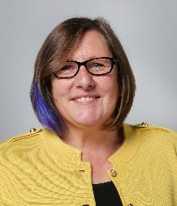
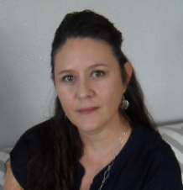
Presenters
Brenda Mora Perea, IMPACTcommunity Ambassador, California State University-MERLOT, SkillsCommons.org
Jennifer Gutierrez, IMPACTcommunity Ambassador, California State University-MERLOT, SkillsCommons.org

Slide 11
Jumpstart to Successful Instruction: IE2EI
Preparing Industry Expert in Becoming Expert Instructors (IE2EI)

Slide 12
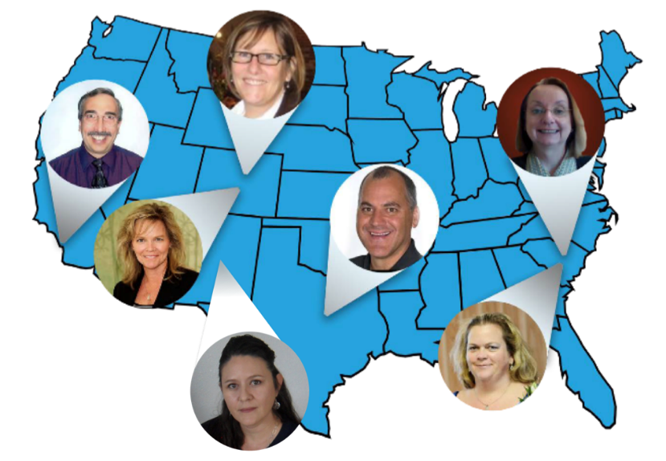
IE2EI Community Members

Slide 13
Challenges
How do you upskill industry experts for their new role as an instructor?
What resources do secondary and postsecondary institutions have to upskill new instructors?
What resources do secondary and postsecondary instructors have to upskill themselves?

Slide 14
Solution
The content was developed through:
Interviews with new college faculty members and experienced instructors who came from industry
Use of a collaborative, iterative build process
Development of “appetizer”-sized course content combined into a full “meal”
Was chunked into short independent modules
Can be used as:
Just-in-Time training
Before first day of course
Midterm
Before start of new semester

Slide 15
Deep Dive into Modules
Sample New Instructor Professional Learning Plan or Training
101-1st Day of the Course
101-Writing an Effective Syllabus
101-Developing Effective Communication
101-Fair and Balanced Formative and Summative Assessments

Slide 16
Live Site Share
Go to the live site located at:
http://support.skillscommons.org/connect/impact-communities/ie2et/

Slide 17
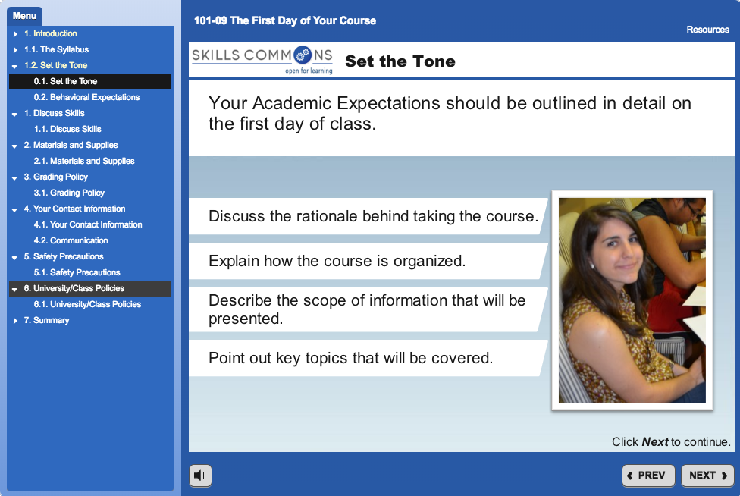
1st Day of Your Course

Slide 18
1st Day of Your Course

Slide 19
1st Day of Your Course

Slide 20
Writing an Effective Syllabus

Slide 21
Writing an Effective Syllabus

Slide 22
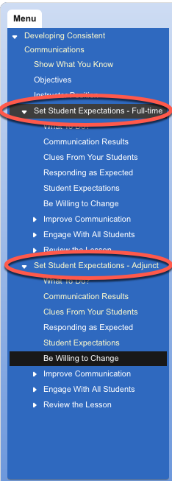
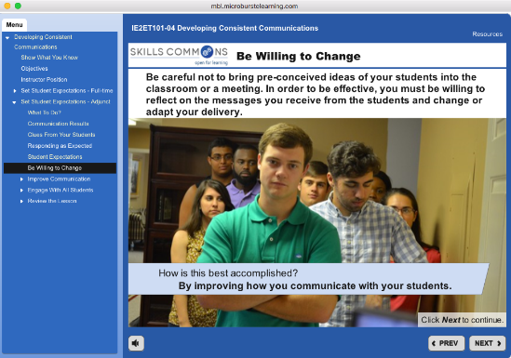
Consistent Communication

Slide 23
Consistent Communication

Slide 24
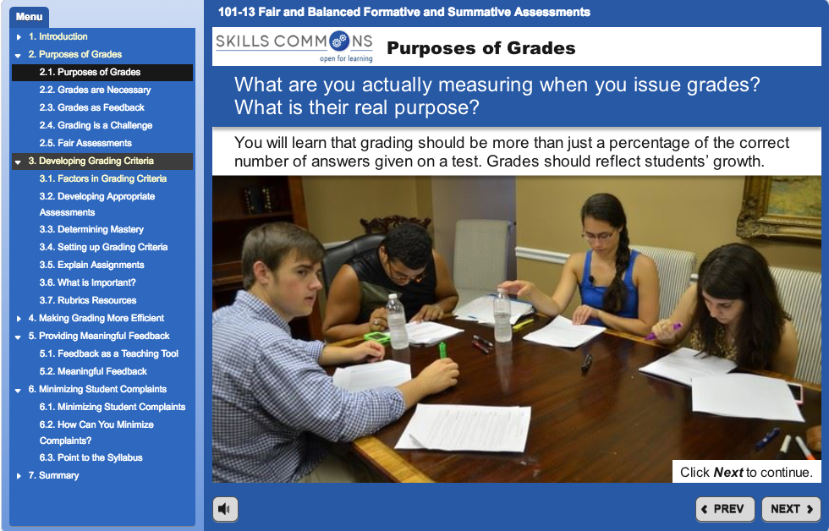
Formative and Summative Assessments

Slide 25
Formative and Summative Assessments

Slide 26
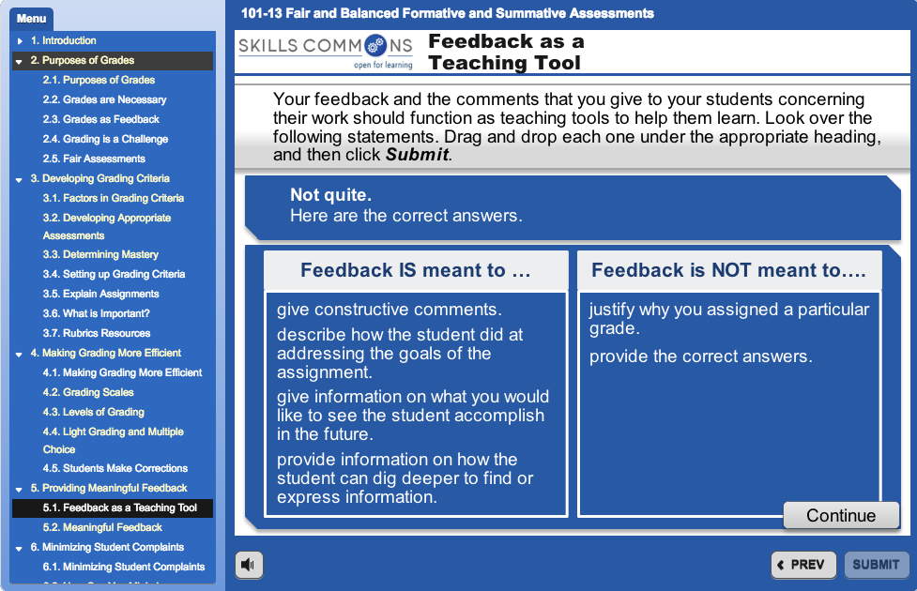
Formative and Summative Assessments

Slide 27
Deep Dive into Modules
Sample Up-Skilling or Re-Skilling Professional Learning Plan or Training
102-Investigating Learning Theory
102-Adopting and Adapting Research Based Learning Theories
102-Student Centered Learning in Higher Education
102-Understanding ADA & Meeting Learner’s Needs

Slide 28
Investigating Learning Theory

Slide 29
Adopting and Adapting Research Based Learning Theories

Slide 30
Adopting and Adapting Research Based Learning Theories

Slide 31
Adopting and Adapting Research Based Learning Theories

Slide 32
Student Centered Learning

Slide 33
Student Centered Learning

Slide 34
Student Centered Learning

Slide 35
ADA and Learners Needs

Slide 36
ADA and Learners Needs

Slide 37
ADA and Learners Needs

Slide 38
ADA and Learners Needs

Slide 39
Questions
Polling Questions
?
Do you anticipate implementing one or more of the Jumpstart to Successful Instruction: IE2EI modules?
If so, how?
Please share your answers with us in the webinar chat.
?
?
?
?

Slide 40
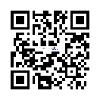
Connect with SkillsCommons Communities
Follow SkillsCommons on social media:
www.skillscommons.org/Facebook
www.twitter.com/SkillsCommons
www.linkedin.com/company/6650163
SkillsCommons Basecamp
Join others in this online resource-sharing and problem-solving community. Send an email to
connect@skillscommons.org, and we’ll get you connected right away!
MERLOT Voices
Join a Voices Industry Sector & IMPACTcommunities forum. Stay informed and get involved in
leadership. Participate in the online communities where you can engage in online dialogs, post
materials, and get connected with colleagues.
SkillsCommons Connect Center Get all the latest SkillsCommons news and feeds!
http://bit.ly/IE2ET

Slide 41
Innovations Leading to Career Success Webinar Series
This webinar series showcases strategies and resources that are of broad interest to educational institutions engaged in career-focused education and training.
If you enjoyed this webinar, you can view previous webinars in the series at:
https://taaccct.workforcegps.org/resources/2018/02/15/20/51/Innovations_Leading_to_Career_Success_Webinar_Series
Upcoming Webinars
August 22:
Jumpstart to Successful Instruction: A Deeper Dive into an Accelerated Course for New Instructors
September 12:
Aligning Workforce Development Stakeholders
September 26:
Increasing Student Support Services to Improve Student/Worker Outcomes
October 10:
Increasing Academic Achievement
October 24:
Adult Learning Strategies at Community Colleges
Innovations Leading to Career Success Webinar Series, Part II

Slide 42
Thank you!
For more information, please visit http://support.skillscommons.org/connect/impact-communities/ie2et/
If you have further questions, you can contact the SkillsCommons team at:
SkillsCommons Support
support@skillscommons.org
This work is licensed under a Creative Commons Attribution 4.0 International License.
This workforce solution was created through a cooperative agreement between the U.S. Department of Labor's Employment and Training Administration and the California State University-Multimedia Educational Resource for Learning and Online Teaching (MERLOT).

