Slide 1
Our Journey Together:
A Trauma-Informed Approach for Youth and the Workforce System
May 2, 2018
Division of Youth Services
May 2, 2018

Slide 3
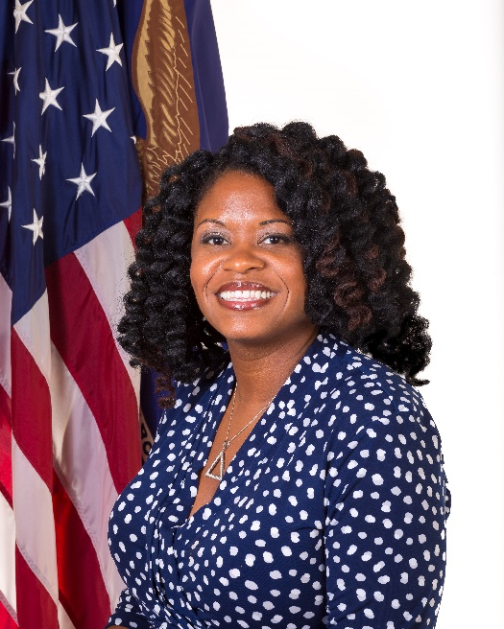
Maisha Meminger
  Manpower Analyst
    U.S. Department of Labor, Employment & Training Administration
    Division of Youth Services

Slide 4

Rebecca Flatow Zornick
  Lead Public Health Analyst
    Substance Abuse and Mental Health Services Administration
    U.S. Department of Health and Human Services

Slide 5

Brie Masselli
  Program Director
    Youth MOVE National

Slide 6

Michael Surko, PhD
  Clinical Assistant Professor
    NYU School of Medicine Department of Child and Adolescent Psychiatry
  Psychology Director
    Bellevue Juvenile Justice Mental Health Service, New York, NY

Slide 7
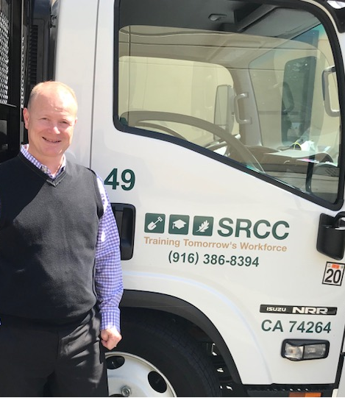
David P. De Mers
  Executive Director
    Sacramento Regional Conservation Corps

Slide 8
Share the basics of Trauma Informed Care
Highlight programs utilizing strategies to address trauma
Share technical assistance resources and training

Slide 9
Where are you (or your organization) in becoming trauma-informed?
Have not started
Have been to a workshop or presentation on trauma
Have been trained in trauma
Are engaged in trauma-informed practices and/or a trauma-informed approach

Slide 10
Trauma?
Why should the Workforce care?

Slide 11
SAMHSA’s Concept of Trauma and Framework for a Trauma-Informed Approach
Rebecca Flatow Zornick
Substance Abuse and Mental Health Services Administration
U.S. Department of Health and Human Services

Slide 12
A National Strategy
Vision: A comprehensive approach to addressing trauma
Mission: Set a strategic direction for behavioral health to advance policy, training, practice, research, evaluation, and coordination across various service sectors to mobilize and encourage organizations, systems, and communities to implement a trauma-informed approach.
Objectives:
Elevate a focus on the connection between trauma and mental and substance use disorders through a public health approach;
Advance the uptake and testing of trauma-specific practices and programs;
Articulate and assess the role of a trauma-informed approach (as differentiated from trauma-specific clinical interventions) in improving care and service delivery;
Partner with organizations to move a public health approach to trauma into behavioral health care, related health and human service systems and communities.

Slide 13
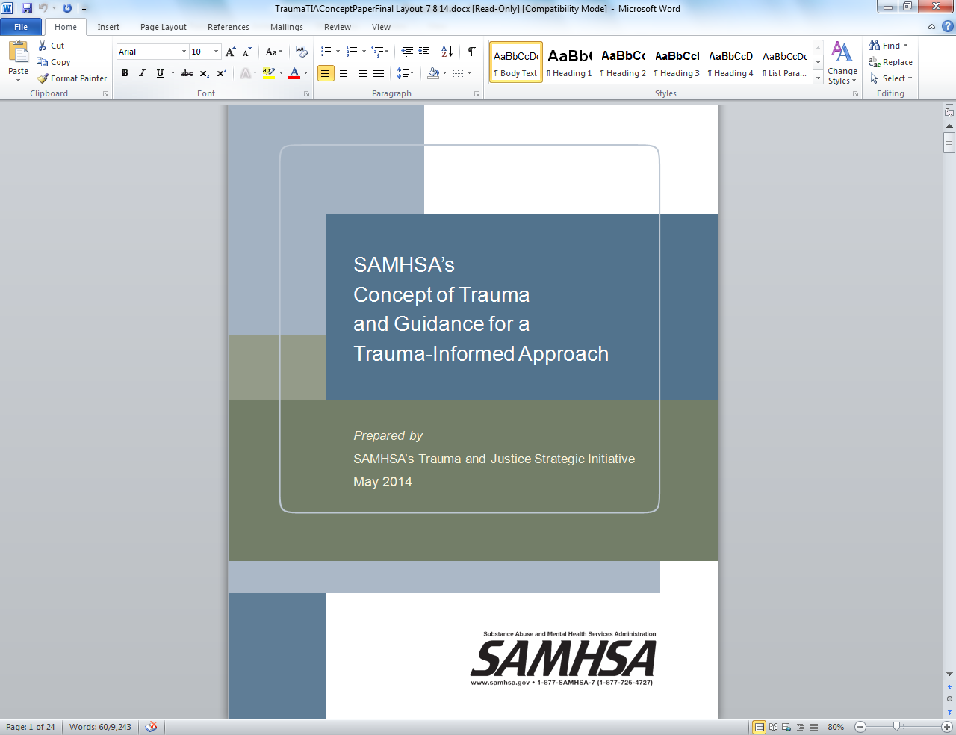
SAMHSA Concept of Trauma and Guidance for a Trauma-Informed Approach
Notes:
Trauma and Trauma-Informed Care Experts Panel (May, 2012)
Leading experts included: Raul Almazar, Rene Anderson, Andy Blanch, Robyn Boustead, Roger Fallot, Norma Finkelstein, Julian Ford, Joan Gillece, Dan Griffin, Gene Griffin, Maxine Harris, Jacki McKinney, Cheryl Sharp, John Rich, Hank Steadman, Charles Wilson and facilitated by Barbara Bazron and Larke Huang
Concept/Framework:
Experts’ Working Definitions of Individual Trauma and Trauma-Informed Approach
Core Values and Principles of Trauma-Informed Approach
Guidelines for Developing a Trauma-Informed Approach
Preliminary discussion on the definition of community trauma
Public Comment (December, 2012) Online posting; >2,000 respondents; 20,000 comments or endorsements

Slide 14
SAMHSA’s Concept of Trauma: “The 3 Es”
“Individual trauma results from an event, series of events, or set of circumstances that is experienced by an individual as physically or emotionally harmful or life threatening and that has lasting adverse effects on the individual’s functioning and mental, physical, social, emotional, or spiritual well-being.”
From SAMHSA’s Concept Paper

Slide 15
A Trauma-Informed Approach (Four R’s)
A trauma-informed program, organization, or system:
Realizes
Realizes widespread impact of trauma and understands potential paths for recovery
Recognizes
Recognizes signs and symptoms of trauma in clients, families, staff, and others involved with the system
Responds
Responds by fully integrating knowledge about trauma into policies, procedures, and practices
Resists
Seeks to actively resist re-traumatization.
From SAMHSA’s Concept Paper
Notes:
Definition of Trauma: “Individual trauma results from an event, series of events, or set of circumstances that is experienced by an individual as physically or emotionally harmful or life threatening and that has lasting adverse effects on the individual’s functioning and mental, physical, social, emotional, or spiritual well-being.”

Slide 16
Key Principles of a Trauma-Informed Approach
Safety
Trustworthiness and Transparency
Peer Support
Collaboration and Mutuality
Empowerment, Voice, and Choice
Cultural, Historical, and Gender Issues

Slide 17
Guidance Domains for a Trauma-Informed Approach
Peer Support
Safety
Governance and leadership
Policy
Physical environment
Engagement and involvement
Cross sector collaboration
Screening, assessment, and interventions
Training and workforce development
Progress Monitoring and Quality assurance
Financing
Evaluation
Collaboration
And
Mutuality
Cultural,
Historical,
Gender Issues
Trustworthiness
and Transparency
Empowerment, Voice, and Choice

Slide 18
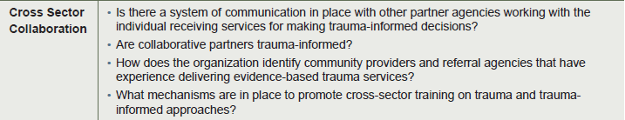
Cross Sector Collaboration
Collaboration across sectors is built on a shared understanding of trauma and principles of a trauma-informed approach.
While a trauma focus may not be the stated mission of various service sectors, understanding how awareness of trauma can help or hinder achievement of an organization’s mission is a critical aspect of building collaborations.

Slide 19
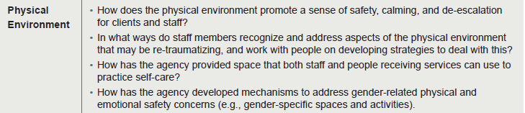
Physical Environment
.
The organization ensures that the physical environment promotes a sense of safety and collaboration.
Staff working in the organization and individuals being served must experience the setting as safe, inviting, and not a risk to their physical or psychological safety.
The physical setting also supports the collaborative aspect of a trauma informed approach through openness, transparency, and shared spaces

Slide 20
Children’s Mental Health Awareness Day
Focus: An integrated health approach to supporting children, youth, and young adults who have experienced trauma.
Date: Thursday, May 10, at 7 p.m. EDT
Live Webcast Viewing Site: https://www.samhsa.gov/children
Goals
  Educate the public about the importance of seeking mental health services when needed.
  Showcase evidence-based practices in the field of children’s mental health.
  Encourage child-serving providers to collaborate with family and youth leaders to meet the needs of children, youth, and young adults with serious emotional disturbance (SED) and their families.
National Event Content
  Attendees will have the unique opportunity to participate in a town hall discussion about making child-serving systems more trauma-informed. Assistant Secretary for Mental Health and Substance Use Elinore McCance-Katz, M.D., Ph.D., will host the dialogue that will include governors’ spouses, senior federal officials, and youth and family leaders, as well as executives from the nation’s leading organizations for professionals in primary care, behavioral health, and child welfare.

Slide 21
Thank you
SAMHSA’s mission is to reduce the impact of substance abuse and mental illness on America’s communities.
www.samhsa.gov
1-877-SAMHSA-7 (1-877-726-4727) ● 1-800-487-4889 (TDD)

Slide 22
Motivating Others through Voices of Experience
Brie Masselli
Program Director
Youth MOVE National

Slide 23
Youth MOVE Purpose
Youth M.O.V.E. National works toward the day when all people will recognize and accept the culture of youth, their families, and the communities that serve them in order to be truly culturally-competent. Youth M.O.V.E. National looks forward to the day when youth are no longer treated as numbers, problems or caseloads, but as individuals and humans. We will all stand as partners: youth, youth advocates, supporters, parents, and professionals to see our youth become successful.

Slide 24
Chapter Model
Youth MOVE National utilizes a capacity building model that supports individuals utilizing services, the communities in which they live, and the services and/or systems that support them
Our model consists of programing that is young adult driven and a data driven approach that
  Builds upon peer connections
  Promotes learning and growth
  Develops partnerships and collaboration
  Identifies service and support gaps
  Seeks to improve access and quality services and supports
Notes:
Builds upon peer connection
Promotes learning & growth
Identifies service gaps
Develops partnerships & collaboration
Seeks to improve quality

Slide 25

Understanding Trauma: Lived Experience Perspective
Have I experienced Trauma? Many don’t call it trauma.
Trauma can be complex, confusing, stressful or minimized as “bad things happen to good people”
Often times people brush it off …
  …That’s just how things are
  …Oh, this is normal for my family
  …Maybe I provoked it
  …Its my fault, I just don’t do anything right
  …I should have know better
  …Bad things happen to everyone

Slide 26

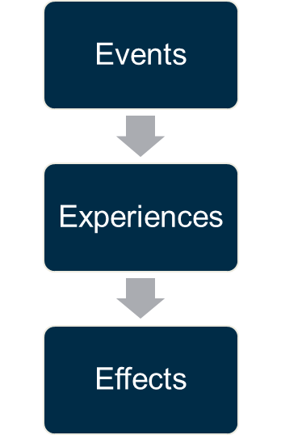
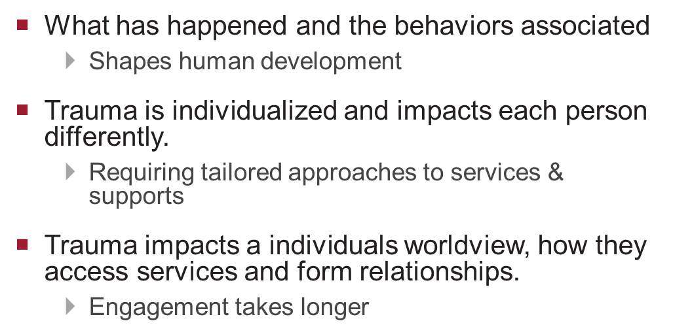
Trauma Informed Care Matters

Slide 27
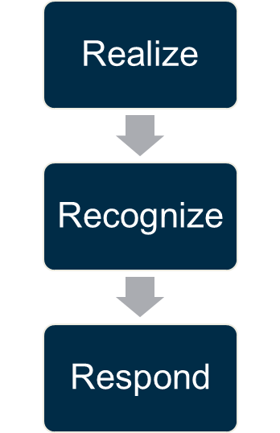
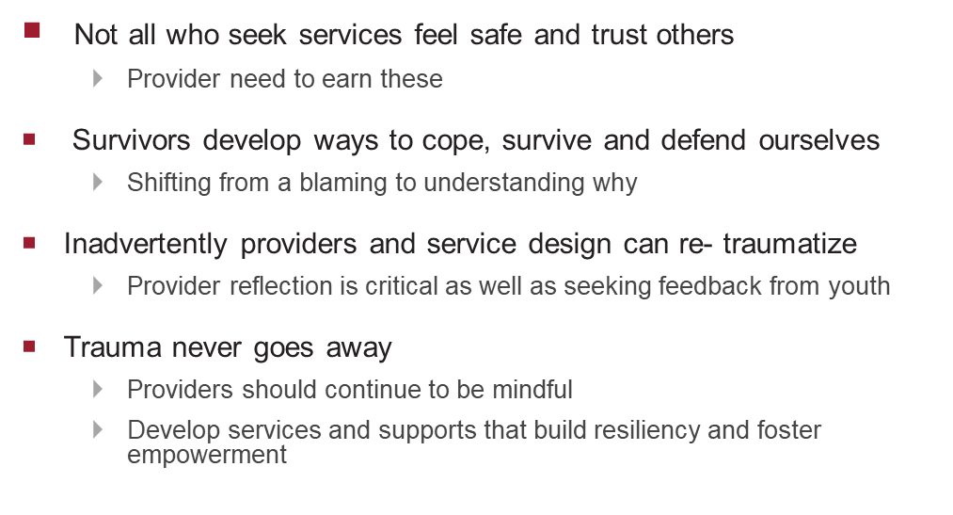
Trauma Informed Care Matters

Slide 28
Trauma Informed Care in Action
Individual Level
Organizational Level
How does the individual define each principle of trauma informed?
How does programing ….
  Create safety
  Become transparent & trustworthy
  Connect to peers
  Build mutuality & collaborate
  Strengthen voice, choice and empowerment
  Respect and value culture, historical and gender issues
How has the organization taken this into consideration at the practice and policy level?
  How have those with lived experience partnered with you to define and design trauma informed care?
  What policies and practices has shifted?
  How are those with lived experience integrated into the workforces & decision making
Notes:
Program design:
Value added to include families and youth in the process of creating change?
Provide education and support
Conveners, facilitators and champions
Bring lived experience
Creativity
Committed at all levels of partnership exploration, planning, implementation and sustainability
Think bigger than just clinical implications of trauma informed care
Partners in selection process of screening & assessment protocols
Partners in development of responsive services and supports
Clinical Supports
Peer to Peer: Coaching & Partner Models
Partners in defining what TI-principles means to them and how that applies to quality of care
Ability to identifying unm

Slide 29
Models of Partnership
Level of Engagement
Consultation
Involvement
Partnership
Direct Care
Receive information about health status & services
Ask about treatment preference
Shared decision making
Organizational
Seek information about experience
Engage as advisors
Involve in QI/ systems efforts
Policy
Conduct focus groups to ask about experience
Use recommendations on research priorities
Equal representation on committees allocating resources
Model for Partnership: Adapted from Carman et al, Health Affairs 32, No.2 (2013):223-231

Slide 30
Ways to Incorporate Family &Youth Voices
Inform | Consult | Involve | Collaborate | Empower
Websites | Focus Groups | Co- Lead Workshops | Advisory groups | Strategy Groups
Information repositories & Kiosks | Surveys | Present at conferences | Networking & Peer support | Steering committees
Media Releases | Face to face Interviews | Serve as expert panelist | Support groups | Decision making
Feature Stories | Public Meetings & Forums | Facilitate groups | Family advisory councils | Hired in staff roles or peer roles
Fairs & Events | Suggestions boxes |  | Youth Advisory Councils
Open Houses | Interviews
Fact Sheets, Brochures and leaflets | Patient Experience trackers
Safety, Transparency & Trust, Empowerment, Choice, Collaboration, Mutuality, Culturally Responsive, Peer Support
Health Affairs 32, No.2 (2013):223-231

Slide 31
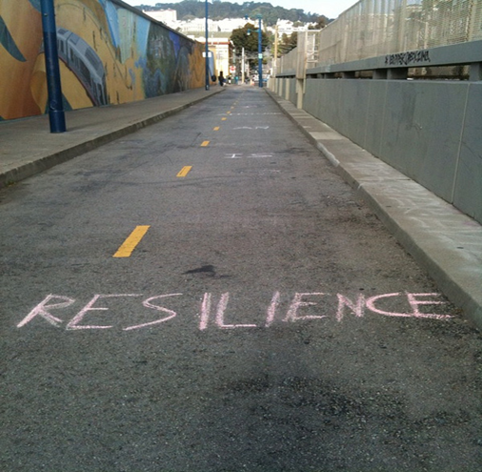
Resilience
Fortunately, brains and lives are somewhat plastic. The appropriate integration of resilience factors born out of ACE concepts — such as asking for help, developing trusting relationships, forming a positive attitude, listening to feelings — can help people improve their lives.

Slide 32
What is Resiliency?
Capacity
Capacity for one to cope, adjust to, recover from stress and negative live events; includes personality traits, social skills, and responses that enable thriving
Internal Factors
Characteristics such as individual talents, energies, strengths, and constructive interests
External Factors
Influences like family support, positive adult role models outside of family, high expectations within community, and the availability and access to of creative activities

Slide 33
ACE’s & Resilience
ACEs
Not a Life Sentence
ACE’s are not set in stone
Resilience
Responsive caregiving provided from trusting adults and moderate effects
Building resilience can counter the effects and help lead youth to more effective, productive and healthy adulthoods
Building Blocks
Include simple actions , responses and attitudes
Each action can look small , yet many small steps together build a strong foundation that allows one to thrive even when life poses inevitable hardships, challenges and disappointment s
The are ways to lessen the effects of ACEs
Learn more about ACES here:
www.cdc.gov/violenceprevention/acestudy/index.html or www.acestoohigh.com

Slide 34
What is needed for post traumatic growth?
Safe environment
Listening without solving
Highlighting the change perspective
Reframing growth & opportunity
Access to services when appropriate
Notes:
What is needed for Post traumatic growth?
Safe environment:
-Since feelings of extreme danger and vulnerability are inherent to most who experience trauma, establishing a sense of safety for youth is necessary before beginning to process the experience
Listening without trying to solve:
Youth May feel angry or scared and express a variety of emotions in order to make sense of the experience (behaviors: remember its not about fixing behaviors only)
Caring adults must resist the urge to “make it all better” which may come from personal needs to make intense feelings more tolerable. Must be willing to sit with discomfort (a tenant of peer support)
Listening with out solving is also a tenant of many peer to peer support models.
Recognizing & highlighting growth & opportunity
-Identify and point out youth’s new insight can help reinforce growth
Reframing growth and opportunity
-There is a tendency to say “traumatic experience caused Growth” It is more helpful to reframe that and say trauma didn’t cause the growth but created a opportunity to learn and grow
Referrals & Access to services
-Many youth don’t know about, are afraid of or have heard negative experiences about the MH services, however counseling can be very useful in helping youth make sense of it all.
-

Slide 35
For more Information
Brie Masselli
Director of Technical Assistance and Evaluation
bmasselli@youthmovenational.org
www.youthmovenational.org

Slide 36


A Trauma-Informed Approach in Youth Programs
Michael Surko, PhD
Clinical Assistant Professor, NYU School of Medicine,
Department of Child and Adolescent Psychiatry
Psychology Director, Bellevue Juvenile Justice Mental Health Service, New York, NY

Slide 37
Bellevue JJ MH Service
Psychiatry and psychology for NYC juvenile detention, 2014-
SAMHSA NCTSN Community Treatment and Services Center -- promote trauma-informed care in juvenile detention, 2012-2020

Slide 38
Our approach
Screen for trauma and related problems, and provide treatment
Build trauma knowledge and self-regulation skills
  Staff
  Youth
  Family members
Engage direct care staff as partners
Support organizational improvements

Slide 39
FACT: Trauma can impact school performance.
Lower GPA
Higher rate of school absences
Increased drop-out
More suspensions and expulsions
Decreased reading ability
Demers, Goulet, & Meyer, 2017

Slide 40
FACT: Traumatized youth may experience physical and emotional distress.
Unpredictable and/or impulsive behavior
Over or under-reacting to bells, physical contact, doors slamming, sirens, lighting, sudden movements
Intense reactions to reminders of their traumatic event
Physical symptoms like headaches and stomachaches
Blowing up when being corrected or told what to do by an authority figure
Resisting transition and/or change
Demers, Goulet, & Meyer, 2017

Slide 41
Impacts: Emotional responses
[Trauma reminders are everywhere]
React often, react powerfully
Easily overwhelmed
Trouble calming down when upset
See danger where it is not
Numbing – “tune out”
NCTSN, Impact of Complex Trauma factsheet

Slide 42
Impacts: Cognition – thinking and learning
[Raised under chronic stress]
Problems thinking clearly, reasoning, problem-solving, planning ahead, anticipating future
Problems sustaining attention
Distracted by trauma reminders
NCTSN, Impact of Complex Trauma factsheet

Slide 43
Impacts: Self-concept/future orientation
Shame, guilt, low self-esteem, poor self-image
Feel worthless, despondent
Distorted negative beliefs about self, others, world
Difficulty feeling hope, sense of purpose, meaning, value
NCTSN, Impact of Complex Trauma factsheet

Slide 44
Survival coping
Behaviors that helped them stay alive and minimize emotional harm in traumatizing situations
Those behaviors pose problems now
  Substance use to mask emotional pain
  Fighting to feel safer and discharge anger
  Multiple sexual relationships to feel closeness
  Rocking and other behaviors to self-soothe
  Refusal to trust others, even when appropriate

Slide 45
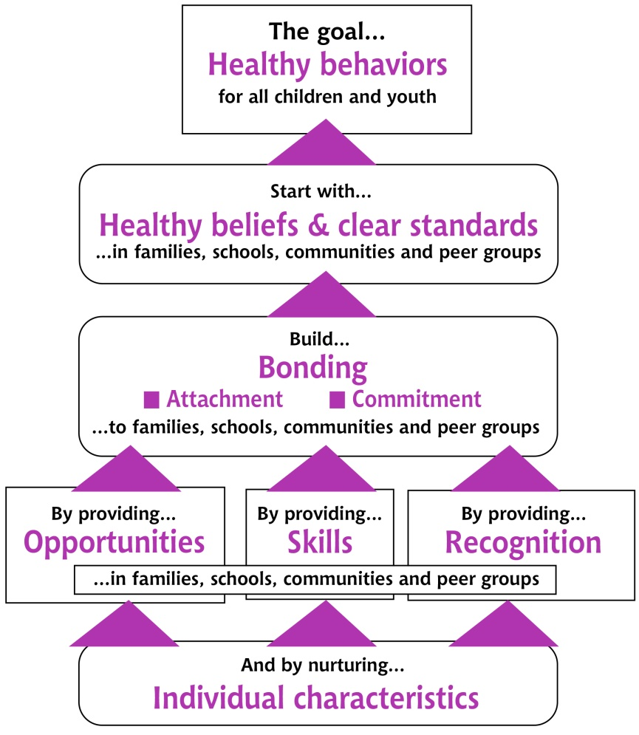
Build resilience through relationships and activities
Graphic from: https://www.channing-bete.com/prevention-programs/risk-protective-factors.html; see also Catalano, Kosterman, & Hawkins, 1996

Slide 46
Useful strategies
Maintain usual routines, consistency, predictability
Give choices
Increase support and encouragement
Start with strengths. Create a victory. Celebrate it.
Assign one or more point people
Set clear, firm limits, and use logical (not punitive) consequences
Recognize that behavior problems may be transient, and may be driven by trauma-related reactions
NCTSN, Suggestions for Educators factsheet

Slide 47
Useful strategies, 2
Safe space to talk
Allow (and encourage) time-outs [Take 5], AND returning to the work
Make accommodations
  Shorten assignments
  Give extra time
  Allow leaving class to see designated adult(s) when overwhelmed (e.g., school nurse, guidance counselor)
  Increase support for organizing and remembering assignments
NCTSN, Suggestions for Educators factsheet

Slide 48
Help youth manage posttraumatic reactions
Triggers |  | Signs of Distress | Coping Skills | Staff Response
“When people blame me for something I did not do.” “Disrespect.” “When someone bullies someone else” “People touching me” “When people are loud for no reason” “Screaming” “Gang talk” Anniversaries Men/women | Mild/Moderate | Making demands. Cursing, singing inappropriate songs. Making threats. Pacing. “Ball my fists”, “crack my knuckles” “I become very loud” “I get quiet” Rocking Crying | “Walking into the bathroom and putting water on my face” “Deep breathing” “Smiling” “Remind myself of my goals” “Make jokes with staff” “Talking to staff that I feel comfortable and connected with” “Playing card games” Separate from a triggering situation Prayer Count down from a high number. “Visualize my family” | Use calm voice and nonthreatening body language. Do not use physical touch if that is a trigger. Respect privacy – pull youth aside if possible and limit “audience”. Reduce stimulation (noise, people, activity). Offer (safe/acceptable) options. Offer opportunities to use coping skills Allow opportunity to explain himself prior to counseling.
 | Severe | Verbal aggression. Physical aggression. | Ask for space. Go to a different area. | Respect youth’s personal space. Take steps to ensure safety.
Self-reports she is “creative, smart, helpful, talkative and a leader” Enjoys being active, has a passion for basketball. Spirituality, God, gospel music and church are very important to her. Staff described her as receptive, redirectable, caring, helpful and kind-hearted when she wants to be. Engaged with mental health services. Would like to go to college and become a doctor.

Slide 49

www.nctsn.org/resources
michael.surko@acs.nyc.gov

Slide 50

A Trauma Informed Program:
Sacramento Regional Conservation Corps
David P. De Mers
Executive Director
Sacramento Regional Conservation Corps

Slide 51
How do we see our youth?
Different
Wrong
Damaged
Costly
Fix
Same
Right
Amazing
Valuable
Serve
OR
Notes:
I’ll admit that, when a youth is blowing up right in front of me, it has been difficult to see how amazing they are, but….
It’s destructive to see anything but the amazing person that you know them to be, or believe them to be.

Slide 52
Start Point
Assumptions
  Same
  Right
  Amazing
  Valuable
  Serve
Notes:
Our youth want the same things we all want. They want success. They want to be able to provide for the people they’re responsible to. They want to have a family, have children, they want their children to be successful, they want a house, and a car that they can afford to pay for. They want to retire and not have to worry about working forever.
-There is nothing “wrong” with our youth. The youth that come to the SRCC exhibit all of the necessary behaviors that are critical for success in the neighborhoods, homes, and environments that they grew up in.
Our youth are amazing, resilient, and successful at what they currently do. They are coming to us to learn how to be successful at something that is, in most cases, entirely new to them.
It takes more time to get to know our youth, (they don’t give respect or trust easily) but it is worth it in the end. Keep in mind that these youth have gone to the school of hard knocks and didn’t do so well, but they haven’t given up.
We are here to serve the youth, not to fix them. If we look at the youth as broken, then we will immediately want to fix them. A youth doesn’t see him or herself as broken, they see themselves as simply needing some assistance, some guidance. If we simply serve them, they’re able to receive.

Slide 53
Fundamentals
We begin with an unconditional acceptance of the youth with an awareness of our own programmatic limitations.
Develop complementary program support from community organizations that specialize in the areas where we’re limited.
      i.e. mental health, housing, child care, food, education, etc.
Plan for, and train staff on trauma informed responses to behaviors we regularly see.
Focus on building relationships with the youth.

Slide 54
Our Process
Time-In
Restorative Consequences
It’s not personal
Train and Try
Who’s catching?
Patience………..
Notes:
-Program policies are designed to keep youth engaged rather than requiring disengagement.
(Time in vs. Time out)
Whenever possible, we’d like to find a way to keep a youth engaged, or expedite their return through a transparent pathway to re-engagement in the program.
-Consequences for unacceptable behavior are restorative rather than punitive.
Consequences are the real-life results of inappropriate behavior. If these don’t exist in your program, you’ll struggle to keep youth engaged. Consequences that are punitive tend to strip the youth of the respect and pride that many need in order to carry themselves around other youth. Consequences that are restorative are designed to help the youth retain their respect while also defining a process of recovery. Punitive consequences also tend to lead to more separation from programs as the consequences for subsequent behavior escalates. Restorative consequences tent to lead to more engagement, while the process may be more laborious as subsequent behavior continues, the youth still know they’re wanted by the organization and are clear on the path to full engagement.
-Youth behavior must be addressed, but cannot be taken personally by staff. The biggest mistakes we make are when we get emotionally checked-in to a situation. It’s ok to be emotionally connected to a youth, but we cannot add our emotions to an already delicate situation.
-Training and hands on practice are critical to staff development.
The best way to learn is to do… Failure is ok. It’s often a quicker path to success than any other.
The key is to fail with humility and acknowledge how we may have let a youth down through our mistake.
-There must be a “catcher” available for youth who need to step away from a situation. Similar to customer service organizations who have a Manager on Duty, you’ll need to define who is going to be available to “catch” the participant(s) that need a break from what is happening right now.

Slide 55
Patience
Define your principles
Coach and reinforce them daily
Actively engage with disagreement
Prepare for the rough patches
Celebrate the small wins
“It’s always darkest before the dawn.”
Know that it works…it really does.
Notes:
-Patience………..
In all honesty, there are times along the path that felt like we were heading to anarchy. Staff felt unappreciated because they couldn’t bring the hammer down on some youth. Youth tested, and still test, every policy and every staff. However, the culture changed, and it will for you. Soon it will be youth focused. Next it will be youth driven. Next, youth in your community will be flocking to you, because you listen, and hear their needs. Your outcomes will improve, and, I’ve heard rumors that your funding will grow as well.

Slide 56
Kids don’t care what you know until they know that you care…
…and they’ll let you know
when you care.
56

Slide 57
David P. De Mers
      ddemers@SACCORPS.ORG

Slide 59
Resources
Interagency Working Group on Youth Programs
youth.gov Trauma-Informed Approaches webpage features a webinar and brief on implementing a trauma-informed approach for youth across service sectors. The webinar and brief discuss the concept and prevalence of trauma; techniques for coping with and recovering from trauma at an individual and systems level; the core principles for building a framework for understanding trauma; and implementation of elements essential for a trauma-informed system as presented by the featured experts. Visit the webpage.
Youth Engaged for Change (YE4C) YE4C’s Current Events webpage gives priority focus to the best federal resources for youth that are timely and responsive to the issues that are top-of-mind to youth today. The current focus is on what to do in an active shooter event, coping with community tragedies, building resilience, dealing with trauma, and finding mental health resources. Visit the webpage.
Prevention News Digest February 21, 2018

Slide 60
Resources
U.S. Department of Education
National Center on Safe Supportive Learning Environments (NCSSLE)
NCSSLE’s Resilience Resources webpage provides two resources on resilience. Bolstering Resilience in Students: Teachers as Protective Factors provides an overview of research on student resilience, particularly teachers' role in creating an environment where students can develop the ability to overcome challenges, and reviews key protective factors and seven strategies teachers can employ in creating environments that foster resilience in students. Adolescent Health Highlight — Positive Mental Health: Resilience presents key research findings on characteristics that are associated with resilience, describes program strategies that promote resilience, discusses links between resilience and avoidance of risk-taking behaviors, and provides helpful resources on resilience. Visit the webpage.
Readiness and Emergency Management for Schools (REMS) TA Center
REMS TA Center’s Adversarial- and Human-Caused Threats webpage offers a variety of federal agency partner resources related to planning for adversarial- and human-caused threats that may affect school districts, schools, institutions of higher education, community partners, and parents. Visit the webpage.

Slide 61
Resources
U.S. Department of Education
National Center on Safe Supportive Learning Environments (NCSSLE) Resilience Resources webpage provides two resources on resilience. Bolstering Resilience in Students: Teachers as Protective Factors provides an overview of research on student resilience, particularly teachers' role in creating an environment where students can develop the ability to overcome challenges, and reviews key protective factors and seven strategies teachers can employ in creating environments that foster resilience in students. Adolescent Health Highlight — Positive Mental Health: Resilience presents key research findings on characteristics that are associated with resilience, describes program strategies that promote resilience, discusses links between resilience and avoidance of risk-taking behaviors, and provides helpful resources on resilience. Visit the webpage.

Slide 62
Resources
U.S. Department of Health and Human Services
National Child Traumatic Stress Network Responding to a School Crisis webpage provides resources for parents and caregivers, youth, and schools, including individualized guidelines for key school personnel to respond to school crises. The page also provides access to psychological first aid for schools and the 3r's of school crises and disaster. Visit the webpage.
National Child Traumatic Stress Network Responding to a School Crisis webpage provides resources for parents and caregivers, youth, and schools, including individualized guidelines for key school personnel to respond to school crises. The page also provides access to psychological first aid for schools and the 3r's of school crises and disaster. Visit the webpage.

Slide 63
National Children’s Mental Health Awareness Day 2018: An integrated health approach to supporting children, youth, and young adults who have experienced trauma
    Thursday, May 10, at 7 p.m. EDT
    https://www.samhsa.gov/children
Our Journey Together: Building and Strengthening Partnerships to Best Serve Youth in Foster Care
    May 22, 2018

Slide 64
Division of Youth Services
      Youth.services@dol.gov

