Slide 1
Integrating WIOA Partners Into Your Comprehensive American Job Center
March 28, 2018
WIOA Wednesday
March 28, 2018, 2:00 – 3:30 pm

Slide 3
Robert Kight, Division Chief
Adult Services and Workforce Systems,
Employment and Training Administration
U.S. Department of Labor
Lekesha Campbell, Management and Program Analyst
Division of Adult Education and Literacy
Office of Career, Technical, and Adult Education
U.S. Department of Education

Slide 4
Integrating WIOA Partners into Your Comprehensive American Job Center
The Workforce Innovation and Opportunity Act of 2014 places a strong emphasis on integrated service delivery.
Implementation of WIOA recognizes the value of an integrated workforce delivery system, and reinforces the partnerships and strategies necessary for success.
Through the American Job Centers, job seekers and workers receive the high-quality career services, education and training, and the supportive services they need to obtain good jobs and stay employed; businesses find skilled workers and access other supports, including education and training for their current workforce.

Slide 5
How integrated is your comprehensive AJC? Poll #1
All of our core programs physically are co-located in the comprehensive AJC.
Most of the core programs are physically co-located in the comprehensive AJC, and we are working to obtain the others.
Only the title I and title III programs are physically co-located in the comprehensive AJC.
None of the above (type in the chat).
Notes:
Question 1:
How integrated is your comprehensive AJC?
All of our core programs physically are co-located in the comprehensive AJC.
Most of the core programs are physically co-located in the comprehensive AJC, and we are working to obtain the others.
Only the title I and title III programs are physically co-located in the comprehensive AJC.
None of the above (type in the chat).

Slide 6
How integrated is your comprehensive AJC? Poll #2
All of the required One-Stop partners provide access to their programs through the comprehensive AJC.
Most of the required One-Stop partners provide access to their programs through the comprehensive AJC, and we are working to obtain the others.
We are still struggling with partner integration.

Slide 7
How integrated is your comprehensive AJC? Poll #3
We have a signed Memorandum of Understanding (MOU) and Infrastructure Funding Agreement (IFA) in place that reflects all of the partners.
We have a signed MOU and IFA in place that reflects most of the partners, and we are working to obtain the others.
Neither of the above.

Slide 8
Meet members of three local areas who have successfully integrated their comprehensive AJCs.
Hear some of the challenges faced and strategies implemented to establish the integrated service delivery system envisioned by WIOA.
Gain practical integration insights from your peers regarding:
Facility Selection
MOUs and IFAs
Staffing
Customer Centered Design
Common Identifier

Slide 9
Featured American Job Centers
American Job Center – Clarksville, TN
North Shore Career Center of Salem – Salem, MA
North Charleston Center – Charleston, SC

Slide 10
American Job Center – Clarksville, TN
John Watz, Director, North TN Workforce Board (Team lead)
John Alexander, Regional Director, AREA 8+9, Tennessee Department of Labor and Workforce Development
Marla Rye, President Workforce Essentials, Career Services provider LWDA 8
Freda Herndon, One Stop Operator, LWDA 8
Natalie McLimore, Vice President for Family Services (TANF AJC partner)

Slide 11
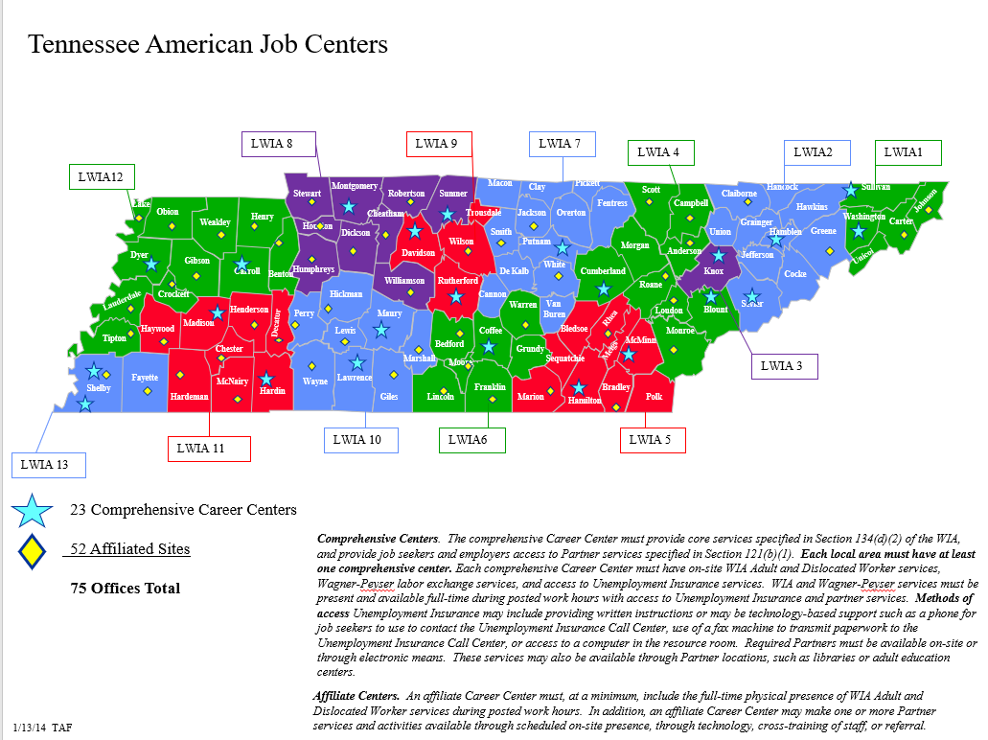

Slide 12
Programs Housed in the American Job Center (Tennessee)
RESEA (Re-employment Services and Eligibility Assessment) | Ticket To Work/Employment Network
SNAP (Supplemental Nutrition Assistance Program) | Ft. Campbell Soldier Transition Program
Families First | Job Corps
TN Vocational Rehabilitation Title IV | Dislocated Worker/Adult/Youth Title I
NCOA (National Counsel on Aging) | Youth CAN
Veteran Representatives (LVER DVOP) | SCEP (Senior Community Service Employment Program)
Title III Wagner Peyser | Title II Adult Ed

Slide 13
TN process started in WIA, 2000 small victories
Continue to change – OSO Dashboard 8 months old, 6th iteration
MOU and IFA – take in phases
AJC – If this is where the jobs are, all partners in some fashion focus on jobs. Therefore, all partners mission is work.

Slide 14
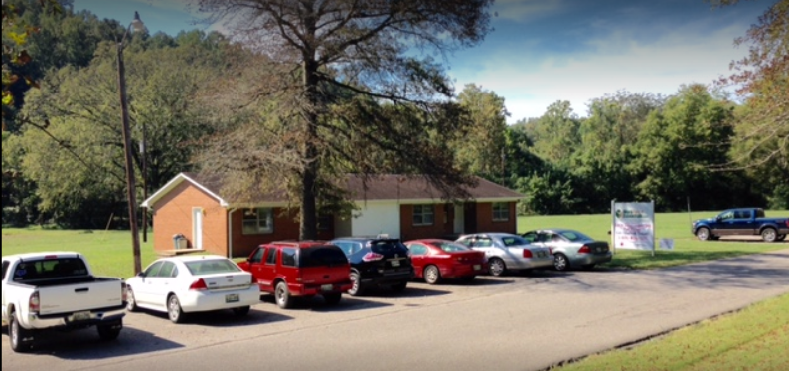
Montgomery County, Dickson and Houston American Job Centers

Slide 15
SC Works Charleston Center– Charleston, SC
Sharon Goss, Workforce Development Director (Team Lead)
Kameron Alston, Performance Outcomes Coordinator, BCDCOG/SC Works Trident
Wendy Courson, Regional Manager, SC Department of Employment and Workforce
Keidrian Kunkel, Regional Manager, Eckerd Connects
Amanda Wagner, Operations Director, Eckerd Connects
Deidre Smalls, One-Stop Manager, Eckerd Connects
Kelly Sieling, VR Supervisor, SC Vocational Rehabilitation Department
Susan Friedrich, Director, Charleston Adult Education

Slide 16
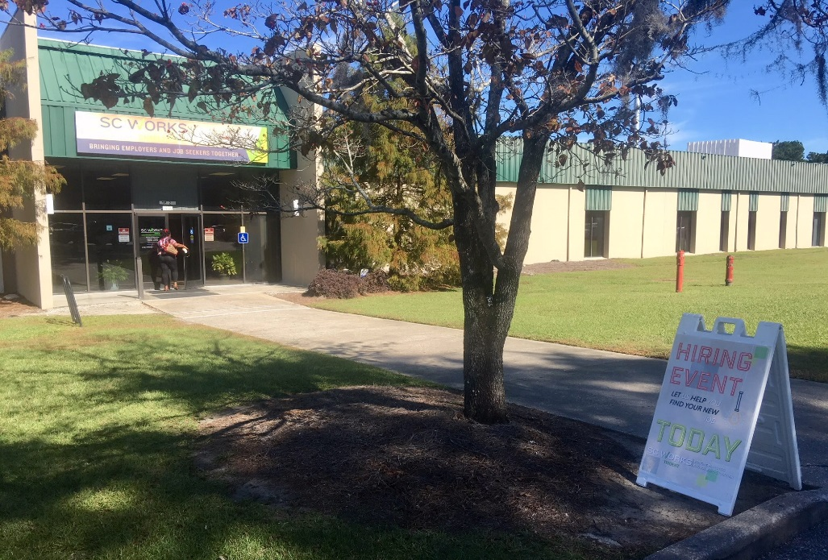
“We have all worked closely together and I believe that frequent communication and being willing to share resources to benefit our clients is probably key. I think our partners are all working together utilizing Stephen Covey’s “Begin with the End in Mind” with the “end” being the success of our clients.”
Kelly Sieling, VR Supervisor

Slide 17
Partner Programs Housed in the SC Works Charleston
Comprehensive Center
SCDEW (UI, TAA, WP, MSFW, VET)
WIOA
Military Community Connections
Charleston Adult Education
Job Corps
SC Department of Social Services Employment and Training Program
Telamon
Trident Technical College
CARTA
Vocational Rehabilitation
SC Commission for the Blind

Slide 18
North Shore Career Center – Salem, MA
Mark Whitmore, Executive Director, North Shore Career Center (Team Lead)
Mary Sarris, Executive Director, North Shore Workforce Board
Paul Ventresca, Operations Manager, Division of Career Services (AJC Partner)

Slide 19
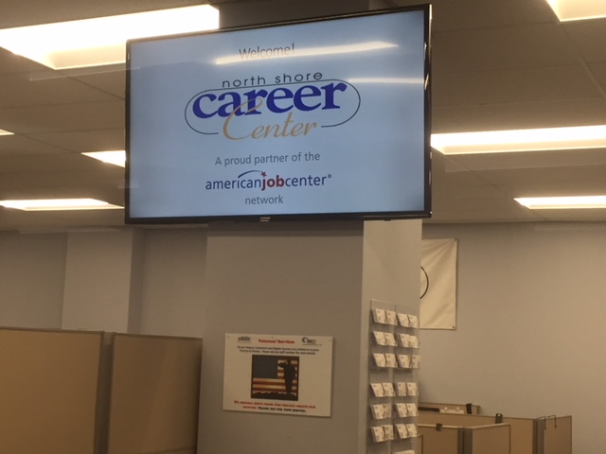
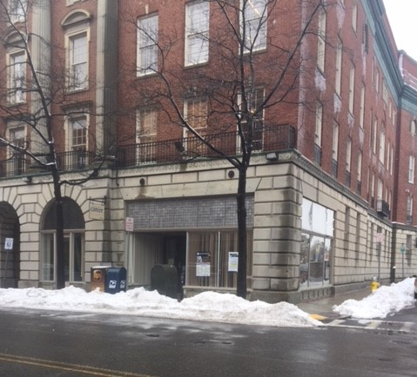
North Shore American Job Centers

Slide 20
North Shore Partner Organizations:
North Shore Workforce Investment Board
North Shore Career Center
Division of Career Services
North Shore Community College
Department of Transitional Assistance
Massachusetts Rehabilitation Commission
Massachusetts Commission for the Blind
North Shore Community Action Program
Operation ABLE
Department of Unemployment Assistance
Training Resources of America
Pathways Inc.

Slide 21
Becoming a Customer-Centered American Job Center
Collaborative planning and “Customer-Centered Design” as critical tools
Shared vision of what the local American Job Center should provide
Understanding of services offered by partner organizations
Learning to trust that partners will care for “my clientele”
Placing the customer’s needs the in the center of any system building discussion is critical to success.

Slide 22
Facilitated Discussion Five Topical Areas
Facility Selection
MOUs/IFAs
Staffing Design
Customer Centered Design
Common Identifier

Slide 23
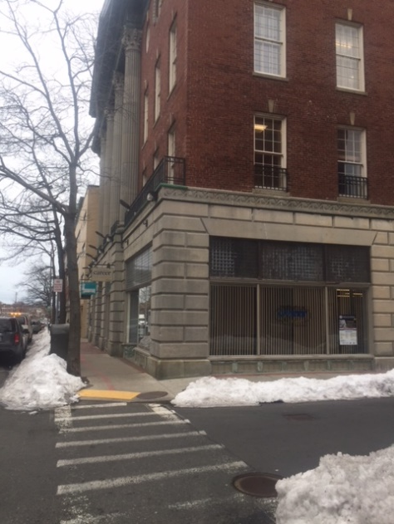
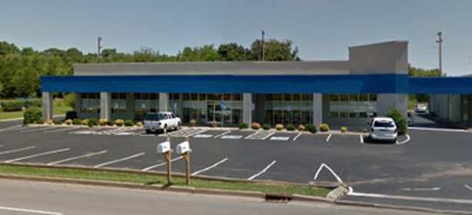
Facility Selection
Add MA picture
Notes:
How did you decide which location would house the comprehensive AJC?
Describe the process of co-locating the partners into the comprehensive center.
What challenges did you face in bringing all of the core partners into the same facility? How did you resolve?

Slide 24
MOUs/IFAs
Notes:
How did you come to agreement during the MOU and IFA process?
Describe how you determined who would pay for training? Supportive services?
What tips might you have for those who do not already have strong relationships in place?

Slide 25
MOU/RSA Process
Partner Programs Housed in the SC Works Charleston
Comprehensive Center
SCDEW (UI, TAA, WP, MSFW, VET)
WIOA
Military Community Connections
Charleston Adult Education
Job Corps
SC Department of Social Services Employment and Training Program
Telamon
Trident Technical College
CARTA
Vocational Rehabilitation
SC Commission for the Blind
Important Points Cont.
Guidance and support from our state workforce agency helped shape the MOU/RSA process.
The One Stop Manager communicates with partners within the system via email and through in-person meetings to communicate the vision for the center and to discuss available space and associated costs.

Slide 26
MOU, IFA - Tennessee
Started March 2017
Distribute shell to partners
Begin Partner input
Assign Sections
Phase 1 – Coordination, collaboration, share the toys, get a number, Resource table, referral
Phase 2 – How to pay, Who Pays, Shared costs, FTE vs Sq. Ft. vs # of customers
OSO Champion of Process - finalize

Slide 27
North Shore: MOU as a Team Building Opportunity
Initial one-on-one brainstorming sessions without any formalized agreement in mind
Coming together as a group – blending new and existing partners
Exploring services – ensuring leadership understands what partners actually do!
Building consensus on partner workforce development needs and concerns
Set priorities for the AJC and finalize MOU
The AJC is “YOUR career resource”
Notes:
One area that comes to mind that we can profile this developmental focus is in the focus that we took with our MOU development process. We looked at this as a team-building process first and a way to get to a workable agreement as the bonus. I would like to propose that our WIB Director offer some aspects of how we used this opportunity to bring new and existing partners into the developmental process and built consensus among the group related to set priorities for the implementation of our AJC sites.

Slide 28
Staffing Design
Notes:
How are your staff working together? Are you functionally aligned?
Do you provide cross-training to the staff? How?

Slide 30
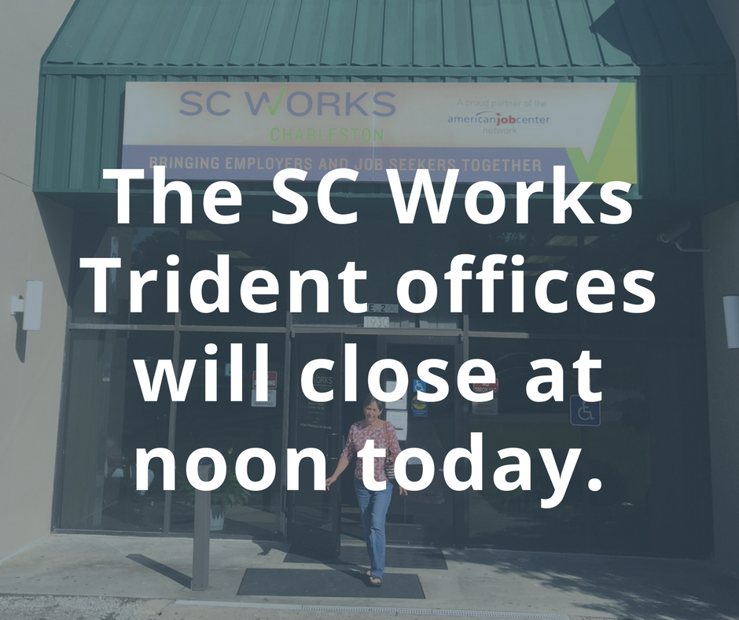
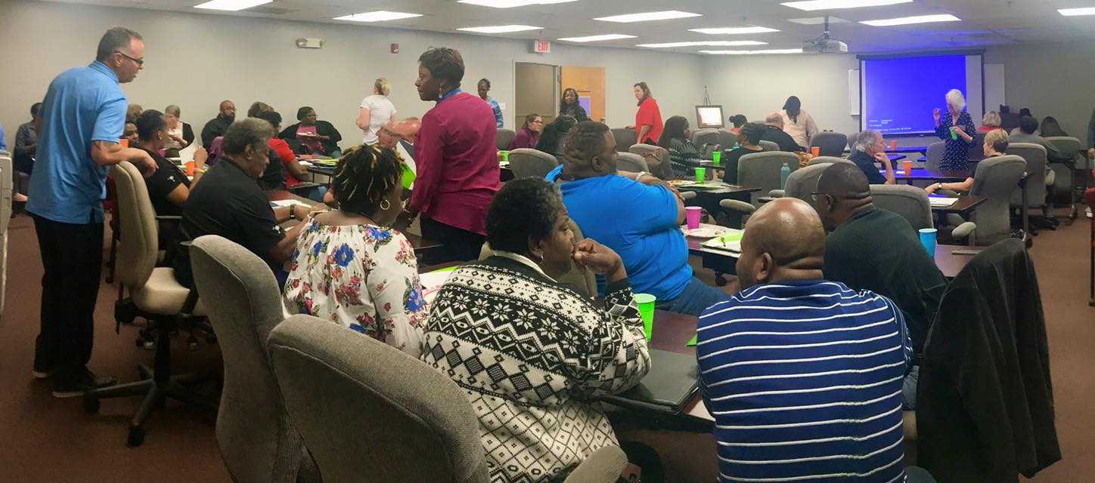
Internal System-Wide Communication
Important Points
It takes partners working together to benefit the public workforce system by educating each other on programs, services and resources available
Integrated Business Service Team developed the Business Service Strategy for the region which promotes communication across agencies to eliminate the duplication of efforts when communicating with employer partners

Slide 31
Customer Centered Strategies
A collaborative, discovery-based journey.
Get inspired by the people you’re serving.
Start by listening to people to get new ideas about how to design for them.
Identify patterns and surprising insights to inspire new opportunities for design.
Brainstorm new ways to serve your customers.
Try out your ideas and get feedback from customers – so you can revise your prototypes and get more feedback.
Try out a pilot program and experiment with ways to implement your new ideas.
Notes:
Do you have an integrated business services strategy? Describe it.
How does a customer flow seamlessly through your system? Do you use an integrated case management system?
What strategies or initiatives have you implemented to better meet the needs of your rural customers?
Robert and Lekesha – I would let MA take the lead on this one. Not all 3 have to answer every question…
May want to ask TN to address their services to rural customers.

Slide 32
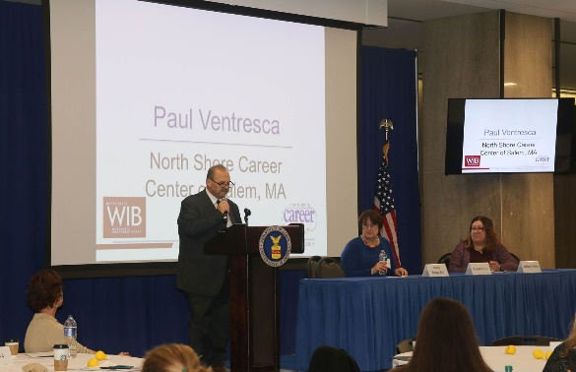
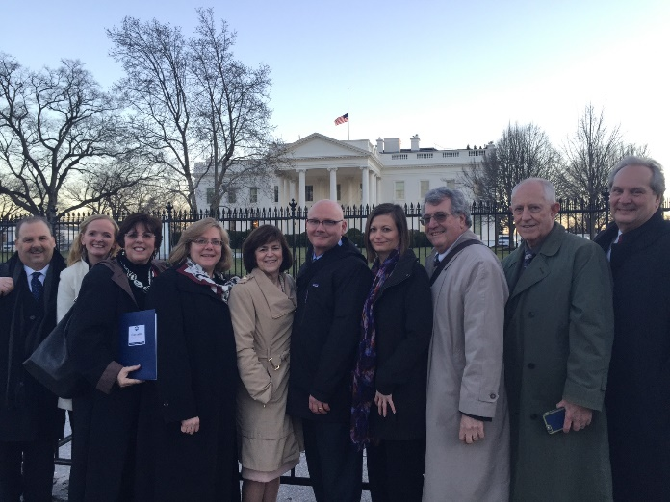
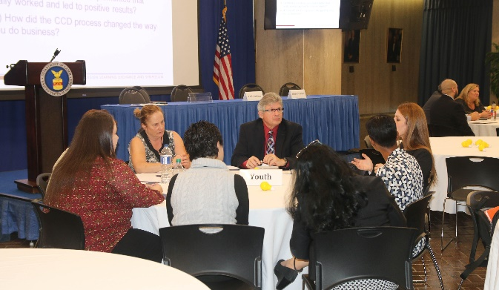
Becoming a Customer-Centered American Job Center - Massachusetts
Introduced to the concept of Customer Centered Design in 2015
Creation of on-going initiatives to enhance shared customer experience at AJC,
Incorporation of partner voice into AJC operation,
Commitment to ensuring that system change starts with customer need.

Slide 33
Becoming a Customer-Centered American Job Center - MA
AJC reception area re-design project
Reduce customer congestion and confusion at reception area,
Incorporation of a “greeter” to replace “front desk”
Improve shared customer first impression and experience,
Touch screen entry with current adaptive technology enhancements,
Smooth transition into AJC services and programs.
“If you can’t point to the outcomes of your work, it’s a waste of the American people’s time and your talent.”
~Jake Brewer

Slide 34
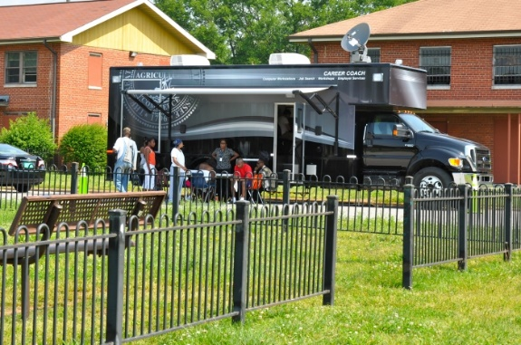
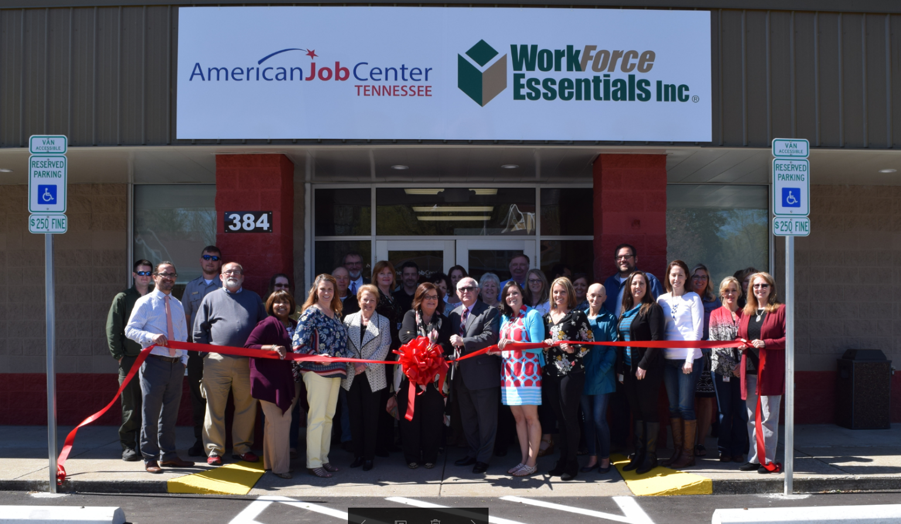
Service to Rural Areas
Physical presence –Affiliate Offices
Title I, Title II, TANF
Mobile Career Coach
Site for other Partners to meet with clients on scheduled basis
Referral to Comprehensive Center, if needed
Board focus on rural development-IWT, OJT, Enrollments
Partner with other agencies to reduce overhead

Slide 35
Common Identifier
https://ion.cms.workforcegps.org/resources/2016/09/30/12/11/AJC-Common-Identifier-and-Branding
Notes:
How is the American Job Center brand represented in your AJC network?
Would let TN take the lead on this one!

Slide 36
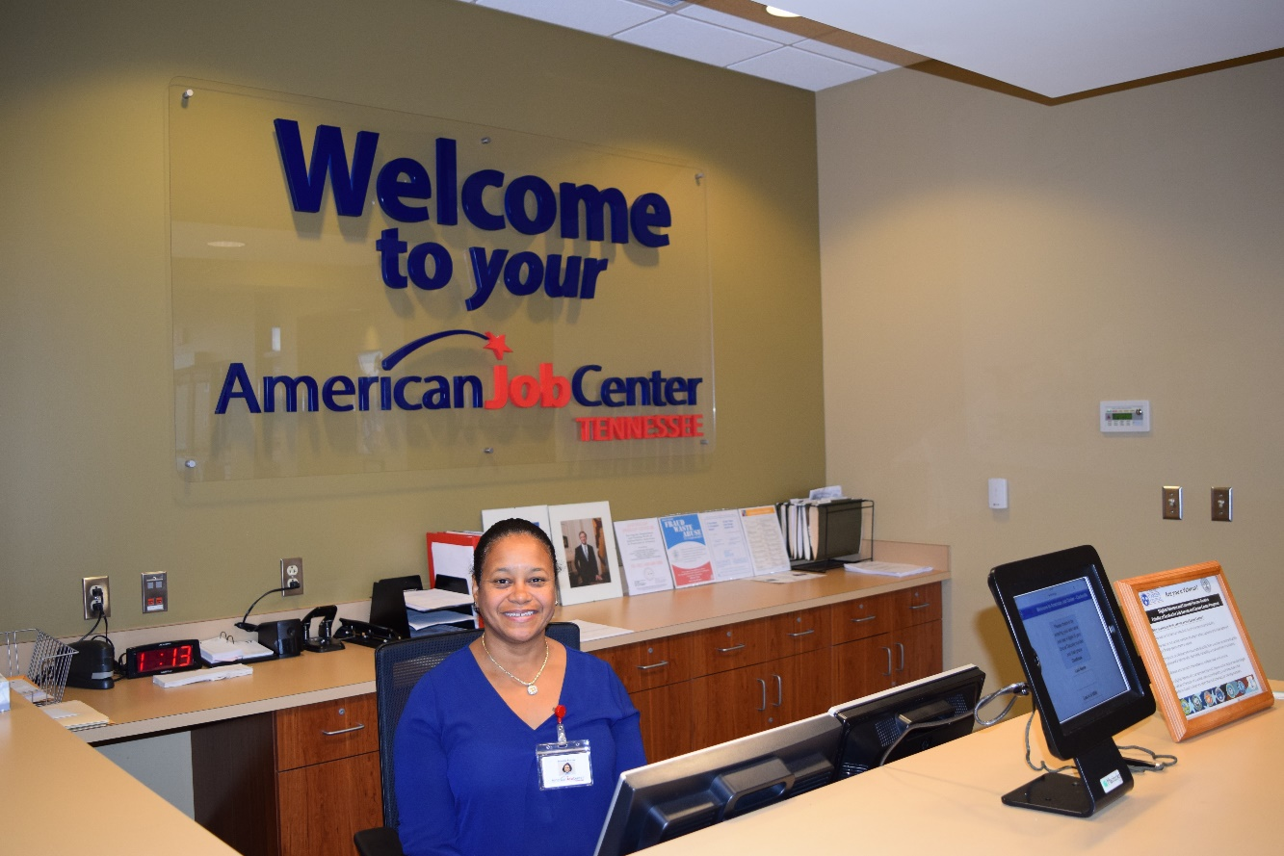
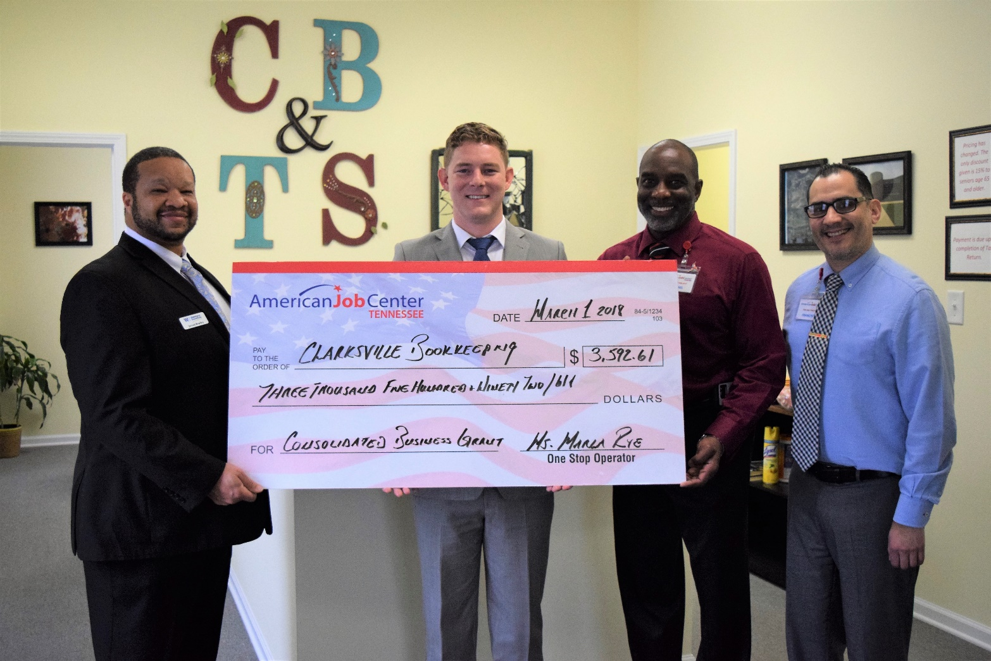
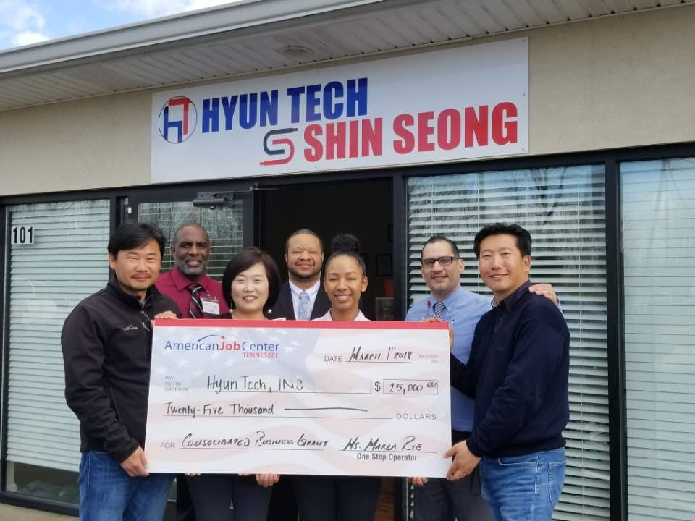
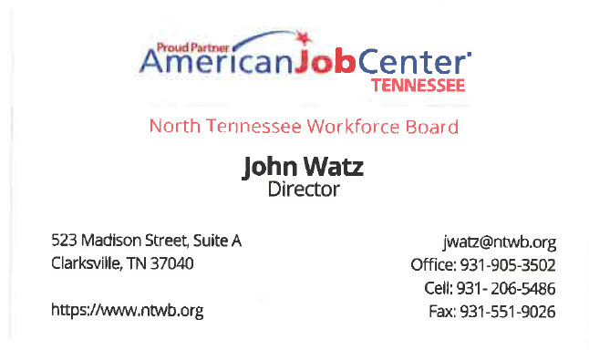

Slide 37
External Communication & Marketing Plan
Important Points Cont.
Social Media and Marketing team promote individual agencies to increase visibility of the variety of services and programs available within the system.
#iWork series promotes individual participant success across agencies to encourage job seekers and employers to engage with the system.

Slide 39
Wrap Up
Notes:
Final comments from presenters.
Final comments from moderator(s).

Slide 40
Take-Aways
You must have a champion, Title I or III.
Get a 70% solution and ‘Go.’ Paralysis by Analysis.
Partners must play together and share their toys.
Local Leaders need support from State and Regional Leaders.
Certain Partners have certain rules you can’t get around. Accept it.
If you build it, they WILL come.

Slide 41
SC Last Thoughts
Customer Centered Design: Begin with the end in mind! Stay focused on what you want to accomplish and always keep the customer experience in mind.
Lead by example and be flexible. Transform the center to increase accessibility and flow for customers. Partners and staff react to change differently and may become territorial and/or resist. Communicate frequently and help everyone understand the larger vision. Change is healthy!
Support and guidance from the State and Local levels are a must.

Slide 42
MA – Last thoughts
Importance of existing relationships
Engaging active participation of both new and existing partners
Share what we each do – pathway to shared customer services
Find early opportunities for collaboration “wins”

Slide 43
Sample MOU and Infrastructure Costs Toolkit
A reference guide when developing your own MOU, including your one-stop operating budget, Infrastructure Funding Agreement (IFA), and cost allocation methodologies.
https://ion.workforcegps.org/resources/2017/03/23/13/30/Sample_MOU_Infrastructure_Costs_Toolkit
AJC Customer Flow Scenarios
This booklet features five illustrated stories representing customer experiences, and the guidance an AJC staff member might provide.
https://ion.workforcegps.org/resources/2017/07/19/10/02/AJC_Customer_Flow_Scenarios
Benefits of Participating in an Integrated American Job Center Network
WIOA Desk Reference – Offers many advantages inherent in partnering in an integrated one-stop delivery system.
https://ion.workforcegps.org/resources/2017/10/02/11/34/Integrated-American-Job-Center-Network
Supportive Services Desk Reference
WIOA Desk Reference – Provides an overview of the different types Supportive Services available for adults, dislocated workers, and youth participants
https://ion.workforcegps.org/resources/2017/07/14/09/22/Supportive_Services_Desk_Reference
Job Search Assistance and Career Readiness
Offers job readiness and career preparation services.
https://ion.workforcegps.org/resources/2015/09/18/20/34/Job_Search_Assistance_and_Career_Readiness

Slide 44
John Watz
Director
North Tennessee WorkForce Board
jwatz@ntwb.org
931-905-3502
Sharon Goss
Workforce Development Director
North Charleston Center
BCD Council of Governments
sharong@bcdcog.com
843-529-0305
Mark Whitmore
Executive Director
North Shore Career Center
mwhitmore@nscareers.org
978-825-7231

