Slide 1
Checking In!
Let’s get to know who is on the call today. Using the poll, select your H-1B Grant Program
Choose the answer that best reflects you (or your group):
H-1B America’s Promise (AP) Grant
H-1B Strengthening Working Families Initiative (SWFI) Grant
H-1B TechHire Partnership (TechHire) Grant
I’m not sure!

Slide 2
Checking In!
Let’s get to know who is on the call today. Using the poll, select the role that you play in your H-1B grant program. Choose the answer that best reflects you (or your group):
For this grant initiative I am the:
Authorized Representative
Program Director/Manager
IT/Data Manager or staff
Training Partner
Employer Partner
Other

Slide 3
H-1B Performance Reporting Webinar 2.0: WIPS Implementation
January 11, 2018
H-1B TechHire Partnership
Strengthening Working Families Initiative
America’s Promise Grantees
3

Slide 4
MODERATOR
Megan Baird, Program Manager, H-1B Grants
Employment and Training Administration
US Department of Labor
PRESENTERS
Ayreen Cadwallader, Workforce Analyst
Employment and Training Administration
Timmy Dudley, Workforce Analyst
ICF International
Denise Dunlap, Senior Business Analyst
Appteon, Inc.
Katie Neupane, Grants Management Specialist
Employment and Training Administration
Gregory Scheib, Workforce Analyst
Employment and Training Administration

Slide 5
OBJECTIVES
Review WIPS performance reporting requirements for the quarter ending December 31, 2017
Review H-1B PIRL data elements and data file structure
Review Data Validation Rules and learn how to resolve common data file errors
Preview H-1B QPR Aggregation Rules
Learn how to access WIPS and upload data files
Discuss next steps and action items for January – March 2018
Provide an opportunity to ask performance questions

Slide 6
What are you most excited about learning today?
Submitting your participant data for the quarter ending December 31, 2017
Learning how to how to access WIPS, upload data files, and resolve data file errors
Previewing the aggregation rules for the H-1B Quarterly Performance Report (QPR) form
Next steps and action items for January – March

Slide 7
H-1B Performance Reporting Guidance
Performance Reporting Guidance for Quarter Ending December 31, 2017
Coming Soon! DOL Performance TEGL

Slide 8
Performance Reporting Guidance for December 31, 2017
Reporting Deadline February 14, 2018
WIPS will be available end of January 2018
Access issued to H-1B Authorized Representatives
Upload a CSV data file
Resolve data file errors
Generate a QPR form
Submit Quarterly Narrative Report via email
Data File
QPR
WIPS
QNR
Grantees who are not yet serving participants do not upload a data file.
Please note in your QNR that you do not have participant level data to submit.
HOT TIP!

Slide 9
Performance Policy Guidance
Coming Soon!
Performance Training and Employment Guidance Letter (TEGL)
Describes performance reporting policies for H-1B authorized programs
Provides an overview of unique H-1B grant terms, definitions, and procedures
Defines WIOA primary indicators of performance
Offers guidelines for collecting Social Security Numbers

Slide 10
POLL: Which of these Performance TA resources has the been most useful to you?
Revised! H-1B Performance Reporting Handbook & WIPS Reporting Guidance
New! Performance Reporting Toolkit
New! H-1B Performance Reporting Pre-Recorded Tutorial: Preparing Data Files for WIPS
New! Summary of H-1B PIRL Data Elements for 2017 through 2018 with Data File Structure
Need a Refresher? H-1B Performance Reporting Orientation Webinar
https://h1bskillstraining.workforcegps.org/resources/2017/06/08/12/17/H-1B_Performance_Reporting_Resources

Slide 11
H-1B PIRL Data Elements
Reporting Participants in your Data File Using H-1B PIRL Data Elements
Amended ETA-9172 DOL PIRL

Slide 12
ETA-9172 DOL PIRL for H-1B Grants
Implementation Overview
WIOA PIRL OMB-Approved 2016
- 109 PIRL data elements selected for H-1B grants for data collection.
- Grantees did not submit participant level data in WIPS in 2016.
2017 WIPS Phase 2
WIOA PIRL OMB-Approved 2016
- 84 PIRL data elements selected for H-1B grants for data collection.
- Grantees will submit data file with 84 PIRL data elements in WIPS starting with Quarter ending December 31, 2017.
Fall 2018 WIPS Phase 3
WIOA PIRL OMB-Approved 2017
- 86 PIRL data elements selected for H-1B grants for data collection.
- Grantees will submit data file with 86 PIRL data elements in WIPS starting Fall 2018.
2016 WIPS Phase 1
See the Summary of H-1B PIRL Data Elements for 2017 through 2018 with Data File Structure for a complete list of the data elements required in each development phase.

Slide 13
ETA-9172 DOL PIRL for H-1B Grants
WIPS Snapshot CSV Data File
00000000000001 | GA | 19981106 | 1 | 1 | 1 | 0 | 0 | 1 | 0 | 0 | 1
00000000000002 | GA | 19960420 | 2 | 0 | 0 | 0 | 0 | 0 | 0 | 0 | 0
00000000000003 | GA | 19970730 | 2 | 0 | 9 | 9 | 9 | 9 | 9 | 9 | 0
00000000000004 | GA | 19900603 | 2 | 0 | 0 | 1 | 0 | 0 | 0 | 0 | 0
H-1B grantees will upload a data file that includes 84 PIRL data elements.
The data file includes code values for each PIRL data element that must be entered for each participant served in your program.

Slide 14
Amended ETA-9172: PIRL 1813 and 2126
DOL is currently seeking OMB-approval for the
Amended ETA-9172 DOL PIRL
PIRL DE # | Data Element Name
PIRL 1813 | Date Completed, During Program Participation, an Education or Training Program Leading to a Recognized Postsecondary Credential or Employment (WIOA)
PIRL 2126 | Entered Training-Related Employment
Grantees are responsible for:
Collecting PIRL 1813 and 2126 when the Amended ETA-9172 is approved
Reporting PIRL 1813 and 2126 in Fall 2018
Not required:
Retroactive collection of PIRL 1813 and 2126 for participants exiting the program before the Amended ETA-9172 is approved is NOT required.

Slide 15
For the reporting quarter ending December 31, 2017, grantees are responsible for collecting PIRL 1813 and 2126 for all participants.
PIRL DE # | Data Element Name
PIRL 1813 | Date Completed, During Program Participation, an Education or Training Program Leading to a Recognized Postsecondary Credential or Employment (WIOA)
PIRL 2126 | Entered Training-Related Employment
True
False

Slide 16
Performance Policy FAQs
How do I …
What’s the difference between …
When do I report …

Slide 17
Performance Policy FAQs
How do I find my H-1B Grant Number?
The H-1B grant number is on your grant agreement, which is a 13 or 14-digit number that starts with HG-xxxxx-xx-x-x-xx, which is the code value that you enter in PIRL 938 H-1B Grant
Do not include hyphens!

Slide 18
Performance Policy FAQs
What’s the difference between Program Entry vs. Date Entered Training
PIRL 900 Date of Program Entry (WIOA) defined as date received grant-funded services
PIRL 1302 Date Entered Training #1 (WIOA) defined as the date in which training actually started
When do I report Date of Program Exit (WIOA)
PIRL 901 Date of Program Exit is the date in which the participant received their last grant-funded service
The date is reported in your data file 90 days after the participant received their last grant-funded service

Slide 19
FAQ: Reporting Training Outcomes
How do I report Training Activities?
Dependent on training design
Flexibility to categorize training courses into three activities with unique start date and end date
PIRL 1302
Date Entered Training #1
PIRL 1309
Date Entered Training #2
PIRL 1314
Date Entered Training #3
PIRL 1308
Date Completed or Withdrew form Training #1
PIRL 1313
Date Completed or Withdrew form Training #2
PIRL 1318
Date Completed or Withdrew form Training #3

Slide 20
FAQ: WIOA Training Types vs. H-1B Training Types
How do I report training types and what is the difference between PIRL 1303 and PIRL 2109?
Flexibility to record up to three courses that comprise PIRL 1302 Training Activity #1
Applies to PIRL 1309 and 1314 Training Activity #2 and #3
Acceptable code values:
01 = On the Job Training
02 = Skill Upgrading
05 = Customized Training
06 = Other Occupational Skills Training 09 = Registered Apprenticeship Training
PIRL 1302
Date Entered Training #1
PIRL 1303
Type of Training Service #1 (WIOA)
PIRL 2109
Primary Type
of Training Service
Training Activity #1
PIRL 2110
Secondary Type
of Training Service
Training Activity #1
PIRL 2111
Tertiary Type
of Training Service
Training Activity #1

Slide 21
FAQ: Reporting Credential Outcomes
When do I report Credential Outcomes?
Credential outcomes are reported after training completion using PIRL 1307, 1312 or 1317 (Training Completed #1, #2, or #3.)
Flexibility to report up to three credentials for one training activity
Report code value 0, if no credentials earned
Review TEGL 15-10 for definition of credentials
PIRL 1307
Training Completed #1 = 1 (Yes)
PIRL 1312
Training Completed #2
= 1 (Yes)
PIRL 1317
Training Completed #2
= 1 (Yes)
PIRL1800
Type of Recognized Credential
(WIOA)
Training with a 2nd Credential
PIRL1802
Type of Recognized Credential #2
(WIOA)
Training with a 3rd Credential
PIRL1804
Type of Recognized Credential #3
(WIOA)
Reporting
Credential Attainment
PIRL1801
Date Attained Recognized Credential (WIOA)
PIRL1803
Date Attained Recognized Credential #2
(WIOA)
PIRL1805
Date Attained Recognized Credential #3
(WIOA)

Slide 22
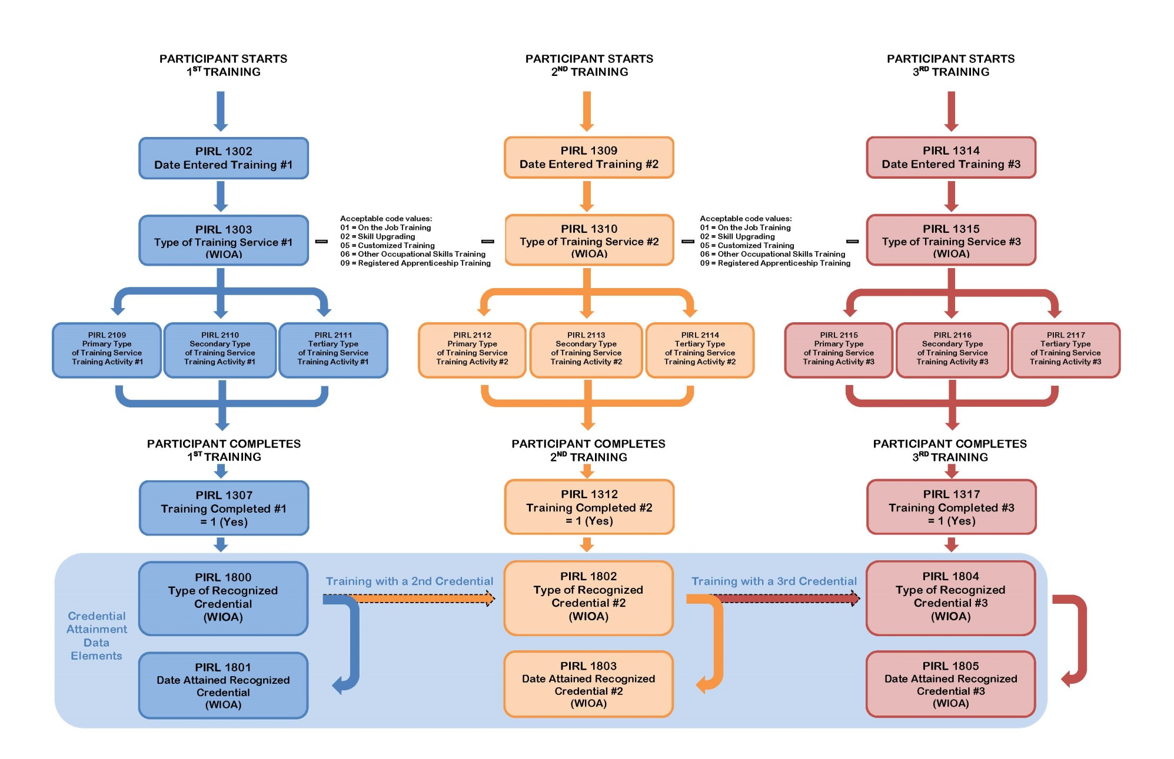
PARTICIPANT TRAINING SERVICES AND TRAINING OUTCOMES

Slide 23
FAQ: Reporting Employment Outcomes
How do I report employment outcomes for Unemployed Individuals
PIRL 2118 Date Entered Employment (Discretionary Grants) applies to participants determined unemployed, long-term unemployed and underemployed at program participation.
Outcomes can be recorded at any time during program participation.
Employment Outcomes for Incumbent Workers
PIRL 2119 Incumbent Workers Retained Current Position
PIRL 2120 Incumbent Workers Advanced to New Employment
Applies to participants determined incumbent workers at program participation that either retained or advanced to a new position in the 1st, 2nd, or 3rd quarter after program completion.

Slide 24
FAQ: Participant Tracking for Performance Reporting
What’s the difference between “follow-up services” and performance tracking?
Post-training follow-up services: Services provided to H-1B participants after training, but before exit from the program
Participant tracking for performance reporting: Grantee activities to track participants in order to report H-1B Real-time performance outcomes

Slide 26
Data Validation and Resolving Data File Errors
Steps for Data Validation & Common Data File Errors

Slide 27
Steps for Data Validation
Step One: Formatting Check Errors
Verify that the format of data file is correct
Appears under format errors hyperlink in WIPS
Step Two: Valid Values Errors
Verify that the code values entered match with the options available
Appears under total errors hyperlink in WIPS

Slide 28
Steps for Data Validation
Step Three: Duplicate Errors
Verifies that duplicative participant records are not in the uploaded file
Appears under duplicate errors hyperlink
Step Four: Logic Rule Errors
Validation check related to the business rules of each code value assigned for all data elements to verify internal logic of participant records
Appears under total errors hyperlink
Steps three and four are run at same time

Slide 29
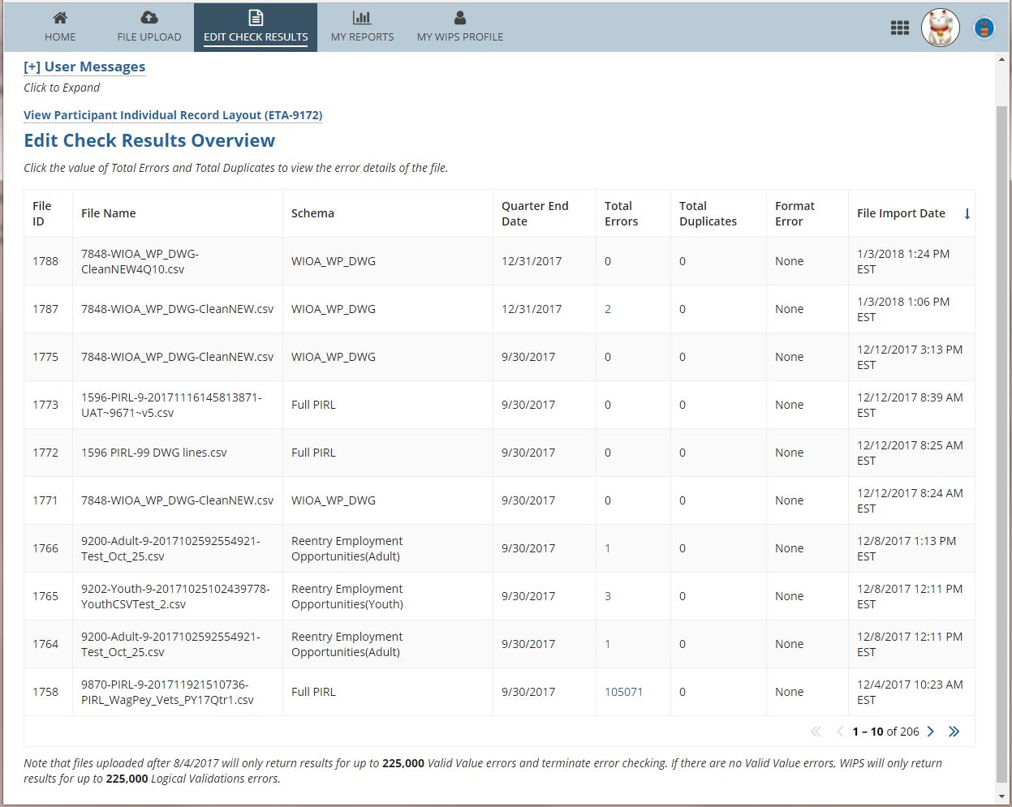

Slide 30
Data Validation Error Report Resolution
Consult error report
Identify error in data file
Verify accurate code value and consult logic rules and valid values
Make corrections to data file
Re-submit data file for the next round of your data validation process

Slide 31
Common Format & Valid Value Errors
Data File Structure
Code values in between commas or a null value
A space in between commas could be an error! A value that contains a space for a null value could be an error!
Do you have headings and data element numbers in your data file?
This will result in a data file error!
PIRL code values that require # digits
Example: PIRL 938 H-1B Grants requires 13 or 14 digits.
Including only 10 digits will result in an error!
Dates in the correct format
Format must be 19771110.
November 10, 1977 or “10111977” will result in an error!

Slide 32
Logic Validation Rule Samples
Logic Validation Rules
Rely on a variety of PIRL data elements to verify your data
PIRL 400 | Reporting Employment Status
IF … | Then …
PIRL 900 (Date of Program Entry) is NOT blank | PIRL 400 must be 0, Unemployed; 1, Employed; 2, Employed but Received Notice of Termination; or 3, Not in labor Force
PIRL 2118 | Reporting Entered Employment
PIRL 2118 (Date Entered Employment) | must be equal to or after PIRL 900 (Date of Program Entry).

Slide 33
Logic Validation Rule Samples
PIRL 2101 Reporting Underemployed Workers
IF … | Then …
PIRL 907 (Recipient of Incumbent Worker Training) is 4, H-1B Funded Grant | PIRL 2101 (Underemployed Worker) must be 0, No.
PIRL 1800 Series | Reporting Credentials
IF … | Then …
PIRL 1800 (Type of Recognized Credential) is 1, 2, 3, 4, 5, 6, or 7, | PIRL 1801 (Date Attained Recognized Credential) must contain a valid date.

Slide 35
Quarterly Performance Report (QPR) Form
How a QPR is Generated in WIPS
QPR Aggregation Rules

Slide 36
H-1B QPR Aggregation Rules
Grantee Database System
CSV Data File Upload in WIPS
QPR Generated
Data File
Data Elements And Edit Checks
Aggregation Rules
Overview of Aggregation Rules
Business rules to aggregate performance data into H-1B Real-time Outcome Measures
Total Participants Served, Began and Completed Training, including types of services, types of training, and credential and employment outcomes
Ensure H-1B aggregation rules are applied to grantee’s internal systems for calculating H-1B Outcome Measures

Slide 37
H-1B QPR Aggregation Rules
Aggregation rules are dependent on:
PIRL 938 H-1B is not null
Date entered is before end of the report period (or current quarter)
Total Participants Served
PIRL 900 Date of Program Entry (WIOA)
Total Participants Unemployed at Program Participation
PIRL 400 Employment Status is 0, Unemployed or 2, Employed, but Received Notice of Termination; and PIRL 900 Date of Program Entry (WIOA)
Total Participants Began Training
PIRL 900 Date of Program Entry and PIRL 1302 Date Entered Training #1
Total Participants Entered Employment
PIRL 2118 Date Entered Employment

Slide 38
H-1B QPR Aggregation Rules
H-1B Outcome Measures on QPR
H-1B “real-time” outcome measures
WIOA performance indicators collected on behalf of grantees by DOL/ETA
COMING Fall 2018!
Program Completion Outcomes
Entered Training Related Outcomes

Slide 39
QPR Form Certification
In WIPS, grantees can:
View the QPR
Download the QPR
Coming Soon! Certify the Data in the QPR
Interim Guidance: QPR Certification Process
Mandatory QPR Comment Section:
This is the official QPR submission for the quarter ending xx/xx/xxxx
HOT TIP!

Slide 41
Refresher: WIOA Primary Indicators of Performance and H-1B Real-Time Performance Outcome Measures
How do these outcome measures appear on my QPR?
What outcome measures are we tracking?!

Slide 42
Refresher: WIOA Indicators of Performance
1. Employment Rate – 2nd Quarter After Exit | Percentage of participants who are in unsubsidized employment during the second quarter after exit from the program.
2. Employment Rate – 4th Quarter After Exit | Percentage of participants who are in unsubsidized employment during the fourth quarter after exit from the program.
3. Median Earnings – 2nd Quarter After Exit | Median earnings of participants who are in unsubsidized employment during the second quarter after exit from the program.
4. New! Effectiveness in Serving Employers | Retention with the same employer in the 2nd and 4th quarter after exit.
5. Credential Attainment | Percentage of participants enrolled in an education or training program who attain a recognized postsecondary credential during participation in or within one year after exit from the program.
6. Measurable Skills Gains | Percentage of program participants who, during a program year, are in an education or training program that leads to a recognized postsecondary credential or employment and who are achieving measurable skill gains.

Slide 43
H-1B WIOA Primary Indicators of Performance on QPR
CSV Data File
DEs used to aggregate:
SSNs used to aggregate:
Measurable Skills Gains
Credential Attainment
Employment Rate – 2nd Quarter After Exit
Employment Rate – 4th Quarter After Exit
Median Earnings – 2nd Quarter After Exit
Effectiveness in Serving Employers (New!)

Slide 44
H-1B “Real-time” Measures on QPR
CSV Data File
DEs used to aggregate:
Total participants served
Total participants enrolled in education/training activities
Total participants completing education/training activities
Total participants who complete education/training activities that receive a degree, or other type of credential
(Measure is separate from and in addition to the WIOA primary indicators of performance “Credential Attainment”)
Total number of unemployed participants who obtain employment
(Measure is separate from and in addition to the WIOA primary indicators of performance “Employment Rate”)
Total number of incumbent worker participants that advance into a new position

Slide 45
Guidance for Collecting Social Security Numbers
Grantees must ask for SSNs
However, if an individual chooses not to disclose their SSN, services cannot be denied
PIRL 2700 → 999999999
DATA ELEMENT NO. | DATA ELEMENT NAME | DATA TYPE/ FIELD LENGTH | DATA ELEMENT DEFINITIONS/INSTRUCTIONS | CODE VALUE
2700 | Social Security Number | IN 9 | Record the Social Security Number (SSN) assigned to the participant. | XXXXXXXXX

Slide 46
Which measures are tracked by DOL/ETA by using Social Security Numbers?
Incumbent Workers Advance into New Position
Measurable Skills Gains
Employment Rate (Q2) & (Q4), Median Earnings (Q2), Effectiveness in Serving Employers
Credential Attainment

Slide 48
WIPS Showcase
Live Demo of WIPS

Slide 49
WIPS Overview
How to Access WIPS
How to Upload a Data File
What Happens to Your Data File in WIPS
Generating an Error Report
Generating a QPR Form
Submitting/Certifying a QPR Form

Slide 50
WIPS Access
Username and Passwords
The ONLY way to access WIPS is with a WIPS-generated username and password.
Both username and password are sent via email to the Grant’s Authorized Representative from the following email address: admin@dol.appiancloud.com.

Slide 51
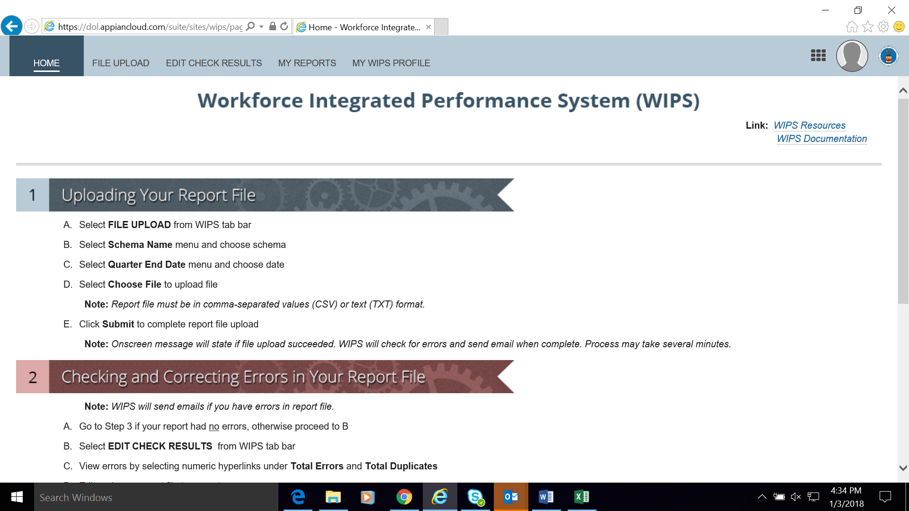
Live Demo of WIPS

Slide 52
H-1B WIPS Homepage (First Tab)
Once the username and password is entered, the WIPS homepage will display.
Instructions for “Uploading your QPR File” and “Checking and Correcting Errors in Your QPR” will be listed below on the homepage.

Slide 53
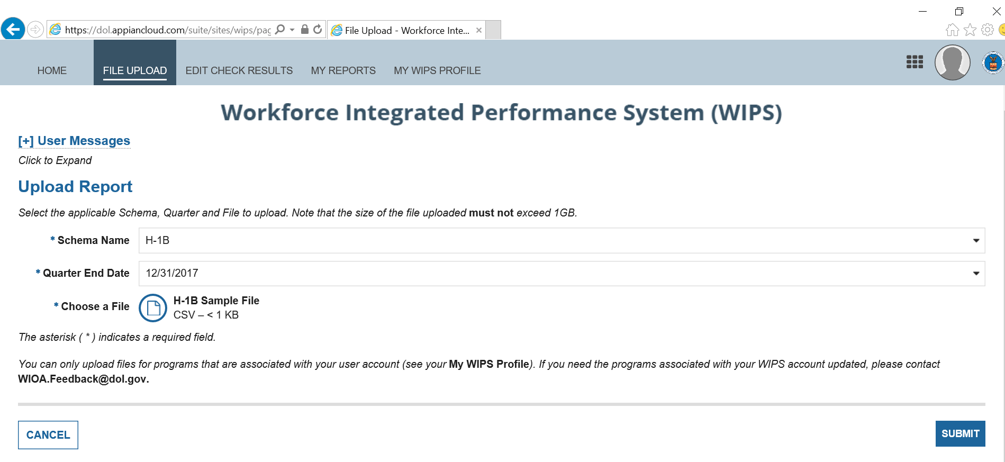
Uploading Your QPR File
Select FILE UPLOAD from WIPS tab bar.
Select Program Name menu and choose program.
Select Quarter End Date menu and choose program.
Select Choose File to upload file.
Click Submit to complete report file upload.
File Upload (Second Tab)
File Upload (Successful Upload Notice)

Slide 54
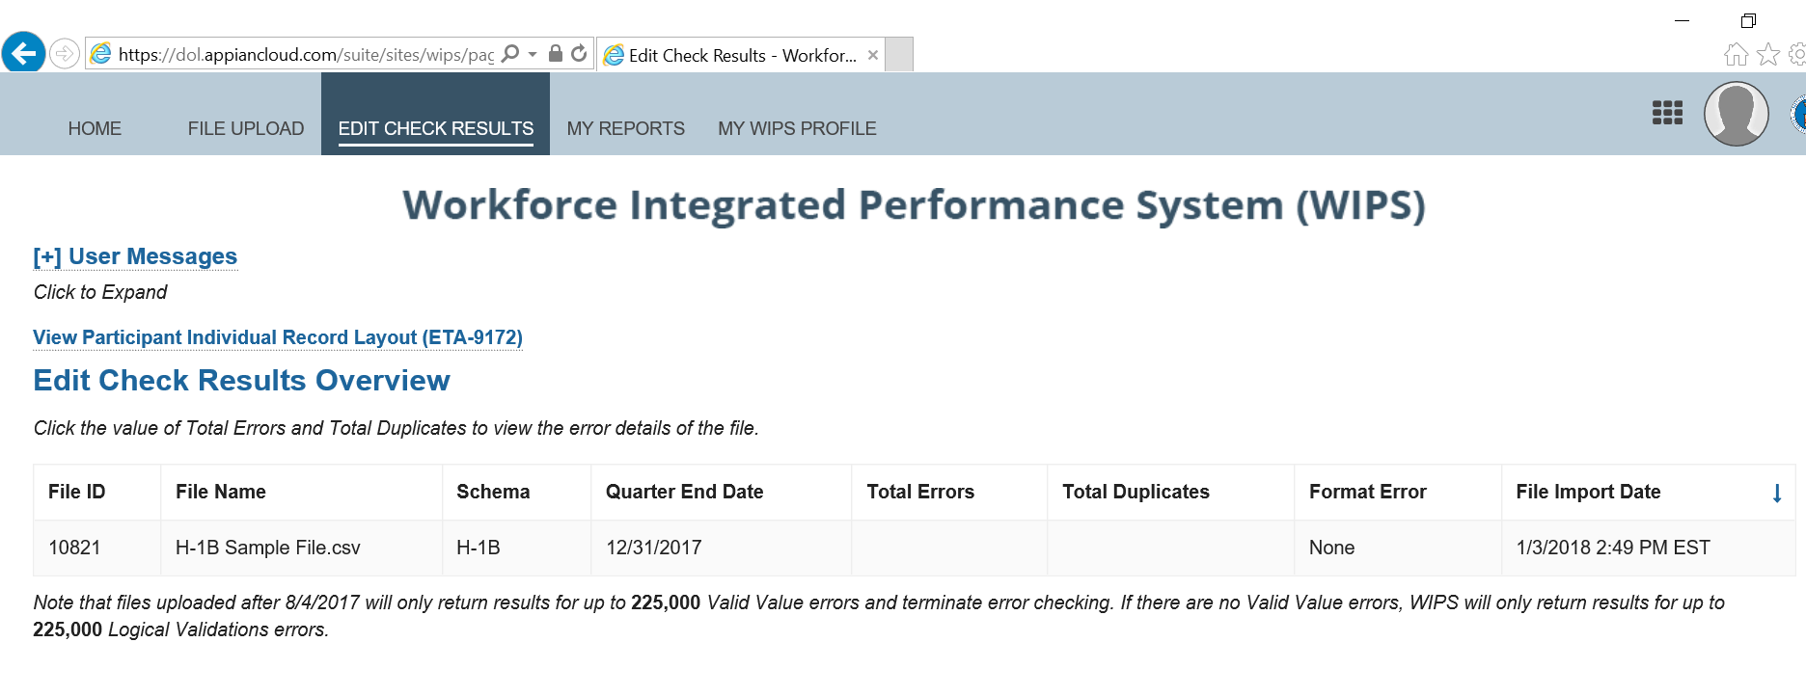
Edit Check Results (Third Tab)
Checking and Correcting Errors in Your QPR
Forgo Below if your report had no errors.
Select EDIT CHECK RESULTS from WIPS tab Bar
View errors by selecting numeric hyperlinks under
Total Errors and Total Duplicates
Edit and save QPR file to correct Errors
Return to Upload your QPR File instructions

Slide 55
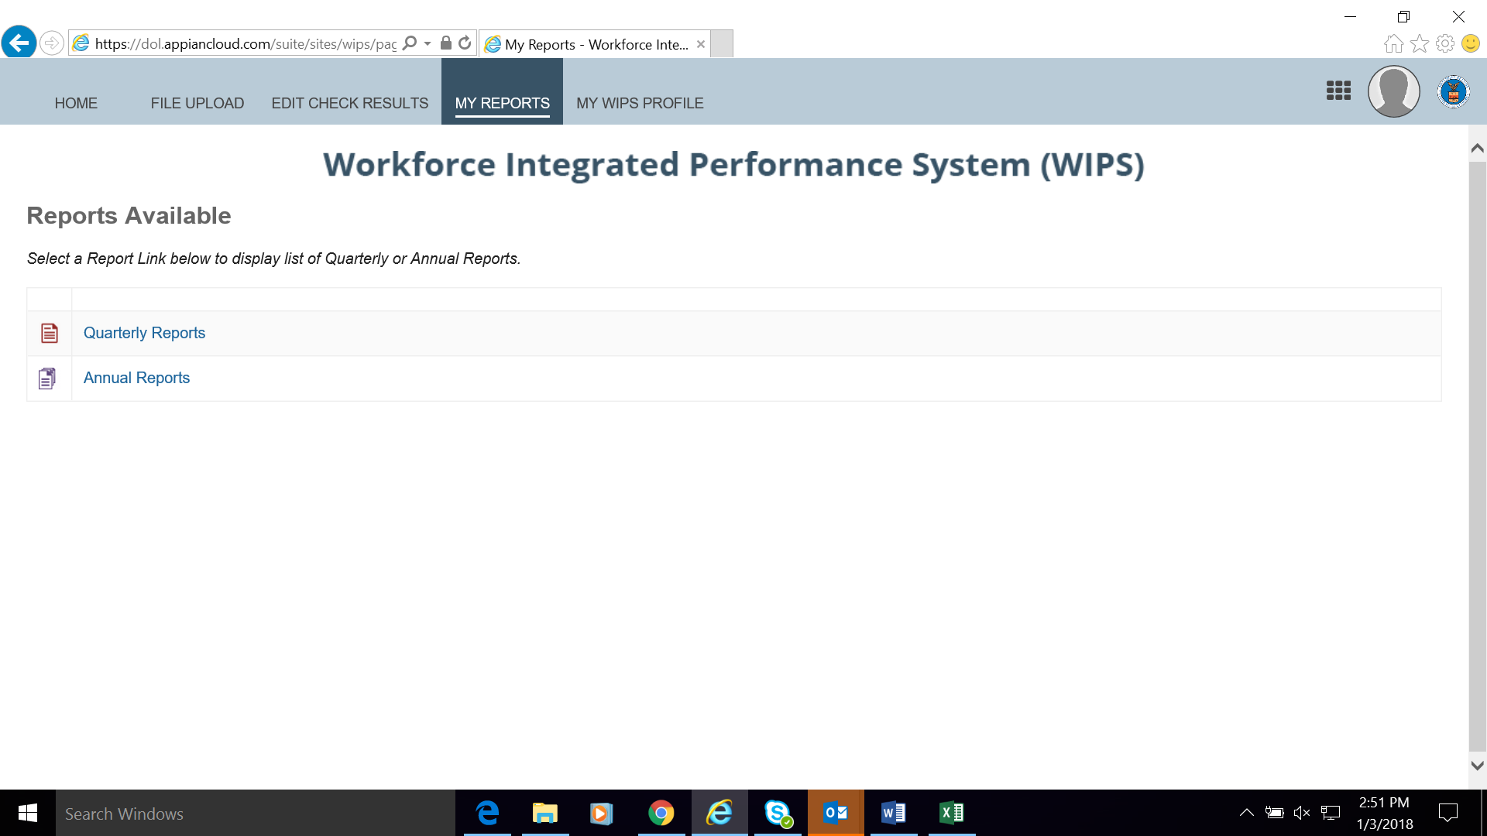
Reviewing Your Uploaded QPR (Fourth Tab)
Select QUARTERLY REPORTS from WIPS tab bar
Find recent report uploaded under Current Quarter section
Open report by clicking hyperlink under Status and Current Quarter(s) section
Confirm accuracy of Information
Contact WIOA.feedback2dol.gov if you have technical issues
Contact your H-1B grant mailbox if you find discrepancies with your outcomes
Coming soon! Click Certify to send QPR for Certification

Slide 57
Next Steps Action Items
What should we do …

Slide 58
NEXT STEPS: Action Items Summary
January 2018
Review Performance TA Resources
Export Data Files
February 2017
Access WIPS
Upload Data Files in WIPS
March 2018
Lessons Learned
Internal Review
Prepare for the next Reporting Quarter ending 3/31/18
Fall 2018
Report on PIRL1813 and 2126
Resolve Data File Errors
Submit and Review QPR

Slide 59
How prepared are you to submit your CSV data file in WIPS?
Eeks! WIPS What?! We’re not ready.
Um…We are still collecting participant data.
Whew, almost there! We have participant data in our MIS data base.
Geronimo! We’re ready to upload a csv data file in WIPS.

Slide 60
Coming Soon!
Valid Values and Logic Rules User Guide
Aggregation Rule Supplement to Performance Handbook
Quarterly Narrative Report Submission in WIPS
The Amended ETA-9712 DOL PIRL for H-1B Grants will be updated shortly to include the H-1B Valid Values and Logic Rules and the Aggregation Rules.

Slide 61
Follow Up
Upcoming TA Activities and Resources
H-1B Performance TA Office Hours
Monday, February 5, 2018 from 3:00 p.m. – 4:00 p.m.
Thursday, February 8, 2018 from 1:00 p.m. – 2:00 p.m.
Friday, February 9, 2018 from 2:00 p.m. – 3:00 p.m.
Coming Soon! Pre-Recorded Performance Tutorials
Valid Values and Logic Rules
Aggregation Rules

Slide 62
Follow Up
Questions
Performance Questions
TechHire@dol.gov
SWFI@dol.gov
AmericasPromise@dol.gov
WIPS Technical Issues
WIOA.Feedback@dol.gov

Slide 64
Thank you for all your hard work!

