Slide 1
Case Counselor Training
Knowing What Employers Want

Slide 2

Benjamin Kushner
  Independent Contractor,
  Jobs for the Future
    Los Angeles, CA
      ben@benjaminkushner.com

Slide 3

Four indicators of effective customer service
A suite of training modules
Intended for Case Counselors
  Keeping Precise and Effective Case Notes
  Understanding Different Career Services
  Improving Time Management
  Knowing What Employers Want
  Consider offering a certificate of completion
Notes:
This training is part of a four-module suite intended for Case Counselors, Career Advisors, Case Managers and their supervisors.
It includes these four indicators of effective customer service delivery.
The training is not meant as official guidance and is more of a collection of promising practices, shared ideas and recommendations.
Individual AJCs can tailor the slides and the associated/embedded notes to their particular needs.
PowerPoint presentations have an option to also embed audio to go along with the slides.
It is recommended that AJCs record the notes of each slide to create a customized audio presentation.
We also recommend that AJCs record the notes using the voices of their own staff members. This way, trainees will hear a familiar voice and while the narrators ”learn their lines” and practice, they are also learning the content.
Each module also comes with a quiz and a Teaching Aid. Since the quiz questions and answers are now published in the public domain, it may be advisable to mix things up a bit by changing the text of the quiz questions and their order.
AJCs should consider issuing a certificate of completion to Case Counselors who successfully complete the training and score a high grade on the quiz. A sample certificate is also offered. This certificate can be tailored by the AJC to reflect completion of each module or the whole suite of modules.

Slide 4
Case Counselors will gain a better understanding of employer needs & the role of the Business Services Team
We will consider the complexities of the Employer relationship
We will try to incorporate what we learn to make the best referrals
We will work to develop a collaborative
action plan
Notes:
This training module could also be called “What every Case Counselor Should Know about Business Services”
Our primary goal with this training is for Case Counselors to have a better understanding of the role that the Business Services Team and the Business Services Rep play.
With a better understanding of these roles, Case Counselors can be more successful in supporting their job seeking customers as they contribute to the success of their AJC as a whole.

Slide 5
What do employers want?

Slide 6

Simplest answer to the question:
Screened, qualified candidates
Workers with “Essential” skills
  Adaptability
  Flexibility
  Professionalism
  Team player
  Good fit
Workers with “Technical” skills
Notes:
This is the simplest way to answer the question: What Do Employers Want?
Ideally, employers want to know that the candidates they interview have been pre-screened and they meet the requirements of the job order.
On a case-by-case basis, employers may have a varying degree of flexibility about all the requirements:
- some of them will not be flexible and want 100% of the requirements
- some will be flexible if the candidate excels in some other way or if they meet some other objective the employer is seeking
- some employers may be more flexible when incentives such as tax credits or OJT are offered; some not.
- some employers may feel a civic duty to hire a worker as a “Second Chance” (for Reentry workers) or to fulfill a commitment to hire women, minorities or people who are disabled; and some may not
It’s up to a good, intuitive Business Service Rep to know when to negotiate some of these points and when to accept that this is not an option.
Almost all employers are looking for candidates with strong, “Essential” skills. The teaching aid for this module is a list of Essential Skills.
Those are the employability or soft skills that are separate from the technical skills, abilities and tasks of a particular job
Among the most in-demand Essential Skills:
Adaptability and flexibility: (Will this person go with the flow and adhere to change? or Will they say “That’s not in my job description”)
Trainability: Can the new worker demonstrate an increasing proficiency as they are trained on the job?
Responsibility and professionalism: Does the worker dress properly, speak with good grammar and vocabulary, address customers and colleagues with respect?
Do they know when NOT to use their personal cell phones at work (believe it or not, this is one of the top objections of some employers)
Will this person be fun or a burden? This sounds inappropriate, but honestly, the employer wants to know that the new worker will “fit in” and won’t be a problem. Worded differently, will the worker fit into the corporate culture of the company? Essential Skills training should cover what is meant by corporate culture and fitting in.
Technical skills
Yes, of course most employers are looking for the technical skills needed to do the job. But many times, employers come to us for entry-level workers. The worker is not expected to perform at 100% on day one. In those cases, the employer plays down the need for technical skills because they feel THEY can train the new worker and bring them up to speed. Those particular employers stress the need for the Essential Skills over the Technical skills. This is one of the key distinctions that the Business Services Rep must make when they take a job order or when they refer a candidate.

Slide 7

What else do Employers Want?
Ability to read and write
Tests for math and reading
Computer literacy
Notes:
Aside from the Essential and Technical Skills, sometimes employers want to see something else in their candidates.
They may be looking for adult basic ed skills plus computer literacy. This can be an area where the Business Services and Career Services teams work together.
There may be opportunities to prepare a group of job seekers for specific skills requested by an employer. Data entry, word processing or Web-based programs are examples.
Working with education and training partners, there may be opportunities to create contextualized learning so that the computer skills taught to trainees become more applicable to the job market or to a particular business customer.

Slide 8
Why is this so challenging?
Notes:
There are three main reasons why this is so challenging:
Employers have many sources of qualified workers
There is no typical employer – many different types need to be managed
The employer’s previous experience with our services can play a key role.

Slide 9

Employers have many sources
Word of mouth
Employment agencies
Career offices at schools
Job boards like Monster and Indeed
Custom job boards like Dice
Newspaper ads
Company websites
Notes:
Aside from using the services of an AJC, there are many ways that an employer finds a qualified worker for a job – these are perhaps the top ways
Word of mouth is still very high up in popularity. A personal referral is valuable to the employer, especially when it comes to the question of creating a “good fit”
Employment agencies are also preferred in many cases because they can “test-drive” a worker who is employed by the agency. If it works out, they hire them directly and pay a fee to the agency. If it doesn’t work out, the worker can be easily dismissed with little or no investment in their orientation to the company.
Employers may have established a relationship with a technical college or even a trade program at the high school level to recruit new workers.
The other options have different levels of risk for the employer because more screening of the candidate will be necessary.

Slide 10

There is no “Typical” Employer
One size does not fit all
  Large family-owned corporations
  Subsidiaries of larger corporations, publicly-owned
  Small shop business owner
Different levels of influence in the community
Notes:
There are different company sizes and different levels of influence in the community.
Some places are “company towns” practically owned by one corporate entity. They hold a lot of sway in the community.
Others are subsidiaries of foreign corporations and out-of-state corporations and, of course there are small “mom-and-pop” shops.

Slide 11
Other Employer differences
Different levels of social responsibility
  Some employers want to “do the right thing”
  Some employers must follow corporate protocol
Different politics
  Role of government
  Suspicion about compliance
Notes:
There are employers who might seek out the services of the AJC to find workers who need a break or a second chance.
Some will do it out of the goodness of their hearts and others will be looking for tax incentives or wage reimbursements like OJT.
Some may do it because they were once in need or a family member was in the position of needing a break.
Some employers will resist any mention of OJT because it is a government program that requires paperwork and red tape.
- some of them MAY be convinced otherwise; some will never accept how easy it can be
Some employers will always be suspicious of a government-paid program because they fear government workers will be inspecting their facilities for safety violations and inspecting their books for wage-and-hour compliance.
Again, the Business Services Rep needs to manage the expectations of all these possible business customers.

Slide 12

Previous Experience plays a role
Return business customer
A long-term nurtured relationship
Grapevine
Notes:
An employer that’s had a positive experience with our services will likely come back when there is another job opening.
Perhaps they felt the candidate was a near perfect fit.
Perhaps they found that the follow up services and the retention services addressed any concerns that arose during the probationary period of the new worker.
Sometimes the Business Services Rep (BSR) nurtures a relationship for many months or years and it finally pays off with one really good, first placement.
It becomes necessary for the BSR to weigh the return on investment of the time they spend on these relationships.
It may also explain why BSRs can be so protective of their employer customers.
An employer may have heard about the AJC through the grapevine or through a local elected official.
A good, professional, problem-solving reputation is valuable to the success of the AJC.

Slide 13
How do we address their needs?

Slide 14

It All Starts with Listening
Job Development and Business Services require listening skills
Near perfect matches often required
Notes:
The Business Services Rep (BSR) needs to be a very good listener. They also need follow-through skills and perseverance.
The BSR wants to avoid the unpleasant conversation when an employer-customer says “I asked for one set of skills and abilities and I got another. I don’t think you were listening to me. I don’t think your candidate was a good fit”.
The Business Services Team must be very careful when they meet employers about their workforce needs.
Sometimes employers want a 100% match of skills, abilities, and experience. Sometimes, they are more flexible.

Slide 15

Some demands cross the line
BSR needs to be EEO “script ready”
  Fill job order based on skills and abilities
  Refer qualified and competent candidates
  Emphasize requirements of the job
Notes:
Sometimes an employer will raise a requirement that clearly crosses the Equal Employment Opportunity (EEO) boundaries. They may say: “The candidate must be woman. The candidate can’t be too old. The candidate should look like us”, etc. What’s a BSR supposed to do? Presumably, your organization has a protocol on how to handle illegal or unethical questions like this. You don’t want to alienate the client but you also don’t want to help them break the law. These are the kinds of challenges your Business Services Rep may face.
As a possible approach, how does this sound?
The BSR could say to the Employer: ‘Based on the skills, abilities and competencies you’ve requested and how they relate to the work involved, I can promise to refer the most skilled and competent worker for the job. I can’t really promise anything else.” It’s a fair promise. But then you need to follow through with the right candidates.
Think about it: if the conversation suddenly becomes a debate, an argument, or a threat to inform the authorities, the relationship will end before it begins.

Slide 16
Offer retention services
How can we facilitate the new employee’s transition?
Are there skill gaps we can fill?
How often should we check in?
How should we contact you?
Notes:
There may also be an opportunity to offer retention services that are customized for the employer.
The Business Services Rep needs to work with employers to learn what potential retention services will be needed.
Perhaps a workshop on professional workplace behavior or on the use of company and personal equipment at the workplace.
They must also figure out how often they need to call the employer to be sure the new hire is working out. They need to negotiate these terms with the employer.
You don’t want to bug them but you DO want to be conscientious.
Maybe you should just come right out and say: I want to be sure to provide you with the best customer service. How often should I check in? When do you want to be contacted? How should I contact you?

Slide 17
What are we selling, exactly?
Workforce solutions
Problem solving tools
Money saving ideas
We avoid selling programs, funding sources, government assistance
Notes:
A good BSR is selling workforce solutions.
A business customer has high-turnover; they’ve hired the wrong people; there’s a massive line of folks about to retire, their start-up costs are getting insurmountable, they want to make their workplace more accessible, or they notice that there’s an unprofessional atmosphere in the workplace.
Through our services the BSR may be able to address some of these issues with the right candidate referral, a good succession strategy, some tax incentive, a consultation on accessibility, an OJT contract or an effective training on Essential Skills in the Workplace.
The sales pitch should not mention acronyms, program jargon or funding streams. It should not emphasize that “the government has an answer for you”.
It should be very transactional: you have a workforce challenge, we have a workforce solution.
BSRs don’t want to turn off business customers by emphasizing programs or appealing to the employer’s good heart to accommodate someone or to give someone else a break.

Slide 18
We provide Labor Market Information
Manufacturing
Retail
Professional Business Services
Education
Health Services
Construction
Wholesale
Financial Services
Transportation/ Warehousing
Notes:
The BSR can learn valuable market information from their employer customers.
If customers share information on salary levels or benefits, the BSR can compare this information to what is publicly available on O*NET or other programs.
They can then gauge how their community and its employers size up against national, state and local averages.
Other LMI that can be verified with employers includes the skills, abilities, knowledge and competencies that are in high demand.
Some employers may want help developing their job orders or job descriptions.
BSRs can help them use O*NET and other programs to get ideas about what to include in job descriptions and what benefits to offer.
Confidentiality of information is always an important consideration. BSRs shouldn’t share competitors’ secrets but labor market information is valuable.
Employers may also be interested in community demographics, information about sectors and industries, supply chain information and credentialing.

Slide 19

Other Business Services we provide
Assessments
OJT contracts
Registered Apprenticeship
Tax incentives
Federal bonding program
Screening
Retention services
Notes:
Here are some of the other services BSRs offer to their employer customers.
Employers may ask about assessment tests or credentialing.
They may need help developing an OJT contract or a connection to Registered Apprenticeship.
They may be interested in tax incentives.
They may want to use the federal bonding program which can assist them when hiring someone with a criminal past.
They may require screening services at the AJC.
They may be interested in follow-up services and retention services that help ensure that new hires are successful in their employment.

Slide 20
How can we support one another?

Slide 21

Form a multi-team task force
Questions to ask the task force:
  Are we doing enough to reach the employers?
  Do we understand employers’ skill needs?
  Are we listening to our employers?
  Are we making the best matches?
  Are we following up with good retention services?
Notes:
The Career Services and Business Services colleagues should form a task force to determine how to serve all customers better through collaboration.
Aside from the traditional outreach efforts, the Career Services and Business Services Teams can cooperate to learn about job openings and companies that are growing.
The Career Services Team can share intelligence they learn from customers about which employers are hiring.
Are there a number of Essential Skills that almost every employer seeks? Can you emphasize these skills in your Essential Skills Training?
Essential skills are especially important for entry-level workers but even older workers can benefit from some of the training.
Is there a way to offer Essential Skills training to recently employed “Follow-Up” customers (as a Follow-Up service) and at the same time, invite job seeking customers?
The teams can also cooperate on programing and designing career fairs that are geared toward education and training as well as job fairs that are attended by employers.

Slide 22

Share labor market information
Types of information
valuable to everyone:
  Who is hiring?
  What skills are most in-demand?
  Salary information
  Job description
  Credentials newly in demand
Notes:
As Career Services and Business Services team members collaborate on projects, they should share the kind of information on this slide:
Information about employers who are hiring, moving into the area, expanding their business
What skills are most in demand? Could there be skills taught to customers in a workshop or special class?
How do salaries offered by actual employers in our area compare to what we see in our national, state, and local databases such as O*NET?
Are there phrases or terminology we see in job descriptions and job orders that resume writers should know about?
Are there phrases or terminology we see on O*NET that our employers should know about if we are helping them write job descriptions?
Is there a new credential everyone seems to be buzzing about. Perhaps employers are asking for the National Career Readiness Certificate? Or something similar.

Slide 23
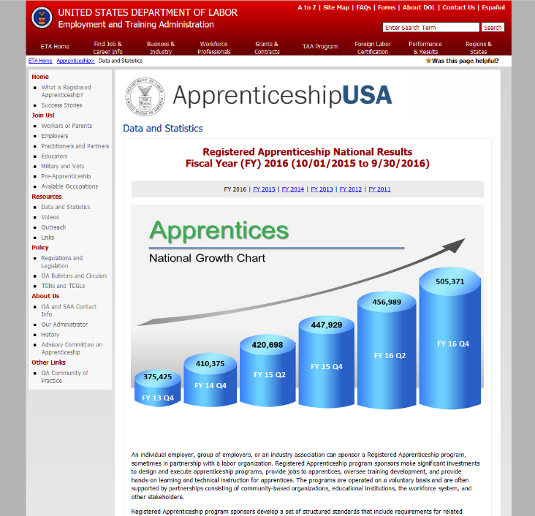
Earn and learn collaboration
Registered Apprenticeship
On the Job Training Contracts
Internships
Notes:
The Business Services Rep may be helping an employer make a connection to Registered Apprenticeship or they may be working together to develop a Work Process Schedule for a registered apprenticeship program.
They may be designing an OJT contract with employers and they need information about the tasks, duties and skills that can be taught on site.
They may be asking employers to hire interns as a way to try out trainee workers for full time employment.
All of these represent opportunities for collaboration among teams. Case Counselors have first-hand knowledge of potential referrals for the programs and they can inform the Business Services Reps about the supply-side. BSRs can share information about openings & the plans their business customers are making. Both teams know enough about skills and work processes to collaborate on contracts.

Slide 24

Evaluate your collaboration
Work toward continuous improvement
Does everyone agree on effectiveness?
Are you sharing information timely?
Are your customers being helped?
Notes:
It’s a good idea to evaluate the collaboration you’re establishing among the AJC staff.
Are your strategies working? Do you agree on effectiveness?
Are you working toward improvement?
In the end: are you providing excellent customer service to job seekers and employers?

