Slide 1
Customer Centered
Design Challenge
Launch of Round 3
January 23, 2017

Slide 2
VIRGINIA HAMILTON
Regional Administrator, Region 6
San Francisco Employment and Training Administration
U.S. Department of Labor

Slide 3
Today’s conversation
Review Human Centered Design Basics
Hear from Contra Costa County and Wisconsin Teams
Get to know IDEO
What to expect from the course
How to register
Q&A

Slide 4
Be customer focused
“These proposed regulations would establish requirements of the one-stop career center system as defined under WIOA, requiring partners to collaborate to support a seamless customer-focused service delivery network.”

Slide 5
WIOA regs mention customer 143 times.

Slide 6
Poll for participants
I’m new to customer-centered design.
I know someone who has taken the class.
I’m a skilled novice.
I’m a pro!

Slide 7
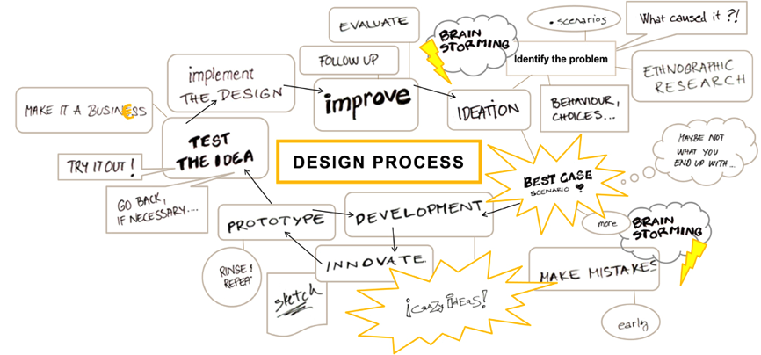
How the course works
Jan.
Feb. - March
April - June
July
Launch webinar
Take class, prototype, test and iterate
Celebration, learning exchange in D.C.

Slide 8
The HCD Process A collaborative, discovery-based journey.
Get inspired by the people you’re serving.
Start by listening to people to get new ideas about how to design for them.
Identify patterns and surprising insights to inspire new opportunities for design.
Brainstorm new ways to serve your customers.
Try out your ideas and get feedback from customers – so you can revise your prototypes and get more feedback.
Try out a pilot program and experiment with ways to implement your new ideas.

Slide 9
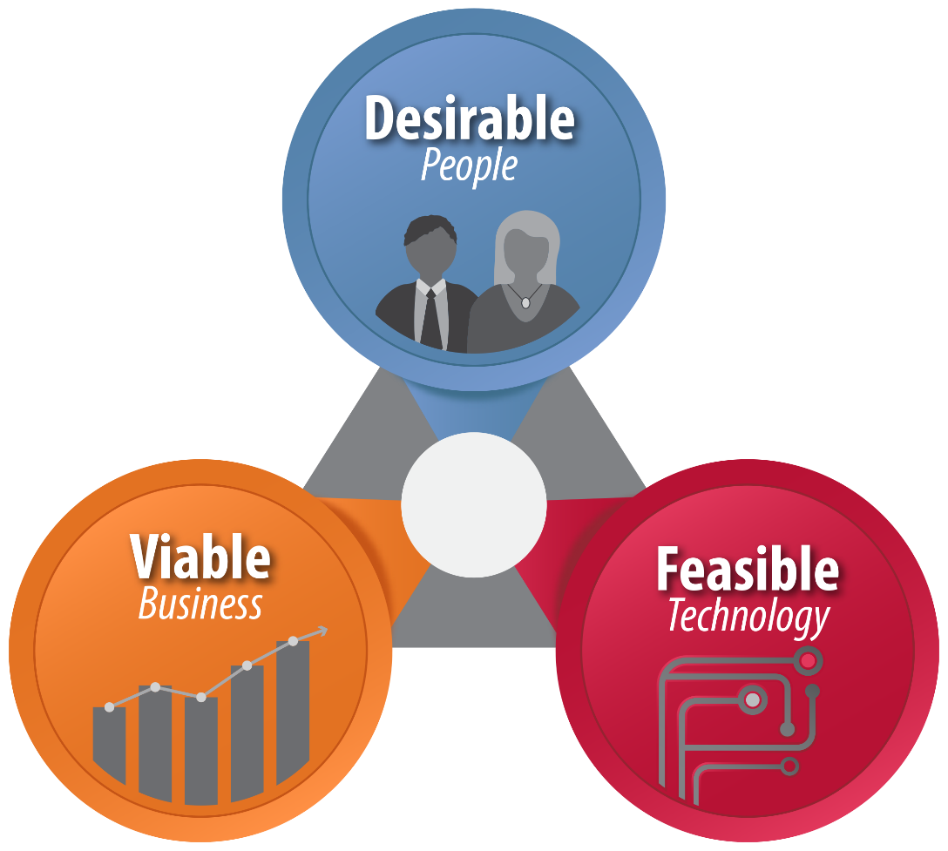
Using Human Centered Design
Start with people

Slide 10
How might we...
assume solutions exist

Slide 11
How might we...
reduce risk and commitment

Slide 12
How might we...
do it together

Slide 13
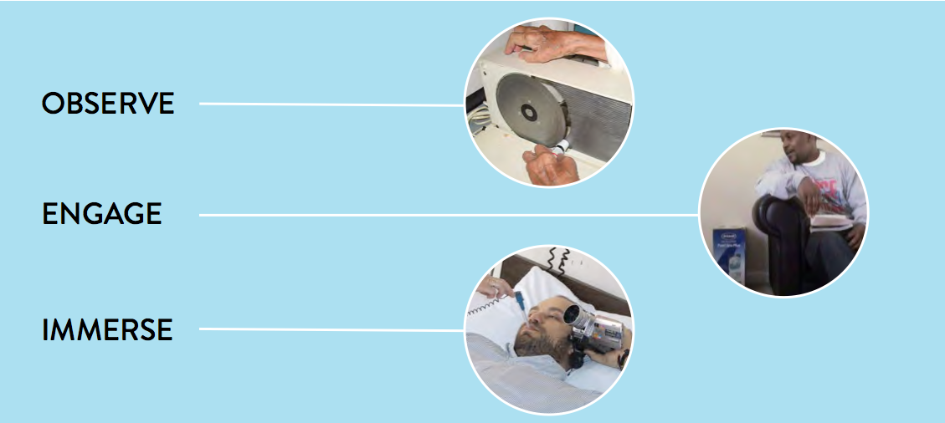
Build empathy

Slide 14
“
I’m copying a friend’s resume, but putting my words to it because I don’t know how to make one.
“
David, 18

Slide 15
“
I’m copying a friend’s resume, but putting my words to it because I don’t know how to make one.
“
David, 18
What if?
Instead of resume-building classes, we provided templates for youth to adapt quickly, since a resume is a means to an end at this stage?

Slide 16
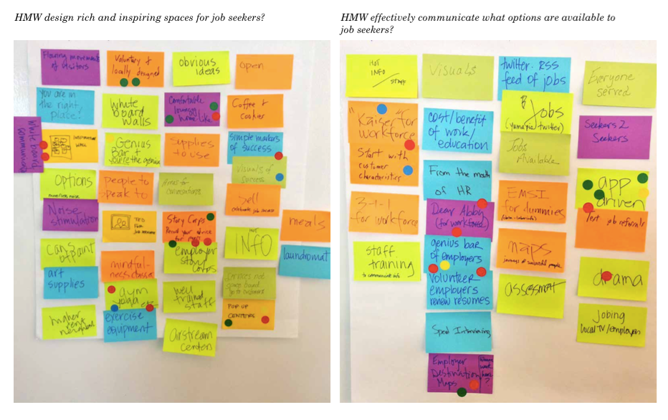
How might we...

Slide 17
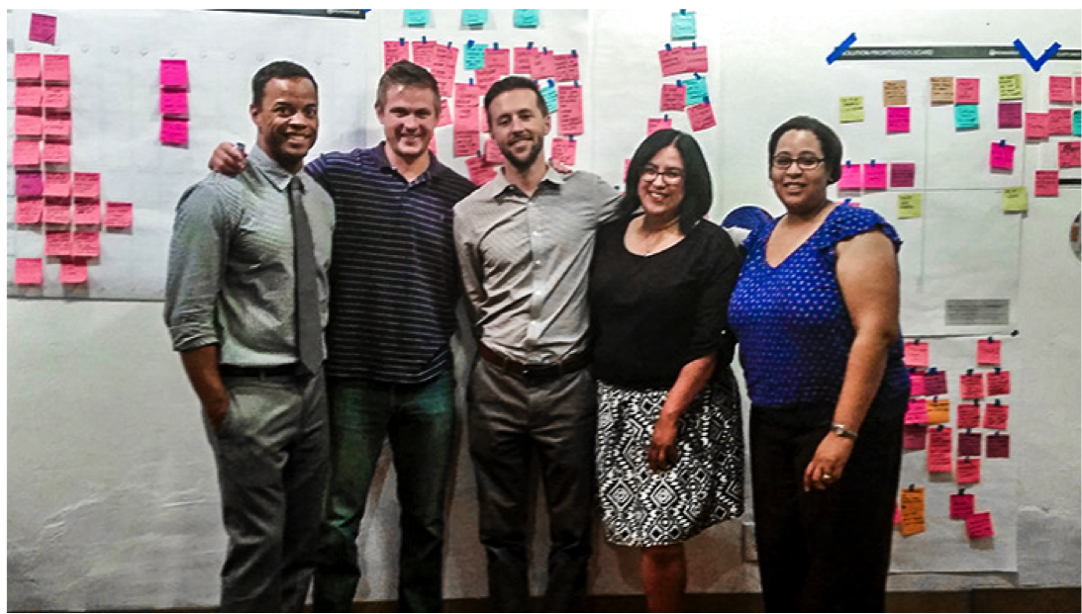
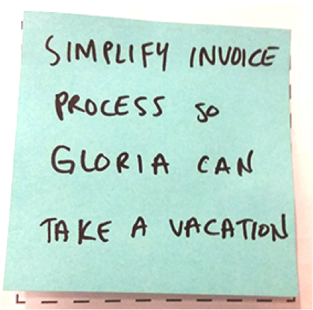

Slide 19
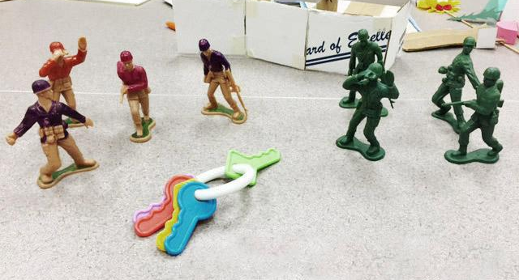
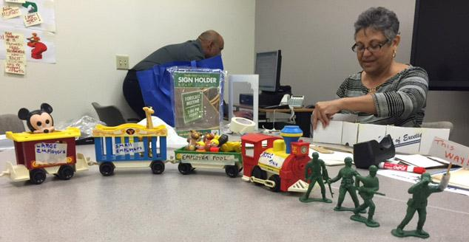
Prototyping
One team leading the way for small and large employer pool to the workforce resource center (AJCC)
The key is to form one team and to be seen as one team

Slide 20
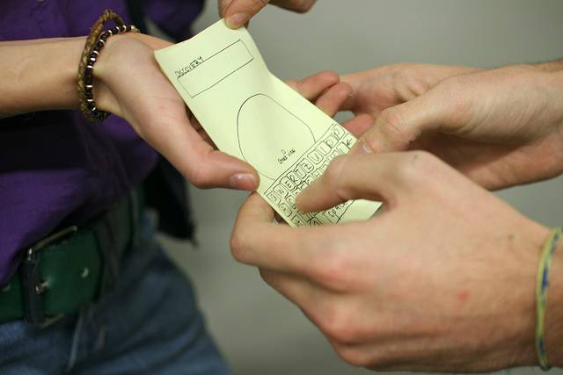

Slide 21
The outcomes
Services are designed for employers and job seekers that better meet their needs.
WIOA implementation is transformative, not “check-the-box.”
You and your Team are supported to think outside of what you know, and use tools to make implementation happen in new, creative ways.
Federal, State, and local workforce professionals have a much better understanding of who the customer is.
Service design happens in a collaborative way with all stakeholders participating.
There is capacity in the system for on-going process improvement, and agencies use design thinking as a regular practice.

Slide 22
Contra Costa County
How might we connect formerly incarcerated individuals to the workforce system?

Slide 23
Customer insights
The longer a person goes without resources, the higher the likelihood of recidivism.
Resources are “rumored” to be available but many are unsure if what they’ve heard about services is true or how to find them.
Employers may not recognize work or certificates earned inside jail.

Slide 24
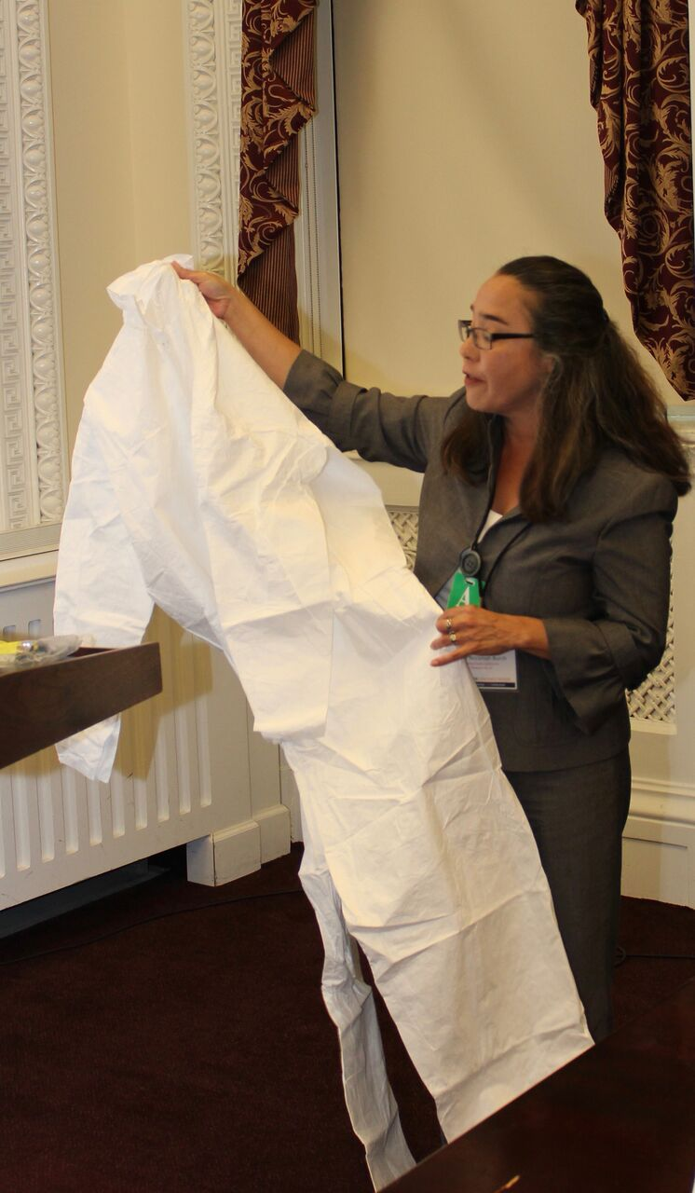
“Flyers are not always helpful. We need more services coming in and talking to us...get us on the waiting lists while we’re waiting to be released.”
Formerly incarcerated individuals may be released from prison in a paper suit.

Slide 25
Tips for your team
Set aside 5-7 hours each week
Schedule a recurring meeting, and add it to everyone’s calendars
Get access to your customers (i.e. the county jails)
Be flexible

Slide 26
Wisconsin
How might we improve the customer experience and outcomes for one-stop customers?

Slide 27
Transforming the look and feel
First update to the physical appearance since the job center opened
Transformed into a coffee shop feel with local art
Added new information in the waiting areas
Launched digital content and social media campaign to better serve tech savvy job seekers

Slide 28
Research insights
Show don’t tell: use customer stories rather than statistics
Design for the future: we narrowed our customers to those under the age of 30
Integrate digital content: only a fraction of job seekers come into the center
A job seekers toggles between 3 devices and multiple tabs

Slide 29
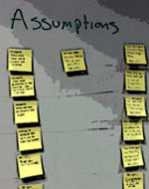
Lessons learned
Go where your job seekers are, and ask for help finding younger people
Ask colleagues about their assumptions about jobseekers
Keep brainstorming and ideating
Move out of the back office and into the jobcenter
Don’t be afraid to fail

Slide 30
IDEO
Kate Lydon: You’re joining a movement

Slide 33
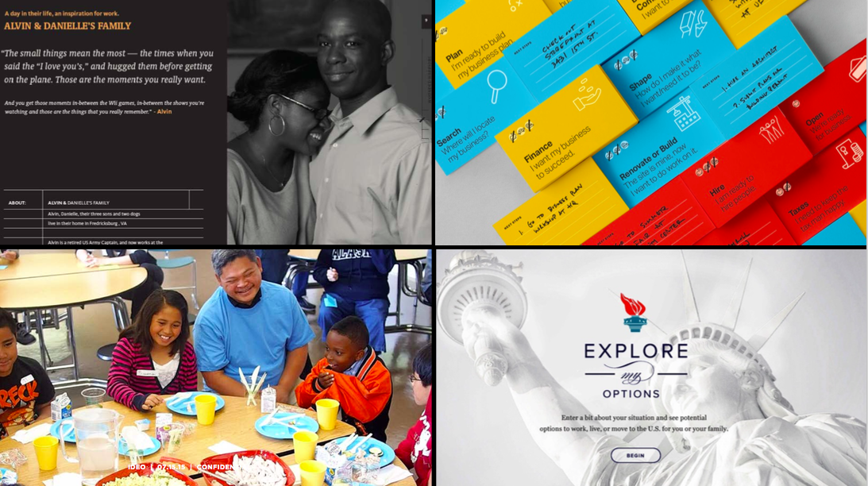

Slide 35
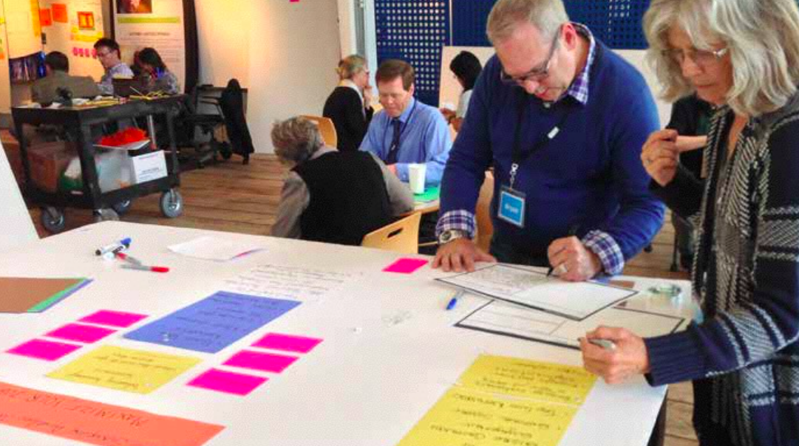

Slide 36
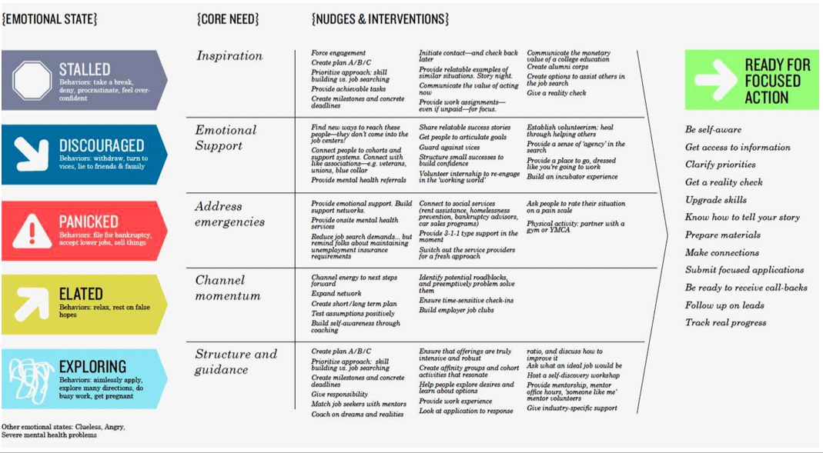

Slide 38
Code for America
Caitlin Docker: We’re in this together

Slide 39
How the course works
Work with 4-8 people for your “design team"
Apply the human-centered design methods to one of seven workforce development challenges
Explore the main human-centered design concepts through readings, case studies, and short videos
Interact and gain inspiration from design teams around the country

Slide 40
What you will learn
Equip you with the mindsets and methods of human-centered design
How to experiment with low risk
How to identify patterns and opportunities for concept development
Inspiration to approach challenges differently
Hands-on experience speaking to, prototyping for, and testing solutions with the people you’re designing for

Slide 41
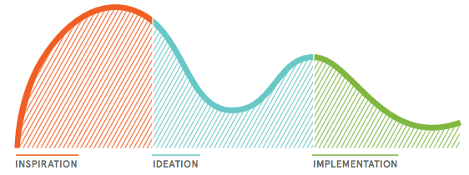
Course begins February 7th
Class 1: Introduction to Human-Centered Design—1 Week
Class 2: Inspiration Phase—2 Weeks
Class 3: Ideation Phase (Synthesis)—1 Week
Class 4: Ideation Phase (Prototyping)—2 Weeks
Class 5: Implementation Phase—1 Week

Slide 42
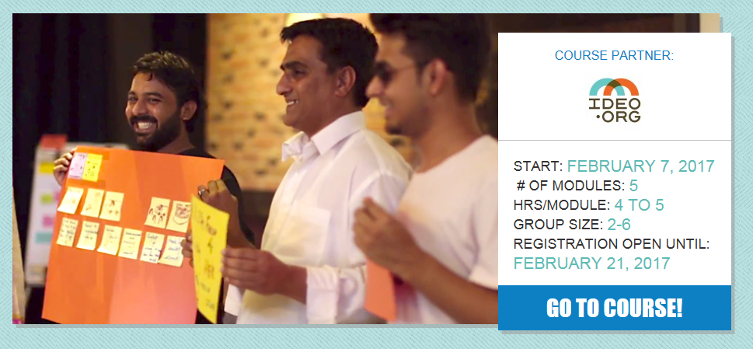
IDEO…Acumen...NovoEd
Is there a set class schedule every week?
No. There is a set curriculum to cover each week, but you are free to review the prep material and meet with your design team within each week whenever it is convenient for the group. It’s a good idea to consider your team’s availability when forming a group.
Will a certificate be awarded upon completion of the course?
Yes, subject to course completion (completion of all assignments), you will receive a statement of accomplishment signed jointly by +Acumen and IDEO.org.

Slide 43
Your timeline
January: Form your design team
Identify your challenge
April 11: Course concludes
Feb 7: Register your team
Start the course
April & May: implement prototype
Feb 21: Registration deadline
January
February
March
April & May
June
July
June: Submit application
March: Take the course
Participate in 1:1 coaching
July: selected teams
announced and visit D.C.

Slide 44
First step: build your design team
Engage a diverse group with 5-8 members.
If the team is too small you may lose the benefits of a multidisciplinary team, but too large and it may be difficult to coordinate schedules and make decisions.
Select people from different backgrounds or have different skill sets. You'll have a better chance of coming up with unexpected, innovative solutions.
Include partners from
Core partner organizations
Stakeholders that “touch the customer”
Front line staff
Business services staff from various partners
Customers

Slide 45
Second step: pick a challenge
One-stop customers
How might we improve the customer experience and outcomes for our shared One-stop customers?
Employers
How might we put employers in the center of sector strategies and career pathway work?
Out of school youth
How might we design services and programs for out-of-school youth that will engage them and produce strong outcomes?

Slide 46
Pick your challenge (con’t)
Formerly incarcerated individuals
How might we help formerly incarcerated individuals obtain employment and education, develop healthy relationships, and make positive decisions?
Individuals with disabilities
How might we design services that are physically and programmatically accessible to individuals with disabilities?
English language learners
How might we improve the customer experience for English language learners across partner programs?
Leadership
How might we design and accelerate cross-sector leadership training for the workforce system?

Slide 47
Step three: register for the course
You’ll receive an email with a link to register your team on Tuesday, Jan. 24
Team Lead, Alternate Lead, and 4-6 others
Check Workforce GPS for updates - a registration link will be posted there.

Slide 48
Our team
Department of Labor
Virginia Hamilton
A great bunch of coaches!
Code for America
Caitlin Docker

Slide 49
Coaching support and peer-sharing
Weekly communication with coaches to help answer questions or brainstorm:
Tips on how to facilitate meetings with your team
Help communicating to your partner agencies/administration
Sharing of best practices & innovative tools others have used
Communicate any issues your team has with course assignments
Biweekly video calls with Code for America for peer-sharing

Slide 50
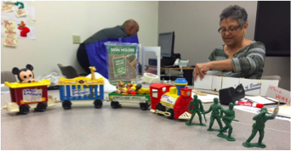
Suggested supplies
Post-it notes or scrap paper cut into squares
Pens, pencils, markers, paper
Prototyping supplies
Mobile phones or a camera to document your work
Prototyping supplies: trains, toy soldiers, hardhats, mickey mouse, cardboard boxes

Slide 52
Questions?
ccd@hipimpact.com

