Slide 2
Assisting YouthBuild Programs to Promote Financial Saving:
America Saves for Young workers
U.S. Department of Labor and America Saves

Slide 4
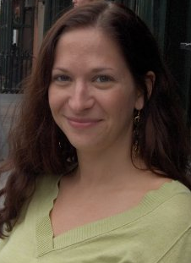
Moderator
Jenn Smith
National YouthBuild Director
U.S. Department of Labor

Slide 5
Review of the financial saving
survey of YouthBuild programs
Introduction to the America
Saves for Young Workers’ platform
Impact on Youth
2016 Research on the effectiveness of ASYW
How to become a partner program
Benefits to becoming an ASYW partner program
Good for youth and good for your agency

Slide 6
Check-In
Did you/your organization participate in the financial literacy survey shared last Fall?
YES
NO

Slide 7
YouthBuild Program Financial Survey
In Fall 2016, YouthBuild programs were asked about the financial literacy and planning practices they use with program youth.
DOL received 69 program responses and 58 programs that fully responded, the results of which were reviewed and tallied in early December 2016.

Slide 8
YouthBuild Program Financial Survey
All respondents stated that they do provide financial education to participants.
Only 36% of respondents (21) stated that they provide direct deposit as a payment option.
Of those who do use direct deposit, the programs were pretty split on how many youth used it, with 8 programs stating 76% or more of the youth use it and 8 programs stating that less than 25% did; the remainder were somewhere in the middle.

Slide 9
YouthBuild Program Financial Survey
All respondents stated that they encourage youth to open bank /credit union accounts and 88% of programs directly assist youth with opening the accounts.
95% of the respondents said they provide encouragement to youth to save money; this is done through a variety of ways, including general info sharing, workshops, and coaching, and direct contact with bank representatives among others.

Slide 10
YouthBuild Program Financial Survey
Programs had additional financial literacy best practices to share beyond what was listed in the survey:
Online stock market game provided by ED
Describe financial scams that are common with youth to build awareness
In-house money saving program that directly saves half of stipends into a “bank” accrual account through the program and provide balance statements and helps with borrowing where needed.

Slide 11
Amelia O’Rourke-Owens
Program Coordinator
America Saves for Young Workers
Washington, D.C.

Slide 12
The Program
America Saves
for Young Workers

Slide 13
The Program

Slide 14
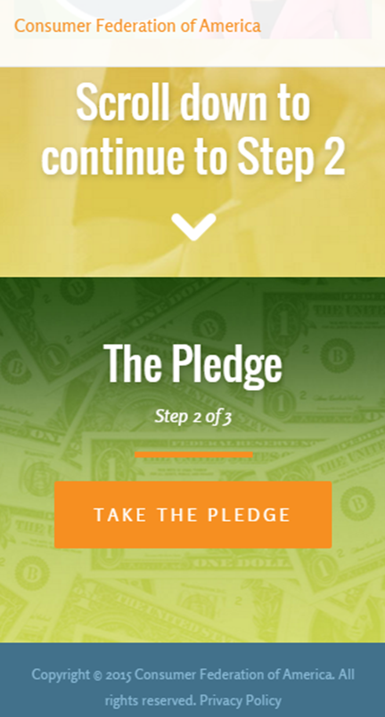
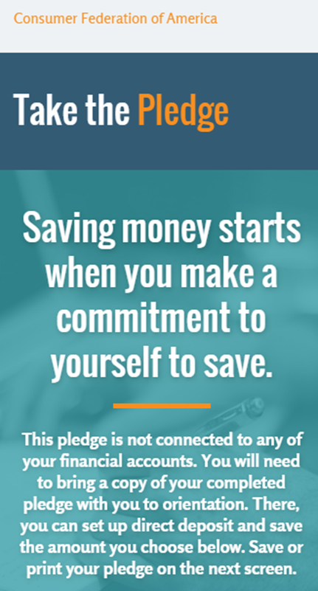
The Program

Slide 15
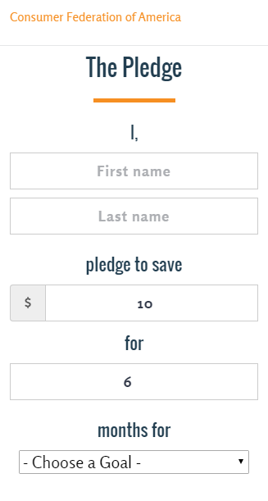
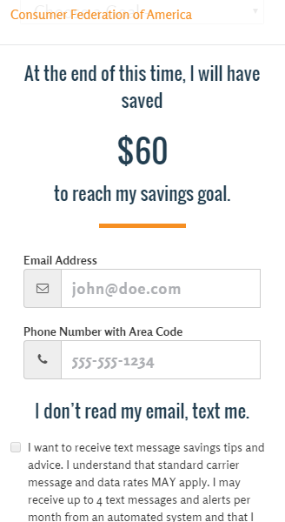
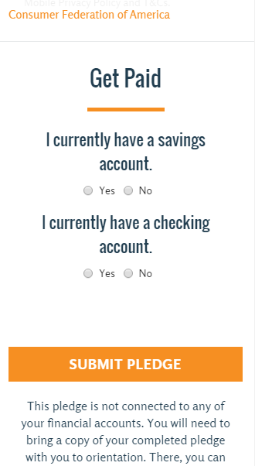
The Program

Slide 16
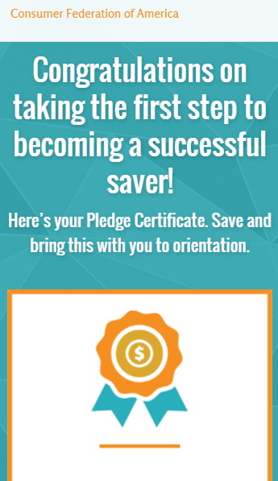
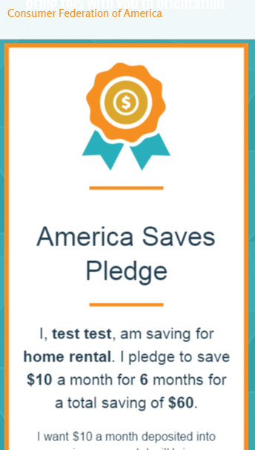
The Program

Slide 17
The Program

Slide 18
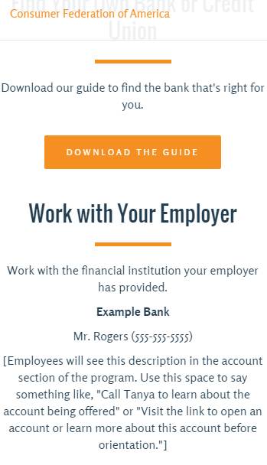
The Program

Slide 19
Impact on Youth
The impact of the America saves program on low-income youth

Slide 20
In Partnership with America Saves, C+R conducted research to track the savings attitudes and behaviors of teens following their introduction to the America Saves program during their summer employment.
15
Minute
Online
Survey
~100
Teen workers who participated in the America Saves program per wave
(238 total unique teens included in this data, and 16 teens have completed all four waves of the study)
Results reflect data collected in August, towards the end of summer employment, and in October, January, and March following their summer employment
A sample size of n=100 per wave reflects a 3.6% coverage rate of the entire population of America Saves participants (n=2771) which is much higher than the average coverage of a fraction of a percent for most marketing research studies.
The population being sampled (America Saves participants) is more homogeneous than the general population, so there is less variability to mirror in the sample; meaning a sample size of n=100 is an appropriate and sufficient representation of the America Saves teen population as a whole.

Slide 21
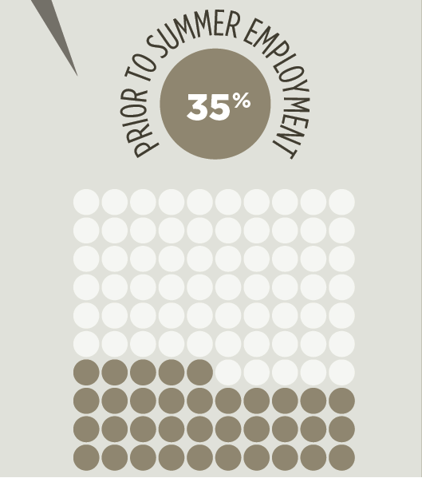
Savings Behaviors and Habits Before Summer Employment
52% of young workers had no previous savings habits
Only 35% of these youth, on average, had savings accounts

Slide 22
When Youth Were Asked:
“What would make it easier to save?”
Having the right tools to build their savings and reduce their spending
“What is the best way to save?”
Know the best way to save is by putting money directly into a savings account (72% on average)

Slide 23
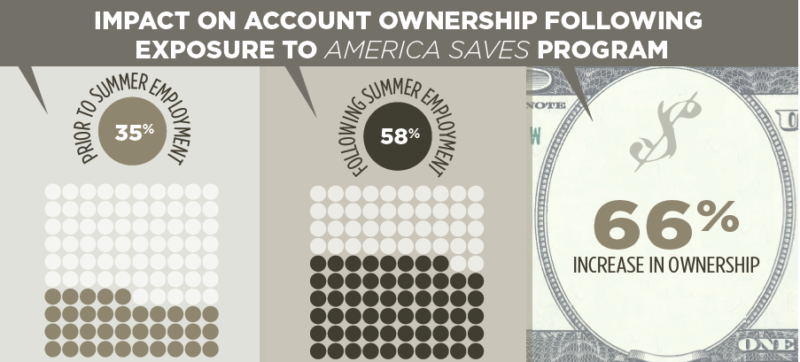
Percentage of Youth Owning Savings Accounts Increased 66%

Slide 24
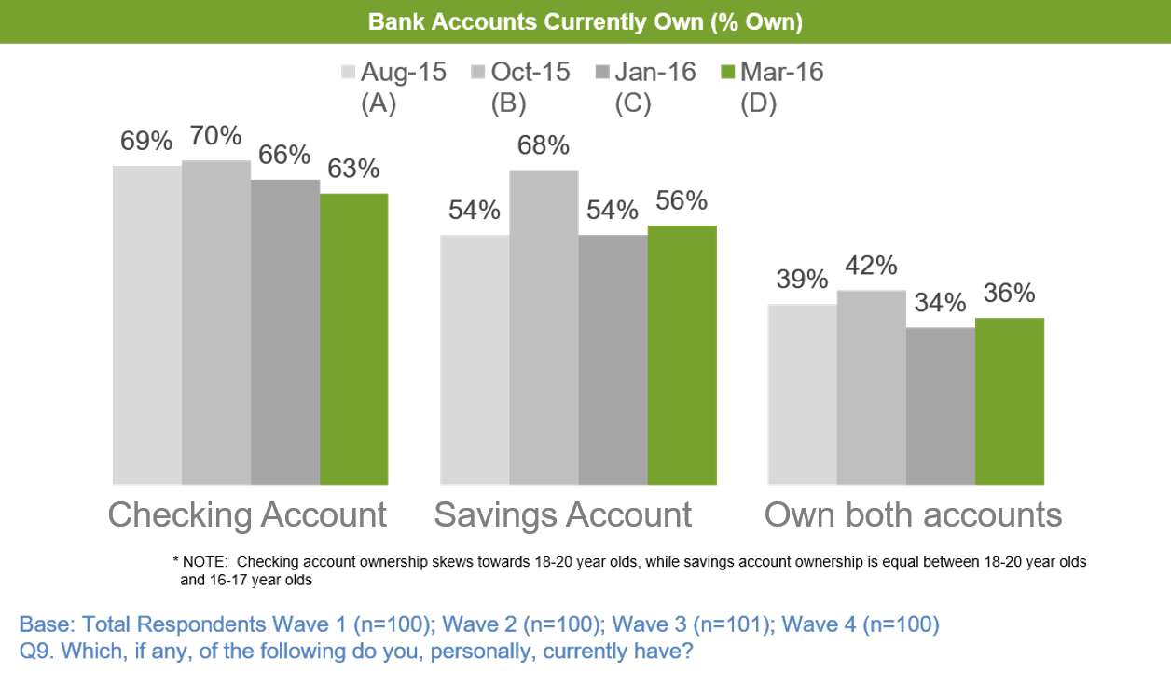
Most Youth Kept Accounts Open

Slide 25
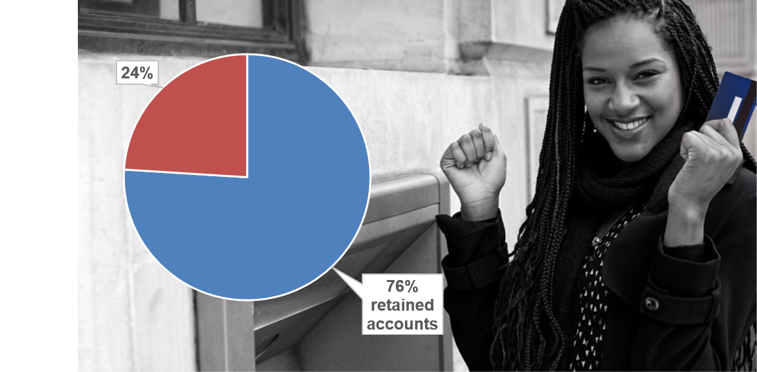
76% Expected to Use The Same Account Next Summer

Slide 26
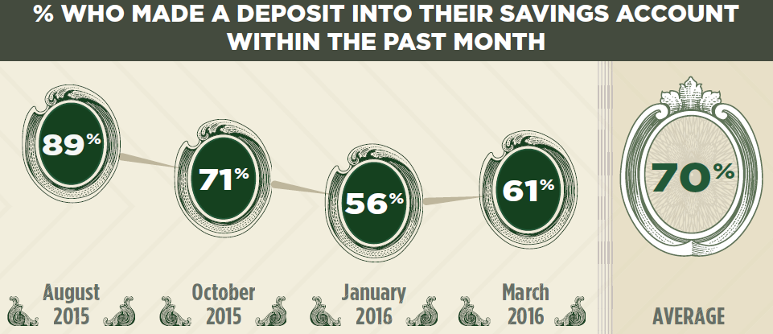
Youth Chose Direct Deposit and Used it to Save Money
Of those given a choice, an average of 66% self-elected to use direct deposit.

Slide 27
Youth Maintained or Expected to Maintain Direct Deposit in Next Job
61% of those who remained employed in another job after their summer employment were maintaining their pay through direct deposit
In March of 2016, as these young workers anticipated their next summer employment, 84% expected to be employed in some way, with 79% hoping they can use direct deposit for their future pay with that job

Slide 28
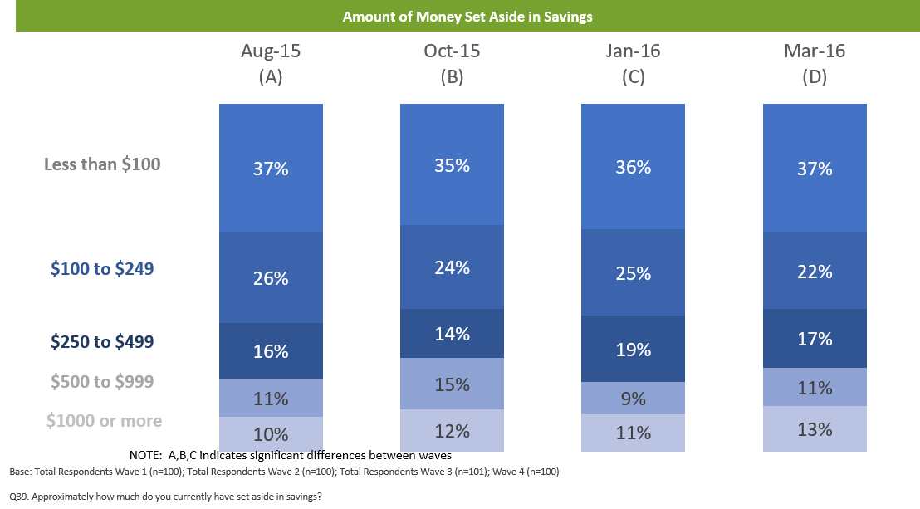
Youth Reported Saving an Average of $400

Slide 29
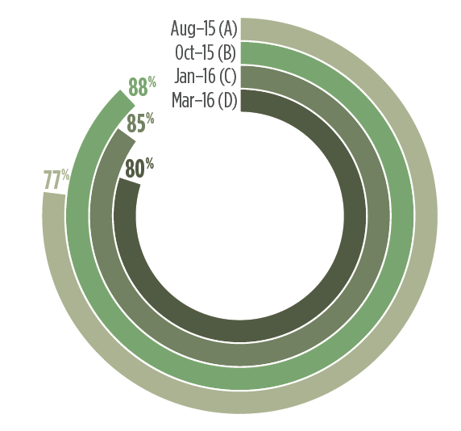
80% of Young Workers Established a Savings Pattern

Slide 30
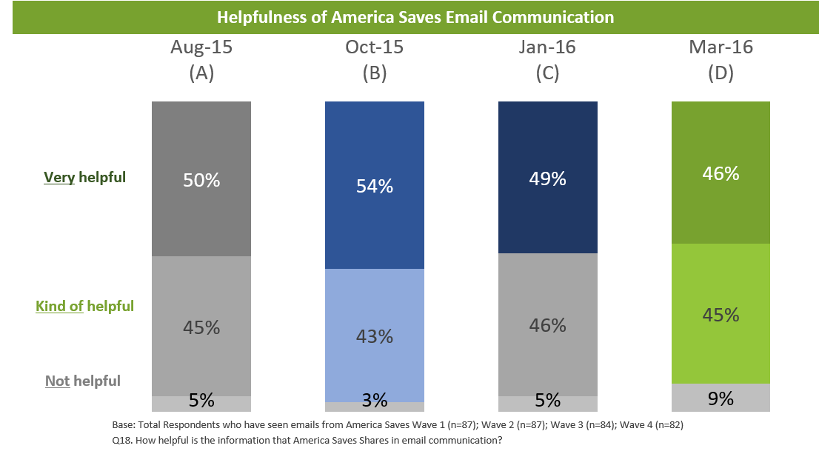
9 in 10 Teens Continued to Find the Communications They Receive from America Saves Helpful

Slide 31
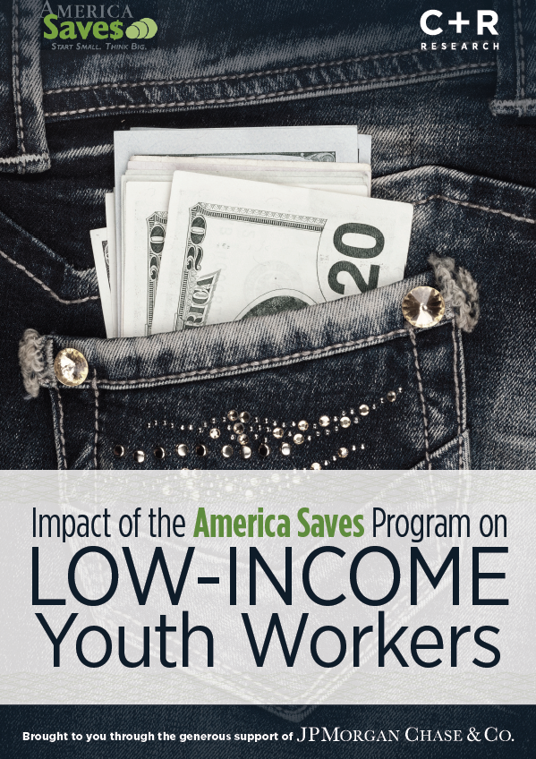
AMERICA SAVES FOR YOUNG WORKERS
Study available at : AmericaSaves.org
Contact:
Amelia O’Rourke Owens ameliao@consumerfed.org

Slide 32
How to Become a Partner Program

Slide 33
How to become a partner program
Hire youth or pay youth
Youth (ages 14-30)
Pay through Direct Deposit
Have an option for employees to split their pay
OR have a partner financial institution that will split incoming pay

Slide 34
How to become a partner program
Sign up online!
www.americasavesforyoungworkers.org
Receive your program’s unique link
Share link w/ youth employees
Youth watch video and take pledge from beginning of today’s slide show!

Slide 35
The Benefits of Becoming a Partner Program
In addition to building better financial habits for your young workers

Slide 36
Good for your program, too
Opportunity to expand agency relationships
Potential new funding sources
Possibility of media outreach and attention

Slide 37
Good for your program, too
New Relationships
Municipal government
Non-profit organizations
Workforce development boards

Slide 38
New Funding Sources
Engaged around supporting local youth to save
→ may be of interest to local foundations.
Program is light-touch to implement.
Collects and aggregates data
Very useful for reporting
Provides new service to young people
Great cost-benefit ratio for partner program!

Slide 39
Possible Media Attention
Great for young people
Innovative idea
Positive impact
→Remember research earlier slides!

Slide 41
Amelia O’Rourke-Owens
Program Coordinator
America Saves for Young Workers
Phone: (919) 972-8646
Email: ameliao@consumerfed.org

Slide 42
Jenn Smith
National YouthBuild Director
U.S. Department of Labor/ETA/OWI/DYS
Phone: (202) 693-3597
Email: smith.jenn@dol.gov

Slide 43
America Saves for Young Workers Website:
Link to sign up
www.americasavesforyoungworkers.org
America Saves for Young Workers 2016 Research:
Blog post w/ PDF
https://americasaves.org/blog/1377-how-summer-youth-employment-encourages-savings

Slide 44
YouthBuild Webinar Series
Save the Date!
March 7, 2016 2:00 – 3:30 pm Et
Documentation requirements and key guidance

