Slide 1
Promoting Economic Self-Sufficiency through Temporary Assistance for Needy Families (TANF) and Workforce Innovation and Opportunity Act (WIOA)
2Gen Partnerships
February 16, 2017

Slide 3
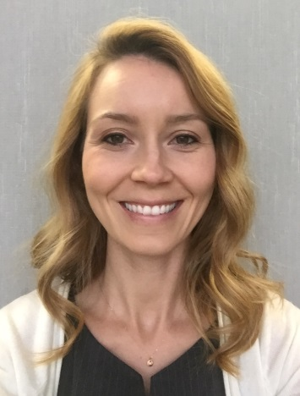

Megan Baird
  Program Manager, Office of Workforce Investment
    Employment and Training Administration US Department of Labor
Susan Golonka
  Acting Director, Office of Family Assistance
    Administration for Children and Families US Department of Health and Human Services

Slide 4
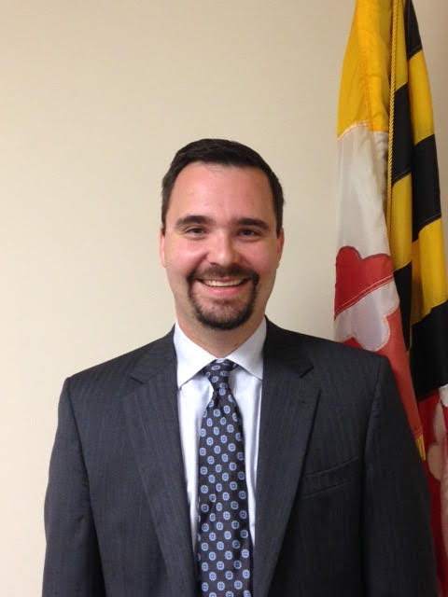

Brandon S. Butler
  Deputy Assistant Secretary
    Maryland Department of Labor, Licensing and Regulation, Division of Workforce Development and Adult Learning
Louisa Erickson
  WIOA Project Manager
    Washington State Department of Social and Health Services

Slide 5
Polling Question
Please identify the statement that best describes your current state's efforts around two-generation policy and programming.
We are fairly new to two-generation concepts and approaches.
We are very familiar with the concept and came to learn more.
We have begun planning and developing two-generation efforts.
We have two-generation efforts in place, and want to take it to the next level.

Slide 6
Provide an overview of Two-Generation Approaches and connection to TANF and WIOA implementation opportunities.
Highlight specific promising strategies that Maryland and Washington are using to leverage TANF and WIOA funding to support 2Gen efforts.
Share how WIOA state planning and 2gen efforts have resulted in improved policies, collaboration, and outcomes for low-income families.

Slide 7
3:00 | Welcome from ACF and DOL
3:10| Maryland’s 2Gen Approach
3:30 | Washington’s WIOA TANF Alignment
3:50 | Discussion and Q&A
4:00 | Closing

Slide 8
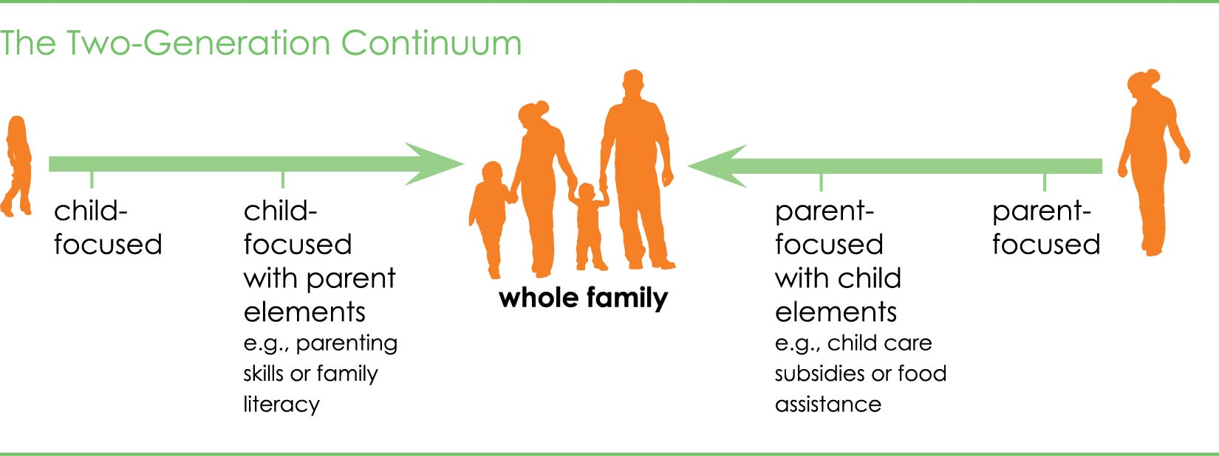

A Two-Generation Approach
Meets the Needs of Children and Parents Together.

Slide 9
Shared Goal:
Better Outcomes for Families
PARENT OUTCOMES
Less parental stress
Stronger parenting skills
Parent confidence as child’s first teacher
CHILD OUTCOMES
Child is ready for school
Improved social and emotional development
More positive high-quality interactions with parents
FAMILY OUTCOMES
Increased family income and financial security
Ability to meet basic needs
A stable and secure environment

Slide 10

ACF Promotes and Supports…
linkages between high quality educational services for children and workforce development services for their parents;
programmatic efforts to help parents gain the skills, knowledge, and resources to support their child’s development;
ensuring that families have access to the economic and social supports needed for stability and resilience and healthy child development, and;
helping families build social capital that can support both resilience and upward mobility.

Slide 11

Examples of Services
Child-focused:
Parent-focused:
Early Head Start / Head Start
High-quality child care
Home visiting
Physical & behavioral health
Workforce development
Occupational training
Post-secondary education
Adult Basic Education/GED/ESL
Financial coaching
Parenting skills
Home visiting
Physical & behavioral health

Slide 12
Two-Gen: TANF & WIOA
TANF agencies and workforce organizations can partner to:
  Offer contextualized adult education (e.g. short-term trainings within career pathways).
  Work around the child’s school day.
  Ensure access to child care and transportation services.
  Promote social connections among parent participants.
  Include a whole-family approach in assessments and goal-setting.

Slide 13
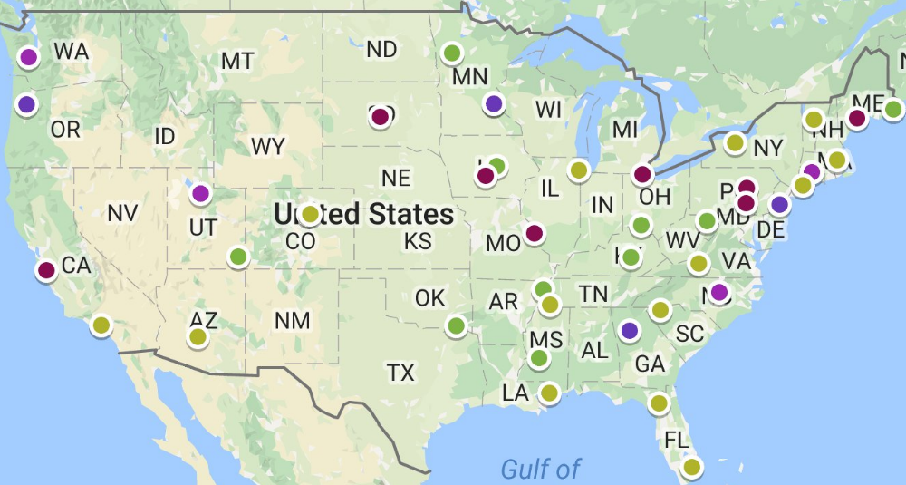
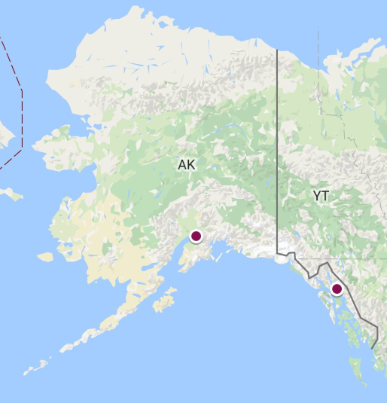
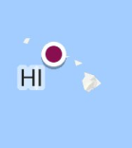
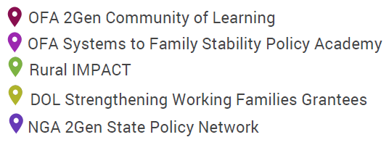
Two-Gen Efforts Nationwide

Slide 14
Strengthening Working Families Initiative (SWFI)
In June 2016, DOL announced nearly $54 million in grant funds awarded to 14 public and Private partnerships to:
  To provide support to parents who face barriers to training and are in need of increasing skills and competencies that will either prepare them for entry into middle-or high-skilled jobs;
  To give more working parents a career pathway and into middle-or high skilled jobs; and
  To give more working parents a career pathway to secure higher wage jobs by addressing the significant barriers to participating in and completing training, and in trying to find and acquire affordable, quality child care.

Slide 15
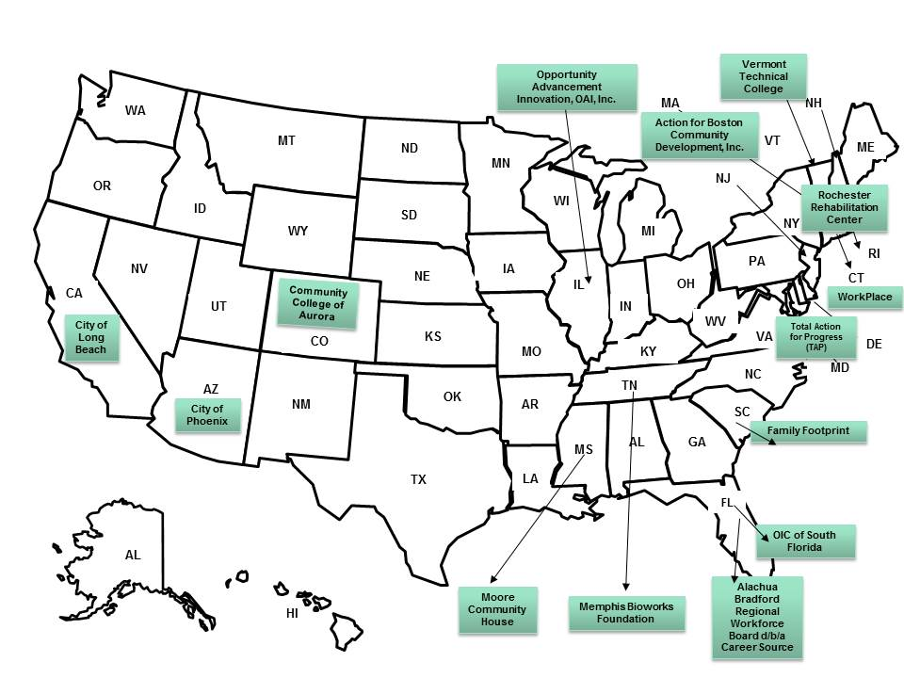
Overview of SWFI Grantees
H-1B SWFI Grantees (14 Total)
To learn more about the SWFI grant program, visit: https://www.doleta.gov/business/pdf/SWFI_Grantee_Abstracts.pdf

Slide 16
Maryland’s 2Gen Approach
Brandon Butler
Pockets of Innovation and Promise for
Maryland’s Families

Slide 17
Vision…
The TANF & WIOA Partnership
  The State’s Combined Workforce Plan
  Local Plans;
  Memoranda of Understanding and Resource Sharing;
  Alignment Group;
  State Convenings
“There’s a way to do it better – find it.”
-Thomas Edison

Slide 18
Let’s get to work…
9 WIOA Workgroups
“Hitting the reset button”
Hundreds of comments over two comment periods
  With every regulation promulgated pursuant to the federal Act, with every guidance issued by the federal agencies charged with oversight of the programs included in this Plan, with every technical assistance and training received, Maryland dedicates to learn together, to discuss the pressing issues, and to come to lasting solutions for our collective customers.

Slide 19
Placing people at the center…
Placing people before performance means that Maryland’s workforce system is dedicated to focusing its efforts on those who need our assistance the most….
This strategy does not mean that Maryland is going to forsake all performance measures. Rather, it requires a change in focus from numbers and figures on a page to people who walk through the doors of any one of Maryland’s American Job Centers, local Department of Social Services offices, or other local career centers. It means that Maryland’s workforce system is dedicated to improving the lives of Marylanders.

Slide 20
It all starts with a plan…
1 of 14 that made TANF a combined plan partner
“Placing people before performance”
  CLASP: Maryland’s Plan “clearly describes implementation of priority of service, as required” under WIOA.
  Aspen Institute: State’s Combined State Plan “illustrat[es] a deep commitment to serving those who face the most significant barriers to employment.”

Slide 21

Now what…
April 2016 could have come and gone…
It’s one thing to plan and it’s a totally different thing to implement
  Local Plans
  MOUs
  Resources Sharing
  Alignment Group

Slide 22
A little help…
State Convenings and thinking of the Maryland Workforce System
Systems to Family Stability National Policy Academy
Ascend at the Aspen Institute
National Governors Association
Fostering Innovation
  2Gen Pilot sites in Garrett/Allegany and Montgomery Counties

Slide 23


Slide 24
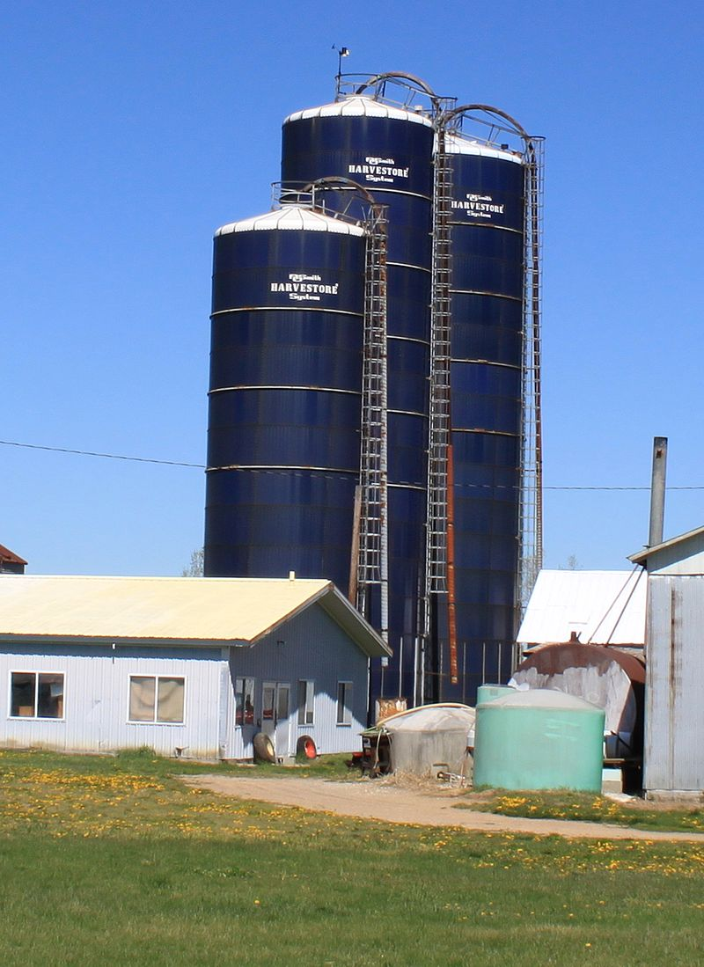
What we’ve learned thus far…
Build a system
  No longer the best kept secret
Celebrate innovation
  Best practices guide
Prepare for barriers
  Cylinders of excellence
  We’ve always done it this way…
  It would be a cold day…
Speak the same language
Don’t be afraid to ask “stupid” questions

Slide 25
A path forward…
How can we leverage 2Gen to add value to the TANF/WIOA relationship?
What does a family-friendly job center look like?
How can we translate 2Gen for workforce development?
Where does adult education fit in?
  The Adult Education and Family Literacy Act

Slide 26
“A key element to innovation is making a compelling case for change. If you can’t convince people that change is needed, you won’t get very far.”
-Brian Elms with J.B. Wogan
Peak Performance: How Denver’s Peak Academy is Saving Money, Boosting Morale and Just Maybe Changing the World

Slide 27
Workforce Innovation and Opportunity Act (WIOA) TANF Alignment
Opportunities to Consider Impacts of Intergenerational Poverty
Louisa Erickson
WIOA Project Manager
WA State Department of Social and Health Services

Slide 28
Approaches to Access and Integration
Considerations around WIOA related requirements for TANF
Establishing a vision for program partnership - near term and future
Recognize customer, program, and partner needs
Be part of the State level WIOA planning and implementation process
Strengthen internal partnerships and alignment
Tap into broader goals and framework to create a capacity building, 2Gen system to impact intergenerational poverty and advance economic security

Slide 29
Partnership Opportunities
TANF-WIOA collaboration
TANF partnering in one-stop system
  Statewide
  In specific localities
Combined State Plan including TANF and SNAP E&T Basic Food Employment and Training (BFET)

Slide 30
TANF perspective: Why partner?
Improve TANF recipients’ access to high quality training opportunities tied to job openings and career pathways
Improve continuity for parents who move off of TANF; or on and off of TANF over time
Reduce duplication of activities, services (possibility of freeing up funds, resources and personnel for other purposes)

Slide 31
Stakeholder Feedback
Cross training and professional development for TANF and workforce system partner staff
Data and information sharing
Common intake
Blended/braided funding
Coordinated approach to ‘life skills,” “soft skills,” and “employment etiquette/career readiness” education

Slide 32
Stakeholder Feedback
Employer and business engagement and education that includes investment on the employer’s end around developing and retaining an effective and skilled workforce.
Access
Equity

Slide 33
Internal Opportunities
Alignment: SNAP E&T, Foster Care, Juvenile Rehabilitation, SCSEP, Department of Vocational Rehabilitation
Department goal, held jointly with state level WIOA partners – reduce the number of households in poverty (at or below 200% FPL) by 2025
Frontiers of Innovation: Executive function capacity building; Evidence based home visiting for TANF parents

Slide 34
Internal Opportunities
Systems to Family Stability Policy Academy Focusing on the WIOA definition of Disconnected Youth with innovative strategies in three program enhancement areas:
  TANF and WIOA Integration
  Two-generational approaches to reducing poverty
  Using NEAR Science(Neuroscience, Epigenetics, Adverse Childhood Experiences (ACEs), and Resilience) to inform coaching and case management
  15 pilots across 25 Community Services Offices

Slide 35
What are Executive Function Skills?
Skills we use to organize and plan things
  Organization
  Time Management
  Planning/Prioritization
Skills we use to control how we react to situations
  Response Inhibition
  Flexibility
  Emotional Control
  Metacognition
Skills we use to get things done
  Task Initiation
  Sustained Attention
  Goal-Directed Persistence
  Stress Tolerance
  Working Memory

Slide 36
WIOA Discretionary Funds
$1.2 million
Intergenerational approaches to impact workforce development
Year 1: Asset and needs mapping, partnership building, strategy development
Focus on sector strategies, career pathways development, educational attainment, incumbent worker training, individual, family, and community capacity building
Year 2: Implementation, evaluation using rapid cycle evaluation techniques, planning for replication and scale

Slide 37
Other Efforts that Enhance TANF and WIOA Integration
Cross agency partnership to examine opportunities to streamline WIOA funded program eligibility for TANF and SNAP participants
Washington Connection, a DSHS administered web portal that allows customers to link to and apply for the most inclusive, statewide, array of education, employment, training, public assistance and other supportive services.

Slide 39
Megan Baird
Baird.megan@dol.gov
Susan Golonka
Susan.golonka@acf.hhs.gov.
Brandon S. Butler
brandon.butler@maryland.gov
Louisa Erickson
Louisa.Erickson@dshs.wa.gov

Slide 40


