Slide 1


Visualizing Data to Improve Workforce Development Collaboration

Slide 2
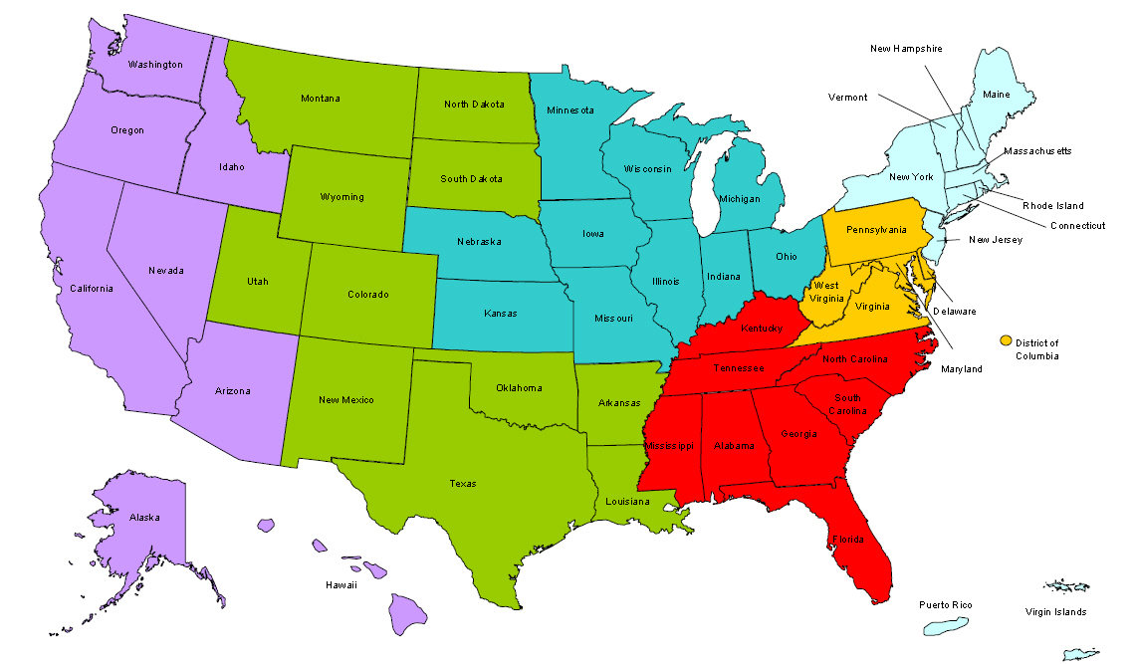
Where are you?
Enter your location in the Chat window – lower left of screen
Enter your location in the Chat window – lower left of screen
Notes:
SPEAKER: Webinar facilitator
In the Chat Room, please type the name of the your organization, your location, and how many people are attending with you today.

Slide 3
Explore ways to display labor market data to best engage workforce development stakeholders
Tailoring labor market data for employer and educator audiences

Slide 4

Colby Spencer Cesaro
  Senior Research Director
    Workforce Intelligence Network
    Southeast Michigan

Slide 5

WORKFORCE INTELLIGENCE NETWORK
OUR MISSION
To create a comprehensive and cohesive workforce development system in Southeast Michigan that provides employers with the talent they need for success.
Data
Employer Engagement
Policy

Slide 6

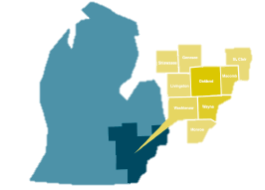
WORKFORCE INTELLIGENCE NETWORK
OUR MISSION
Data & research guided employer strategies and policy
DATA
Working Smarter Series
Quarterly labor demand reports
Posting-to-employment forecasting
Special Report Requests
EMPLOYER STRATEGIES
Information technology
WIN tech council
ExperienceIT
Heath Care
Health Systems HR Execs Council
Manufacturing
Innostate – New Product manufacturing
Green Mobility planning & talent partnerships
LIFT
Retail and Hospitality
Career Pathways
POLICY
Process improvement
Business Services Network
Career Services Network
Administrative change
Legislative change
Exemplary practice identification & adoption
Data-driven training, education, experiences & career guidance

Slide 7

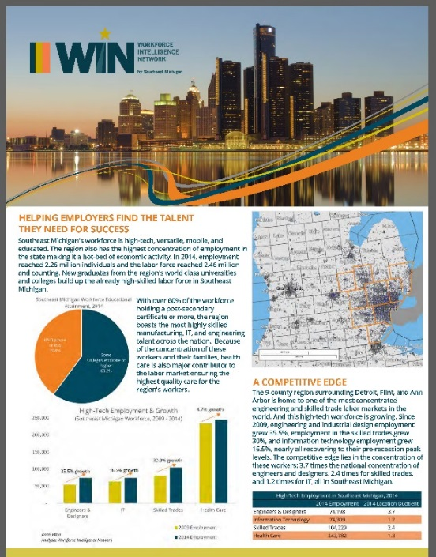
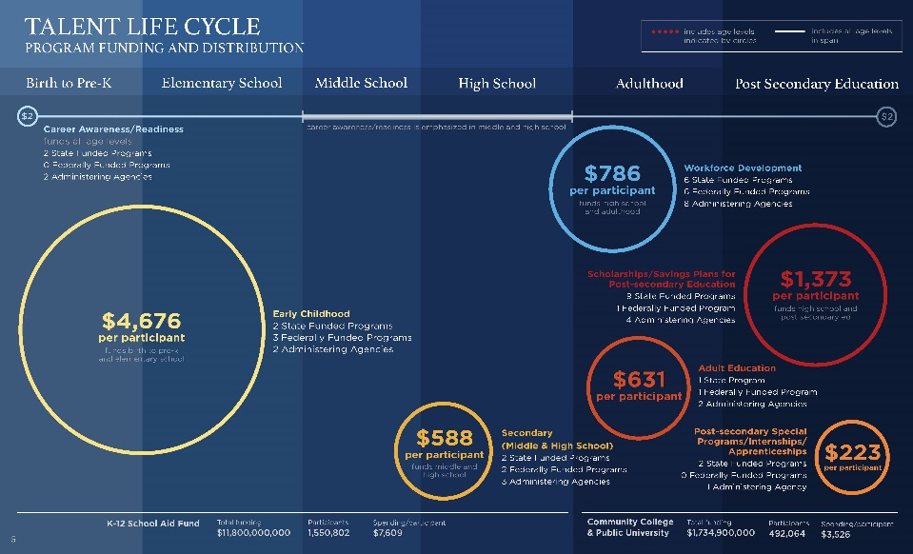




We do “stuff”

Slide 8










Examples from WIN
Community Colleges
Workforce development
Economic development
Other Partners

Slide 9
Example Data Requests
What jobs are trending in the region?
Where should we invest workforce dollars?
What jobs are falling behind?
How do we make sure employers have what they need?
What new program should we create?
What major should I tell my students to take on?

Slide 10
Data Rules we live by
Try NOT to ONLY use ONE source of data!
  We LOVE EMSI, BUT we pair it with other sources to get a complete picture and understand nuances in the numbers.
Dig in for more information, “reality check”
  Not all data is created equal, if something looks funny it probably isn’t right.
Double-check with your local employers and the talent system for extra detail
  Employers will give you additional information about their needs to better flesh out data and provide insight on their needs. Schools will do the same on their program offerings, enrollments etc.

Slide 11

Keep this in mind
There isn’t always a black and white answer so be sure to talk about the data’s limitations.
For requests: Asking the purpose of the data is often the most helpful for you as a researcher. Geography, time-period etc., are important, but the use will dictate how you explain your findings and present them.

Slide 12
Examples from WIN
Community Colleges
Workforce development
Economic development
Other Partners

Slide 13

Community colleges
Grants
Program development

Slide 14
Community Colleges
$19.4 million in equipment grant funds
Projected growth
What jobs are growing in the coming 5-10 years?
Current employer needs
Job postings, what do they need now?
What makes the area competitive?
Location quotient in higher wage areas, higher wage jobs that need a boost!
WIN community colleges awarded 39% of total state funding available for new equipment
WIN assists partners with grants
WIN research team identified key areas for each college to invest
Data!
Annual openings, completions, postings (from Burning Glass), etc. + identify which occupations require large equipment for training

Slide 15
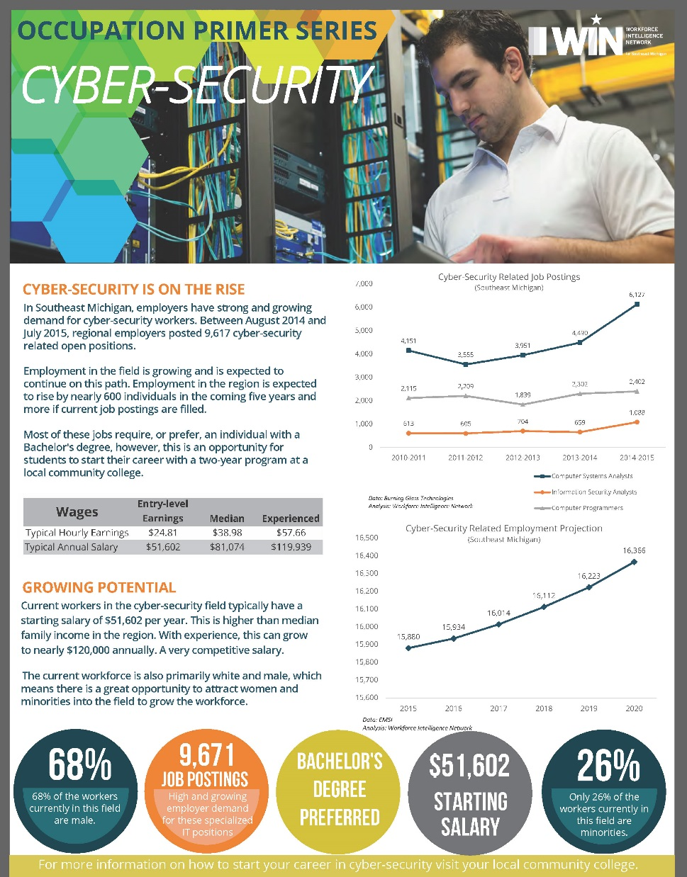
CC Program development
What occupations are trending?
Many growing occupations require a BA but community colleges focus more on the 2-year degree. What programs can CCs create that allow students to get a leg-up to an in-demand career?
Who should the school recruit?
Workforce gap analysis can help with this. Identify:
  Demographic gaps
  Salaries (only invest in higher wage areas)
  Skills required
  Transferability to a 4-year program

Slide 16
Examples from WIN
Community Colleges
Workforce development
Economic development
Other Partners

Slide 17

Workforce development
Quick spending
Business services

Slide 18
Workforce dollars
Employer needs (Job Ads)
Postings and skills in-demand for lower skills workers
Growth areas and annual openings
Growth areas and annual need for lower skill workers
O*NET: identifying specific skills/credentials aligned with growth occupations that can be attained in 6 months or less
Request from WIB on where to do make a quick investment for strong impact
Requirements:
  Need to spend down dollars
  6-month training or less
  Lower skill population demographic
  Credential awarded after training
  Employer-centered

Slide 19
WIB Business Services
Employers have lots of turnover
Can you guess why?
Wages! They don’t pay enough
Employer goes to WIB to request comparison data on wages
Regional data on wages helps
WIB is able to deliver quality wage data to employer and encourage higher wages to reduce turnover

Slide 20
Why ROI now?
Lots of open jobs and too few qualified workers to fill them, employers need workers NOW and will need more in the future.

Slide 21
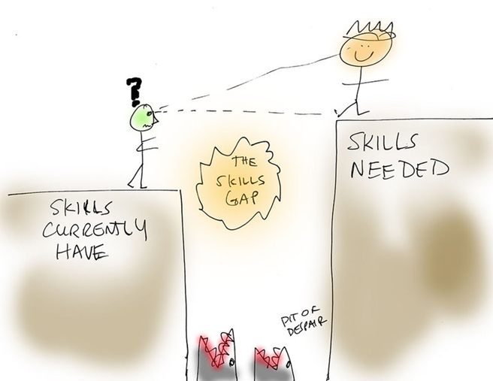
Why ROI now?
Employers need a better way to train workers for SPECIFIC needs.
Workers need on-the-job experience to get a foot in the door.

Slide 22

Why ROI now?
10,000 baby-boomers reach retirement age everyday…
Retirement cliff, it is coming. Employers are not prepared.

Slide 23

What IS Competitive?
During difficult economic times some candidates will accept a lower rate
Once you’ve started down the slippery slope of paying below market rates…
Pay-for-performance systems have a hard time keeping up

Slide 24

Want to be Average?
What does being Average mean?
Want average employees?
How about average output? Performance?

Slide 25
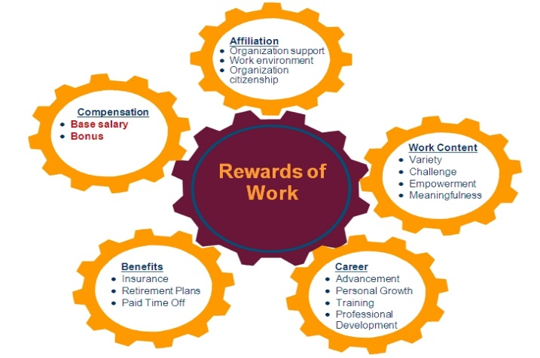
How much should you pay?
HR manual: should this be reviewed at your organization?
Use data!
http://www.jobsearchintelligence.com/NACE/salary-calculator-intro/
http://www.onetonline.org/
Quick trick! (2,080 hours = full-time)

Slide 26

Don’t forget!
ASK questions
How the data will be used can help dictate the level of detail you present and how you share the research findings. Always ask your requestor HOW the data will be used and WHO the audience is
Look at many sources
Corroborate your results with other data sources. Economic data is complicated because all sources aren’t created equal. Did Brookings find something TOTALLY different than you did? Then you probably need to re-check those numbers and sources. If it looks wrong, it probably is.
Talk to the talent system
Talk to Employers
Are grads getting hired? What programs are growing enrolment? What are employers asking for?
Employers are the ones posting for jobs and they have more information about what they want than they can write down. Ask them questions when you see changes in the data!

Slide 27
Breakout Questions
What data points have been the most helpful in engaging employers and educators?
What kinds of data visualization create the strongest engagement from workforce development stakeholders?

Slide 28
Breakout Facilitators
Breakout 1 Facilitator
  Jeremy Kelley, Senior Program Manager, Jobs for the Future
Breakout 2 Facilitator
  Veronica Buckwalter, Senior Program Manager, Jobs for the Future

Slide 30

Speakers’ Contact Information
Speaker: Colby Spencer Cesaro
Organization: Workforce Intelligence Network
Email: colby.cesaro@win-semich.org
Notes:
SPEAKER: Moderator

Slide 32

Polling Question
After attending this Virtual Institute, or any of the other Sector Strategies TA events, do you feel your organization:
Is better prepared to advance sector strategy approaches?
Has more tools to adapt quality practices?
All of the above
None of the above
Notes:
SPEAKER: Moderator

